Slide 1
Recent CEOS Mission Launches

Slide 2
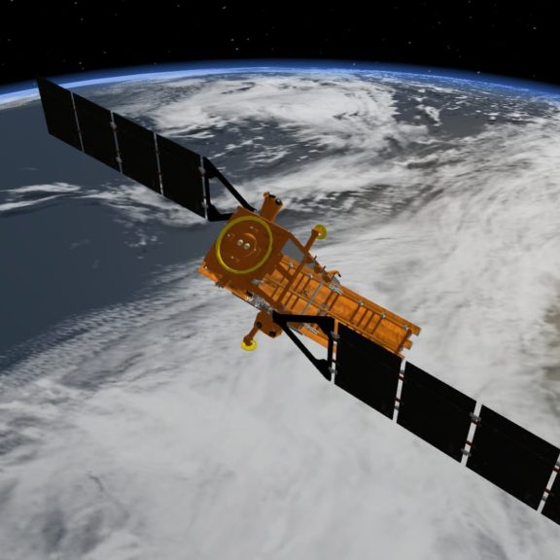
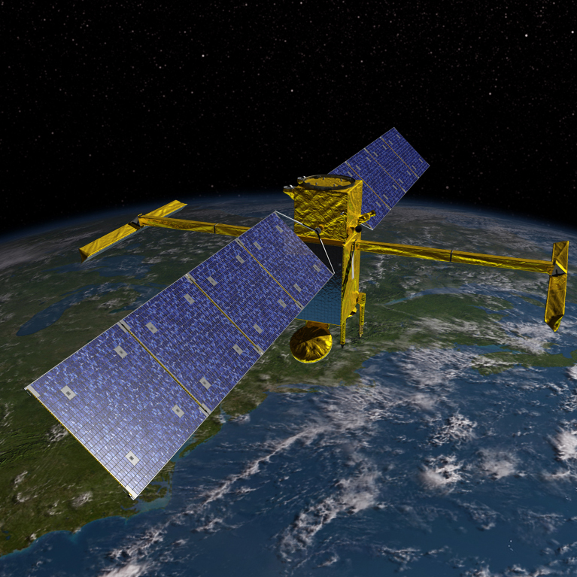
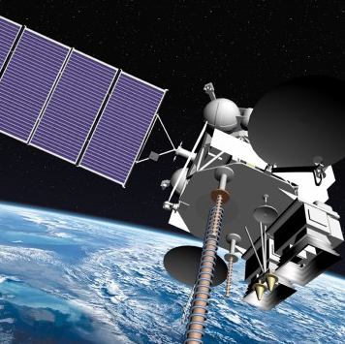
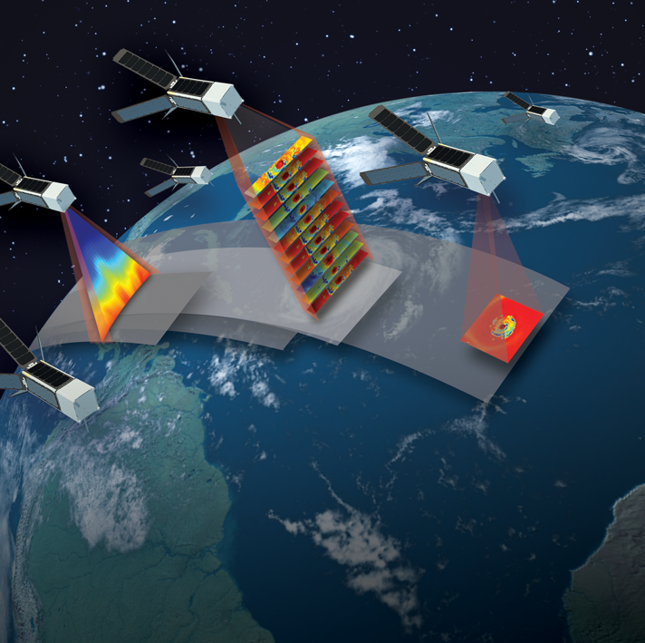
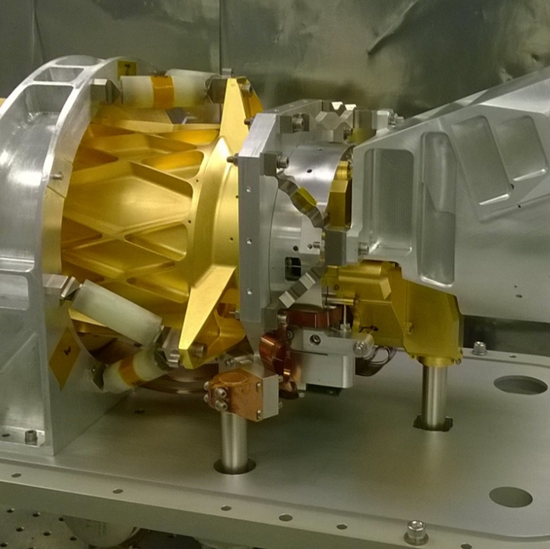
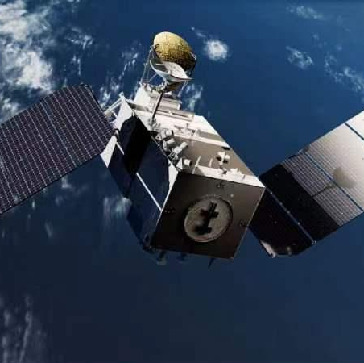
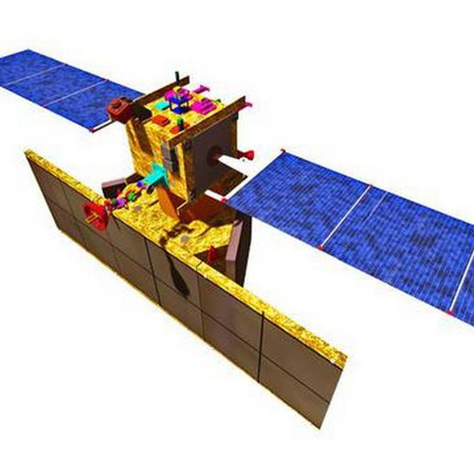
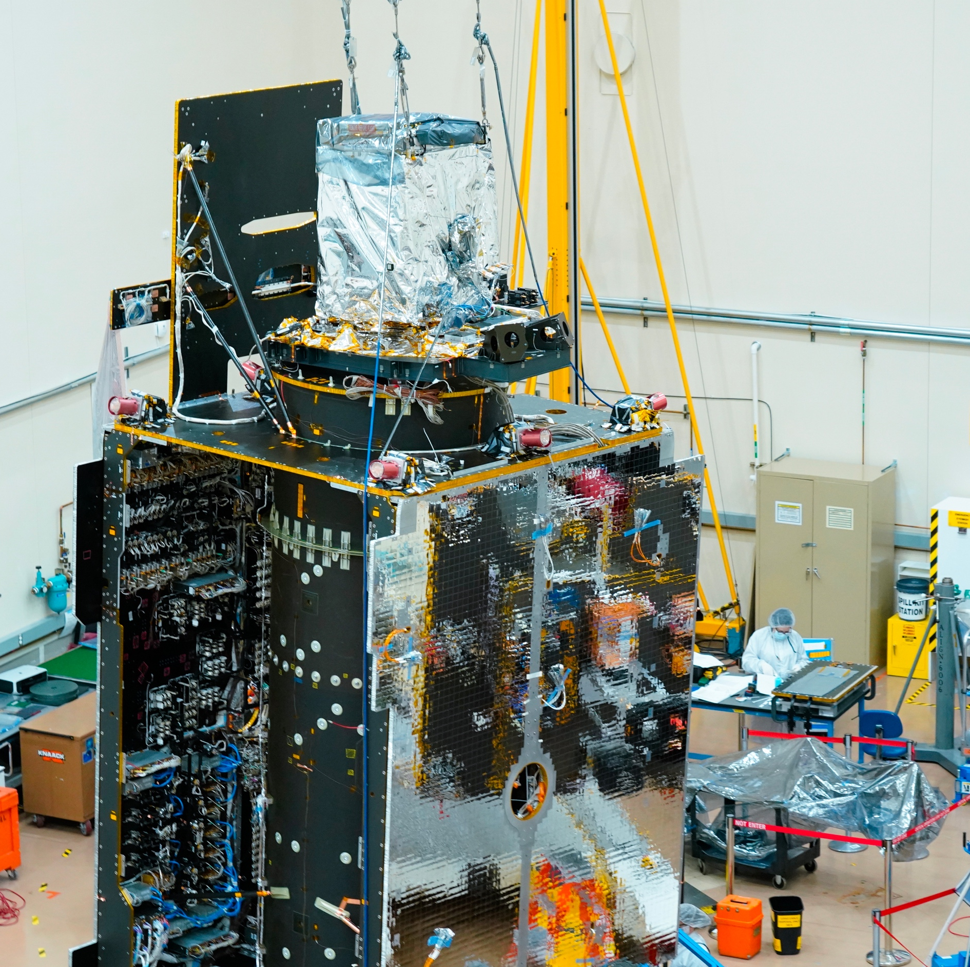
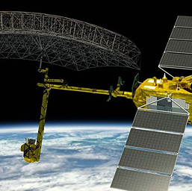
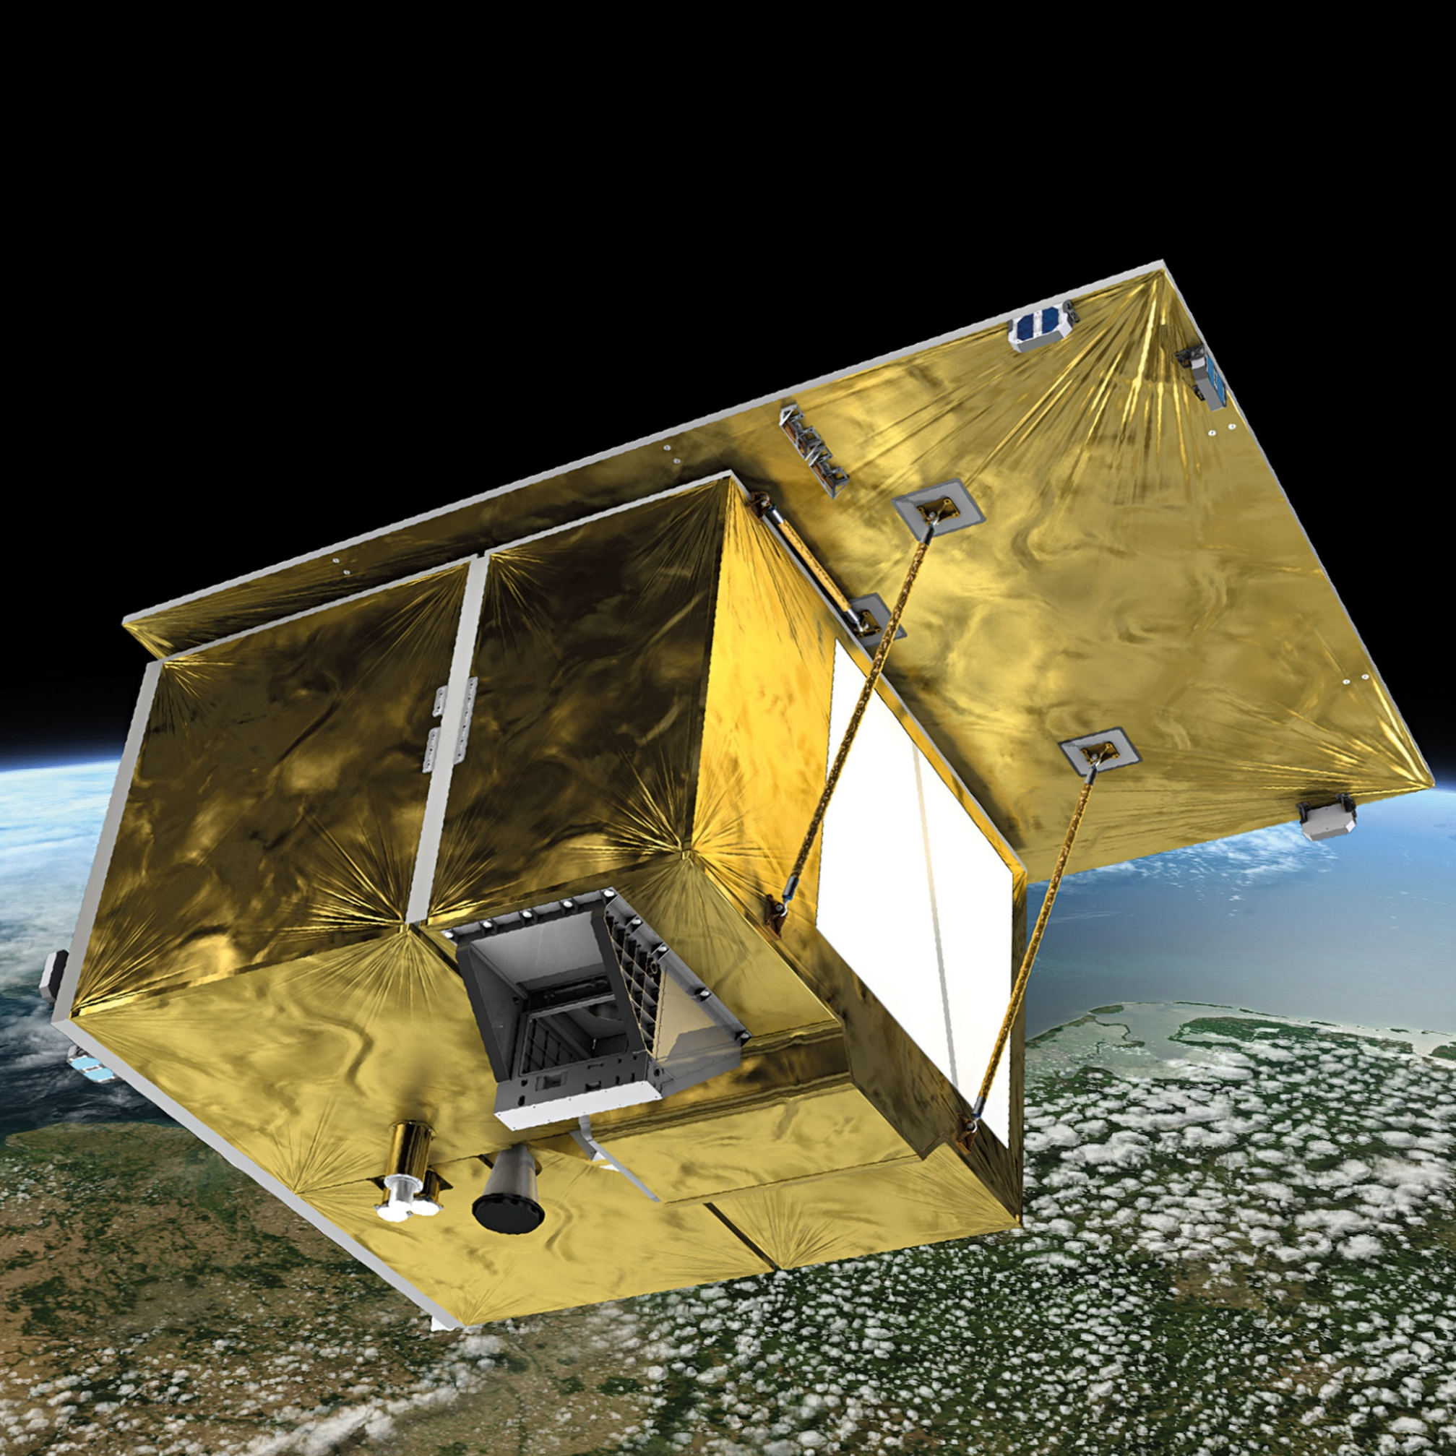
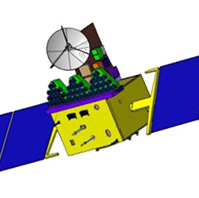
Recent CEOS Mission Launches
SWOT
NASA / CNES / CSA / UKSA
NORSAT-TD
NOSA / ASI / CNES / NSO
LARES-2
ASI
Elektro-L N4 ROSKOSMOS / ROSHYDROMET
CSG-2
ASI
GOES-T (-18)
NOAA / NASA
13 Jul
16 Dec
15 Apr
31 Jan
JPSS-2
NOAA / EUMETSAT
/ NASA
TROPICS
NASA
10 Nov
05 Feb
08 & 26 May
01 Mar
Jan 2022
Apr 2022
Jul 2022
Oct 2022
Jan 2023
Apr 2023
Jul 2023
16 Apr
14 Feb
14 Jul
13 Dec
07 Apr
26 May
RISAT-1A
ISRO
01 Apr
26 Nov
EnMAP
DLR
TEMPO
NASA
EMIT-on-ISS
NASA
FY-3RM-1
NSMC-CMA
MTG-I1
EUMETSAT / ESA
Kondor-FKA N-1
ROSKOSMOS
Oceansat-3
ISRO

Slide 3
CSG-2
Launched 31st January, 2022
Second of Italy’s COSMO-SkyMed Second Generation series of radar satellites, which together will be able to observe the same points on Earth twice a day
Follows the original 4-satellite COSMO-SkyMed constellation, launched 2007-2010.
Applications in environmental monitoring, surveillance and risk management, environmental resources management, maritime management, and topographic mapping
CSG-2
ASI

Slide 4
RISAT-1A
Launched 14th February, 2022
Also known as EOS-4 (Earth Observing Satellite-4)
Carries a C-Band SAR instrument, and designed to provide high-quality images under all-weather conditions
Applications include agriculture, forestry, soil moisture, hydrology, and flood mapping
RISAT-1A
ISRO

Slide 5
GOES-T
Launched 1st March, 2022
GOES = Geostationary Operational Environmental Satellites
GOES-T was renamed GOES-18 following launch, and is the third in a series of four advanced geostationary weather satellites, known as the GOES-R Series
The GOES-R Series provides advanced imagery and atmospheric measurements, real-time mapping of lightning activity, and monitoring of space weather.
GOES-T (-18)
NOAA / NASA

Slide 6
EnMAP
Launched 1st April, 2022
EnMAP is the first ever German optical Earth observing satellite, and carries a hyperspectral imager, with 230 spectral channels in the solar-reflectance range
Mission objectives include to measure, derive, and analyse numerous diagnostic parameters which describe vital processes on the Earth’s surface
EnMAP data was already assessed as CEOS Analysis Ready Data prior to launch.
EnMAP
DLR

Slide 7
LARES-2
Launched 13th July, 2022
H303 retrorefelectors that will reflect laser pulses from ground stations and allow the position of the satellite to be measured to within 1 mm
The precisely determined orbit of the satellite will be used to calculate the dragging of inertial frames due to the Earth's angular momentum, known as the Lense-Thirring effect.
LARES-2
ASI

Slide 8
EMIT-on-ISS
Launched to the ISS on 14th July, 2022
Installed on the exterior of the ISS on July 22nd – 27th
EMIT is comprehensively measuring the mineral composition of Earth’s dust source regions
Helping scientists understand how dust can heat or cool our planet when strong winds lift the particles from Earth’s desert and dryland regions and carry them great distances through the atmosphere.
EMIT-on-ISS
NASA

Slide 9
JPSS-2
Launched 10th November, 2023
Renamed NOAA-21 following launch
The second mission of the new generation of NOAA's POES (Polar-Orbiting Environmental Satellites) system
Provides operational continuity of satellite-based observations and products for numerical weather prediction
JPSS-2
NOAA / EUMETSAT / NASA

Slide 10
Oceansat-3
Launched on 26th November, 2022
Multi-sensor mission to provide service continuity for users of Oceansat-2 data and improve upon existing remote sensing capabilities in the field of oceanography
Oceansat-3 data has applications in ocean colour, biology, and surface winds and temperature
Also carries the ARGOS-4 data collection system, in partnership with CNES
Oceansat-3
ISRO

Slide 11
MTG-I1
Launched 13th December, 2022
First of the six-satellite Meteosat Third Generation geostationary constellation
Four MTG-I (Imager) satellites will be complemented by two MTG-S (Sounder) satellites
Carries Europe’s first lightning imager – which will give weather forecasters greater confidence in their predictions of severe storms, particularly in remote regions and on the oceans where lightning detection capabilities are limited
MTG-I1
EUMETSAT / ESA

Slide 12
SWOT
Launched on 16th December, 2022
A swath-based Synthetic Aperture Radar (SAR) altimetry mission, following from the Jason-1, -2 and -3 missions
SWOT will perform a global survey of the Earth's surface water, collecting detailed measurements of how water bodies change over time
The data collected by this mission could improve ocean circulation models and weather predictions, while aiding in freshwater management around the world
SWOT
NASA / CNES / CSA / UKSA

Slide 13
Electro-L N4
Launched 5th February, 2023
Operational meteorology satellite hosted in Geostationary orbit at 165° East, over Eastern Asia and the Pacific.
Carries the Module for Geophysical Measurements (GGAK-E) to monitor and forecast solar activity, radiation and magnetic fields around Earth
Also carries the multispectral scanning imager-radiometer (MSU-GS) which measures multiple parameters for operational meteorology.
Elektro-L N4
ROSKOSMOS / ROSHYDROMET

Slide 14
TEMPO
Launched as a payload on Intelsat 40E on 7th April, 2023
Intelsat 40E is a commercial communications satellite in geostationary orbit at 91° West
TEMPO is the first space-based instrument to measure air quality over North America hourly during the daytime and at spatial regions of several square miles
TEMPO
NASA

Slide 15
NORSAT-TD
Launched 15th April, 2023
Carries multiple advanced or experimental payloads, including an iodine propulsion system, a satellite tracking and navigation payload, a laser data downlink system, and an AIS receiver
NORSAT-TD
NOSA / ASI / CNES / NSO

Slide 16
FY-3RM-1 (FY-3G)
Launched on 16th April, 2023
Dedicated rainfall mission in low Earth orbit
Will help monitor and predict meteorological disasters like rainstorms and typhoons during the main flood season
Equipped with a Ku/Ka-band dual-frequency precipitation measurement radar
FY-3RM-1
NSMC-CMA

Slide 17
TROPICS
Launched 8th May and 26th May, 2023
Four-satellite constellation
Provides rapid-refresh microwave measurements to monitor tropical storms
Aims to improve the understanding and prediction of the evolution of tropical cyclone structure, size, and intensity
TROPICS
NASA

Slide 18
Kondor-FKA N-1
Launched on 26th May, 2023
Hosts an S-band Synthetic Aperture Radar (SAR) instrument, with spatial resolutions up to 1 m, and swaths as wide as 500 km across various modes
The data has applications in disaster monitoring, sea surface monitoring, and environmental management
Kondor-FKA N-1
ROSKOSMOS

Slide 19
Recent CEOS Mission Launches
SWOT
NASA / CNES / CSA / UKSA
NORSAT-TD
NOSA / ASI / CNES / NSO
LARES-2
ASI
Elektro-L N4 ROSKOSMOS / ROSHYDROMET
CSG-2
ASI
GOES-T (-18)
NOAA / NASA
13 Jul
15 Apr
31 Jan
JPSS-2
NOAA / EUMETSAT
/ NASA
16 Dec
TROPICS
NASA
10 Nov
05 Feb
08 & 26 May
01 Mar
Jan 2022
Apr 2022
Jul 2022
Oct 2022
Jan 2023
Apr 2023
Jul 2023
16 Apr
14 Feb
14 Jul
13 Dec
07 Apr
26 May
RISAT-1A
ISRO
01 Apr
26 Nov
EnMAP
DLR
TEMPO
NASA
EMIT-on-ISS
NASA
FY-3RM-1
NSMC-CMA
MTG-I1
EUMETSAT / ESA
Kondor-FKA N-1
ROSKOSMOS
Oceansat-3
ISRO

