Slide 1



2025
SIT TECHNICAL WORKSHOP
9-11 SEPTEMBER 2025
DARMSTADT, GERMANY

Slide 2
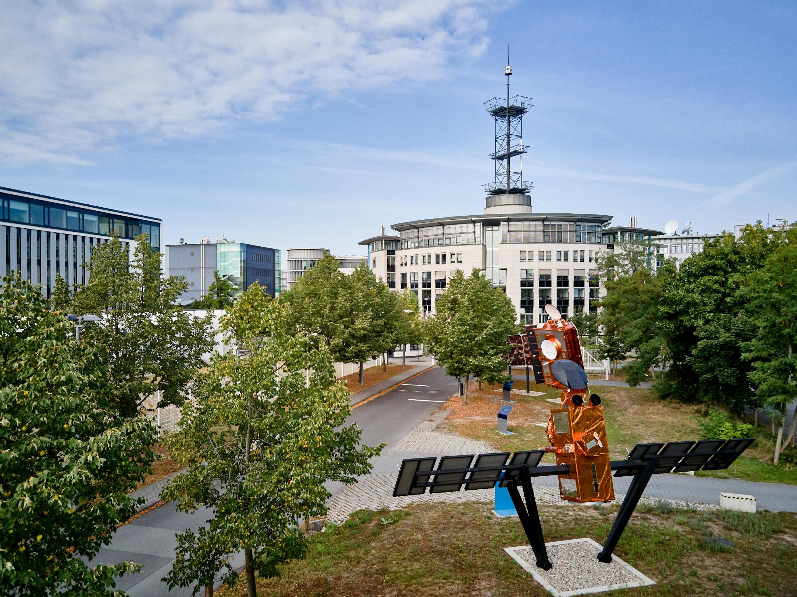
DATES
AND
LOCATION
The SIT Technical Workshop will be held on 9-11 September 2025 at EUMETSAT.
Location:
EUMETSAT Headquarters, Darmstadt, Germany
Address: Eumetsat-Allee 1, 64295 Darmstadt, Germany

Slide 3
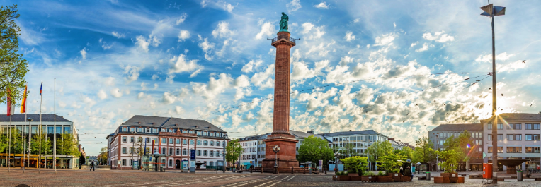
ABOUT DARMSTADT
Located just 30 km south of Frankfurt, Darmstadt is known as the ‘City of Science,’ blending a rich heritage of art and innovation.
The vibrant city center offers pedestrian-friendly streets, restaurants, and shopping, while the nearby Odenwald mountains, Rhine valley and Bergstrasse wine region provide stunning escapes for nature lovers.

Slide 4
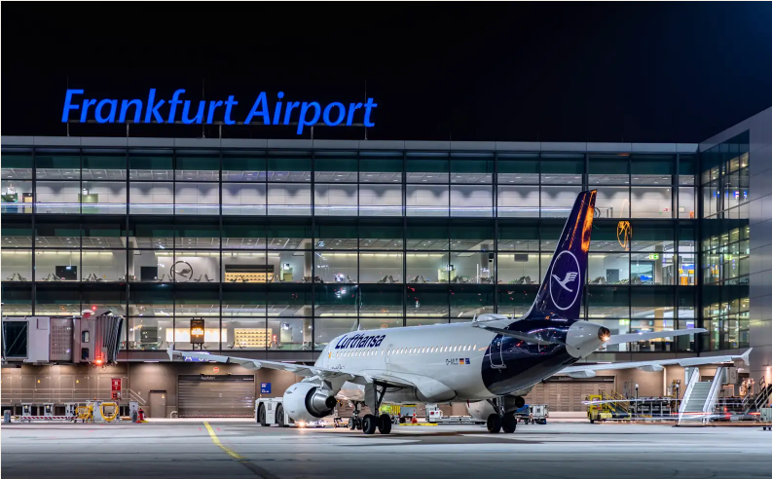
GETTING
THERE
Airplane - Frankfurt International Airport is about 20 minutes away.
Every half hour, the AirLiner bus brings passengers from Frankfurt Airport (Terminal 1) directly to Darmstadt.
Rail - Darmstadt’s central railway station can be reached with regional services as well as IC/ICE.

Slide 5
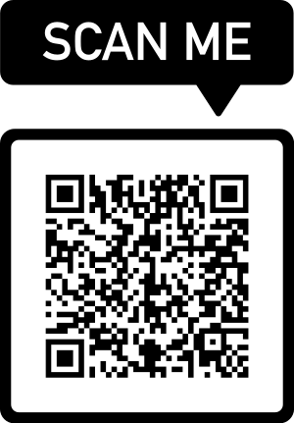
VISA SUPPORT
If you require a visa support letter, please contact the local organising team at events@eumetsat.int.

Slide 6
WEEK AT THE GLANCE
9 September 2025 | 10 September 2025 | 11 September 2025
Side meetings Icebreaker event | SIT Technical Workshop Dinner hosted by EUMETSAT | SIT Technical Workshop

Slide 7
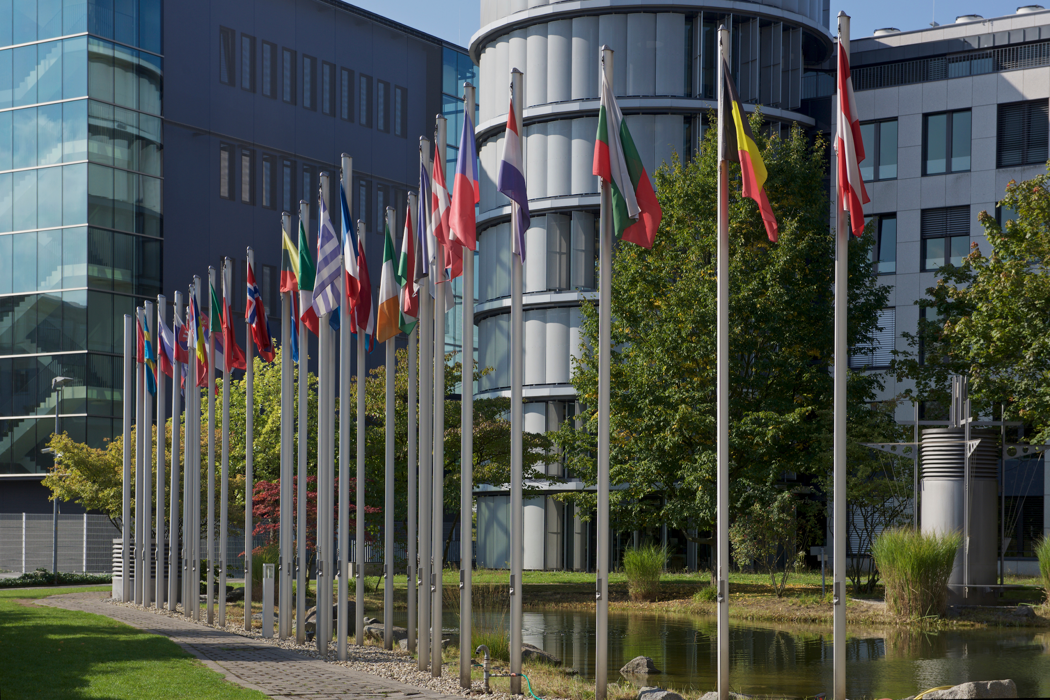
WE ARE LOOKING FORWARD TO WELCOMING YOU AT EUMETSAT HQ IN SEPTEMBER!

