Slide 1
CEOS MIM Database
SIT-40
Fukuoka, Japan
8-10 April, 2025

Slide 2

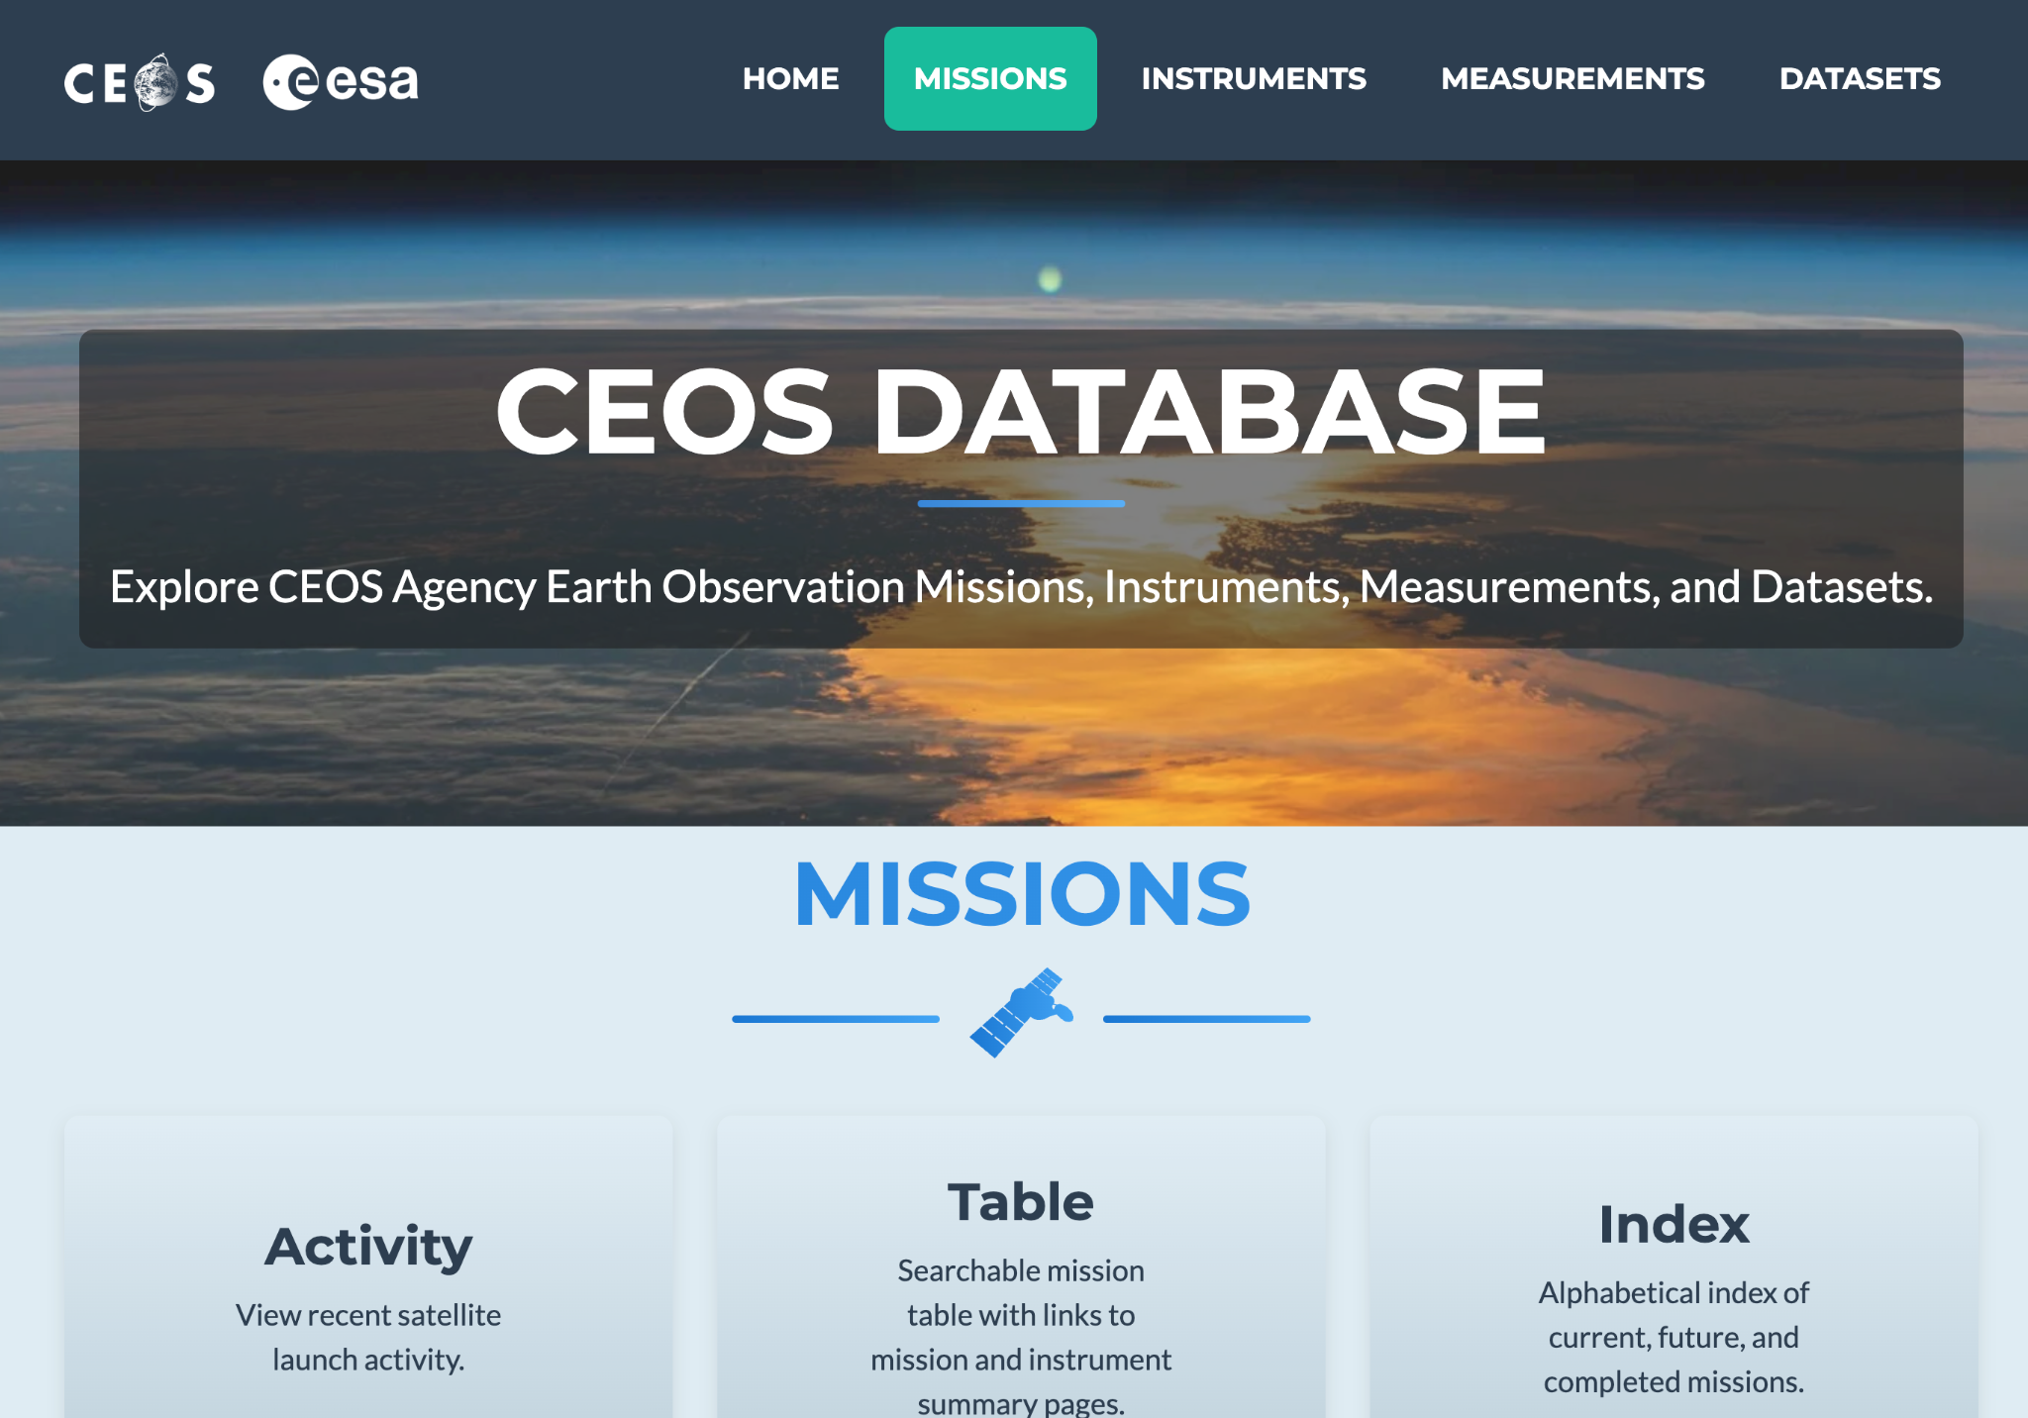
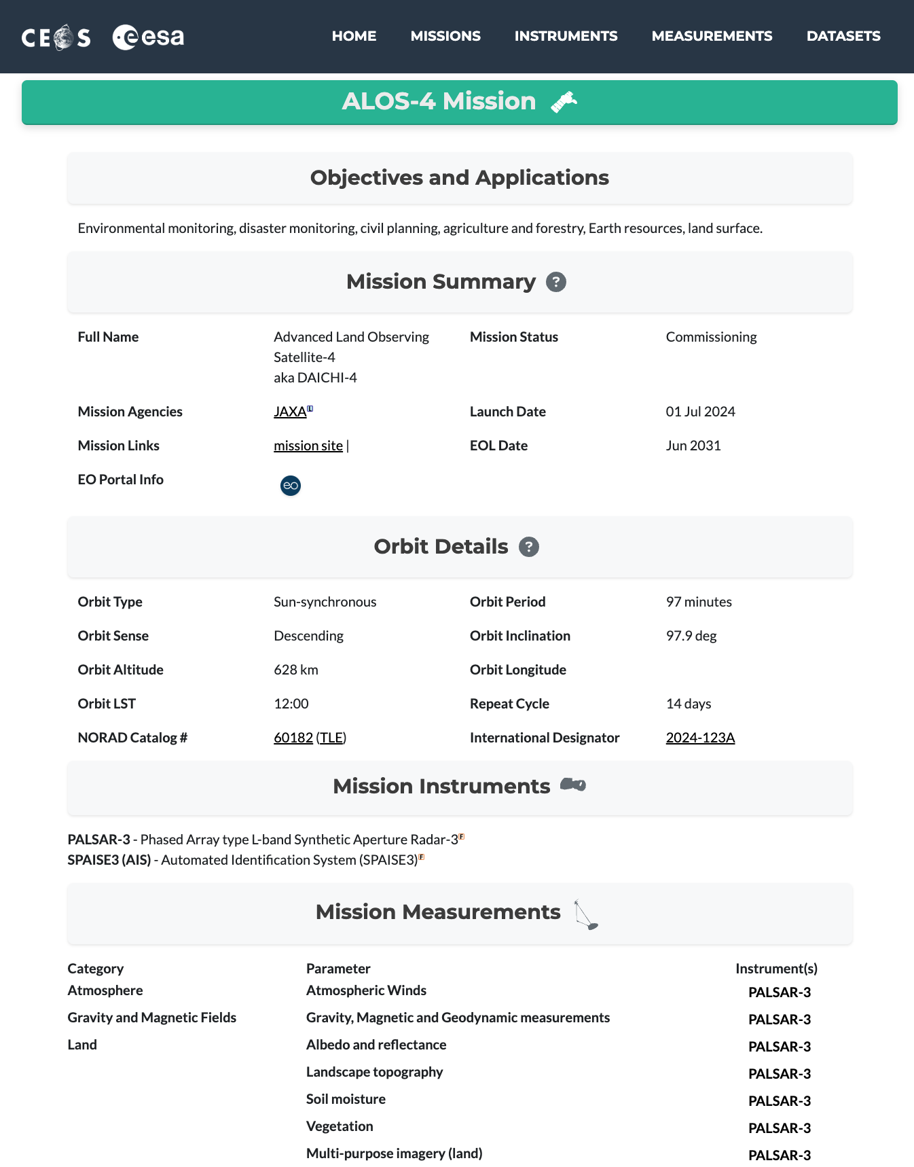
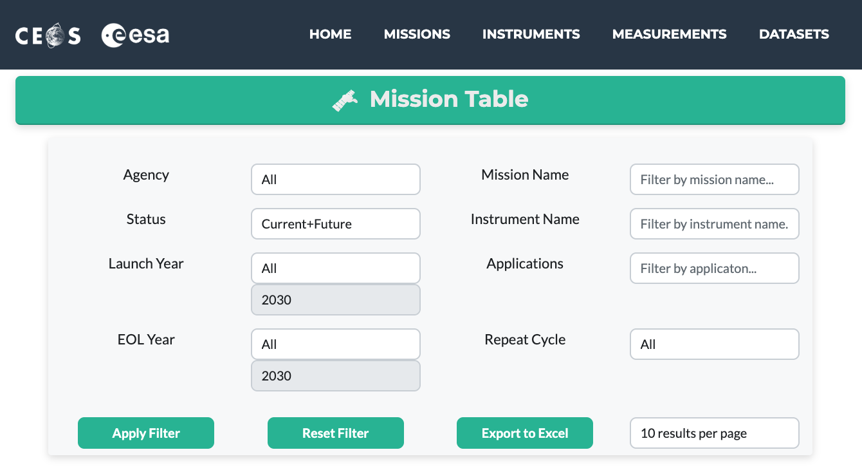
New Website!
database.eohandbook.com

Slide 3
2025 MIM Database Survey
Will shortly initiate the 2025 survey process
Ask that all agencies please note the deadlines below
Timeline:
Letter from Simonetta
QA Checks Finished
2025 MIM Database published
Survey files distributed
Reviewed files due
Confirm POCs
Agency review period
CEOS Plenary
SIT TW
May | June | July | August | September | October
November

