Slide 1
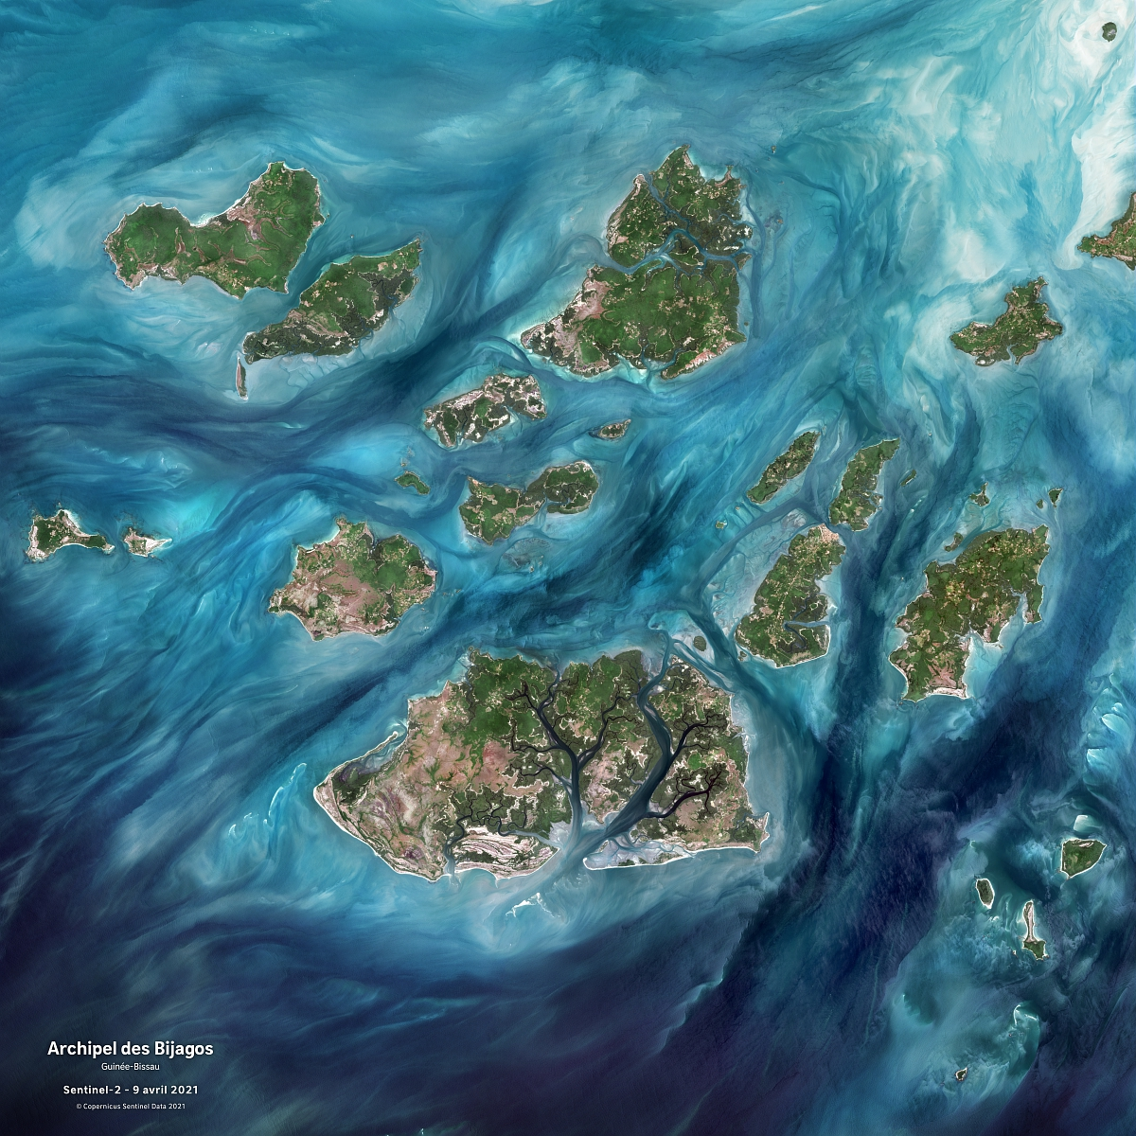

The Space4Ocean Alliance
Dr. Selma Cherchali,
CNES
SIT-40 Side Meeting
Fukuoka, Japan
8-10 April, 2025

Slide 2


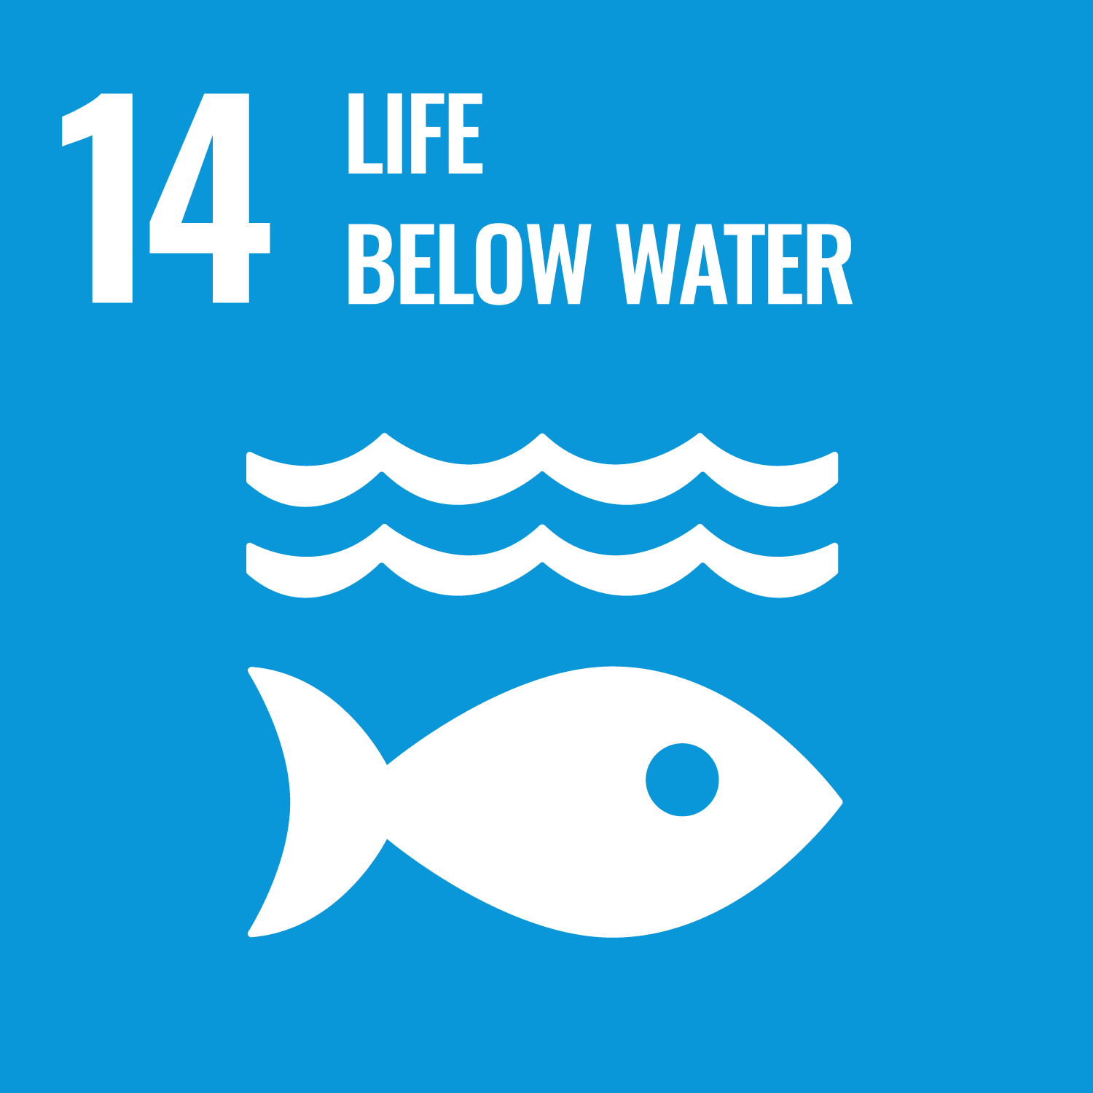
Our oceans at high risk
71%
« A fundamental gap in understanding how humanity is affecting the ocean is our limited knowledge about the pace of change (…) on ocean ecosystems » Halpern et al. 2019
80%
Ocean surface on Earth
Proportion of Earth’s unexplored, unmapped oceans
600M
>3 B
Livelihoods depending on fisheries and aquaculture
People depending on marine and coastal resources
Conservation and sustainable use of the ocean, seas and marine resources

Slide 3
Actions Towards SDG 14
To reduce marine pollution, ocean acidification
To conserve marine & coastal areas
To increase scientific knowledge, marine research and technology for ocean health
To promote sustainable fisheries
To reinforce international sea law

Slide 4


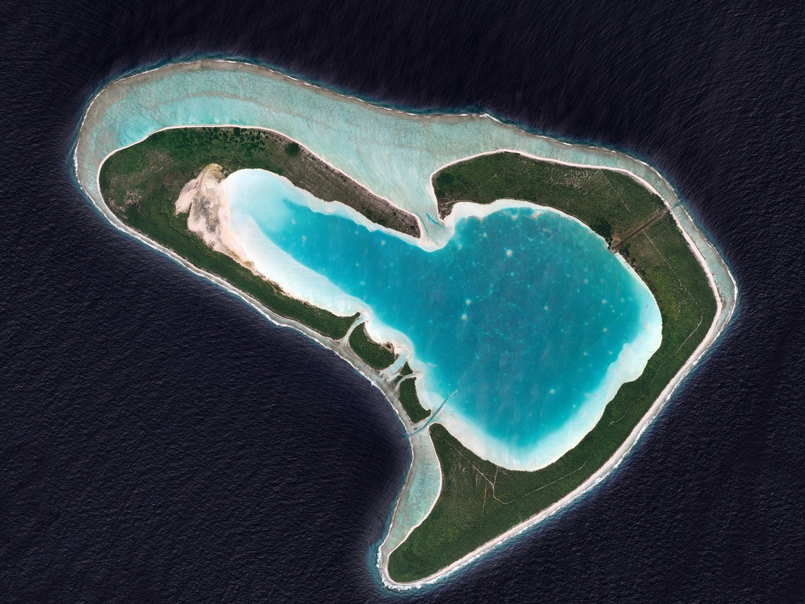
The space4OCean ALLIANCE outline
01
02
03
04
Road to UNOC
Rationale and objectives of the Space4Ocean Alliance
Proposed Governance
Looking forward

Slide 5


ROAD TO UNOC-3
2025
The United Nations Ocean Conference (UNOC) series
is dedicated to support the implementation of SDG 14
June 3-6
June 9-13, Nice
One Ocean
Science Congress (OOSC)
June 7
2017
2022
New York
Blue Economy
and Finance Forum
(BEFF)
Lisbon
June 7-8
Summit on Ocean Rise and Resilience
(ORR)
Notes:
UNOC 3 events are unique opportunities to gather marine and maritime stakeholders to act in a collective manner towards an improved Ocean and Coasts knowledge and management
The Space Sector is one of those important stakeholders and contributes heavily and continuously to this global and common effort

Slide 6
UNOC-3 some highlights
2025
June 9-13, Nice
Elaborate an action plan to address Ocean’s critical condition
(e.g. pollution,ecosystems, acidification, overfishing, etc.)
Acknowledge Mercator Ocean International as an Intergovernmental Organisation
Define and produce scalable Ocean Health indicators
Neptune Ocean Exploration initiative
…
Launch the Space4Ocean Alliance
UNOC 3 events are unique opportunities to gather marine and maritime stakeholders to act in a collective manner towards an improved Ocean and Coasts knowledge and management
The Space Sector is one of those important stakeholders and contributes heavily and continuously to this global and common effort

Slide 7
The space4OCean ALLIANCE outline
01
02
03
04
Road to UNOC
Rationale and objectives of the Space4Ocean Alliance
Proposed Governance
Looking forward

Slide 8

Rationale for the SPACE4OCEAN ALLIANCE why?
Our Oceans are at high risk. It requires decisive, rapid and unified efforts to remedy to their critical condition
Monitoring the ocean is challenging: Oceanography and Earth Observation from space are invaluable assets in addressing ocean and coastal challenges
There is a significant lack of coordination and communication between the space sector, marine and maritime stakeholders
Several gaps remain in addressing ocean challenges: data usage, applications to meet users needs, assesment indicators, space missions providing all necessary data…
The Space4Ocean Alliance objective is to coordinate and create more synergies,
avoiding overlaps and leveraging operational solutions

Slide 9
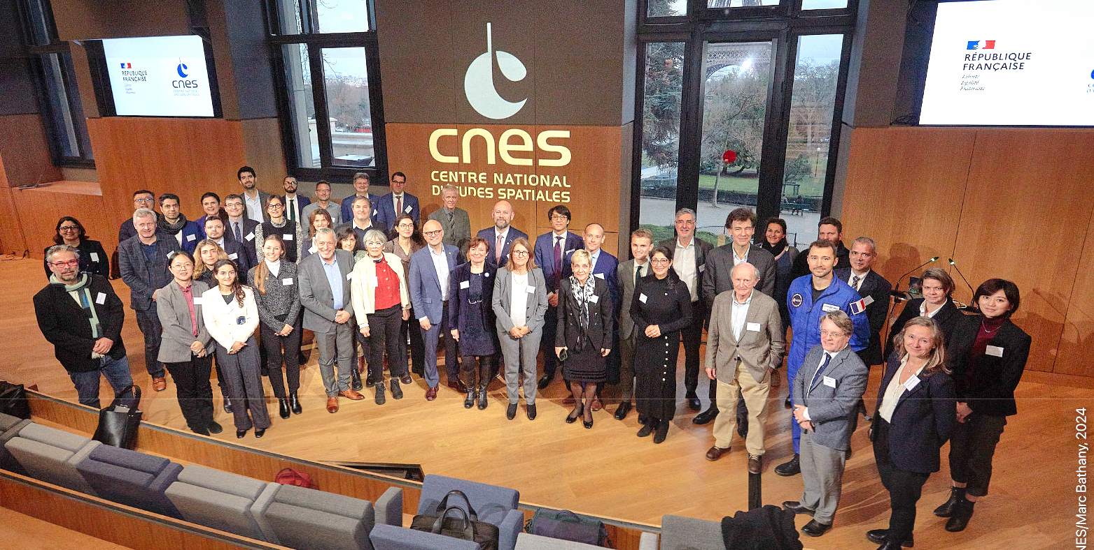
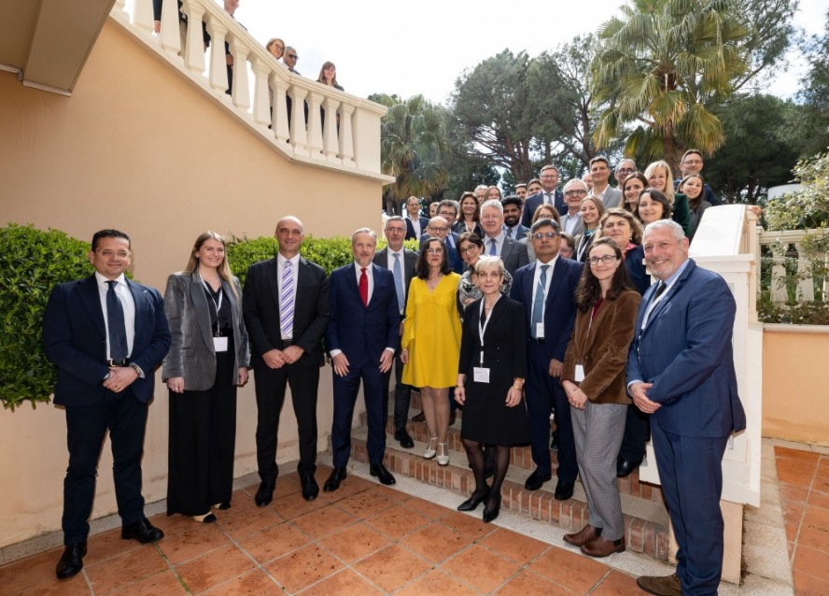
ALLIANCE MILESTONES
Kick-off meeting
Paris - Dec 18, 2024
Space4Ocean Alliance Event
Monaco – March 25, 2025
100+
Space agencies,
embassies,
international organizations
15
Participants
100+
New signatories of the
Joint Declaration of Interest
Countries
Participants

Slide 10
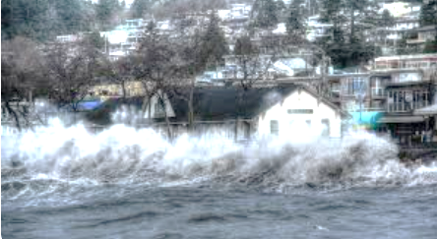

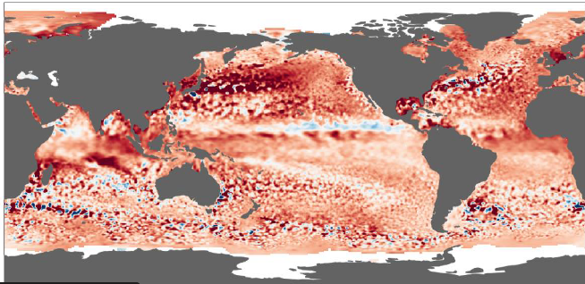
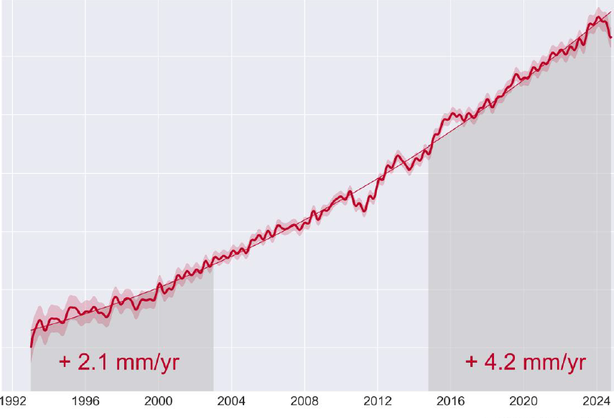
Objectives
1
Better connect
the space sector
and stakeholders
2
Develop
capacity building
3
Share
good practices
4
Develop
advanced
ocean indicators
5
Support the development of
innovative
space missions
6
Design
new applications and services

Slide 11
Objectives
1
Better connect
the space sector
and stakeholders
Provide and improve a permanent dialogue between the international space sector and the global ocean community
Provide a gateway with the UN Member States to enable the use of operational solutions and reach policy targets
Gather user needs to fill data and services gaps

Slide 12
Objectives
2
Develop
capacity building
Empower frontline countries such as SIDs and LDCs
Expand access to observation data

Slide 13
Objectives
3
Share
good practices
Foster training initiatives
Facilitate access to space data and operational services

Slide 14
Objectives
Advocate for the development of evidence-based, local, regional and global ocean indicators
Define and produce scalable indicators to maintain a sustainable balance between anthropogenic maritime activities
4
Develop
advanced
ocean indicators

Slide 15
Objectives
Contribute to addressing observational and operational gaps
Advance the foundational ocean science
5
Support the development of
innovative
space missions

Slide 16
Objectives
Support and promote the delivery of operational services
6
Design
new applications and services

Slide 17
Fundamentals of the SPACE4Ocean ALLIANCE
Space
data
In-situ
data
Numerical
models
Offer a global vision from space, allowing to monitor and anticipate changes to the oceans
Collected directly in the field,
like sentinels and
warrants of the best accuracy
Merging all data into practical tools and operational solutions, providing scenarios and forecasts allowing informed decision making

Slide 18
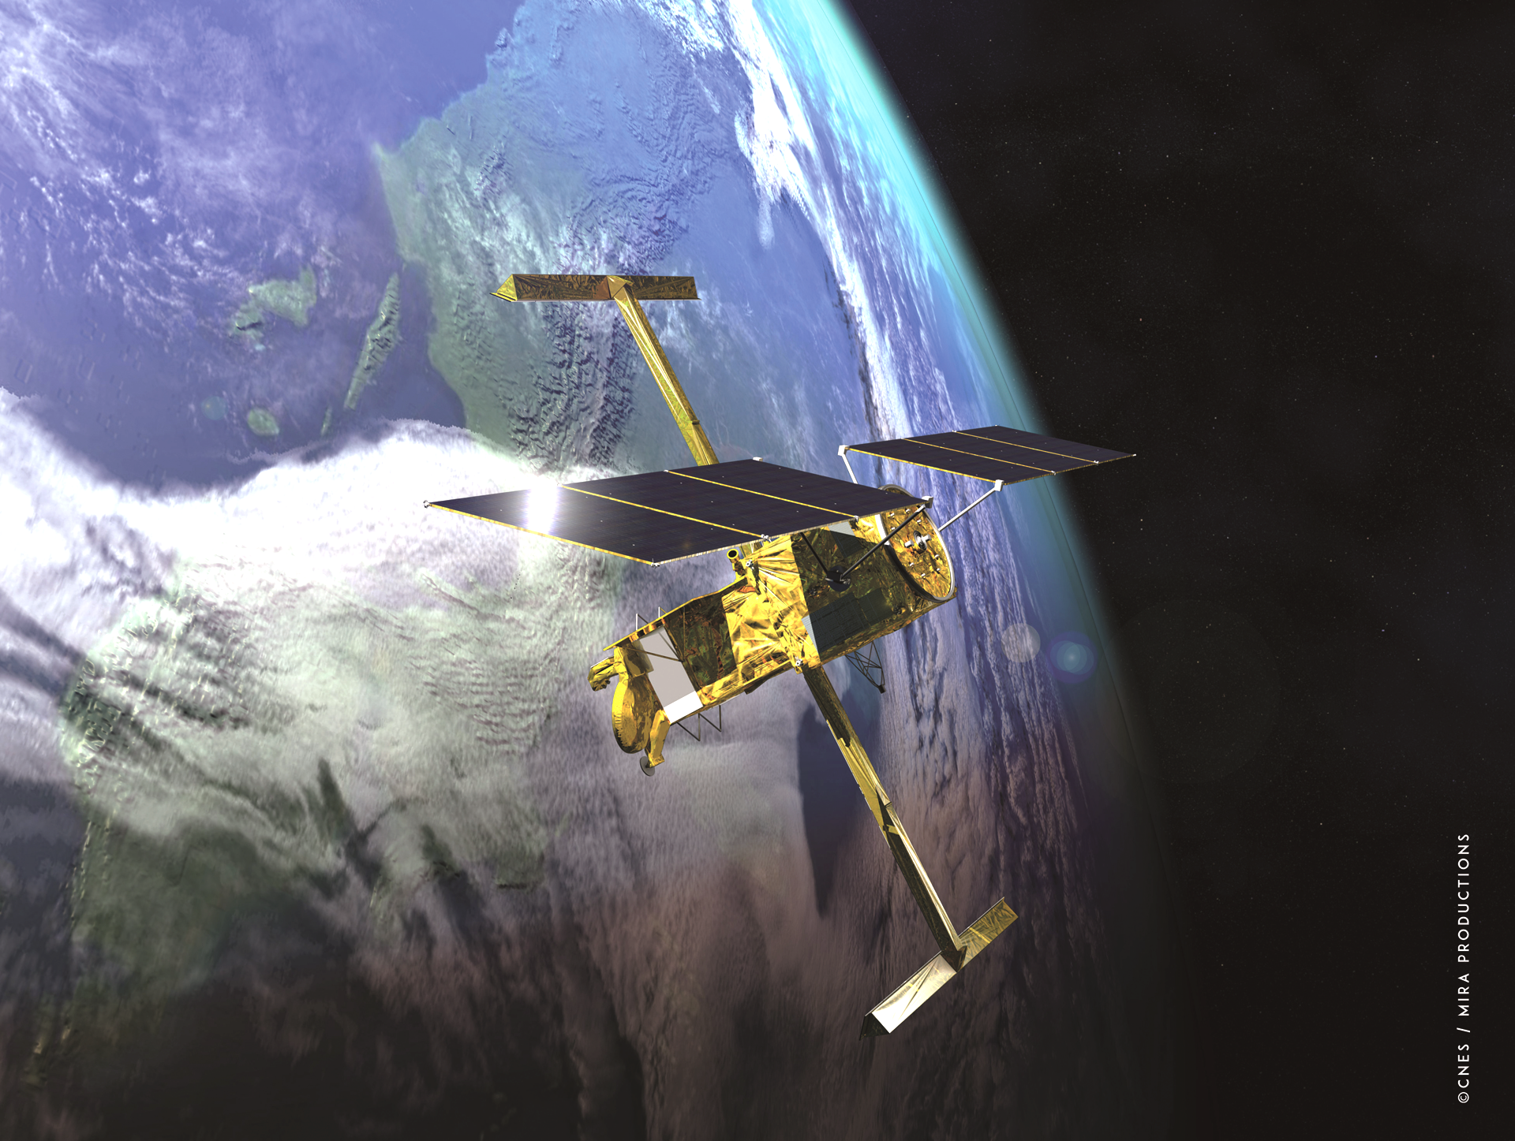
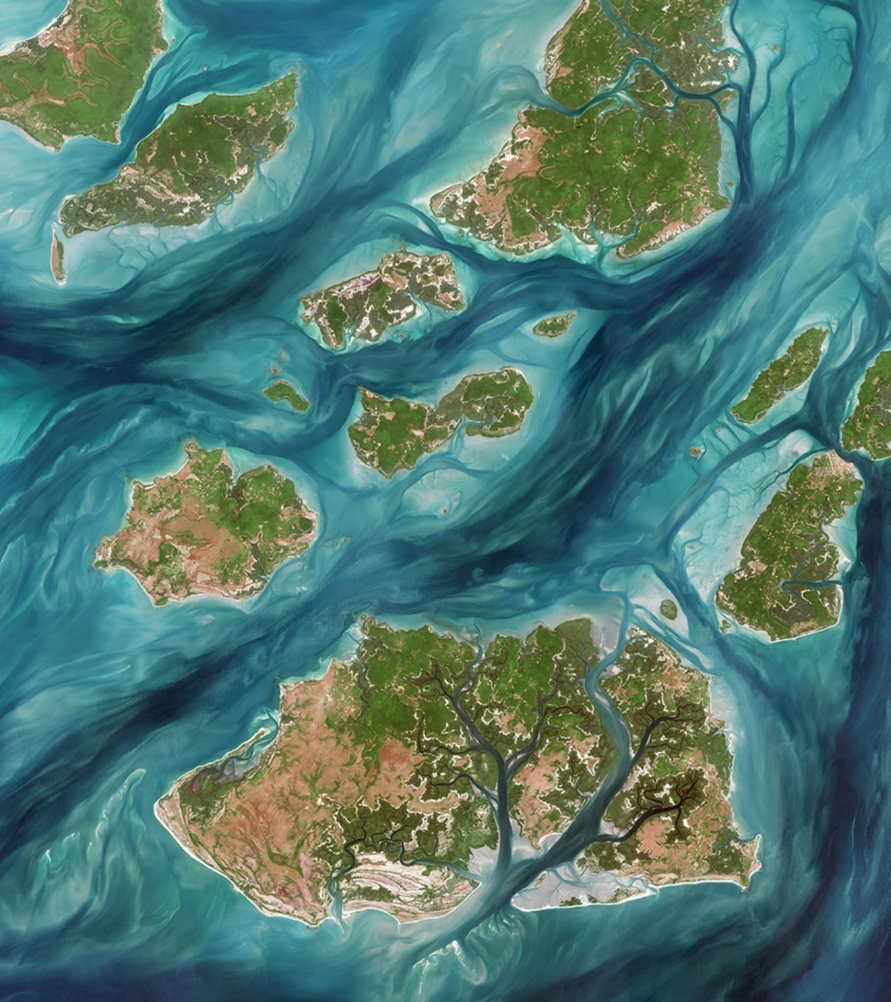









Rationale for the SPACE4OCEAN ALLIANCE
HOW?
to services
The Space4Ocean Alliance
will strengthen synergies and foster coherence with existing frameworks,
without duplication
From data
Notes:
Buoy pictogram © KMG Design

Slide 19
Key issues to be adressed by the Space4Ocean Alliance
to services
EO data
for ocean
Numerical models
Sustainable Blue Economy
Marine biodiversity protection
Climate change impacts
on Oceans
In-situ data
Coastal zone management
Foundation
Ocean Science
Marine and coastal pollution
Maritime Security and Surveillance
From data

Slide 20
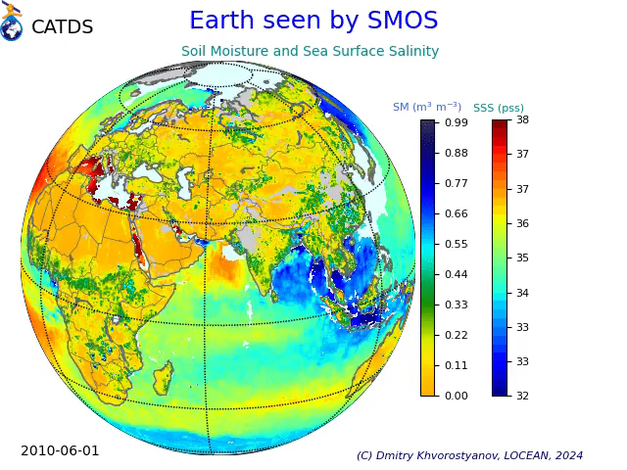
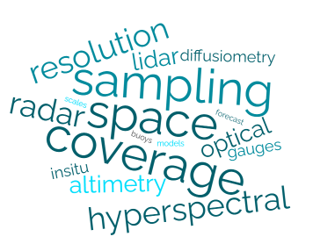
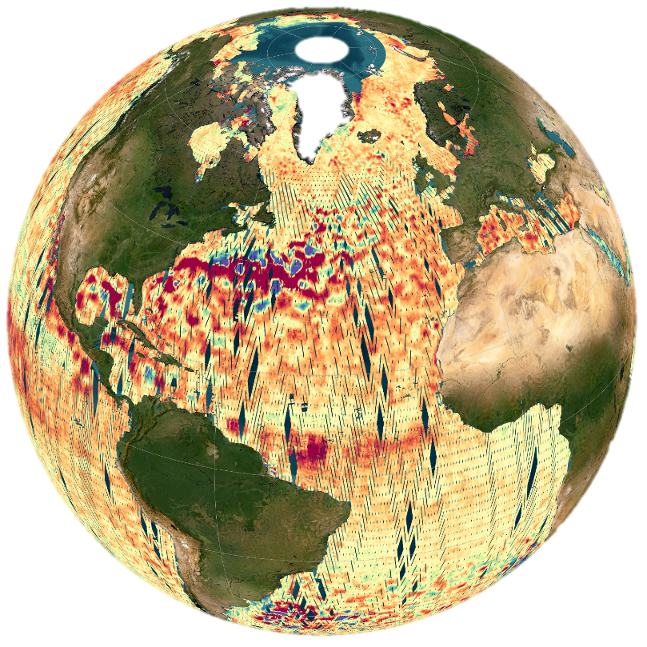
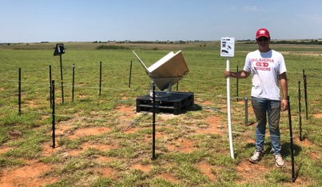

Fundamentals of the
Space4ocean alliance
Performance and gaps of EO data
for ocean
Foundation
Ocean Science

Slide 21
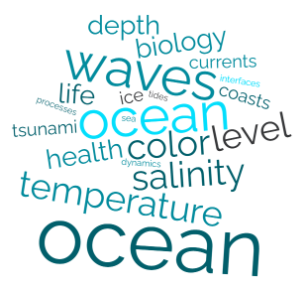
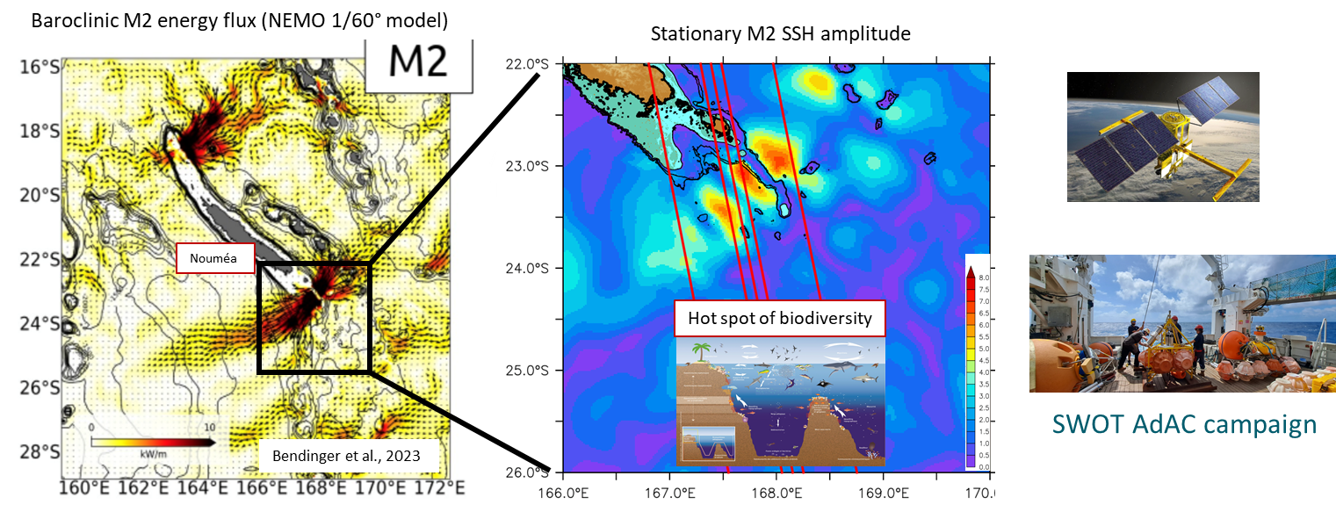
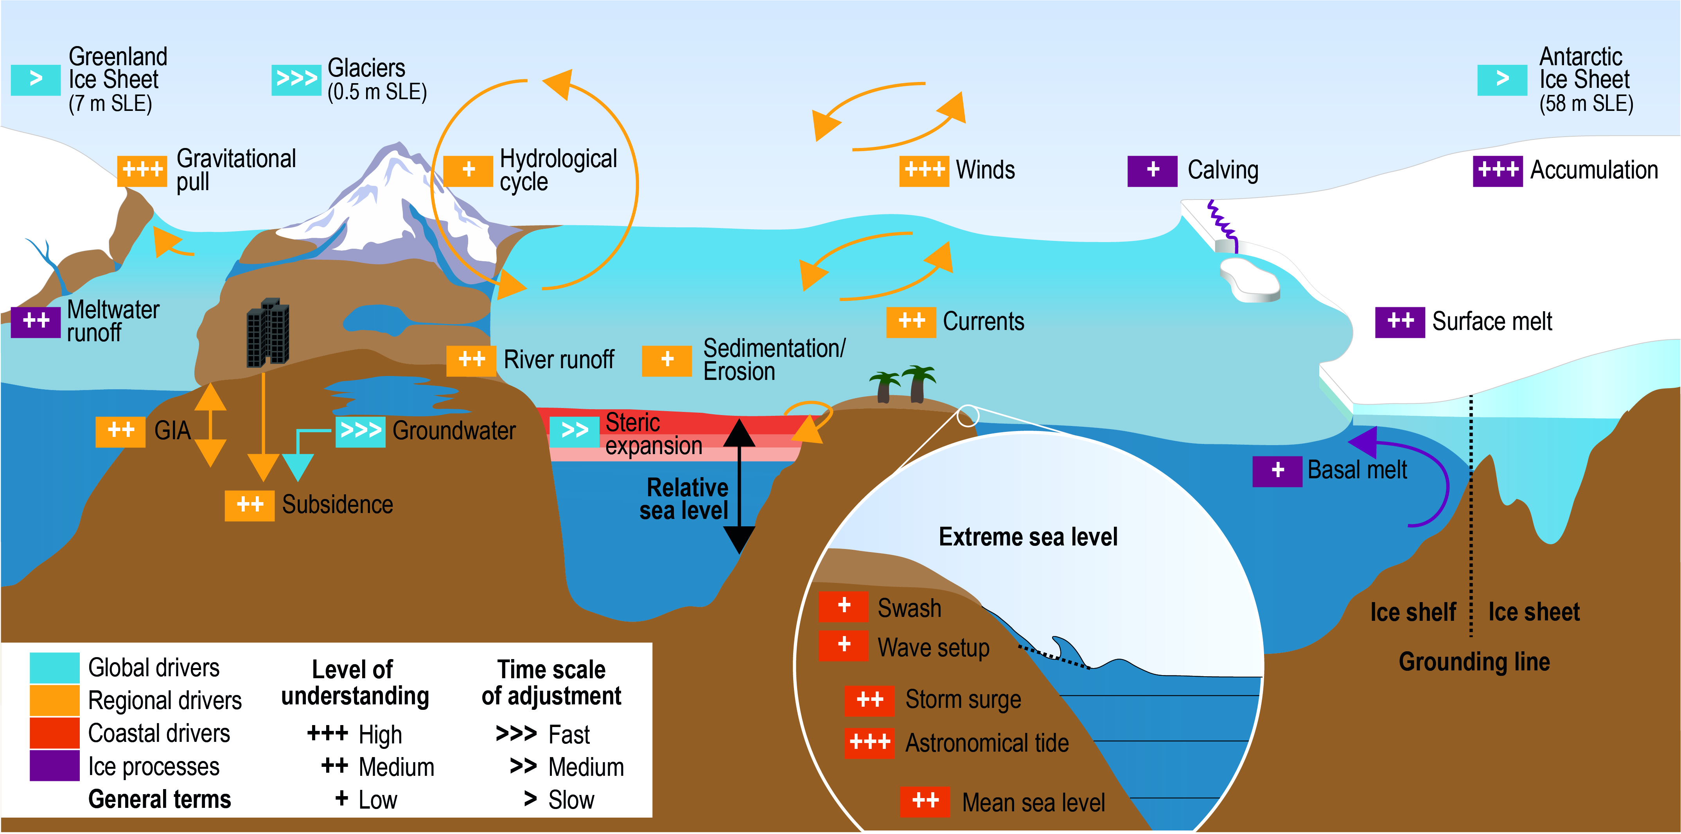
Fundamentals of the
Space4ocean alliance
From Zhao et al.2024
Performance and gaps of EO data
for ocean
© Gourdeau & Cravatte, LEGOS, SWOT-TROPICS project
Foundation
Ocean Science
Fig 4.4 from IPCC 2019 Chapter 4 report
Oppenheimer et al.
Notes:
Oppenheimer, M., B.C. Glavovic , J. Hinkel, R. van de Wal, A.K. Magnan, A. Abd-Elgawad, R. Cai, M. Cifuentes-Jara, R.M. DeConto, T. Ghosh, J. Hay, F. Isla, B. Marzeion, B. Meyssignac, and Z. Sebesvari, 2019: Sea Level Rise and Implications for Low-Lying Islands, Coasts and Communities. In: IPCC Special Report on the Ocean and Cryosphere in a Changing Climate [H.-O. Pörtner, D.C. Roberts, V. Masson-Delmotte, P. Zhai, M. Tignor, E. Poloczanska, K. Mintenbeck, A. Alegría, M. Nicolai, A. Okem, J. Petzold, B. Rama, N.M. Weyer (eds.)]. Cambridge University Press, Cambridge, UK and New York, NY, USA, pp. 321-445. https://doi.org/10.1017/9781009157964.006.

Slide 22

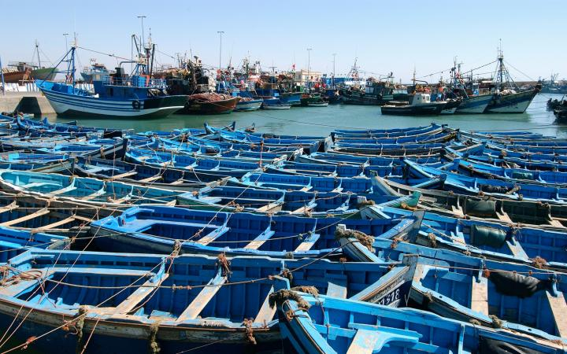

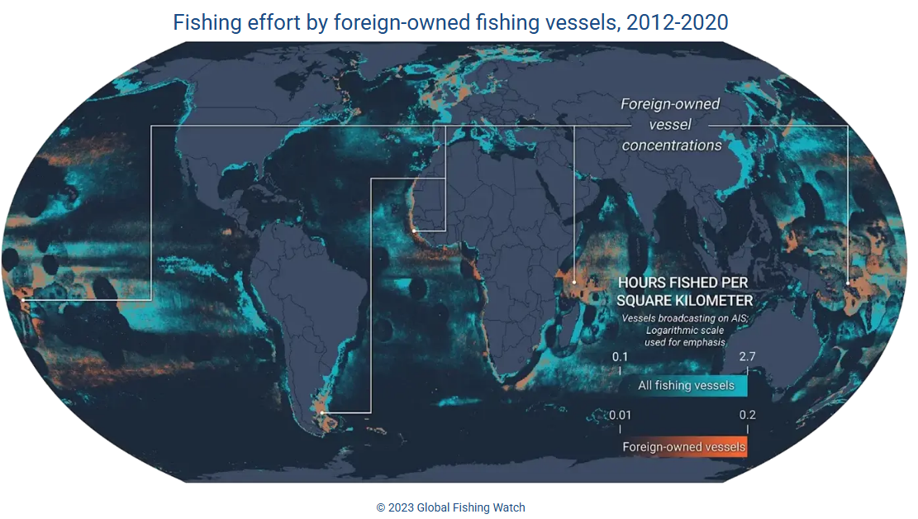
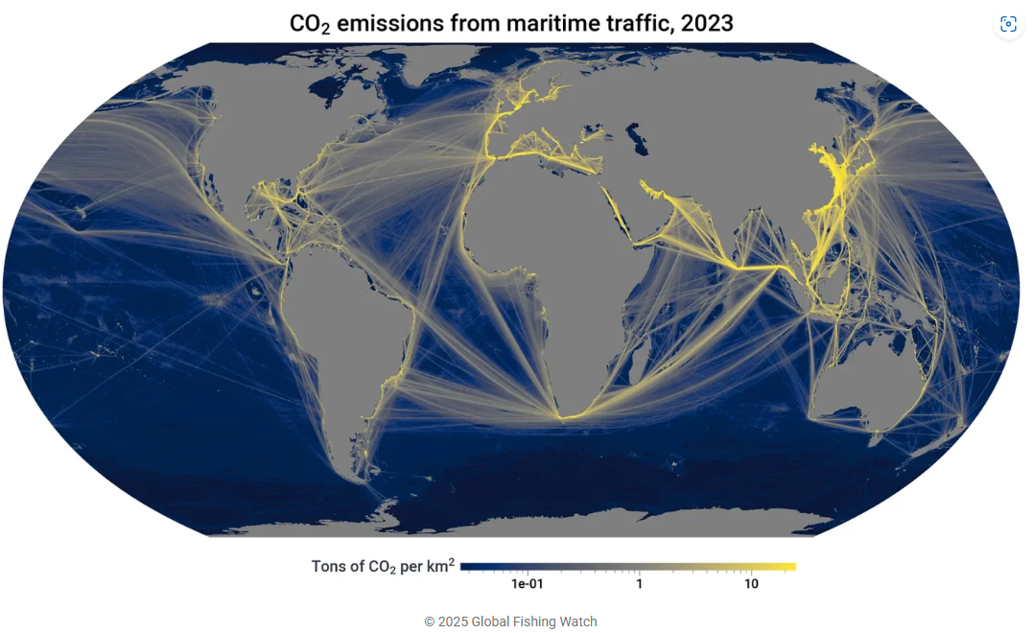
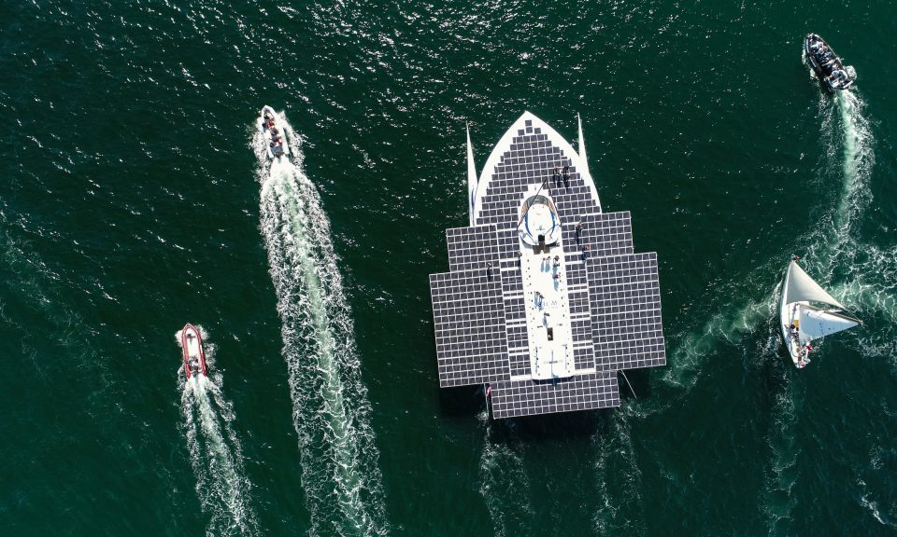
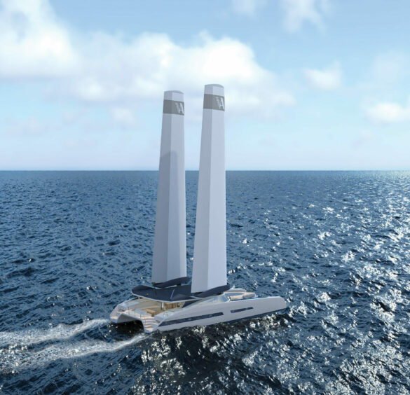

Examples of services
Sustainable fishing & aquaculture
Sustainable Blue Economy
Marine biodiversity protection
Coastal zone management
Marine and coastal pollution
Maritime Security and Surveillance
Decarbonization of the maritime world

Slide 23
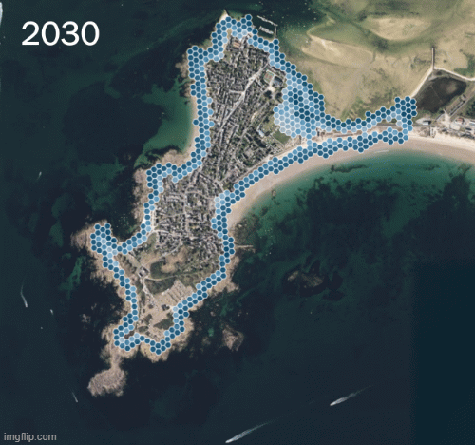

Examples of services
Coastal flooding hazards
LITTOSCOPE | Space for Climate Observatory
Sustainable Blue Economy
Marine biodiversity protection
Coastal zone management
Marine and coastal pollution
Maritime Security and Surveillance
Resilience to extreme events

Slide 24
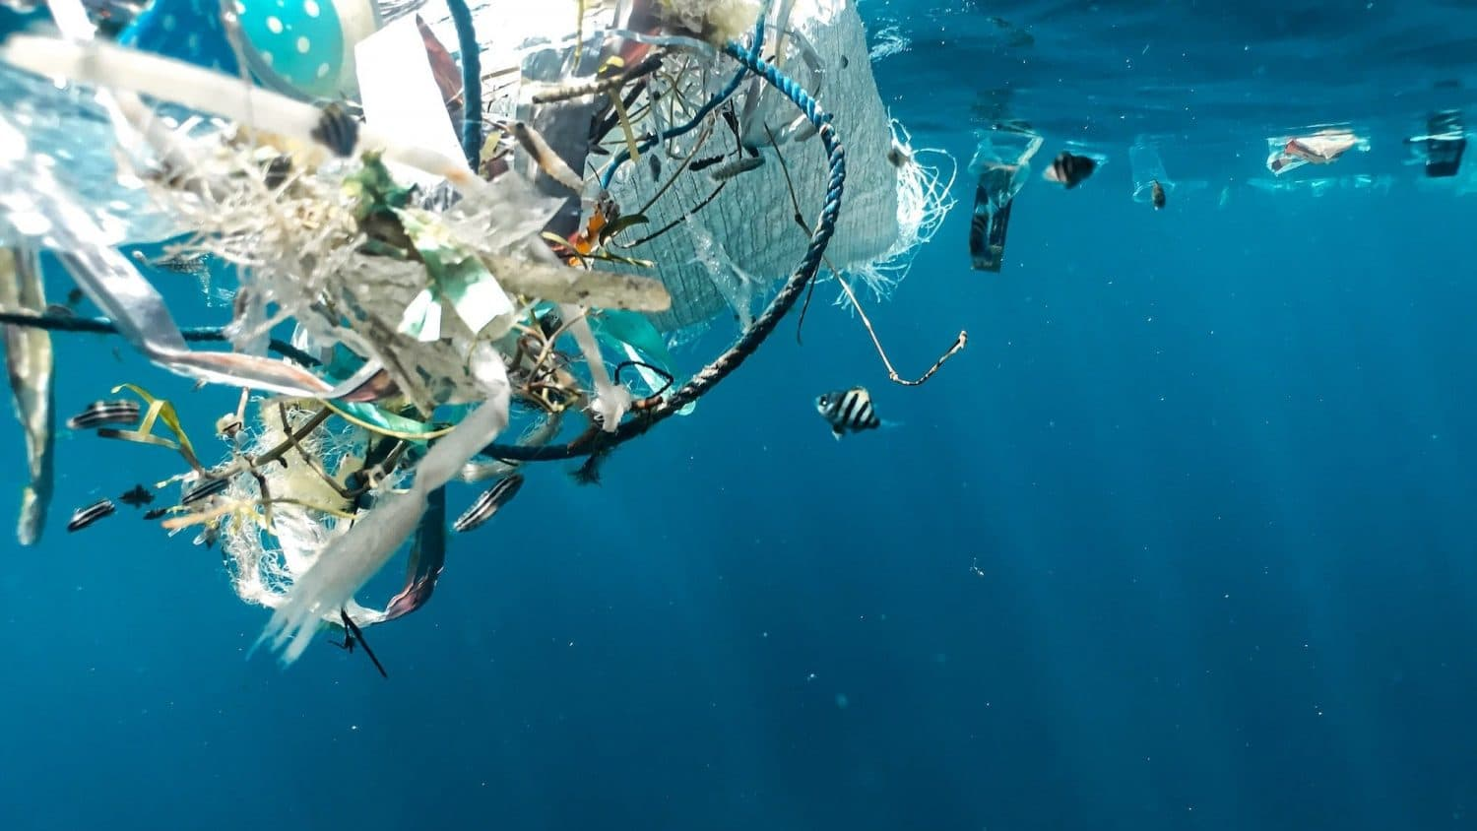
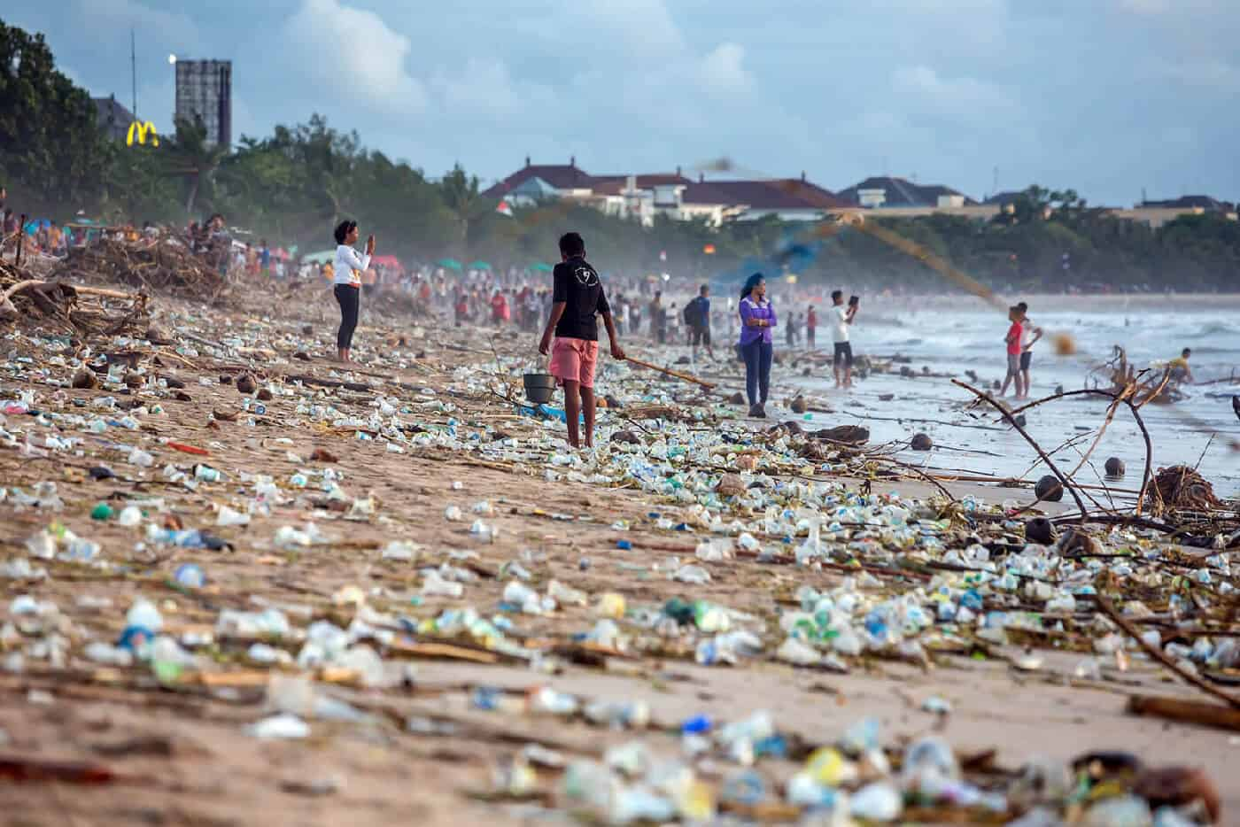


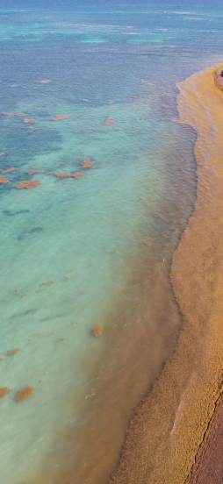

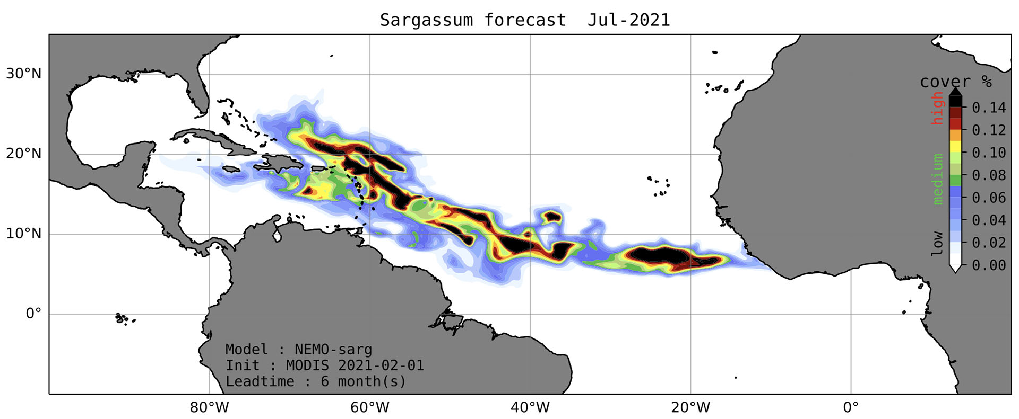
Examples of services
Ocean Plastic Pollution
Sustainable Blue Economy
Marine biodiversity protection
Oil Pollution prevention
Sargassum forecast and warnings
Coastal zone management
Marine and coastal pollution
Maritime Security and Surveillance
SeSaM | Space for Climate Observatory

Slide 25
The space4OCean ALLIANCE outline
01
02
03
04
Road to UNOC
Rationale and objectives of the Space4Ocean Alliance
Proposed Governance
Looking forward

Slide 26














Members of the alliance
As of April 7, 2025
Founding
Members
Confirmed Interest
pending internal process approval
Steering Committee
Members
Notes:
+ Maroc +

Slide 27
Proposed governance
Membership
The Alliance is open to all Member States of the United Nations, national/regional/international institutions and organizations, public and private stakeholders
A focal point is designated for each signatory member of the Alliance
UNOC-3 is an opportunity for stakeholders to join the Alliance
Role of the Steering Committee
Will designate a Member in charge of the Alliance Secretariat
Will design, approve and follow a multi-annual Implementation Plan
Meetings
Steering Committee meetings at least twice a year to oversee progress on the Implementation Plan
Annual event to follow-up on Alliance achievements and way forward
Future UNOCs dedicated events and technical workshops
Founding
Members
Steering Committee
Members up to date

Slide 28
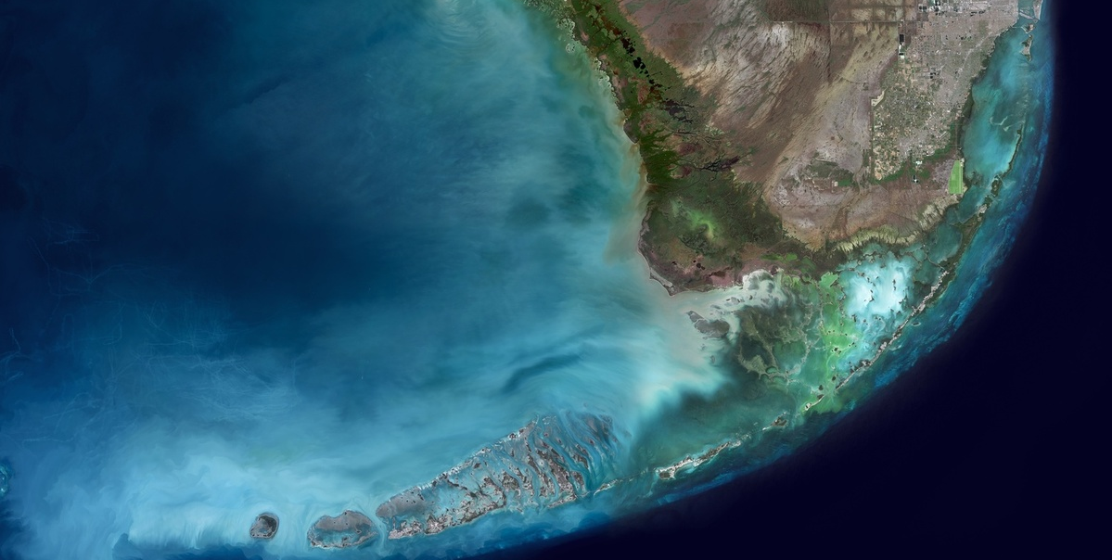
Join
the space4ocean alliance
now !
Declaration of interest sent by CNES CEO on April 4th
RSVP requested by the end of April
Please send us:
  Confirmation of Interest and intention to sign the Declaration
  Intention to participate in the June events (UNOC3), with a list of expected participants
  Expected level of representation:
    For June 9: at least heads of agencies, organizations, institutes with authority to sign
    For June 10 or 11: higher level desired
Selma Cherchali
selma.cherchali@cnes.fr

Slide 29
The space4OCean ALLIANCE outline
01
02
03
04
Road to UNOC
Rationale and objectives of the Space4Ocean Alliance
Proposed Governance
Looking forward

Slide 30
2-year perspective (2025-2027)
Success criteria
Number of new members
Structure and enlarge the Alliance
Identify user needs
Provide the state of the art of existing services and applications
Define ocean health indicators
Identify observation gaps, if any, and establish a roadmap to fill those gaps
Identify missing operational services, if any, and implement 5 new operational services
Promote Earth Observation for ocean science and applications at international level
Provide dedicated training on Ocean Science
Define a « capacity building package » and move on with a first implementation
Organize and coordinate the space contribution at UNOC-4
Publish a Users Requirements Document
TBD
TBD
TBD
TBD
TBD in the UNOC declaration

Slide 31
5-year perspective (2030+)
Success criteria
Number of new members
Further enlarge the Alliance
Update Users Needs
Implement the ocean health indicators and inform the community about the results
Start implementing the roadmap of projects and services
Assess the impact of the Alliance
Organize and coordinate the space contribution at UNOC-5, UNOC-6
Update the Users Requirements Document (URD)
Publication of indicators
TBD in the roadmap, e.g. 25 new projects/services provided to the community
Number of new members
TBD in the UNOC declaration

