Slide 1
Outcome Step-C&D of the External Request Process of UNCCD.
Satoshi Uenuma, SIT Chair Team
Agenda Item 8.3
SIT-40 Fukuoka, Japan
8-10 April, 2025

Slide 2
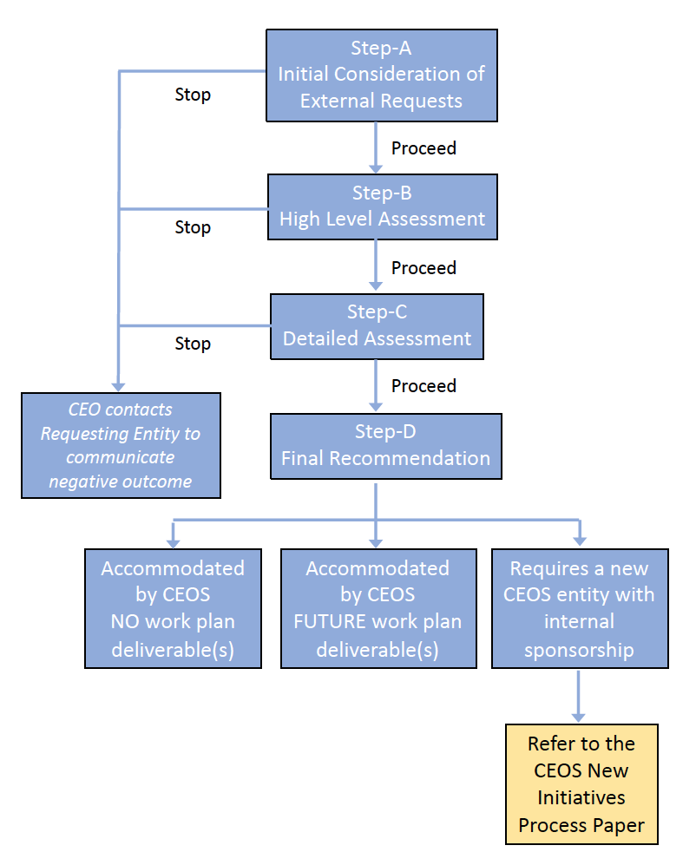
Background
CEOS has supported UNCCD on SDG 15.3.1 through SDG CG for several years.
CEOS received Letter of Cooperation from UNCCD on May 2024.
CEOS, with the lead of the SIT Chair, SEO, CEO, started assessment of this external request in accordance with the CEOS External Request Process Paper and confirmed it had passed the Step B at the 2024 SIT-TW in Sydney.
Considering the content of each request, SIT Chair and SEO conducted the Step-C and D assessment with SDG-CG, LSI-VC, BST, ESA and EC.
The Decision Tree of Assessment process
We are here

Slide 3
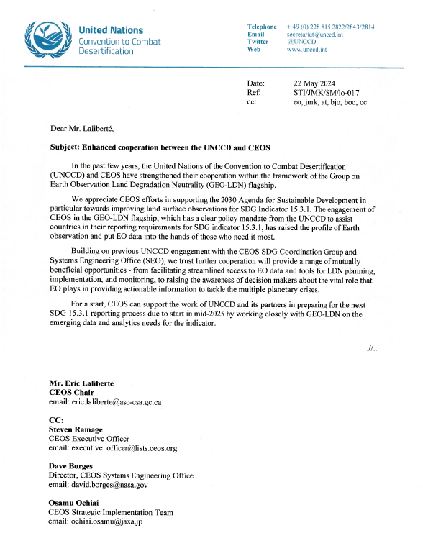


7 requests from UNCCD
Preparing for the next SDG 15.3.1 reporting process with GEO-LDN on the emerging data and analytics needs for the indicator.
Assessing the availability and suitability of land surface datasets for these geographies, by prioritizing SIDS and hyper arid areas.
Providing assessment and improved guidance on:
  Linking estimates of land condition between coarse and fine scale datasets
  Cross-calibration of historical and new satellite observations
  New and emerging datasets provided by the UNCCD to countries for reporting.
Development of OGC standards for geospatial LDN reporting indicators, building on the ARD concepts and prior work by GEO-LDN for SDG 15.3.1.
Playing a role in efforts to synergize national target setting between the UN CBD and the UNCCD LDN target-setting programme.
Providing Strategic guidance to GEO-LDN, In-kind contributions to GEO-LDN capacity development activities and collaboration on joint communications and outreach.
Participating to the UNCCD COP16 and contribute to the delivery of Action Agenda.
  The request CLOSED (Neil Sims, CSIRO attended the COP16 in Dec 2024).

Slide 4
Assessment Criteria for Step-C
Which specific Agencies and CEOS entities would be involved in addressing this?
Is the proposed activity well-aligned with existing activities of CEOS (e.g., VCs, WG, or other initiatives)? If so, identify those activities and entities.
What data/information products would CEOS generate in support of this initiative/task and when would those products be needed?
Assess the detailed feasibility and affordability of the external request and its intended outcomes. CEOS Agencies must possess the necessary personnel and fiscal resources to support a new initiative so it can fulfill its intended outcomes.
Are there additional CEOS Agency policy considerations that would encourage or discourage their involvement (e.g., overarching data policies or prevailing public/private partnerships)?
Assess CEOS current priorities and commitments. Taking into consideration existing priorities and commitments, can CEOS Agencies and entities support the intended outcomes of this external request?

Slide 5
Assessment Results
# | Request | Assessor | Result
1 | Preparing for the next SDG 15.3.1 reporting process | SDG-CG, SEO | This request directly aligns with our annual updates to EO Support Sheet 15.3.1, led by Neil Sims (CSIRO) who will remain engaged with UNCCD and GEO-LDN on this topic.
2 | Assessing the availability and suitability of land surface datasets | SDG-CG, SEO | SEO (as member of SDG-CG) has worked directly with UNCCD in the past to address similar requests, but is not able to respond to these new requests.
3 | Providing assessment and improved guidance | SDG-CG, SEO
4 | OGC standards for geospatial LDN reporting indicators | LSI-VC | A Cooperation with UNCCD is well in line with the activities in LSI-VC. ARD OG and LSI-VC will monitor OGC Geospatial Reporting Indicators Standards Working Group(OGC GRI SWG) developments over time and will remain open to providing CEOS-ARD updates to the OGC GRI SWG if/when requested.
5 | To synergize national target setting between the UN CBD and the UNCCD LDN | BST | A new entity, expected to considered after the BST, may be able to engage this request.
6 | Contributions to GEO-LDN strategic guidance, capacity development activities and collaboration on joint communications and outreach. | SDG-CG, WGCapD CEOS Comm Team | WGCapD could schedule meeting with GEO-LDN leadership to share activity plans and identify any opportunities for capacity building collaboration. CEOS Communications Team remains open to specific requests in terms of joint communications.

Slide 6
Additional Comments by EC & ESA
# | Request | Assessor | Result
1 | Preparing for the next SDG 15.3.1 reporting process | ESA | ESA is willing to cooperate with SDG-CG and EC to address this request. collaborate.
 |  | EC | EC can support this request through Copernicus Land Monitoring Service (CLMS) and Version1 of the reprocessed JRC LPD for the new reporting cycle.
2 | Assessing the availability and suitability of land surface datasets | ESA | ESA SEN4LDN Project can contribute to SIDS.
 |  | EC | EC can support this request with the new 10m Land Cover and Forest Monitoring (LCFM) of the CLMS portfolio available from Q3 2025.
3 | Providing assessment and improved guidance | ESA | The consistency between coarse and fine-scale datasets has been analyzed in the SEN4LDN project. But substantial future additional work is essential to support this request and it is unclear to support additional work at this stage.
4 | OGC standards for geospatial LDN reporting indicators | EC | Contribution to standardization of global reporting indicators is inline with the EU space regulation and Copernicus data policies. EC can support this request and is already significantly supporting the knowledge base of UNCCD by joining the GEO LDN Working Group 2 on Data Quality Standards.
6 | Contributions to providing Strategic guidance to GEO-LDN, capacity development activities and collaboration on joint communications and outreach. | ESA | ESA is already engaged in GEO-LDN in terms of providing strategic guidance and will continue supporting.

Slide 7
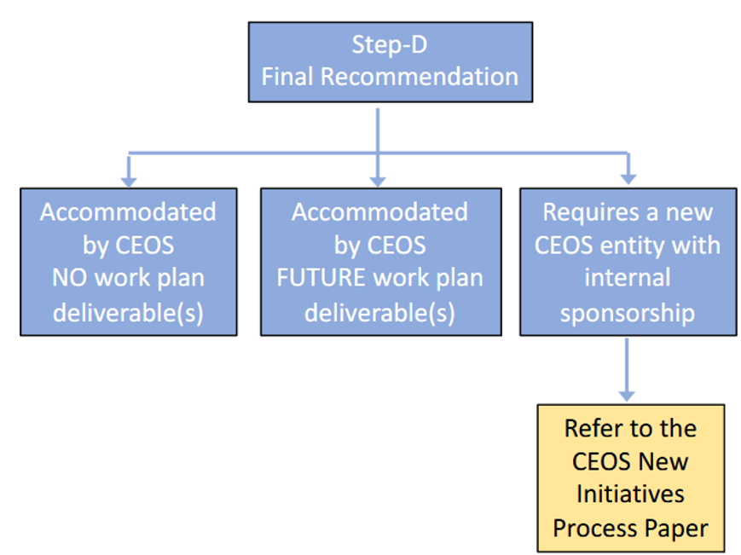
Step-D (Final Recommendation)
In Step-D, CEOS must consider which of the following 3 recommendations applies to the external request.
  Accommodated by Existing CEOS agencies/groups but it won’t be added to CEOS Work Plan deliverable(s).
  Accommodated by Existing CEOS agencies/groups, as future CEOS Work Plan deliverable(s).
  Requires a new CEOS entity with internal sponsor ship.
A
B
C

Slide 8
Results of Step-D
# | Request | Step-D Option | CEOS Entity in Charge | Note
1 | Preparing for the next SDG 15.3.1 reporting process | B (add to WP) | SDG-CG | SDG-CG will support UNCCD through EO Support Sheet 15.3.1, in the cooperation with EC and ESA
2 | Assessing the availability and suitability of land surface datasets | A (without WP) | SDG-CG | Technically, it is possible to support by SDG-CG however specific resources have not been identified through the CG. The ESA SEN4LDN Project and EC’s CLMS could contribute to this subject for SIDS and should coordinate further through SDG-CG.
3 | Providing assessment and improved guidance | A (without WP) | SDG-CG | Technically, it is possible to support by SDG-CG however specific resources have not been identified through the CG. The ESA SEN4LDN Project could contribute to this subject and should coordinate further through SDG-CG.
4 | OGC standards for geospatial LDN reporting indicators | A (without WP) | LSI-VC | LSI-VC/ARD OG will address this request in the cooperation with EC.
5 | To synergize national target setting between the UN CBD and the UNCCD LDN | N/A | A new entity after BST | A new entity, expected to considered after the BST, may be able to engage this request.
6 | Strategic Guidance support. Contributions to GEO-LDN capacity development activities and collaboration on joint communications and outreach. | A (without WP) | SDG-CG WGCapD CEOS Comm Team | Just like #2&3, The ESA could contribute to this subject and should coodinate further through SDG-CG. WGCapD could support the capacity development of GEO LDN. Comm Team could support the collaboration on joint communication.

Slide 9
Thank you

Slide 10
Backup

Slide 11

About UNCCD
UNCCD: the United Nations Convention to Combat Desertification
UNCCD is a Convention to combat desertification and mitigate the effects of drought through national action programs that incorporate long-term strategies supported by international cooperation and partnership arrangements.
UNCCD is one of the three major treaties known as the Rio Conventions— alongside climate change and biodiversity.
UNCCD COP16 (Riyadh, Saudi Arabia in December 2024) will be a landmark event for accelerating action on land and drought resilience.
Designated UN Custodian Agency for SDG indicator 15.3.1 (Land Degradation)

Slide 12
Assessment Criteria for Step-B
Is there sufficient clarity in the request to perform a high-level assessment and, in particular, does it contain well-formulated requests to CEOS Agencies?
Does the request relate to the Group on Earth Observations (GEO) Work Programme or a global policy framework (e.g., UN-SDG, UNFCCC, SBSTA, GCOS, Sendai Framework)?
Is there a benefit to internal and/or external stakeholders? This value should be societal benefit but may also be monetary.
Is Earth observation data relevant to the needs of this request?
Assess the feasibility of a potential contribution from CEOS Agencies. Are the type of observations, resolution and frequency of observations compatible with the Earth observation data resources of CEOS Agencies?

Slide 13
CEOS External Request Process
The CEOS defines the following process for external requests
  Step-A: Initial Consideration of External Requests
  Managed by CEO and supported by the CEOS and SIT Chairs. Is the request relevant and clear?
  Step-B: High-Level Assessment
  Managed by the SIT Chair and supported by the SEO and CEO. Assess relation to GEO and external frameworks, benefits, relevance of EO data and feasibility
  Step-C: Detailed Assessment
  Managed by the SIT Chair and supported by the SEO and CEO. Also supported by CEOS Members and entities.
  Assess specifics of CEOS Agency support, data needs and feasibility and priorities vs. commitments
  Step-D: Final Recommendation
  Accommodate in CEOS (work plan task or not), add a new CEOS entity (refer to New Initiatives Process Paper).
the CEO will contact the external requesting entity to communicate the outcome of each Steps.

