Slide 1
CEOS SIT-40
SDG Coordination Group
Report
SDG
Coordination Group
Agenda Item 8.2
SIT-40
Fukuoka, Japan
10 April 2025

Slide 2
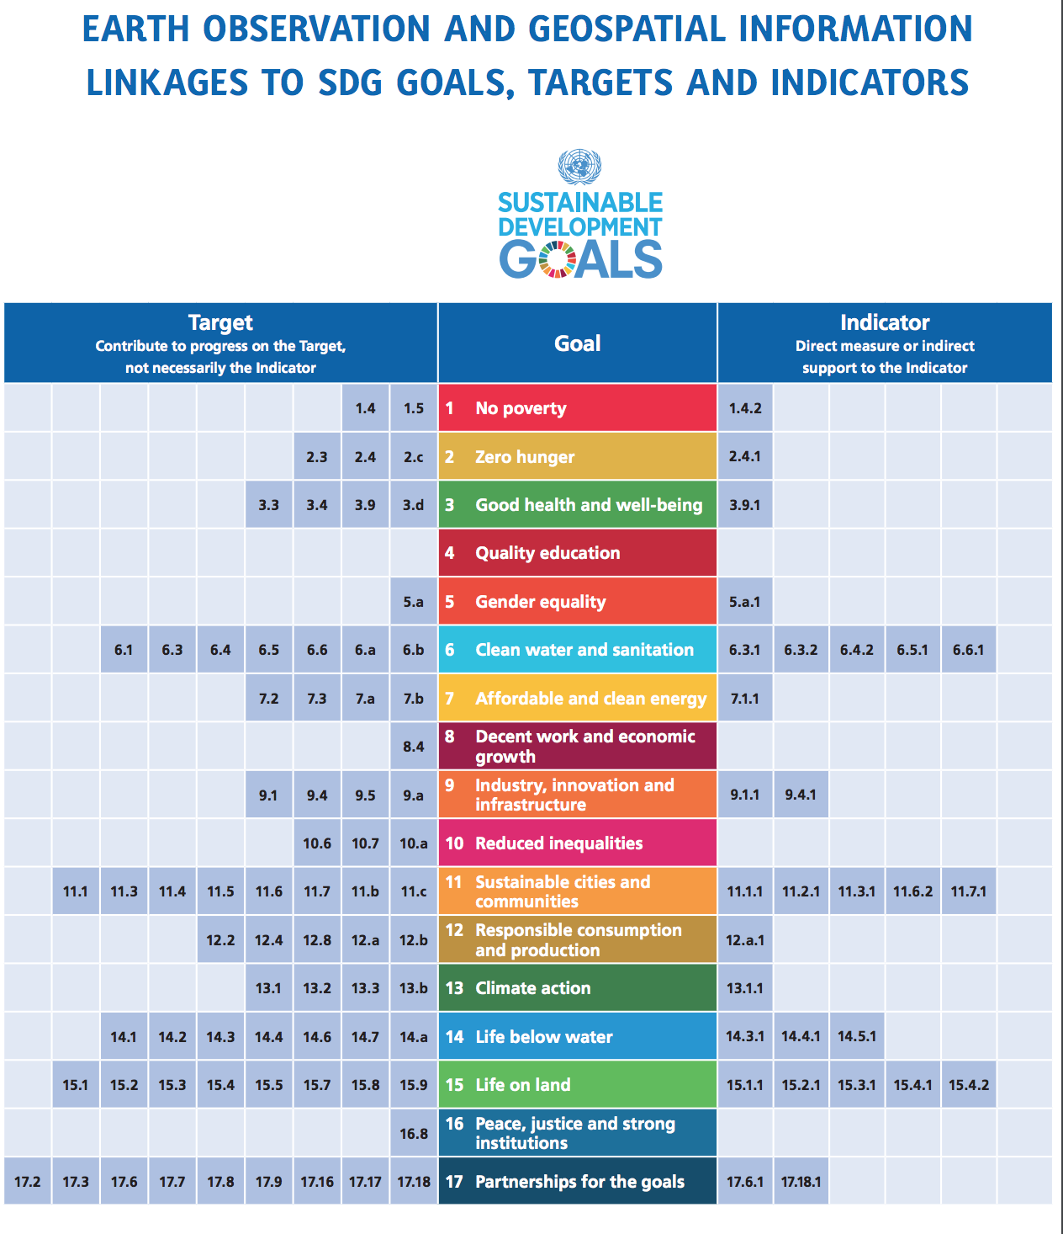
Context and Progress
CEOS Strategic Priority
Strategic Lead: JAXA SIT Chair
Primary Membership:
CSIRO, ESA, CEO, SANSA, GEO Secretariat
All 2024 Deliverables addressed.
Monthly meetings held and continue.
Website refresh underway; Storymap developed.
SIT-39-15 Completed: Engage CEOS Secretariat on matter of invigorating support for SDGs. Thank you!

Slide 3
2025 Deliverables
Number | Deliverable Title | Due | Responsible User | Responsible Agency | PROGRESS
SDG-24-01 | EO Support Sheet for Indicator 6.6.1 (Water related Ecosystems) Review | 2025 Q3 | Marc Paganini | ESA | ONGOING
SDG-25-01 | EO Support Sheet for Indicator 11.3.1 (Urbanization) Review | 2025 Q4 | Martyn Clark, Nale Mudau | GEOSEC, SANSA | ONGOING
SDG-25-02 | EO Support Sheet for Indicator 14.1.1 (Marine Pollution) Review | 2025 Q4 | Paul DiGiacomo | NOAA | ONGOING
SDG-25-03 | EO Support Sheet for Indicator 15.3.1 (Land Degradation) Review | 2025 Q4 | Neil Sims | CSIRO | ONGOING
SDG-23-04 EO Support Sheet for Indicator 15.3.1 (Land Degradation) Review (Neil Sims, CSIRO) COMPLETE (Online)
SDG-25-04 | UNSC IAEG-SDGs WGGI Development Agenda Engagement | 2025 Q4 | CEO, Flora Kerblat | SDG CG/CEO | ONGOING
SDG-25-05 | Create CEOS strategic communique for national delegations to UN-GGIM 15th Session. | 2025 Q3 | Flora Kerblat, Osamu Ochiai, CEO | SDG CG/CEO | ONGOING

Slide 4
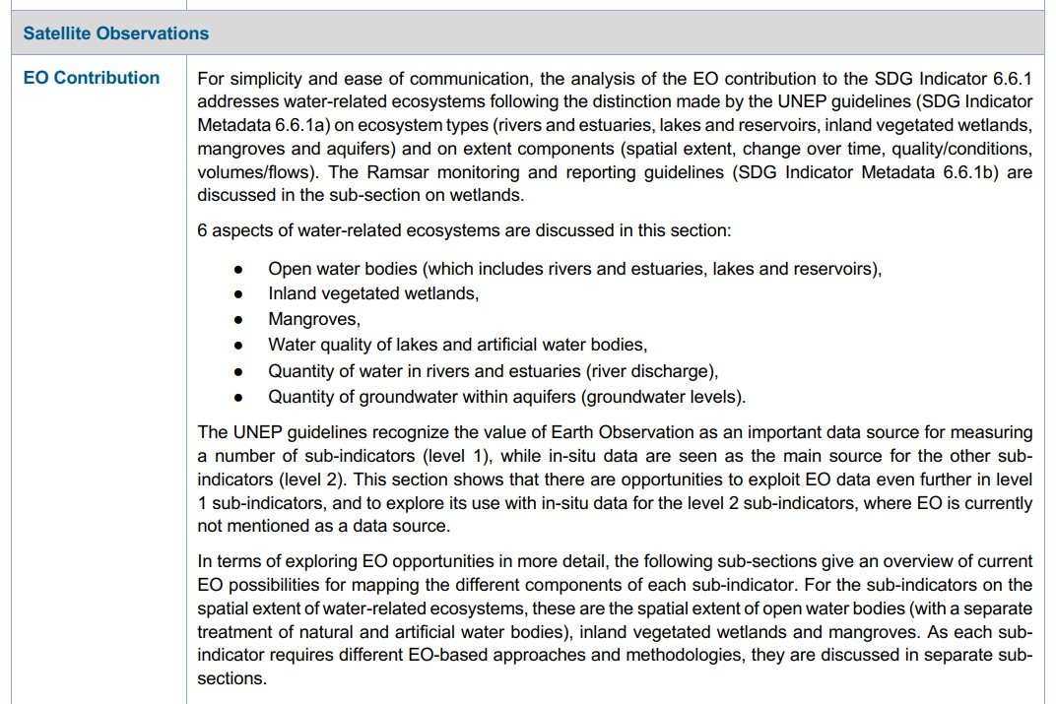
Water-related Ecosystems
Title: Change in the extent of water-related ecosystems
Indicator 6.6.1
Custodian(s): UNEP, Ramsar Secretariat
ESA leading engagement with custodian agencies, aligning 2025 update with UNEP guidance.
Coordinating closely with BST.

Slide 5
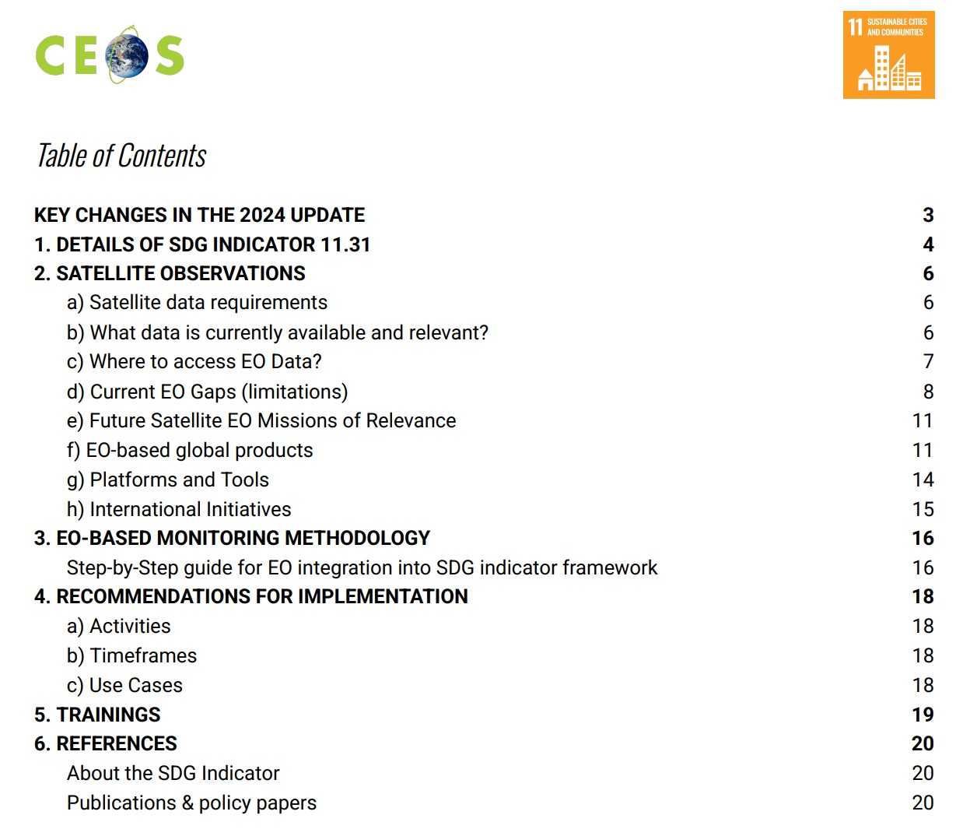
Urbanization
Title: Ratio of Land Consumption Rate to Population Growth
Indicator 11.3.1
Custodian: UN Habitat
GEO Secretariat and SANSA working closely with UN Habitat to provide holistic annual updates to the EO Support Sheet.

Slide 6

Marine Pollution
Title: Index of Coastal Eutrophication and Floating Plastic Debris Density
Indicator: 14.1.1a
Custodian(s): UNEP
In close partnership with GEO Blue Planet, SDG CG members work with UNEP to provide relevant annual updates.

Slide 7
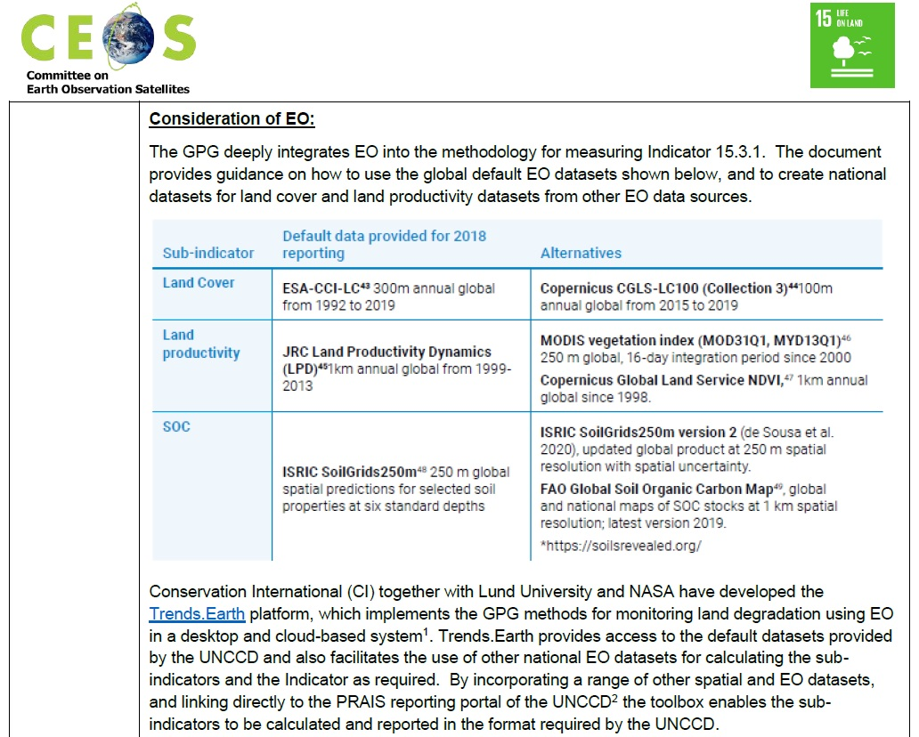
Land Degradation
Title: Proportion of land that is degraded over total land area
Indicator 15.3.1
Custodian(s): UNCCD
CSIRO leading engagement with UNCCD and GEO-LDN is ensuring direct feedback and guiding annual updates.
Coordinating closely with BST.

Slide 8

UN-GGIM Engagement
Coordination Group working to ensure the availability and capabilities of Earth observations are understood as the next Global Development Agenda is shaped.
Provided technical contributions to the UN Global Geospatial Information Management (GGIM) Working Group on Geospatial Information (WGGI) Paper, highlighting the value and role of geospatial and Earth observation data in global development:
https://unstats.un.org/UNSDWebsite/statcom/session_56/documents/BG-3e-Rescuing-the-SDGs-with-Geospatial-Information-E.pdf
“Thinking and discussions are already taking place about what comes next...after the current Global Indicator Framework.”
-Cara Williams, Co-Chair
UN Inter-Agency and Expert Advisory Group for Sustainable Development Goal Indicators
https://storymaps.arcgis.com/stories/14598ba2348e4717bcac6d86e10e3815

Slide 9
Questions / Discussion
How can CEOS improve addressing the UNSDGs as a priority in the next 5 years?
Interactions with GEO EO4SDG (status to be updated)
Engagement with UN GGIM and UNSC and other global SDG key players contributing to the longer term strategy; ensuring EO data included as a reliant source of datasets

