Slide 1
International Coordination Group for Spaceborne SAR
Report to CEOS SIT-40
Shin-ichi Sobue, JAXA
Agenda item 8.1
CEOS SIT-40
Fukuoka, Japan
8-10 April, 2025

Slide 2
ICGS-SAR Overview
Closer coordination and collaboration for SAR missions can significantly enhance the overall utility of the present and planned systems for the benefit of all
Since 2018, a group of space agencies began community-wide discussions on ways to improve the international coordination of SAR missions to maximum science and societal returns.

Slide 3
ICGS-SAR Overview
More information: https://intl-sar-coord-group.space/

Slide 4
ICGS-SAR Overview
Participating CEOS Agencies:

Slide 5
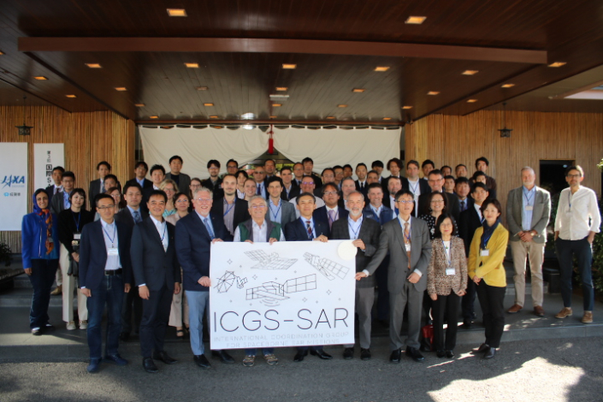
Workshop #3: Japan, November 2024
Developed a series of recommendations to be considered by Space Agencies in future SAR Activities
Available here: Recommendations Intl SAR Workshop Nov 2024
Separated into three main groups:
Data access and tasking
Future mission coordination
Science and applications research enhancement

Slide 6
Recommendation 1b
Agencies should explore establishing automated disaster monitoring tasking and data sharing on Web GIS systems and coordinate with existing international frameworks such as the International Disaster Charter (International Charter Space and Major Disasters) and Sentinel Asia. Agencies should advocate for the automation of tasking requests following activation of the International framework, as well as consider automated or facilitated tasking for forecasted disasters (e.g. typhoons). Low latency data products (<=1 hr, SLC, L1 or higher) need to be provided to ensure the appropriate response to a disaster management.

Slide 7
Recommendation 1d
Agencies should consider the interoperability of their cloud systems by using APIs, standard metadata (STAC, YAML, etc.) and data formats, such that multi-mission data analysis is streamlined.

Slide 8
Recommendation 1f
Observations for the polar regions (Greenland, Arctic sea ice, and Antarctica) should be coordinated to maximize science and applications needs with right-, left-, and multi-looking missions (i.e. Sentinel-1, NISAR, and ALOS-2/4) while filling polar observational gaps. Agencies should support and propose membership for the evolution/re-establishment of WMO's Polar Space Task Group (PSTG).

Slide 9
Recommendation 2a
To improve digital elevation models and 4D change observations, future SAR missions (of any band) should consider companion satellites, passive or active, such as Harmony for Sentinel-1.

Slide 10
Recommendation 2c
Agencies should cross-validate agency mission planning tools with other agencies, to ensure optimal mission plans, aligned with the observation requirements from Thematic Areas 1 & 2.

Slide 11
Recommendation 3d
Agencies should consider establishing an activity similar to the CEOS LSI-VC POLINSAR task for 3D-InSAR to coordinate imaging geometry diversity at regional sites worldwide.

Slide 12
Recommendation 3h
Commercial VHR X-band SAR missions have a potential complementary role to play to public medium-resolution SAR missions through their capacity for targeted observations at high spatial and temporal resolution. However, dedicated observation scheduling is imperative to make the data useful. Agencies considering governmental data purchases for science (e.g. NASA CSDA, ESA EDAP) are recommended to consider tasking rights a requirement for procurement.

Slide 13
Recommendation 4a
Agencies should continue to advocate to their national frequency authorities for protection of the radar band (X-, C-, S-, L-, P-band) allocations for use for Earth observation, and not be used by the telecommunication sector looking for additional spectrum, to ensure the missions can continue to operate. Commercial companies should also advocate for this.

Slide 14
Future direction
The group is currently informal, however international coordination for SAR missions is important to maximise societal benefit
We are exploring the options to become integrated with CEOS, potentially as a Virtual Constellation.
Better coordination with other activities (LSI-VC, CEOS-ARD, WGDisasters, etc.)
Formalisation of activities within the CEOS Work Plan
Ensure continuity of the activities beyond the engagement of individuals
Will discuss with CEOS leadership over the coming months with submitting draft concept of potential integration / harmonization, and potentially present a proposal at SIT Technical Workshop 2025

