Slide 1
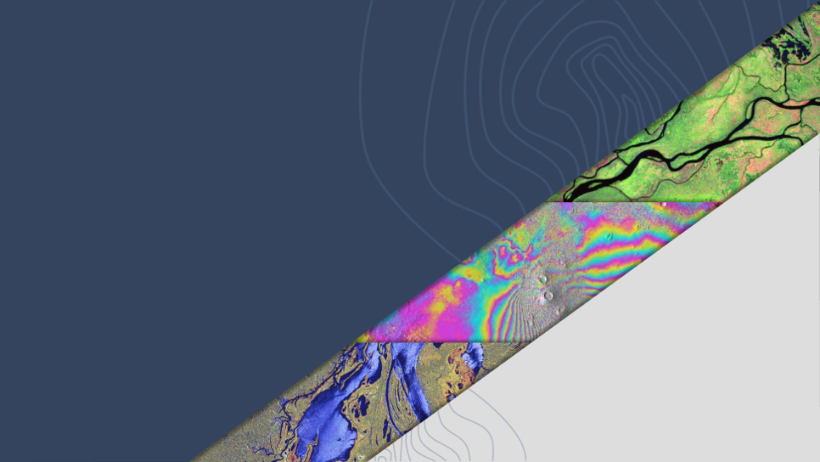
LSI-VC Report
Takeo Tadono,
JAXA, LSI-VC Co-Lead
Agenda Item #7.6
SIT-40
Fukuoka, Japan
8-10 April, 2025

Slide 2
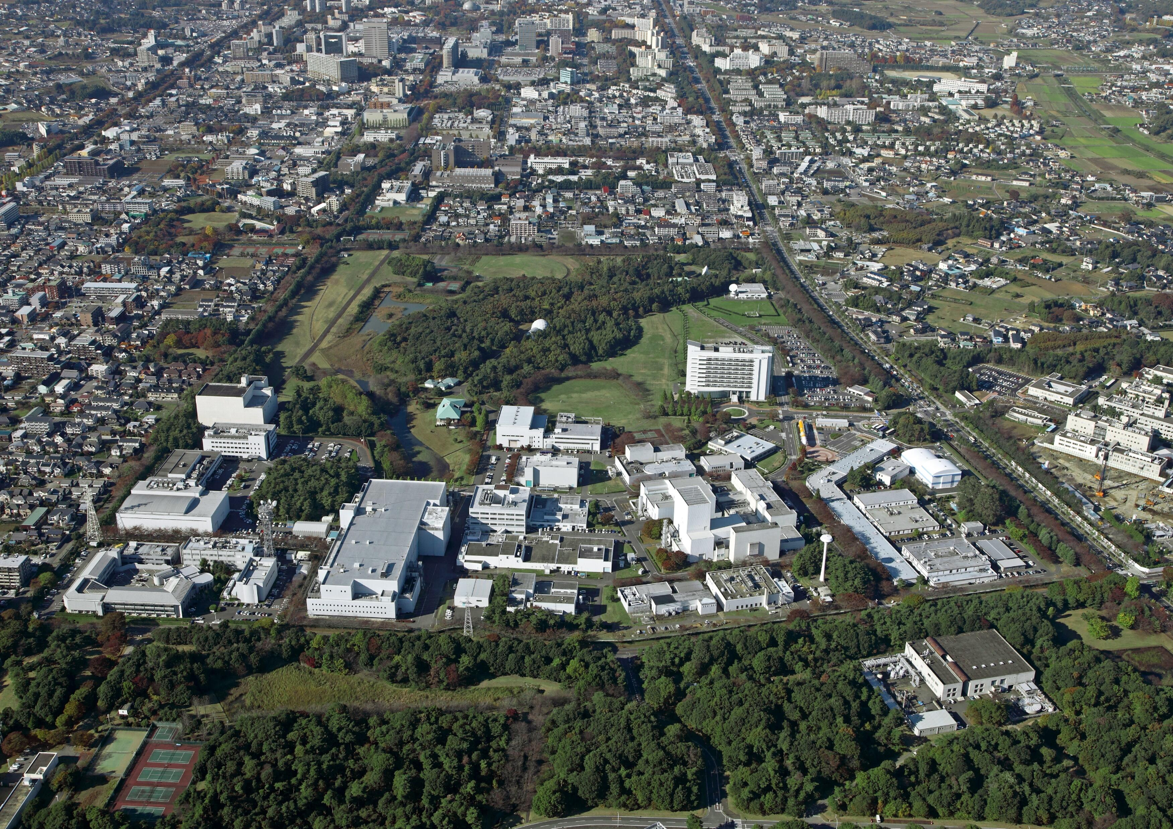
LSI-VC-17
Next week, April 14-16 in Tsukuba, Japan
Hosted by JAXA @ Tsukuba Space Center
Objectives & Agenda here - including Webex, all welcome
Headlines:
Various Japanese commercial sector engagements
CEOS-ARD on GitHub working session
Modularisation and consolidation of CEOS-ARD requirements
WGISS TEIG assessment of AI/ML readiness of CEOS-ARD (presented by JAXA)
Endorse Version 2.0 of the Aquatic Reflectance CEOS-ARD PFS
Endorse an update of the Combined CEOS-ARD for SAR PFS to include Interferometric Radar (InSAR) products
Discussing the need for a future iteration of CEOS-ARD that introduces higher requirements for data ‘quality’
Review consistency of the CEOS-ARD Optical PFS Requirements
Joint sessions planned with WGCV experts on CEOS-ARD + Cal/Val Maturity Matrix and ‘Match-up Database’ activities
ESA-NASA Joint Earth Observation Mission Quality Assessment Framework (CSDA and EDAP) and the possibilities for CEOS-ARD
Framework for historical commercial archive data procurement
AFOLU Roadmap implementation
Addressing GEOGLAM EAVs
CEOS engagement with Ramsar Convention on Wetlands and UNCCD
Plans for LSI-VC POLINSAR activity

Slide 3
AFOLU Roadmap
LSI-VC oversees implementation of the CEOS AFOLU Roadmap actions (Forests & Biomass Subgroup)
Need to determine the appropriate dynamic and people to regularly report to LSI-VC and CEOS leadership level meetings

Slide 4
LSI-VC management of thematic areas for CEOS
Overdue to ensure consistent and robust oversight and inclusion of thematic work within LSI-VC
Co-Leads propose:
formalise POCs for each of AFOLU, GFOI, GEOGLAM
quarterly calls for progress updates
dedicated session at each physical LSI-VC meeting
POCs on hook for reports to SIT/SIT TW/Plenary as needed
Individuals (below) have agreed - welcome Principals confirming ok with the roles
LSI-VC AFOLU:
Ben Poulter (NASA) Clement Albergel (ESA)
LSI-VC GFOI:
Osamu Ochiai (JAXA) Stephen Ward (JAXA)
LSI-VC GEOGLAM:
Sven Gilliams (GEOGLAM) Alyssa Whitcraft (GEOGLAM)
Confirmed

Slide 5
GEOGLAM (Agriculture)
LSI-VC-GEOGLAM (Agriculture) subgroup looking to bolster membership to tackle CEOS response to Essential Agriculture Variables (EAVs)
Need to understand CEOS agencies’ roles and ambitions wrt agriculture + stocktake what is already happening
Q1 2025 teleconference (slides, notes) to brief agency POCs so they can identify the right people in their agency / country to engage
Send those people to the GEOGLAM / EAV workshop (@ EC JRC, Ispra) to start the stocktake and scope the GEOGLAM+CEOS relationship.
More responses needed..!
Workshop now hybrid and asynchronous
Propose action at SIT-40 to help the workshop:
Provided draft LSI-GEOGLAM terms of reference (here)
SIT-40 action to review terms of reference by May 10 and respond as to whether agencies see POCs participating in the ways detailed in the Terms of Reference, and suggesting alternatives, specific people, etc.
Confirmed for the GEOGLAM / EAV workshop:
ESA: Zoltan Szantoi
NASA: Brad Doorn
UKSA: John Remedios
ISRO: Bimal Bhattacharya
CMA: Jinlong Fan
SANSA: Abel Ramoelo
GA: Michael Wellington
Yet to be confirmed:
EC, JAXA, DLR, KARI, KMA, CNES, ECMWF, NSO, USGS, NOAA, CSA, CSIRO
VNSC unable to attend at this occasion.

Slide 6
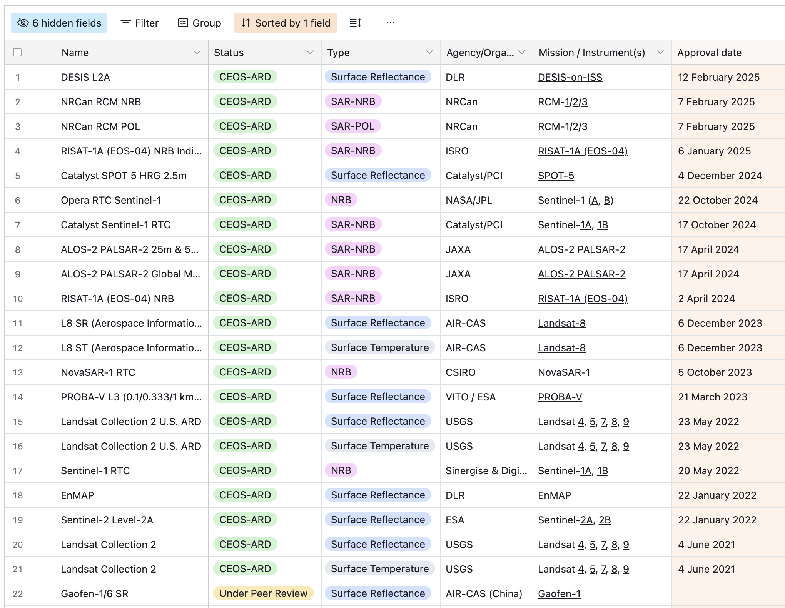
Current CEOS-ARD Products
New since CEOS Plenary 2024

Slide 7
CEOS-ARD Updates
Consolidation of land optical CEOS-ARD PFS ongoing
Increasing consistency
Migration of PFS development to GitHub
Increase community engagement, extensibility, facilitate new PFS, discussion forum, raising issues and suggestions, etc.
Version 2.0 of the Aquatic Reflectance CEOS-ARD PFS
Expansion from coastal and inland waters -> include oceans too
Version 1.2 of the Combined CEOS-ARD for SAR PFS
Interferometric Radar (InSAR) product specs added.
Next targets for CEOS-ARD for SAR: New/adjusted PFSs to accommodate specifications for Level 3 products (e.g. multi-source mosaics, InSAR displacement maps, etc.) and commercial VHR SAR data for which current PFSs are not adapted
Consider update of CEOS-ARD Framework to tidy schema and facilitate higher level products, etc.
Reflecting on potential need for a future iteration of CEOS-ARD that introduces requirements/goals for data ‘quality’, including for metadata, measurand uncertainties, and the introduction of tolerances and bounds for corrections, as well as a framework for ongoing monitoring of these qualities.

Slide 8
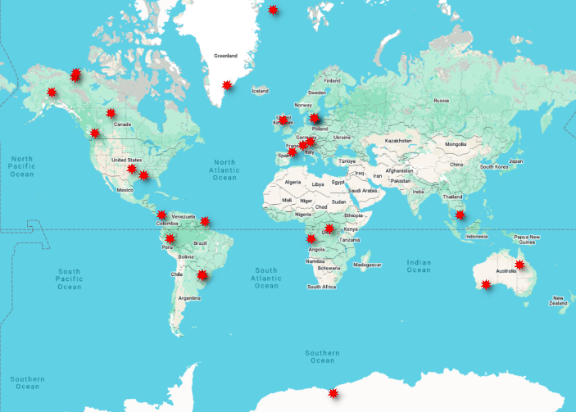
LSI-VC Polarimetric SAR activity
LSI-VC “PolSAR” activity established to advance biophysical parameter retrieval by polarimetric and multi-frequency SAR. Originates from ESA “POLINSAR” workshop series.
Proposed duration: Evaluation after 2 years
SIT-39-09: Relevant CEOS Agencies asked to designate a PoC for engagement in the LSI-VC PolInSAR Team, which includes support for systematic observations over Reference Sites [on a best-effort basis].
Progress since SIT-39:
PoC nominations received from 5 agencies. P-band, L-band and C-band SAR missions well covered.
Nominations still pending from a few. Participation by S-band and X-band mission agencies most welcome.
LSI-VC PolSAR Science Team established. 20 members from CEOS agencies & academia.
25 PolSAR Reference Sites defined, covering a range of land cover types (Forests, Wetlands, Agriculture, Urban, Glaciers, Sea ice) to assess PolSAR potential.
PolSAR Reference Sites

Slide 9
Ramsar Convention on Wetlands
LSI-VC theme on “EO & Wetlands” initiated in 2024
Supports AFOLU Roadmap (Recommendation 5 - Systematically target activities to support IPCC Land Cover classes: Other Land Use/Wetlands)
Ramsar Convention on Wetlands
New Ramsar initiative to foster knowledge exchange and guidance on EO.
Ramsar Earth Observation Day (Dec 2024) organised in collaboration with CEOS agencies (JAXA/ESA/EC) and CEOS CEO
Ramsar Science and technology Review Panel (STRP) considering EO as a Priority Task in the next (2026-2028) Work Plan
Ramsar STRP leading new GEO-Wetlands initiative.
Formal liaison with the Committee on Earth Observation Satellites (CEOS) explicit recommendation in STRP report to Ramsar Standing Committee¹.
Opportunity for closer CEOS/Ramsar engagement.
¹ “Draft report on the consultation on the use of Earth Observation for wetland inventory, assessment, monitoring and conservation” (SC64 Inf.2)
https://www.ramsar.org/sites/default/files/2025-01/SC64_inf2_earth_observation_consultation_e.pdf

Slide 10
UN Convention to Combat Desertification
Looking at UNCCD request for enhanced land EO contribution to GEO LDN / SDG indicator 15.3.1 (Proportion of land that is degraded over total land area)
ARD as a convenient starting point for UNCCD indicator processing chains. Input data consistency.
SDG Indicator 15.3.1 products as CEOS-ARD specs (Level 3+) ? Need LDN community to take lead.
Or work together to refine the existing CEOS-ARD specs so that Level 2 data is optimal
Space asset continuity studies related to UNCCD needs
Moderate resolution data is relatively well covered by baseline observations
Availability and suitability of land surface datasets for SIDS and hyper arid areas, as well as regions with mountainous states
UNCCD also asking for a CEOS perspective on the usefulness and trustworthiness of commercial data -> WGCV

Slide 11
Thanks for your attention
Questions welcome
Takeo Tadono,
JAXA, LSI-VC Co-Lead
Agenda Item #7.6
SIT-40
Fukuoka, Japan
8-10 April, 2025

