Slide 1
CEOS SIT-40
New Missions for Global Precipitation Measurement
Takuji Kubota, JAXA
Chris Kidd, NASA/GSFC
Agenda Item 7.5
SIT-40
Fukuoka, Japan
8-10 April, 2025

Slide 2
Mapping Global Precipitation
Why do we need more than just one satellite/sensor?
  Precipitation varies greatly in time and space – often over just a few miles/km or a few minutes.
  The single sensors can provide high-quality measurements, but it cannot measure global precipitation alone
Global Precipitation Measurement (GPM)-Core and international partner missions
  United States (NASA, NOAA, DoD), Japan, EUMETSAT and India have been or are involved with GPM, and many more counties contributing to the GPM with maintaining, expansion and exploitation of (not directly funded) global ground validation (e.g. USA, Europe, S.Africa, S.America, Japan, S.Korea, India, Australia, China, etc).

Slide 3
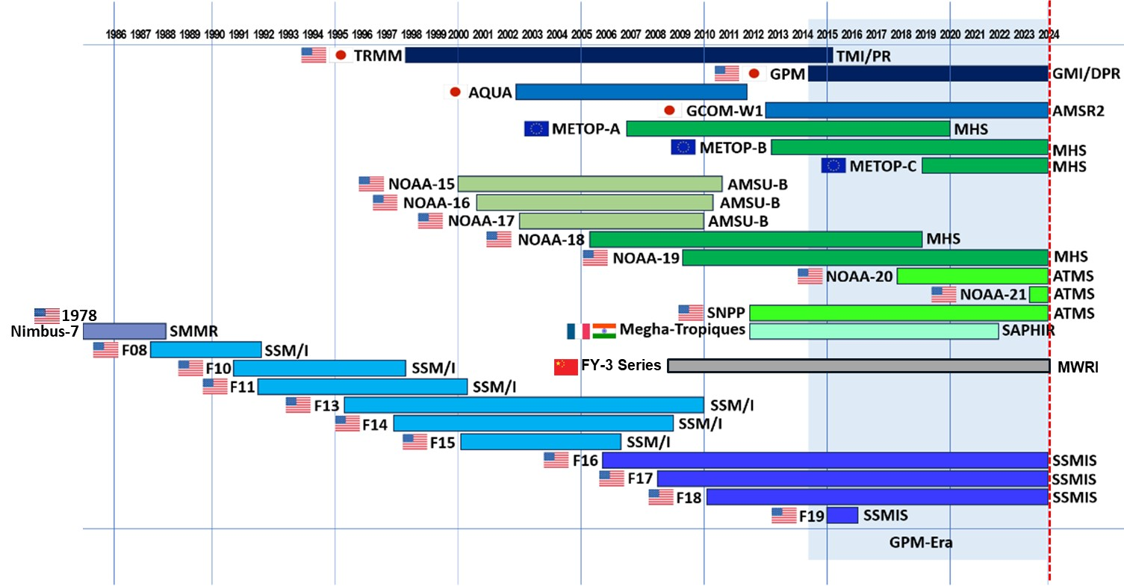
Evolution of satellite precipitation observations
MWRI/ PMR

Slide 4
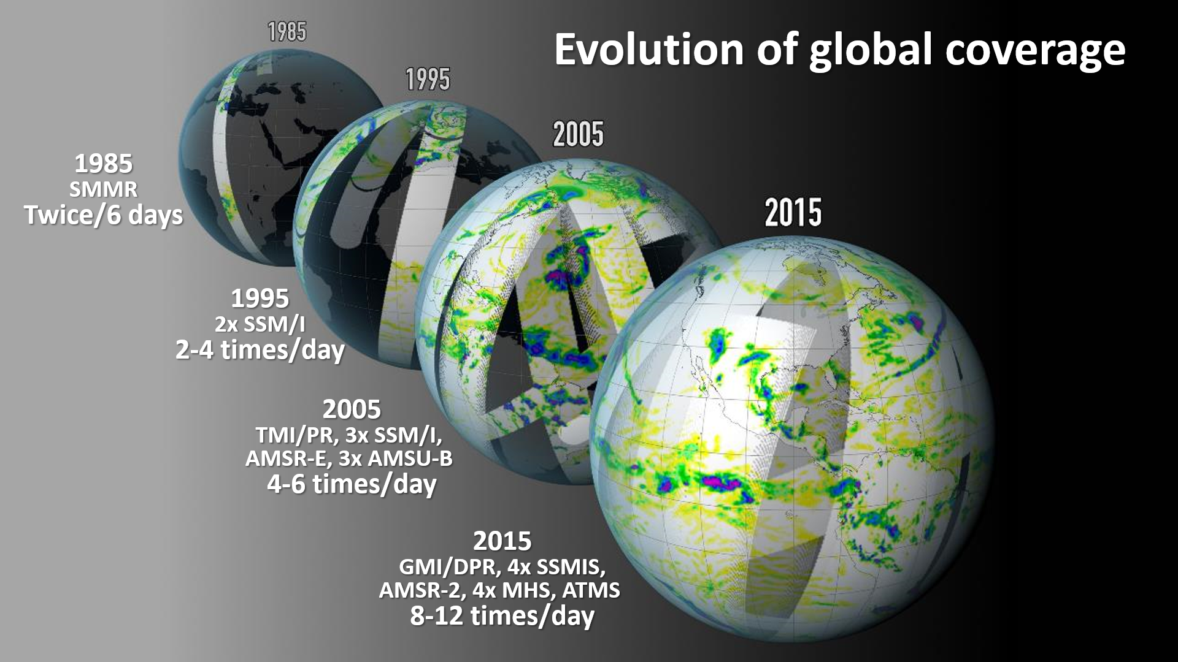

…an evolving success story…

Slide 5
Future missions
JAXA GOSAT-GW with AMSR-3 in JFY2025
EUMETSAT Polar System (EPS) Second Generation (SG) with MicroWave Sounder (MWS) and MicroWave Imager (MWI) and Ice Cloud Imager (ICI) and EPS-Sterna (in its Phase C).
NOAA QuickSounder (2026), JPSS-4 (2027), JPSS-3 (2032), LEO Weather Satellites (LWS, 2030+), GeoXO (2032+)
NASA Atmosphere Observing System (AOS) – International collaborative missions with JAXA PMM (precipitation radar) with CNES radiometer (C²OMODO-R) precipitation processes. (NASA/JAXA/CNES/…)
ESA Copernicus Imaging Microwave Radiometer, CIMR. (2029)

Slide 6
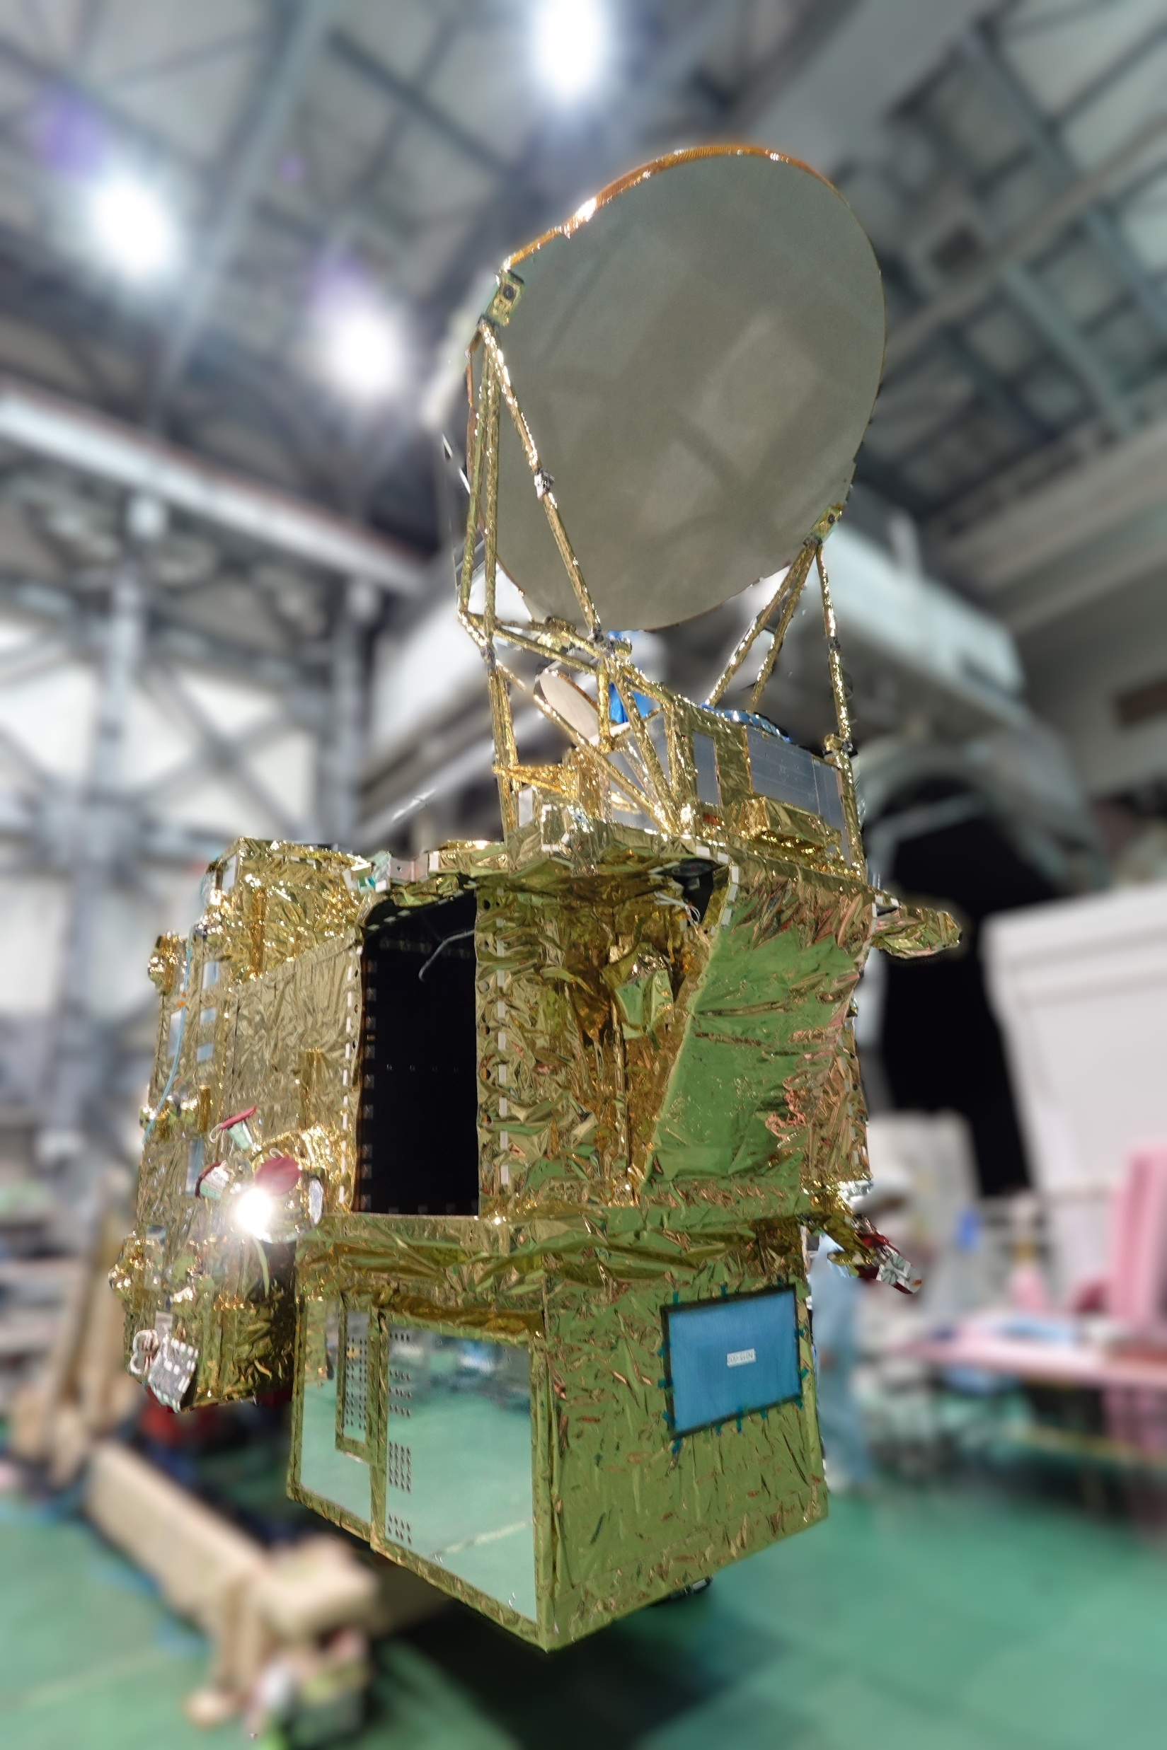
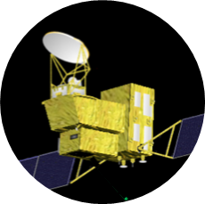
JAXA updates (1)
GOSAT-GW will carry AMSR3, which contributes to precipitation measurement.
  AMSR3, developed by JAXA, will succeed AMSR series observations adding new high-frequency channels for solid precipitation retrievals and water vapor analysis in NWP.
  Target launch is the first half of JFY2025 (Apr. 2025 - Sep. 2025)
Feature of the GOSAT-GW satellite with AMSR3 Main Reflector deployed
To be launched
in JFY2025
GOSAT-GW
Water Cycle
©MELCO
Status of development
  GOSAT-GW system development is in the final stage of Phase D.
  After the PQR of satellite system and Development Completion Review, we will move on to the launch operation at the launch site, Tanegashima Space Center
  Launch date of the GOSAT-GW is scheduled in the first half of JFY2025
Public data release of AMSR3 is panned 1-year after the launch from the JAXA G-Portal system (https://gportal.jaxa.jp/gpr/).
Satellite specification
Mission Instruments |  | AMSR3 (JAXA) TANSO-3 (MOE/NIES)
Orbit | Type | Sun-synchronous, Sub-recurrent orbit
 | Altitude | 666km, recurrent cycle 3days (same as GOSAT)
 | Local sun time at ascending | 13:30±15min (same as GCOM-W)
 | Revisit time | 3 days
Satellite Mass |  | 2.6 tons (including propellant)
Designed lifetime |  | > 7 years
Launch |  | First half of JFY2025 by H-IIA rocket
AMSR3 Major Improvements
Additional 166 & 183 GHz channels to enable monitoring of global precipitation (rain & snow) and contribute to water vapor analysis in NWP
Additional 10.25 GHz channels with improved NEDT to enable robust SST retrievals in higher spatial resolution

Slide 7
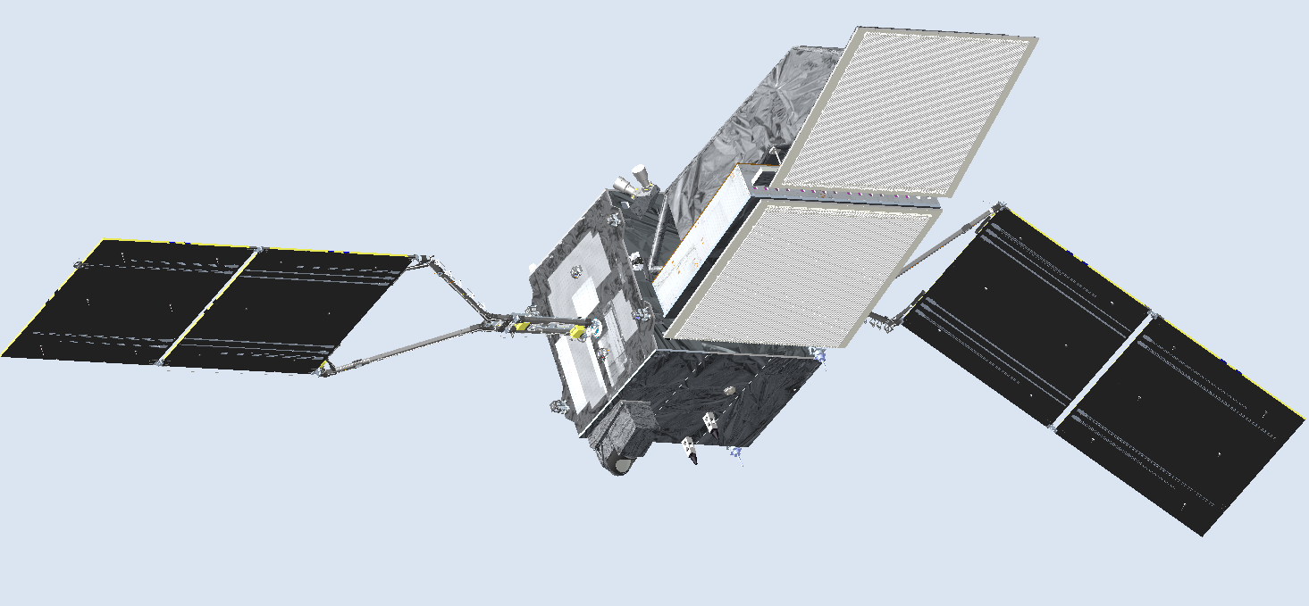
JAXA updates (2)
In June 2023, JAXA’s Precipitation Measuring Mission (PMM) Project Team was established on for the Spacecraft carrying the Ku-band Doppler Precipitation Radar, with participation in NASA Atmosphere Observing System (AOS) mission.
Targeting launch is JFY2028 (April to March 2029). Preliminary Design Review (PDR) is scheduled in JFY2025.
JAXA PMM KuDPR
JAXA’s KuDPR will focus on advanced observation of precipitation.
  Doppler velocity observation & High sensitivity observation
  International collaboration with NASA AOS mission will bring us integrated understanding of Aerosol, Cloud and Precipitation processes.
AOS sensors
CNES Radiometer (C²OMODO-R)
Cloud Water（Horizontal
KuDPR major characteristics
Snowfall
(Horizontal)
Frequency | 13.6 GHz
Observation modes | ・ Doppler obs. mode ・ Dense sampling obs. mode ・ Normal scan obs. mode
Vertical Motion of Cloud
Rainfall
(Horizontal)
＊
Vertical Motion of Precipitation
＊
＊
＊
＊
＊
The Ku-band Doppler Precipitation Radar (KuDPR) will be two-antenna system that adopts Displaced Phase Center Antenna (DPCA) approach (Durden et al. 2007, Tanelli et al. 2016).
🡪 The DPCA approach can lead to more accurate Doppler measurement.
＊
Aerosol
Snowfall (vertical)
＊
＊
＊
＊
Rainfall
(vertical)
＊
＊

Slide 8
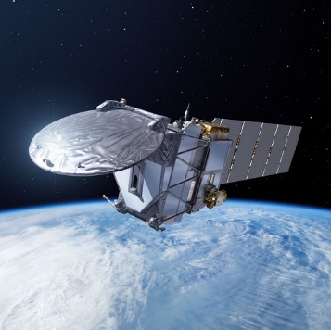
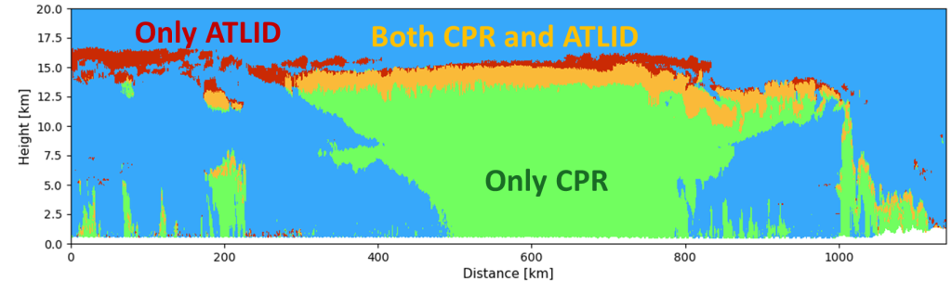
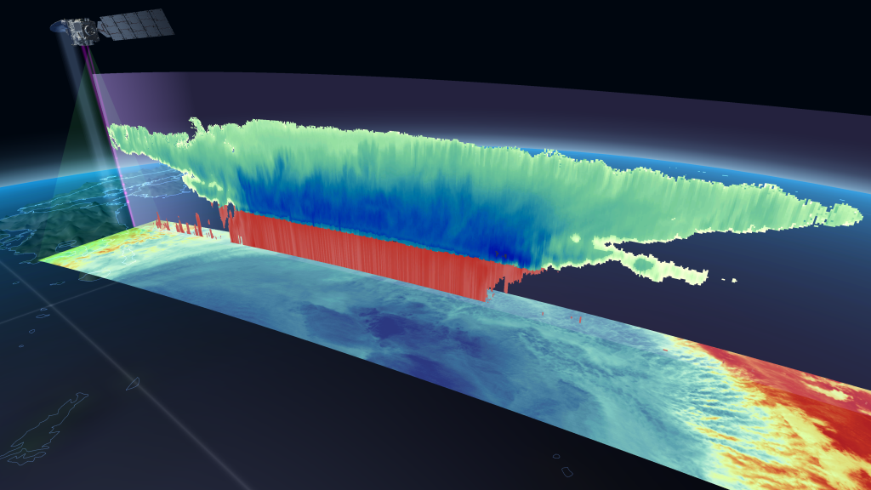
JAXA-ESA updates
EarthCARE (Earth Cloud Aerosol and Radiation Explorer)
Launched
in May 2024
ESA-JAXA joint mission
3 dimensional global distributions of cloud and aerosol to contribute to precise understanding of climate change
JAXA and NICT provides world's first satellite-based cloud vertical motion by the Cloud Profiling Radar (CPR) with 94 GHz with Doppler Capability
EarthCARE
Cloud/
Aerosol
Radiation
Budget
Level-1 data were released to the public in Jan. 2025, and Level 2a Single sensor Products and Level 2b two-sensor synergy Products were released in Mar. 2025.
Orbit | Sun-synchronous sub-recurrent orbit Altitude: approx. 400km Inclination angle: 97.05° Local Sun Time at Desc.: 14:00 Revisit time: 25 days
Instruments | - Cloud Profiling Radar (CPR) by NICT & JAXA - Atmospheric Lidar (ATLID) by ESA - Multi-Spectral Imager (MSI) by ESA - Broad-Band Radiometer (BBR) by ESA
Mass | Approx. 2.2 tons at launch
Designed lifetime | 3 years
Cloud ice
The CPR can provide observations of not only cloud but also snowfall and light rainfall.
Snow
Rain

Slide 9
NASA updates
GPM updates – 11th anniversary (February 2025)
Orbit boost – Nov 2023: Small changes in characteristics due to increase in footprint size
Constellation: US DoD WSF-M1 launched April 2024 (data ‘should’ be available soon’)
TROPICS (cubesat constellation)
T01 – failed in December 2023 (2.5 yr operations), T07 failed after 1 month.
T03/T05/T06 ‘operational’ with precipitation (GPS and onboard storage has failed on all three satellites, and orbital degradation is greater due to solar activity)
Atmosphere Observing System – International collaborative missions in a Decoupled Architecture: 6 spacecraft and 4 launches
PMM (JAXA) + HF radiometer (France)
HF radiometer (France)
NASA SmallSat bus (NASA launch)
Lidar, Italy (NASA contribution)
Inclined
Polar
HF radiometer + Polarimeter (NASA) + TICFIRE (Canada) HAWCsat (Canada)
Doppler Radar (competed mission)

Slide 10
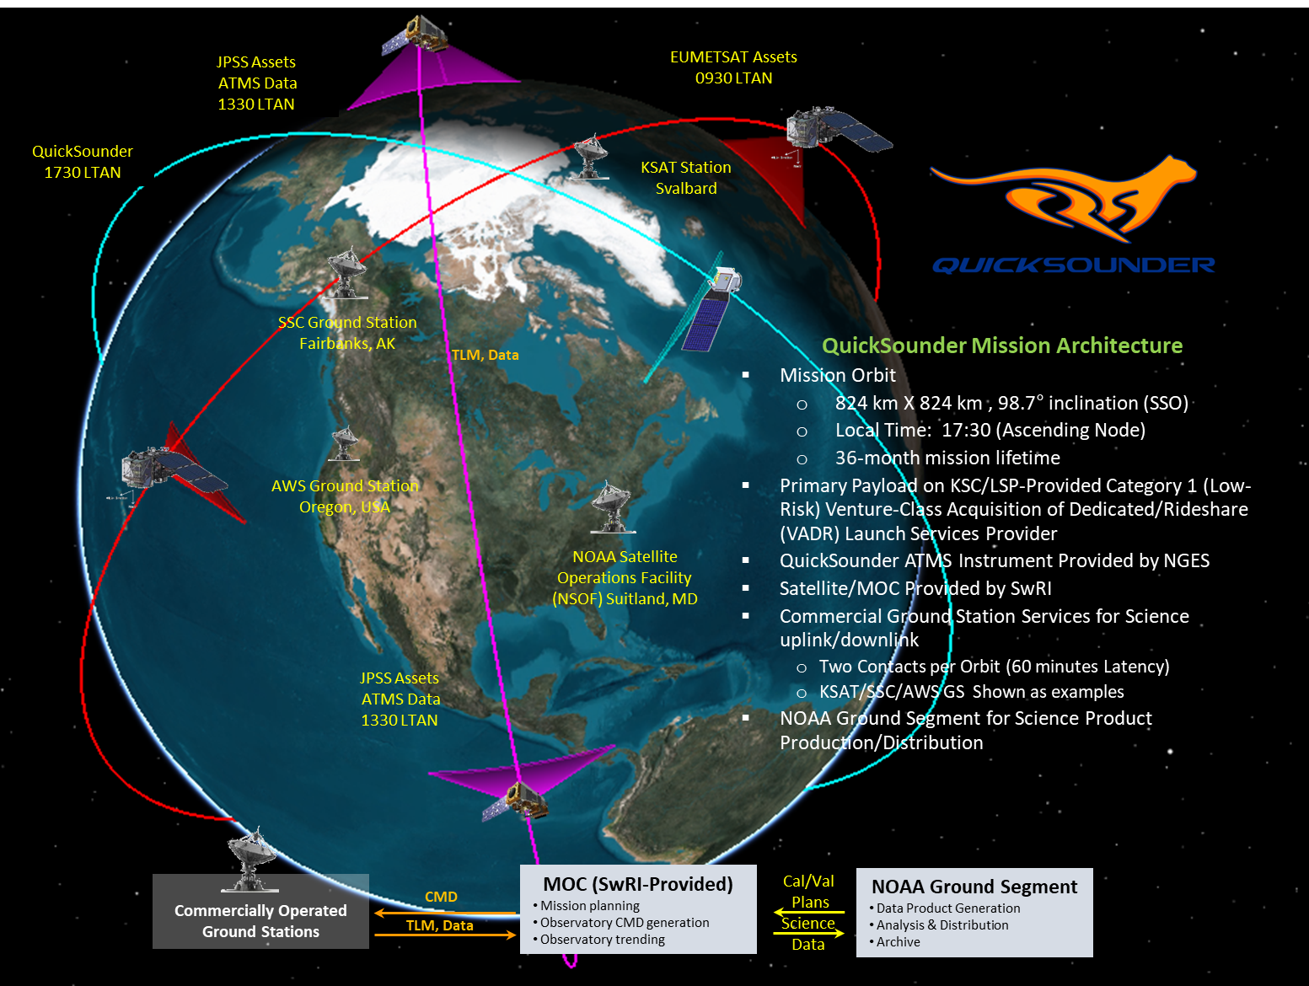
NOAA updates
QuickSounder Mission
QuickSounder is NOAA’s first smallsat mission and a pathfinder for NOAA’s next generation of low earth orbit environmental satellites
Combined with existing JPSS/Partner assets, QuickSounder will provide four-hour global refresh of microwave sounder measurements
Mission progress is proceeding as planned
Scheduled launch date: July 2026
GOES-19 Mission
GOES-19 was launched on 25 June 2024
The satellite was declared the operational GOES-East satellite on 7 April 2025, replacing GOES-16
The GOES Enterprise Rain Rate product has been updated from GOES-16 to GOES-19

Slide 11
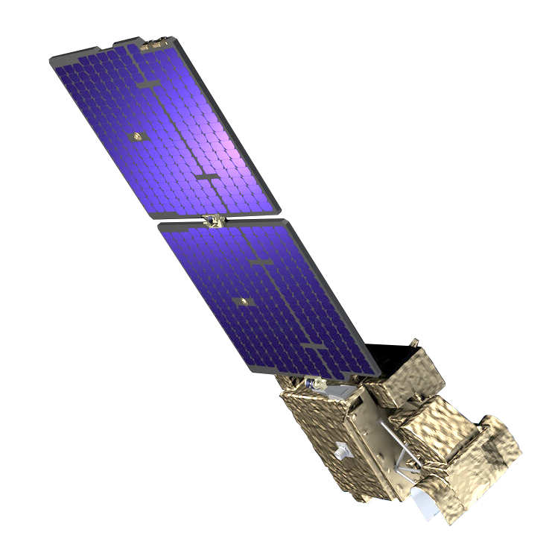
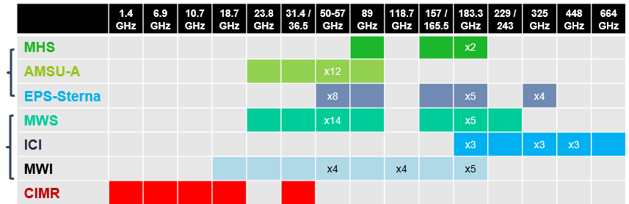
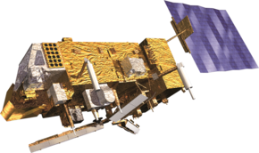
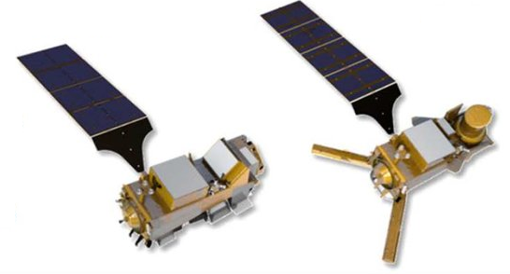
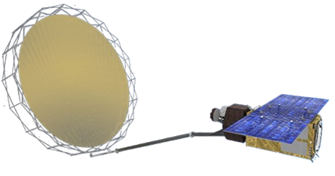
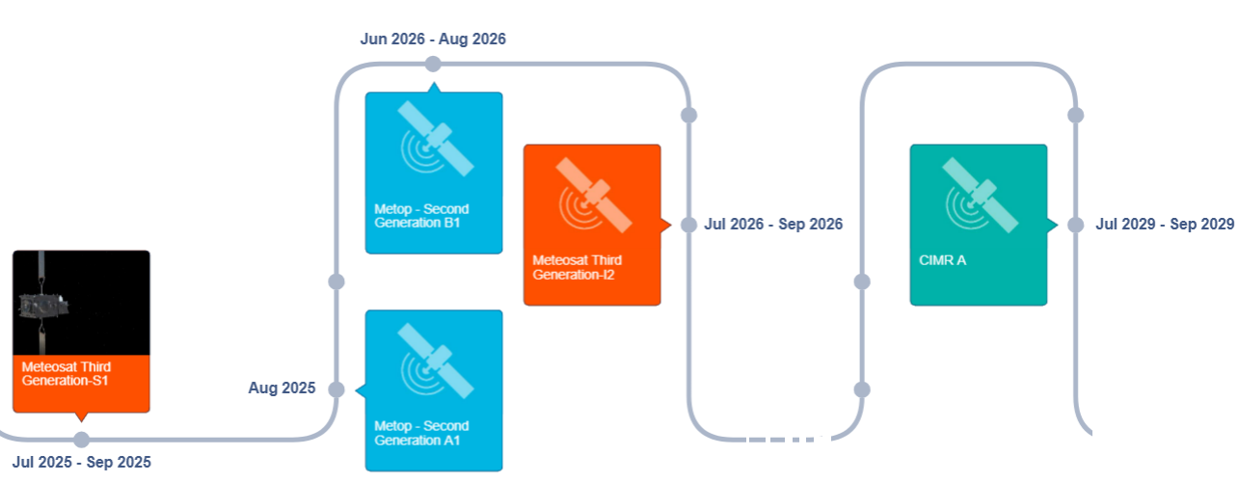
EUMETSAT Passive Microwave Missions
As follow-on of the EUMETSAT Polar System (EPS) Programme, (with the MHS and AMSU-A), the EPS – Second Generation (SG) will include the MicroWave Sounder (MWS) and MicroWave Imager (MWI) and Ice Cloud Imager (ICI). MWS will be complemented by a constellation of small PMW sounders - EPS-Sterna (in its Phase C). Finally, the Copernicus Imaging Microwave Radiometer, CIMR, Level-2 global ocean and atmospheric products will be developed and operated at EUMETSAT.
EPS
EPS-SG
Copernicus
https://www.eumetsat.int/
planned-launches

Slide 12
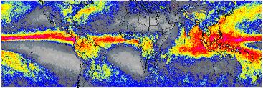
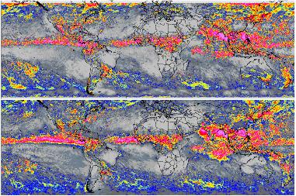
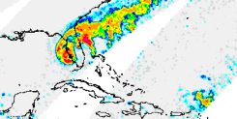
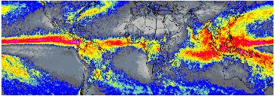
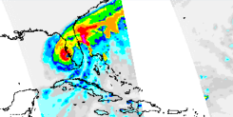
The rise of the cubesat/smallsats
New technology has enabled smaller PMW sensors to be developed – as demonstrated by the TEMPEST and TROPICS-TMS sensors.🡪 ESA AWS, NOAA QuickSounder Mission, EUMETSAT EPS-Sterna.
  Operating at frequencies from ca.89 to 183.31/204.8 GHz with resolutions similar to current PMW sounding instruments.
  Results to date are very encouraging, showing that basic retrievals are comparable with retrievals from current sensors.
Mean annual precipitation (Aug’21-’22)
Monthly: August 2022
Hurricane Ian
TEMPEST-H8
2022-09-28 PM
PRPS-TEMPEST-H8
TROPICS-TMS
GPROF-NOAA19
GPROF-NOAA20
2022-09-28 PM
GPROF-N20-ATMS

Slide 13
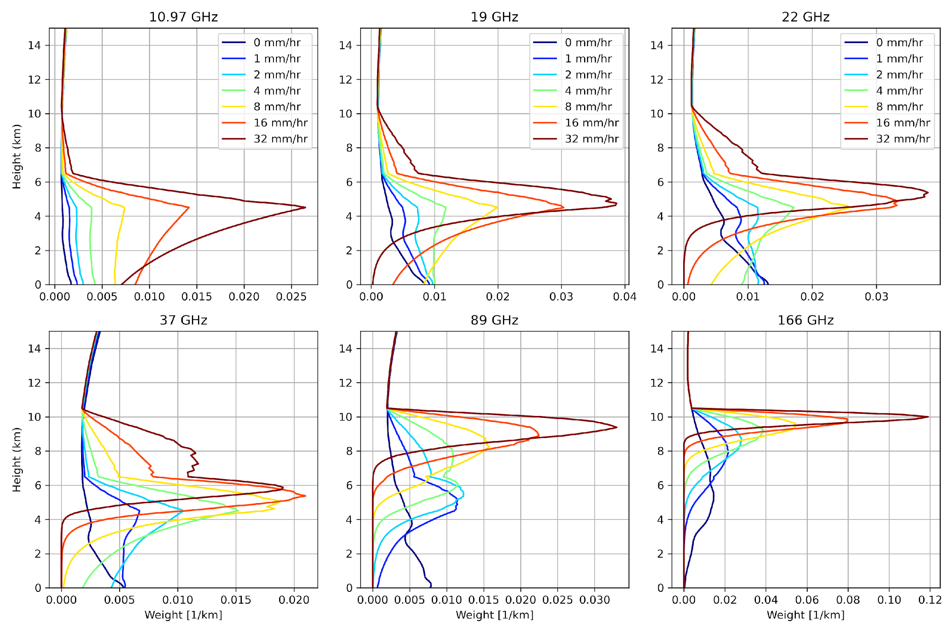
Needs for passive MW observations designed for precipitation with low-frequency channels.
Right figure generated by Mircea Grecu (NASA/GSFC) shows the weighting functions at different frequencies for different surface rain rates (for a particular typical case study)
Need for the lower frequencies (10-37 GHz) - the ones that have sensitivity near the surface - which is why AMSR-3 and the EUMETSAT EPS & EPS-SG missions/sensors are so important for the precipitation measurement.
Sensitivities near surface
Sensitivities of ice scattering in high altitudes
Frequencies of PMW sensors in cubesat/smallsats
(89 to 183.31/204.8 GHz)

Slide 14
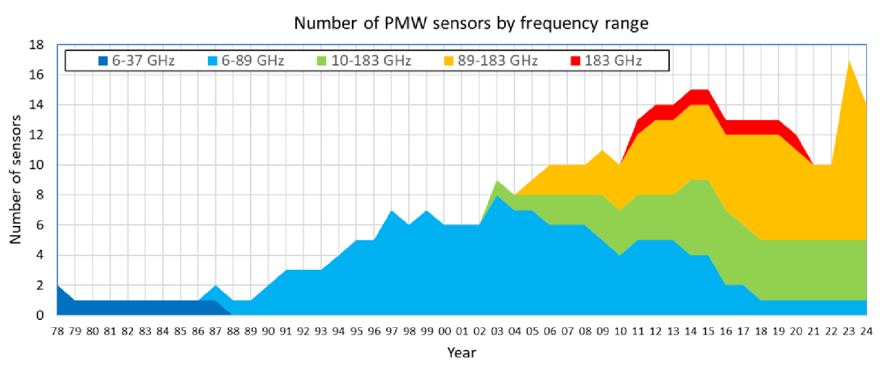
Needs for passive MW observations designed for precipitation with low-frequency channels.
Timeline from 1978-2023, showing the total number of passive microwave (MW) sensors, broken apart by channel set
Many
HF*-only
cubesats/smallsats
expected
The use of HF-only sensors for precipitation skews the derived precipitation estimates towards
indirect, ice-based (scattering) retrievals, rather than the precipitation closer to the surface.
*HF= High-
Frequency,
defined here
as >= 89 GHz
The post-GPM era will likely see a rise in the number of cubesat/smallsat-sized passive MW sounders, which will lack the preferred conically-scanning channels < 90 GHz.
Long term strategy for coordinating future precipitation radars (e.g., JAXA Ku-Doppler, others) with coincident passive MW observations designed for precipitation such as with the lower frequencies (10-37 GHz) , with the inclined orbit, and so on.

