Slide 1
JAXA Space Applications for Environment CH4Rice Project in APRSAF & GEOGEOGLAM Asia Rice team (AOGEO TG5) - Rice paddy field methane reduction -
Shin-ichi Sobue, JAXA
Agenda Item #7.3
SIT-40
Fukuoka, Japan
8-10 April, 2025

Slide 2
Presenter Outline
CH4Rice project background in the Asia-Pacific Regional Space Agency Forum (APRSAF) and Asia-Oceania GEO (AOGEO) TG5
Current activities in cooperation with the private sector, especially around satellite data usage in standard guidelines for carbon trading (Voluntary Credit Mechanism (VCM) , Joint Crediting Mechanism (JCM)) and the IPCC / GST.
Publications and research activity
Next Action and way forward
Challenges in EO cycle

Slide 3
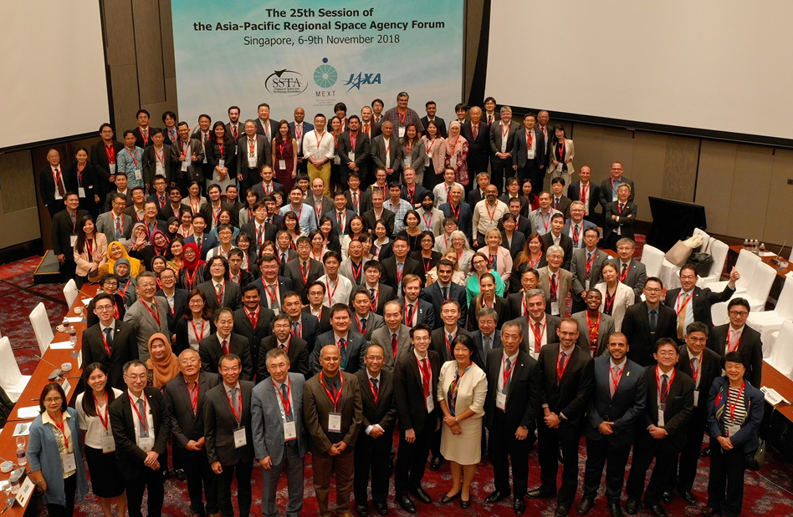
What is SAFE project?
Established in 1993
http://aprsaf.org
Asia-Pacific Regional Space Agency Forum(APRSAF)
The largest space-related conference in the Asia-Pacific region with over 40 countries and regions.
Supports the establishment of international projects as solutions for common issues, such as disaster management and environmental protection, so that participating parties will benefit from mutual cooperation.
SAFE initiative has 3 projects, including CH4Rice project.
Satellite Applications for Societal Benefit Working Group (SAWG)
Established in 2008

Slide 4
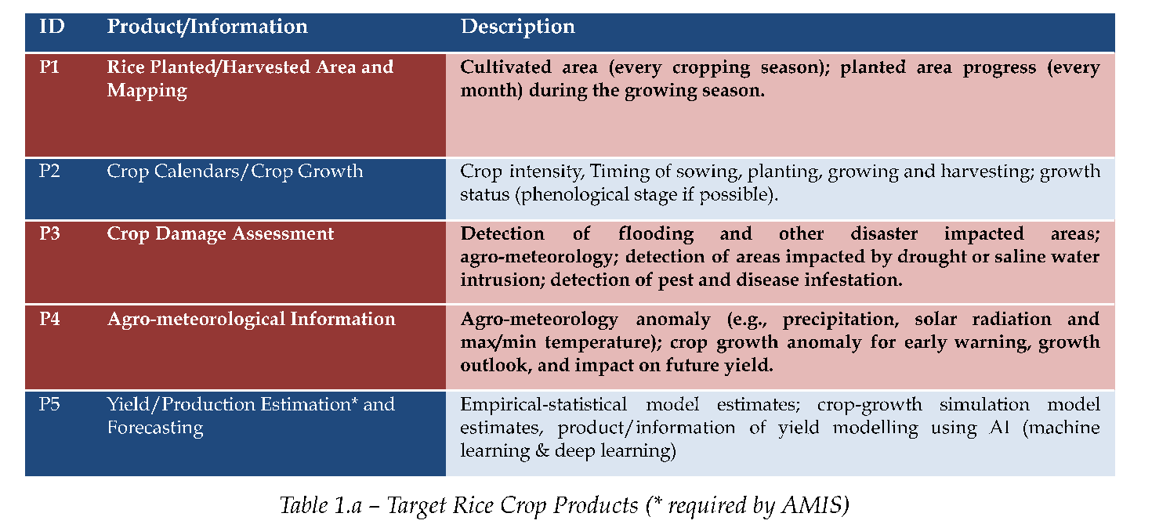
AOGEO TG-5 Asia Rice
Rice monitoring for food security in Asia and Oceania, and R4D network on rice monitoring in Asia, especially IPS Mekong region.
The role of Asia-RiCE as “a network of networks” was emphasized
Future joint session (TG5/crop-TG3/forestry-TG1/water) was proposed for land use
Promote outreach and data, information and knowledge sharing in AO region
More Information https://asia-rice.org
Newly added Table1.b
Phase 4 Work Plan Rev C (March 2025)

Slide 5
What is CH4RICE project?
CH4Rice project was approved at SAWG, APRSAF-28 (Hanoi, Vietnam, Nov., 2022)
Expect to Contribute (Outcome)
Climate change mitigation such as carbon credit through CH₄ MRV (Monitoring, Reporting and Verification) using satellite and in-situ data
Water management by efficient irrigation with lower CH₄ emission (e.g. Alternate Wetting and Drying (AWD) or water saving irrigation)
Regional and global sustainable agriculture related initiatives/activities (e.g. CEOS, SDGs Goal2/13, GEOGLAM/Asia-RiCE, AOGEO etc. )
Implementation
Development of the methodology to monitor water inundation and CH₄ emission from rice paddies
Data/Tool/Knowledge sharing and capacity building for multi-lateral collaborations
Promote dialog with stakeholders/end-users with showing results (considering national policy, try to reach related agencies)
Synergies with other SAFE projects, Agromet and Rice Monitoring Projects

Slide 6
Methodology
Annual Methane Emissions
Emission Factors
Cultivation Period
Harvested Area

Slide 7
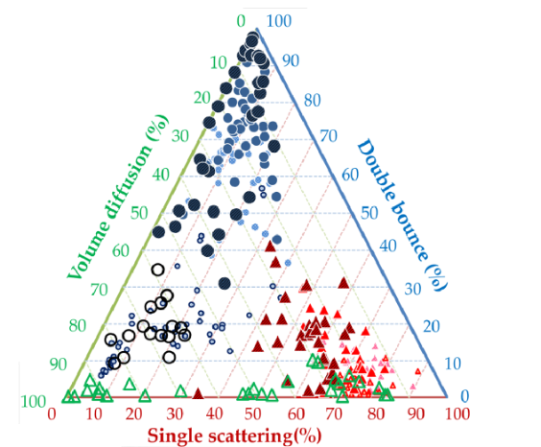
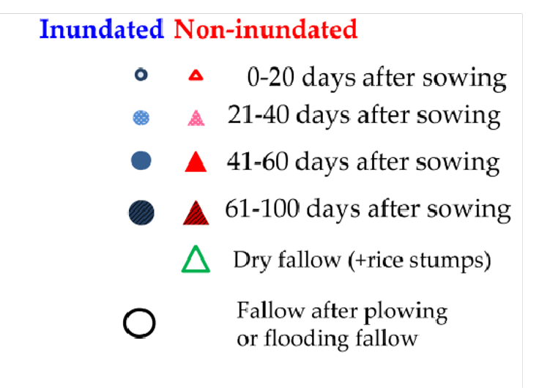
Water Inundation Monitoring using L-band SAR
L-band SAR penetrates rice canopy and can identify the existence of water under rice.
Existing algorithm : Inundated paddy field shows strong double-bounce scattering. [Arai et. al, 2018]
→ Under evaluation in each country
Paddy with water (inundation)
Paddy without water (non-inundation)
Double bounce
Single scattering
[H. Arai, W. Takeuchi, L. D. Nguyen et al., Remote Sens., 2018]

Slide 8
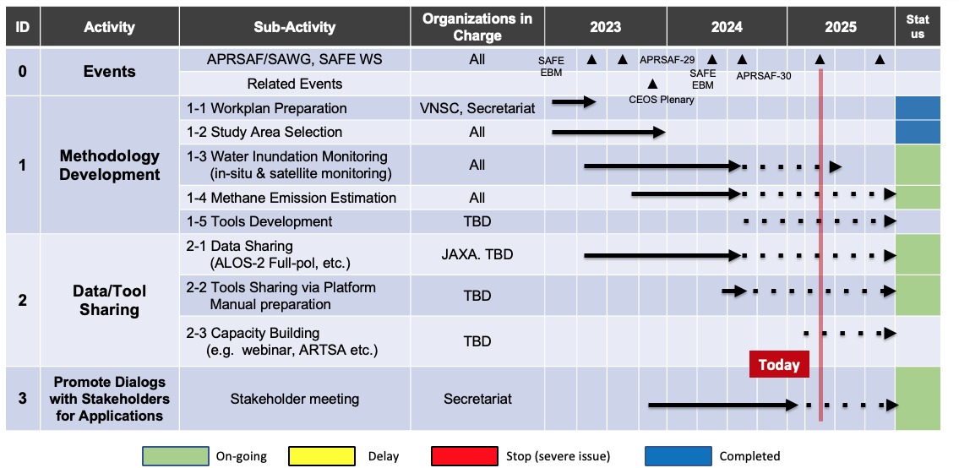
Current activity

Slide 9
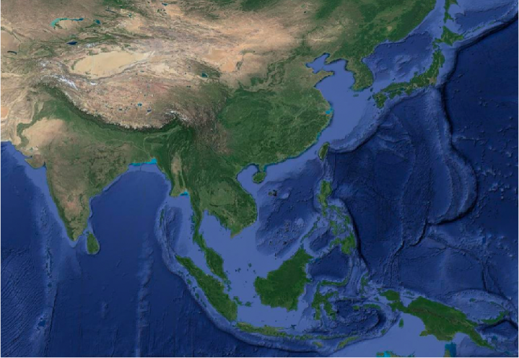
Current project sites
ALOS-2 PALSAR2 (L-band, Full-Pol SAR) observation
in-situ water-level/inundation measurement
Super Site Selection
BRIN Indonesia: Subang
GISTDA Thailand: Suphan Buri
ISRO India: Nawagam
JAXA Japan:
Miyagi, Akita, Niigata, Ibaraki
PhilSA Philippine: Bulacan
PUST Bangladesh: Rajshahi
VNSC Vietnam: Mekong Delta
An Giang, Bac Lieu province
Cambodia and more other sites
Bangladesh
Japan
Philippine
Thailand
India
Vietnam
Indonesia
As of 2024/11/25

Slide 10
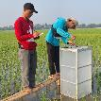
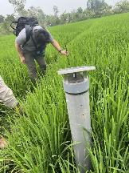
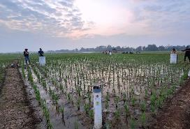
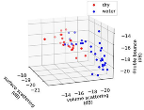
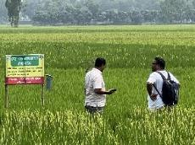
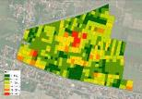
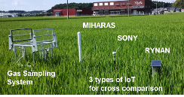
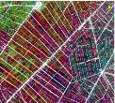
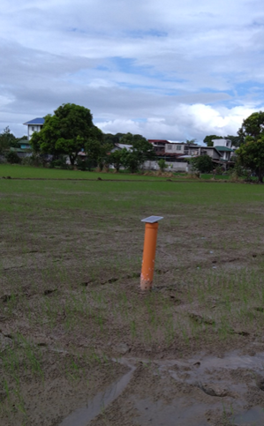
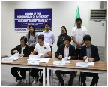
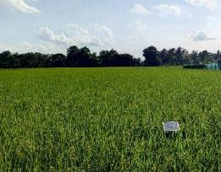
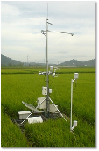
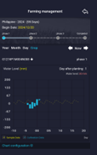
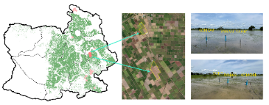
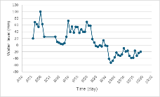
Ground data collections
Bangladesh/PUST, UT
Indonesia/BRIN and BB-Paddy
Japan/JAXA, UT with private sectors
CH4
sampling
CH4e Estimation
(testing)
6 AWD sites with automation water table checking.
RGB drone drone measurements were carried out.
Classifying inundated and non-inundated areas
Estimating CH4 emission by applying IPCC formula
Water level/CH4 flux measurement and manual field survey
Water level/CH4 flux measurement and manual field survey
Inundated/non-inundated identification
Philippines/PhilSA, Bulacan
Thailand/GISTDA, TSRI
Vietnam/VNSC and CESBIO
Conducting data processing, field measurement and IoT installation
Water level measurement and manual field survey
Ground data collection
30 automatic water level monitoring stations
Water level/CH4 flux measurement and manual field survey
Water level measurement and CH4 monitors
Manual Field survey

Slide 11
Next step
Refine Water / Non water detection methodology
Conducted field surveys and/or Installed in-situ water level measurements to study sites
Started/continued to compare in-situ water-level with ALOS-2 PALSAR-2 Full-pol data based existing algorithm and other methods
Validate results derived from studies with more data in more regions to publish research papers as scientific evidence.
Methane Emission Reduction Study by AWD (Alternate wet and dry – water control)
Need to set more inexpensive Gas Sampling System and started to measure CH4 flux on study sites.
Data Sharing
ALOS-2 PALSAR-2 (full-pol) observation for study sites and sharing the data
Tools Sharing via Platform Manual preparation
Evaluated differences between water level measurement devices with manual survey and provide feed backs to sensor vendors.
Recognized the importance of calibration and quality improvement to develop standrized ground based observation data base.
Importance of cost effective CH4 measurement devices
Promote Dialogues with Stakeholders for Applications
Publish research papers to show scientific evidence
Started dialogue with stakeholders both public and private sectors.

Slide 12
Way forward
Continue to do research and study of inundation / non inundation validation using ALOS-2 PALSAR-2 Full-pol data with field survey, in-situ water level measurement and CH4 flux monitoring to validate the existing algorithm and other methods to publish results as scientific evidence.
By using those results
Accelerate discussion with Stakeholders for Applications to propose satellite usage to guideline documents by Verra/Gold standard/JCM, etc. with donor agencies
Coordinate and cooperate with private companies’ activities (emission trading)
Provide feedback and requests to water level sensors / CH4 measurement sensor companies

Slide 13
Challenges in EO cycle
(1) EOs to Analysis-Ready Data (ARD)
Transform
Need for EO
EO Cycle for Food Security
(2) ARD to Essential Agricultural Variables or Decision-Ready Products
(3) Policy, land use, crop management
Application
(1) Challenge is effective deployment of big training data for validating rice area information
Need for closer coordination among regional/national initiatives was emphasized
Efficient methods to collect training data including in situ data for machine learning are needed
Data sharing scheme (open-data platform, standardization of data) was emphasized
(2) Examples of decision-ready products are rice area, growing period, and crop yield
Importance of cross-comparison of outputs (e.g. rice map, drought monitoring, argo-net info) and knowledge sharing (including capacity building) among different initiatives was emphasized
(3) We started to discuss the objective-based application (early warning system, land use, etc)
Need for closer collaboration with stakeholders in agricultural sector, including engagement of agricultural policy makers (at least awareness creation), was emphasized

Slide 14
Challenges in EO cycle
＜Needs of the Asia-Oceania region for each task group‘s theme＞
Cross comparison on rice cultivation area monitoring and water management for reducing methane emission from paddy fields between different countries using space based, ground base data and model to publish scientific papers to promote evidence-based decision making for food security and sustainable agriculture
Enhance collaboration with various stakeholders (e.g. Ministry of Agriculture) on rice statistics
Continue capacity building using available international donor funds
＜From Earth Observation to Earth Intelligence＞
Earth Observation Data
Potential Examples of Earth Intelligence
Crop status and condition
Land use (timely and accurate rice and other crop map)
Agromet information climate extremes (drought/flood)
Crop supply information and forecast information for Food security and Global market
Farm advice information for sustainable agriculture
GHG information for carbon trade and national inventory
Crop status and condition (crop monitoring)
Land use (high-quality rice and other crop map)
Agromet information Climate extremes (drought/flood)

Slide 15
Challenges in EO cycle
Earth Intelligence for TG5 - Asia-RiCE to contribute to National and regional Info.System and commercial e-Agriculture service
Model
Area
outlook
Yield
forecast
Food security policy decision making
National Agriculture Ministry / regional activities
Area
estimate
Prod
estimate
Outlook
bulletin
Vulnerab.
report
Space Agency,
R&D entities
for
Crop Area, Growth, Condition, Outlook, Yield, Agromet , Water info, land use info
EO Data
AI/ML
With Function model
Early
warning
Int market
report
Farming advice
Commercial partners
Suitable farming and GHG trading
In Situ Data with IOT and statistical info
Carbon trading
Crop insurance
Smart farming

