Slide 1
SIT-40 Revised Requests on Improved Coastal Coverage in Future TIR Sensors from SST-VC & COAST-VC
Misako KACHI, JAXA
with SST-VC & COAST-VC
Agenda Item #7.1
CEOS SIT-40
Fukuoka, Japan
8th – 10th April 2025

Slide 2
Discussion at 2024 SIT TWS
At the SIT TWS in Sep. 2024, under agenda item 8.3, the SST- and COAST-VCs presented a community request for improved coastal coverage in future Ultra-High Resolution¹ TIR sensors, especially the NASA SBG mission, to make it more scientifically useful for the coastal ocean applications.
Action was assigned to liaise further with member agencies on this issue, especially with SBG mentioned (SIT-TW-2024-09).
It is also suggested the original 100 km from coast recommendation, a ‘one-size-fits-all approach’, may fail to fully consider various coastal user needs and lack scientific justification.
1. Ultra High Resolution TIR is characterized as sub 100 meter pixel size. SBG-TIR is 60 meter resolution.

Slide 3
Response to action
In response to action SIT-TW-2024-09, we had following activities.
Meeting with the NASA/JPL SBG TIR mission team on 16 Oct. 2024 to discuss possibility of extension of coastal coverage. The following is the summary:
Current global map of SBG-TIR ultra-high resolution (60m) coverage was defined after an extensive trade study and harmonizing of different requests from various communities and is near final.
No increase in coverage in one area can be accommodated without removing coverage from another due to limitation of X-band downlink technology.
Joint presentation on SST coverage recommendation at the TRISHNA Science Meeting in November 2024 hosted by ISRO.
To ensure the coastal coverage distance recommendation is science-based, we convened a series of discussions and six teleconferences during the period from 21 Nov. 2024 to 5 Mar. 2025, inviting subject matter experts to advise on this topic. List of experts are included in Appendix A of the statement.

Slide 4
Output from Expert Meetings (1)
Consensus agreement captured six coastal features for which ongoing scientific research demands ultra high-resolution SST data. They are:
Boundary currents;
Estuaries/river mouth (major);
Meltwaters;
Chronic Harmful Algal Bloom (HAB) areas;
Operational high-resolution coastal model areas; and
Highly productive habitats.

Slide 5
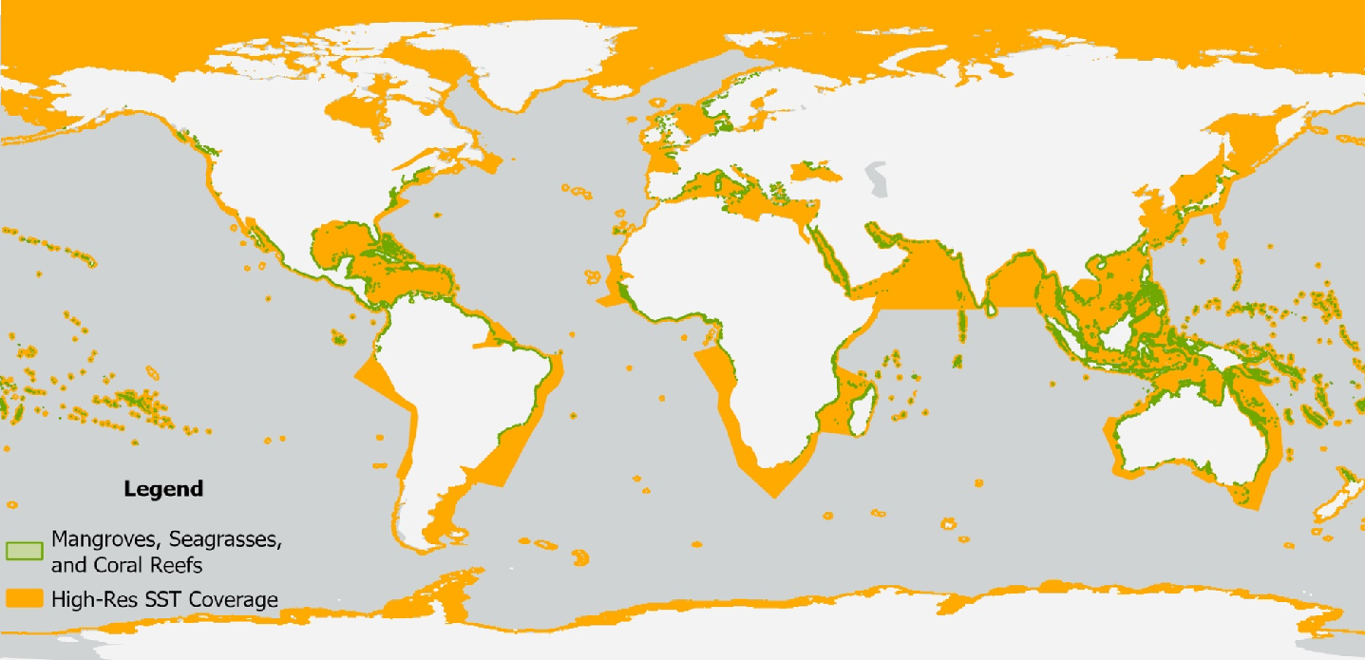
Output from Expert Meetings (2)
Composite CEOS Global coverage mask areas recommendation (yellow) for Ultra High-Resolution SST.

Slide 6
Output from Expert Meetings (3)
For these six features, the recommended coverage distances from the nearest shore, and seasonal sampling optimization for a few features, are summarized in the table (next page).
The revised coastal coverage recommendations capture coastal areas where temperature dynamics might especially influence ecology, biogeochemical, and physical processes; or where coastal high resolution models require ultra-high resolution SST inputs.

Slide 7
Output from Expert Meetings (4)
Summary of six coastal features, areas, and seasonality of Ultra High Resolution SST data collection for the global ocean.
Feature |  | Distance from Shore (km) | Example Areas (respectively) | Data Collection Seasonality
Boundary Currents | Eastern | 350, 200, 225, 300, 250 | Benguela, Canary, Humboldt, California, Leeuwin | Yes: widest in hemispheric summer/fall and narrowest in winter/early spring.
 | Western | 100, 400, 300, 100, 300 | Gulf Stream, Kuroshio, EAC, Brazil, Agulhas | Yes: widest in hemispheric summer/fall and narrowest in winter/early spring.
Estuaries/River Mouth (major) |  | to reach of major boundary current | (many) | Yes: during the hemispheric wet season;
Meltwaters | Hi Latitude | 250 |  | Yes: during hemispheric spring/summer
 | Himalayan | 200 |  | Yes: during N hemisphere spring/summer
Chronic Harmful Algal Bloom (HAB) Areas |  | 350 | GOM/WFS, Arabian Sea, Baltic, Cape and horn of Africa, Med, Mozambique channel | Yes: during the start and end of known HAB seasons
Operational Hi Res Coastal Model Areas |  | 100 |  | No
Highly Productive Habitats | Reefs | as needed to encompass | GBR, Caribbean islands, Maldives, | No, despite assumptions about high heat in summers it may be cooler season stressors that set up bleaching, thus yearlong data collection is justified
 | Seagrasses | as needed to encompass | GBR, Dutch Wadden Sea, Northern Australia, Madagascar, Bahamas and Florida Bay, Indonesia, English Channel | No
 | Mangroves | as needed to encompass | Sundarban, Indonesia, Northern Australia, Equatorial Africa, Gulf of mexico/Caribbean, | No

Slide 8
Request to CEOS Members
We strongly encourage that CEOS members who plan future ultra high resolution TIR missions to provide the opportunity to obtain coastal SST in GHRSST format with enough coverage up to minimum 100 km from the coast, like TRISHNA.
In addition, we strongly recommend that future mission planners enable the coastal coverage distances for features listed in page 5 and 7, and based on the justifications detailed in the appendices herein.
Following these recommendations will make data from emerging missions significantly more valuable and usable to the scientific coastal ocean communities, and increase the likelihood of breakthrough science and improved information for decision making and societal benefits.

