Slide 1
CEOS SIT-40
CEOS Agriculture, Forestry and Other Land Use (AFOLU) Roadmap Actions
Ben Poulter, NASA GSFC
Agenda Item 6.4
SIT-40
Fukuoka, Japan
8-10 April, 2025

Slide 2
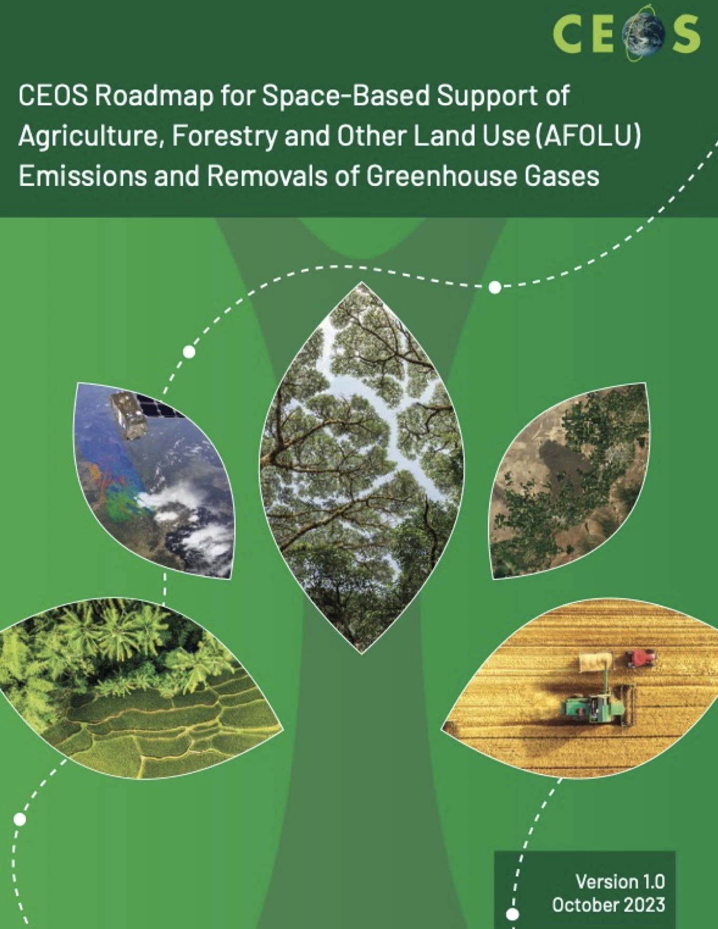
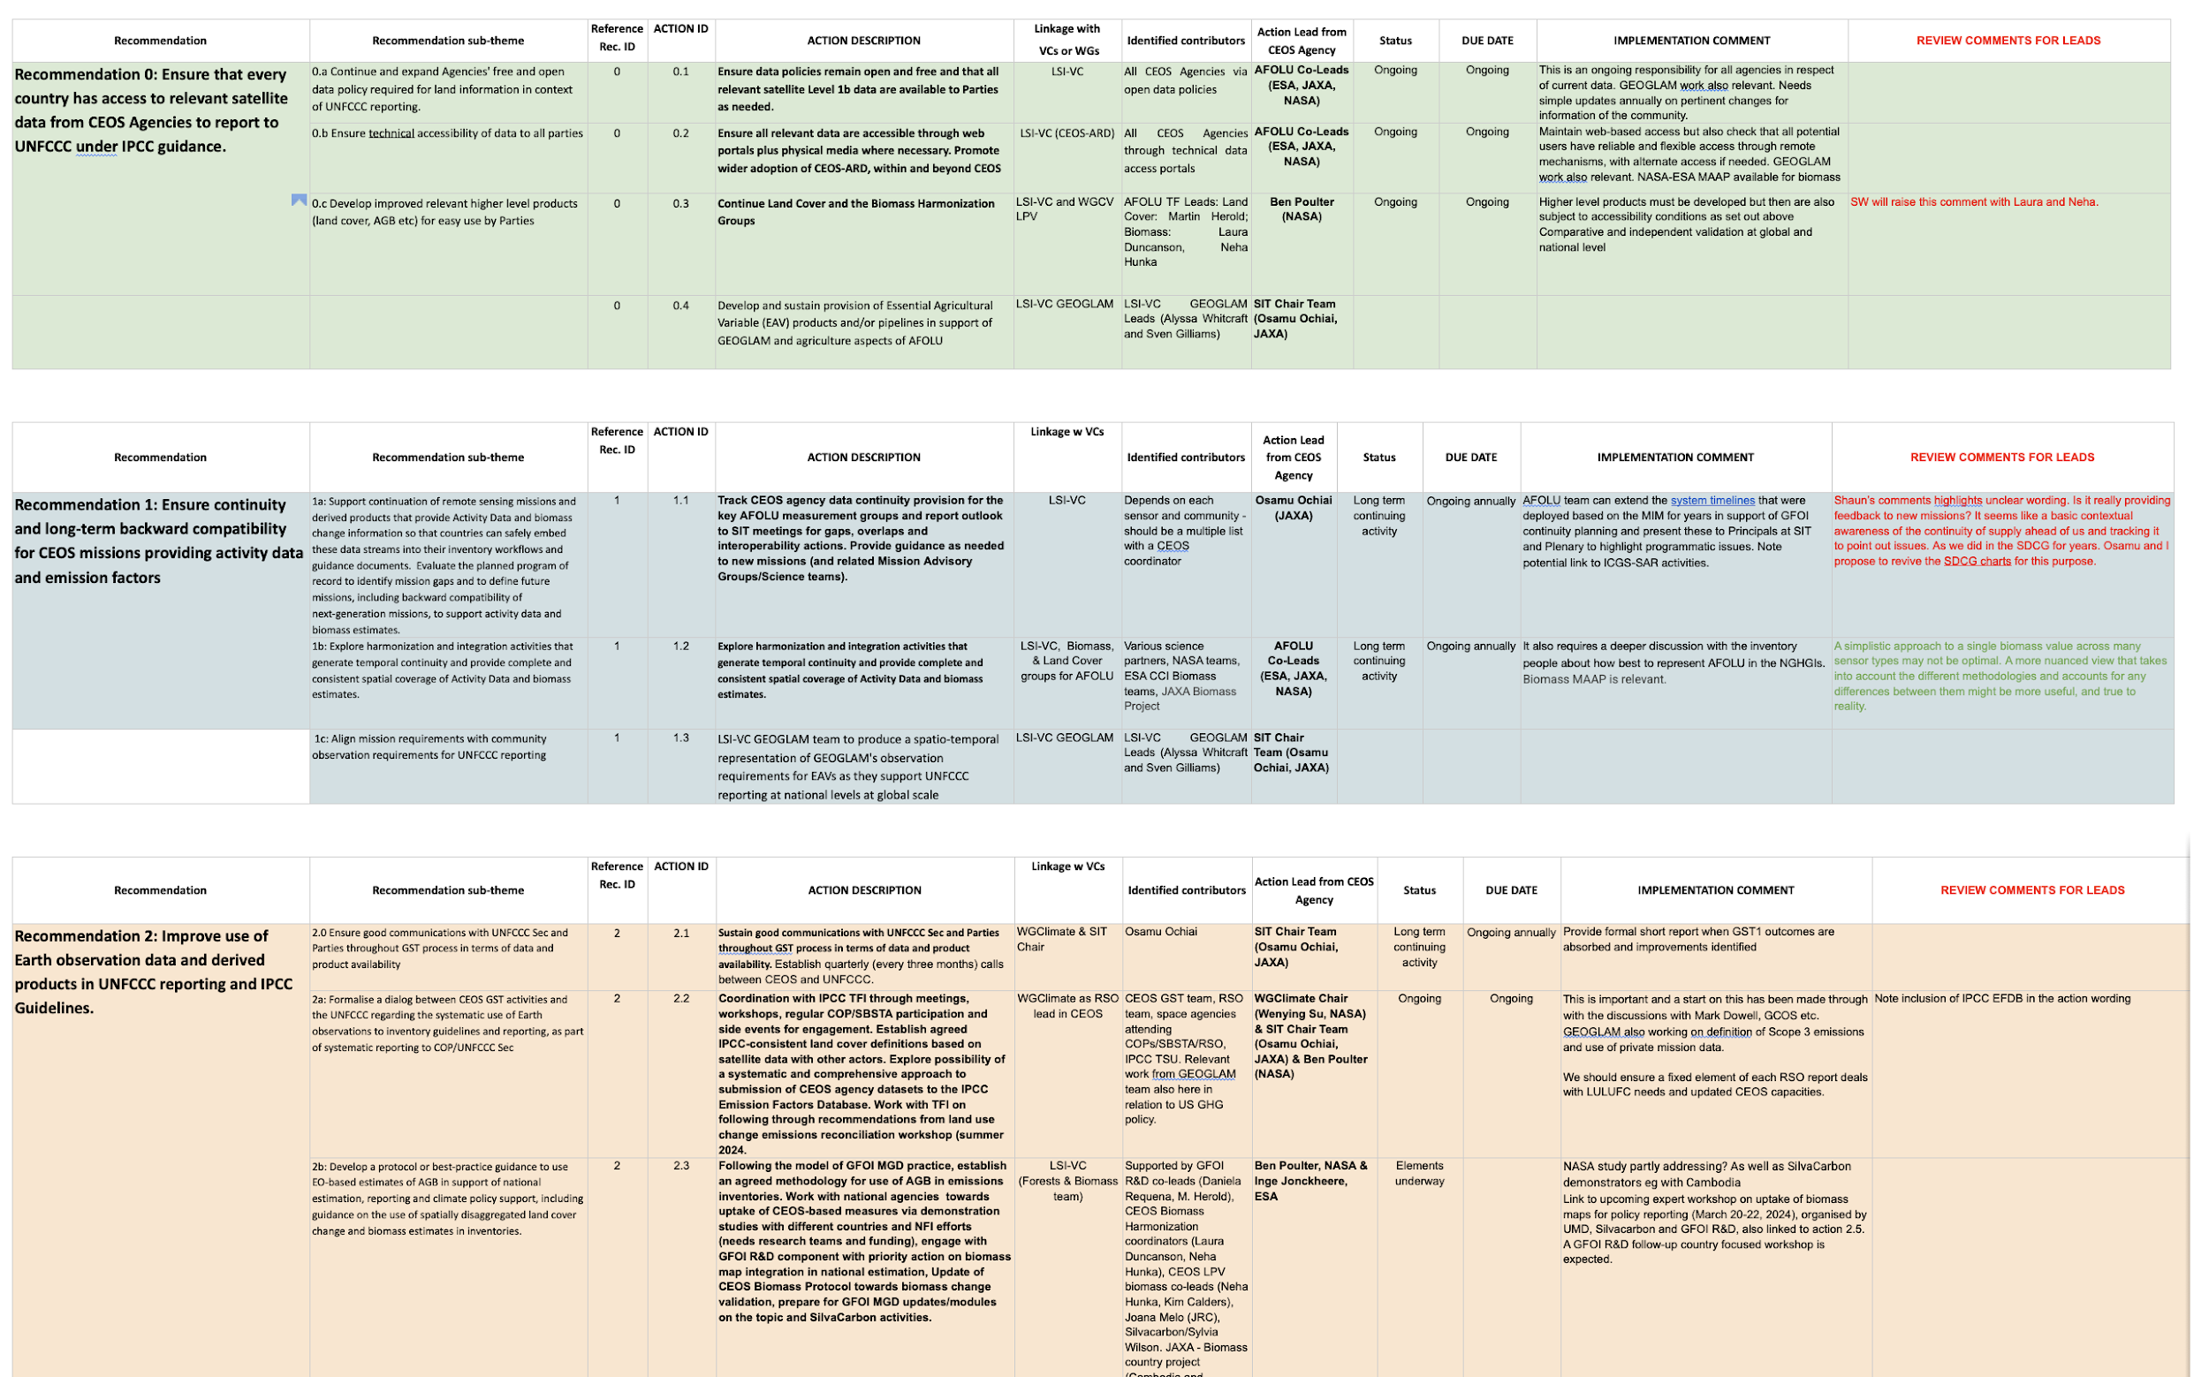
The AFOLU Roadmap (2023)
AFOLU Action Plan (2023-2025)
https://docs.google.com/document/d/1AL3_ExBVbTdvV5NdOmvsOiw44PwQCArlRwbvJ-RiA-E/edit?tab=t.0

Slide 3
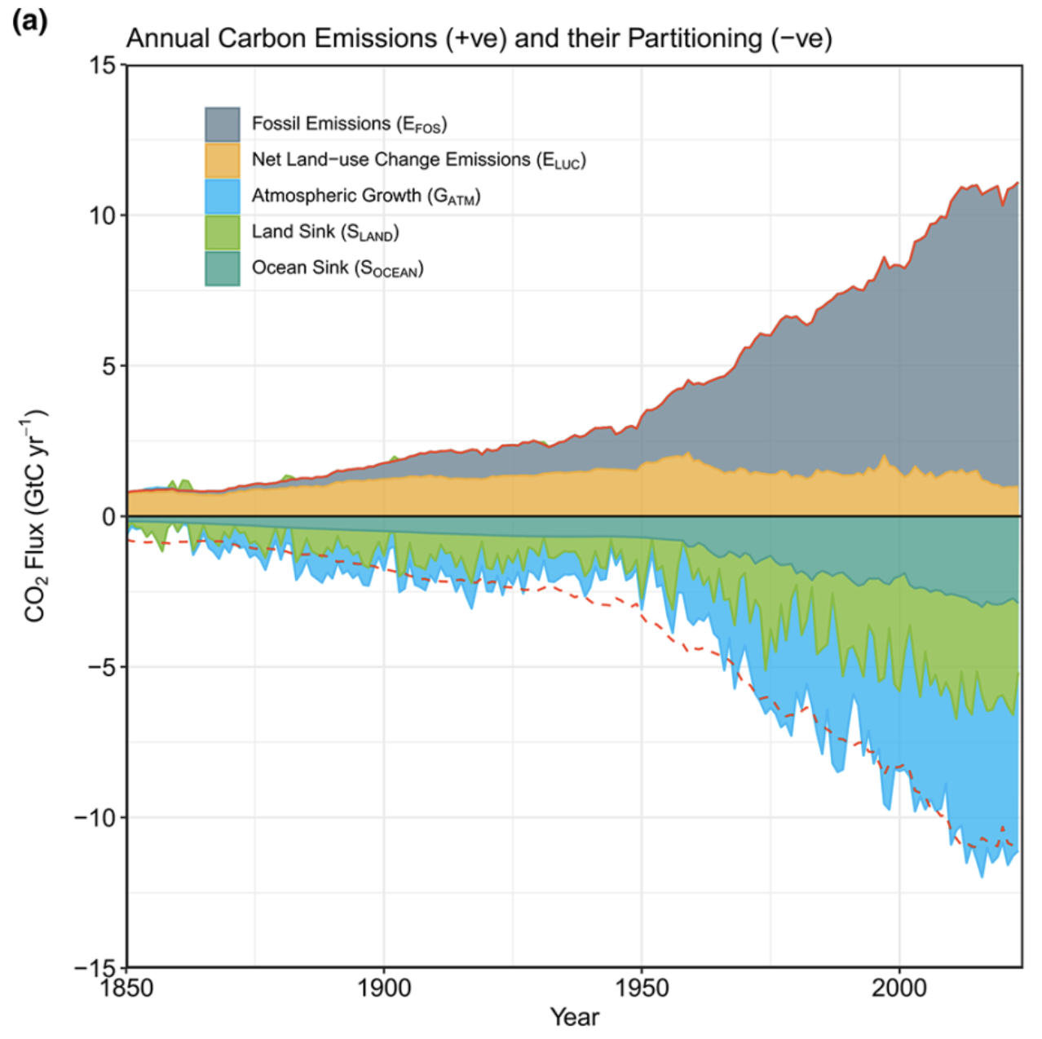
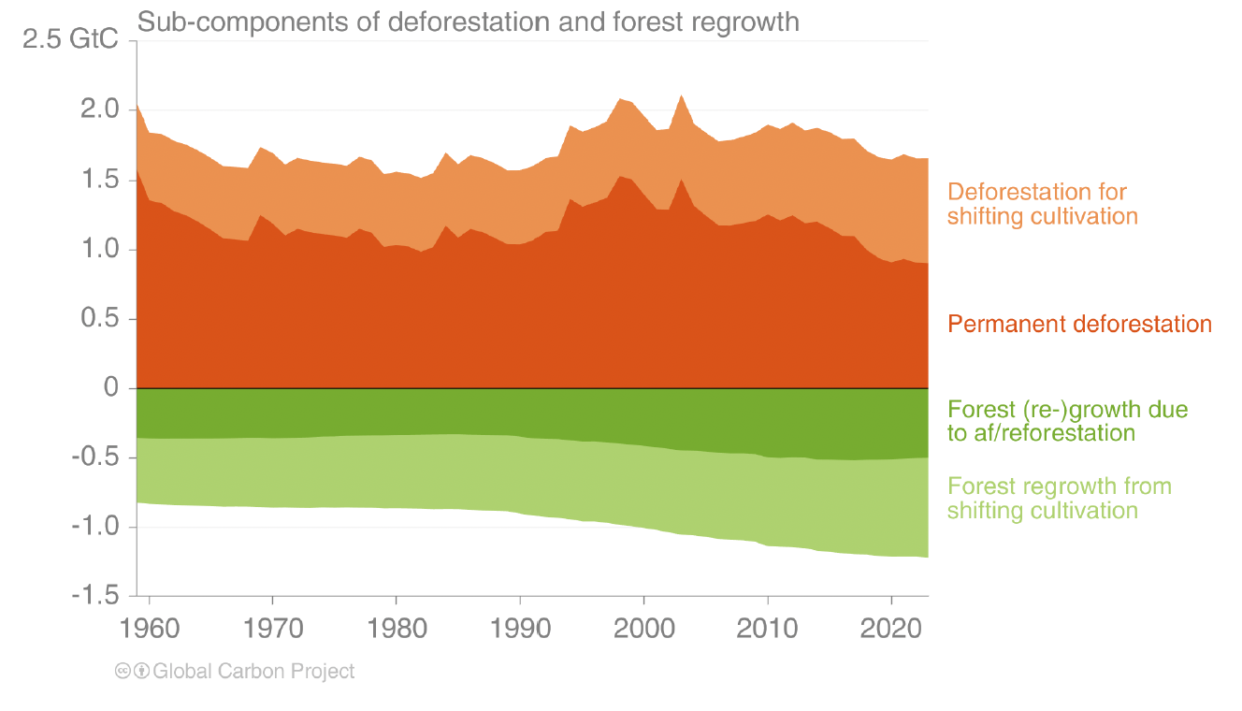
Land use and land cover change is net emitter of greenhouse gases
LULUC~10% of CO₂ emissions
AFOLU ~30% of CO₂-eq emissions
  Livestock, fertilizer, rice, waste…
Friedlingstein et al., 2025

Slide 4
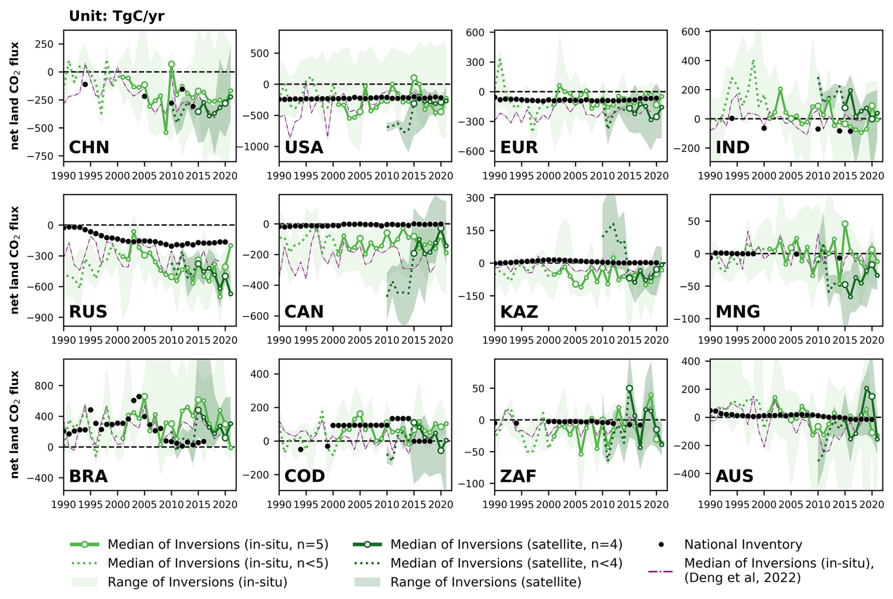
Role of AFOLU in the Global Stocktake
Agriculture, forestry and other land (AFOLU) use activity data and emissions factors to provide greenhouse gas emissions and removal data from direct human-induced land use, land-use change, and forestry activities including agricultural emissions
In National Inventory Reports (NIR), AFOLU includes two of the five sectors (‘Land Use Land Use Change and Forestry’, and ‘Agriculture’)
  Includes six land use categories: forest, cropland, grassland, settlement, wetland, and other land
Independent verification of net GHG emissions from AFOLU is an active area of research using new methods requiring reconciliation for definitions
Deng et al., 2025, ESSD

Slide 5
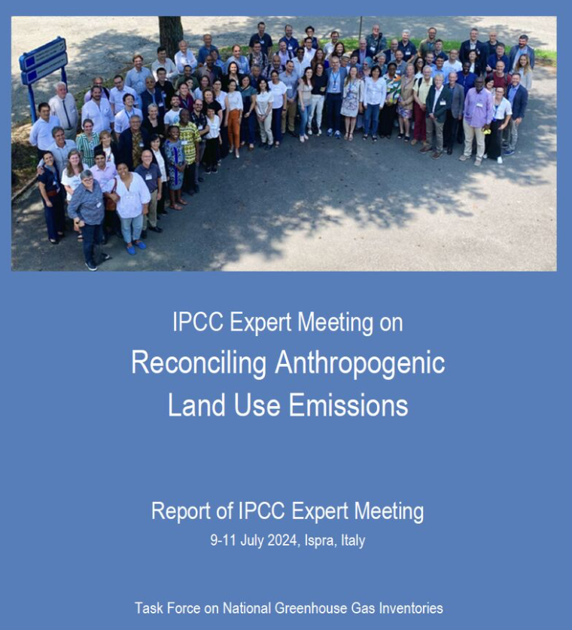
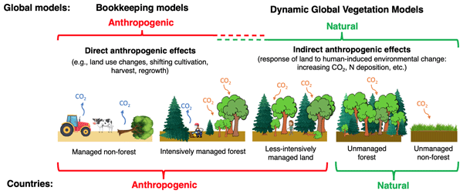
Role of AFOLU in the Global Stocktake
Rosetta stone developed to reconcile IPCC/NGHGI and IPCC/GCP approaches to estimate AFOLU emissions
  Mainly, the loss of additional sink capacity (LASC), the definition for managed lands, and the cadence of national forest inventory sampling drive differences
  The REgional Carbon Cycle Assessment and Processes (RECCAP) study has helped developed methods for reconciling the approaches
Grassi et al., 2024, ESSD

Slide 6
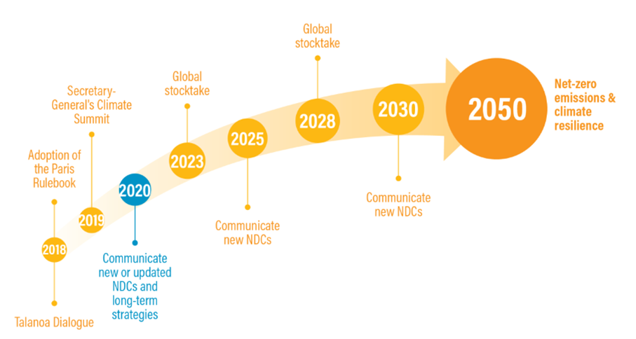
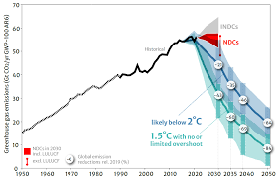
Role of AFOLU in the Global Stocktake
Timing of CEOS AFOLU Actions aligned with Global Stocktake (GST) reporting cycle
Unclear timing of IPCC AR7 publication for second GST
Analysis from 2023 Global Stocktake
Only ~20 countries have submitted 2035 NDCs (feb. 2025 deadline)

Slide 7
Recommendations from CEOS AFOLU
Ensure that every country has access to relevant satellite data from CEOS Agencies to report to UNFCCC under IPCC guidance.
Ensure continuity and long-term backward compatibility for CEOS missions providing activity data and emission factors
Improve use of Earth observation data and derived products in UNFCCC reporting and IPCC Guidelines.
Enable dialogue between inventory practitioners and CEOS community, recognizing that different countries have various requirements to support their system for reporting
Support efforts to reconcile bottom-up, top-down, and inventory estimates of GHG emissions and removals
Systematically target activities to support IPCC Land Cover classes
Work with New Space data providers and commercial partnerships to provide the most comprehensive coverage possible in supporting national GHG inventories
Ensure consistency of CEOS AFOLU and GHG Roadmaps to support an integrated national GHG inventory system, GHG+.

Slide 8
Development and implementation of AFOLU Actions
Regular coordination meetings between NASA, ESA, JAXA
Two active sub-groups (Biomass and Land Cover and SilvaCarbon)
Synergies with GHG Task Team, WGClimate and Carbonara field campaign
Around 40 actions have been defined, with co-leads assigned, and milestones listed
  1.2: Explore harmonization and integration activities that generate temporal continuity and provide complete and consistent spatial coverage of Activity Data and biomass estimates.
  2.2: Coordination with IPCC TFI through meetings, workshops, regular COP/SBSTA participation and side events for engagement. Establish agreed IPCC-consistent land cover definitions based on satellite data with other actors. Explore possibility of a systematic and comprehensive approach to submission of CEOS agency datasets to the IPCC Emission Factors Database. Work with TFI on following through recommendations from land use change emissions reconciliation workshop (summer 2024.
  3.3 Support NFI teams and review experts accessing independent estimates derived from EO in the context of Enhanced Transparency Framework
  4.1: Develop guidance and datasets to support the consistent comparison and assessment of bottom-up and top-down methodologies with national GHG inventories.
  5.5: Establish closer collaboration with the Ramsar Convention Secretariat and Scientific and Technical Review Panel (STRP).

Slide 9
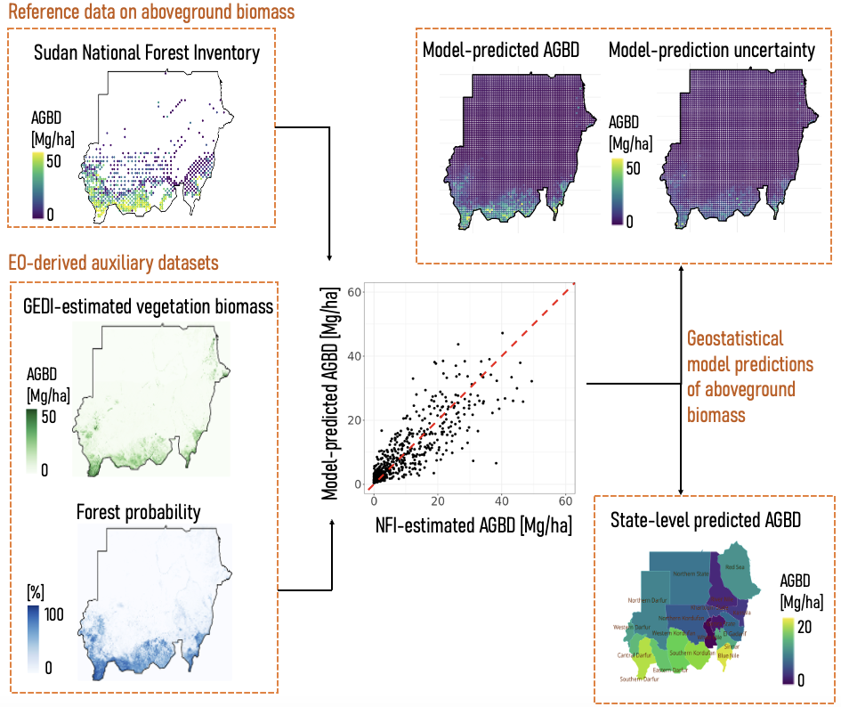
Action 0.3: Support biomass harmonization efforts
Objective: Align the up-take and use of EO data (for forest biomass or emission factor estimation) with policy reporting requirements.
Several countries are showing keen interest in increasing area-wide precision in estimates or “gap-filling” incomplete National Forest Inventories with Forest Height or Biomass Maps. National-scale cases in a few countries have been demonstrated. Working with GFOI, demonstrations in Peru, Mozambique and Brazil are underway currently.
Republic of Sudan has successfully submitted a Forest Reference Level (FRL) report to the UNFCCC that includes the use of NASA GEDI, ALOS PALSAR and Landsat imagery. The Methodology is approved in the Technical Assessment (TA) and expected to be finalized in June/July 2025.

Slide 10

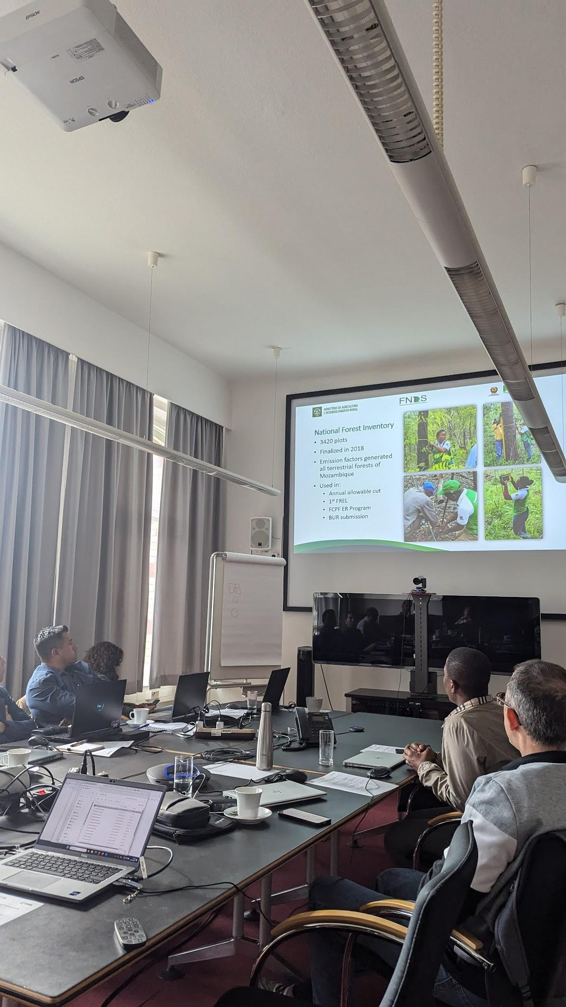
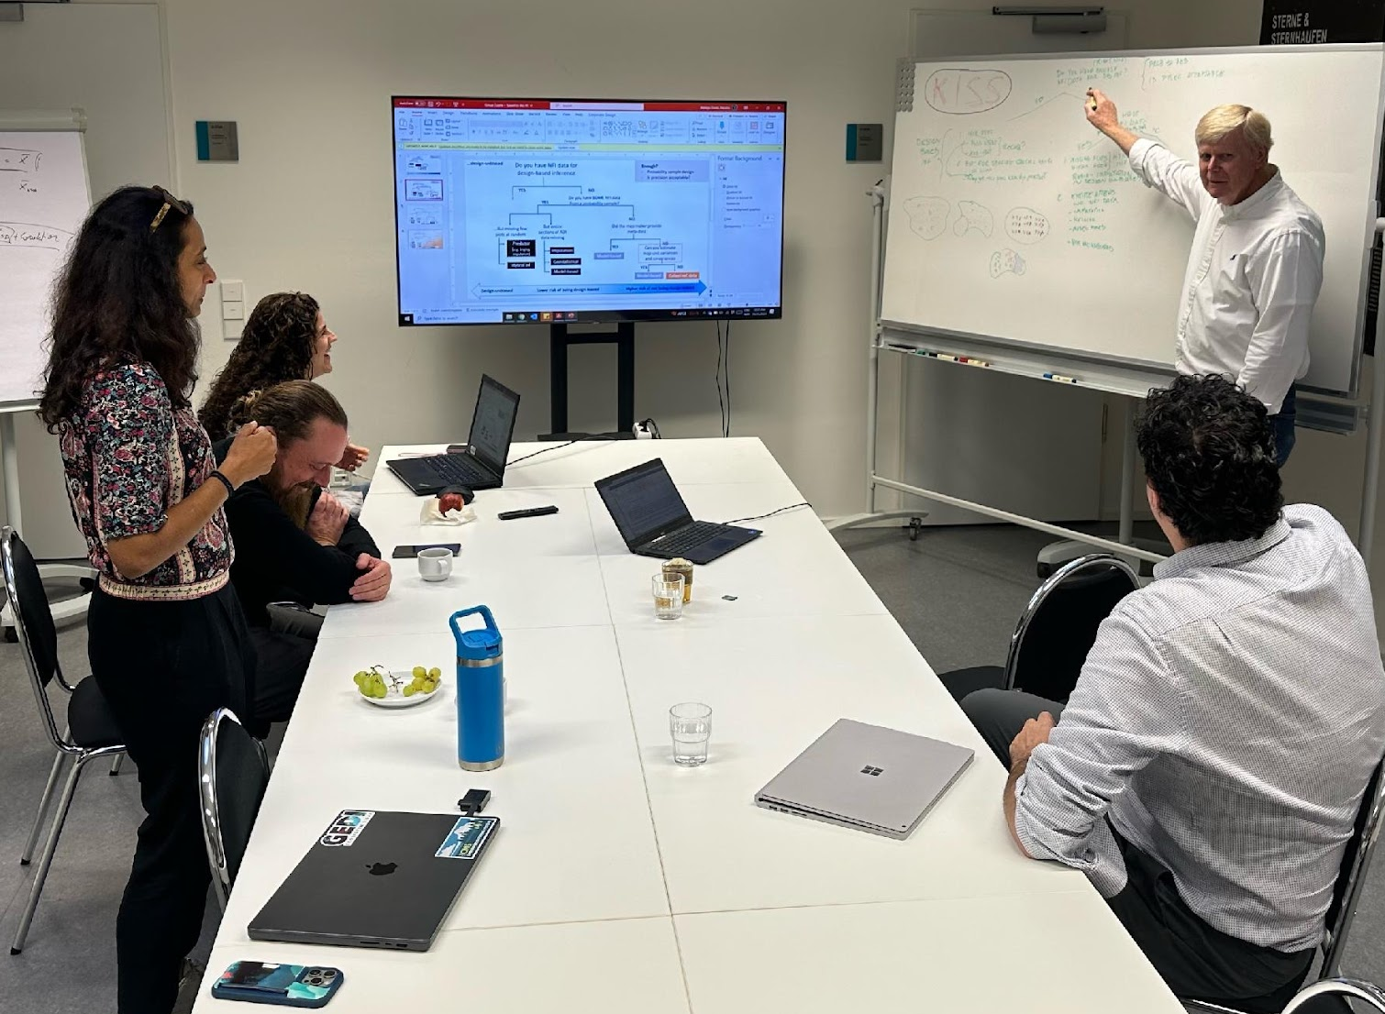
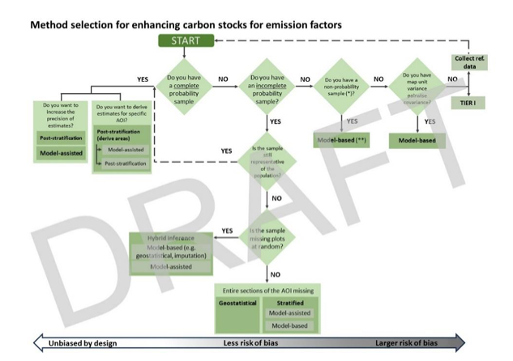

Action 2.6/2.8/3.1: GFOI R&D efforts on informed uptake of space-based biomass products
GFOI R&D/MGD Workshop: “Informed use of space-based biomass data in MRV procedures”, 23-25 October 2024. Workshop Outputs (in development)
GFOI Rapid Response Module currently in development (2025 Q4)
  Examples of possible applications and their current status of operational readiness (following CALM framework)
  Good practices considerations for the use of biomass datasets in NGHGHIs and REDD+ activities
  Methodological framework for selecting the best methodological approach for the integration of NFI data with EO-based biomass data for improving EFs
Open and user-friendly methodological resources for the integration of ground forest inventory data with biomass datasets
Synthesis on user needs and workshop insights for biomass map users and R&D community
Continued support for country studies in collaboration with national forest monitoring teams

Slide 11
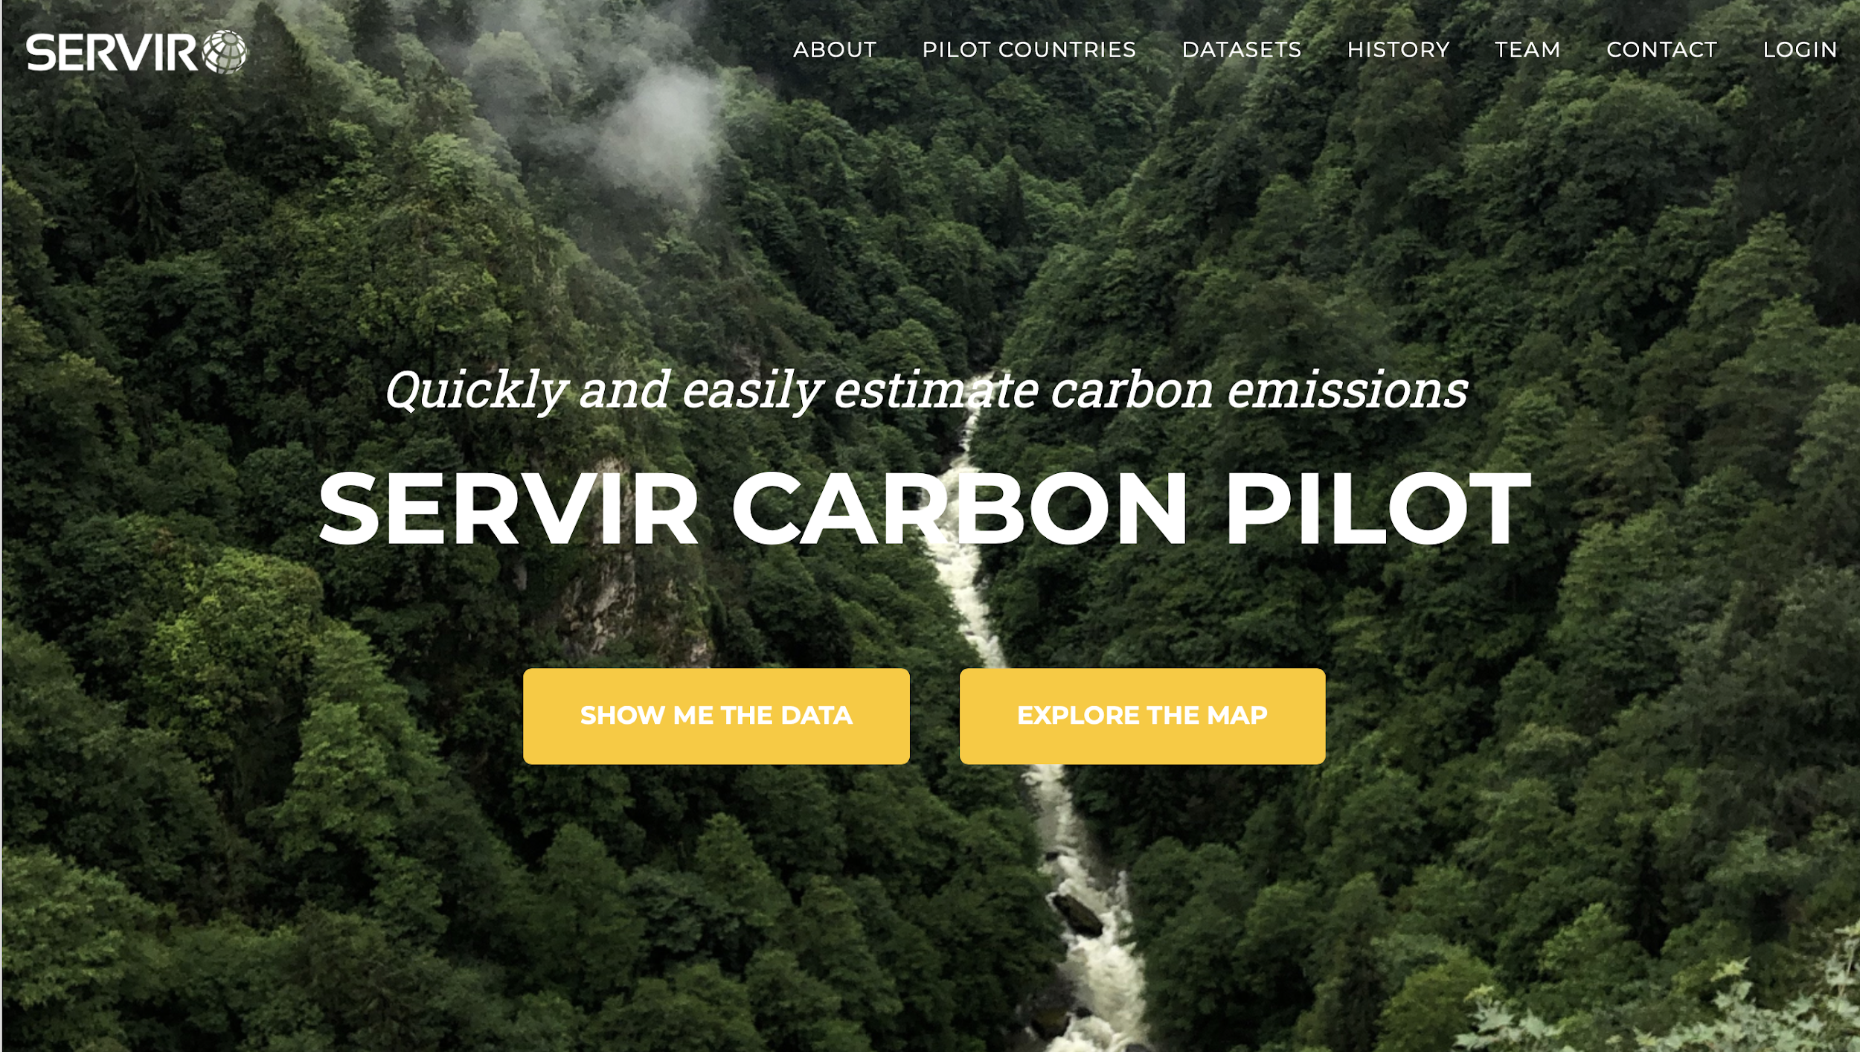

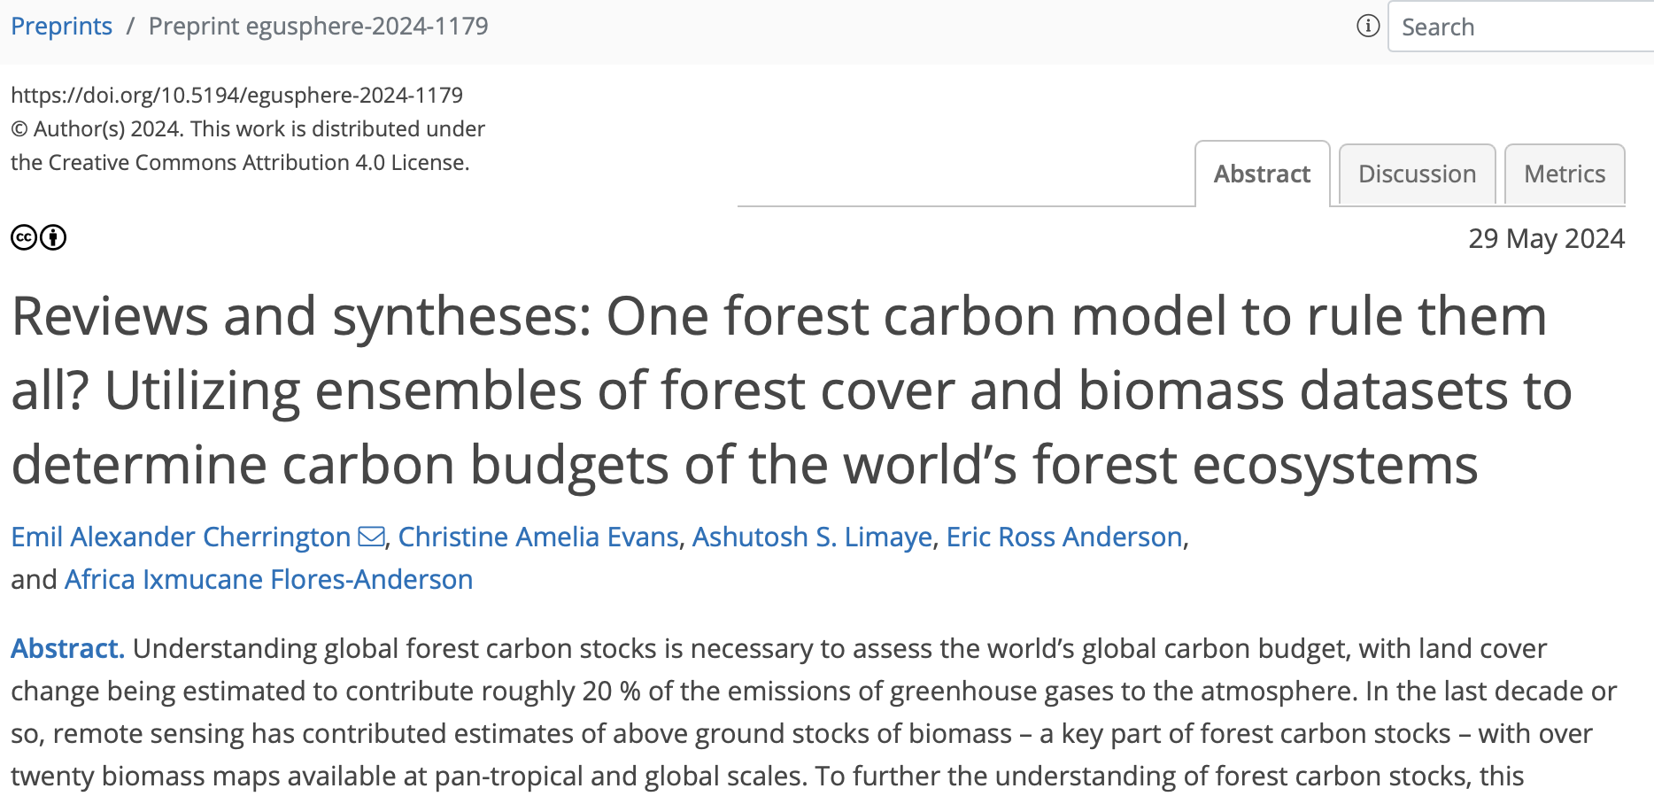
Action 2.8: Scaling from global to national inventory needs

Slide 12
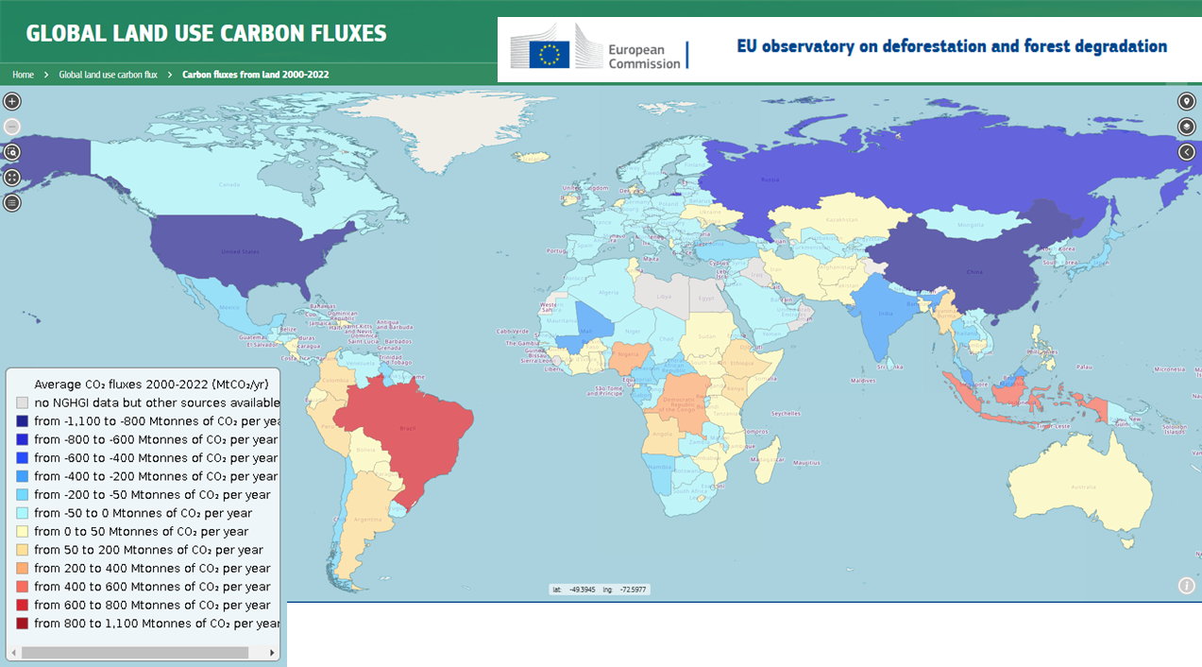
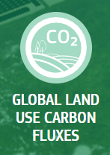

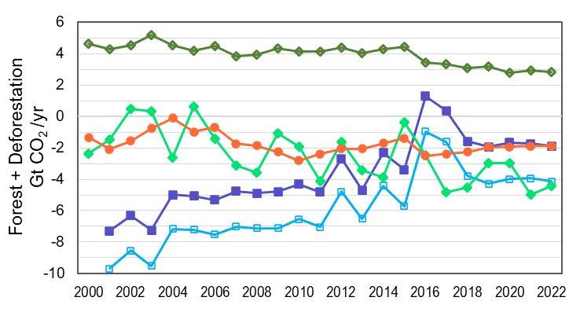
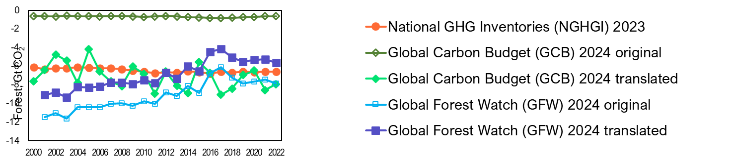
Action 2.8: Scaling from global to national inventory needs
LULUCF data-hub
Hosted by the European Commission Joint Research Centre in the EU Observatory
Strengthening dialogue across communities
Showing ongoing efforts from the scientific community in presenting their data in a conceptually similar way to NGHGI / IPCC guidance to effectively help track progress in achieving the objectives of the Paris Agreement
(Pierre Friedlingstein et al., 2025)
(link to presentation from session 4.2)
(Gibbs et al., 2025)

Slide 13
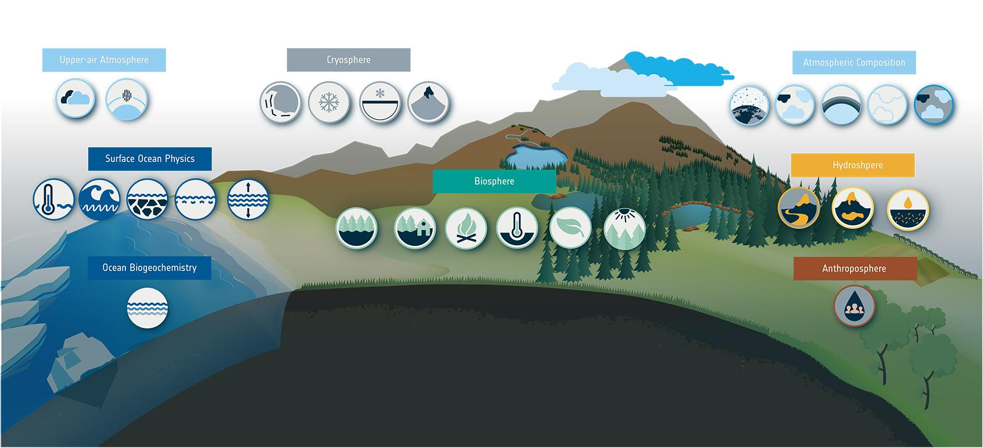
Action 2.9: Supporting GCOS for NRT and low latency variables
GCOS defined 55 Essential Climate Variables | 36 benefit from space observations
27 generated by ESA Climate Change Initiative
Cloud
Upper Atmosphere Water Vapour
Ice Sheets
Snow
Permafrost
Glaciers
Aerosol
Greenhouse gases
Ozone
Precursors
Other
Long-lived GHGs
Sea Surface
Temperature
Sea State
Sea Ice
Salinity
Sea Level
River
Discharge
Lakes
Soil
Moisture
Above-ground Biomass
Land
Cover
Fire
Land Surface
Temperature
Leaf
Area
Index
Fraction of Absorbed Photosynthetically Active Radiation
Ocean Colour
Harnessing >40-yr of ESA, COPERNICUS and other EO data
Anthropogenic
Water Use
Open data access - climate.esa.int

Slide 14
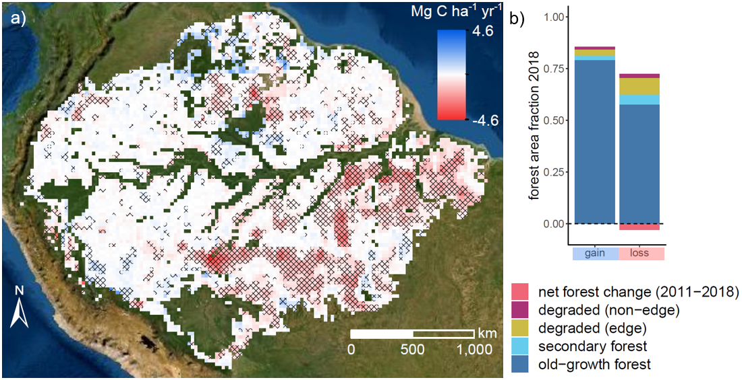
Action 3.2/6.1: ESA-INPE Campaign
Scoping an Amazon experiment (CarbonARA)
Location: Tapajos (Para state)
Land cover
Here you have the full range of land cover types (degraded, agriculture, secondary and intact forests)
Climate Risk
This area was massively impacted by the last El Nino in 2015/16 leading to increased burning.
Challenges
Fire modelling; response of intact forest to detrimental climate;
lack of representation of secondary and degraded forests in models (disturbance and recovery dynamics; new PFTs for secondary forests);
mosaic and edge effects (i.e. landscape heterogeneity);
representation of agriculture.
AGC trends (2011–2019) over the Amazon biome.
Fawcett et al., GCB, Amazon biomass in decline due to deforestation and degradation (esa.int)

Slide 15
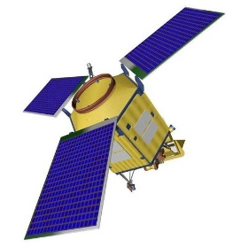
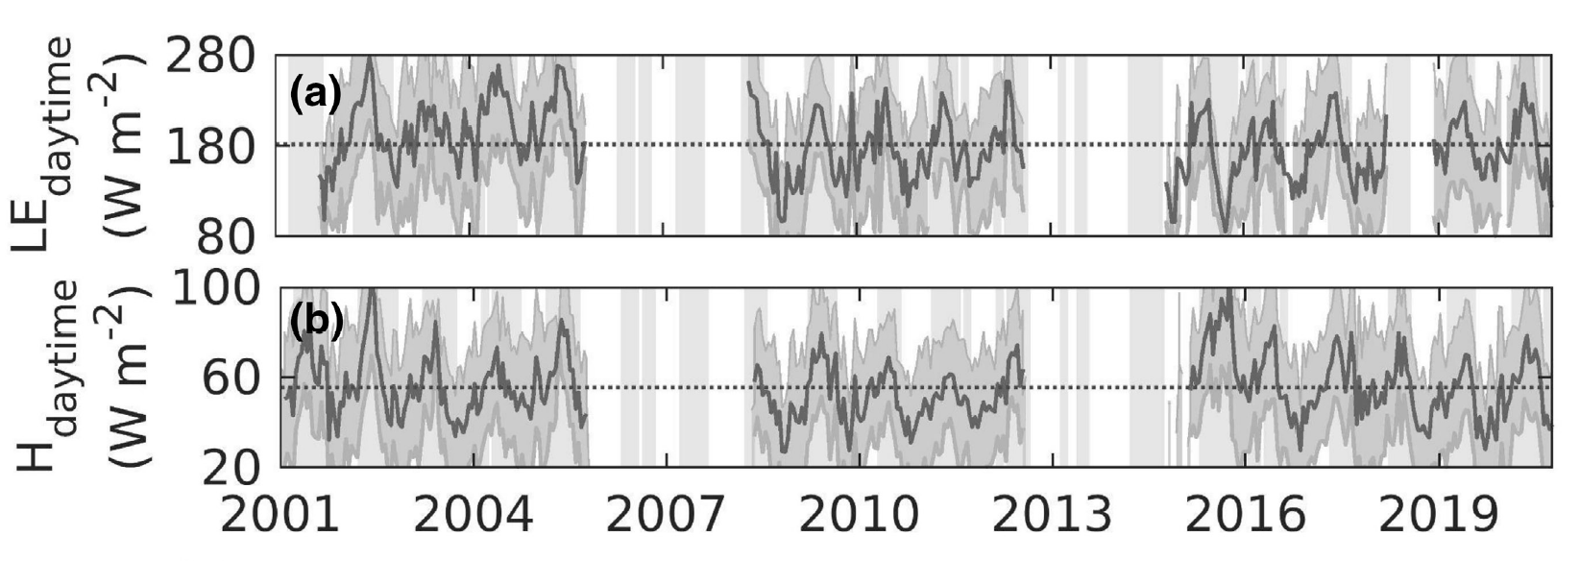
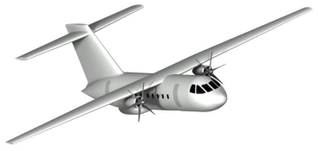

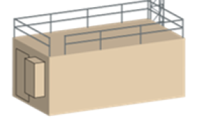
Action 3.2/6.1: ESA-INPE Campaign
Scoping an Amazon experiment (CarbonARA)
Sentinel5p, Sentinel2, Sentinel3, SMOS, OCO-2 …
Schematic representation of the planned observing strategy
Restrepo-Coupe et al. 2023
GHG concentrations Quantification and Verification
Satellite Validation and Interpretation
Fire Impact
Model Development and Evaluation
RS and in-situ Aircraft observations e.g. BAS Twin Otter
Carbon and land-surface modelling including long-term components
Tower-based GHG measurements including:
Ecosystem scale fluxes:
Soil sensors:
Radiation sensors:
Water Fluxes
Tree growth and biometric measurement
Notes:
Timeline: 15 Sep to 5 Oct 2025 for the flying to happen. A week before for installation and a week after the campaign for de-installation

Slide 16
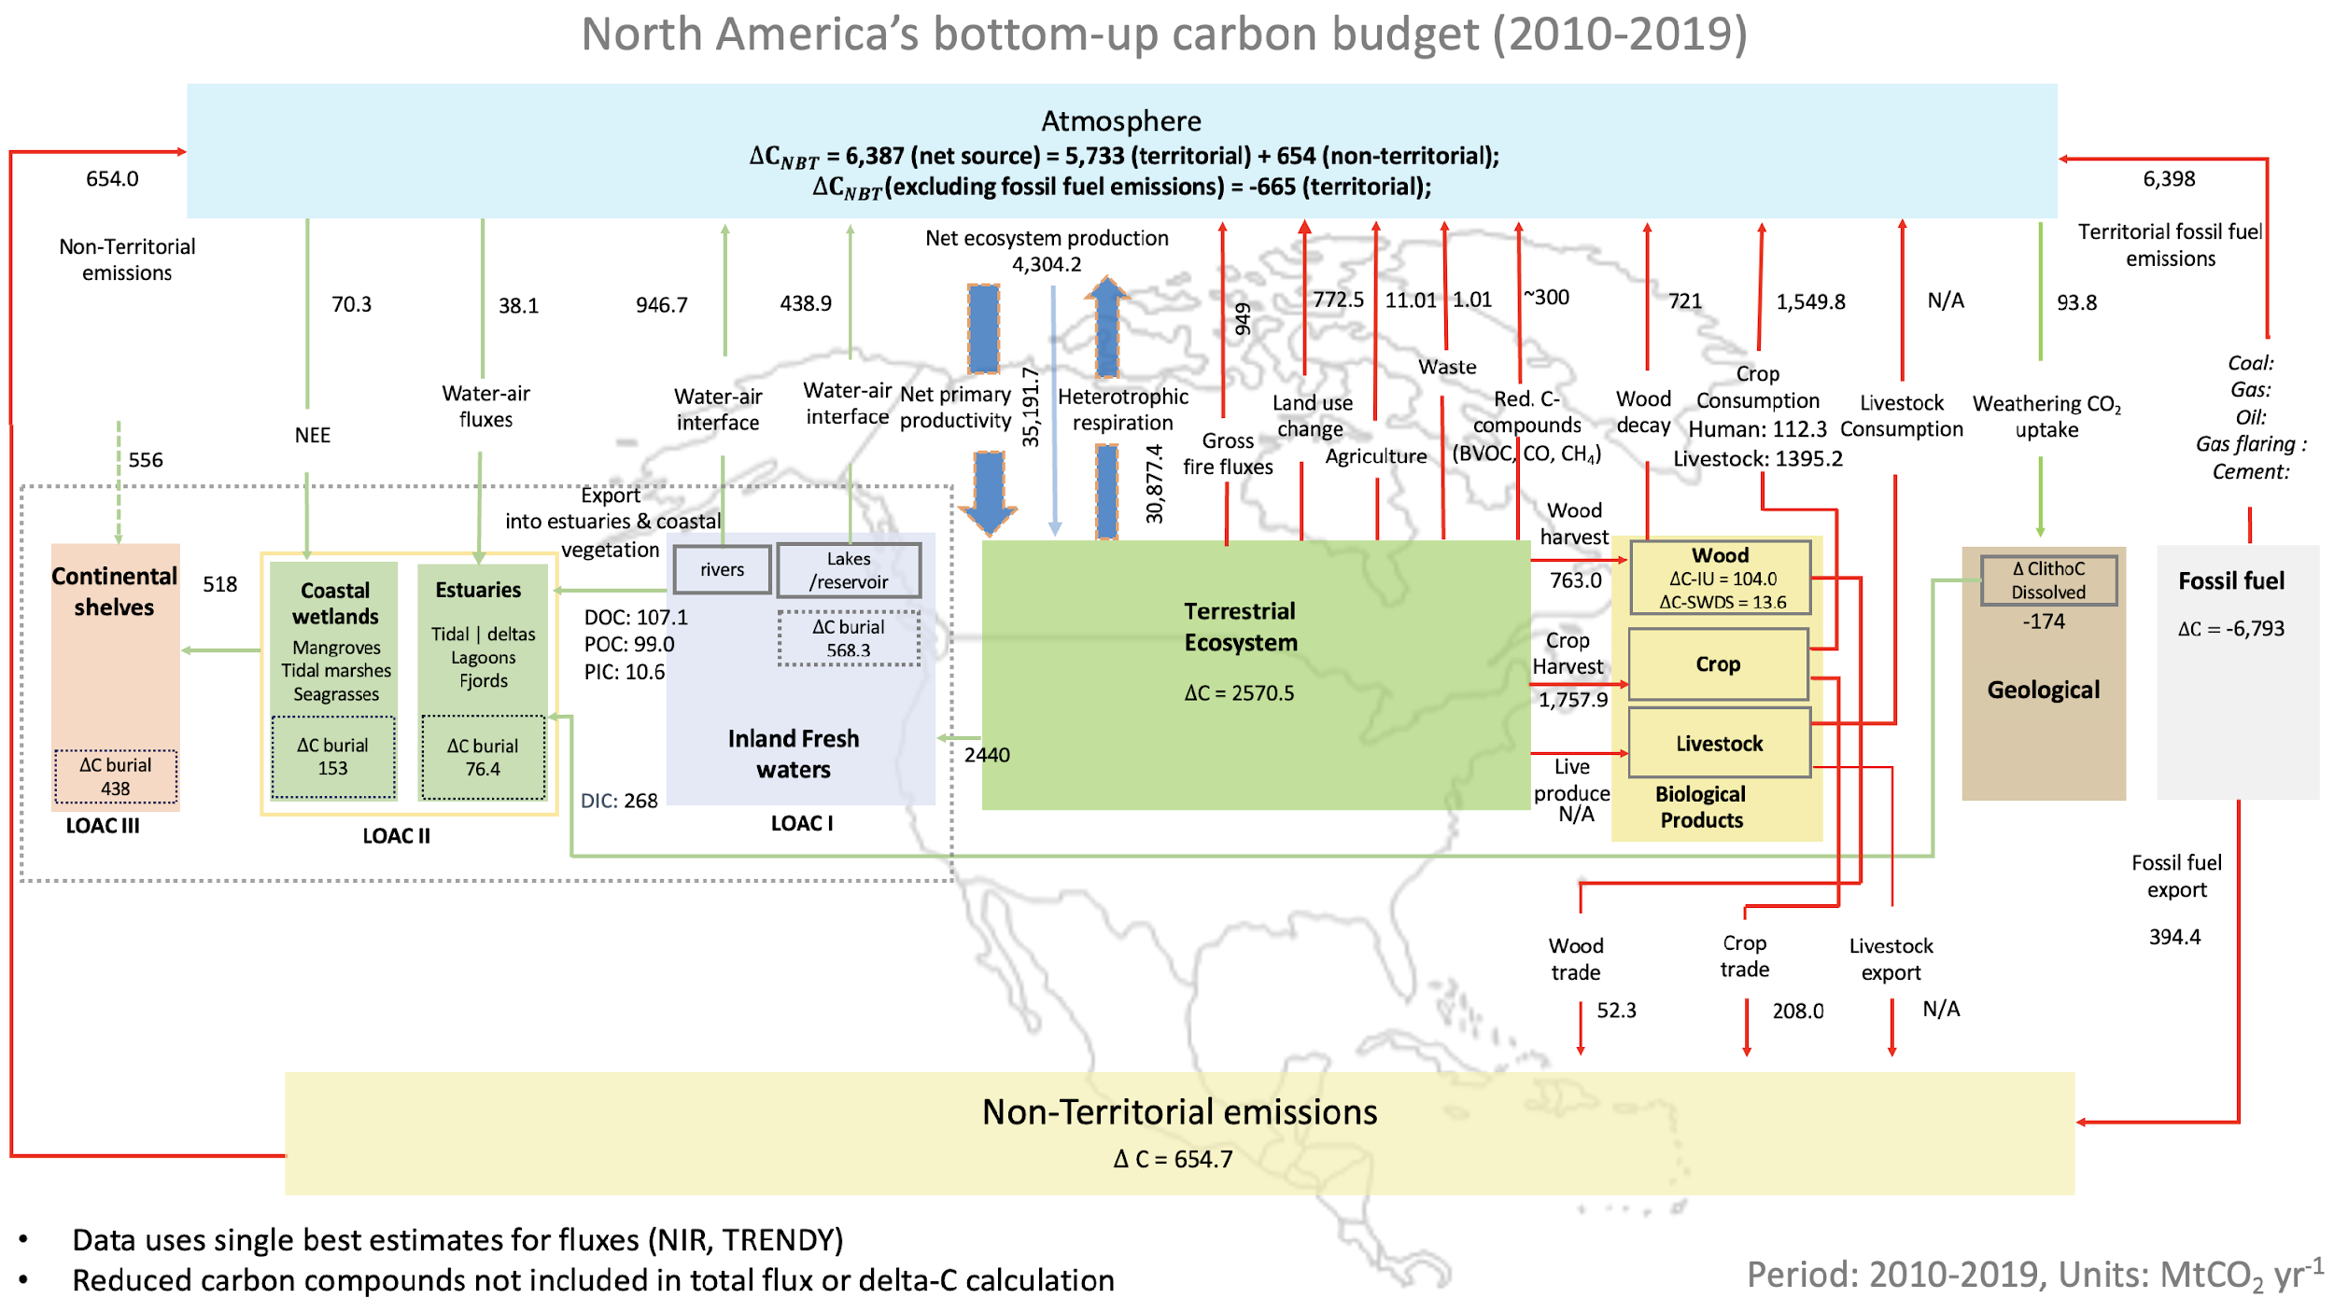
Actions 4.1 to 4.4: Reconcile activity- & atmospheric based AFOLU estimates
NASA-ESA Carbon Budget Reconciliation Challenge
Recruitment of post-doctoral scientists in US (start June 2025)
Briefing to the CEOS/CGMS WGClimate-22 and GHG Task Team (Feb 2025)
‘Networking session’ ESA-NASA Carbon Budget Reconciliation Challenge ESA Living Planet Symposium, 2025
Lessons learned from RECCAP2 applied ‘challenge’ design
Poulter et al., 2025

Slide 17
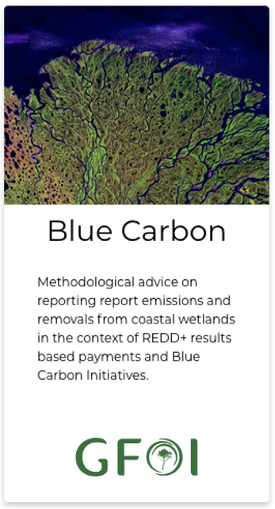
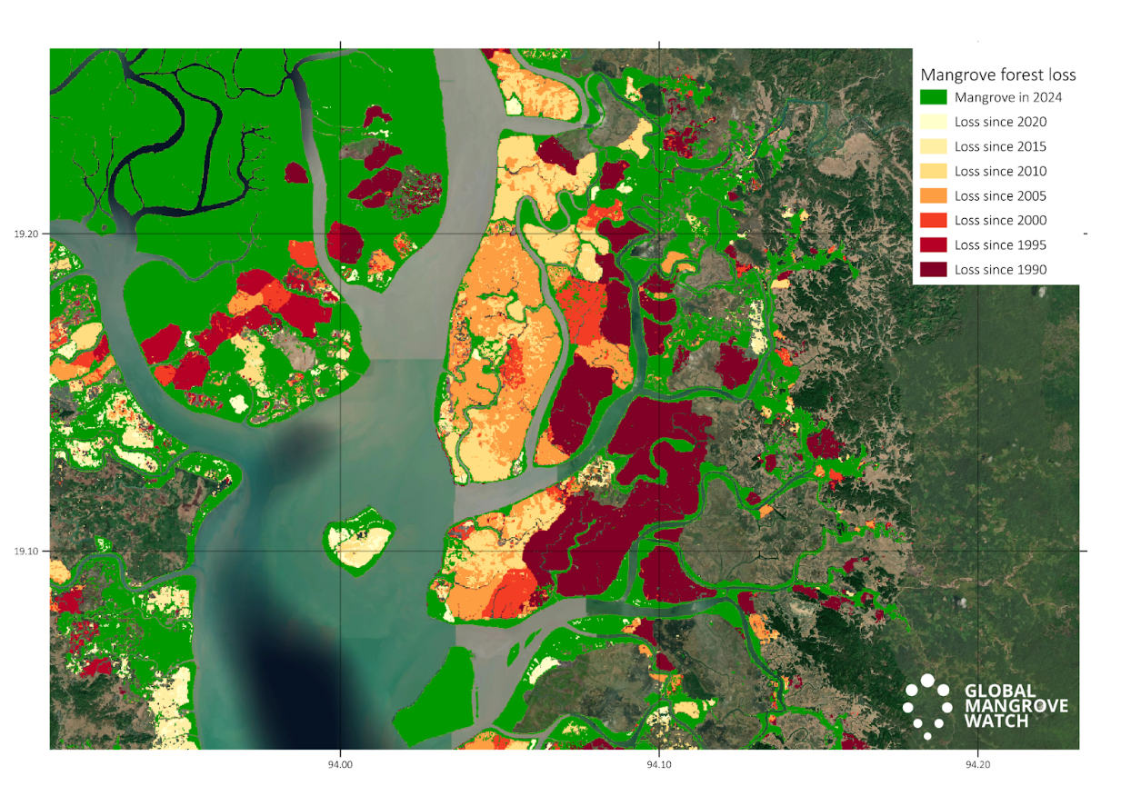

Action 5.3 – 5.5: Supporting wetlands mapping and monitoring
Activities in the AFOLU Roadmap directly related to Wetlands:
        Action 5.3: Consider best practice for including Blue Carbon Ecosystems (BCEs) in national inventories. GFOI MGD Blue Carbon Guidance released Feb 2025
        Action 5.4: (a) Explore the development of new CEOS initiatives on wetlands mapping and monitoring. (b) Ensure that new CEOS missions consider wetlands amongst their mission goals. (a) Wetland initiatives: GEO-Wetlands proposal (Ramsar/ESA/JAXA) for post-2025 GEO Work programme. Global Mangrove Watch (JAXA) (b) Missions including wetlands goals: ALOS-2/ALOS-4, NISAR
        Action 5.5: Establish closer collaboration with the Ramsar Convention and Ramsar Science and technology Review Panel (STRP)
Blue Carbon Guidance for national reporting
https://www.reddcompass.org/mgd
Activity Data. Global Mangrove Watch map showing mangrove extent 2024 [green] annual losses [yellow/orange/red] and annual gains [blue] for 1990-2024
Directive from Ramsar Standing Committee for STRP to develop initiative to foster knowledge exchange and guidance on EO for national wetlands inventory
Ramsar Earth Observation Day organised Dec 2024 in collaboration w CEOS agencies (JAXA/ESA/EC) and CEO
STRP considering EO as a Priority Task in the Work Plan for the next triennium 2026-2028.

Slide 18
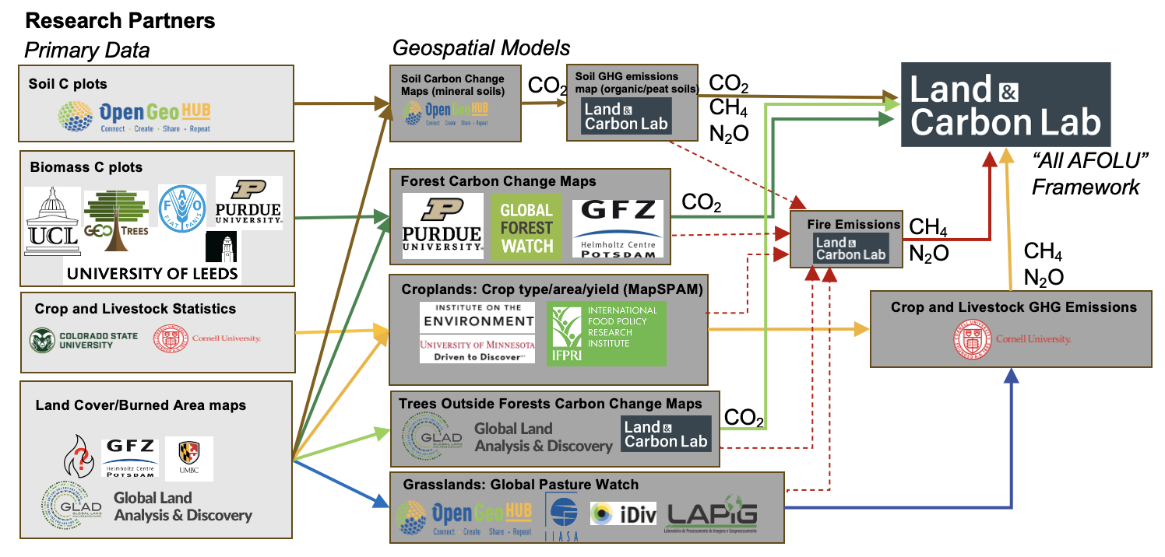
Action 5.6: Improve grassland and rangeland mapping
N Harris, World Resources Institute

Slide 19

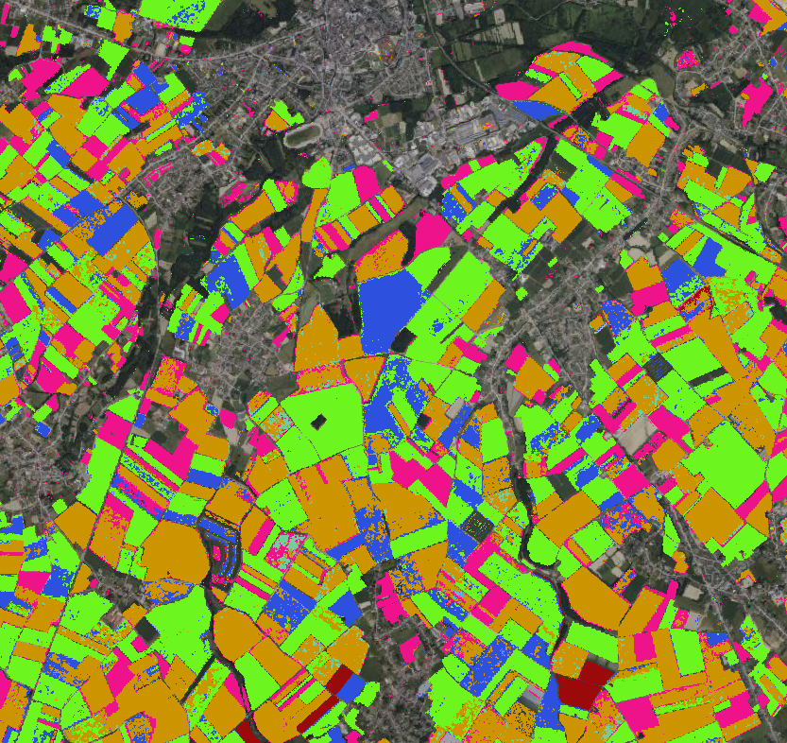
Action 5.7 & 5.8: WorldCereal products
Phase I
Scientific and technical feasibility study
Phase II
Operational and flexible crop mapping service
User-friendly cloud-based processing system
(powered by OpenEO and Copernicus Data Space Ecosystem)
New set of global products for 11 crop types
(maize, winter cereals, spring cereals, sunflower, rapeseed, millet, sorghum, wheat, barley, rye, soybean)
Customizable crop type model training and application
Addition of crop yield module to the system
Focus on capacity building → towards increased adoption of the system
More details: https://esa-worldcereal.org/en/about/worldcereal-phase-ii
Notes:
WorldCereal cloud-based processing system for cropland and crop type mapping at field scale was launched in October/2024.
GeoGlam contribution to AFOLU
the processing module allows users to:
Apply a pre-trained cropland detection model on a region and year of interest. This model has been trained on a global land cover dataset, spanning multiple years and should be readily transferable both in space and time. We are of course continuously updating this model as more in-situ reference data is being added to the system, through the Reference Data Module.
Train and apply your own cropland detection model based on your definition, for your region and year of interest. For this, you can make use of all public land cover training data currently present in the system.
Train and apply your own crop type detection model for your region, season and crop types of interest. Training of models can be done using the publicly available crop type data currently ingested in the system. Soon however, we will release the next version, allowing you to effectively use your own (private or public) in-situ reference data as well.

Slide 20
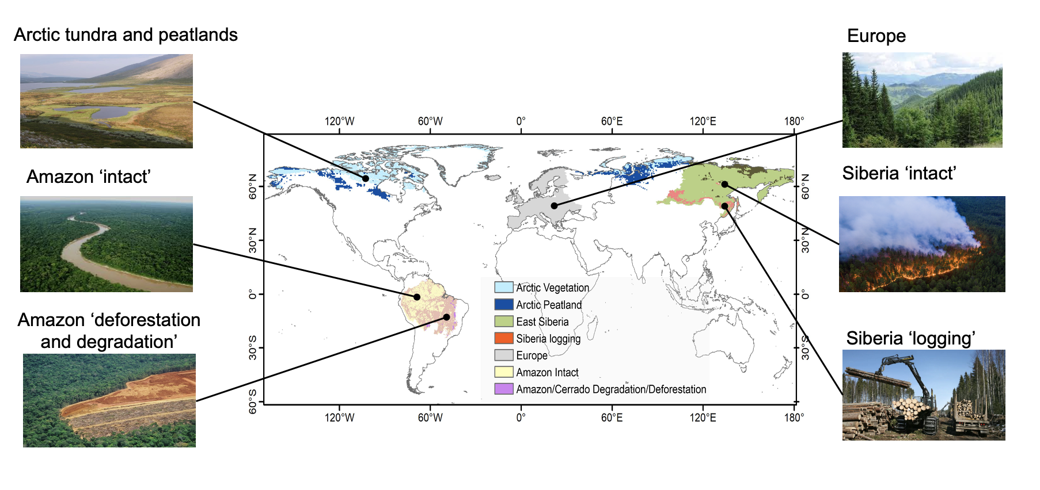
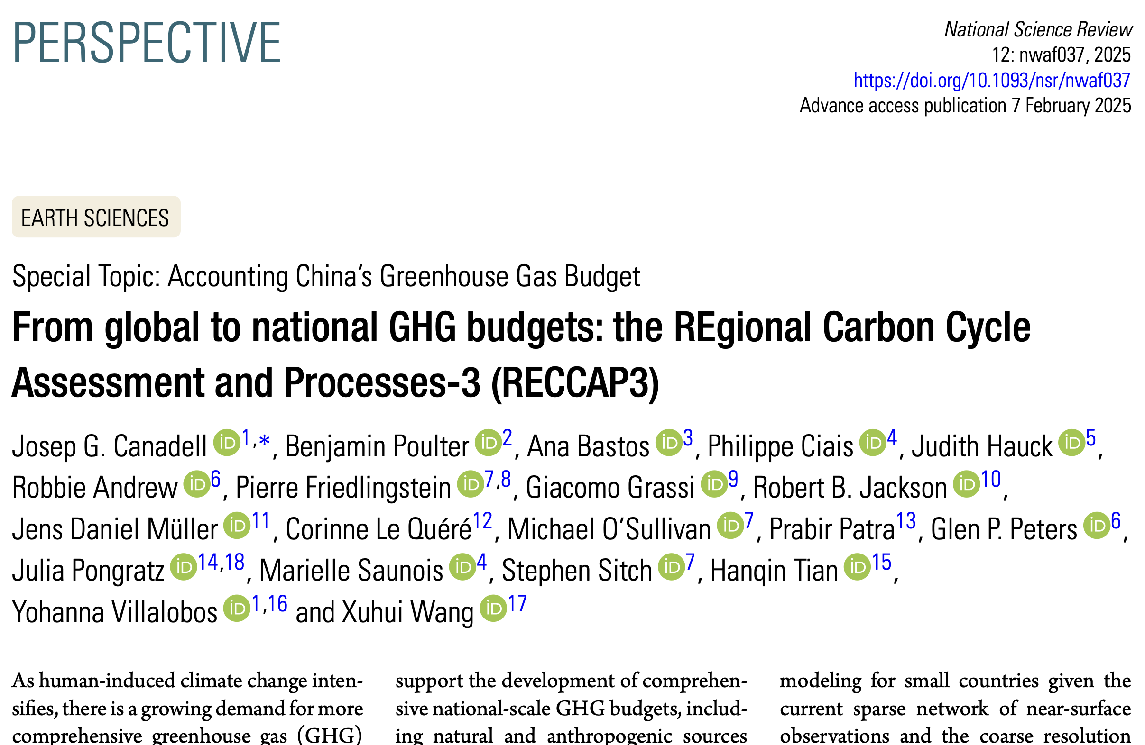
Action 7.1: REgional Carbon Cycle Assessment & Processes study (RECCAP 2 and 3) study
ESA supporting the assessment of GHG gross and net fluxes for six case study regions
Top down and bottom-up estimates using EO will be compared and reconciled with inventories
These regional case studies are completed by the collection and analysis of global ECVs aiming to reduce the uncertainty on the global biomass carbon change and methane budgets
This project integrates across CCI ECVs
Global Carbon Project initiating RECCAP3 in 2025

Slide 21
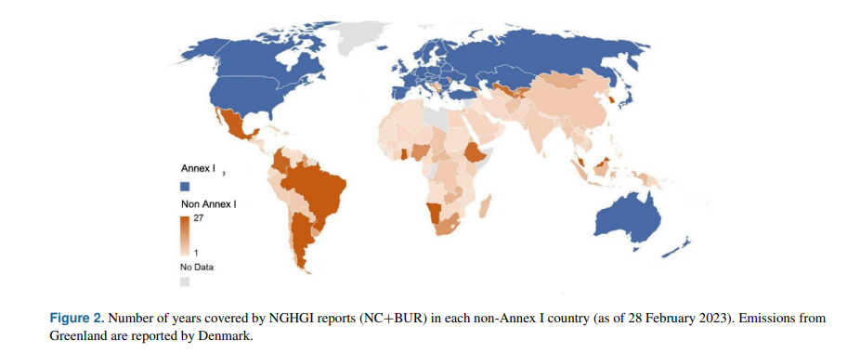
Action 7.1: REgional Carbon Cycle Assessment & Processes study (RECCAP 2 and 3) study
Integration and synthesis (global perspective): periodical comparison and evaluation of EO based GHG budgets against UNFCCC national Greenhouse Gas inventories
Partnership with CITEPA, CMCC. Collaboration with UKDES and INPE
Make system boundaries & definitions as close as possible between EO data and IPCC Guidelines used for NGHGIs
Data cube for data homogenization and visualisation Scientific publication to track progress of national mitigation efforts
National Agency engagement and contribution to the Global Stocktake
ESSD - Global greenhouse gas reconciliation 2022
https://climate.esa.int/en/supporting-the-paris-agreement/reccap-2-climate-space/

Slide 22
Future of CEOS AFOLU Actions
Individual actions traceable to the CEOS AFOLU Roadmap are successfully on a path to support…
1-3 year goals
  Iterate on Actions, compensate for leadership/turnover and associated activities
  Support CEOS Aquatic Roadmap to identify synergies
  Consider Version 2.0, similar to success of GHG Roadmap V2.0
5+ year goals
  Enable Earth Observations to support successes for
    2nd UNFCCC Global Stocktake
    7th IPCC Assessment Report
    WMO Global Greenhouse Gas Watch
Partners recognize the value of leveraging their work with the CEOS AFOLU Roadmap
CEOS AFOLU provides high visibility for Agencies & synergies with GHG and Aquatic Roadmaps

