Slide 1
Country Engagement Session
Introduction
Stephen Ward
JAXA SIT Chair team
Agenda Session 6
SIT-40 2025, Fukuoka, Japan
8th - 9th April 2025

Slide 2
Context
Clear from the GST1 process that space agencies need to prioritise engagement of national agencies, including inventory agencies, to improve understanding and uptake of our EO satellite data and its use in national reporting systems and processes
CEOS and its agencies have a strong heritage in this area that provides a solid foundation for enhanced efforts
GFOI engagement since 2009, which is country-led
SilvaCarbon capacity building workshop series since 2011
Biomass harmonisation work (EO-based IPCC Tier 1 Biomass Estimates)
Many individual agency efforts (NASA SERVIR etc)

Slide 3
Session objectives
Consider and debate the various ideas emerging from our discussions on optimal ways to improve country engagement outcomes and address the GST Lessons Learned
Agency feedback and preferences sought
Including the trial session on national inventory partnering from WGClimate meeting (Feb, UK)
Hear the latest on the SIT Chair national pilot activity with SilvaCarbon in Cambodia
Finalise the first version of the AFOLU Roadmap actions

Slide 4
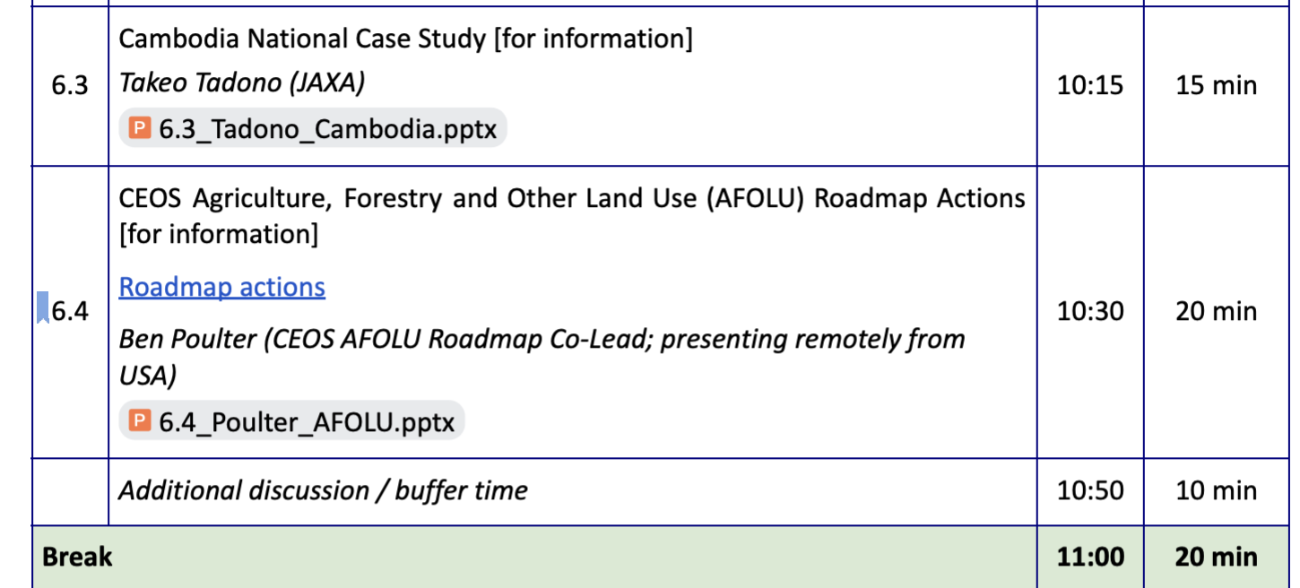
Our session today

