Slide 1
CEOS SIT-40
WMO Activities and Perspectives on the UN’s Early Warnings for All (EW4All) Initiative
Natalia Donoho, WMO
Agenda Item #5.3
SIT-40
Fukuoka, Japan
8-10 April, 2025

Slide 2

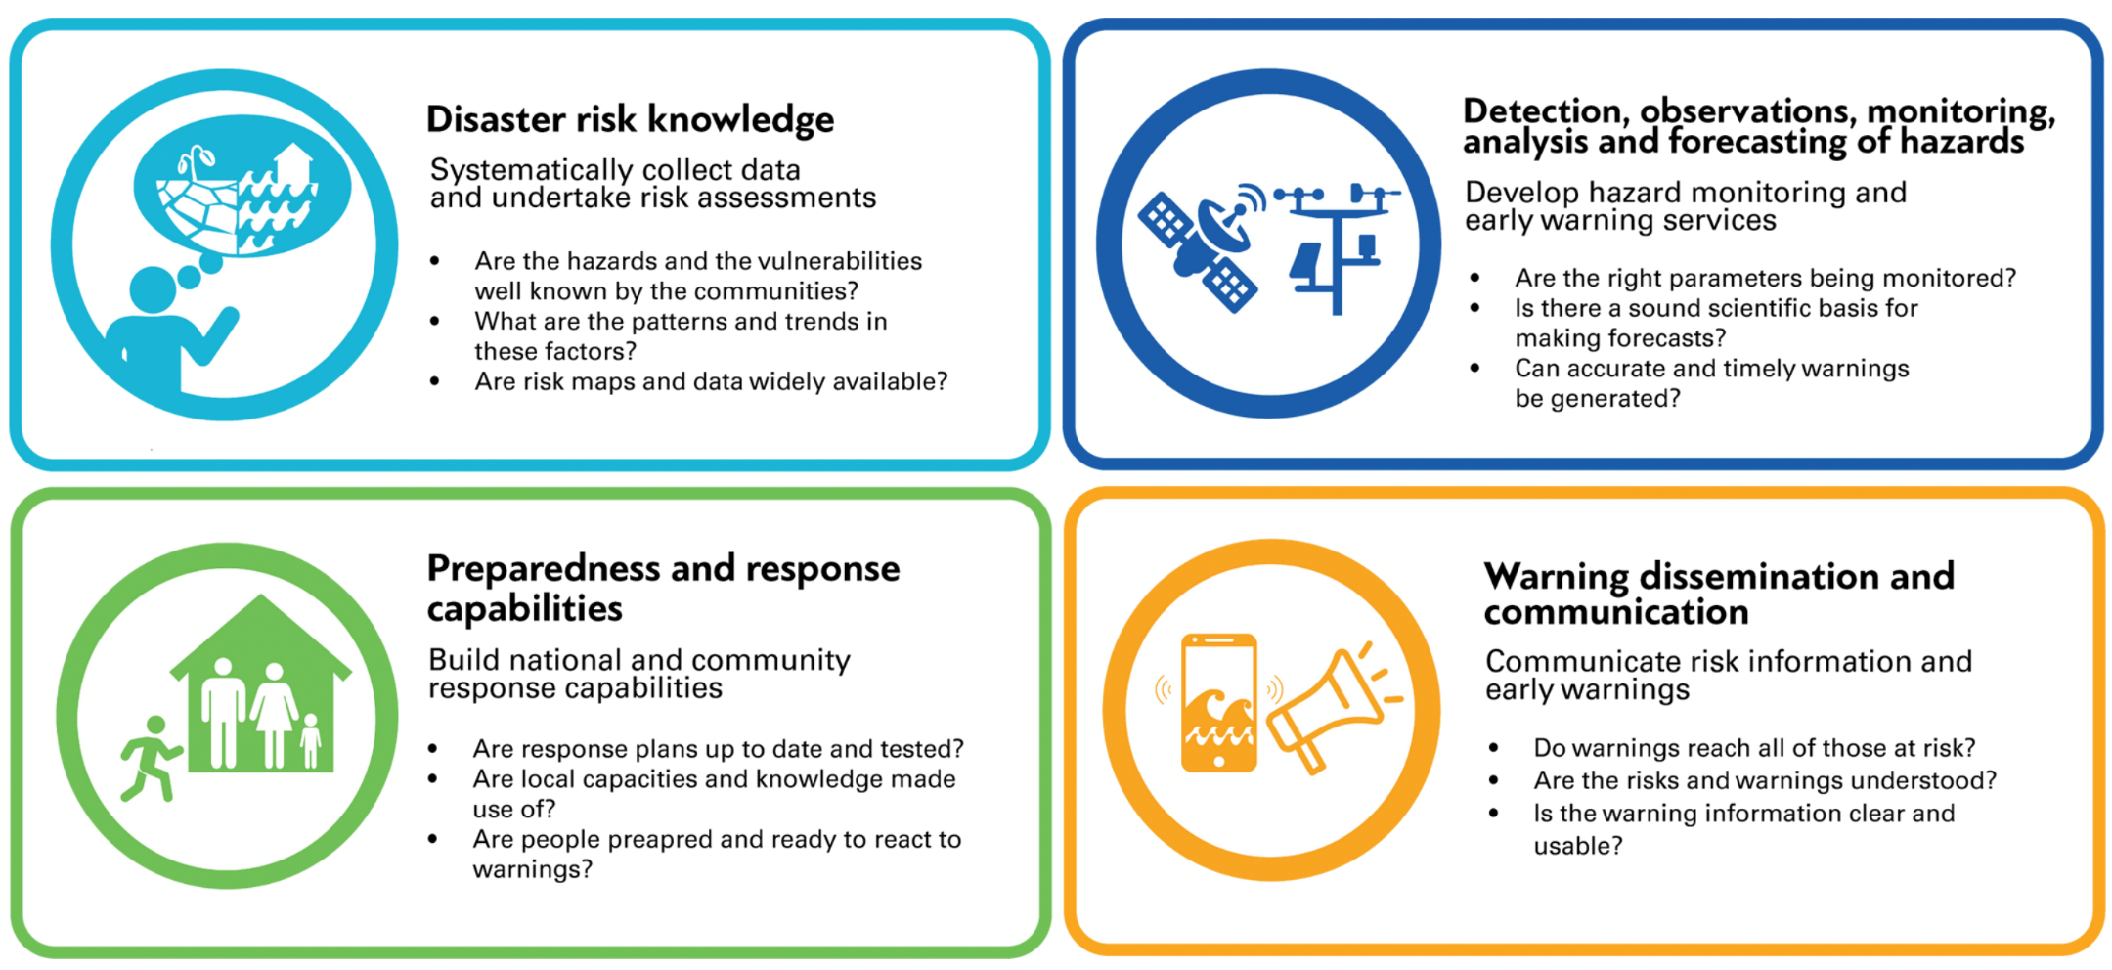
Refresher: EW4All MHEWS ‘4 Pillars’
Notes:
Refresher WMO EW4All Roadmap

Slide 3
Refresher: WMO EW4All Scope
(a) Non-hazard specific/cross- cutting | (c) Extended range i. Drought/dry spells
(b) Hydrological i. Flash floods ii. Riverine floods | (d) Cross-domain i. Coastal inundation/storm surge ii. Cryosphere-related hazards iii. Emerging and additional environmental hazards (e.g. wildfire, sand and dust, tsunamis, landslides and volcanic activity).
(b) Meteorological/synoptic i. Tropical cyclones and extra-tropical storms ii. Heatwaves iii. Cold waves iv. Thunderstorms/squall lines

Slide 4
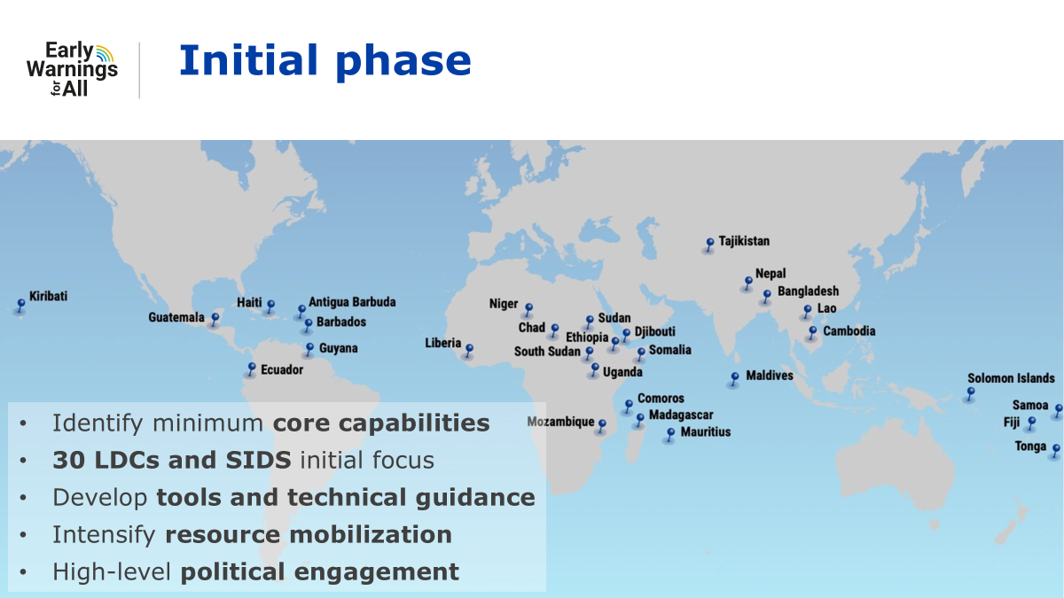

Slide 5
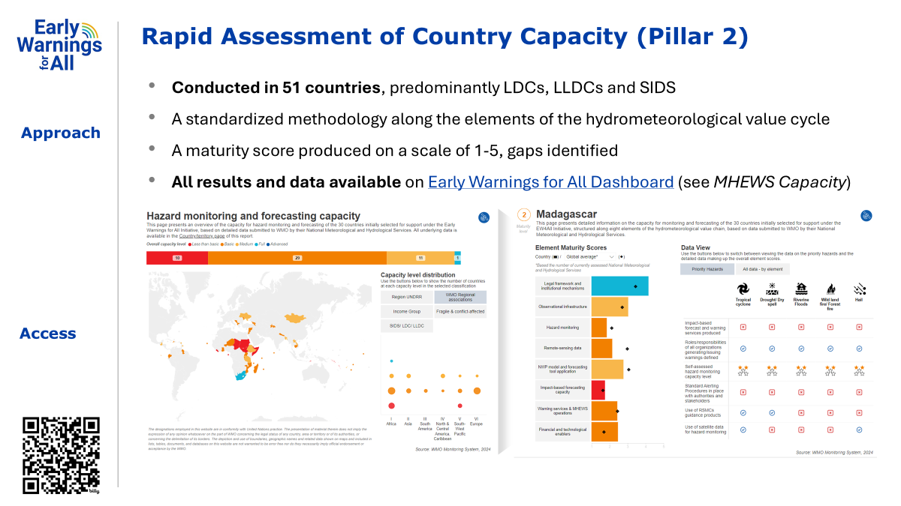

Slide 6
Non-hazard specific: International exchange of data– WMO Information System (WIS2)
Recent progress
WIS 2.0 implementation is on track to deliver a reliable real-time data sharing framework to support EW4All
WIS 2.0 is operational since January 2025
Global Services are provided by 11 Countries around the world
50+ WIS2 nodes are sharing real-time data
WIS2 training has been delivered to 90 countries in the last 2 years
Upcoming
WIS2 training to be delivered to 70 countries in 2025
At least 30 more countries with WIS2 nodes operational
CAP alerts shared by countries through their WIS2 nodes

Slide 7
Non-hazard specific: International exchange of data – WIPPS
Recent progress
Mandatory/recommended products from WIPPS-DCs for global NWP and limited-area NWP have been significantly upgraded including a new set of tropical low/cyclone vortex variables.
New WIPPS activity for Global Climate Reanalysis was established, and two Centres and one Lead Centre were designated.
Demonstrate the WIPPS RRR, Initiate the pilot for Global Riverine Flood Prediction
Upcoming
Support WMCs to implement new mandatory/recommended products and enhance graphical products
Designate more Centres for limited-area NWP, nowcasting and hydrological prediction
Improve the access to impact-related indexes, especially for Heatwave and Drought
Enhance the capacity development activities to promote the use of WIPPS products
Notes:
WIPPS constantly increasing available forecast products

Slide 8
Draft Work Plan to address gaps in satellite data/ products in support of EW4ALL
No. | Deliverable | Delivered to (body, e.g. INFCOM-3) | Body responsible (Team, Secretariat, etc.) | Consultation with, support from (Secretariat, etc.) | Effort type (meetings, workshops, consultancy, secretariat) | Estimated timeline
1 | Preparation of the mapping exercise on the utilization of satellite data for priority hazards |  | Regional Associations (e.g. Regional Coordination Groups on Satellite Data Requirements) | Secretariat (Regional offices, Space Systems and Utilization Division), with the guidance from ET-SSU | Virtual meetings, email exchange, Secretariat work | July 2024
2 | Conduct the mapping exercise among Members |  | Regional Associations | Secretariat (Regional offices) | Dynamic mapping exercise | September 2024
3 | Identity the initial (regional) list of satellite products for each priority hazards based on: (1) results of mapping exercise above and (2) results of data call on EW4ALL provided by satellite providers |  | More experienced users in each region (particularly the leads of satellite data requirements groups and VLab members) | Secretariat (Regional offices, Space Systems and Utilization Division), with the guidance from ET-SSU | Virtual meetings, email exchange, Secretariat work | November 2024
4 | Validate the list of products with satellite providers to include any additional products that users may not be aware of, as well as with Members in each region | INFCOM MG & Regional Associations MG via Regional Coordination Groups on Satellite Data Requirements | Satellite providers and WMO Members | Secretariat (Regional offices, Space Systems and Utilization Division), with the guidance from ET-SSU |  | December 2024 – February 2025
5 | Gap analyses in terms of access to satellite data, training on processing, visualization, and use of satellite data and products | INFCOM MG & Regional Associations MG via Regional Coordination Groups on Satellite Data Requirements | Regional Coordination Groups on Satellite Data Requirements, with support from ET-SSU | Secretariat (Regional offices, Space Systems and Utilization Division), with the guidance from ET-SSU | Virtual meetings, email exchange, Secretariat work | April 2025
6 | Develop regional implementation plan(s) to address the gaps identified in the gap analyses for inclusion in the regional operating plans | Regional Associations | Regional Associations | Secretariat (Regional offices, Space Systems and Utilization Division), with the guidance from ET-SSU | Virtual meetings, email exchange, Secretariat work | TBD by Regional associations
Notes:
The ultimate goal is to provide a critical resource to inform the satellite component of a funded proposal aimed at enhancing nation-based hazard warning systems.
To consider exploring a few countries in each region to understand the entire value chain involved in issuing warnings. This approach is essential because gaps may not only be associated with satellite-related issues but also with other factors such as connectivity, visualization, training, etc.

Slide 9
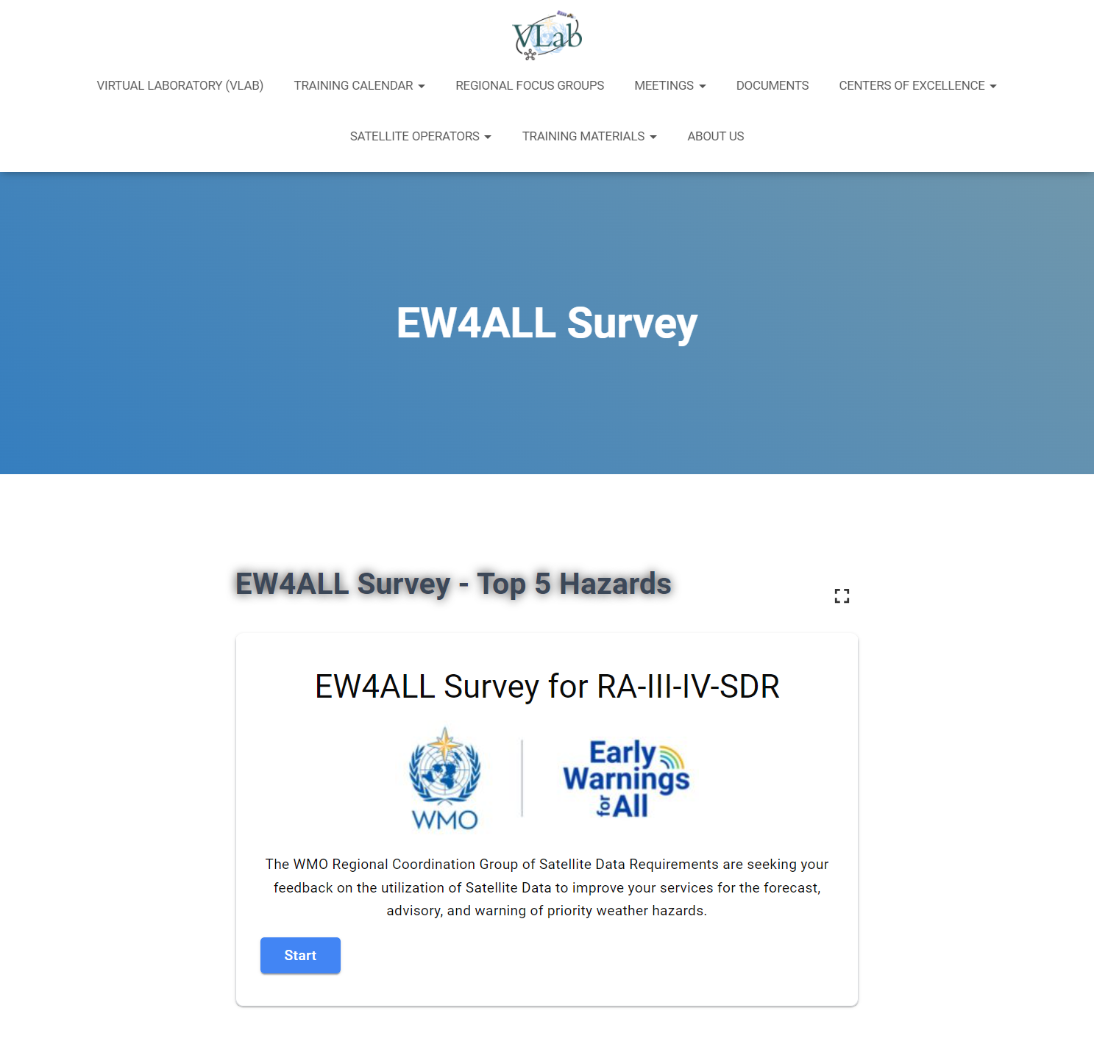
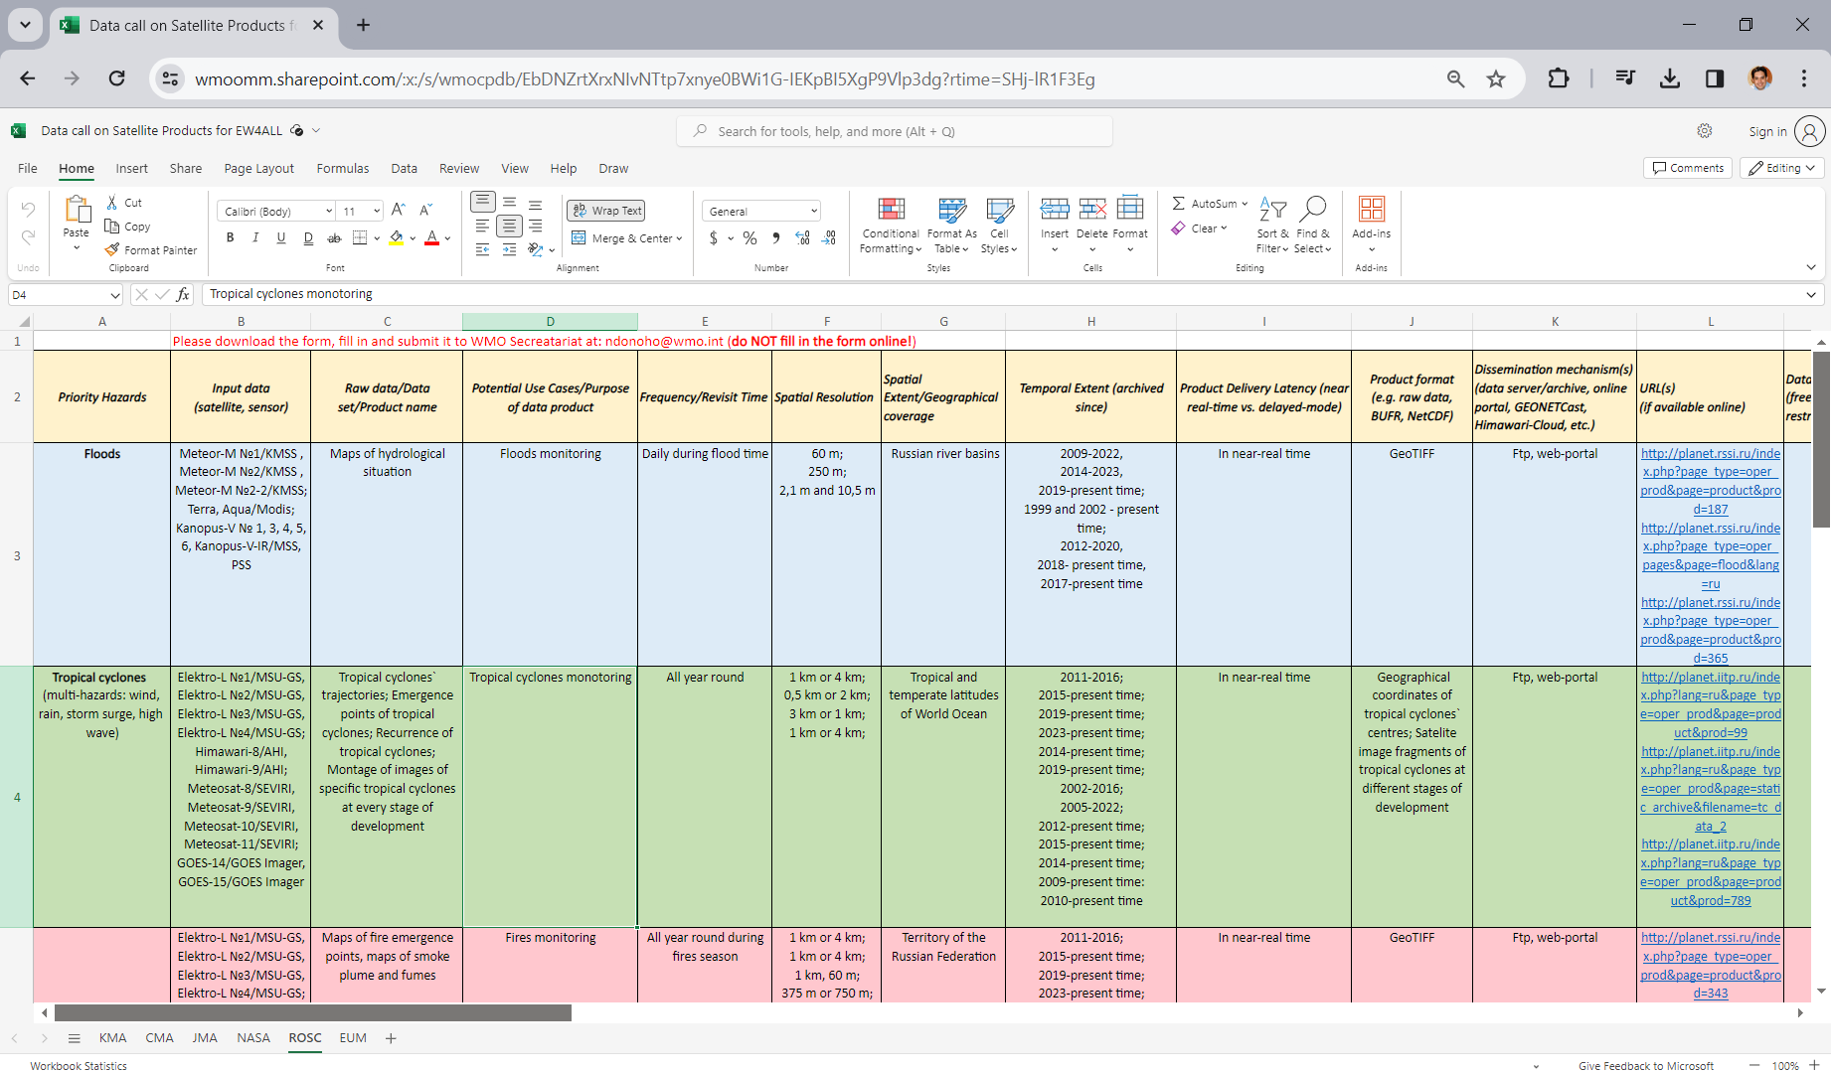



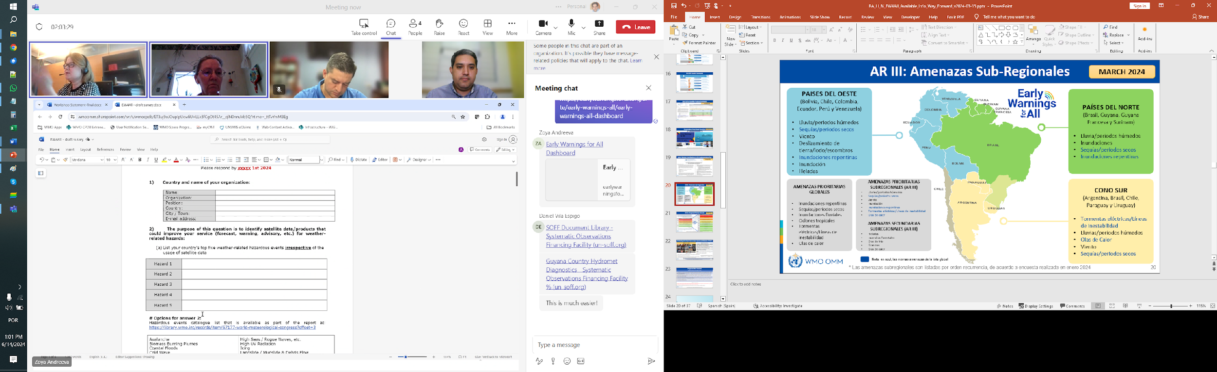

Activities in Support of EW4All: Gap Analysis
Expected from Members
Expected from Data Providers
Expected from Regional Experts
ANSWER THE SURVEY
(ONE COMBINED REPONSE PER INSTITUTION)
FILL IN THE TEMPLATE SPREADSHEET FROM THE DATA CALL ON EW4ALL
IDENTIFY THE INITIAL REGIONAL LIST OF PRODUCTS FOR EACH HAZARD
VALIDATE THE LIST OF PRODUCTS IDENTIFIED
GAP ANALYSES IN TERMS OF ACCESS AND USE OF SATELLITE DATA/PRODUCTS AND ASSOCIATED TRAINING NEEDS
After the steps above:
Efforts are currently underway to conduct a gap analysis regarding access to and use of satellite data for hazard monitoring. A Regional Implementation Plan will be developed to address the identified gaps.
 | ‹#›

Slide 10


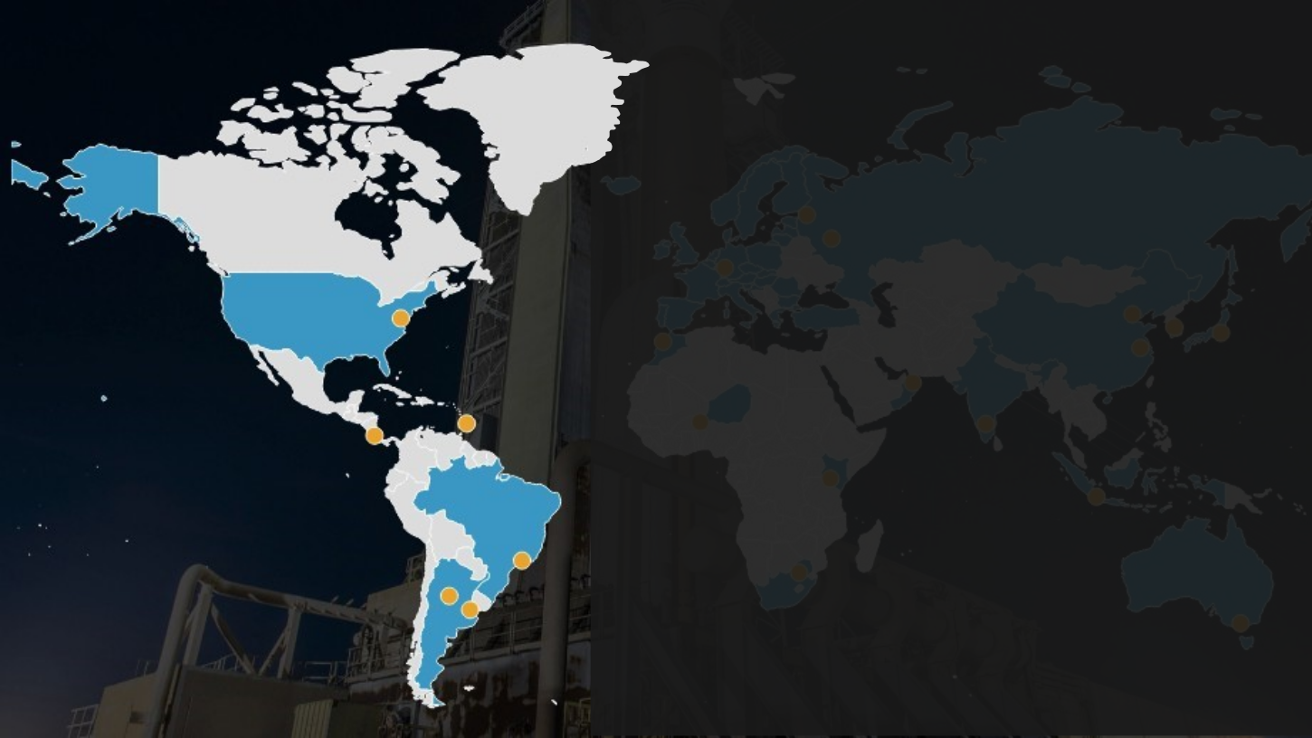








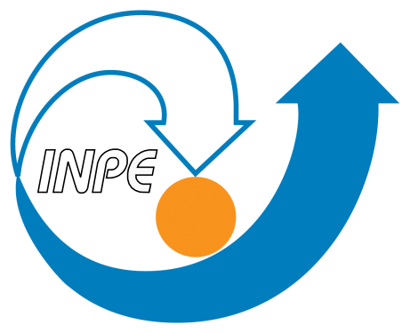

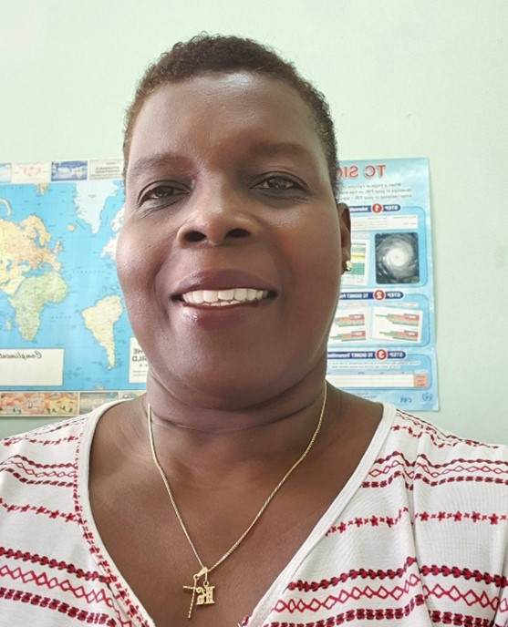


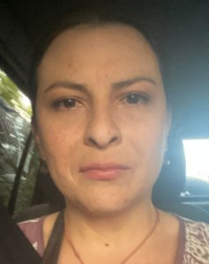


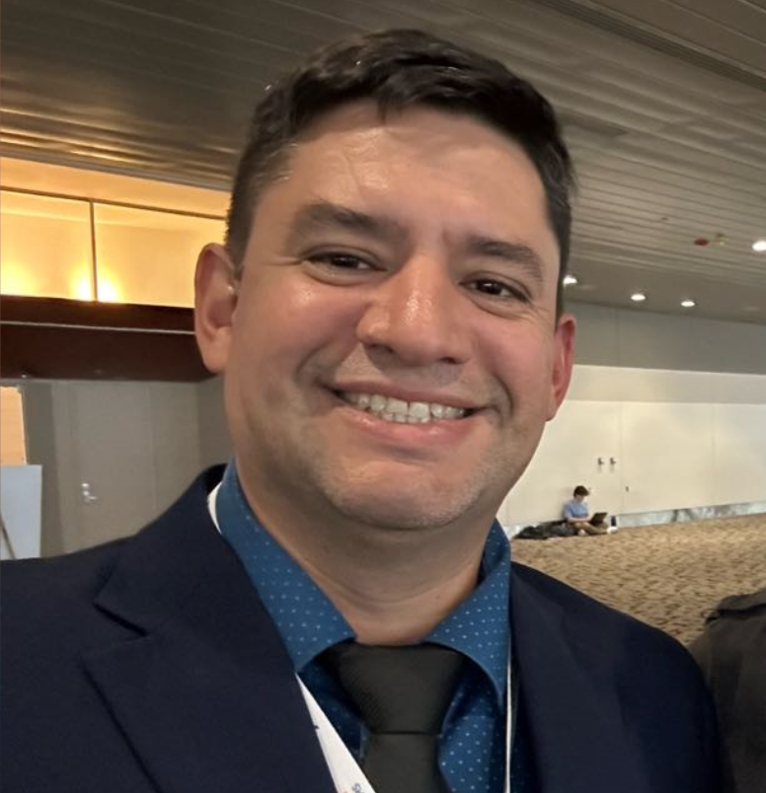



VLab in Support of EW4All: Participants
Development of Training Resources by VLab Centers of Excellence in RA-III and RA-IV in Support of EW4All
PARTICIPANTS OF THE PILOT PROJECT
VLab Centers of Excellence (CoEs)
NOAA
Barbados
Costa Rica
VLab Focal Points
Kathy-Ann Ceasar
Romina Mezher
Inés Leyba
Gabriela Mora
Diego Souza
(Regional Coordinator)
Brazil
Project Contributors
Argentina
Hugh Atherley
Juan Ignacio
Juan Ruiz
Daniel Poleo
Regina Ito
Bernie Connel
(VLab Co-Chair)
Marcial Garbanzo
(VLab TSO)
Zoya Andreeva
(WMO SSU/I)
Maite Cancelada
Wayne McGeary
Luciano Vidal
Paola Salio

Slide 11
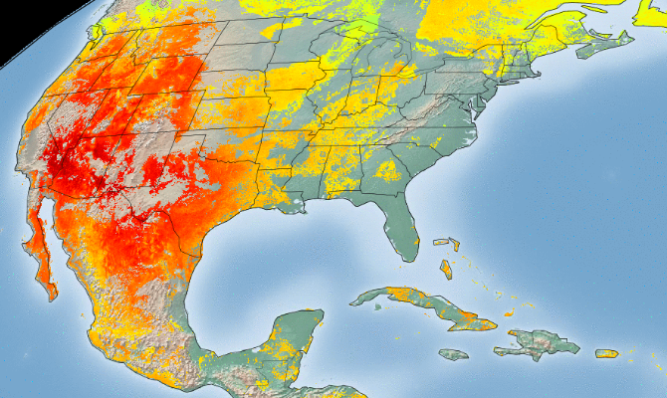
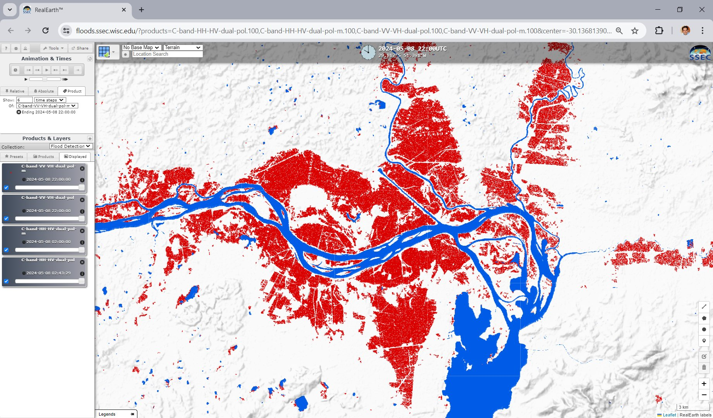
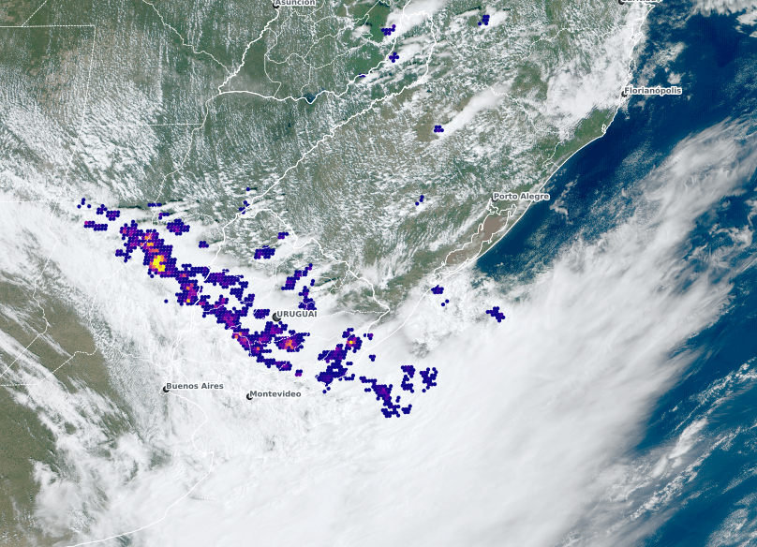
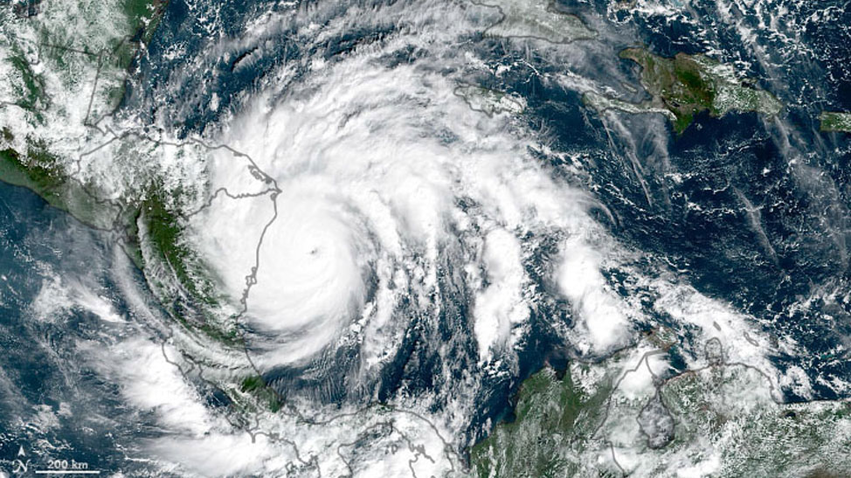
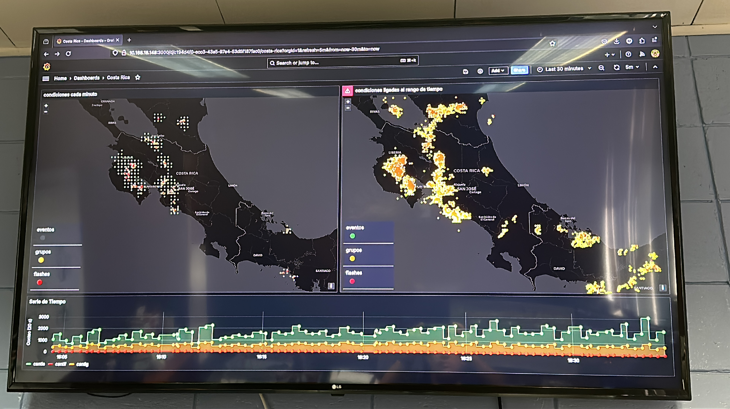

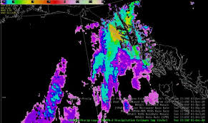
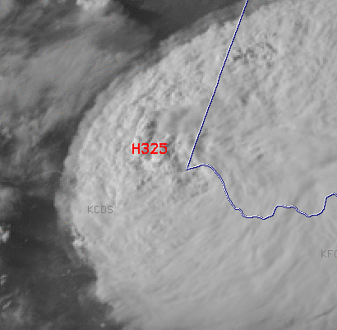
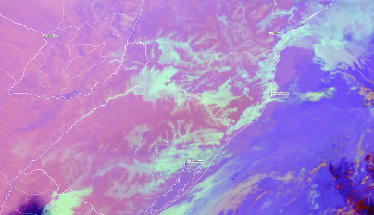
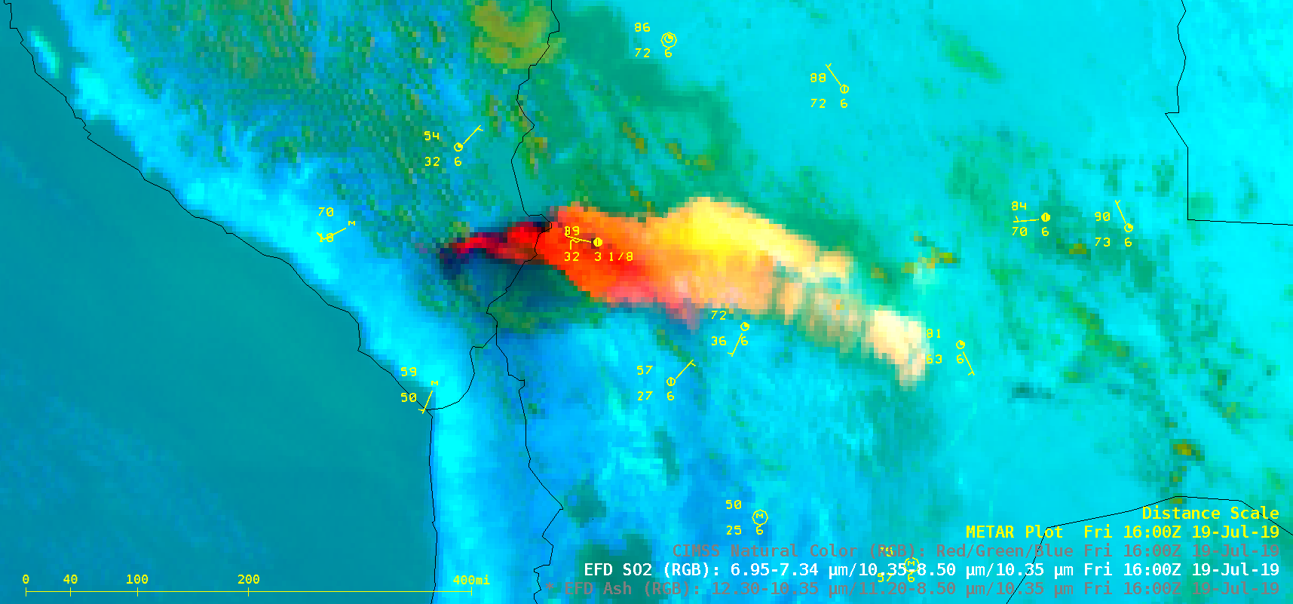
VLab in Support of EW4All: Hazard Contributions
Heatwaves
Floods
Thunderstorms
/ Squall Lines
Tropical Cyclones
Lightning
Rain / Wet Spell
Hail
Fog
Volcanic Ash

Slide 12
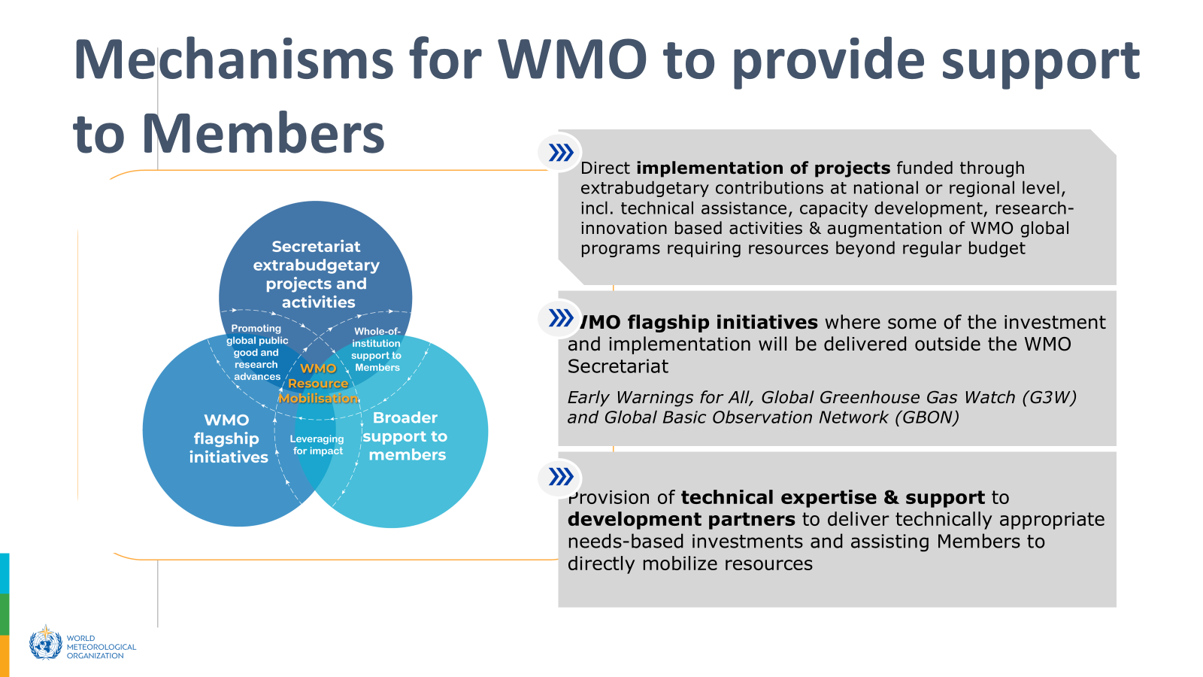
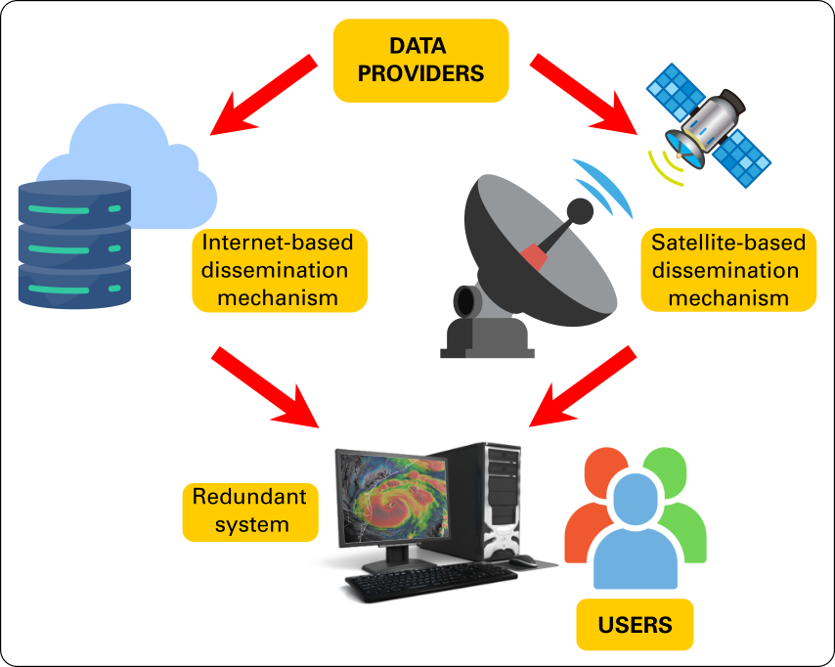
ASW Strengthening Early Warning Systems
Improving Data Access with Redundant Systems
Pilot Project: Strengthening Early Warning Systems in pilot countries in the Caribbean & Latin American through improving Satellite Data utilization
Guyana, Suriname, Jamaica, and Belize
Overall Objective
To enhance the capacity of targeted countries in the Caribbean and Latin America for effective satellite data utilization, thereby strengthening their EWS.
Outcome
Strengthened EWS through improved technical capacity and infrastructure. This initiative will empower Members to leverage satellite data for precise hazard monitoring and forecasting, enabling the delivery of timely, actionable information that supports preparedness, risk reduction, and response efforts. The project thus focuses on strengthening the capacities of NMHSs and hence strongly impacts their ability to produce early warning services for their respective populations, especially those most at risk.
Infrastructure challenges
Technical support
Comprehensive training
Written by:
Ing. Diego Souza, FP- Satellite Data Requirements for RA-III
Dr. Marcial Garbanzo, FP - Satellite Data Requirements for RA-IV
A new pilot project is under discussion to enhance data access in the Region by implementing redundant systems (satellite-based and internet-based), particularly for priority countries.
 | ‹#›

Slide 13

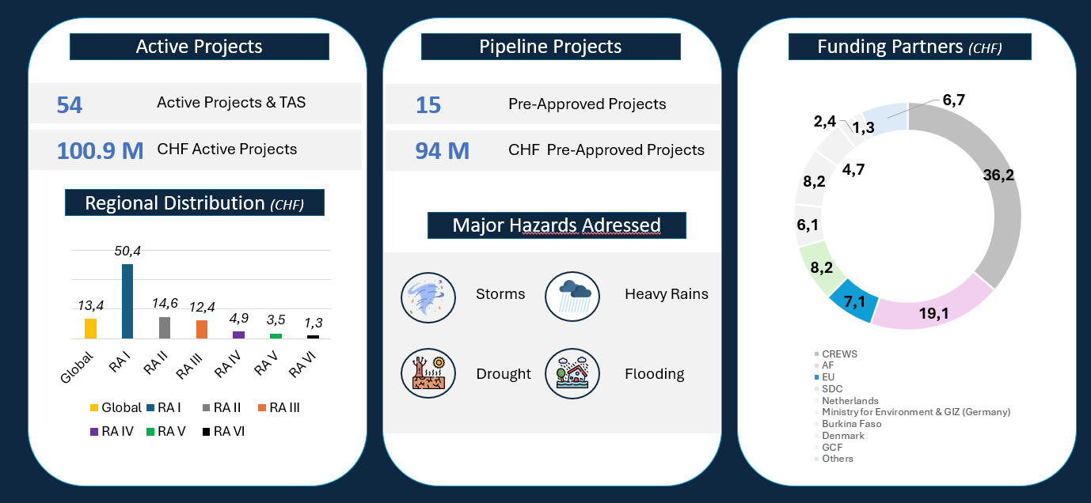
WMO Project contribution to EW4All

