Slide 1
CEOS Carbon Roadmap Coordination
Osamu Ochiai
JAXA SIT Chair Team
Agenda Item 4.7
SIT-40 2025, Fukuoka, Japan
8th - 9th April 2025

Slide 2
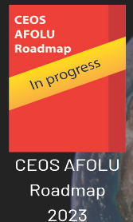
Support Carbon monitoring in all domains
CEOS Global Stocktake Strategy Paper and Global Stocktake Portal
CEOS Aquatic Carbon Roadmap
Under development!
Demonstrate the value of Earth Observation satellite datasets to support the Global Stocktake process
Summary of CEOS thematic observing strategies:
https://ceos.org/observations/
<< www.ceos.org/gst
Notes:
CEOS has been formalising its strategies for various aspects of carbon and climate in all three domains:
In 2020: Greenhouse Gas Roadmap has been agreed.
In 2021: Strategy to Support the Global Stocktake.
In 2023: Agriculture, Forestry and Other Land Use (AFOLU) Roadmap in 2023.
In 2024: Aquatic Carbon Roadmap is under development. Also an AFOLU Roadmap actions supplement.
WMO regularly engages with the implementation of the CEOS Greenhouse Gas Roadmap, through the CEOS-CGMS Working Group on Climate Greenhouse Gas Task Team. This is a key area for CEOS and WMO collaboration.

Slide 3
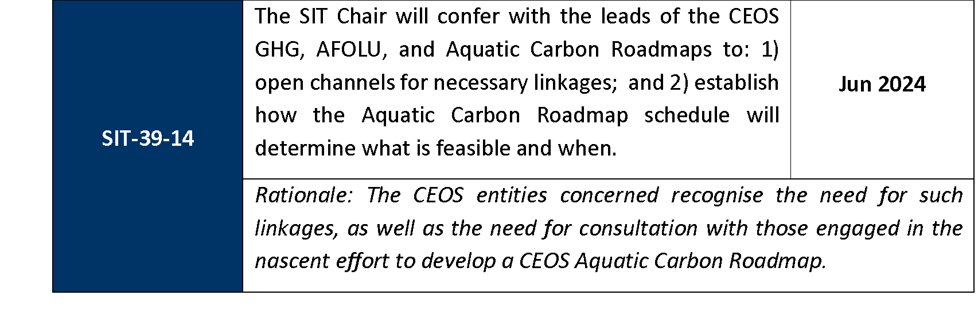
SIT-39 decision and action
GHG Roadmap being updated in 2024 - reflecting context changes like G3W and IMEO
AFOLU Roadmap actions being finalised - seeking SIT-40 endorsement
Aquatic Carbon Roadmap started, aiming for Q4 2025 finalisation

Slide 4
SIT Term Overview
2024
2025
SIT-39
SIT-TW
Plenary
Canada
SIT-40
SIT-TW
Plenary
UK
COP-30
GST STRATEGY
GST 1 LESSONS LEARNED
GST STRATEGY UPDATE
Draft
Draft & CEOS WP actions
CARBON ROADMAPS
GHG ROADMAP UPDATE
Draft
AFOLU ROADMAP ACTIONS
SIT CHAIR TO ENSURE LINKAGES NEEDED
AQUATIC CARBON ROADMAP DEVELOPMENT
IMEO & G3W
INTERFACES
PROGRESS IMEO & G3W TOPICS/challenges
GHG Best Practices
CEOS GHG BEST PRACTICES
UKSA COP-30 actions
Draft
Final
GCOS IP
CEOS RESPONSE
Mid-2025 for CEOS & CGMS
ECV INVENTORY
VERSION 5
VERSION 6
STRATEGIC TOPICS
NEW PATHWAYS/TARGETS
NEW CEOS WP ACTIONS RE GST2
IPCC TSU engagement
INTEGRATED PLANNING FOR COP & SBSTA
NATIONAL ENGAGEMENT

Slide 5
Progress to date
Multiple coordination calls in 2024 and 2025 (most recent 27 Feb) featuring the leads for the 3 CEOS Roadmaps
Side meeting yesterday agreed to continue call series from May and progress discussion on roadmap interactions and actions
Connecting the teams and sharing updates on progress
Mainly supporting the ACR team in defining the structure of their Roadmap and how it must consider linkages to the GHG and AFOLU domains

Slide 6
Issues arising… for discussion
From last year…
Need more integration with the inverse modelling community
WMO G3W is a potential gateway to the policy world - there is an opportunity for us to guide G3W. Need to be aligned internally to do so with exchanges between the roadmap teams
GOOS may be helpful for the ACR effort
GHG team considering linkages needed with others in update
Potentially useful linkages via the Global Carbon Project?
Could the 3 roadmaps together study what will be needed from them in future by the inversion modelling community as a strategic endeavour?
Could WGClimate consider this?

Slide 7
Issues arising… for discussion
From the last call (February 27th)
Importance of properly considering interfaces (fluxes from land to ocean, atmosphere - aquatic ecosystems exchange), including using models
need to identify the best products for inland waters and information on eutrophication
The Aquatic Roadmap should identify products for top-down and bottom-up reconciliation.
Is there a need for an inter-carbon activity within CEOS to look at product gaps?
On the methane side, the double counting problem is leading to big errors. There is a need for better definitions and datasets.
Each Roadmap has user engagement and capacity building-> to be coordinated
Aquatic carbon needs to be made visible at G3W

Slide 8
Way Forward
SIT Chair team will continue to support coordination among the 3 Roadmap lead teams
WGClimate may look at how to connect their CDR work to needs of the inversion modelling community
Ensure ACR contents reflect integration needs
Insight session on “Toward an Aquatic Carbon Roadmap as a key integrated contribution to the Global StockTake” at the upcoming Living Planet Symposium (Vienna, 23-27 June) as an unique opportunity to bring together contributors from the three CEOS roadmaps and discuss synergies and interconnections across the three efforts. Deadline for providing list of speakers: May 1st 2025

