Slide 1
Aquatic Carbon Roadmap
Marie-Helene Rio
ESRIN-ESA
Agenda Item #4.6
SIT-40
Fukuoka, Japan
8-10 April, 2025

Slide 2
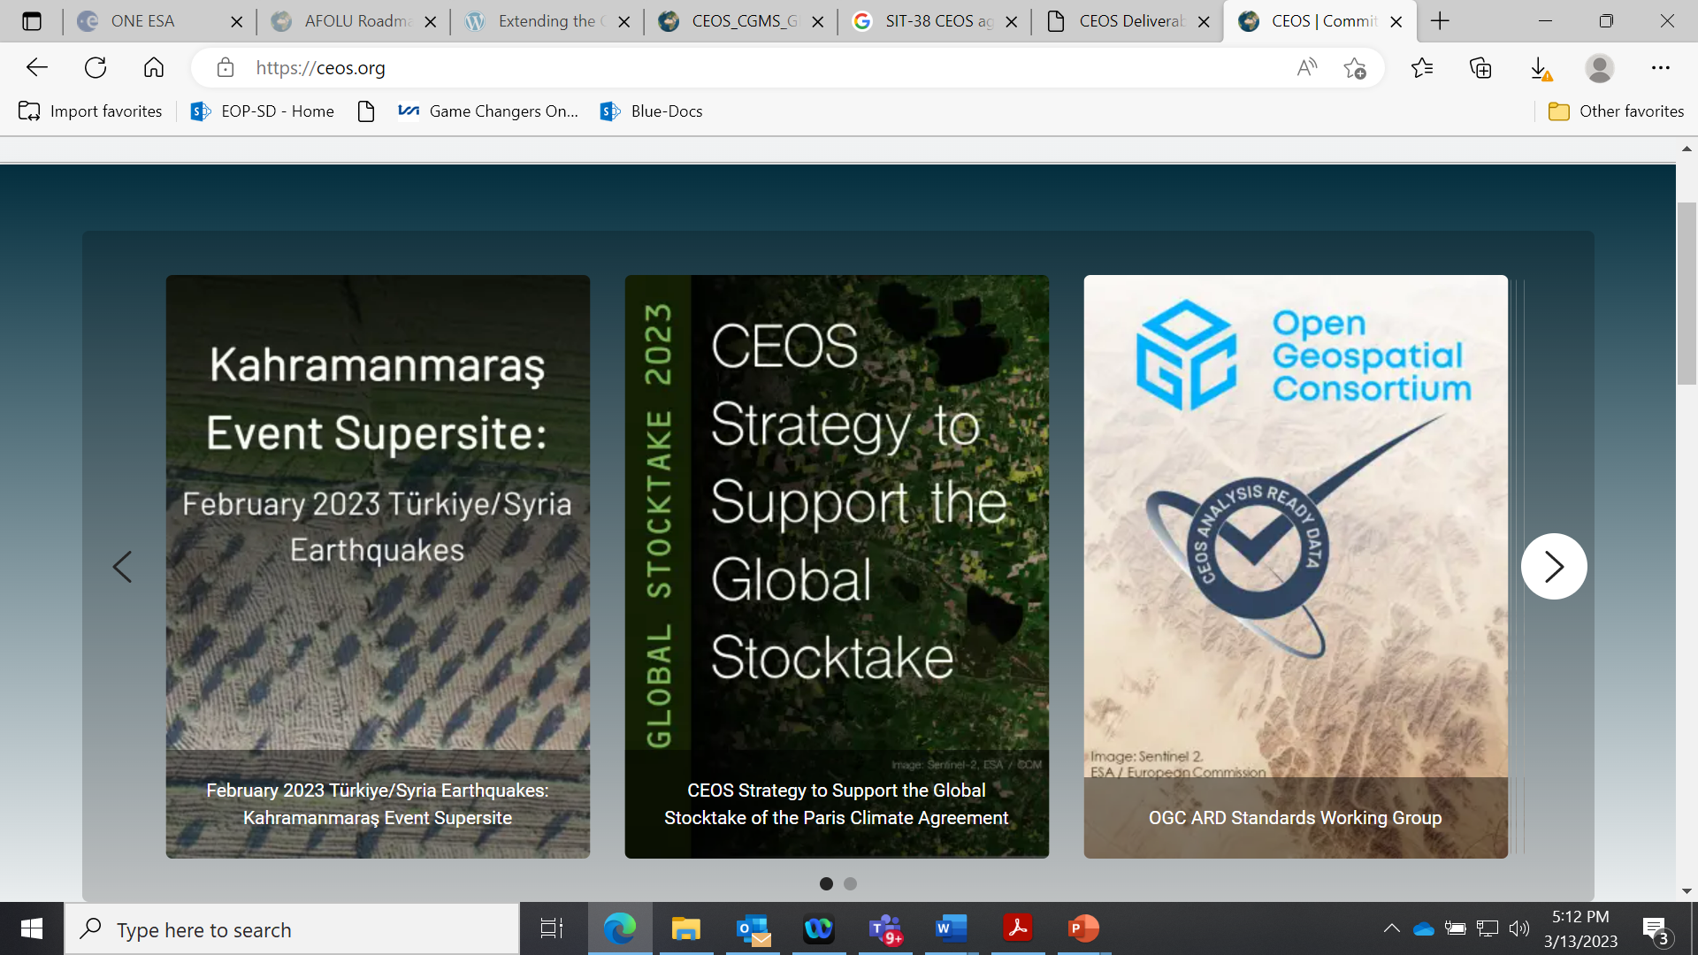
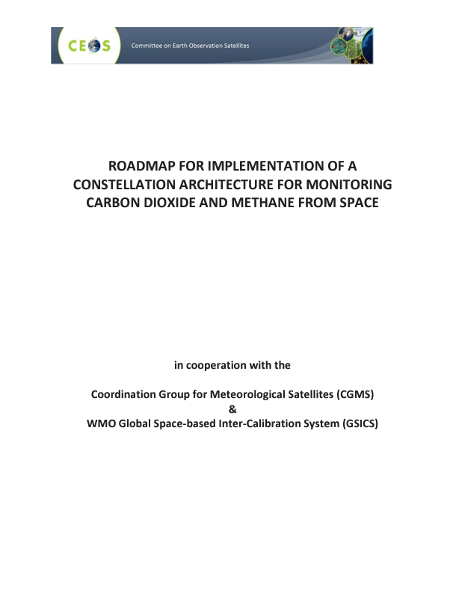
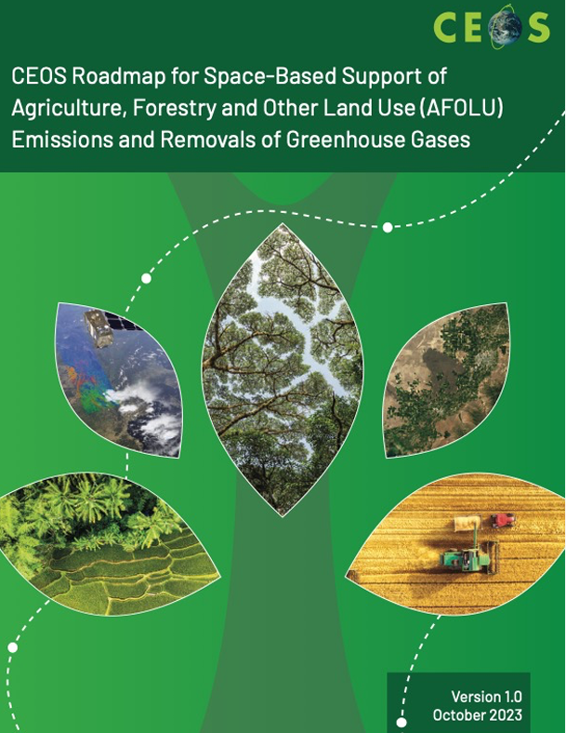
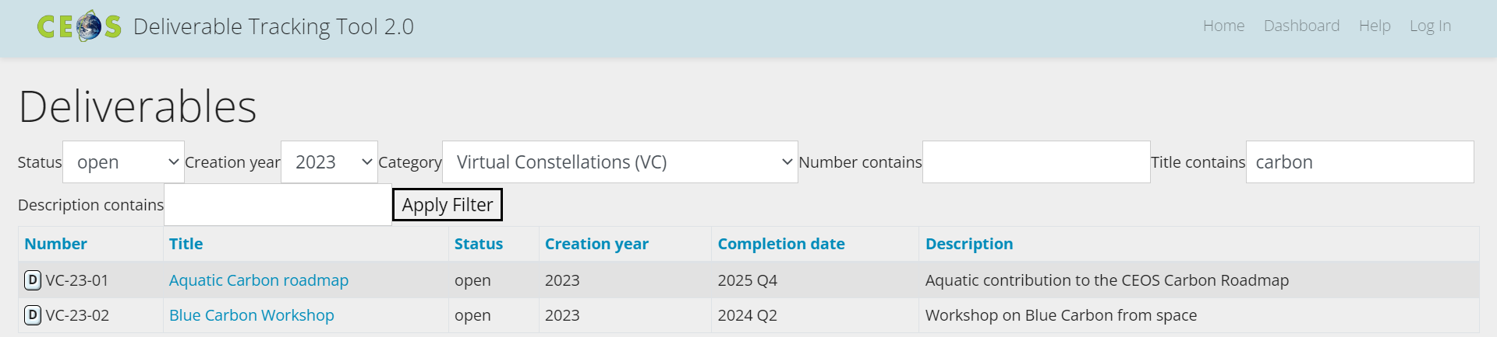
Context
CEOS
Aquatic Carbon Roadmap
Roadmap concept presented and endorsed at CEOS plenary in November 2023 as the “Aquatic leg” of the CEOS Carbon strategy, in complement to the GHG and AFOLU roadmaps. Deadline for completion: Q1 2026
Space Agency Coordinators: Marie-Helene Rio (ESA), Laura Lorenzoni (NASA), Hiroshi Murakami (JAXA). Scientific Leaders: Jamie Shutler (University of Exeter), Bob Brewin (University of Exeter), Cecile Rousseaux (GSFC-NASA), Kelsey Bisson (NASA)

Slide 3
TIMELINE
Jan
Feb
Mar
Apr
May
Jun
Jul
Aug
Sep
Oct
Nov
Dec
CEOS Meetings
SIT-40: April 8th-10th 2025
SIT Technical Workshop: September 9th-11th 2025
39th CEOS plenary: November 4th -6th , 2025
Other relevant events
Living Planet Symposium
23rd -27th June 2025
Ocean Carbon From Space Workshop (23-26 November 2025, virtual)
6th IOCS Dec 1st - 4th Darmstadt
Jan
Feb
Mar
Apr
May
Jun
Jul
Aug
Sep
Oct
Nov
Dec
Aquatic Carbon Roadmap Delivery
Aquatic Carbon Roadmap Deadlines
1st Draft, bullet points per section
2nd Draft
Consolidated draft
+Submission to a peer-reviewed journal

Slide 4
Authors
Coordinating Agencies
Marie-Helene Rio (ESA)
Laura Lorenzoni (NASA)
Hiroshi Murakami (JAXA)
Scientific leaders
Jamie Shutler (University of Exeter)
Bob Brewin (University of Exeter)
Cecile Rousseaux (GSFC-NASA)
Kelsey Bisson (NASA)
And 20 contributors from the CEOS OCR-VC / IOCCG space agencies and the scientific community (alphabetical order):
Lionel Arteaga (NASA GSFC, US), Benoit Beguet (I-Sea, France), Dustin Carroll (SJSU, US), Blake Clark (NASA, US), Helen Findlay (PML, UK), Joaquim Goes (Columbia University, US), Luke Gregor (Swiss Data Science Center, Switzerland), Meghan Halabisky (University of Washington, US), Kevin Kroeger (US Geological Survey, US), Tiit Kutser (Estoninan Marine Institute, Estonia), Peter Landschutzer (Flanders Marine Institute, Switzerland), Antonio Mannino (NASA, US), Ben Poulter (NASA GSFC, US), Dimitris Poursanidis (FORTH, Grece), Rosa Roman (JRC, EC), Raphael Savëlli (SJSU, US), Amelie Sechaud (I-Sea, France), Oscar Serrano (CSIC, Spain), Stefan Simis (PML, UK), Tom Worthington (University of Cambridge, UK)

Slide 5
Outline and list of contributors
1-Key message and executive summary
2-Introduction
3-Current satellite Earth observation capabilities
3.1 Open-ocean and shelf-seas, leader: Bob Brewin Contributors: Cecile Rousseaux, Kelsey Bisson, Jamie Shutler, Lionel Arteaga (NASA GSFC), Joaquim Goes
3.2 Near-coast, leader:? Contributors: Blake Clark (NASA), Tiit Kutser
3.3 Coastal blue carbon, leader: Dimitris Poursanidis, Contributors: Kevin Kroeger, Amelie Sechaud, Benoit Beguet, Tom Worthington, Tiit Kutser, Oscar Serrano.
3.4 Inland bodies of water, leader: Antonio Mannino, Contributors: Stefan Simis, Meghan Halabisky (inland wetlands/ contributor), Tiit Kutser
3.5 Land to ocean flows, leader: Blake Clark (NASA), Contributors: Dustin Carroll, Raphael Savëlli , Joaquim Goes, Antonio Mannino

Slide 6
Outline and list of contributors
4.0 Critical challenges, gaps and opportunities
4.1 Open-ocean and shelf-seas, Leader: Cecile Rousseaux and Kelsey Bisson Contributors: Bob Brewin, Jamie Shutler, Gemma Kulk, Lionel Arteaga (NASA GSFC), Joaquim Goes, Dustin Carroll
4.2 Near-coast, leader:? Contributors: Blake Clark (NASA), Tiit Kutser
4.3 Coastal blue carbon, leader: Kevin Kroeger (USGS), contributors: Benoit Beguet, Amelie Séchaud, Tom Worthington, Dimitris Poursanidis. Joaquim Goes, Oscar Serrano, Tiit Kutser
4.4 Inland bodies of water, leader: (Dalin Jany or Hongtao Duan or Meghan Halaby’s)? , contributors: Antonio Mannino, Tiit Kutser, Stefan Simis
4.5 Land to ocean flows, leader: Dustin Carroll (SJSU/JPL), contributors: Blake Clark (NASA), Raphael Savëlli (SJSU), Ben Poulter (NASA GSFC)

Slide 7
Outline and list of contributors
5.0 Demonstrating the power of sustained and improved aquatic carbon assessments
5.1 Supporting the global carbon stocktake, Leader:Rosa Roman, Contributors: Blake Clark (NASA), Rosa Roman
5.2 Supporting global carbon assessments of the IPCC and GCB, leader: Peter Landschutzer, contributor: Lionel Arteaga (NASA GSFC), Rosa Roman, Ben Poulter (NASA GSFC)
5.3 Case study 1 – demonstrating ocean health communication for policy makers, Jamie Shutler, Luke Gregor, Helen Findlay
5.4 Case study 2 – demonstrating ocean constraint within global carbon assessments, leader: Nicolas Mayot ?
5.5 Case study 3 – demonstrating National Determined Contribution assessments, leader: Rosa Roman, contributors: Oscar Serrano
6.0 Complementarities and linkages to the GHG and AFOLU roadmaps
Leader: Rosa Roman, contributors: ?, Ben Poulter (NASA GSFC)
7.0 Expanding visibility, utilisation and capacity development building, leader: ? Contributors: Gemma Kulk, Joaquim Goes
8.0 Forward look
Appendix 1 Table of Recommendations

Slide 8
Example of content
3-Current satellite Earth observation capabilities
3.5 Land to ocean flows, leader: Blake Clark (NASA), Contributors: Dustin Carroll, Raphael Savëlli , Joaquim Goes, Antonio Mannino
Cross platform integration and standardization of products for estimating carbon and sediment concentration from higher order rivers (100 m width) to the ocean
        Utilize full suite of optical satellites (Sentinel 2, Sentinel 3, PACE, Landsat, SBG, EarthCARE, etc)
Integration of optical satellites with satellite observations for river flow (SWOT) and models (hydrologic models) to achieve realistic fluxes of carbon and sediment to the ocean (with uncertainties) – and potentially water-atmosphere CO2 fluxes at the river catchment scale using optical proxies
can ultimately lead to a carbon budget that integrates at the watershed scale, improving country, regional, and global carbon stock take
Continued investment in algorithm development stratified by biome/latitude with in-situ measurements of paired water samples and radiometry. Currently very limited in coastal waters and delta systems, especially large rivers that are remote and polar systems that are covered in ice when much flow is occurring
Moving from bulk carbon concentration to carbon composition, source, and reactivity with hyperspectral capability and associated in-situ measurements
Active data assimilation into modeling efforts to quantify and monitor evolution of major events over time (Clark and Schollaert Uz 2024)
Use of sub-orbital platforms to improve coverage and estimate of fluxes especially during impactful, transient events such as tropical storms (Paerl et al. 2020)

Slide 9

Upcoming events
Ocean Carbon dedicated sessions:
A.08.09 Marine and Coastal Ocean Carbon
Insight session:
Toward an Aquatic Carbon Roadmap as a key integrated contribution to the Global Stocktake
This insight session will spotlight the developing Aquatic Carbon Roadmap and bring together contributors from the other CEOS roadmaps to highlight synergies and interconnections across the three efforts towards an enhanced understanding of the Earth as a System within the framework of the global stocktake. It will offer an opportunity to meet, exchange ideas, put the roadmaps in context of other efforts, and advance the efforts of the Aquatic Carbon Roadmap.
CEOS Action: Support the organisation and communication of this Insight session
Aquatic Carbon Roadmap preparation meeting

Slide 10
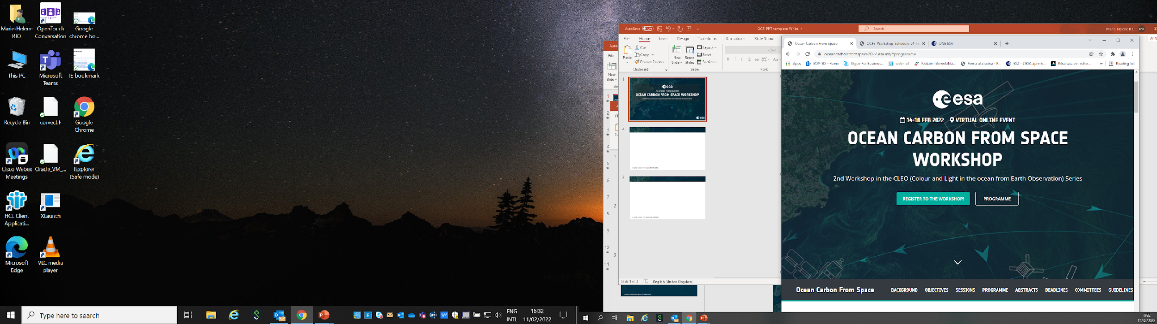

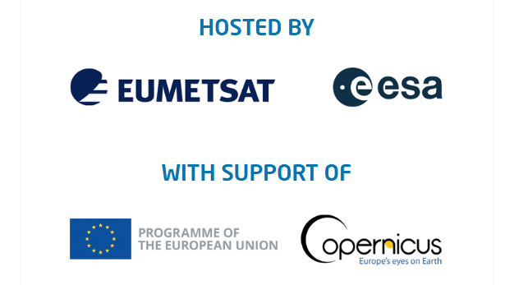
Upcoming events
https://oceancarbonfromspace2022.esa.int/
Preparing for Ocean Carbon From Space 2025 workshop: 24th-27th November 2025 - virtual
+ plenary session AND Breakout session at the International Ocean Colour Symposium (Darmstadt, December 1st – 4th 2025)
Aquatic Carbon Roadmap preparation meeting

Slide 11
Cross-Roadmap coordination
Recognizing the synergies across roadmaps, CEOS has been supporting coordinate activities across the GHG, AFOLU, and Aquatic Carbon Roadmaps.
The GHG Roadmap has included in its new version a section with examples for implementing this coordination. Ideas to explore beyond use case scenarios in that roadmap include having partner/stakeholder-defined use case scenarios.
Roadmaps interface at the fluxes/stocks: Top down/bottom-up approaches. These are also the gaps that exist across roadmaps.
  There is space to work with efforts such as RECCAP and GCP, which are partners in these activities.
  We are also exploring relevant projects across CEOS members that are already building towards these interfaces.
Coordination with the modeling community remain important; we are exploring how to interact/engage
We are working to
  Identify common activities across roadmaps
  Identify areas that are primed for action
  As the Aquatic C Roadmap continues to be developed, some of these areas may further crystallize
Regular cadence of meeting will continue, and the Roadmaps will meet in Vienna at LPS Insight Session with the goal of distilling actions to be presented at the CEOS meeting in September 2025.
Carbon Roadmap coordination

Slide 12
Presenter Guidelines
Presenters should name their file using the following convention:
  AgendaItemNumber_LastName_Subject (e.g., 1.1_Maejima_Welcome)
Documents and presentations should be uploaded to the shared folder to allow for streamlined self service
  Shared Presentation Folder (default view only, ask for upload/edit permission as required)
  For support contact the SIT Chair Team: jaxa-sit-chair-2024-25@googlegroups.com
  Documents for decision should be submitted by 25 March
  Presentations and documents for information should be submitted by 1 April
Reporting to engage discussion or decision is encouraged, but detailed reporting should be provided as pre-meeting reading material or in background slides.
Please explicitly highlight the decisions, outcomes, or actions you are seeking. The more explicit you are, the better. i.e., feel free to provide text for a proposed action – it may be revised later, but this approach will help with the efficient preparation of the actions record of the SIT meeting.

