Slide 1
CEOS SIT-40
UNFCCC / COP / EID engagement
Mark Dowell (EC)
and Vincent-Henri
Peuch (ECMWF)
Agenda Item # 4.2
SIT-40
Fukuoka, Japan
8-10 April, 2025

Slide 2
Context & Issues
Lessons learned from GST 1
Evolving international stakeholders
Streamlining of dialogue with UNFCCC (Secretariat & Parties)
More effective preparations and briefings for COPs
Earth Information days are key: longer-term strategy, process and content

Slide 3
Establish a Dedicated “Tiger Team” for Coordination
This team, led by WGClimate leadership and supported by members of the CEOS Chair and CEOS SIT Chair teams , would focus on aligning objectives across space agencies, national delegations, and other relevant stakeholders.
Mandates of this team would include ensuring consistent preparation for EID, enhancing coordination at key events, and transforming EID into a compelling platform for showcasing the transformative potential of space-based data.
This team should develop a comprehensive multi-year engagement strategy aligned with the phases of the GST process. A central component of this strategy is the proactive preparation for party submissions.
The multi-year plan should clearly define key objectives for each COP and EID, ensuring that CEOS and CGMS efforts are strategic and aligned with broader climate goals.

Slide 4
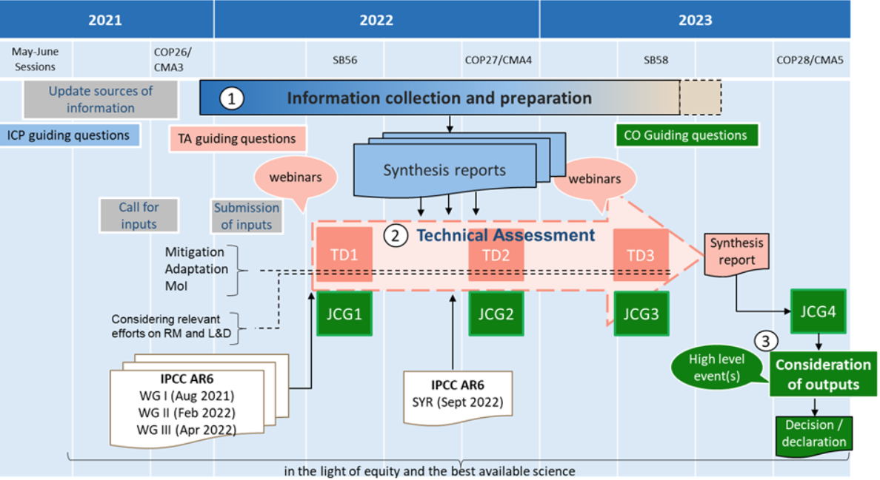
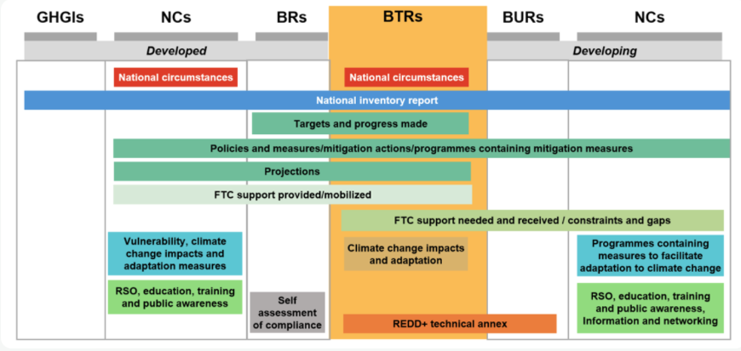
More than just GST
Biannual Transparency reports

Slide 5
Opportunities in the GST-1 follow up and GST-2
How space-based data can support GST-2:
Providing a comprehensive, up-to date data source to inform:
Tracking of GHG emissions (consideration of temporal and spatial monitoring)
Present observed climate impacts (including loss and damage, land-use change)
Determine the effectiveness of climate action- utilizing existing baselines
Courtesy to Maseko-Msyale

Slide 6
Opportunities cont’d
Positioned to support global transparency
Facilitate anticipatory action
Enablers
Understanding of data requirements
Effective coordination
Thematic alignment
2025
Discussions on modalities
2026
Information Collection (launched @ CMA 8)
2027
Technical work
2028
Political outcomes
Courtesy to Maseko-Msyale

Slide 7
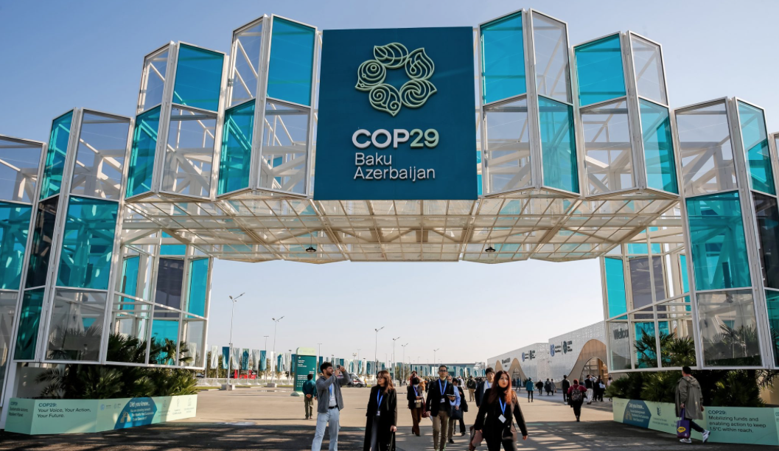
Building Strategic Relationships with Key Stakeholders
Foster stronger connections with high-level COP delegations, whose decisions directly influence climate negotiations
Prioritize tailored communication that aligns with the specific policy priorities of these delegations
Identify and nurture “COP champions”, who can serve as influential advocates for integrating space-based data into global climate frameworks
Possible secondment to UNFCCC

Slide 8
Unified and Strategic Representation at UNFCCC Events
Leverage WMO as a Credible Central Channel
Collaborate closely with WMO, aligning CEOS-CGMS initiatives with WMO’s globally recognized authority. This partnership will enable the Earth observation community to present a cohesive and authoritative voice.
Participate in WMO-led activities to ensure that CEOS-CGMS priorities are seamlessly integrated into broader discussions about the role of Earth observations in climate policy.
Empower National Delegations for Advocacy at Earth Information Day (EID)
Proactively engage with CEOS-CGMS country delegations and prepare cohesive, impactful submissions, CEOS and CGMS can ensure their priorities are prominently represented.
This include identifying themes well in advance of the August EID submission deadline, crafting clear and actionable messaging, and developing proposals that emphasize the relevance of satellite-derived data to national and global climate goals.

Slide 9
Raise Awareness of Space-based Data
Implement tailored communication strategies designed specifically for policymakers and COP delegates (e.g., concise and impactful presentations, visually engaging materials, and executive summaries) to articulate the relevance of satellite-derived data to national mitigation and adaptation strategies.
Highlight case studies showcasing the successful integration of space-based data into national inventories and climate policy.
Build broader support among policymakers and position satellite-derived data as a critical tool in achieving national and global climate goals.

Slide 10
Tiger Team
Lead V-H Peuch (VHP) Vice Chair WGClimate
Strengthen dialogue with UNFCCC
Preparation for Earth Information Day at the COPs is a key task for the Tiger Team. Defining and improving a process of preparation each year to be more effective and proactive, as well as to ensure consistent and clear messaging.
increase collective awareness of the activities of all the agencies in order to ensure streamlined engagement with UNFCCC.
Need to work on empowering each of the members of CEOS to engage their national representatives/negotiators, to amplify the messaging.
Provide a briefing document from WGClimate to reflect the key messaging and strategic inputs. (Making it easy to pass from space agencies to negotiators to ensure some degree of alignment (it is recognised of course that each delegation may have their own strategic communications objectives on top).

Slide 11
Tiger Team
Process
The team membership will remain open should additional people wish to join.
Twin telecons will be organised to allow participation at reasonable hours for all.
Calls will be held monthly, and more frequently as needed.
Proposed lifetime of Team 18-24 months
Initial Actions:
Formulate a brief each year to be passed to national negotiators.
Investigate the negotiation process works for UNFCCC COP. The potential pre-formulation of positions will have to be considered for the activities timeline.
Checking with UNFCCC Sec regarding how GCP and Finance should be addressed.

Slide 12
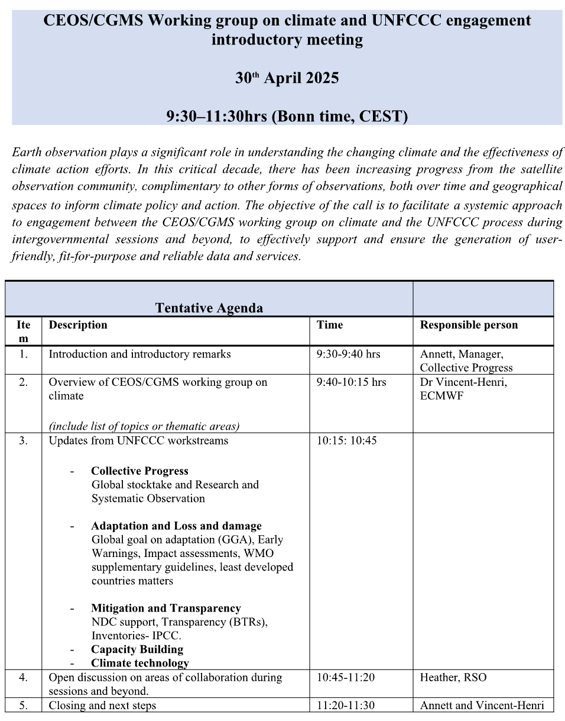
Progress on dialogue with UNFCCC
Vincent-Henri met with Heather Maeseko and Annette Möhner from UNFCCC on 19 February.
Bi-monthly tag ups (every other month) will be organised with UNFCCC and a small group from WGClimate
Plan is to organise a half-day virtual workshop in April to inform and engage with all the division focal points, and
Define some activities to follow up with colleagues/divisions accordingly.
Would hope to advertise more broadly across CEOS and CGMS, using the virtual nature to encourage more participation.
30th April planned date for workshop.
Four potential streams:
Collective progress (RSO / GST)
Adaptation and Loss and damage (incl training and capacity building)
Mitigation (IPCC TFI)
Transparency
+ Climate Finance

