Slide 1
CEOS GST Strategy Update
Osamu Ochiai
JAXA SIT Chair team
Agenda Item 4.4
SIT-40 2025, Fukuoka, Japan
8th - 9th April 2025

Slide 2

CEOS GST Strategy
Issue 1 published in 2021 under Australian SIT Chair Team
Focused on the first GST in 2023
Nine headline recommendations
Contributions from a large number of CEOS groups: WGClimate, LSI-VC, WGCV LPV, SilvaCarbon etc etc
JAXA has committed to providing an update in its SIT Chair Term reflecting lessons learned from GST1 efforts
  WGClimate offered their lessons learned (report)
  All CEOS groups invited to add from their perspective
    responses from LSI-VC Leads, WGCV LPV Biomass team

Slide 3
Issue 2 of the CEOS GST Strategy
Goals:
  Address Lessons Learned study outcomes
    take forward priority recommendations
  Understand the changing landscape with UNFCCC, GEO, WMO, etc. and optimal CEOS engagement
  Define next steps to improve the representation of systematic observations in the GST process and possibly beyond
  Engage relevant CEOS agency experts and groups on the way for implementation capacity

Slide 4
Timeline
2024
2025
SIT-39
SIT-TW
Plenary
Canada
SIT-40
SIT-TW
Plenary
UK
COP-30
GST STRATEGY
GST 1 LESSONS LEARNED
GST STRATEGY UPDATE
Draft
Draft & CEOS WP actions
WGClimate LL paper circulated in February
All CEOS agencies and groups invited to input by SIT Chair
GST 1 Lessons Learned - seek endorsement at SIT-40
Kick off GST Strategy update at SIT-40
Draft GST Strategy Issue 2 presented for discussion at SIT TW (Sept 2025)
Final GST Strategy Issue 2 presented for endorsement at CEOS Plenary (Nov 2025)

Slide 5
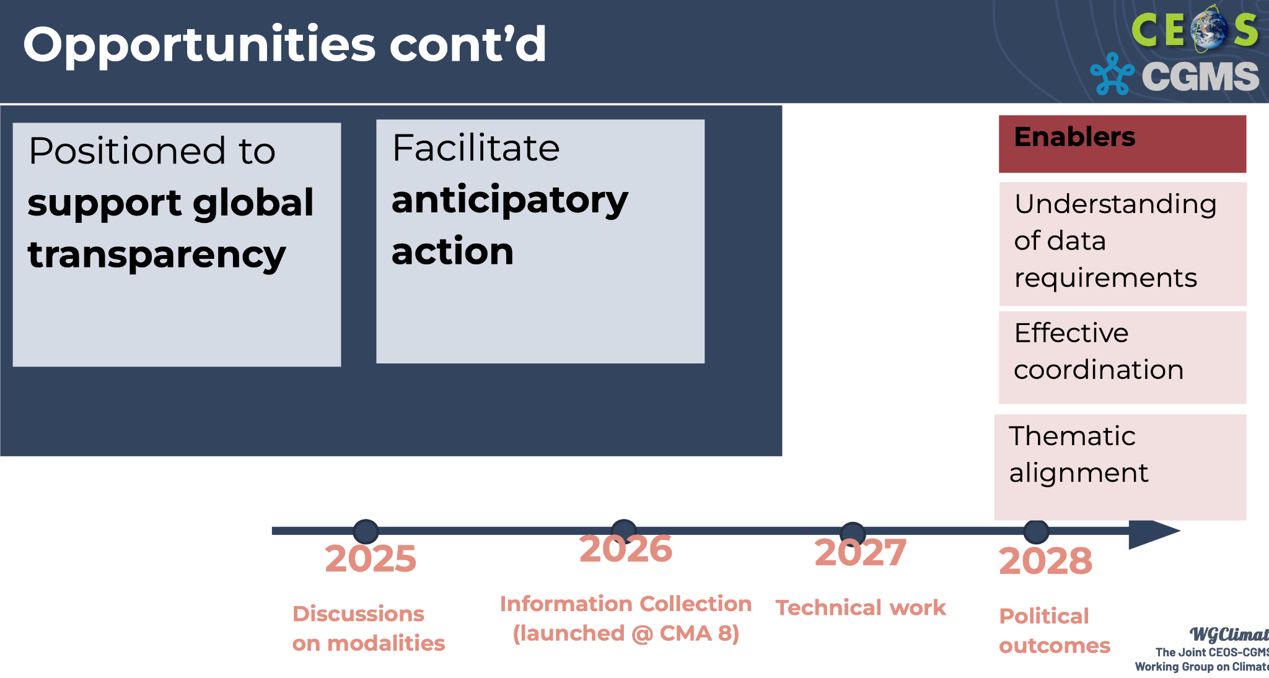
GST 2 Timeline
From UNFCCC SEC at WGClimate mtg

Slide 6
Preliminary ideas - from the LL
& Climate Policy Impact call series
More proactive, strategic and long-term UNFCCC engagement
  Tiger team to develop and implement a plan (already initiated at WGClimate under V-H Peuch (ECMWF)
  More coordinated RSO community prep (CEOS, WMO ++)
  More systematic CEOS-UNFCCC SEC engagement
  Secondment to UNFCCC SEC

Slide 7
Preliminary ideas - from the LL
& Climate Policy Impact call series
More emphasis on country engagement and data uptake
  WGClimate LL points
    Lesson 2.1: Limited Advocacy and Fragmented Representation at UNFCCC Events
    Recommendation 2.1: Build Stronger Relationships with COP Delegates and Leverage CEOS and CGMS Member Countries at Key UNFCCC Events
Lesson 2.2: Lack of Collaboration with National Inventory Agencies
Recommendation 2.2: Enhance Country Engagement Through Targeted Support, Capacity Building, Strategic Partnerships, and Co-Development of GHG Flux Products
Lesson 3.1: Bridging Knowledge Gaps Among Inventory Compilers
Recommendation 3.1: Equip Inventory Compilers with Targeted Training and Resources
Lesson 3.2: Addressing Limited Awareness of Space-Based Data Among COP Delegates
Recommendation 3.2: Raise Awareness of Space-Based Data Through Targeted Communication

Slide 8
Preliminary ideas - from the LL
& Climate Policy Impact call series
More emphasis on country engagement and data uptake
  Develop a directory of national inventory contacts for CEOS agencies.
  A partnering process involving space agencies and national inventory counterparts
  National inventory communities may need step-by-step and clear guidance on the differing potential roles (interpretations) of the top-down vis-a-vis the bottom-up approaches
  Need for improved corporate memory and coordination between country engagement efforts so that overall progress is better managed and quicker (MGD type approach?).
  Could the SilvaCarbon model be expanded to included GHG flux datasets? Capacity building continuity is currently at significant risk!
  Data source continuity is fundamental to country uptake and needs a rethink by CEOS agencies on how to assure this (per biomass experience)

Slide 9
Preliminary ideas - from the LL
& Climate Policy Impact call series
On IPCC engagement
  The reconciliation/translation of EO datasets into country definitions using IPCC guidance (discussed by the IPCC, TFI and included in AR7 by WGs) is essential to be addressed by EO providers for trust in datasets and their uptake
  We need more comprehensive/systematic representation of CEOS agency capabilities in the IPCC Emissions Factor database
    GEDI/CCI experience

Slide 10
Next steps
Decision: SIT Chair to lead the GST Strategy Issue 2 development and oversee implementation
Looking for champions to help draft Issue 2 of the GST Strategy:
  Volunteers welcome, please contact SIT Chair team
  Seeking broad participation from CEOS groups and agencies
ACTION: for Principals & CEOS groups to nominate representatives to help GST Strategy update effort in 2025
Feedback on the preliminary ideas from your agency perspective
Finally… we must recognise there is more to do beyond the GST and on a continuous basis. (Agenda item 4.4 & discussion).

Slide 11
GST Strategy update team so far
SIT Chair coordination
Dave Crisp
Clement Albergel
Mark Dowell
John Remedios
Yasjka Meijer
Joana Melo
Jorg Schulz
Gianpaolo Balsamo

