Slide 1
Translation of EO datasets to NGHGI definitions
4.2 CEOS engagement with the IPCC
Joana Melo
European Commission
Agenda Item 4.2
SIT-40 2025, Fukuoka, Japan
8th - 9th April 2025

Slide 2
translation of EO datasets to NGHGI definitions
Track progress in achieving the objectives of the Paris Agreement
the IPCC has explicitly indicated in the outlines of its AR7 reports that estimates and scenarios for anthropogenic land-based CO₂ fluxes shall ensure consistency with national inventory definitions
(https://www.ipcc.ch/site/assets/uploads/2025/03/Decision-8-Working-Group-Outlines.pdf )
Is the Earth Observation community aligning with this aim and enabling like-for-like comparisons with the released datasets?
Yes. An example:

Slide 3
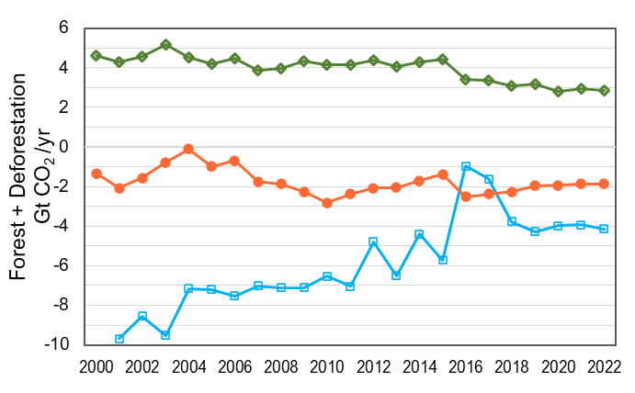
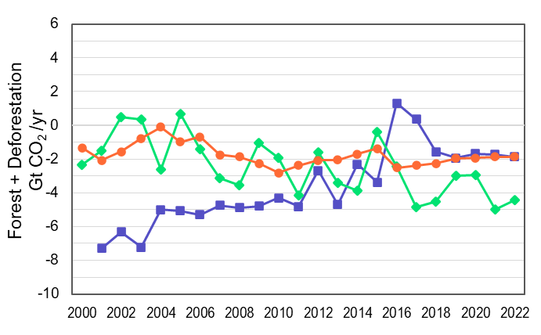
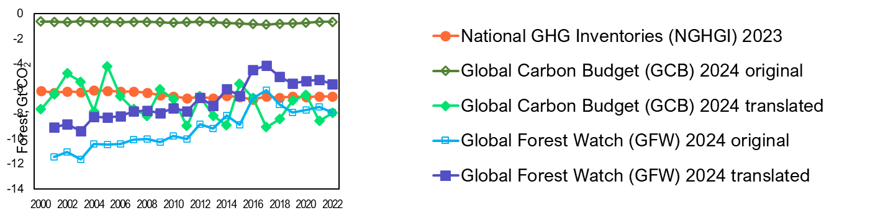
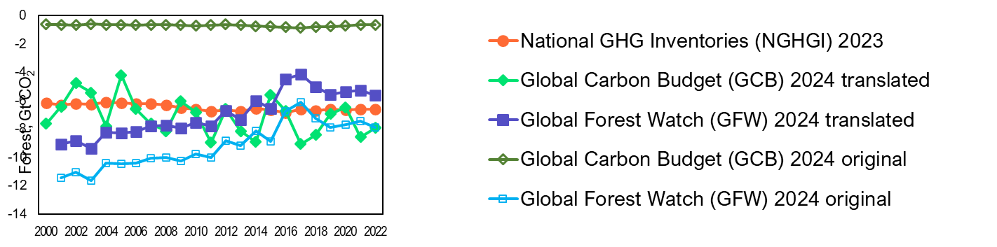
translation of EO datasets to NGHGI definitions
At the global level, the historical gap in forest-related CO₂ emissions is explained/reduced when independent estimates are translated to the NGHGI (IPCC Guidelines) definitions
of ‘natural’ and ‘anthropogenic’ sink
9.8
Gt CO₂/yr
1.2
Gt CO₂/yr
(Pierre Friedlingstein et al., 2025)
(Pierre Friedlingstein et al., 2025)
(Gibbs et al., 2025)
(Gibbs et al., 2025)

Slide 4
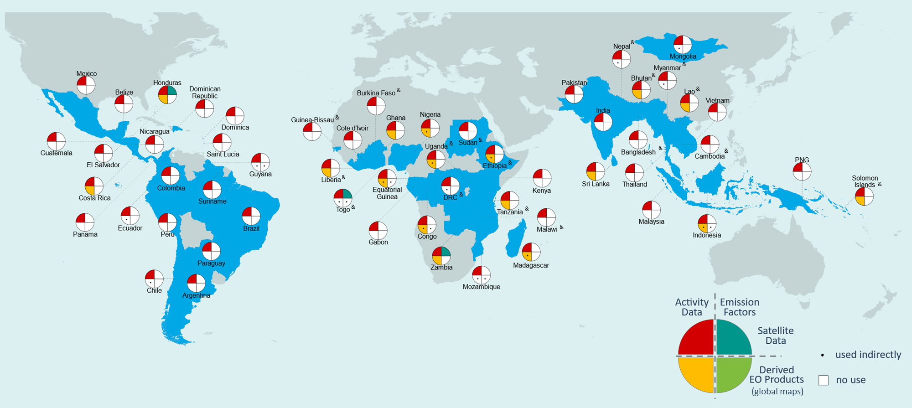
translation of EO datasets to NGHGI definitions
(pre-Paris) Submissions to the UNFCCC from 56 countries covering 80% of tropical forests
(a subset of the 153 developing countries included in the JRC database; cut-off date 2022)
All developing countries use satellite imagery to quantify land extent and land dynamics (red quadrant)
30% use available global maps (only one, GFC; yellow quadrant)
Melo et al 2023 Environ. Res. Lett. 18 034021
Different ways of handling data renders different estimates
High uptake of satellite imagery but still conflicting results with satellite-based global estimates!

Slide 5
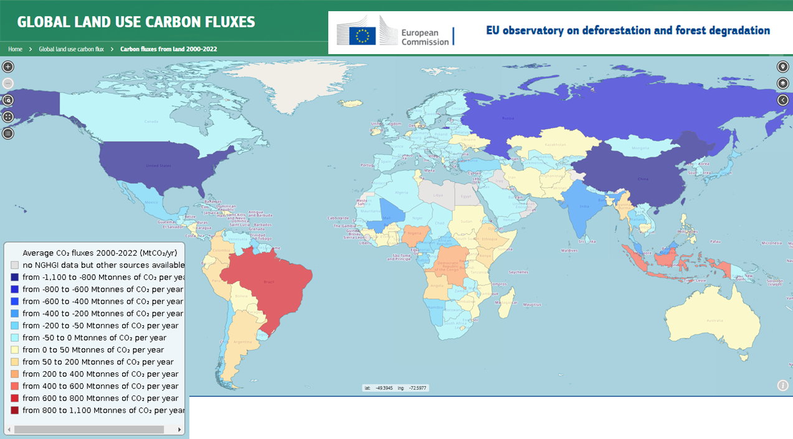
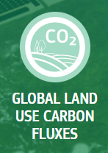

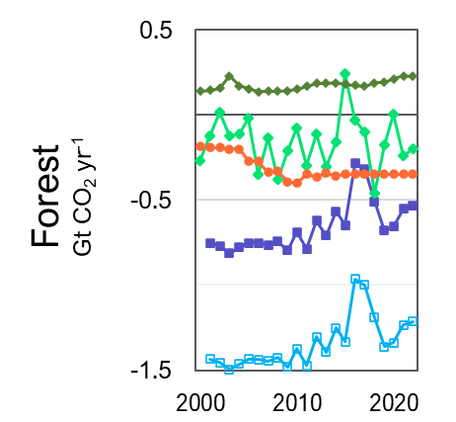
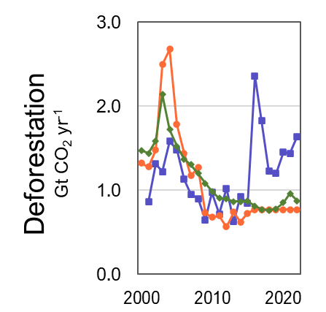

translation of EO datasets to NGHGI definitions
LULUCF data-hub
Hosted by the European Commission Joint Research Centre in the EU Observatory
Strengthening dialogue across communities
Showing ongoing efforts from the scientific community in presenting their data in a conceptually similar way to NGHGI / IPCC guidance to effectively help track progress in achieving the objectives of the Paris Agreement
Example of Brazil
Recommendations 2f, 4 and 5
of the CEOS AFOLU Roadmap

