Slide 1
Climate Policy Impact Session
Introduction
Osamu Ochiai
JAXA SIT Chair team
Agenda Item 4.1
SIT-40 2025, Fukuoka, Japan
8th - 9th April 2025

Slide 2
Objectives
“EO Data Impact” a priority of our 2-year SIT term seeks to address obstacles and opportunities for CEOS agency data to have maximum impact in the key climate policy processes such as the Global Stocktake of the Paris Agreement
CEOS and its agencies invest more effort in the climate sphere than any other
We need to assess and reflect on whether we are engaging with the right stakeholders in the best way - or whether we might consider alternate or additional strategies
JAXA SIT Chair term seeks to confirm whether our current relationships and activities are the optimal ones for impact of our data on the climate policy process or whether adjustments are needed. And to increase opportunity for discussion among our experts.

Slide 3
Call series
SIT Chair convening series of Climate Policy Impact calls throughout our term to increase available discussion time on these important topics
Sincere appreciation to the many CEOS groups and individuals that have engaged
31 Jan / 13 Mar / 13 June / 22 July / 4 Sep / 18 Dec / 6 March 2025
Extremely productive and yielding strong ideas - will continue through 2025 (as needed in addition to GST Strategy update calls, where many of the ideas will converge)

Slide 4
SIT Term Overview
2024
2025
SIT-39
SIT-TW
Plenary
Canada
SIT-40
SIT-TW
Plenary
UK
COP-30
GST STRATEGY
GST 1 LESSONS LEARNED
GST STRATEGY UPDATE
Draft
Draft & CEOS WP actions
CARBON ROADMAPS
GHG ROADMAP UPDATE
Draft
AFOLU ROADMAP ACTIONS
LATE
SIT CHAIR TO ENSURE LINKAGES NEEDED
AQUATIC CARBON ROADMAP DEVELOPMENT
IMEO & G3W
INTERFACES
PROGRESS IMEO & G3W TOPICS/challenges
GHG Best Practices
CEOS GHG BEST PRACTICES
UKSA COP-30 actions
Draft
Final
GCOS IP
CEOS RESPONSE
Mid-2025 for CEOS & CGMS
ECV INVENTORY
VERSION 5
VERSION 6
STRATEGIC TOPICS
NEW PATHWAYS/TARGETS
NEW CEOS WP ACTIONS RE GST2
INTEGRATED PLANNING FOR COP & SBSTA
NATIONAL ENGAGEMENT

Slide 5
Our SIT Term priority and threads
Addressing opportunities for EO data impact on climate policies
Progress AFOLU Roadmap implementation
Insights and new opportunities from important dataset harmonization studies
National Case Studies on EO data impact
Asia focus of SilvaCarbon: working dataset for reporting and more
Responding to GST1 outcomes and reinforcement of UNFCCC engagement
EO-related support arising from 1st Global Stocktake
Effort targeting EO data role in the next update of the IPCC Task Force on Inventories Good Practice Guidance (circa GST2 in 5 years)
Insecure interfaces for CEOS (and the observations community) to climate policy processes
Other policy engagement
Updated Space Agency Response to GCOS IP (Plenary 2024)
Alternate angles (eg large cities)

Slide 6
SIT-40 objectives
Today
Debate and endorse the GST Lessons Learned Report led by WGClimate
Hear Principal guidance for the updating of the CEOS GST Strategy - by Plenary
Debate UNFCCC/COP and IPCC engagement options inc. guidance on measures already underway from the GST LL process
Update from the Aquatic Carbon Roadmap team and provide feedback
Any guidance on coordination among the Carbon Roadmaps (ACR, GHG, AFOLU)
Tomorrow
Session dedicated to Country Engagement initiatives and issues as a priority theme emerging from the LL exercise
Finalise v1.0 of the AFOLU Roadmap actions

Slide 7
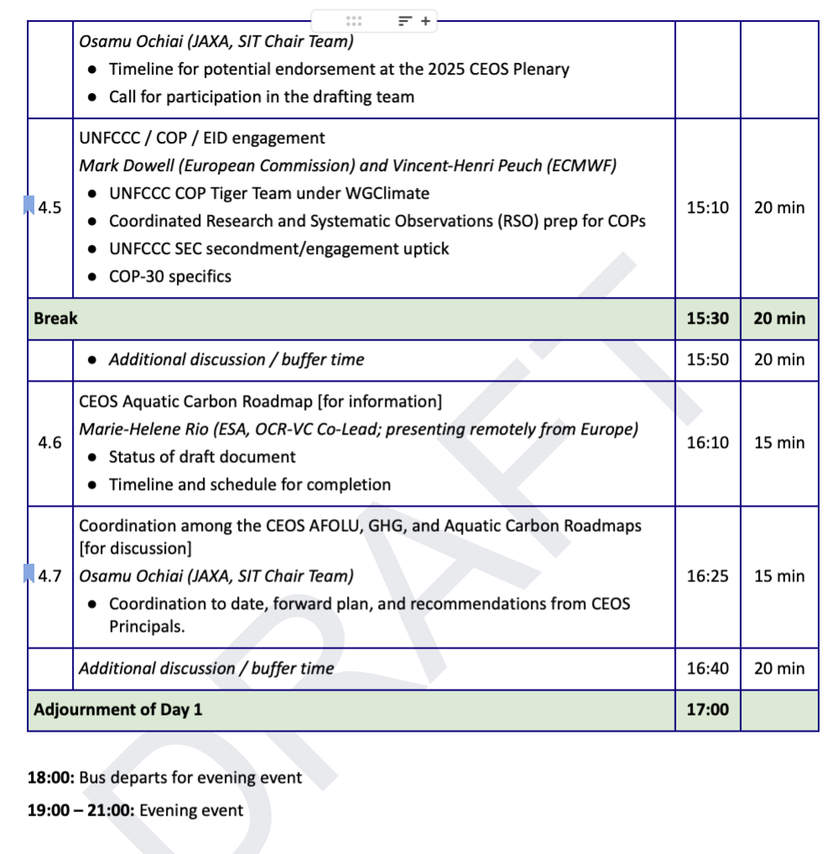
Our session today

