Slide 1
WGClimate Report
Wenying Su, NASA
Vincent-Henri Peuch, ECMWF
On behalf of WGClimate
Agenda Item 3.3
SIT-40
Fukuoka, Japan
8-10 April, 2025

Slide 2
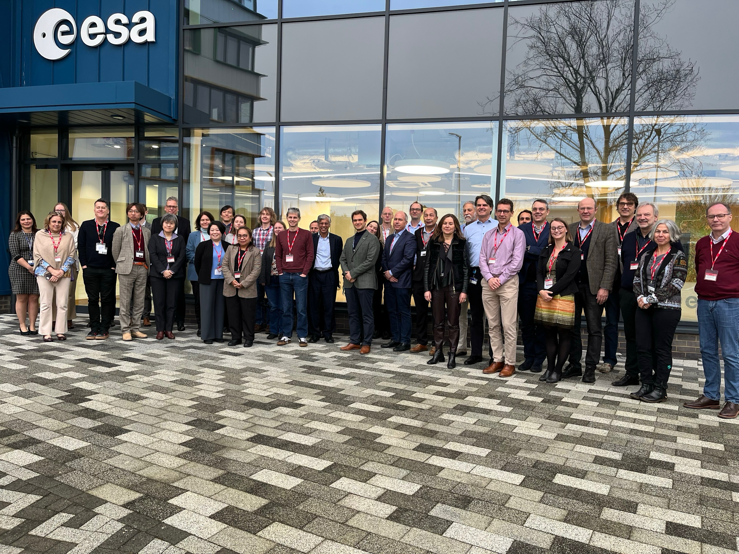

Joint WGClimate and GHG Task Team meeting
The WGClimate and Greenhouse Gas Task Team meeting was held in Harwell, U.K., on Feb 11-13, 2025, with 43 in-person and 34 virtual participants, including representatives from the CEOS Chair team, CEOS SIT Chair team, and national GHG inventory communities.
Participants encouraged the CEOS and CGMS to send a letter to WMO in support of the Global Greenhouse Gas Watch (G3W) initiative. WGClimate drafted the letter, which was sent to the WMO Secretary General, Dr. Celeste Saulo. Letter sent on March 30th.
Representatives from World Climate Research Programme (WCRP) also attended the WGClimate meeting and expressed their interest in working more closely with WGClimate to support initiatives such as Earth System Modelling and Observations (ESMO) and the Coupled Model Intercomparison Project (CMIP).

Slide 3


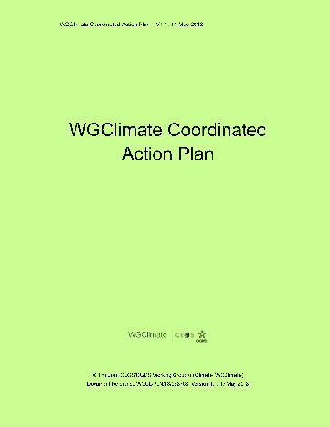
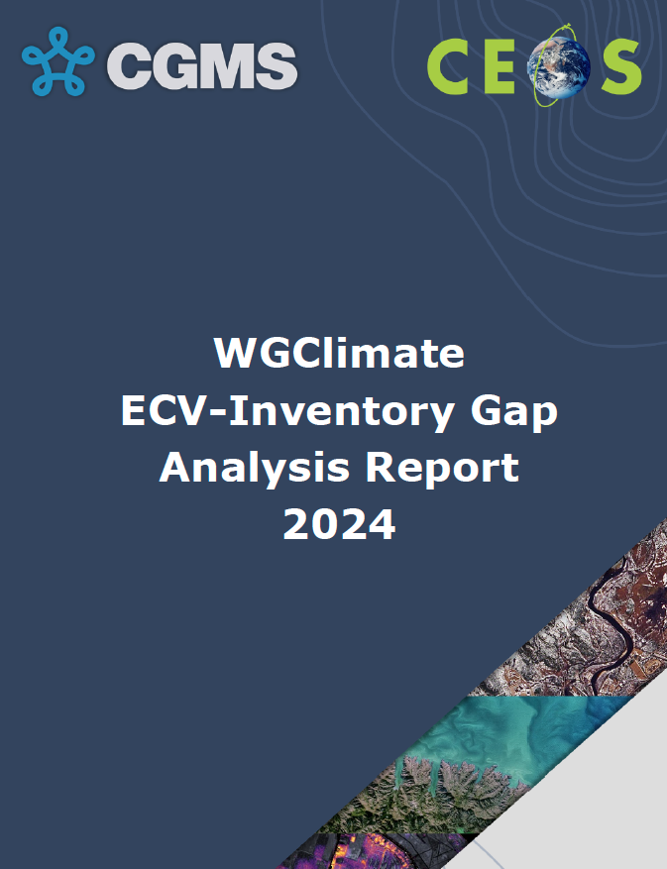
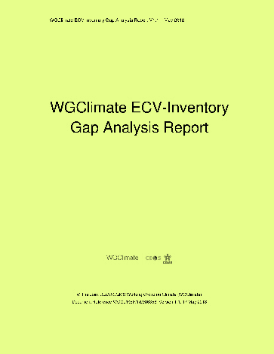
Overarching workflow of WGClimate
Gap Analysis & Coordinated Action Plan
2018, based on ECV Inv v2.0
2024, based on ECV Inv v3.0 + v4.1
CDR Inventory
WGClimate
Climate Experts
Improved CDRs
Gap Analysis
Data producers
Improved observing system
Coordinated Action Plan
WGClimate
CEOS / CGMS
Notes:
ECV Inventory and Process is baseline for WGClimate to:
provide a comprehensive and accessible view of existing and planned Climate Data Records
deliver further climate data records through best use of available data
optimise the planning satellite missions

Slide 4
Transition to CDR Inventory
Inventory publication timeline:
v2.0: October 2017
v3.0: August 2020
v4.0: October 2021
v4.1: November 2022
v5.0: 31.10.2024 (backlog since V4.1)
1289 entries (918 existing + 371 planned)
119 entries added / updated
minimal adaptation to GCOS-244
hybrid approach to “verification”
v6.0: Q2.2025
integration of backlog and clean-up
complete update with respect to GCOS-244
small updates to registered entries (eg URLs)
CDR Inventory:
Public release of new user interface and database in May/June 2025
new database structure, system, UI
enhanced user experience and reporting capabilities
new workflow (input and verification)
continuous update and publication
focussed harvesting as needed (GA, other reporting needs/actions)
adaptation to emerging priorities
Notes:
WGClimate decided to transition the ECV Inventory into a CDR Inventory:
new technical baseline
simplified process to populate and verify it
continuous publication, individual time tags used for record updates.
EUM and EC continue to fund activities until mid-2029.

Slide 5
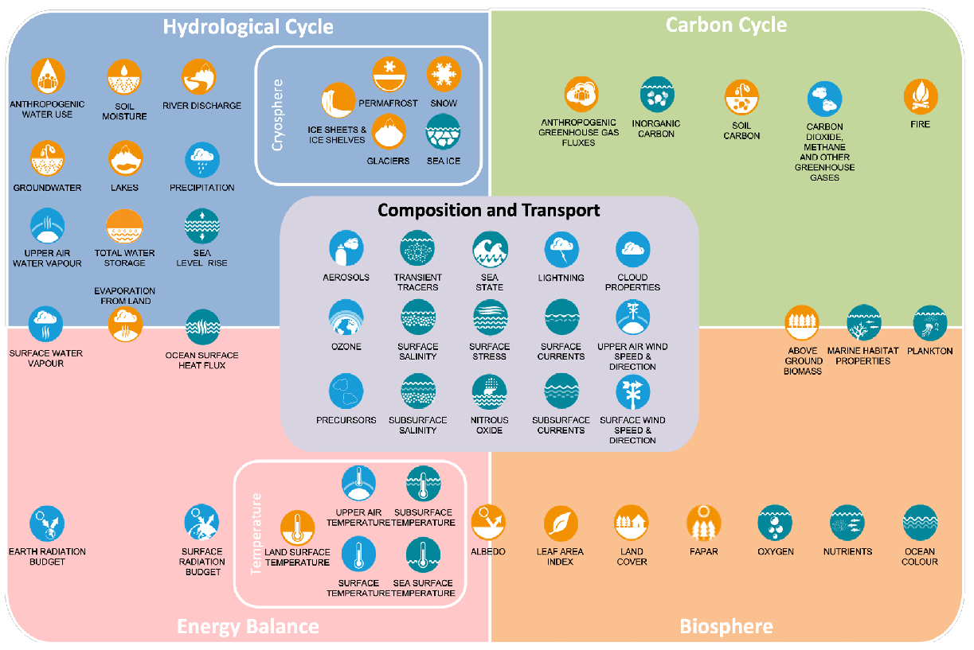
Expanding the Utility of CDR Inventory to Address Emerging Priorities
Application/stakeholder typology
Science (Cycles, Climate modelling (EMSO, CMIP), attribution, tipping points, Global Carbon Project, EW4ALL, Solar Radiation Management, …)
Policy/Decision support:
  Climate Adaptation (Urban, Natural Based Solution, water resource management, energy management, Solar Radiation Management, …)
  Mitigation (GHG/G3W, AFOLU, Blue Carbon) …
Notes:
Category “champions” to map CDRs onto individual application/stakeholder “types”

Slide 6

Space Agencies’ Response to the 2022 GCOS Implementation Plan
Provided responses to 48 activities.
Feedback from GCOS panels addressed.
Appreciate the comments and clarification that we have received so far from the GCOS panels.
These responses represents collective efforts from major space agencies, with the goal to provide a comprehensive response to each of those activities.
Submitted for CEOS review on March 24, 2025. WGClimate is seeking CEOS endorsement at SIT-40.
Submitted for CGMS review for endorsement at the end of March 2025.

Slide 7

Lessons Learned and Recommendations for the GST1
CEOS provided the pilot top-down CO2 and CH4 inventories to support GST1 in 2023.
Received positive recognition at international settings, but few national inventory compilers have adopted these satellite-based data to support inventory development or for quality assurance or quality control.
CEOS & CGMS are reevaluating their approach to inform future efforts. The lessons learned and corresponding recommendations are categorized into three key areas:
  GHG flux datasets
  Stakeholder engagement
  Communication
More details --> item 4.3

Slide 8
UNFCCC Engagement Coordination Tiger Team
Ensure consistent preparation across CEOS and CGMS agencies for Earth Information Days.
Enhance coordination at key UNFCCC events throughout the year.
Develop a comprehensive multi-year engagement strategy aligned with the phases of the GST process, including proactive preparation for party submissions.
Define key objectives for each Conference of the Parties (COP) and Earth Information Day (EID) to ensure CEOS and CGMS efforts are strategic and aligned with broader climate goals.
Notes:
Item 4.5

