Slide 1
CEOS SIT-40
Overview of CEOS Interoperability Handbook 2.0
Nitant Dube
& Tom Sohre (WGISS)
Agenda Item #3.2
SIT-40
Fukuoka, Japan
8-10 April, 2025

Slide 2
CEOS Interoperability Handbook V 2.0
Objective
CEOS Interoperability Handbook Version 2.0 should provide guidance to the organizations for development of Interoperable Data and Services and help them in measuring their maturity level
Interoperability Handbook
Maturity Matrix

Slide 3
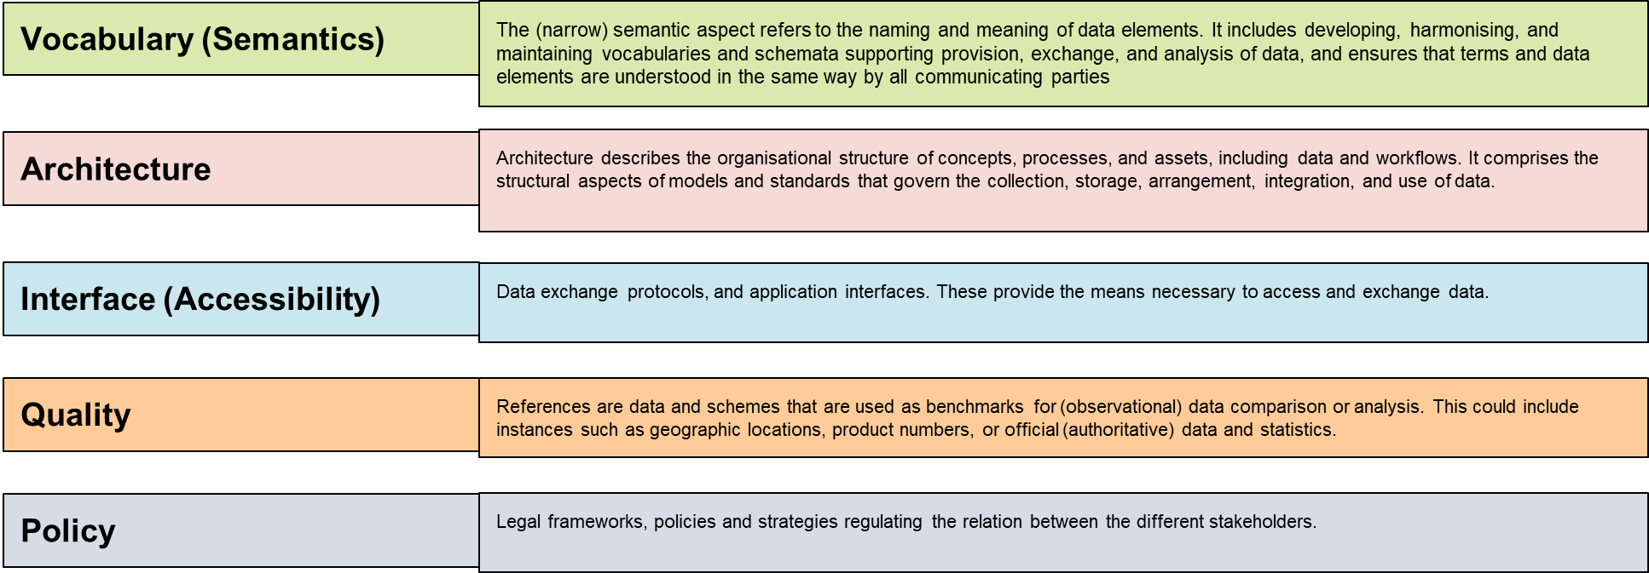
Interoperability Framework : Factors
Management
Policy
Technology
Quality
Vocabulary
Interface
Architecture

Slide 4
Handbook on github
The First Draft of Interoperability Handbook 2.0 is now available on github
https://github.com/ceos-org/interoperability-handbook

Slide 5
Handbook Chapter Layout
Chapters
Chapter-1 : Introduction
Chapter-2: Interoperability Framework
Chapter-3: Vocabulary (Semantics)
Chapter-4: Architecture
Chapter-5: Interface (Accessibility)
Chapter 6: Quality
Chapter 7: Policy

Slide 6
Recommendations

Slide 7
Vocabulary
Major Contribution by: LSI-VC, WGISS
Semantic (6)
CEOS Common Online Dictionary, Version control and Change management of terms, ISO TC 211, OGC, WMO, GEO for domain wide adoption, GCMD keywords
Vocabulary (14)
Division of terms into classes, Avoid Circular dependencies, , terms to have clear dependencies (parent –child), Notes to be added for quoting examples or discussions, link to source document, , Version Control of terms, Alternate definitions for controversial terms
Thesaurus (8)

Slide 8
Architecture
Preservation (9)
OAIS, CEOS Data Appraisal, Producer-Archive Interface Methodology, CEOS Data and Software Preservation guidelines, Shared collection Life-cycle Management
Major Contribution by: SEO, WGISS, LSI-VC
Architecture (40)
CEOS-ARD Framework, Product Family Specifications, ISO 19115 Metadata Standards, Collection and Granule Discovery Best Practices, Persistent Identifiers, CEOS Open Data cube
Data & Metadata (11)
Publishing (5)
CEOS STAC, Cloud

Slide 9
Interface
Major Contribution by: WGISS, Data Discovery and Access Team
CEOS STAC/CEOS OpenSearch, Service Discovery, OGC Standards, Keywords using Linked Data, Data Steward Maturity Matrix, Data Collection Management
Data Discovery (11)
Interface (18)
Data Access (3)
Support for Web based protocols for access, File and Pixel based access
Authentication and Authorization (3)
Support for Human and Machine to Machine Interface, OpenID Connect, OpenAPI3.0

Slide 10
Quality
Major Contribution by:
Working Group on Calibration and Validation (WGCV)
Engagement with Community calibration and validation groups, Quality Indicators, , CEOS Fiducial Reference, CEOS Cal/Val Sites (RAdCalNet and SARCalNet), Q4AEO, EDAP based Quality Matrix, Best Practices Document for cal/val activities, CEOS CAL/VAL Portal
Quality
Calibration & Validation ( 5)

Slide 11
Policy
Major Contribution by: WGISS &SEO
Community Engagement (CEOS/GEO/CGMS), CEOS MIM Database, Open Standards and Specifications, Open Data, Open Source Software, Open Science, Data Licensing, Data Procurement from 3rd party, Data Preservation, Purge Alert
Policy
Policy (8)

Slide 12
Sequence of Activities
WGISS-59 (Thailand) Detailed discussion of each factors and recommendations (Completed, 1st Draft available)
SIT-40 : Presentation to SIT on 1st Draft and Approval for Community Review
April 2025: Circulation of 1st Draft for Community Review
June 2025: Brief on status to SEC
SIT-Technical Workshop (Sept 2025): Review of Community Recommendations and their Close-out
WGISS-60 (Oct 2025) : Review of Final 1st Draft
CEOS Plenary (Nov 2025) : Interoperability Handbook 2.0 for Endorsement

Slide 13
Actions
Communicate to CEOS for comments on CEOS Interoperability Handbook 2.0 (Community Feedback to be provided by 02-June-2025)
CEOS Interoperability Handbook 2.0 may be advertised through various CEOS communication channels for benefit to New Space Startups and Commercial data suppliers

Slide 14
Thanks nitant@sac.isro.gov.in tsohre@usgs.gov libby@symbioscomms.com
Vocabulary | Architecture | Interface | Quality | Policy
Peter Strobl | Alex Leith | Filippo Marchesi | Cody Anderson | David Borges
Katrin Molch | Matt Paget | Damiano Guerrucci |  | Nitant Dube
Emma Wolliams | Matthias Mohr |  |  | Tom Sohre
 | David Borges
 | Mirko Albani
 | Iolanda Maggio

