Slide 1
CEOS SIT-40
Biodiversity Study Team Progress
Gary Geller
NASA Jet Propulsion Laboratory
California Institute of Technology
Shaun Levick, CSIRO
Marc Paganini, ESA
Agenda item 3.1
SIT-40, Fukuoka, Japan
8-10 April 2025
(c) 2025 California Institute of Technology.
Government sponsorship acknowledged.

Slide 2
Agenda
How we got here
BST Mandate
Status of the stakeholder assessment
Plan to CEOS Plenary 2025
Belted Kingfisher
Wikipedia Andreas Trepte
Notes:
Purpose of session:
Inform Agencies, WGs, VCs, and other CEOS entities of BST status and plans

Slide 3
How we got here...
~2012: “Biodiversity Activity” initiated
~2020: Informal discussions on increasing engagement
Triggered by biodiversity crisis; CBD GBF
2021: Biodiversity “Discussion Group” initiated
2022-2024: Ecosystem Extent Task Team
Overarching goal: Long term engagement
2024
CEOS Chair (CSA) selects Biodiversity as its focus theme
BST established based on Chair’s recommendation (Plenary, October):
2025 (Plenary, November): BST presents recommendation
Notes:
In 2024 the Chair initiated consultations with internal (to CEOS) & external Biodiversity actors to collect inputs and help guide the Recommendation.

Slide 4
BST Mandate
Overall task: Assess the options for sustainable support for biodiversity in CEOS and make a recommendation at Plenary 2025.
Phase 1: Conduct a stakeholder assessment (identify end user needs)
Phase 2: Consult across CEOS entities and agencies (assess potential to address user needs)
Phase 3: Develop recommendation for sustainable CEOS support for biodiversity and associated documentation

Slide 5
Stakeholder Assessment Process
Utilize a standard User Needs Table format
Assign “needs leads” to key organizations (e.g., CBD)
Populate User Needs Table for each organization
Existing knowledge
Organization’s documentation
Discussion with the organization
Focus on key, high level user needs
BST co-leads consolidate into single table

Slide 6
Stakeholder Assessment: Scope & Depth
Q: How detailed does the Assessment need to be?
Heavy overlap among the needs of the organizations, e.g…
Ecosystem extent
Ecosystem condition
BST should match information level to its mandate
“Deep dive” not needed for BST to make its recommendation
Implication
Focus on key, high-level needs
Consolidate across user organizations
Notes:
The BST must stick to its mandate.
Particularly true since BST schedule and bandwidth is challenging

Slide 7
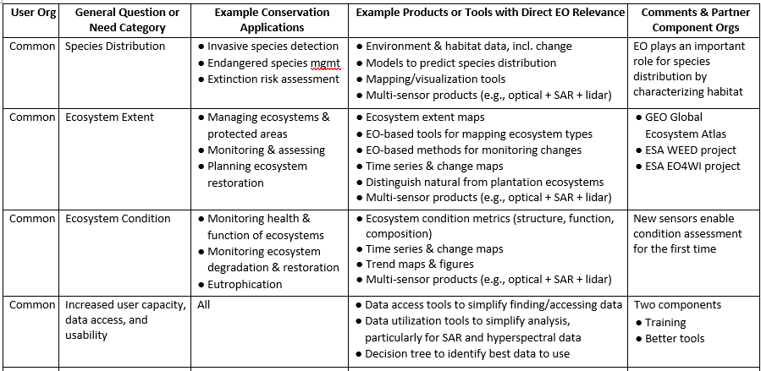
User Needs (Abridged)
Notes:
Purpose: Give WGs, VCs, agencies a sense of user needs; these will be shared in Phase 2 for feedback

Slide 8
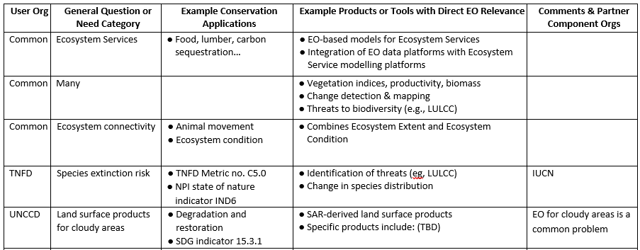
User Needs (Abridged)
More
Notes:
Purpose: Give WGs, VCs, agencies a sense of user needs; these will be shared in Phase 2 for feedback

Slide 9
Looking Ahead
Phase 1:
Now finalizing consolidated User Needs Table
Phase 2: CEOS consultation
Share User Needs Table with WGs, VCs, and agencies to request review
Include specific guidance on type of feedback wanted
Follow up individually by appropriate means
~15 May: Wrap up consultation, then consolidate until 30 May
Phase 3: Develop recommendation and deliverable documents
Most of (N hemisphere) summer
26 August: Submit draft deliverable documents for SIT-TW
SIT-TW: side meeting for feedback & socialization
Plenary
Notes:
These phases are expected to be somewhat iterative.

Slide 10
Summary
Challenging but good progress so far
On track to delivery at Plenary
Expect BST to contact you
Red Knot, US FWS

Slide 11
Questions?

Slide 12
Backup

Slide 13
Schedule
January: Develop baseline needs list
1 February- 24 March: Organization leads engage with end users and develop needs & barriers lists
24 March: Assessment for each organization completed
24 March – 4 April: Consolidation
4 April: Consolidated list completed
8-10 April: SIT-40. Present update on progress
8 April – 15 May: Identify potential CEOS support areas (CEOS consultation)
15 – 30 May: Consolidation
30 May: CEOS support areas list completed
30 May – 8 August: Develop recommendation and draft deliverable documents
8-26 August: Prepare draft for submission
26 August: Submit draft deliverable documents for TW
9-11 September: SIT TW. Side meeting and plenary session to discuss draft materials
21 October: Submit draft deliverable documents for endorsement at Plenary
4-6 November: 39th Plenary. Side meeting for socialization and proposal materials for endorsement
Phase 2
Timeline will be updated as activities proceed

Slide 14
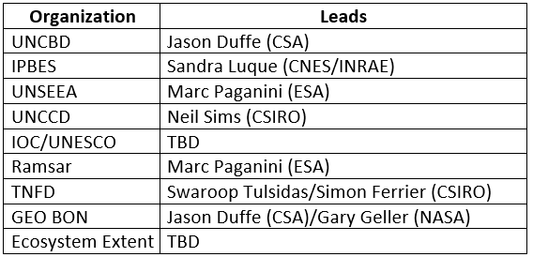
Stakeholder Organizations

Slide 15
BST Mandate
The BST is the outcome discussions at the 38th Plenary (Decision 38-03), see CEOS New Initiative Proposal – Biodiversity Study Team (23 Oct 2024). The key part capturing the BST’s mandate follows:
“The establishment of the CEOS Biodiversity Study Team seeks to provide information for CEOS to assess which shape or form biodiversity activities would take, as well as to design its potential mandate. The CEOS Biodiversity Study Team would:
Assess the options for sustainable support for biodiversity in CEOS.
Conduct a stakeholder assessment.
In collaboration with the CEOS executive officer, develop supporting documentation for the recommended option.
Consult across CEOS entities and agencies to leverage existing practices on biodiversity and implement lessons learned and recommendations”

