Slide 1
CEOS SIT-40
Update and status of the WMO Global Greenhouse Gas Watch (G3W) initiative
N. Donoho, WMO
V.-H. Peuch, ECMWF
Agenda Item #2.4
SIT-40
Fukuoka, Japan
8-10 April, 2025

Slide 2
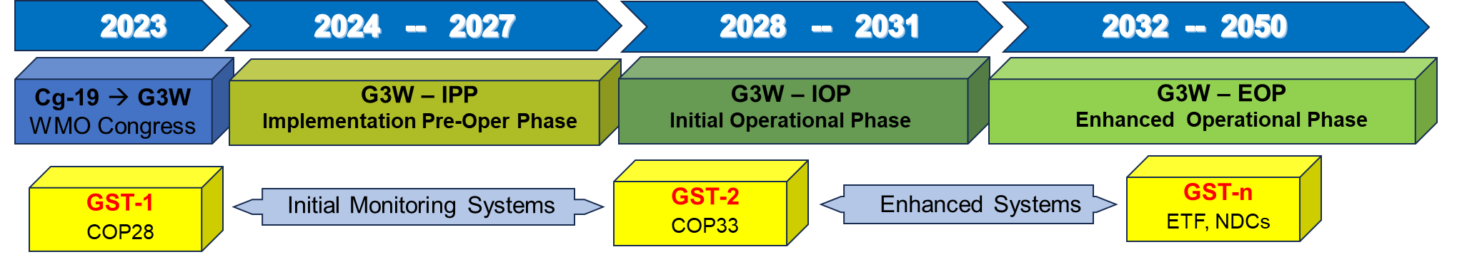
G3W timeline and recent updates
G3W timeline and recent updates
G3W endorsed by WMO EC-78 in the week of the 10th of June 2024.
G3W Implementation of pre-operational phase officially starts.
G3W Advisory Group and Task Teams (Modelling, Networks, Data) are formed in summer and autumn 2024 and starting working.
G3W was presented at Earth Information Day and Progress noted by SBSTA SB61 in COP29 11th and 16th November 2024.
(G3W was presented at the CEOS-CGMS WG Climate meeting in Harwell, UK, 11-13 February 2025.)
Technical “data providers” workshop was organized in Geneva on 5-7 March 2025.

Slide 3
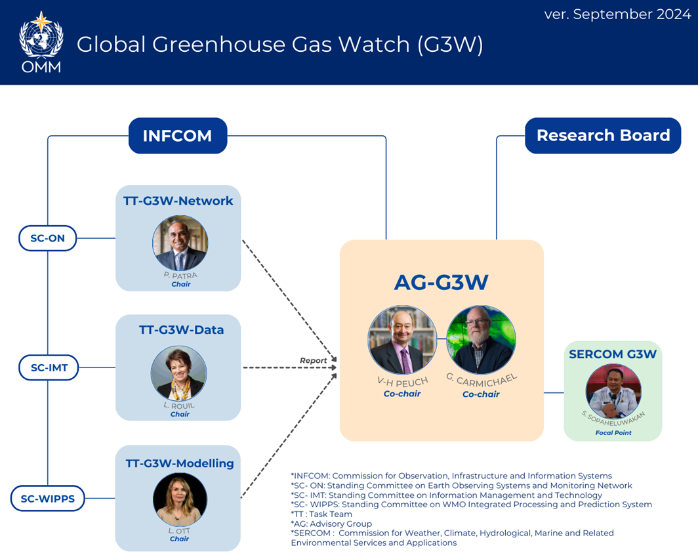
G3W Working structure and priority deliverables
AG-G3W: Oversight of implementation.
TT-G3W-Network: Comprehensive inventory of the GHG Observations, and a Network-design for G3W presented to the INFCOM.
TT-G3W-Modelling: WIPPS manual is updated to include G3W operations and recommendations on the methods and protocols for the quality control and verifications of infrastructure outputs are established and presented to the INFCOM.
TT-G3W-Data: Mapping of the current practices related to GHG data characterization, data exchange, data management and data policies.
Design of the architecture for global data sharing in support of G3W.

Slide 4
G3W Data Provider Workshop: 5-7 March 2025
Focus on modelling systems and data exchange (led by TT-G3W-modelling and TT-G3W-Data)
Modelling
Output products
Target: <1 deg., weekly fluxes with 1 month latency, 3D concentration data with days latency.
Threshold: <1 deg., monthly fluxes with quarterly update, 3D concentration data with days latency.
Ancillary data products (to be provided alongside): analysis increments, prior fluxes, uncertainties.
Output verification
Need to understand availability of in situ data within 1-month target window – guides implementation of evaluation protocols.
Ideally metrics show system performance and help document improvement over time (e.g. similar to NWP skill score).

Slide 5
G3W Data Provider Workshop: 5-7 March 2025
Data
Input data considerations:
Satellite observations – need to improve latency and spatial coverage, data processing capabilities at operational modeling centers is robust and can cope with low latency up to NRT.
Ground-based remote sensing important for validation – can leverage existing efforts through GAW, CEOS/CGMS.
Input/verification data considerations:
Observations - In situ: guidance on low latency products is needed; for surface ocean data priority for modelling is coverage over latency.
Prior fluxes: all modeling centers have unique priors and advanced workflows for generating/processing them; exchanges between the centers may allow some degree of convergence (although this is not strictly required); recommendation to share priors used in operational systems as part of outputs (for transparency towards the users).

Slide 6
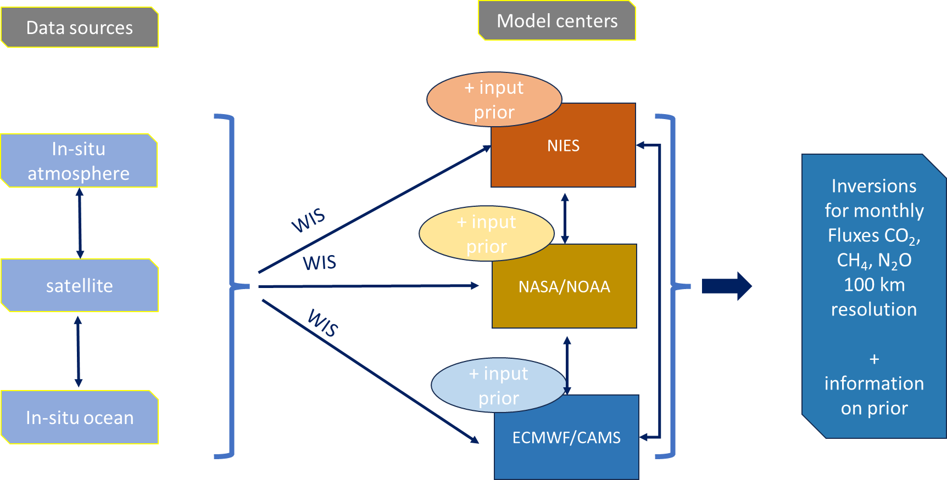
G3W Data Provider Workshop: 5-7 March 2025
Initial thoughts on the data architecture

Slide 7
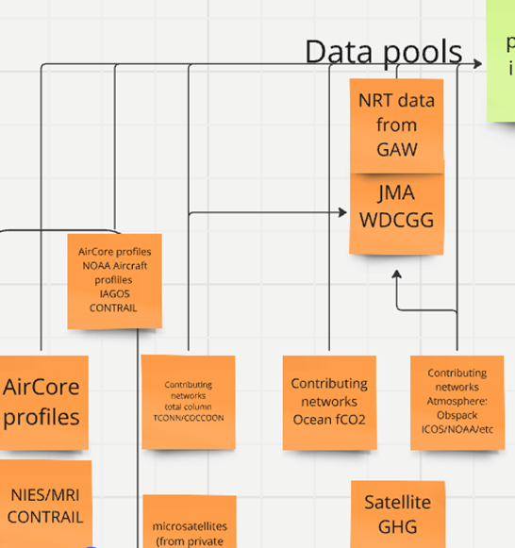
G3W Data Provider Workshop: 5-7 March 2025
Mapping of the input data
Satellite input data
Data exchange framework well defined under CEOS-CGMS Working Group Climate & GHG Task force.
Various situations regarding operational data exchange but WIS2.0 already implemented in some satellite data centers.
In-situ ocean
Exchange of existing datasets via WIS2.0 is possible
NRT data access nice to have for the inversions but not at the detriment of spatial coverage.
Clear “service-level” requirements (if there are) from the modelling community must be raised.
Atmospheric non-satellite data
Granularity of the “data-centers” or data agregators to be precised.
How to ensure redundancy?
Governance issues when talking about a regulatory network.
Questions about the capacity of regional/aggregator centers to perform QA/QC and how to harmonise.

Slide 8
Key issues of relevance
Implementation of G3W is progressing well. Excellent dovetailing with CEOS-CGMS activities, which effectively represent the Space component of G3W.
Presentation at upcoming Policy Advisory Committee (this week) and Executive Council (June) of WMO. Some degree of concern regarding the long-term funding of a critical mass of people within the G3W secretariate at WMO.
Specific recommendations for CEOS:
  Continue working on low latency products as this is decisive input for the overall system latency.
  Need to fill spatial gaps (particularly identified: stratospheric methane).
  Observations sustainability for long-term operations.

