Slide 1
CEOS-IMEO Engagement
Stephen Ward
JAXA SIT Chair team
Yasjka Meijer
GHG TT (ESA)
Agenda Item 2.3, SIT-40 Fukuoka, Japan
8th - 9th April 2025

Slide 2
CEOS-IMEO heritage
UNEP’s IMEO exists to provide open, reliable and actionable information to individuals with the aim to reduce methane emissions
CEOS started to engage with IMEO in 2021, via SIT Chair Team (AU)
Objective is to get CEOS agencies and their data closer to the user – similar to GFOI
In June 2023, we organised a joint CEOS-IMEO Workshop in Harvard
“International Coordination Workshop on Detection of Anthropogenic Methane Emissions from High-resolution Satellites”
Five IMEO working groups followed Harvard Workshop. They only met twice & then stalled
IMEO attended SIT-39 in Tokyo in April 2024
Toward end of 2024, stronger collaboration with latest call in Feb 2025 (following exchange of letters with SIT Chair) identified a number of common interests to pursue
GHG TT (led by Yasjka) and SIT Chair Team managing the interface

Slide 3
Objectives today
Update on IMEO activities of interest - and the CEOS-IMEO collaborations in particular
Seeking agencies support and/or participation to progress on (some) of these aspects
Feedback and (priority) guidance from Principals

Slide 4
Topics
IMEO WGs revitalisation
Methane best practices
Controlled release & observations database
Tip-and-cue system & data requests to CEOS
CEOS-IMEO community workshop
AOB

Slide 5
WG Revitalisation (Yasjka)
IMEO WGs from Harvard meeting are considered still very relevant
GHG TT initiative to revitalise under CEOS leadership (co-lead with IMEO)
Stepwise approach: Use Case WG first, Roadmap WG to follow (and other to be assessed later)
Use Case WG output
  Detailed use cases showing various source sectors & varying stakeholder needs
  Connect these to (current) EO capabilities
KO meeting was held on 11 March (Use Cases)
Most progress will follow through a shared document.
Use Case document will be used to revitalise the Roadmap WG enabling it to set priorities
Roadmap WG to follow around August-September 2025

Slide 6
CH4 best practices (Paul)
IMEO review provided on draft with helpful ideas
Hopes for IMEO roles
  Support the publicity effort in Q3-Q4 2025, and align activities towards COP30
  Support the engagement with producers and users (for O&G fugitive methane)
  Promote into IMEO-funded research projects
  Input into roadmap beyond O&G fugitive methane, e.g. area mappers and diffuse sources
  IMEO badge?
Next steps

Slide 7
Controlled release & measurements database
“There are many controlled releases occurring for individual satellites, as well as campaign style experiments being conducted that involve one or two satellite teams. Could we bring the community together by organizing an online scheduling tool / calendar which would document all the upcoming locations, schedule, and approximate magnitude of releases so that the whole community can take advantage of all possible controlled targets. From discussion it would seem sensible to focus on the satellite aspect of controlled releases to begin with and potentially broaden out to other types of controlled release experiments once a database has been set up.”
The potential items that could be put onto the database:
  Academic controlled release experiments suitable for satellite detection (i.e. the sort of work that Adam Brandt’s group is doing, and that should also start happening under METEC 2.0).
  Commercial controlled release experiments suitable for satellite detection.
  Campaign style experiments where there is satellite targeting of a known emitter (for inter-comparison of satellite measurements).
  Multi-scale campaign experiments involving satellite targeting (i.e. Campaigns akin to the Madrid landfill MEDUSA program with ESA).
  Scheduled industrial events of sufficient magnitude that could be targeted with sufficient notification (i.e. Compressor station events).
The reaction from the MARS team at IMEO has been incredibly positive, and also has support from the broad science team and from the data integration team.

Slide 8
Controlled release & measurements database
Call with James France (EDF, IMEO) last month
Needs (central database, provide data access)
how to best collect all the needs/requirements on functionality?
Opportunities (widen the reach of each controlled release)
- experiments can be announced (allowing specific groups to generate new entries)
- alerting satellite operators to join in
- ease of measurement data access in common platform
Possible approaches and roles
CEOS agencies with relevant missions encouraged to engage and contribute
Next Steps

Slide 9
Tip and cue system & data needs
IMEO currently thrives on point-source methane emissions, specifically from oil&gas industry.
Through Methane Alert and Response System, they perform:
  Tip (global mapper)
  Cue (facility-scale mission). This can also be done using hyper-spectral imagers
  Locate facility
IMEO is using EnMAP (DLR), PRISMA (ASI) and want to expand to Himawari data (JAXA/JMA)
Current usage of PRISMA (ASI) and EnMAP (DLR) was perceived limited (quota, data access)
IMEO scope is huge. We have discussed and proposed
  Enlarging the allocated quotas
  Easing (currently manual) data access
  bringing processing to the data (reducing volume transfer and burden on agencies)
  Prioritisation of locations/times (supersite style) to make it palatable:
    Australia, Argentina, Brazil, Canada, Kazakhstan, Romania

Slide 10
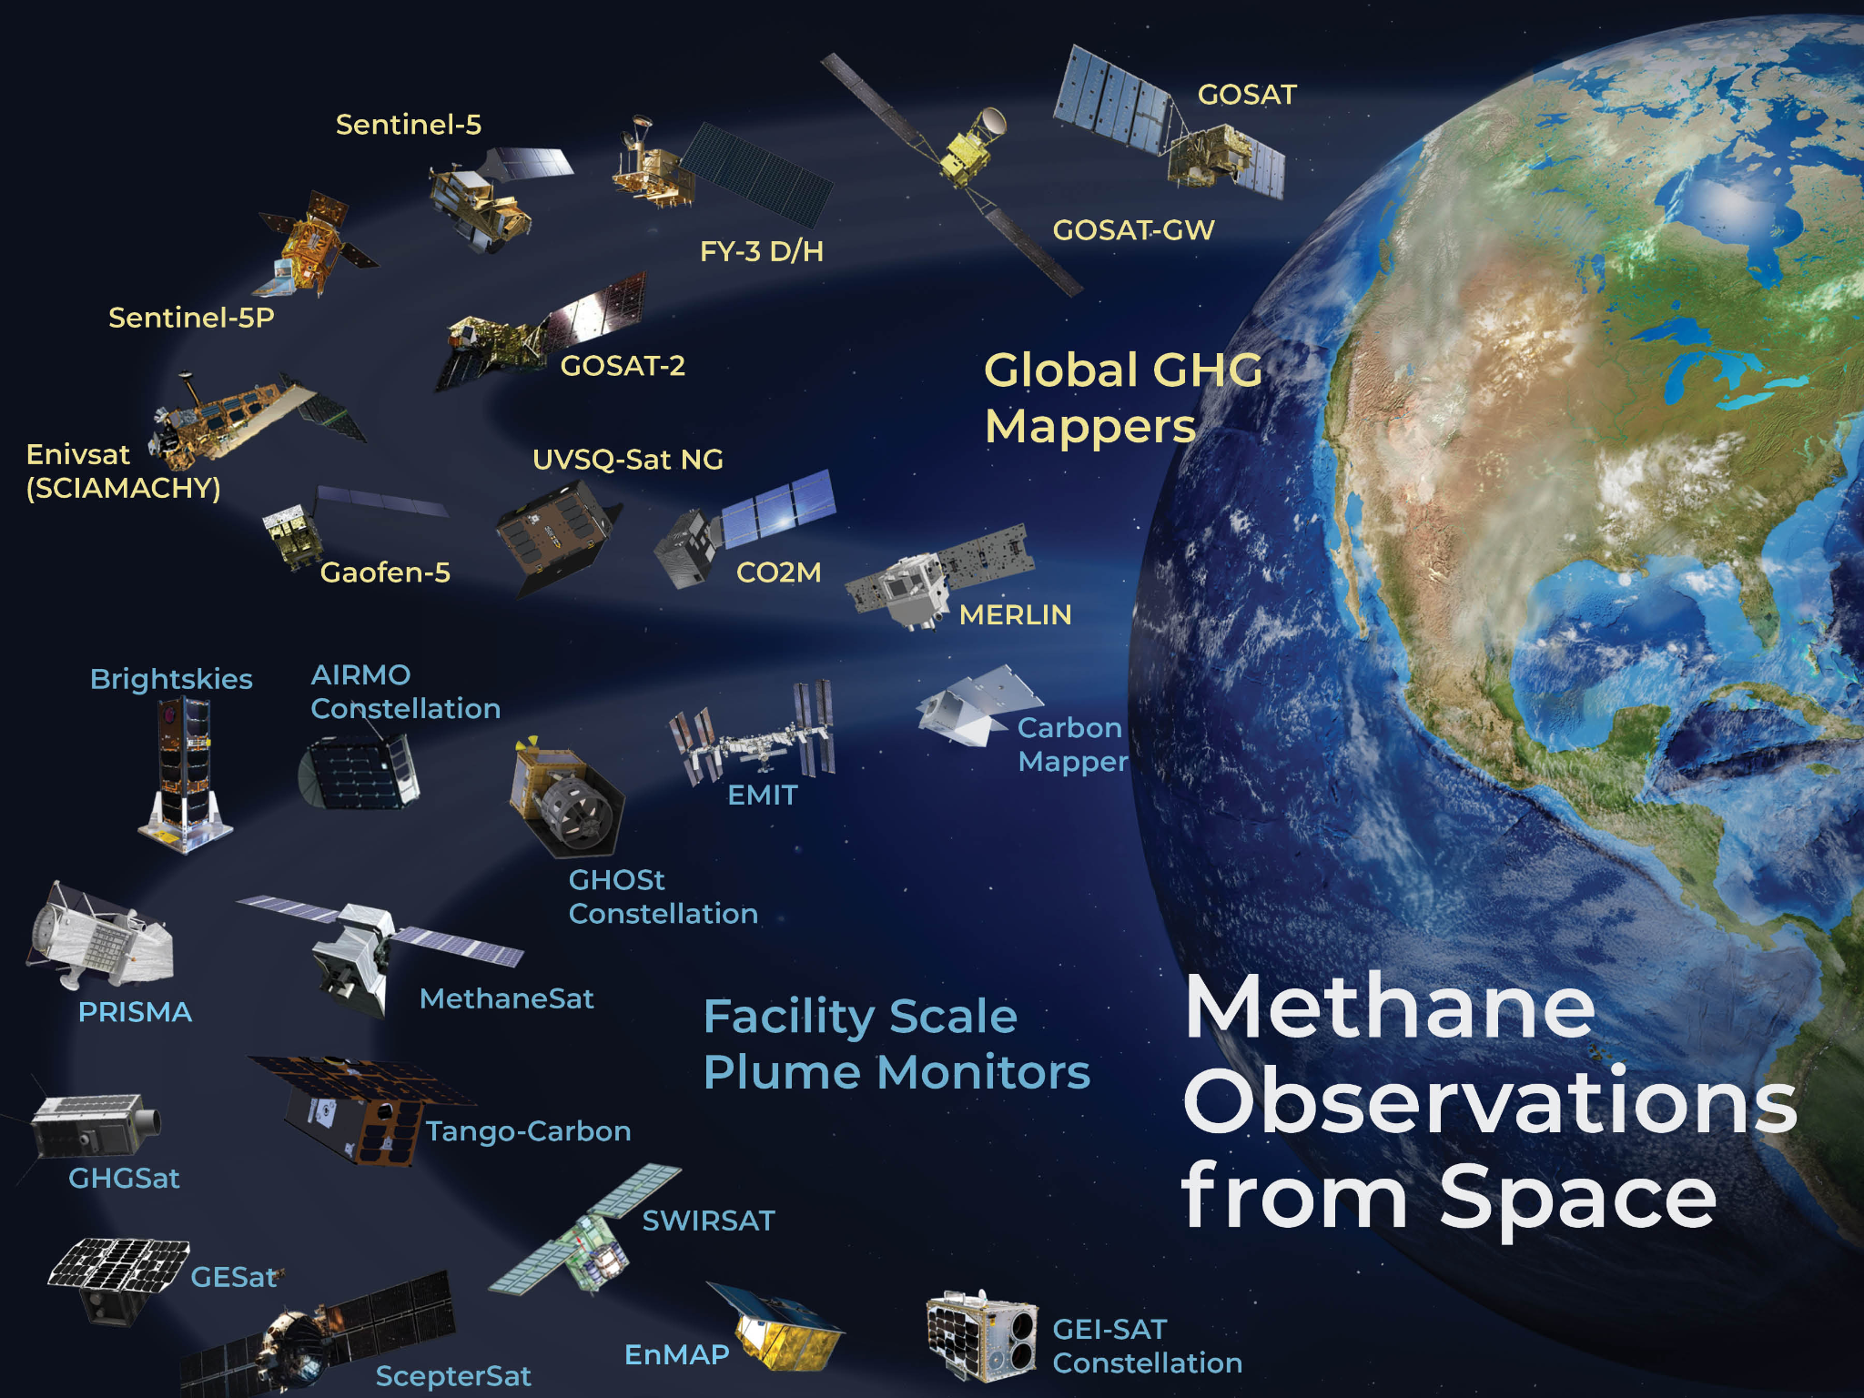
Tip and cue system – requests to CEOS
SIT Chair and GHG TT propose to support liaison between IMEO and the key agencies concerned (ASI, DLR, JAXA/JMA) to address data needs
  PRISMA; quota increase
  EnMAP & Himawari; ease of accessing archive data
We plan to poll CEOS agencies on methane detection algorithm efforts to ensure optimal cooperation and
efficiency amongst different teams, including IMEO
  Please inform/connect us to known activities
  Advise on any new mission plans

Slide 11

Tip and cue system - requests to CEOS: STATUS
Engagements have started with
ASI - PRISMA
  Conversation started (Giorgio Licciardi via Laura Candela - call last week)
DLR - EnMap
  Conversation started (Albrecht von Bargen ←–→Yasjka)
JAXA/JMA - Himawari
  Conversation started (Toshi Kurino, JMBSC via Osamu)

Slide 12
IMEO-CEOS community workshop in 2025
Why, when and where?
  Initial idea is to have the workshop to discuss the Use Case WG output and initial Roadmap priority settings.
  WG output required to progress beyond Harvard WS →→ in Q4 2025
  In Europe, two potential locations are offered (ECSAT/Harwell, SRON/Leiden)
Objectives
  Discuss output of WGs
  Confirm/agree on priorities and required next steps

Slide 13
Next steps
Proceeding with Use Case WG and initial use cases
  Participation still welcome
Finalise best practices and work with IMEO (et al) on adoption
Progress controlled release and obs database with IMEO - link to CEOS GHG Portal
Work with ASI/DLR/JAXA/JMA on tip and cue data access & support
Agencies with active methane detection algorithms invited to notify GHG TT lead (Yasjka Meijer)
Late 2025 CEOS-IMEO workshop arrangements will be advised

