Slide 1
Greenhouse Gas Roadmap Activities
Yasjka Meijer (ESA)
GHG Task Team Lead
Agenda Item 2.1, SIT-40
Fukuoka, Japan
8-10 April 2025

Slide 2
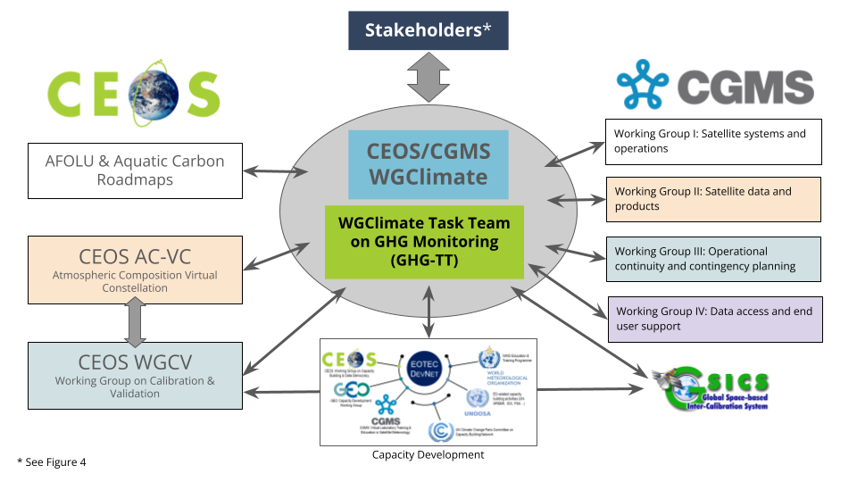
GHG Task Team & Roadmap - Recall
Greenhouse Gas Task Team (GHG TT) is part of joint CEOS-CGMS WGClimate
Responsible for maintaining and implementation of the GHG Roadmap
Coordinates GHG related activities across various CEOS & CGMS WGs
GHG Roadmap issue 1 is from Mar. 2020
and followed from recommendations in
GHG White Paper
SIT-39 decision to update GHG Roadmap

Slide 3

GHG Roadmap – Issue 2 – final
Issue 2 has been established in close
coordination with CGMS, G3W and IMEO
Endorsement received at CEOS Plenary
Endorsement received by CGMS in parallel
Issued publically in October 2024, available here

Slide 4
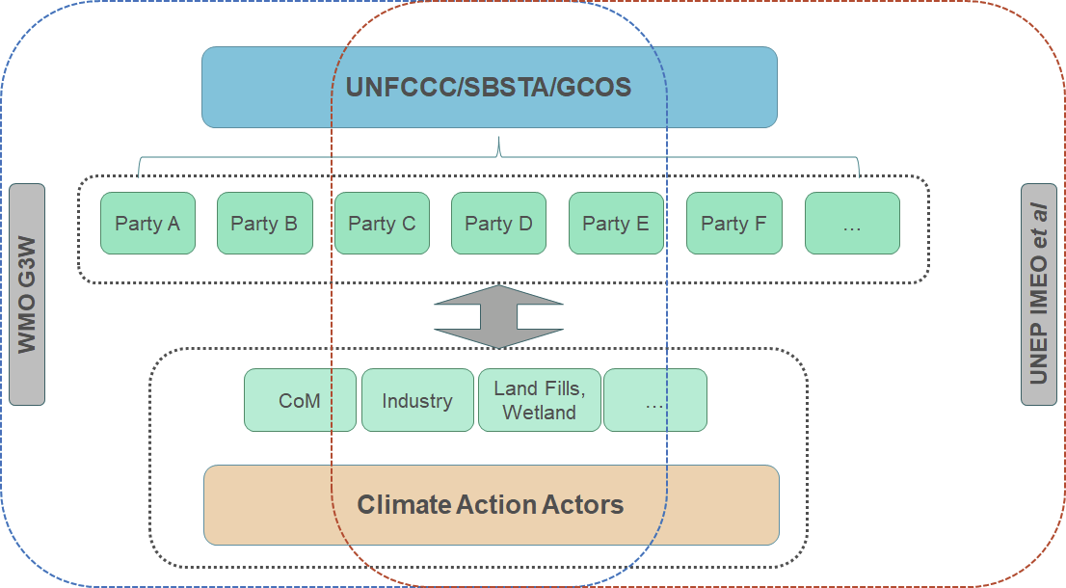
GHG Roadmap – Stakeholder
Issue 2 has specific focus on co-developing with stakeholders fit-for-purpose products
Section 3 covers “Stakeholders and their Requirements”, which explicitly
includes WMO G3W and UNEP’s IMEO
Section 5a describes the thematic activity for “Fostering Stakeholder Engagement”

Slide 5
GHG TT – Next steps
Thematic activities (long-term goals) described in section 5 with leads (plus deputies):
Fostering Stakeholder Engagement - Mark Dowell (John Worden, Wenying Su)
Sensor Development and Constellation Architectures – John Worden (AC-VC) (Yasjka)
Calibration and Level 1 Products – Hiroshi Suto (Akihiko Kuze)
Level 2 Products and Validation – Ruediger Lang & Dave Crisp
Flux Inversion Modelling and Validation – Kevin Bowman (Frederic Chevallier)
Best Practices – John Worden (Paul Green)
System Development – Richard Engelen (John Worden, Kevin Bowman)
Capacity Building – TT and EO TecNet
Implementation will focus on short-term actions as (to be) described in GHG Roadmap Annex C
Required resources are like current level (current activities)
Additional resources for new/larger activities will enter CEOS Work Plan and/or CGMS HLPP
CGMS role is specifically to support the transition to operational GHG Monitoring

Slide 6
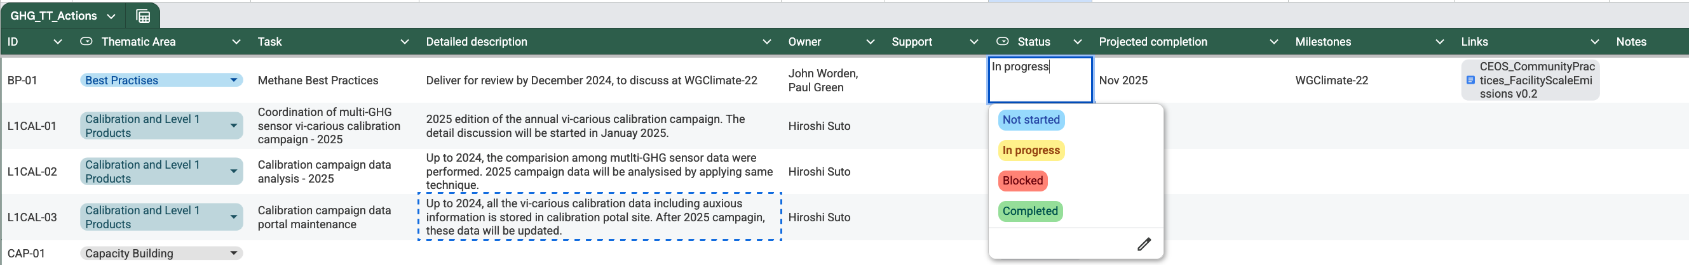
Short term activities – overview
Joint WGClimate and GHG Task Team meeting in Harwell
in February including stakeholders
Focus on fit-for-purpose serving stakeholders
Thenmatic area leads coordinated short-term action definition
Annex C of Roadmap issue 2 is maintained online → here

Slide 7
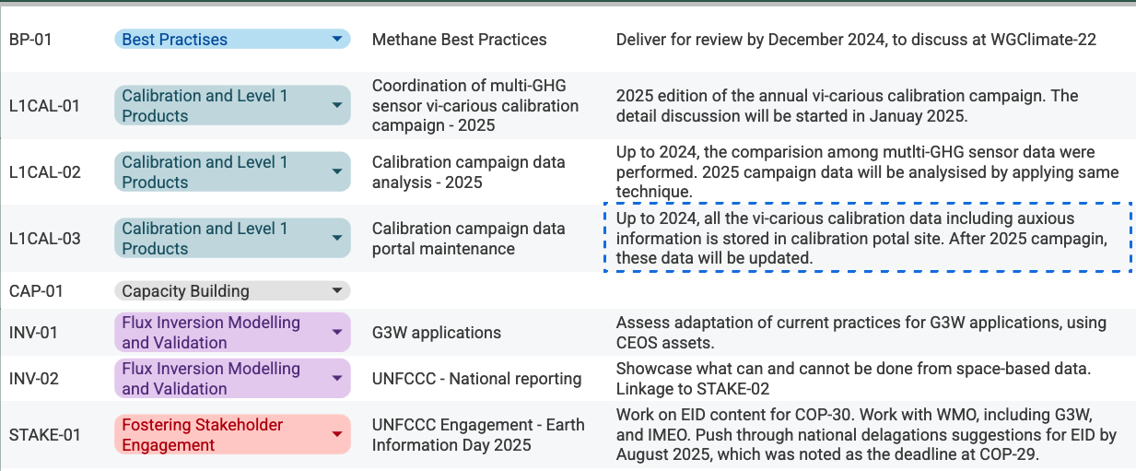
Short term activities – 1/3

Slide 8
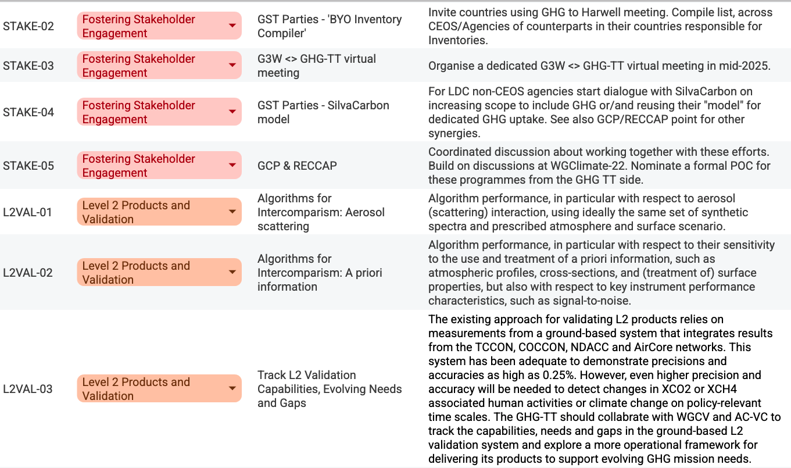
Short term activities – 2/3

Slide 9
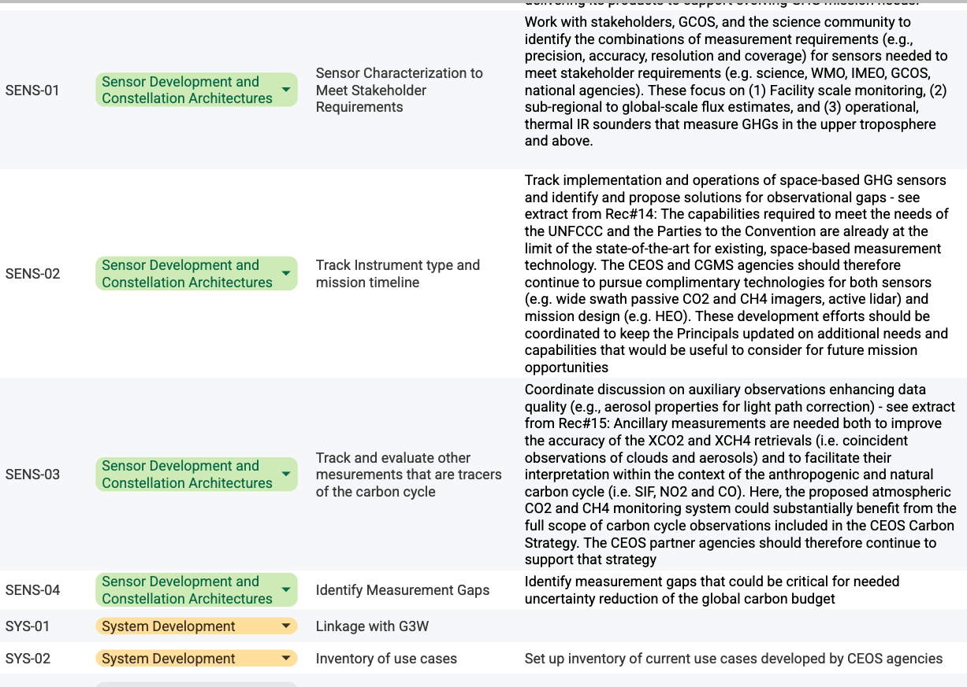
Short term activities – 3/3

Slide 10
Progress on activities
Started and on-going:
Best practices for GHG monitoring with initial focus on
facility-scale methane emissions → (next) agenda item 2.2
Collaboration with UNEP’s IMEO has been reestablished → agenda item 2.3
Continued strong involvement with WMO’s G3W → agenda item 2.4
Engagement with UNFCCC and planning for GST-2, plus broader
coordination between related CEOS roadmaps → session 4
National stakeholder engagement established in Harwell → agenda item 6.1
Gaps still to be tackled:
Capacity building, initial contact made in Harwell but needs to be followed up
At upcoming (June) AC-VC meeting more progress on defining activities

Slide 11
Time for questions,
discussion and actions
THANKS!

