Slide 1
UKSA CEOS Chair
Chair themes update
Beth Greenaway
UKSA CEOS Chair Team
Agenda Item 1.5
SIT-40
Fukuoka, Japan
8-10 April, 2025

Slide 2
UKSA CEOS Chair Themes: Unlocking Earth Observation for Society
Unlocking EO for Public Service
Unlocking EO for the UNFCCC Global Stocktakes
Unlocking EO for the Global Methane Pledge
CEOS in Schools and Youth Event

Slide 3
Unlocking EO for Public Service
To be covered in more detail at item 4.8 in EO Data Impact session
Planning a side meeting at SIT TW to discuss CEOS Agency initiatives for increasing the use of EO for public service
E.g. urban planning, climate/environment, minerals
All welcome to attend
Compile inputs to produce a short paper highlighting barriers and opportunities

Slide 4
Unlocking EO for the GST
Side meeting yesterday: Developing stronger links between CEOS Agencies and National COP Delegates to support the use of EO in climate policy decision making
JAXA/MEXT & UKSA/DESNZ started the discussion on their experiences in participating and negotiating at COP - different perspectives from UNOOSA, ESA, CSIRO, DLR, CSA
Outcomes:
There are lots of COPs - Intervention doesn’t start at the event
Have a key objective and focus for what we want to achieve - what do we want from the negotiators.
Tailor communication to the audience in a very complex environment.
Coordinate messaging and everyone speaks with one voice.
Next Steps: Tiger Team to discuss learning and collective actions for COP-30

Slide 5
Unlocking EO for the Global Methane Pledge
UKSA focus is to drive awareness and facilitate uptake of the methane best practices
Working with the Climate and Clean Air Coalition (CCAC) and Global Methane pledge teams to secure their recognition of the best practice work.
Best practice work was previewed at the recent CCAC plenary (Brasilia)
UK’s Department of Energy security and net zero has recently taken on the role of CCAC vice chair.
CCAC have offered a meeting between the methane best practice leads and GMP champion countries in late April to discuss in more detail.

Slide 6
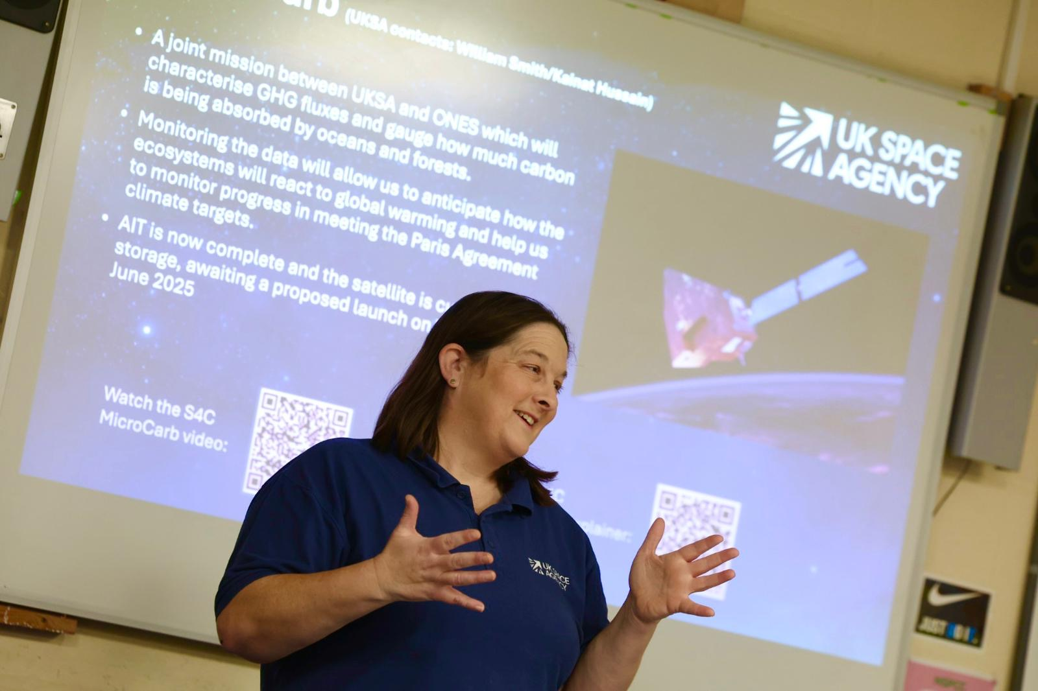
Recap: CEOS in Schools
Aim: Pilot a CEOS programme to inspire global youth collaboration in Earth Observation.
Educate: Create a low-cost, potentially repeatable pilot programme that can educate and inspire young people on the benefits of EO for Society.​
Collaborate: Provide opportunities for students to work collaboratively across borders using the platform of CEOS. ​
Engage: Facilitate a discussion between CEOS principals and youth representatives on key CEOS topic areas. ​

Slide 7
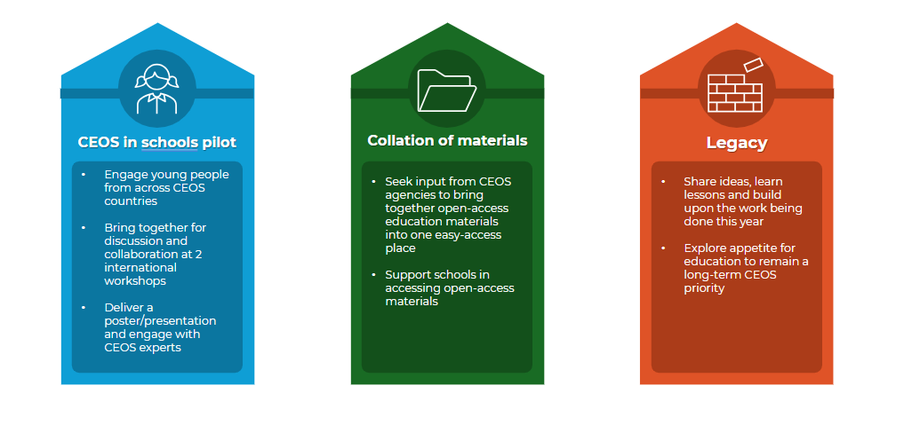
Three pillars of Youth programme

Slide 8
CEOS in Schools: Programme Overview
First international webinar (EO for urban environment) - 26 February 2025
Second international webinar (EO for biodiversity) - 26 March 2025
Posters - Students will develop poster presentations on their learnings to be showcased at Plenary
CEOS Youth Event - to be held at CEOS Plenary 2025 in Bath, UK.

Slide 9
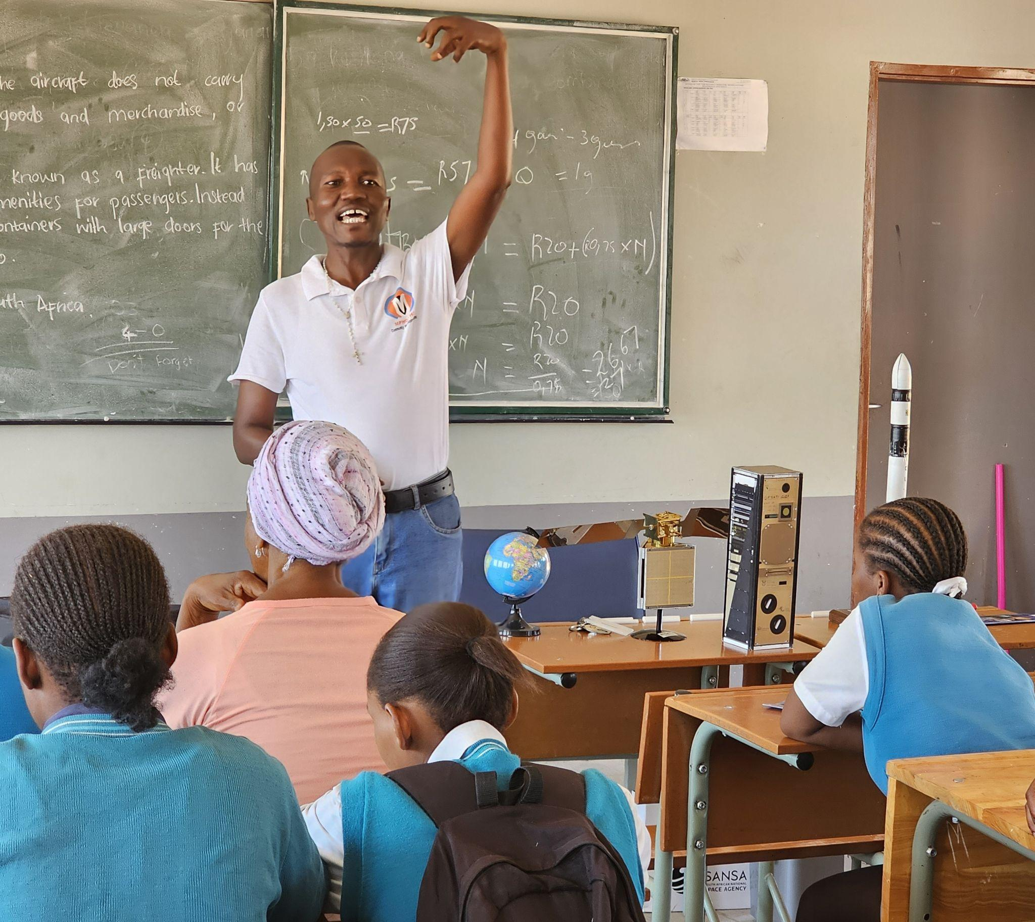
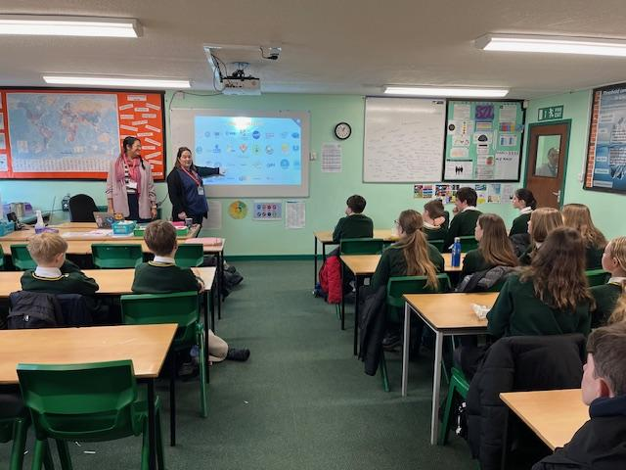
CEOS in Schools: 2 International Webinars
First international webinar: 26 February 2025, ‘EO for the Urban environment’
Attended by 125 students across six countries (Australia, Canada, Thailand, Japan, South Africa and the United Kingdom)
Use of EO for natural disasters and the urban environment with local examples
Second international webinar: 26 March 2025, ‘EO for biodiversity’
Featured a speaker from ESA’s Biomass mission
Theme provides continuity to the CSA CEOS Chair priority

Slide 10
CEOS in Schools: Youth Event
The CEOS in Schools Youth Event will take place on Tuesday of CEOS Plenary 2025 in Bath, UK.
Participating students will present their posters and take part in an Q&A with participating CEOS Principals
Posters will be on display throughout CEOS Plenary
Looking to foster a two-way dialogue between the youth voice and CEOS principals

Slide 11
CEOS in Schools: Collation of educational material
Problem: Identified a common challenge that educators are not able to easily locate accessible EO educational material
Objective: bring together open-source EO educational material from across CEOS agencies into one easy-access location for schools to access.
Timeframe: May - November
How: UKSA will coordinate and will reach out to CEOS agencies to sign-post open source EO educational material to be collated at an accessible site (CEOS.org?)

Slide 12
CEOS in Schools: Longer term
The CEOS Chair are keen to explore the appetite for retaining CEOS in Schools as a blueprint for future CEOS Chairs
Discussions have been held with SANSA chair of WGCapD on the possibility to continue the programme in WGCapD.
UKSA will be holding meeting in June/July with the CEOS community to gauge appetite for the programme’s sustainment.
We are keen for open feedback on the pilot programme to understand what would provide the most value to CEOS

Slide 13
A busy 2025!
BIOMASS Launch
Microcarb Launch
CEOS Chair
ESA Council of Ministers
COP-30

