Slide 1
CEOS SIT-40
CEOS 2025-2027 Work Plan
Steven Ramage
CEOS Executive Office
Agenda Item 1.4
SIT-40
Fukuoka, Japan
8-10 April, 2025

Slide 2

Governance & Work Planning
Four key governing documents primarily guide the work of CEOS:
  CEOS Terms of Reference defines the mission and scope of CEOS activities
  CEOS Strategic Guidance document articulates the overarching long-term purpose and goals of CEOS
  CEOS Governance and Processes document provides guidelines on the structure, operations, and processes CEOS employs to achieve its goals
  CEOS Work Plan (3-year rolling) sets forth near-term actions to achieve the goals outlined in the CEOS Strategic Guidance document
The CEOS Executive Office is the custodian of all CEOS Governing Documents, including the annual update of the 3-year CEOS Work Plan and the definition and monitoring of the deliverables it informs.

Slide 3


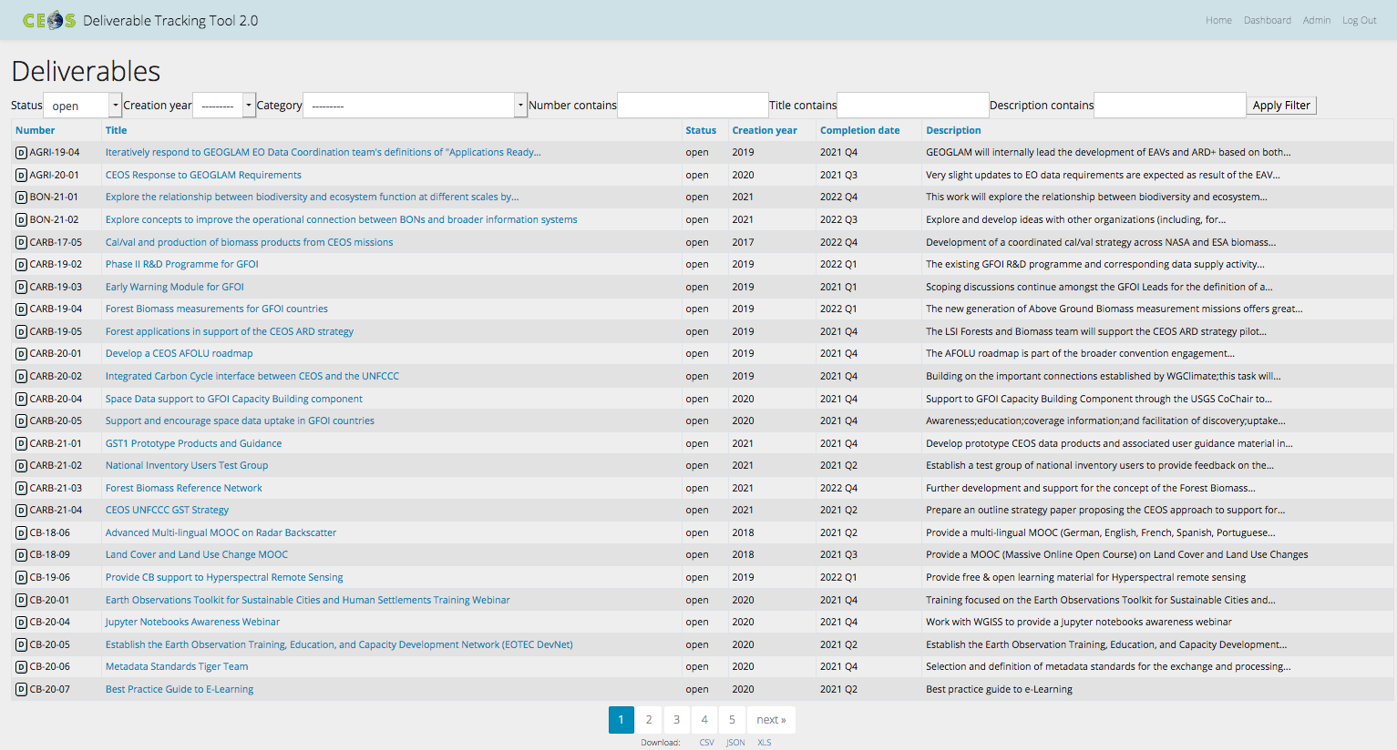
CEOS Work Plan
The 3-year work plan is updated by all CEOS entities every year and put forward for formal endorsement at the SIT in April. This year it is virtual endorsement afterwards. Rigorous work planning, execution, and monitoring are critical to the credibility of CEOS.
Jan
Dec
Feb
Nov
Mar
Plenary
Oct
SIT
Apr
Sep
May
SIT TW
Aug
Jun
Jul
Detailed work defined as deliverables: outlined in the WP, reconciled and tracked in the CEOS deliverable tracking tool
Notes:
We propose that virtual endorsement of the CEOS 2024-2026 Work Plan officially occur on Thursday 18th April 2024 subject to agreement and feedback.

Slide 4
CEOS Work Plan Structure
 | Chapter in Work Plan | Responsible
1 | Climate Monitoring, Research, and Services | WGClimate
2 | Carbon Observations in Support of Climate Science and Policy | GHG Task Team, GFOI, AFOLU
3 | Observations in Support of the Global Stocktake of the UNFCCC | UNFCCC
4 | Observations for Agriculture | GEOGLAM, AFOLU
5 | Observations for Disasters | WGDisasters
6 | Data Quality | WGCV
7 | Capacity Building and Data Democracy | WGCapD
8 | Data Discovery, Access, Preservation, Usability and Exploitation: approaches, systems, tools and technologies | WGISS
9 | Advancement of the CEOS Virtual Constellations | VCs, ARD Oversight Group
10 | Observations in support of the United Nations Sustainable Development Goals | SDG Coordination Group
11 | Support to Other Key Stakeholder Initiatives | UN Ocean Decade, Biodiversity Study Team, New Space and commercial sector
12 | CEOS Services | Accessibility of CEOS Agency datasets, RadCalNet, ECV Inventory, MIM Database

Slide 5
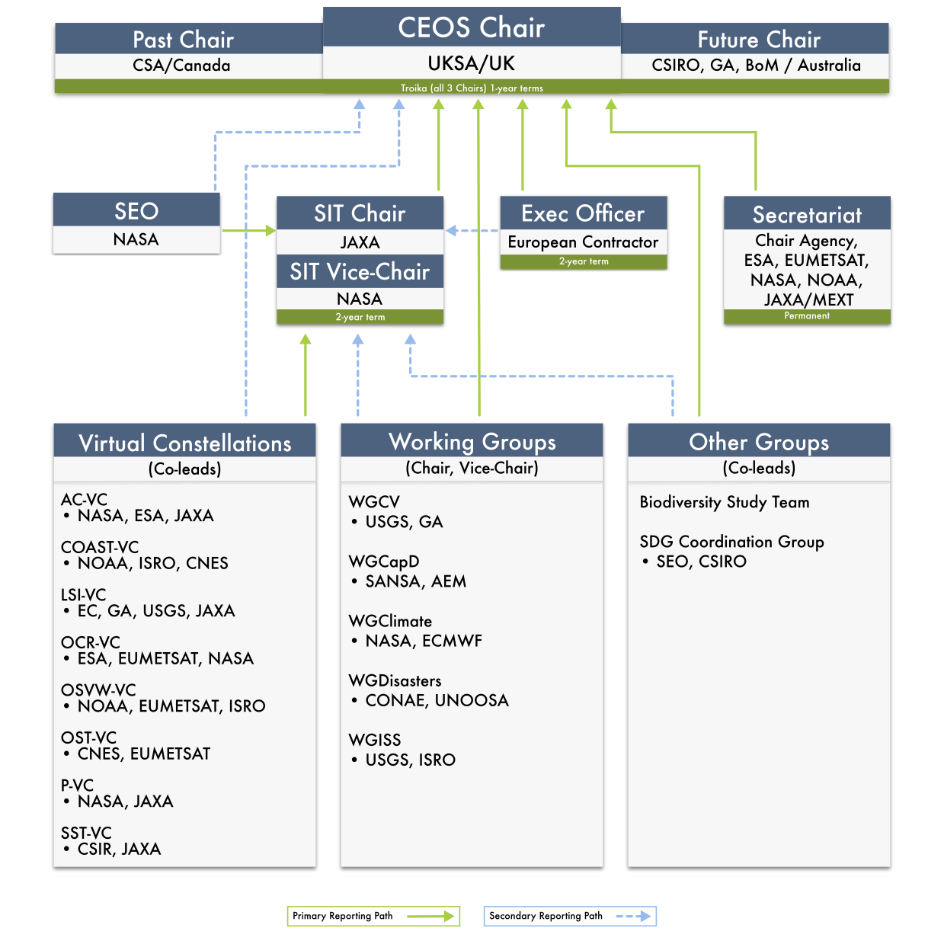
CEOS Organisation

Slide 6
2025 Progress
Chapter |  | Closed from 2024-26 WP | Carried over from 2024-26 WP | New for 2025-27 WP
1 | Climate Monitoring, Research, and Services | 3 | 5 | 4
2 | Carbon Observations in Support of Climate Science and Policy | 8 | 4 | 8
3 | Observations in Support of the Global Stocktake of the UNFCCC | 1 | 4 | 0
4 | Observations for Agriculture | 0 | 2 | 2
5 | Observations for Disasters | 4 | 7 | 0
6 | Data Quality | 6 | 9 | 0
7 | Capacity Building and Data Democracy | 4 | 12 | 19
8 | Data Discovery, Access, Preservation, Usability and Exploitation: approaches, systems, tools and technologies | 3 | 3 | 4
09 | Advancement of the CEOS Virtual Constellations | 7 | 18 | 7
10 | Observations in support of the United Nations Sustainable Development Goals | 6 | 1 | 6
11 | Support to Other Key Stakeholder Initiatives | 5 | 3 | 2
 | Totals | 47 | 68 | 52

Slide 7
Current deliverable deadlines
Chapter |  | 2025 | 2026 | 2027 & beyond
1 | Climate Monitoring, Research, and Services | 5 | 3 | 1
2 | Carbon Observations in Support of Climate Science and Policy | 4 | 0 | 8
3 | Observations in Support of the Global Stocktake of the UNFCCC | 4 | 0 | 0
4 | Observations for Agriculture | 4 | 1 | 0
5 | Observations for Disasters | 3 | 1 | 3
6 | Data Quality | 8 | 1 | 0
7 | Capacity Building and Data Democracy | 15 | 16 | 0
8 | Data Discovery, Access, Preservation, Usability and Exploitation: approaches, systems, tools and technologies | 3 | 4 | 0
9 | Advancement of the CEOS Virtual Constellations | 11 | 8 | 4
10 | Observations in support of the United Nations Sustainable Development Goals | 7 | 0 | 0
11 | Support to Other Key Stakeholder Initiatives | 0 | 5 | 0
 | Totals | 64 | 39 | 16

Slide 8
CEOS Work Plan links to SIT-40
 | Chapter in Work Plan | SIT-40 Session links
1 | Climate Monitoring, Research, and Services | 1,3,4,6
2 | Carbon Observations in Support of Climate Science and Policy | 1,4,6
3 | Observations in Support of the Global Stocktake of the UNFCCC | 1,2,4
4 | Observations for Agriculture | 1,4
5 | Observations for Disasters | 1,5
6 | Data Quality | 1,3,5
7 | Capacity Building and Data Democracy | 1,8
8 | Data Discovery, Access, Preservation, Usability and Exploitation: approaches, systems, tools and technologies | 1,8
9 | Advancement of the CEOS Virtual Constellations | 1,7,8
10 | Observations in support of the United Nations Sustainable Development Goals | 1,5,7,8
11 | Support to Other Key Stakeholder Initiatives | 1,8

Slide 9
Work Plan Timeline
❖ Current version 3 of the Work Plan to be shared
with CEOS Secretariat and other entities
❖ All updates to outstanding issues by 30th April 2025
❖ Distribution to CEOS Principals on 5th May 2025
❖ Virtual endorsement of the CEOS 2025-2027 Work Plan
by CEOS Principals 19th May 2025

Slide 10
Thanks for all contributions
Steven Ramage
CEOS Executive Office
Agenda Item 1.4
SIT-40
Fukuoka, Japan
8-10 April, 2025

