Slide 1
CEOS SIT-40
Objectives & Action Review
Osamu Ochiai, JAXA
Agenda Item #1.3
SIT-40
Fukuoka, Japan
8-10 April, 2025

Slide 2
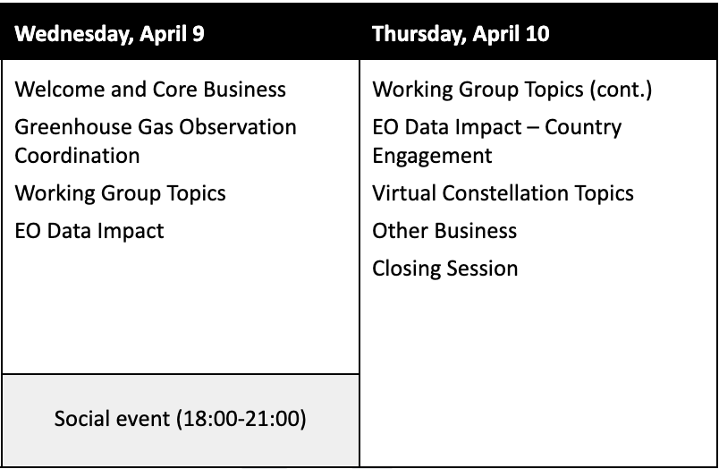
SIT-40 Sessions

Slide 3
Greenhouse Gas Observation Session
Best Practices for Remote Sensing-based Estimates of Facility-scale Emissions (methane best practices)
  Audience, context, uptake, Global Methane Pledge
International Methane Emissions Observatory (IMEO) contributions and opportunities
CEOS Greenhouse Gas (GHG) Roadmap implementation
WMO Global Greenhouse Gas Watch (G3W) and CEOS engagement.

Slide 4
EO Data Impact Session
For endorsement: WGClimate Global Stocktake Lessons Learned
CEOS country engagement activities for national inventories and reporting
Decision: SIT Chair led revision of the CEOS Global Stocktake Strategy
Aquatic Carbon Roadmap
AFOLU Roadmap actions + implementation, tracking and resourcing.
Increased CEOS engagement with the IPCC – Task Force on National Greenhouse Gas Inventories (TFI) and representation of satellite Earth observation data and products in their Emissions Factor Database (EFDB)

Slide 5
Working Group Topics
WGDisasters: Early Warnings for All (EW4All) and workshop proposal.
WGISS: Draft Interoperability Handbook and recommendations for Architecture, Interface, Vocabulary, Quality, and Policy.
WGClimate: endorsement of the Space Agency Response to the 2022 Global Climate Observing System (GCOS) Implementation Plan.
WGCV: Match-up Database

Slide 6
Virtual Constellation Topics
COAST-VC and SST-VC: priority coastal areas for extended SST observation coverage for new ultra-high-resolution thermal infrared instruments
  Action: for agencies to review ahead of virtual endorsement
COAST-VC: UN Ocean Decade talking points
LSI-GEOGLAM: CEOS response to the Essential Agriculture Variables (EAVs) and update on May 2025 EAV Workshop.
  New terms of reference and action calling for representatives to team and EAV workshop
P-VC: New Missions for Global Precipitation Measurement
LSI-VC: CEOS-ARD updates

Slide 7
Other Business
Review initial progress of the CEOS Biodiversity Study Team
Conclude Step-C (and D?) of the External Request Process analysis of the UNCCD approach to CEOS
Discuss the Third International Workshop for Coordination of International Spaceborne SAR Missions
CEOS In Schools virtual workshop outcomes and options for long-term sustainment of this initiative in CEOS
WIGOS 2050 Vision development
Space4Ocean Alliance
Sustainable Development Goals (SDG) Coordination Group Report
SEO report, CEOS Work Plan 2025-2027, UKSA CEOS Chair themes

Slide 8
Actions due at SIT-40

Slide 9
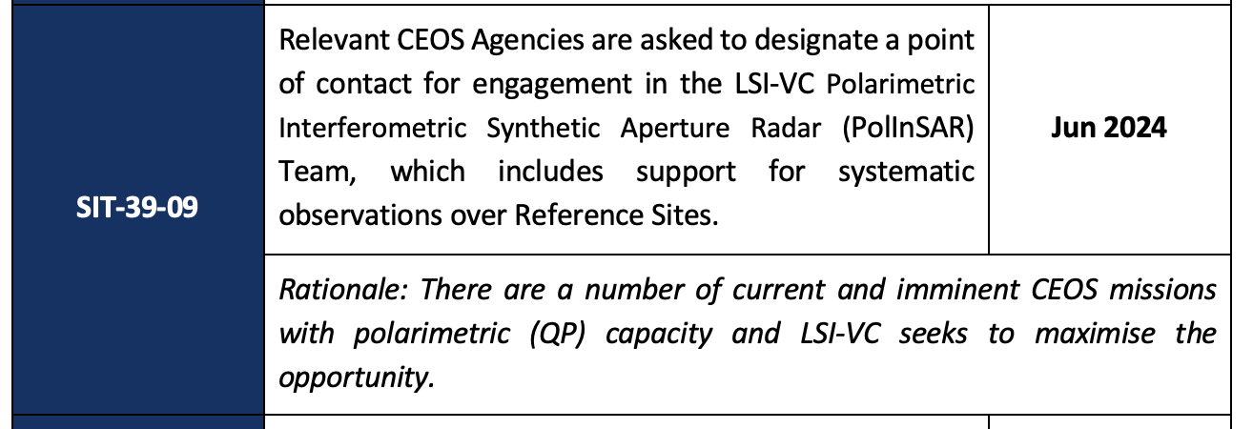
NASA (NISAR) - POC designated
JAXA (ALOS-4) - POC designated
ESA (BIOMASS) - POC designated
CSA (RCM, Radarsat-2) - POC designated
CSIRO (NovaSAR) - POC designated
CONAE (SAOCOM-1) - in progress
ASI (COSMO-SkyMed) - in progress
DLR (TSX dual-pol) - no response
ISRO (EOS-04, NISAR-S) - no response
The roles of the Points of Contacts would be to support the coordination of observations with their respective SAR mission(s) over the POLINSAR reference sites - on a best effort basis - and to facilitate access of the data acquired to the science team, preferably on the POLINSAR repository hosted by the SEO on the CEOS Analytics Lab.

Slide 10
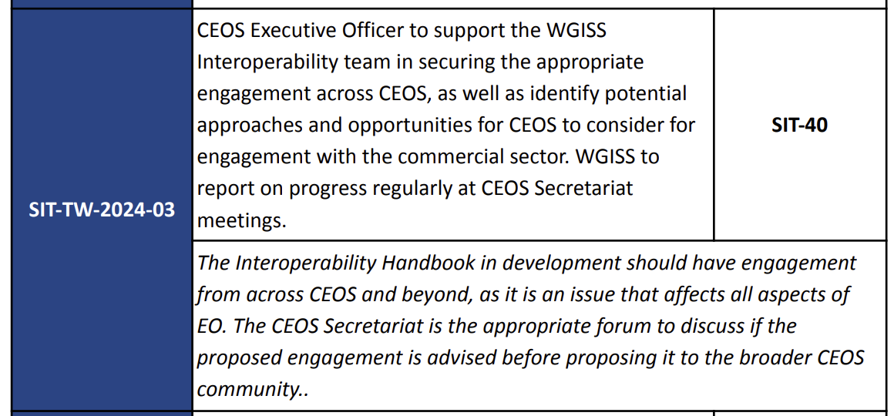
>> Interoperability Handbook update scheduled at SIT-40 (item 3.2)
>> Sufficient representation, action closed.

Slide 11
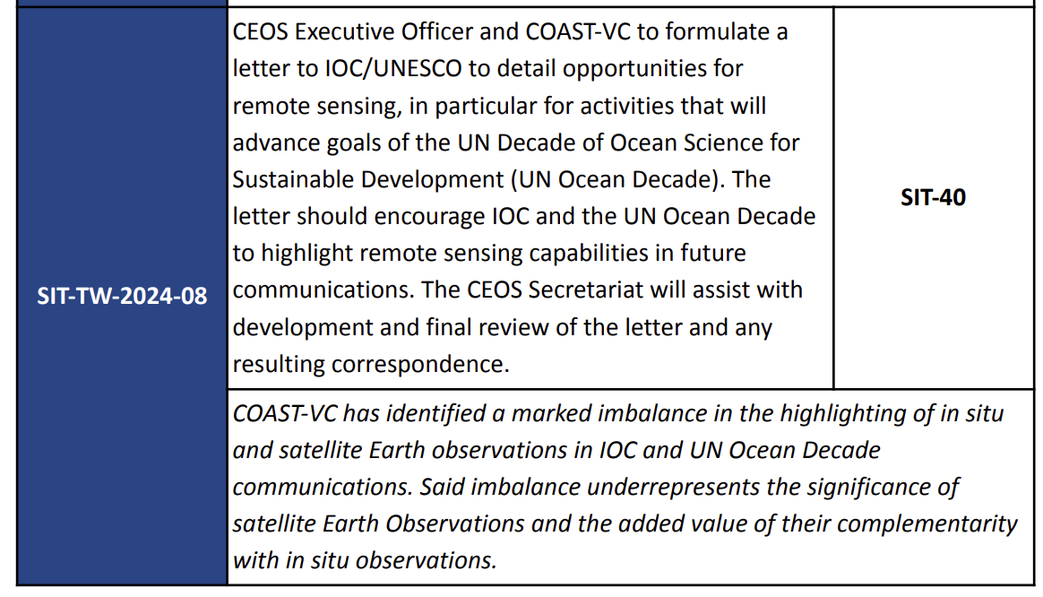
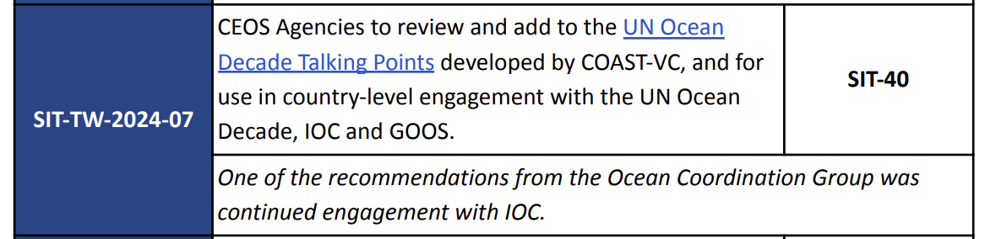
>> Update on COAST and the talking points presented under item 7.2
>> Actions closed

Slide 12
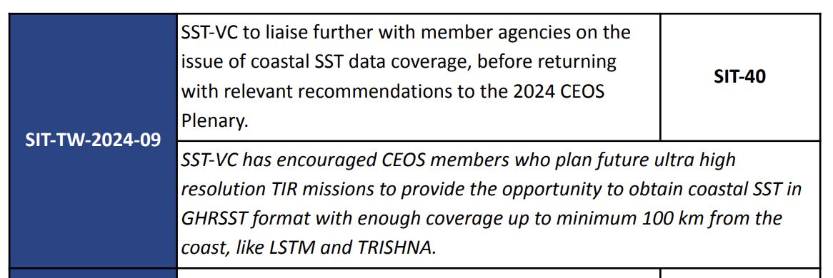
>> Recommendation from COAST-VC and SST-VC regarding extended observation coverage from new ultra-high-resolution thermal infrared instrument being presented under item 7.1 - action closed
>> Virtual endorsement after SIT a likely action

Slide 13


Slide 14
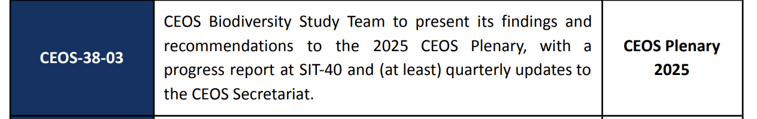
>> Biodiversity Study Team presenting to SEC regularly
>> BST invited to present at SIT-40 (item 3.1)
>> Action closed

Slide 15
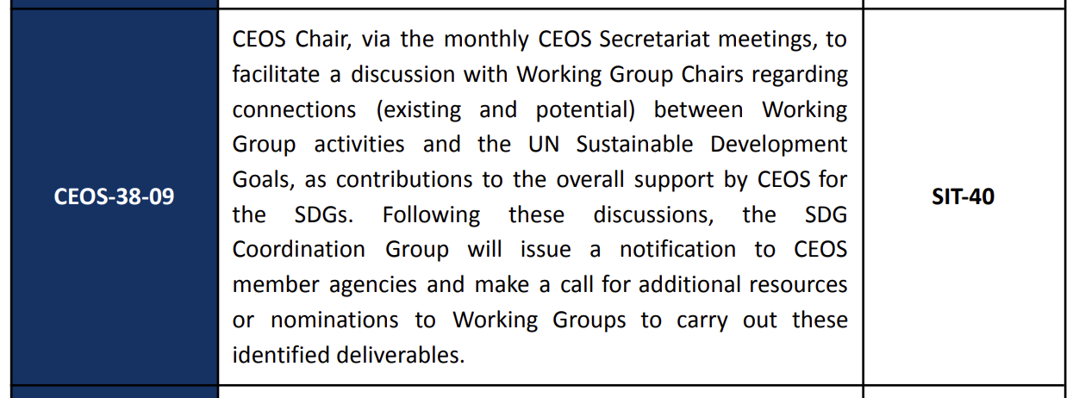
>> CEOS chair invited feedback from WG Chairs and passed info to SDG CG, but nothing relevant to start a new activity
>> Action closed

