Slide 1
Hybrid Meeting Protocols
In-person presenters: The SIT Chair Team will share presentations on behalf of presenters
Presentations should be uploaded to the Google Drive in advance
You will be given a clicker to advance your slides
Inform the SIT Chair Team if you wish to display your slides instead.
Online presenters: Share your own slides
Unless you are presenting or making an intervention, please do not activate your webcam or microphone.
If you want to intervene, please raise your hand in webex
If your bandwidth is slow while presenting, please turn off your webcam.

Slide 2
Other Logistics
Group Photo:
After Session 2.2, the logistics team will guide you all to the Group Photo place.
Coffee Break:
Coffee and snacks will be served in the Foyer of SIT-40 Room.
Lunch:
Lunch will be served in Link Room 2+3. (next to SIT-40 Room)
Dinner Reception(April 9th/18:45~20:45):
Shuttle Bus departs at 18:00 ( Meeting Place: TBD)
Return Bus departs at 21:00 for the Daimyo Conference via Hakata Sta.
Meeting Room:
Please ask the staff at registration desk about room availability.

Slide 3
Guest Wi-Fi
Please pick up Wi-Fi connection info/Floor map at registration desk

Slide 4
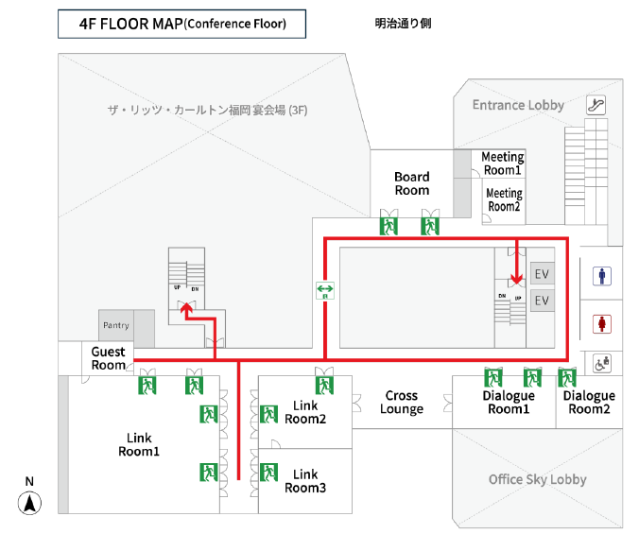
Emergency Exit & Route

