Slide 1
CEOS SIT-40
Session 1: Welcome and Opening
SIT-40
Fukuoka, Japan
8-10 April, 2025

Slide 2
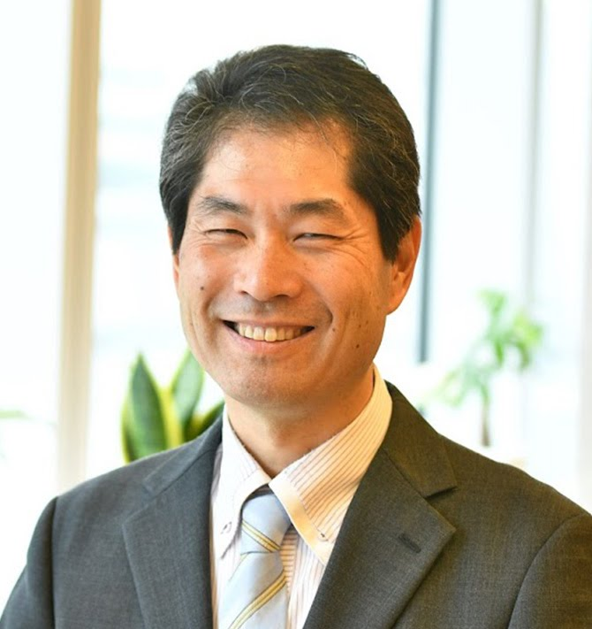
Welcoming Remarks
Hironori Maejima
CEOS SIT Chair 2024-2025
Senior Chief Officer of Earth
Observation Missions
JAXA
SIT Chair Team, JAXA
Agenda Item #1.1
SIT-40 2025, Fukuoka, Japan
8-10 April, 2025

Slide 3
SIT 2024-25 Approach
Focused: a few priorities reflecting major thrusts across civil EO programmes and priority needs, consistent with past CEOS outcomes
Tangible and achievable outcomes with enduring benefit
Ensuring continuity: for existing SIT and CEOS WP activities
Reflecting resource availability
Stressing CEOS agency participation
Consistent with the original vision for SIT:
Principals in SIT meetings address significant challenges via coordination and observing system harmonisation across space agencies
Effective use of the different meetings:
SIT: Significant debate and decision - for Principals
TW: Working Teams reporting, interaction, and prep for Plenary
All meetings cannot accommodate reporting of all CEOS business
Ensure effective intersection between CEOS management and WP contributors

Slide 4
JAXA SIT Chair Priorities
JAXA SIT Chair Priorities
Climate Policy Impact – addressing obstacles and opportunities for CEOS agency data, particularly AFOLU/Biomass map datasets, to have maximum impact in the key climate policy processes such as the Global Stocktake of the Paris Agreement
GHG observations from space – addressing coordination for data continuity challenges ahead and developing good practices so that operators of all kinds may contribute to societal needs
Supporting existing & emerging CEOS business
Escalating, elevating and expediting the CEOS WP activities underway and planned in which CEOS agencies are investing

Slide 5
SIT Term Overview
2024
2025
SIT-39
SIT-TW
Plenary
Canada
SIT-40
SIT-TW
Plenary
UK
COP-30
GST STRATEGY
GST 1 LESSONS LEARNED
GST STRATEGY UPDATE
Draft
Draft & CEOS WP actions
CARBON ROADMAPS
GHG ROADMAP UPDATE
Draft
AFOLU ROADMAP ACTIONS
LATE
SIT CHAIR TO ENSURE LINKAGES NEEDED
AQUATIC CARBON ROADMAP DEVELOPMENT
IMEO & G3W
INTERFACES
PROGRESS IMEO & G3W TOPICS/challenges
GHG Best Practices
CEOS GHG BEST PRACTICES
UKSA COP-30 actions
Draft
Final
GCOS IP
CEOS RESPONSE
Mid-2025 for CEOS & CGMS
ECV INVENTORY
VERSION 5
VERSION 6
STRATEGIC TOPICS
NEW PATHWAYS/TARGETS
NEW CEOS WP ACTIONS RE GST2
INTEGRATED PLANNING FOR COP & SBSTA
NATIONAL ENGAGEMENT

Slide 6
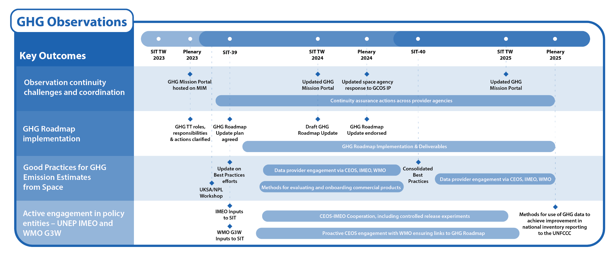
GHG Observations

Slide 7
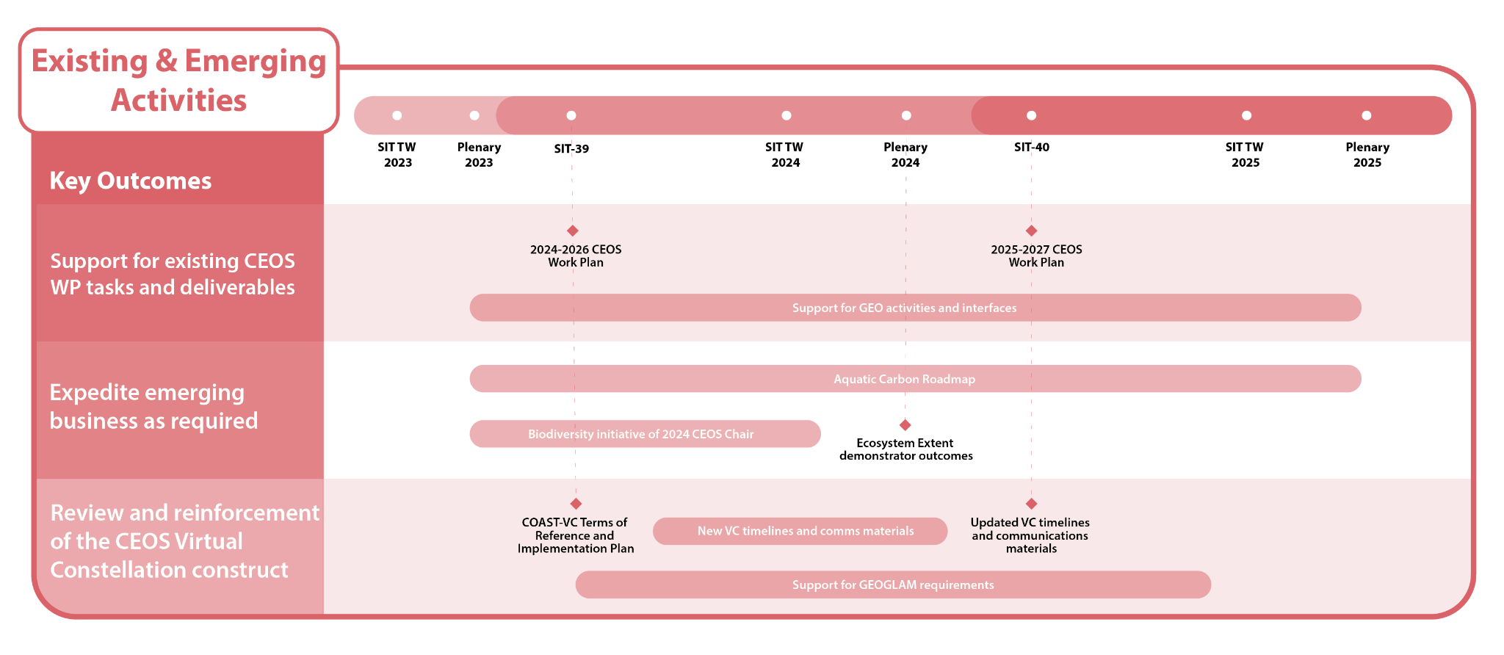
Existing & Emerging Activities

Slide 8
Tour de Table
Round table introduction by Principals of members of their delegation (in person and online)

