Slide 1

Welcome to SIT-39
Hosted by JAXA
Wifi: Hall_Houou
Password: houou001

Slide 2
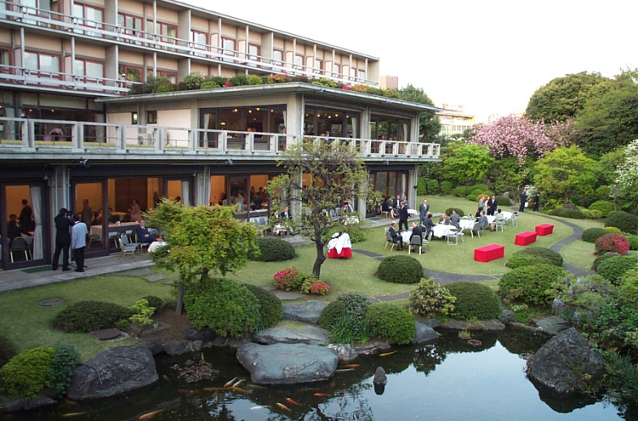

Reception: International House of Japan
Daruma

Slide 3

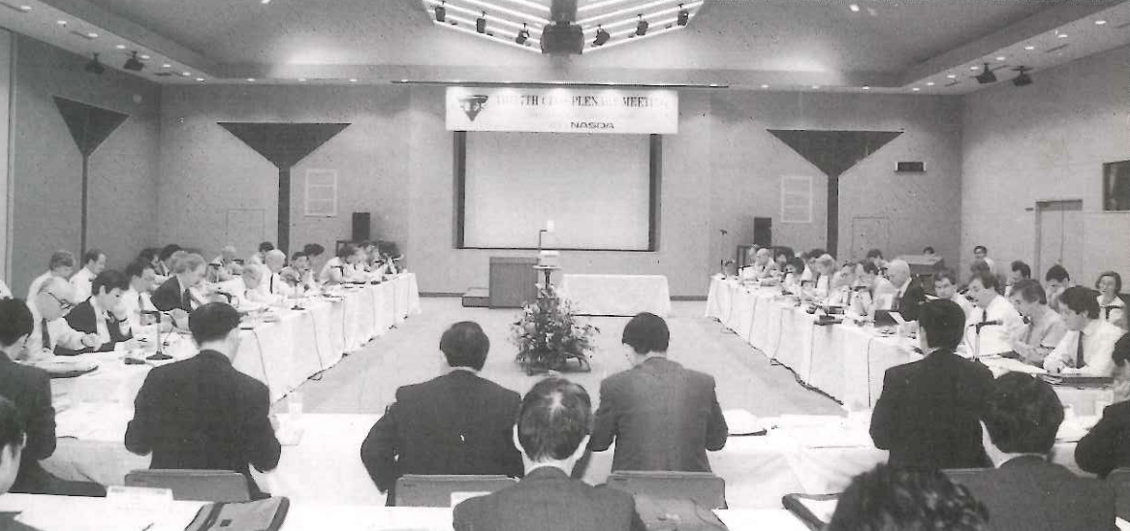
2024 is CEOS’ 40th Anniversary!
7th CEOS Plenary in Tsukuba Space Centre, hosted by NASDA (now JAXA)

