Slide 1
SIT-39 2024
Wrap-up
JAXA SIT Chair Team
Agenda Item #8.6
SIT-39 2024, Tokyo, Japan
10th - 11th April 2024

Slide 2
Wrap-up
  Day 1 review covered first thing today
  Day 2 summary/actions covered below.
  Formal minutes and actions review opportunities in coming weeks

Slide 3
6.1 Virtual Constellation/Working Group Issues & Discussions
Issues raised
  A ‘light’ Precipitation ARD PFS is being considered. Mature standards for precipitation datasets already exist - will look at assessing common criteria amongst existing providers as a start on a PFS activity.
  Updated CEOS ARD strategy for endorsement at Plenary
  Annick Sylvestre-Baron (CNES) of OST-VC replaced by Yannice Faugere (CNES)
  SST-VC seeking additional membership from CONAE, CSA, and INPE
  Ed Armstrong (NASA) of SST-VC replaced by Misako Kachi (JAXA)
Action and Decisions recorded and Documents endorsed
  P-VC TOR updated
  LSI-VC POLINSAR POCs requested. And inclusion of effort in CEOS WP

Slide 4
6.2 WMO Update
Issues raised
  Priorities for CEOS from CM-15 include: EW4ALL, collaboration with the commercial satellite sector (CGMS WGIII), G3W, update of the WIGOS 2040 Vision document
Action and Decisions recorded and Documents endorsed
  Connect WGDisasters with EW4ALL via WMO SP

Slide 5
6.2 Commercial Sector Issues
Issues raised
  Reminder of the NSTT recommendations and WP actions
  LSI-VC held successful Japan commercial EO workshop last week
  SEO progressing work on CEOS Analytics Lab and commercial data interoperability with CEOS data
  USGS updated on their commercial sector engagement including JACIE and use of commercial cloud data hosting and distribution services

Slide 6
7.1 Session Introduction
Issues raised
  GHG Observations a headline priority for the JAXA SIT term

Slide 7
7.2 CEOS Greenhouse Gas Roadmap Update
Issues raised
  Changes in the operating context and new requirements from G3W and IMEO in particular necessitate the update of the GHG Roadmap
  Propose to bring a draft to SIT TW and updated Roadmap to Plenary
  Note the need for linkages to land/ocean carbon
Action and Decisions recorded and Documents endorsed
  Agreed to update the Roadmap
  GHT TT tasked to do so, aiming for Plenary

Slide 8
7.3 IMEO Activities and CEOS Cooperation
Issues raised
  UNEP’s IMEO aims to provide the data required to target methane reductions at the speed and scale needed to achieve climate goals
  IMEO is a core implementing partner of the Global Methane Pledge
  Key asks of CEOS are:
    Reduced latency of alert products
    Help with a tip-and-cue system with global mappers to automatically aid in coordination of plume imager tasking
    Engage with IMEO on best practices to promote trust in data
    Collaboration on controlled release studies
    Support process of moving from L2 to L4 products
  Noted the need for quick, low accuracy data with few false positives for plumes
Action and Decisions recorded and Documents endorsed
  GHG Roadmap 2024 update to reflect IMEO requirements

Slide 9
7.4b UKSA/NPL efforts
Issue raised
  Auditing scheme - aiming for pre COP30 publication (Q4 2025)
  NPL hosted a UKSA-sponsored methane reporting standards workshop 26-28 Feb
  Builds on previous CEOS work and partners with key parallel programmes and stakeholders to add value as an underpinning framework to enable reporting
  CEOS can act in a co-ordinating role in this relatively immature phase but open to stepping back as the initiative matures and suitable stakeholders assume roles.
  Various asks in: GHG inventories, standards development, and validation

Slide 10
7.4 Emission Measurement Best Practices & Standards
Issue raised
  Emissions based on Public and New Space observations of GHG increasingly used for policy/science and needed for a functioning carbon market
  We need a set of best practices (community accepted methodology, Verification, Validation, Uncertainty Quantification+traceability to reference measurements, reproducibility)
  CEOS support of ”Best Practices” effort enables interaction with New Space measurements 🡪 New Space adoption of best practices increases trust / usability of their data.
  Lessons learned can apply to developing best practices for area fluxes in support of the global stock take that are needed to track changes to the global carbon cycle.

Slide 11
7.5 GHG Continuity Coordination and Focus
Issues raised
  Some cancellations, delays and budget cuts
  Gaps include large urban areas and oceans
  Highlighted goals for GST2 timeframe
  Multiple CEOS bodies involved: SIT, GHT TT, WGCV, AC-VC, LSI/AFOLU, WGCapD
  Several requests to support continuity and utility of data

Slide 12
7.6 WMO Global Greenhouse Gas Watch (G3W) and CEOS Cooperation
Issues raised
  G3W is a WMO Flagship
  $1Bn: 70% Observations, 29% Integration, 1% Coordination
  2025 onwards Ramp up Operations with sustained funding
  Crucial that G3W Space Remote Sensing components well coordinated.
  Observations need to satisfy G3W Operating Centres
  Need regular updates re GHGs satellite capabilities (public & private)
  G3W Cal/Val activities with CEOS Agencies and National and Regional efforts

Slide 13
7.7 GHG Observations Closing Discussion
Support efforts to update to the GHG Roadmap to incorporate new capabilities (e.g., facility-scale missions) and new data users (e.g., WMO G3W, UNEP IMEO)
Commit to specific efforts supporting implementation of GHG Roadmap activities
Fully support ongoing GHG missions to ensure data quality and continuity
Expedite implementation of new GHG missions that more fully meet stakeholder needs for precision, accuracy, resolution and coverage
Ambitious timetable highlighted in comments

Slide 14
8.1 CEOS Aquatic Carbon Roadmap Update
Issues raised
  ACR to provide a framework and serve as a guiding vision for long term (~ 15+ years) coordination of CEOS agency observing programmes in support of the science and policy needs for Aquatic carbon related information
  Coordinators: Marie-Helene Rio (ESA), Laura Lorenzoni (NASA), Hiroshi Murakami (JAXA)
  Some progress since plenary endorsement
  Objective to have the consolidated outline + Book captains assigned before the next IOCCG Committee Meeting (April 24th-26th)
  ESA Blue Carbon from Space Forum 14-17 Apr, Bern
ACTION: SIT Chair will confer with Aquatic Carbon, GHG and AFOLU leads to establish the necessary linkages and their timing

Slide 15
8.2 CEOS Sustainable Development Goals (SDG) Coordination Group Update
Issues raised
  CEOS maintains EO Support Sheets
  SDGs are least resourced of all four CEOS Strategic Priorities
Action and Decisions recorded and Documents endorsed
  CEOS Chair & SEO to follow up at future SEC meetings regarding support for SDGs from more broadly across CEOS.

Slide 16
8.3 CEOS Communications Update
Issues raised
  Strategy focusing on
    40 years of CEOS
    Biodiversity
    GHG obs
  Impact cards planned
  Outreach at SatSummit, IGARSS, GEO week

Slide 17
8.4 ICGS-SAR and CEOS Agency Engagement
Issues raised
  ICGS established in 2018 to maximise science & societal returns from SAR missions
  ASI, CONAE, CSA, DLR, ESA, ISRO, JAXA, and NASA
  Cooperation with CEOS has been discussed and concluded a ‘Bridging’ Mechanism would be welcome
  Provide some sort of connection between ICGS-SAR and CEOS Agency Principals - via POCs
Action and Decisions recorded and Documents endorsed
  Follow up planned

Slide 18
8.5 NASA’s Earth Science to Action Strategy
Issue raised
  Overview of the strategy
  Invitation to collaborate

Slide 19
8.6 SIT-39 Wrap-up
Issue raised
Action and Decisions recorded and Documents endorsed

Slide 20
SIT term meeting dates
SIT TW 2024: 17-19 September, Sydney (CSIRO/GA host)
SIT-40: Targeting week 7 April, 2025
SIT TW 2025: Week 8 Sep 2025, Darmstadt (EUM host)

Slide 21
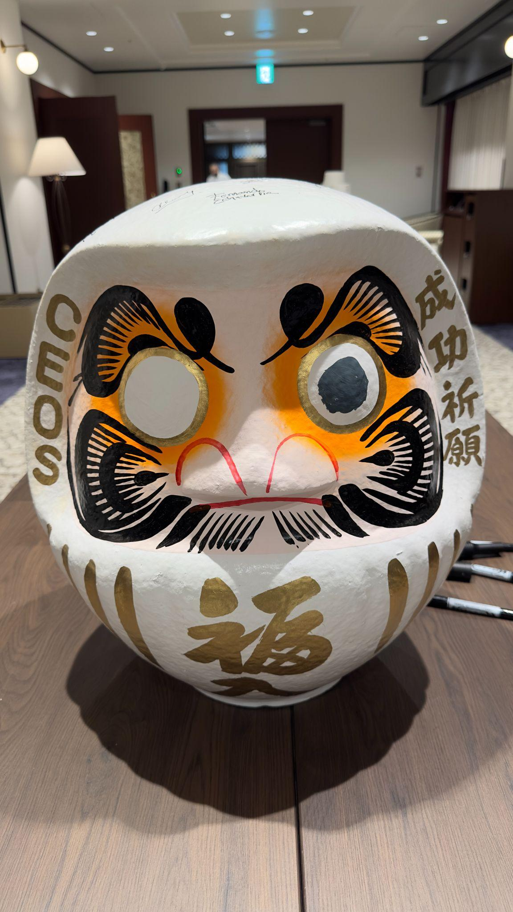
Did we get the second eye?
Be sure to sign the daruma

