Slide 1
SIT-39
2024
NASA’s Earth Science-to-Action Strategy
Call for International Coordination & Collaboration
Sid Boukabara, NASA
Agenda Item #8.5
SIT-39 2024, Tokyo, Japan
10th - 11th April 2024

Slide 2
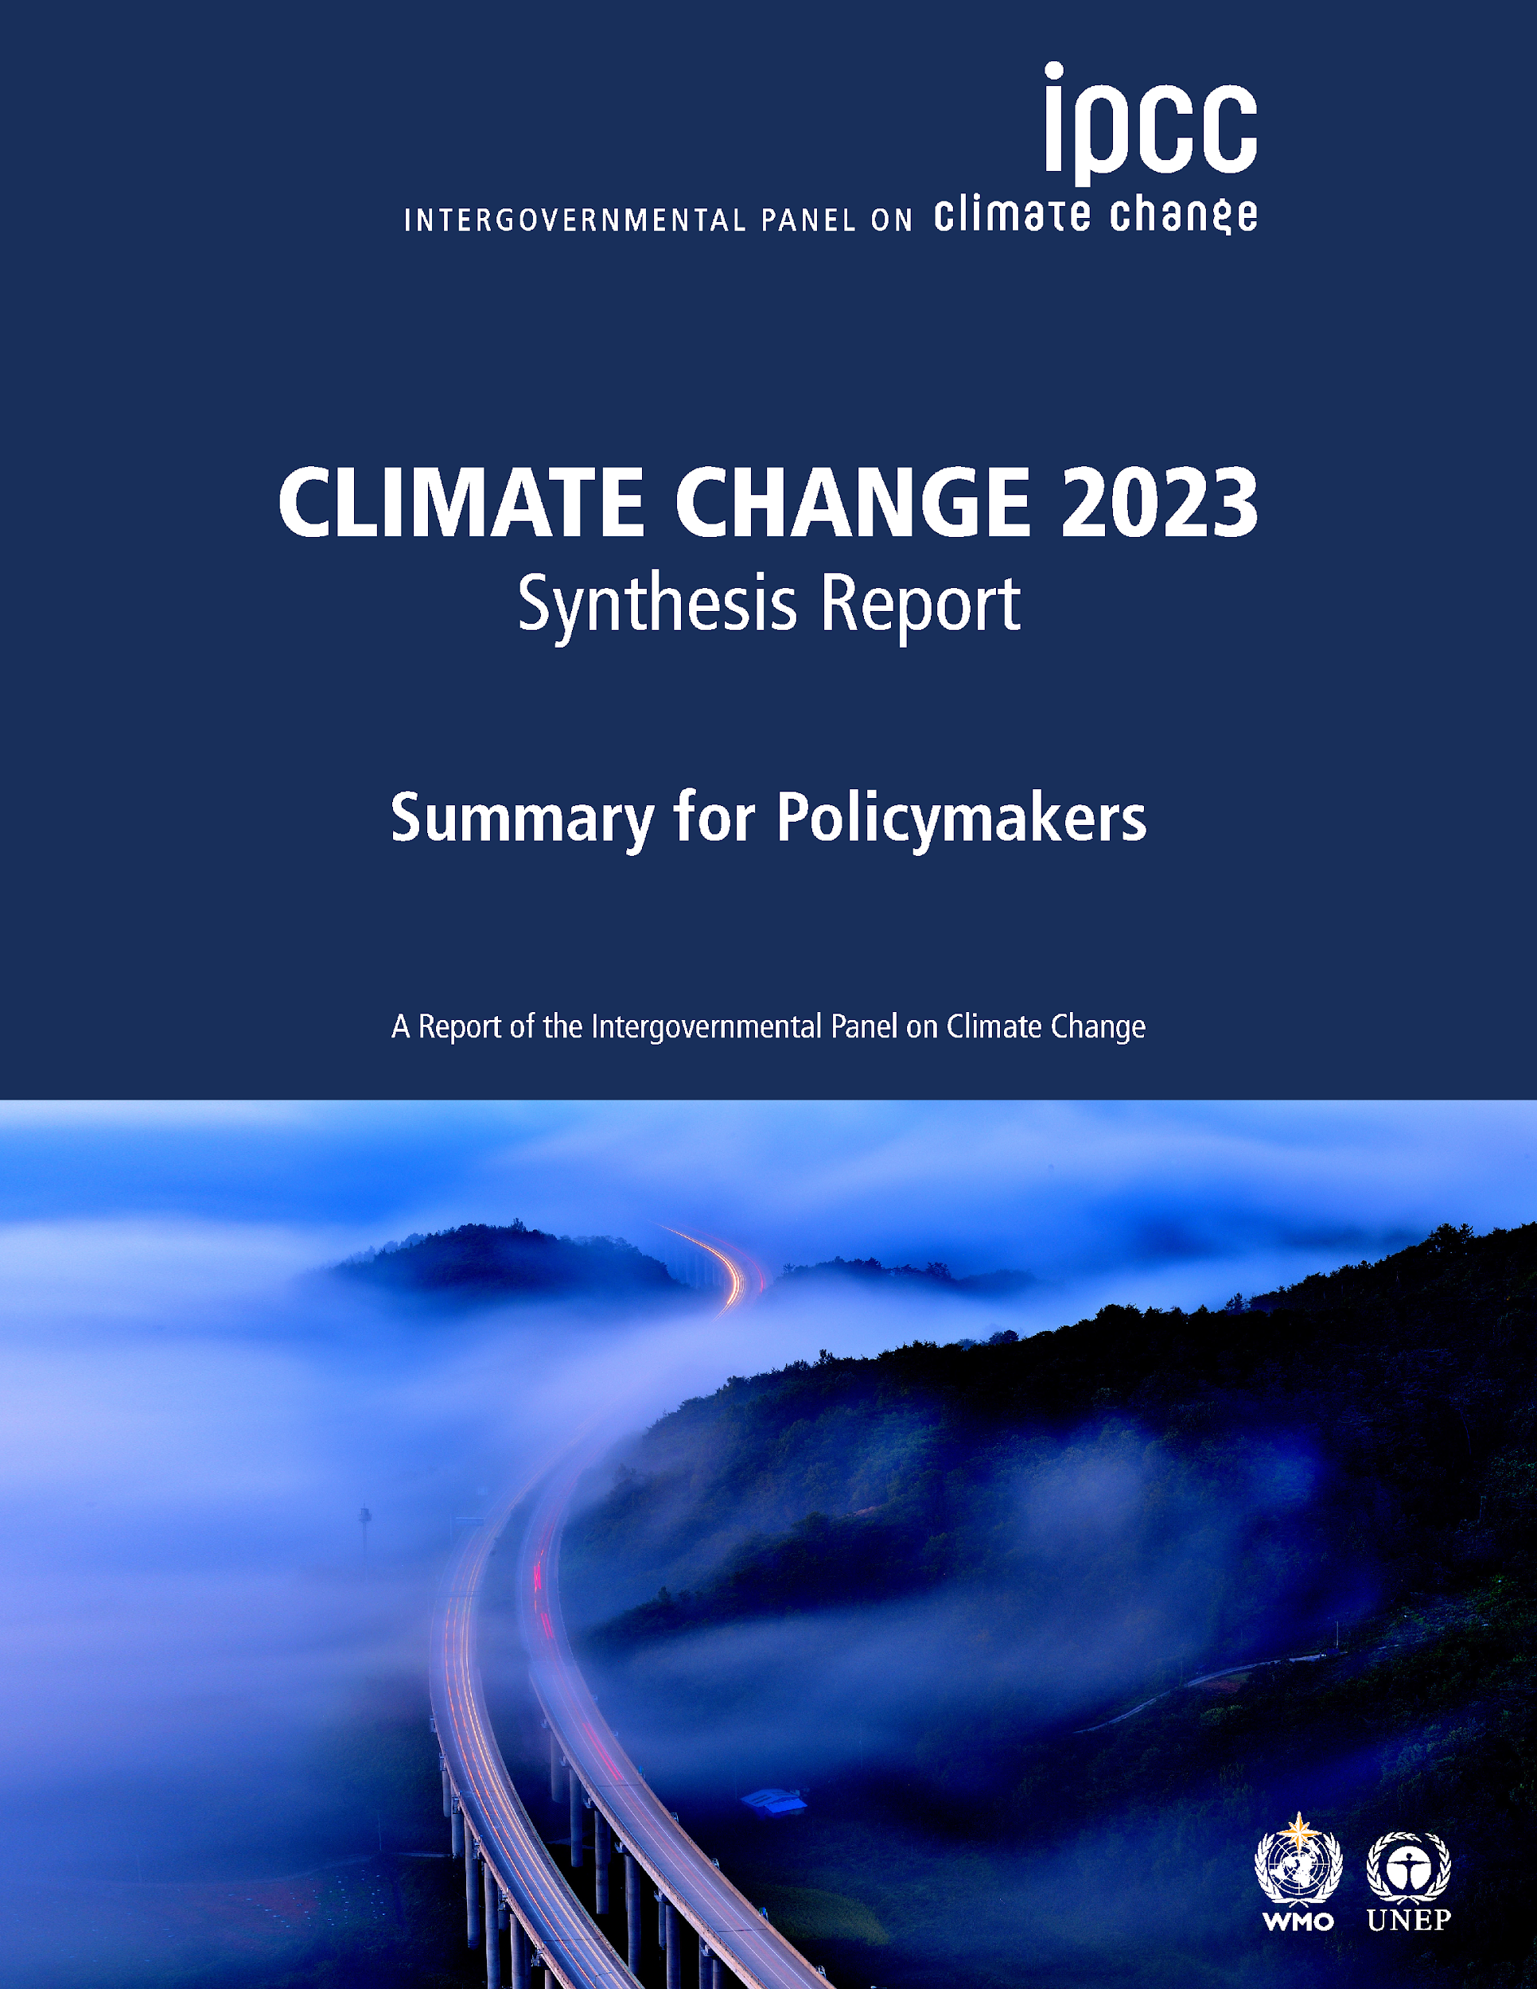
  We are in a pivotal moment
Urgency of Near-Term Integrated Climate Action
“Climate change is a threat to human well-being and planetary health (very high confidence). There is a rapidly closing window of opportunity to secure a liveable and sustainable future for all (very high confidence). Climate resilient development ….. and is enabled by increased international cooperation …... The choices and actions implemented in this decade will have impacts now and for thousands of years (high confidence)”
The Benefits of Near-Term Action
“Deep, rapid and sustained mitigation and accelerated implementation of adaptation actions in this decade would reduce projected losses and damages for humans and ecosystems (very high confidence), …. “
    IPCC. CLIMATE CHANGE 2023. Synthesis Report
THE CHALLENGES WE FACE ARE STEEP:
Global changes at an accelerating (and non-linear) rate
Interconnected nature of Earth components
Need to Scale Information
Increased Society Reliance on Env information
Risks of Cascading Effects and Tipping Points
WE ARE AT PRECIPICE OF A GOLDEN AGE:
Unprecedented volume, quality and diversity of Earth data
New technologies (hardware: quantum,.. and compute: AI, DT.)
Increased momentum to help Earth resilience activities (from private, philanthropy, commercial and Govt sectors)
Increase in number of space-faring nations
Challenges
(to address)
Opportunities
(to leverage)
The NEW NASA STRATEGY, IS DESIGNED TO COMPREHENSIVELY INFORM ACTIONS AND MEET THE URGENCY OF THE CHALLENGES BEFORE US.
For more Info: https://science.nasa.gov/earth-science/earth-science-to-action/

Slide 3
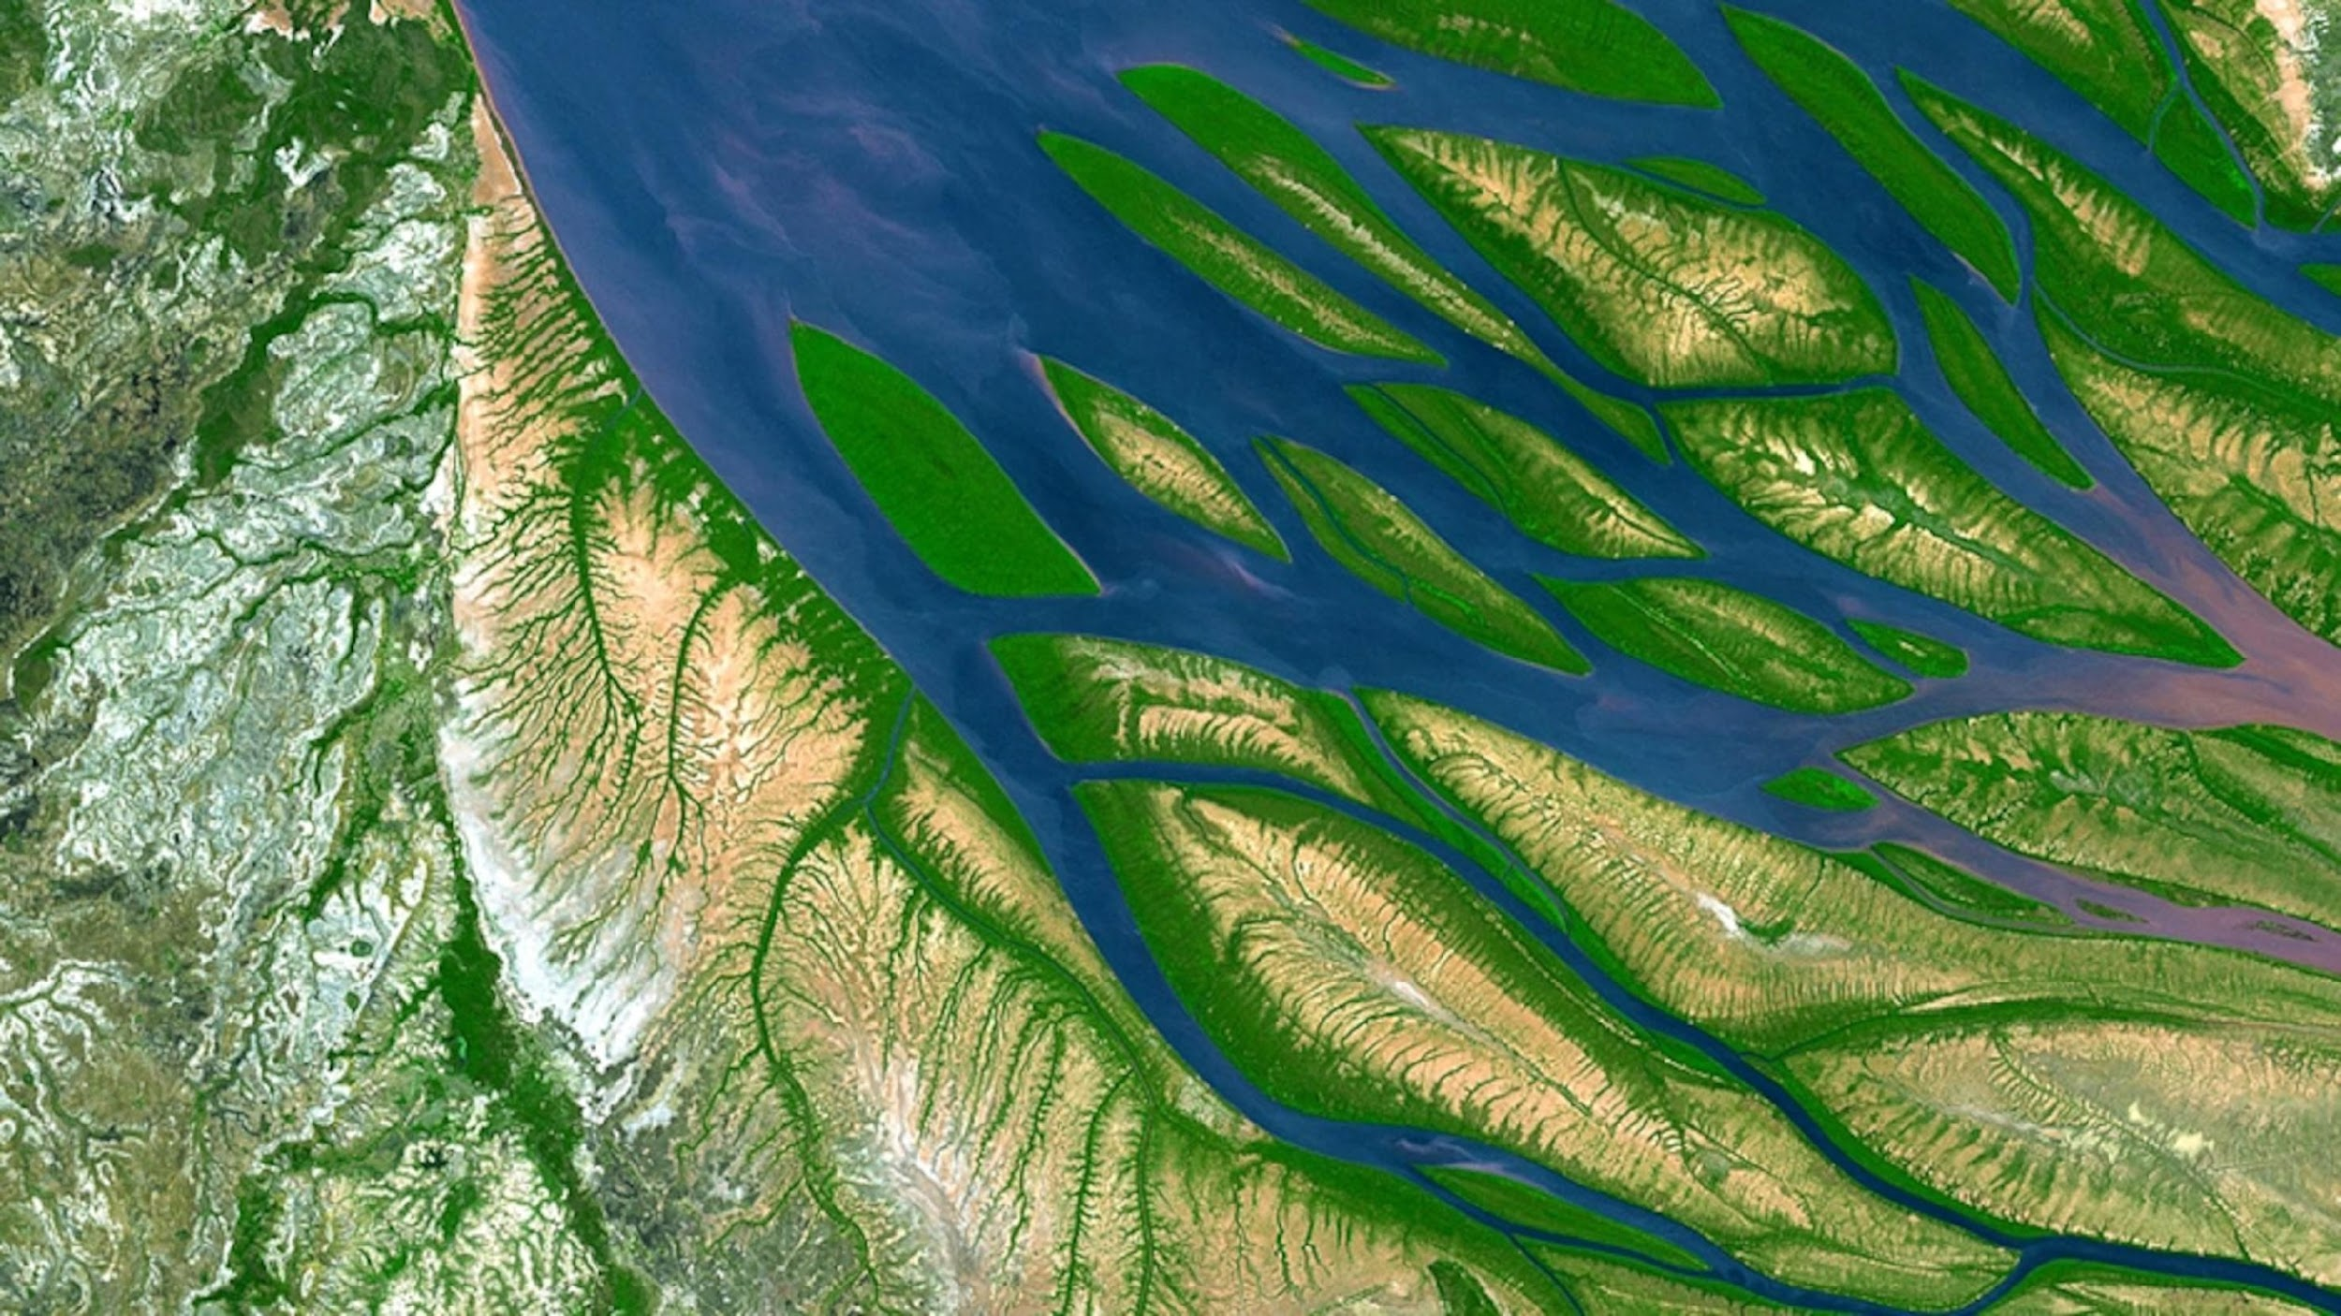
OUR MISSION
Strategy
OUR VISION
STRATEGIC GOAL
Within a decade, we will advance and integrate Earth science knowledge to empower humanity to create a more resilient world.
A thriving world, driven by trusted, actionable Earth science
Compelled by our planet’s rapid change, we innovate and collaborate to explore and understand the Earth system, make new discoveries, and enable solutions for the benefit of all
Objective 1
Holistically observe, monitor and understand the Earth system
Objective 2
Deliver trusted information to drive Earth resilience activities

Slide 4

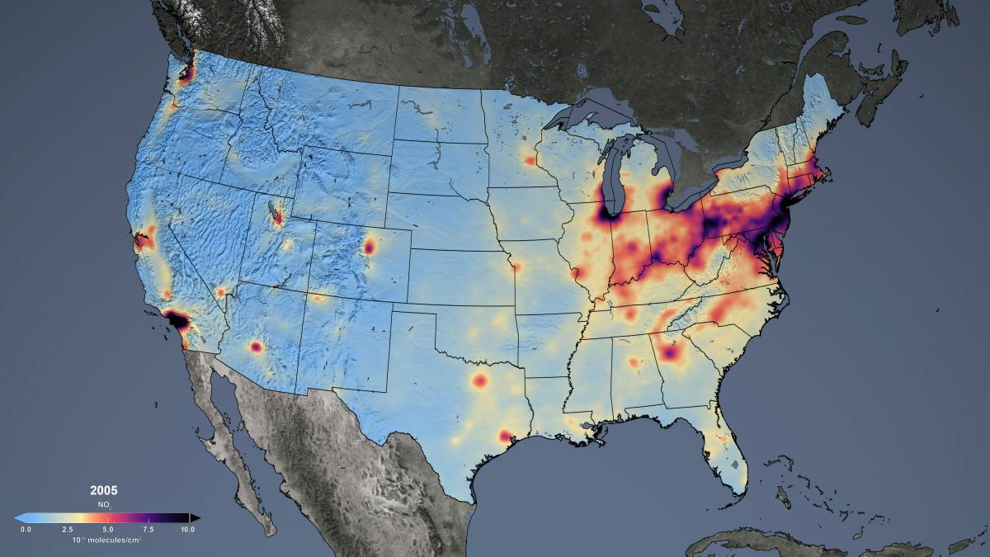
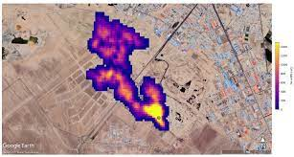
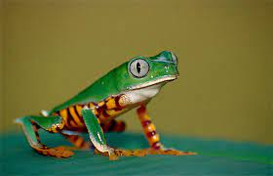
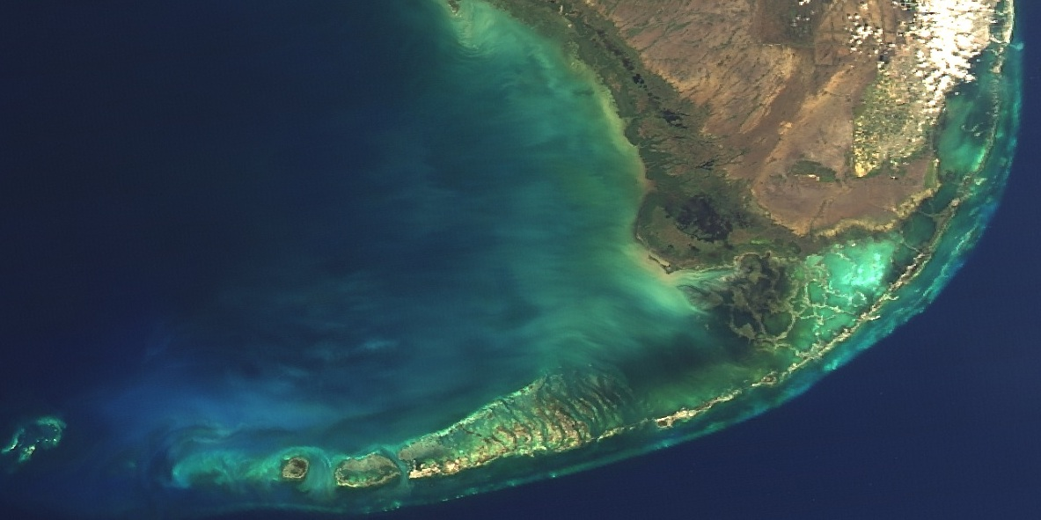

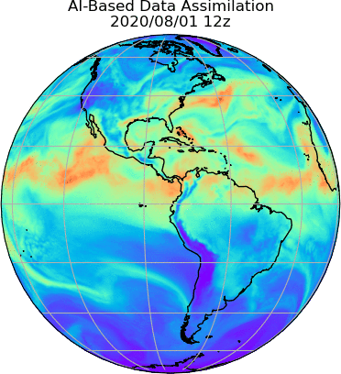

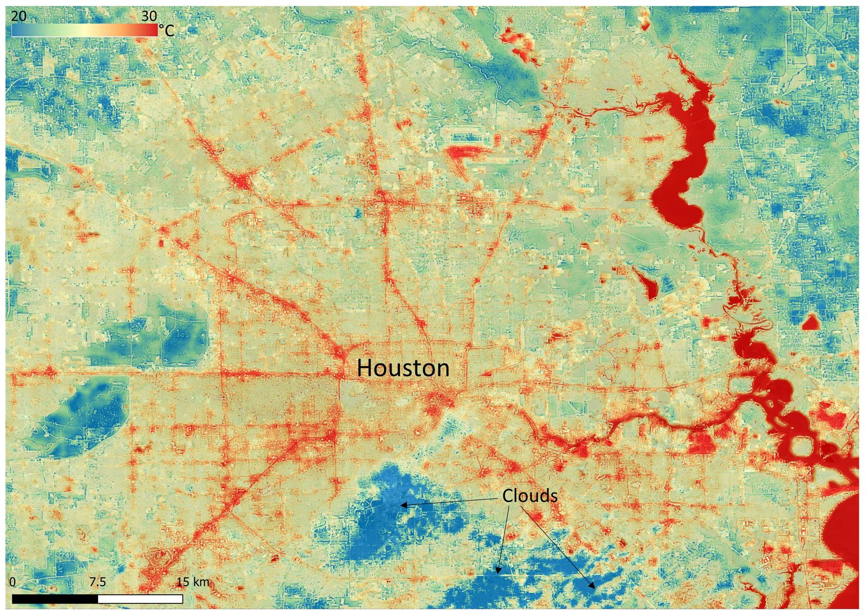


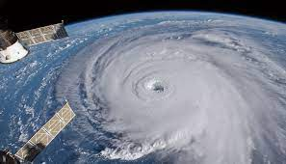

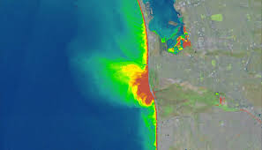
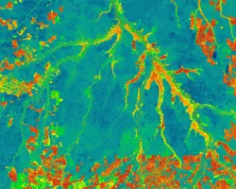
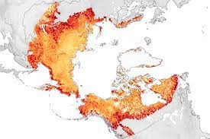
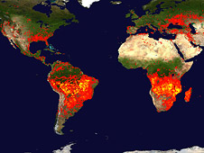
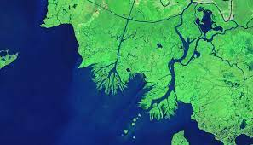
Focus Areas
The strategy identifies 16 systems that sustain well being of humanity:
Air Quality & Stratospheric Ozone
Biodiversity
Greenhouse gases
Sea Level Rise and Coastal
Agriculture
Socio-Economic Sectors
(transport, real estate, etc)
Earth Science To Action Strategy
Urbanization
Energy and Infrastructure
Disasters
Policy/Decision-Making Support
National Security
Wildfires
Human-Ocean Interactions
Environmental health & Water Quality
Carbon Accounting
Water & Food Resources

Slide 5
NASA Earth Science-To-Action Strategy:
Partnership and International Coordination are Key
Transnational Organizations
NGOs
Inter-Agency Groups:
Diverse Earth Science Communities
International Groups:
WCRP
WMO
CGMS (incl. EUMETSAT)
CEOS
IPCC
GEO/GEOSS
Etc.
Philanthropies
“These challenges are global in nature, interconnected, and therefore are best addressed through collaborations, partnerships and by joining forces.”
Karen St Germain, NASA Earth Science Division Director, ES2A Strategy, March 2024.
US Govt Agencies:
NOAA
USGS
EPA
USDA
DoE, DoI
DoS
CDC
Etc.
Earth Science To Action Strategy
Technology Partners / Industry:
Foundations
International Space agencies
Private Sector:
Academia :
Commercial Sector
UN Orgs

Slide 6
“We undertake this challenge and opportunity with a sense of urgency and responsibility. I invite you to join us.”
Karen St Germain, NASA Earth Science Division Director,
Earth Science To Action Strategy 2024-2034, March 2024.
For more Info: https://science.nasa.gov/earth-science/earth-science-to-action/
Notes:
KAREN PENNED A NOTE TO GO AT THE FRONT OF THE STRATEGY WHEN WE RELEASE IT. SHE ENDED THAT NOTE BY SAYING “WE UNDERTAKE THIS CHALLENGE AND OPPORTUNITY WITH A SENSE OF URGENCY AND RESPONSIBILITY.” AND SHE INVITED THE COMMUNITY TO JOIN US.
YOU’LL SEE HERE WE’VE ADDED THE WORD “LEADERSHIP” FOR YOU ALL TODAY. THE PIVOTAL MOMENT WE FACE REQUIRES CONTRIBUTIONS FROM EVERY CORNER OF OUR COMMUNITY. AND IT REQUIRES DISTRIBUTED LEADERSHIP. THIS CHALLENGE WILL NOT BE MET BY A COMMAND-AND-CONTROL MODEL. IT WILL TAKE EVERY ONE OF US ON STAGE, AND EVERY ONE OF YOU, TAKING OWNERSHIP OF THE STRATEGY AS KAREN SAID IN HER VIDEO, AND LEADING FROM WHERE YOU ARE.
WE CAN SET THE STRATEGY, BUT IT IS IN YOUR HANDS TO MAKE IT HAPPEN. I CAN’T WAIT TO SEE WHAT WE WILL DO TOGETHER.

