Slide 1
CEOS Engagement with the International Coordination Group for Spaceborne SAR (ICGS-SAR)
Eric Laliberté, CSA
Agenda Item #8.4
SIT-39 2024, Tokyo, Japan
10th - 11th April 2024

Slide 2

International Coordination Group for Spaceborne Synthetic Aperture Radar (ICGS-SAR) Overview
Established in 2018 to improve the international coordination of spaceborne synthetic aperture radar (SAR) missions.
  Two workshops held: 2018 at CalTech, and 2022 at ESRIN. Next workshop planned for November 2024, in Japan.
Objective: Maximise science and societal returns from SAR missions
Members: Representatives from CEOS agencies operating or developing SAR missions (ASI, CONAE, CSA, DLR, ESA, ISRO, JAXA, and NASA) – as well as from key user and research groups
Executive Board: Comprising approximately
30 members
Website: https://intl-sar-coord-group.space/
Notes:
Explore interest in and value of a more coordinated approach among the organisations flying, planning SAR

Slide 3
Working Groups and Thematic Areas
Working Groups
WG1: Present and Future Data ‐ Visibility and Access (L0‐L2)
WG2: Future Imaging Systems ‐ Goals, Plans, Challenges and Opportunities
  Coordinating with CEOS MIM DB Team
WG3: Data exploration ‐ Cal/Val, Fusion and Assimilation (L3‐L4)
  Potential overlap with CEOS WGCV SAR Subgroup
Thematic Areas
TA1: Polarimetric and Multi-frequency SAR Applications
TA2: Interferometric SAR Applications
TA3: Program and Mission Coordination

Slide 4
Increased Coordination with CEOS
Benefits
Higher profile and direct connection to CEOS Principals
Reduction of overlaps and avoid redundancies
Organisational clarity
Awareness and clear communications
ICGS-SAR characteristics need to be maintained
Autonomy
Low overhead
Efficiency
Cross-cutting nature

Slide 5
Suggested Approach
Establish a ‘Bridging’ Mechanism
  Provide some sort of connection between ICGS-SAR and CEOS Agency Principals
  Perhaps establishing an official POC
Invite representation at SIT, SIT TW, Plenary
  Regular reporting opportunity

Slide 6
Summary
Don’t want to hinder the great work happening within ICGS-SAR with unnecessary overhead
Increase the visibility of ICGS-SAR work at a CEOS Principal level, and provide a mechanism to direct recommendations
Ensure coordinated SAR efforts between ICGS-SAR and CEOS, including WGCV SAR Subgroup and the CEOS-ARD SAR team

Slide 7
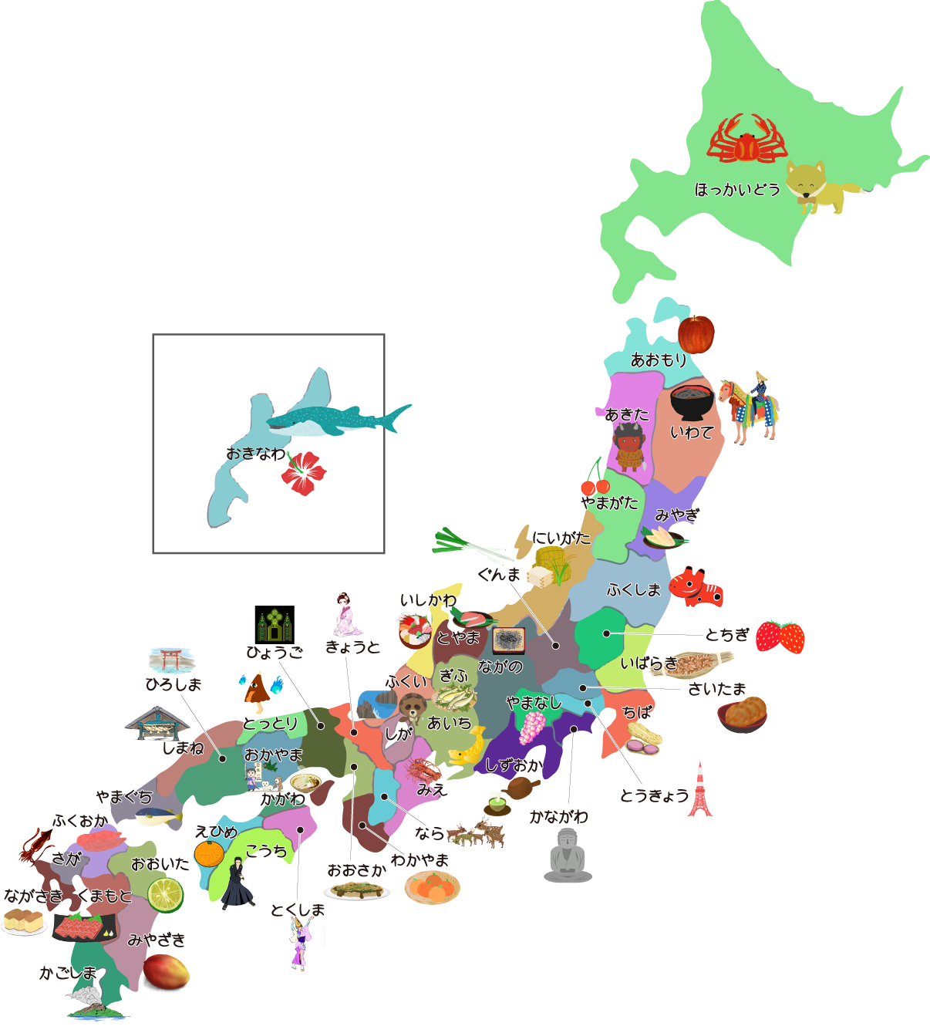
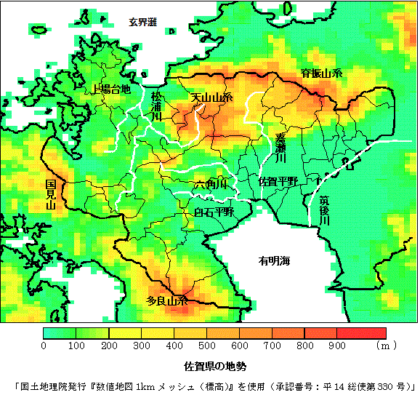
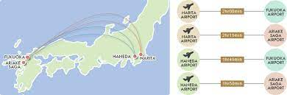

Third ICGS-SAR Workshop in Japan
When: November 6-8, 2024
Location: Saga Pref http://uresino.net/english/access.html
Including incoming SAR players from Asian space agencies and new space

Slide 8
Thank You

