Slide 1

CEOS Communications
2024 Update & Plans
Dave Borges, NASA SEO
Agenda Item 8.3
SIT-39 2024, Tokyo, Japan
10th - 11th April 2024

Slide 2
2024 Campaigns
As per the Communication Strategy endorsed at the 2023 CEOS Plenary:
40th Anniversary of CEOS
  Reflect on past 40 years, and look to the future
EO for Biodiversity
  Support CSA Chair Priority
  Promote EETT White Paper & EO for Ecosystems
Greenhouse Gas Observations from Space
  Support JAXA SIT Chair Priority
  Promote related deliverables and activities
Feel free to use this badge throughout the year!

Slide 3
40th Anniversary of CEOS
Planned activities:
“From the Archives”
  Tenth anniversary speech, Twentieth anniversary video
  Other suggestions welcome
Storymap of Plenary over the years
  With group photos & major milestones
  Please help us get copies of group photos from the earlier plenaries!
‘Faces of CEOS’ Video
  Interviews with CEOS Principals
  Asking for support from Agencies media departments to put together a high quality video (more information here)
+ more!
Feel free to use this badge throughout the year!

Slide 4

Impact of CEOS
Capturing our Impact →
Focus on the four key CEOS Priorities
Branch out to each CEOS Entity
  Simple survey method
  Will reach out after SIT-39

Slide 5
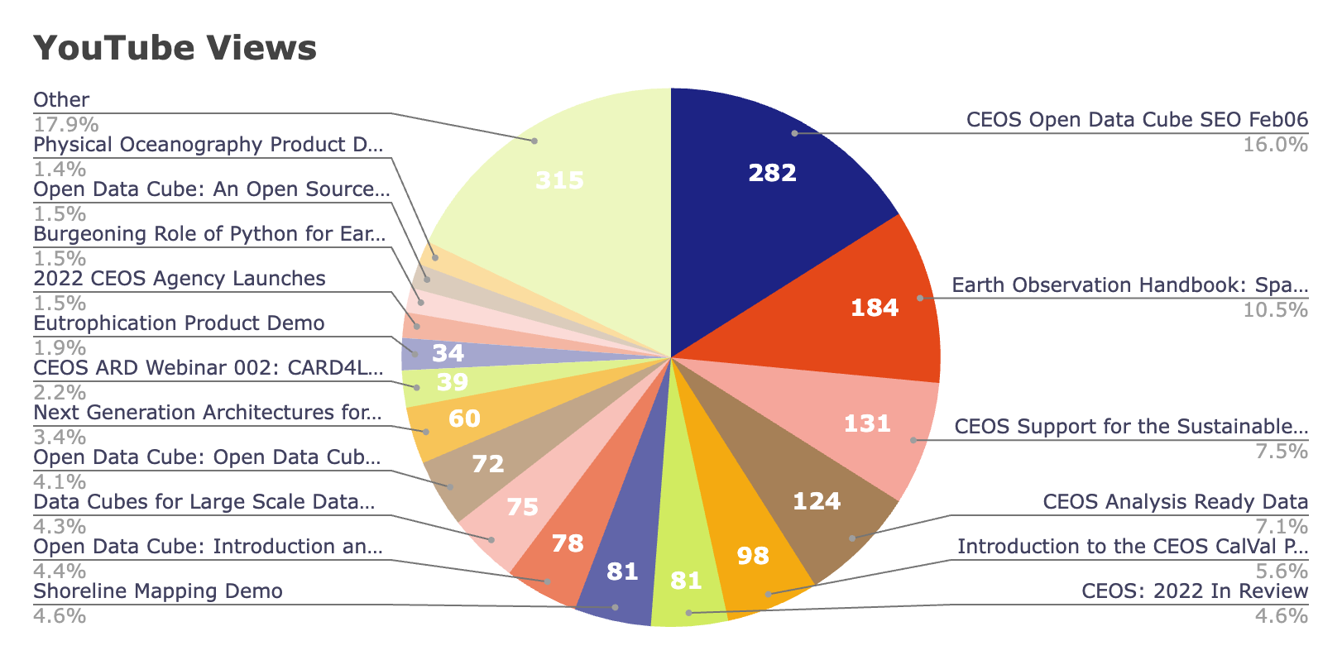
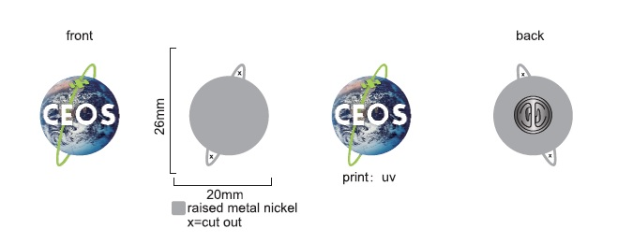
On the Rise: Social Media metrics
Coming Soon!
New CEOS Lapel pins
Total views: 1789
Total watch time: 67.4 hours
(over 12 months)
Platform | Metric | March 2024 | September 2023 | Percentage change
Twitter | Followers | 5475 | 5196 | ↑5.37%
 | Average impressions per post | 969.81 | 741.89 | ↑30.72%
 | Average engagement rate per post | 4.87% | 4.28% | ↑14%
Facebook | Followers | 2096 | 2015 | ↑4.02%
 | Average impressions per post | 369.55 | 125.86 | ↑193.62%
 | Average engagement rate per post | 6.18% | 6.65% | ↓-7%
LinkedIn | Followers | 674 | 29 | ↑2224.14%
 | Average impressions per post | 558.39 | N/A | N/A
 | Average engagement rate per post | 7.46% | N/A | N/A

Slide 6



CEOS Outreach Efforts
SatSummit 2024
  Washington, D.C.
  16-17 May
IGARSS 2024: CEOS Booth
  Athens Greece
  7-12 July
GEO Week 2025
  Location TBD

Slide 7





Learn more about CEOS
Twitter: @CEOSdotORG
Facebook: @socialceos
LinkedIn: @CEOSdotORG
YouTube: @CEOSdotORG
CEOS Communications Quarterly Revisit
Quarterly Newsletter Mailing list
Sign up!
http://eepurl.com/ij_2z1

Slide 8
Back up

Slide 9
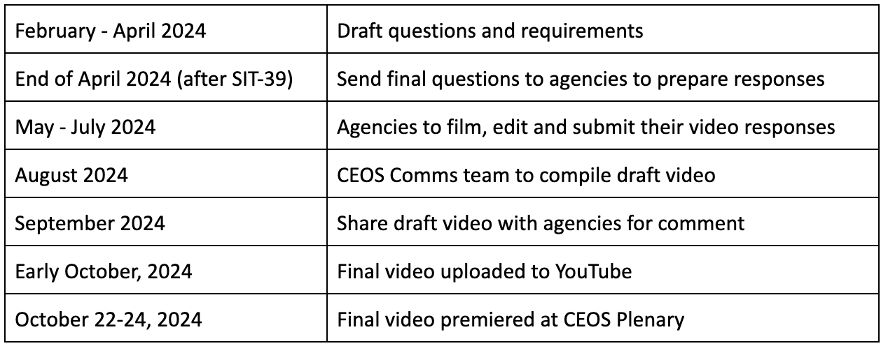
‘Faces of CEOS’ Video details
Questions:
How has your organisation benefited from being part of CEOS?
Please share an example of when CEOS has had societal impact.
How do you see CEOS shaping the future of Earth observation over the next 40 years?
Production Timeline:
More details: CEOS 40th Anniversary Video: Requests to Agencies

Slide 10
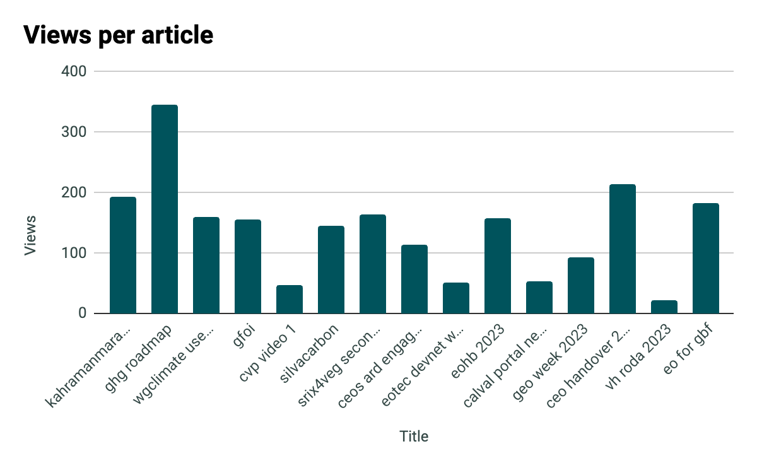
Additional Info - Blog metrics
URL | Publication date
ceos.org/news/kahramanmaras-event-supersite/ | 06 Mar 2023
ceos.org/news/ghg-roadmap/ | 03 Apr 2023
ceos.org/news/wgclimate-use-cases/ | 19 Apr 2023
ceos.org/news/gfoi/ | 27 Apr 2023
ceos.org/news/cvp-video-1/ | 24 May 2023
ceos.org/news/silvacarbon/ | 09 Jun 2023
ceos.org/news/srix4veg-second-workshop/ | 28 Jun 2023
ceos.org/news/ceos-ard-engagement-with-industry/ | 08 Sep 2023
ceos.org/news/eotec-devnet-website/ | 15 Sep 2023
ceos.org/news/eohb-2023/ | 20 Nov 2023
ceos.org/news/calval-portal-newsletter-nov2023/ | 29 Nov 2023
ceos.org/news/geo-week-2023/ | 15 Dec 2023
ceos.org/news/ceo-handover-2024/ | 15 Jan 2024
ceos.org/news/vh-roda-2023/ | 16 Feb 2024
ceos.org/news/eo-for-gbf/ | 23 Feb 2024
Each blog post had on average 139.73 views, which increased from 125.08 over the previous period (up 11.71%)

