Slide 1
Sustainable Development Goals
Coordination Group
David Borges, CEOS SEO
Flora Kerblat, CSIRO
Agenda Item 8.2
CEOS SIT-39
Tokyo, Japan

Slide 2
Context & Structure
CEOS Strategic Priority
“Proactively engage in global discussions on the critical challenges that face society, including attaining the 2030 Agenda for Sustainable Development.”
Strategic Lead: JAXA SIT Chair
Implementation Lead: SEO
Primary Members:
CSIRO, ESA, NOAA, SANSA, NASA, CEO, GEO Sec

Slide 3
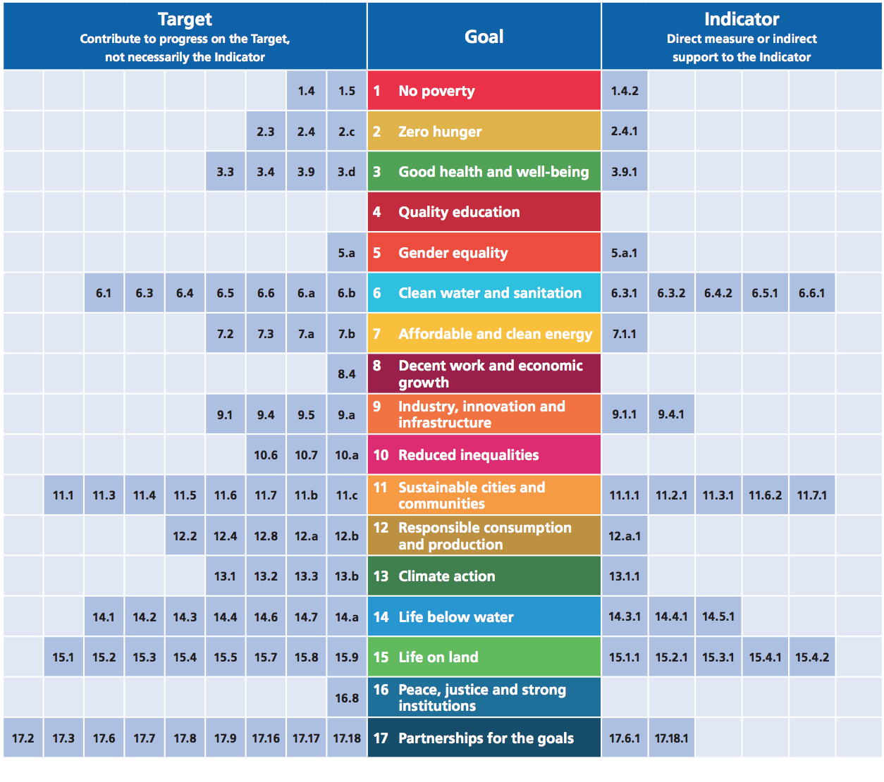
Earth Observations and Geospatial Information for SDG Monitoring
Alignment of Earth Obs. to the SDG Goals, Targets, and Indicators
SDGs with most opportunities:
Notes:
Earth observations can contribute to progress on many more Targets than Indicators
11.4: Strengthen efforts to protect and safeguard the world’s cultural and natural heritage
11.4.1: Total expenditure per capita spent on the preservation, protection & conservation of all cultural and natural heritage
13.3: Improve education, awareness-raising and human and institutional capacity on climate change mitigation, adaptation, impact reduction and early warning
13.3.1: Number of countries that have integrated mitigation, adaptation, impact reduction and early warning into primary, secondary and tertiary curricula

Slide 4
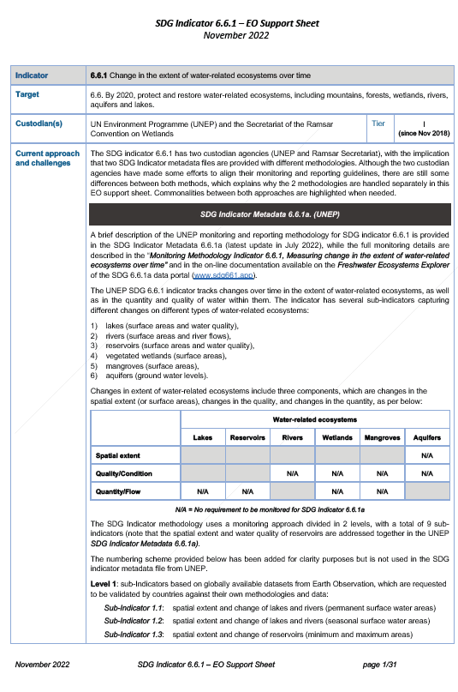
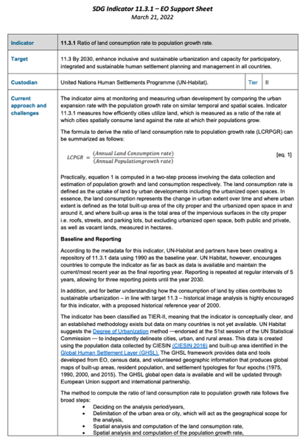
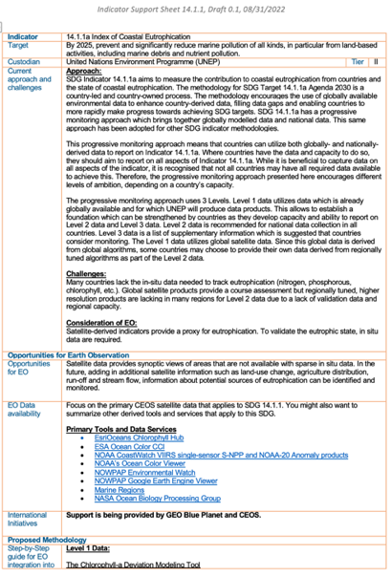
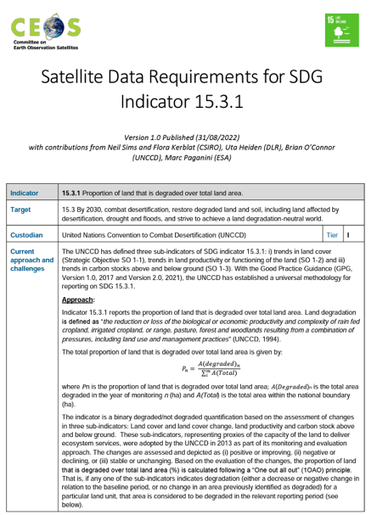
EO Support Sheets
ceos.org/sdg
SDG-24-01
Water
SDG-24-02 Urbanization
SDG-24-03
Coastal Eutrophication
SDG-23-04
Land Degradation
The Earth Observation (EO) Support sheets are a valuable resource for the user community and Custodian Agencies: CEOS plans to keep them updates by undertaking an annual review to ensure that details including current approaches and challenges, data requirements, access and tools, and publication references remain up-to-date and useful.

Slide 5
2024 SDG Deliverables
Number | Deliverable Title | Due | Responsible User | Responsible Agency
SDG-24-01 | EO Support sheet for SDG Indicator 6.6.1 (Water) | 2024 Q4 | Marc Paganini | ESA
SDG-24-02 | EO Support sheet for SDG Indicator 11.3.1 (Urbanization) | 2024 Q4 | Martyn Clark, Nale Mudau | GEO Sec, SANSA
SDG-24-03 | EO Support sheet for SDG Indicator 14.1.1 (Marine Pollution) | 2024 Q4 | Paul DiGiacomo, Katy Matthews | NOAA
SDG-23-04 | EO Support sheet for SDG Indicator 15.3.1 (Land degradation) | 2024 Q4 | Neil Sims | CSIRO
SDG-24-04 | UN-GGIM IAEG-SDGs WGGI Paper: “Rescuing the SDGs” | 2024 Q2 | Flora Kerblat, Dave Borges, Osamu Ochiai | CSIRO, SEO, JAXA
SDG-23-05 | GEO-LDN: SIDS Cloud Cover Analysis | 2024 Q2 | Dave Borges | SEO, CSIRO
SDG-24-05 | UNCCD: SIDS Land Cover Dataset Suitability Analysis | 2024 Q4 | Dave Borges, Neil Sims | SEO, CSIRO

Slide 6
Supporting GEO-LDN & UNCCD
SDG-23-05
Address UNCCD data concerns by conducting Cloud Cover Analysis over Small Island Developing States (SIDS), with South Pacific focus (Landsat, Sentinel-2)
Responsible: SEO, CSIRO
Completion: 2024 Q2
SDG-24-05
Evaluate potential for two new Land Cover datasets to support UNCCD SDG 15.3.1 reporting guidance to member states
Responsible: SEO, CSIRO
Completion: 2024 Q4

Slide 7
UN-GGIM: “Rescuing the SDGs”
SDG-24-04
Co-author UN-GGIM IAEG-SDG WGGI* White Paper: “Rescuing the SDGs”. How can the community ensure geospatial data broadly, and EO data specifically, play a greater role in SDG national reporting between 2025-2030.
Further, how can our community influence the creation of a Post-2030 Sustainable Development global policy framework where EO is integral?
*UN Committee of Experts on Global Geospatial Information Management (UN-GGIM)
Inter-Agency and Expert Group on SDG Indicators (IAEG-SDG) Working Group on Geospatial Information (WGGI)

Slide 8
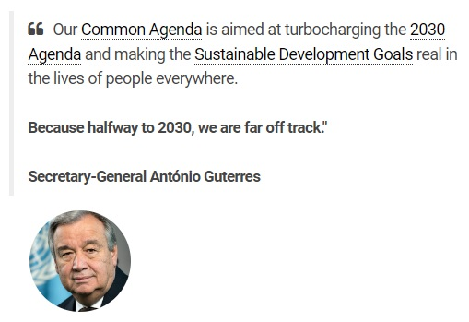
Policy Impact Opportunities
SDG reporting architectures are based on “Country-owned, Country-led” national statistical data
Large data gaps are well documented, limiting country abilities to report on progress
Earth observations are classified as “Non-Traditional Data Sources”
Opportunities exist to advocate for increased role of EO in future sustainable development framework

Slide 9
Policy Impact Opportunities
Post-2030 Sustainable Development Outlook
Open Working Group Establishment
Historically, this group was created three years prior to 2030 Agenda launch (2012)
UN Summit of the Future
Create conditions in which implementation of 2030 Agenda can more readily be achieved.
Post-2030 Sustainable Development Global Policy Framework Launch
2025
2027
2029
2024
2026
2028
2030
Comprehensive Review
Led by IAEG-SDGs, provides opportunity to improve indicator framework.
Adoption of new Framework
By decision UN Statistical Commission (UNSC)

Slide 10
CEOS Strategic Direction on SDG
Coordination Group Side Meeting Outcomes
Deliverables Tracking Tool update
CEOS Work Plan mapping exercise
SIT-39 Discussion
SDGs are least resourced of all four CEOS Strategic Priorities
“Sustainable development” activities require additional effort to actually support SDG Framework
New Indicator EO Support Sheets could be created with additional support from WGs, VCs, etc.
Does CEOS want to pursue SDG policy impact at Strategic Priority level?

