Slide 1
SIT-39
2024
Aquatic Carbon Roadmap Update
Marie-Helene Rio, ESA
Agenda Item #8.1
SIT-39 2024, Tokyo, Japan
10th - 11th April 2024

Slide 2
Toward an Aquatic Carbon Roadmap
CEOS Global Stocktake strategy paper
-> demonstrate the value of Earth Observation satellite datasets to support the Global Stocktake process
CEOS Aquatic Carbon Roadmap?

Slide 3
OCR-VC contribution to the CEOS Workplan
2020-2023
2023-2025

Slide 4
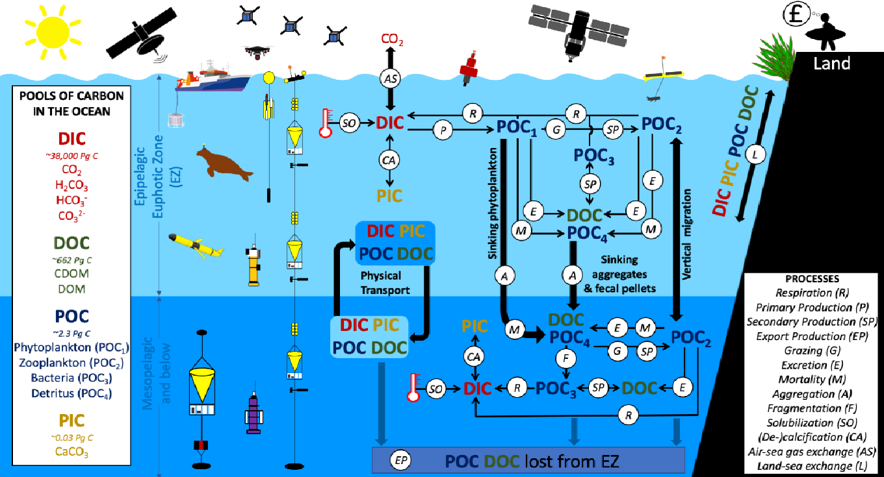
Aquatic Carbon Roadmap Focus
Deliverable VC-23-01
Pools and processes of the ocean biological and solubility carbon pumps
Both the GHG and AFOLU roadmap have a strong focus on the major milestones of GST1 (2023) and subsequently for GST2 (2028) and how remote sensing data can effectively support these by providing means to monitor carbon emissions and removals, based either on a top-down approach (GHG roadmap) or a bottom-up approach (AFOLU roadmap).
Why should we care about the Aquatic realm?
The ocean acts as a significant carbon sink, by absorbing large amounts of carbon dioxide from the atmosphere through the ocean biological, solubility and injection pumps.
The coastal ocean also host crucial blue carbon ecosystems (mangroves, seagrass, salt marshes)
The inland waters also play crucial roles in the global carbon cycle by storing, sequestering, and transporting carbon, as well as influencing regional and global climate dynamics.
Brewin et al, 2001:Sensing the ocean biological carbon pump from space: A review of capabilities, concepts, research gaps and future developments, Earth-Science Reviews 217 (2021) 103604.
An improved understanding and monitoring of the aquatic carbon components will enhance the accuracy and reliability of global carbon stocktake assessments by providing insights into the role of the aquatic/oceans as a carbon sink and the factors influencing carbon storage dynamics.

Slide 5
Aquatic Carbon Roadmap Objectives
Deliverable VC-23-01
To provide a framework and serve as a guiding vision for long term (~ 15+ years) coordination of CEOS agency observing programmes in support of the science and policy needs for Aquatic carbon related information in the context of the CEOS carbon strategy.
To contribute to support the needs and ambition cycle of the Global Stocktake of the Paris Climate Agreement, by
driving the inclusion of inorganic and organic carbon in the ocean within global and regional carbon assessments constraining the global carbon budget
supporting countries reporting on their NDC by improving the estimation and monitoring the changes in CO2 fluxes from/to the inland waters/Oceans at country level (within each country’s exclusive economic zone (EEZ))
improving the monitoring of major Blue Carbon coastal ecosystem’s extent and carbon stock around the world.
To characterize the needs, gaps and challenges, regarding the required data and products to support science, services and applications and the observing systems that can support their developments, including the needs to plan for ground and space segments. This includes addressing basic observation continuity and the necessary agency coordination to achieve it.
To clarify the importance and elevate the profile and complexity of remote sensing and satellite Earth observation that are already routinely used within carbon assessments, highlighting how Earth observation has much more to offer beyond its current use and serve as an effective means for communicating our intentions to society, UNFCCC, national inventory community.

Slide 6
Toward an Aquatic Carbon Roadmap – Contributors
Coordinators
Marie-Helene Rio (ESA)
Laura Lorenzoni (NASA)
Hiroshi Murakami (JAXA)
Scientific leaders
Jamie Shutler (University of Exeter)
Bob Brewin (University of Exeter)
Cecile Rousseaux (GSFC-NASA)
Kelsey Bisson (NASA)
And many contributors from the CEOS OCR-VC / IOCCG space agencies and the scientific community

Slide 7
Aquatic Carbon Roadmap Main achievements since the Plenary endorsement
The ESA SCOPE project (Satellite-based observations of Carbon in the Ocean: Pools, fluxes and Exchanges) was successfully kicked off in December 2023.
Objective to provide the best possible characterization of the ocean carbon budget from satellite observations and further the understanding of its variability in space and time. Satellite-based products and uncertainties of the pools (phytoplankton carbon, particulate organic carbon, dissolved organic carbon, particulate inorganic carbon and dissolved inorganic carbon) and fluxes (primary production, export production, air-sea exchange and land-sea exchange) of the ocean carbon cycle will be produced using the 25-year time series of Ocean-Colour Climate Change Initiative.
The project will organize the 2nd Ocean Carbon From Space Workshop in September 2025, whose outcome will strongly contribute to the CEOS Aquatic Carbon Roadmap
One task in the project (Roadmap) is specifically dedicated to contributing to the CEOS Aquatic Carbon Roadmap
Project Prime (Gemma Kulk, PML) and partners (Jamie Shutler, Robert Brewin from University of Exeter) belong to the scientific leader team of the Aquatic Carbon Roadmap

Slide 8
Aquatic Carbon Roadmap Main achievements since the Plenary endorsement
The ESA Coastal Blue Carbon project was successfully kicked off on March, 5th 2024.
Objective is to develop new methods and innovative indicators to improve the estimation of the carbon stock of major Blue Carbon Coastal ecosystems specifically for: mangroves, salt marshes, and seagrasses in representative areas in the world.
One task in the project (Roadmap) is specifically dedicated to contributing to the CEOS Aquatic Carbon Roadmap
Project partners will actively contribute to the writing of the Aquatic Carbon Roadmap for the three main Blue Carbon ecosystems (seagrass, mangroves, salt marshes)

Slide 9
Aquatic Carbon Roadmap Main achievements since the Plenary endorsement
Regular meetings with the Aquatic Carbon Roadmap team (coordinators+scientific leaders+scientific contributors): last one on April 3rd
A shared working document has been created to refine the outline provided at the plenary (now working on version 2)
Still working on assigning Book Captains for the different topics
Objective: to have the consolidated outline + Book captains assigned before the next IOCCG Committee Meeting (April 24th-26th), where a dedicated discussion point is planned on the CEOS Aquatic Carbon Roadmap to endorse the proposed outline and Book Captain assignment
Very actively working on the organisation of the upcoming joint ESA-NASA Coastal Blue Carbon From Space ISSI Forum

Slide 10
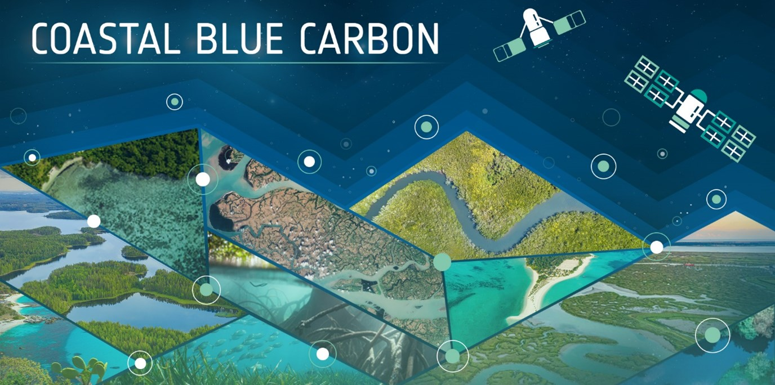
Blue Carbon from Space Forum
14-17 May 2024 | ISSI, Bern, Switzerland
ISSI Forums are informal and free debates among up to 25 high-level participants on open questions of scientific nature or science policy matters.

Slide 11
Blue Carbon from Space Forum Objective
Bring together experts from different fields (remote sensing, in-situ, modelling), relevant stakeholders (e.g., academics, government representatives, investors, NGOs, community representatives, …), and international initiatives (e.g., the Blue Carbon Initiative, Global Mangrove Watch, Wetland International, the IPCC, the Global Carbon Project, …) to discuss the
state-of-the-art,
challenges and
opportunities
regarding the use of satellite observation to advance Coastal Blue Carbon ecosystem (mangroves, seagrasses, salt marshes).
Forum co-conveners: Marie-Helene Rio (ESA), Laura Lorenzoni (NASA), Benjamin Poulter (NASA), Stephen Plummer (ESA), Clement Mathieu Jacques Albergel (ESA), Sophie Hebden (ESA), Sarah Connors (ESA), Alina Blume (ESA)

Slide 12
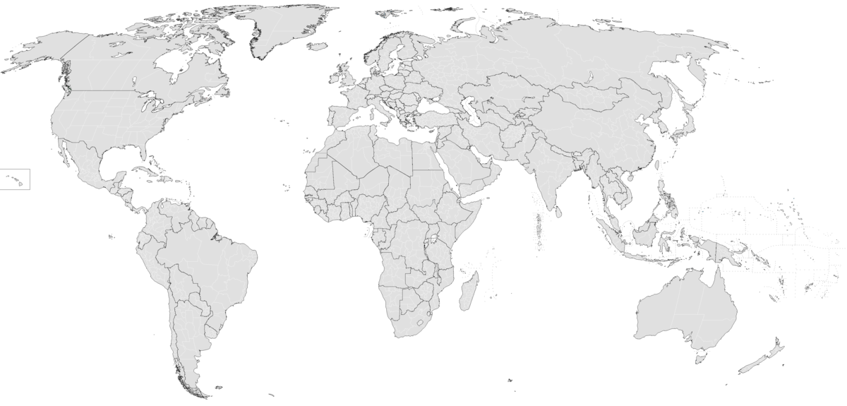
30 Participants
Participants
Attending Organisers
1
3
1
5
1
Gender Split
2
1
2
6
1
1
1
1
1

Slide 13
Topics
Observing Systems
EO capabilities to map BC ecosystem’s extent/carbon stock/ change: current status, gap identification, observation system requirements to fill gaps (including in-situ/airborne observations)
Impacts of external drivers
Further understanding and predicting the impact of external drivers on BC ecosystems (climate change, hurricanes, aqua- and agriculture, coastal development, etc.)
Mitigation
To what extent do BC ecosystems represent a NBS for mitigating the impact of climate change? What is the impact of ecosystem restoration and preservation actions on mitigation and how to quantify it?
Economic value
Carbon Credits, MRVs etc.
Policy needs
What are the tools/ products/indicators needed to support policy with a focus on the needs and ambition cycle of the Global Stocktake of the Paris Climate Agreement?

Slide 14
Draft Program
As of 08/04/2024
Time | Tuesday 14.05 Setting the floor
14:00 – 17:45 Incl. 30’ break | Opening Plenary Opening Speech & Setting the scene (ESA/NASA) (40’) Keynote (20’) Topics + Seed questions (10’) Logistics (10’) Break Lightening talks of all participants (1.40hrs)
Time | Wednesday 15.05 Science
09:00 – 12:00 Incl. 30’ break | Observing Systems Introduction of each ecosystem (30’) Break out sessions by ecosystem Discussion (45’) Wrap up (15’) Plenary Presentation of Wrap Ups (15’ ) Discussion (45’)
12:00 – 13:30 | Lunch
13:30 – 16:30 Incl. 30’ break | Impacts of External Drivers Introduction of each ecosystem (30’) Break out sessions by ecosystem Discussion (45’) Wrap up (15’) Plenary Presentation of Wrap Ups (15’ ) Discussion (45’)
Time | Thursday 16.05 Science to Action
09:00 – 12:00 Incl. 30’ break | Climate Change Mitigation Introduction of each ecosystem (30’) Break out sessions by ecosystem Discussion (45’) Wrap up (15’) Plenary Presentation of Wrap Ups (15’ ) Discussion (45’)
12:00 – 13:30 | Lunch
13:30 – 15:30 | Economic Value Keynote (~30 min’) Plenary Discussion (1.15hrs) Wrap Up (15’)
15:30 – 16:00 | Coffee Break
16:00 – 18:00 | Policy Needs Keynote (~30 min’) Plenary Discussion (1.15hrs) Wrap Up (15’)
Time | Friday 17.05 Action
09:00 – 12:30 Incl. 30’ break | Closing Plenary Session Introduction (10’) For each session: Session outcome presenation and plenary discussion (2hrs) Closing Speech (15’)
Invited Dinner at
Submit Feedback here:
Padlet
Start
19:00

Slide 15
Forum Outcome
Community White Paper
Identifying the main gaps and opportunities related to the use of space-borne data to support Coastal Blue Carbon science and policy needs.
Including a roadmap towards filling the identified research gaps.
The community White Paper will directly contribute to the CEOS Aquatic Carbon Roadmap

Slide 16
Thank you for your attention

