Slide 1
GHG Continuity Coordination and Focus
Hiroshi Suto and
David Crisp (SIT Chair Team)
Agenda Item 7.5
SIT-39 2024, Tokyo, Japan
10th - 11th April 2024

Slide 2
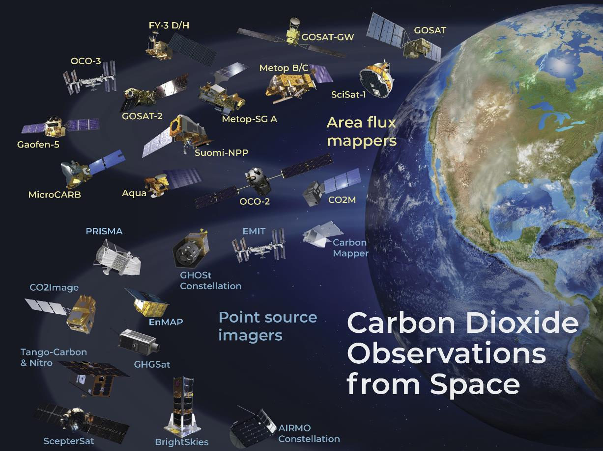
Greenhouse Gas Satellite Missions Portal
https://database.eohandbook.com/ghg/
This Portal aims to provide a comprehensive and up-to-date list of all current and planned satellite missions with the ability to measure greenhouse gases. This includes those planned and operated by both public and commercial organisations, as well as NGOs. The Portal is based on data from the CEOS MIM Database
Missions are categorised under three headings according to their purpose and capabilities
Operational sounders
Global GHG Mappers
Facility Scale Plume Monitors

Slide 3
Stakeholders’ Needs
Space-based GHG measurements could provide transparent, traceable, independent assessments of emissions and collective progress toward the mitigation and adaptation goals of the Paris agreement
Different stakeholders have different requirements
UNFCCC - Sector-specific annual/biennial national-scale inventories of emissions
High accuracy & traceability to internationally-recognized standards (e.g., IPCC-TFI)
UNEP IMEO Methane Alert Response System, MARS
Low-latency alerts to large CH₄ emissions from fossil fuel extraction, transport, use
WMO Global Greenhouse Gas Watch
Accurate, traceable, global 1° x 1° gridded GHG concentrations and fluxes at monthly intervals
Carbon cycle science community
Concentration & flux data with precision, accuracy, resolution & coverage to quantify climate forcing & response of land biosphere and ocean sources & sinks to human activity & climate change

Slide 4
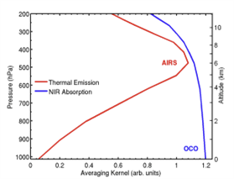
Existing and Planned GHG Missions
Operational sounders (e.g., AIRS, IASI, CrIS)
Can measure CO₂ & CH₄ in the upper troposphere, but have little or no sensitivity to surface sources and sinks
Facility-scale missions (e.g., GHGSat, PRISMA, EMIT, MethaneSAT, Carbon Mapper)
optimized to monitor the most intense emission plumes for CH₄ (> 300 kg/hr) and CO₂ (>500 tCO₂/hr), but do not provide global coverage and cannot quantify extended sources or CO₂ sinks (e.g., forests, oceans)
Global GHG mappers (e.g., GOSAT, OCO, TROPOMI, CO2M)
have the sensitivity needed to monitor extended CO₂/CH₄ sources & sinks (cities, agriculture, forests, oceans) responsible for > 90% of all GHG fluxes
Thermal IR sensors on Operational Sounders are primarily sensitive to CO₂ and CH₄ in the upper troposphere. Solar, near-infrared sensors on GHG mappers are most sensitive to CO₂ and CH₄ near the surface.
Purpose-built public-sector global GHG mappers place the most critical constraints on GHG emissions and climate

Slide 5
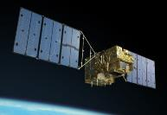
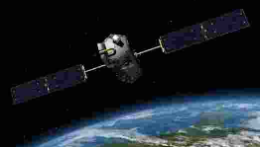
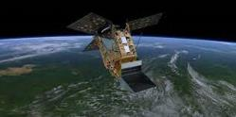
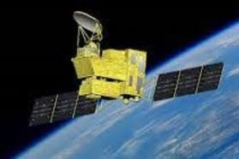
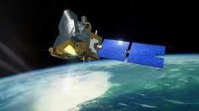
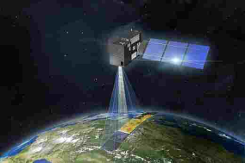
Status of Global GHG Mappers
First-generation global mappers currently returning data
GOSAT – in its 16th year or operations (5-year nominal mission)
OCO-2 – in its 10th year of operations (2-year nominal mission)
GOSAT-2 – in its 6th year of operations (5-year nominal mission)
S5p TROPOMI – in its 7th year of operations
OCO-3 – in storage on ISS, to be redeployed in JULY 2024
Upcoming Launches
GOSAT-GW – launch delayed to JFY2024 (April 2024 to March 2025)
MicroCarb – launch delayed to 2025
Sentinel 5 – launch delayed to 2025
CO2M Constellation – first launch delayed to 2026
FY-3H, Gaofen-5,TanSAT-2, TBD
As missions are delayed, there is a growing threat to data continuity supporting the second global stocktake in 2028 (data cutoff is 2026)

Slide 6
Status of Facility Scale GHG Missions
Currently Operating Missions provide global access, but not global coverage
GHGSat - Purpose-built, commercial imaging Fabry Perot spectrometers
12 satellites (11 CH₄ & 1 CO₂) with ~25 m x 25 m resolution over a 12 km x 12 km scene
Hyperspectral Imagers – not optimized for GHG, but sensitive to intense CO₂ & CH₄ plumes
ASI PRISMA – launched in 2019, 30 m x 30 m resolution over 30 km x 30 km scenes
NASA EMIT – deployed on ISS in 2022, 60 m x 60 m over 80 km x 80 km scenes – Extended mission
DLR EnMAP - launched in 2022, 30 m x 30 m resolution over 30 km wide swath
MethaneSAT – EDF (NGO) developed Intermediate-scale (facility to city) mapper
launched in 2024, 120 m x 400 m over ~30 200 km x 200 km scenes each day
Upcoming Missions
Carbon Mapper - public/private partnership, mid/late 2024 launch, 30 m x 30 m resolution over 18 km swath
TANGO A, B – twin satellites (CO₂/CH₄ & NO₂); late 2025 launch, 300m x 300m over 30 km x 30 km
Other commercial missions: Several under development

Slide 7
Gaps in Existing GHG Mission Plans
Large urban areas are thought to produce > 70% of anthropogenic emissions
Currently, neither Global Mappers or Facility Scale missions are optimized with the combination of spatial resolution and sensitivity needed for this application
Sensors with sensitivities of < 0.25% (1 ppm for CO₂, < 5 ppb for CH₄) in sub-km (300-500m) footprints could provide sector-specific (e.g., transportation, power, heavy industry) estimates of changes in emissions associated with policy changes
The ocean is currently the second largest sink of CO₂, but the efficiency of this sink is expected to change in response to anthropogenic emissions policy & climate change
The ocean sink is currently massively under sampled by in situ sensors
Even the Global Mappers do not have the sensitivity needed for this application
Space-based sensors with very high precision and accuracy (< 0.025%) but low spatial resolution (1°x1°) could revolutionize our ability to monitor the ocean sink

Slide 8
The Need for Coordination
No single class of satellite GHG sensor can address all of these applications
Global Mappers and Facility Scale monitors are highly complementary
Global GHG mappers
provide coverage of the entire globe on daily to monthly time scales and are most sensitive to source and sinks on scale of megacities to nations
bias (absolute accuracy) more of a limitation than precision on these scales
have limited sensitivity to point sources and provide little sector-specific information for use in bottom-up inventories
Facility Scale Plume Monitors
optimized for detecting intense CO₂ and CH₄ plumes, and can provide sector-specific information about these large sources
provide limited coverage & have no sensitivity to the weak, spatially extended sources & sinks (oceans, forests, wetlands, wet agriculture) responsible for MOST surface fluxes
Close coordination could improve utility of both classes of satellites

Slide 9
Strategic Goals for GST2 Timeframe
Complete and launch the GOSAT-GW, MicroCarb & CO2M missions as soon as possible to reduce the likelihood of a space-based GHG data gap prior to GST2
Work with WMO G3W to deliver global 1°x1° maps of CO₂ and CH₄ column mole fractions and fluxes at monthly intervals to support GHG science and policy
Work with IMEO MARS to develop a low-latency end-to-end CH₄ anomaly alert system for detecting and reporting large CH₄ plumes
Coordinate global mappers and facility-scale monitors to yield sector-specific estimates for the most intense CO₂ and CH₄ sources
Work with IPCC TFI to define and implement policy-relevant space-based GHG products for developing national GHG inventories, assessing their quality (QA/QC), and assessing collective progress and creating more ambitious NDCs
Work with the UNFCCC to demonstrate a pre-operational system to deliver sector-specific, national-scale space-based CO₂ and CH₄ budgets to support GST-2 by 2026

Slide 10
Examples of Roles within CEOS (1 of 2)
CEOS Strategic Implementation Team (SIT)
Coordinate overall effort across CEOS organizations, inc GST strategy actions
Working Group on Climate GHG Task Team (WGClimate GHG TT)
Implement GHG Roadmap actions to foster transition from science to operations
Manage interfaces with WMO G3W, IMEO, UNFCCC and other stakeholders
Working Group on Calibration and Validation (WGCV)
Identify on-orbit radiometric, spectroscopic and geometric calibration standards and traceability of space-based observations to these standards to facilitate the development of interoperable GHG observations
Coordinate campaigns to cross calibrate public and private sector sensors against available standards

Slide 11
Examples of Roles within CEOS (2 of 2)
Atmospheric Composition Virtual Constellation (AC-VC)
Track sensor capabilities and mission timelines to identify opportunities and gaps
Coordinate retrieval algorithm and emission flux model intercomparisons
Define use-case-dependent concentration and flux validation standards and coordinate campaigns to cross validate public and private sector concentration and flux products against these standards
Agriculture, Forestry and Other Land Use group (LSI-VC Forest & Biomass)
Coordinate efforts to refine activity and emission factors for agriculture and forestry to facilitate the combined use of top-down & bottom-up emissions data
Working Group on Capacity Building and data Democracy (WGCapdD)
Coordinate development of materials to educate and foster interactions between the space-based GHG and stakeholders communities

Slide 12
Specific Requests to CEOS Principals
Fully support the implementation, launch and in-orbit checkout of GOSAT-GW, MicroCarb & CO2M to avoid significant gaps in the global, space-based GHG record
Provide resources to support the cross-calibration and cross-validation of data products from existing and planned GHG missions so that their products can be combined into a continuous, interoperable data record spanning 2009-present
Encourage collaboration among the CEOS GHG-TT, AFOLU group and emerging Aquatic Carbon roadmap activities to track changes in carbon cycles of the natural biosphere and ocean associated with human activity and climate change
Provide resources to foster partnerships with academia, government agencies and research institutes to develop purpose-built CH₄ and CO₂ flux products that fully exploit the full suite of space-based GHG sensors and meet stakeholder needs
Provide resources and coordination of capacity-building activities to prepare stakeholders to use space-based GHG products

