Slide 1
Methane Reporting Documentary Standards – Recommendations & Timeline
Paul Green (NPL) | UKSA
Agenda item #7.4
SIT-39 2024, Tokyo, Japan
10th - 11th April 2024

Slide 2
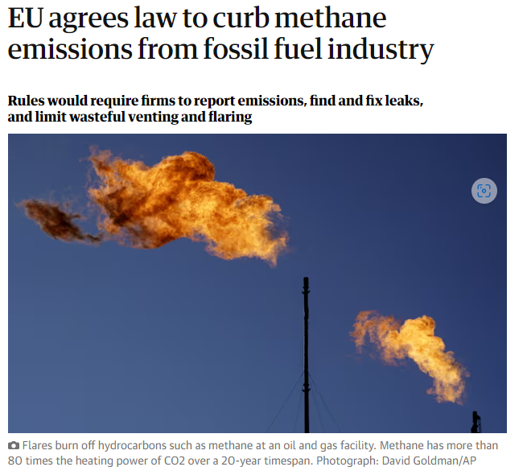
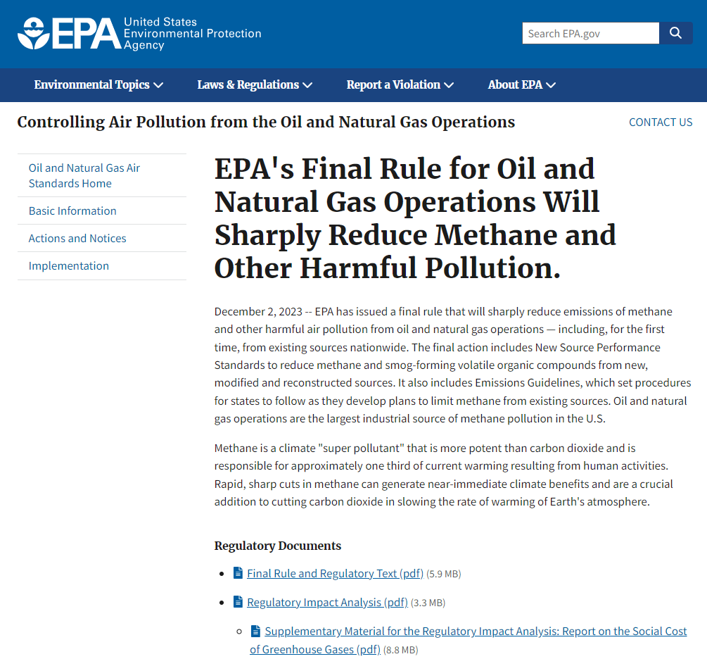
New rules on Energy sector
https://www.epa.gov/controlling-air-pollution-oil-and-natural-gas-operations/epas-final-rule-oil-and-natural-gas
https://oeil.secure.europarl.europa.eu/oeil/popups/ficheprocedure.do?reference=2021/0423(COD)&l=en

Slide 3
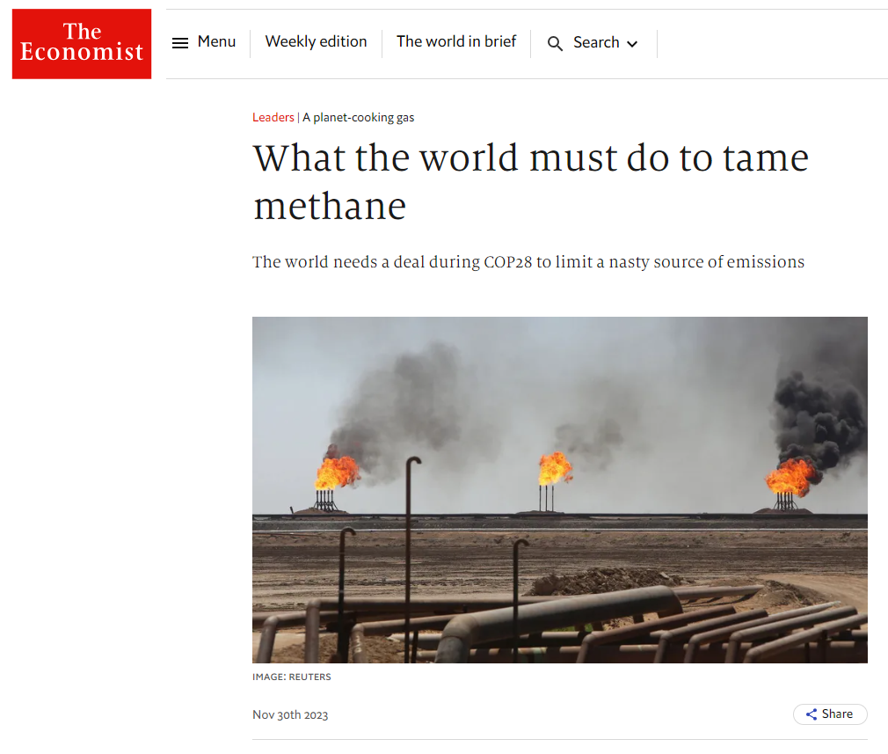
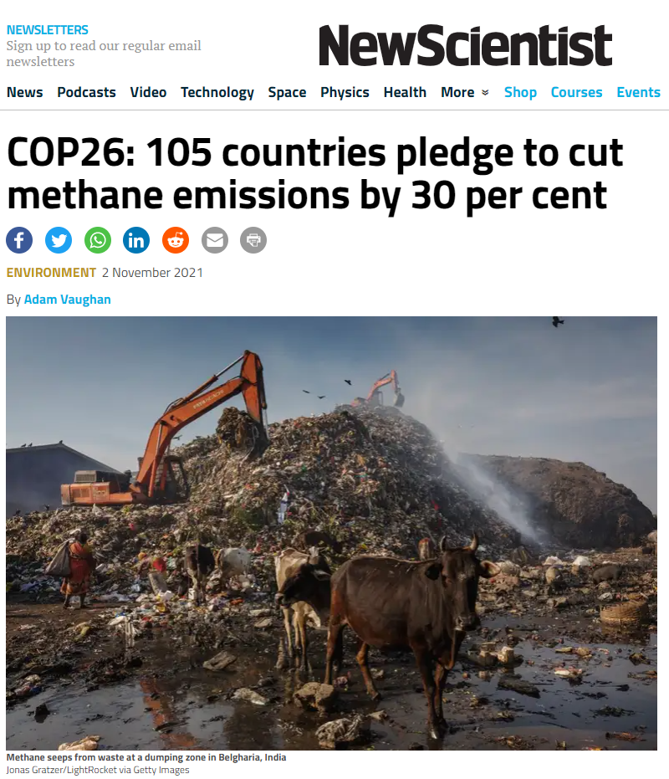
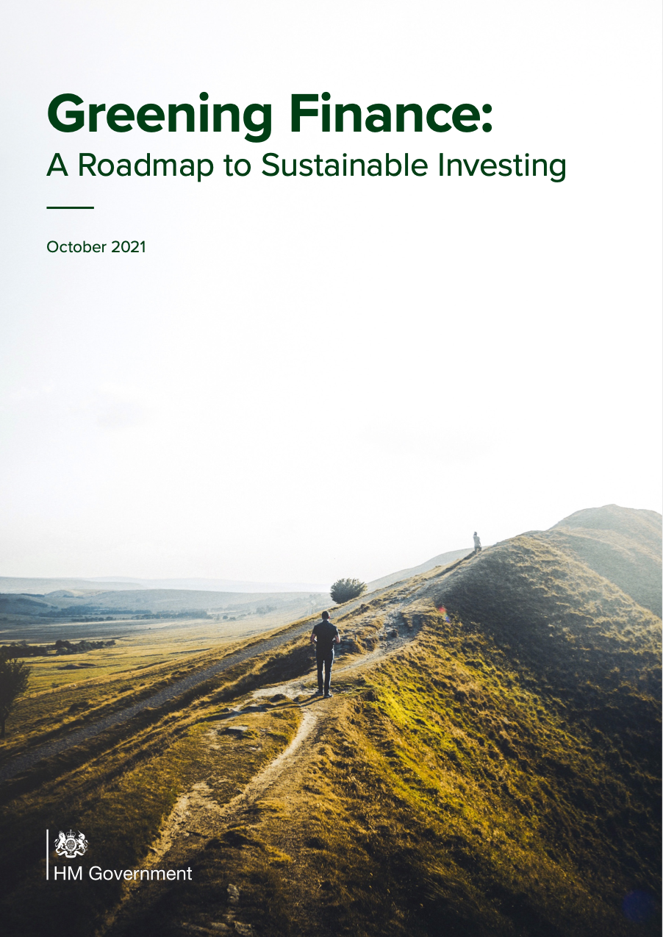
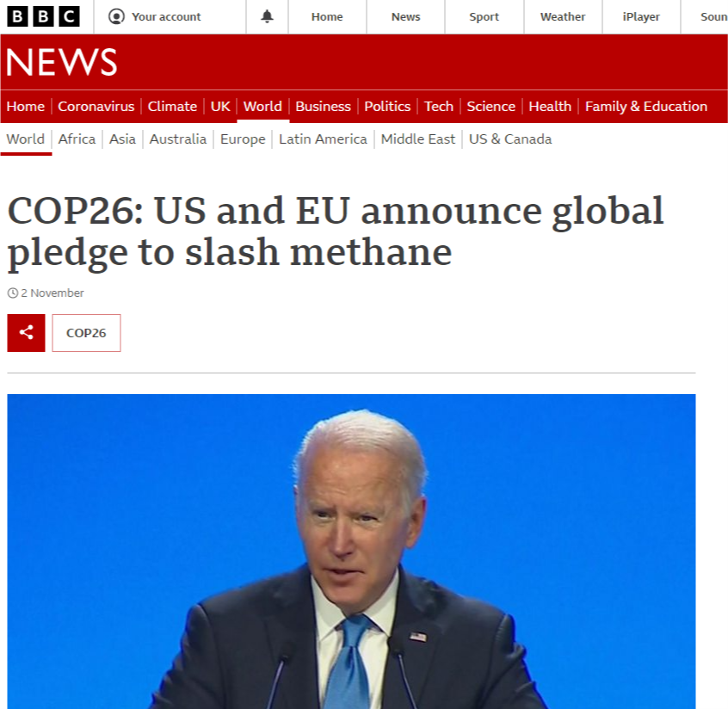
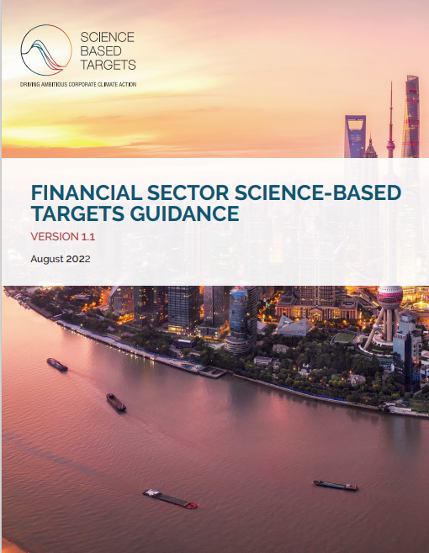
Corporate emissions and climate risk reporting
TCFD
New and refined regulatory drivers form the basis of a corporate report B2B business model
Rapidly growing SA & private satellite/product sector drive urgency for independent quality assurance

Slide 4
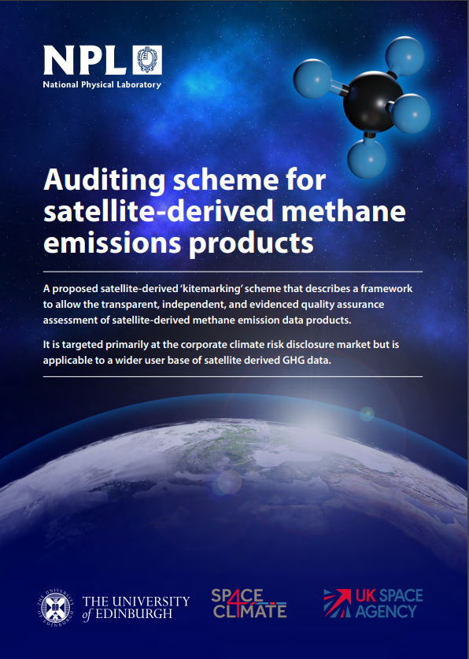
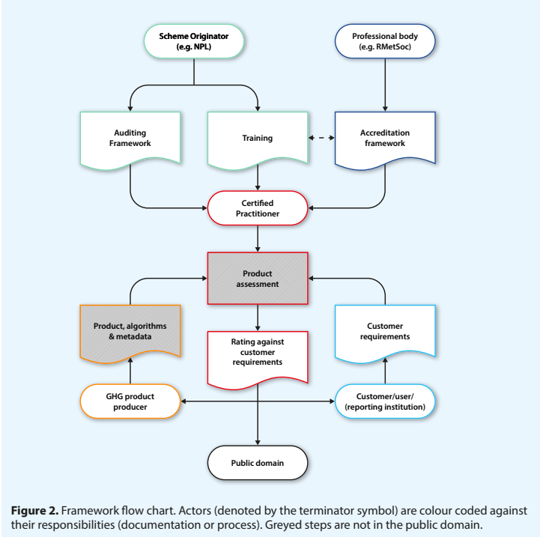
Satellite-derived Methane standards initiative
Published auditing scheme report – May 2023 following UKSA support from late 2022
Builds on WG climate GHG TT activity and iterated with feedback from TT through 2023
UKSA supported activity over 2 years working towards publication and presentation at COP 30
Development taken forward in close collaboration with NIST/US GHG centre

Slide 5
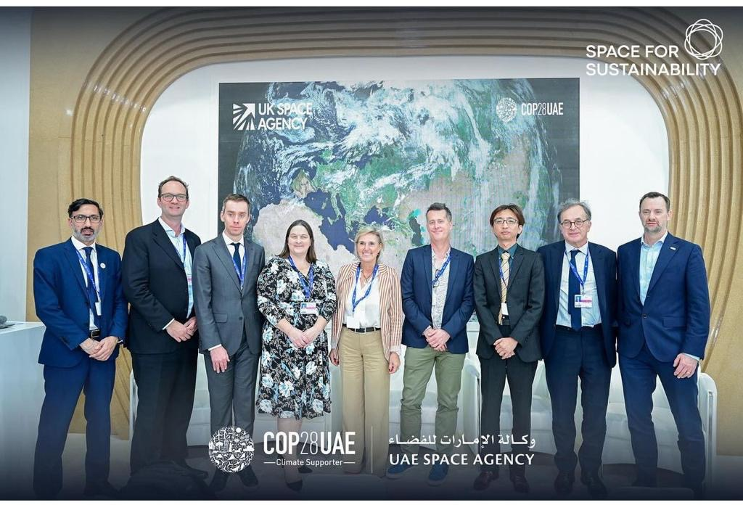
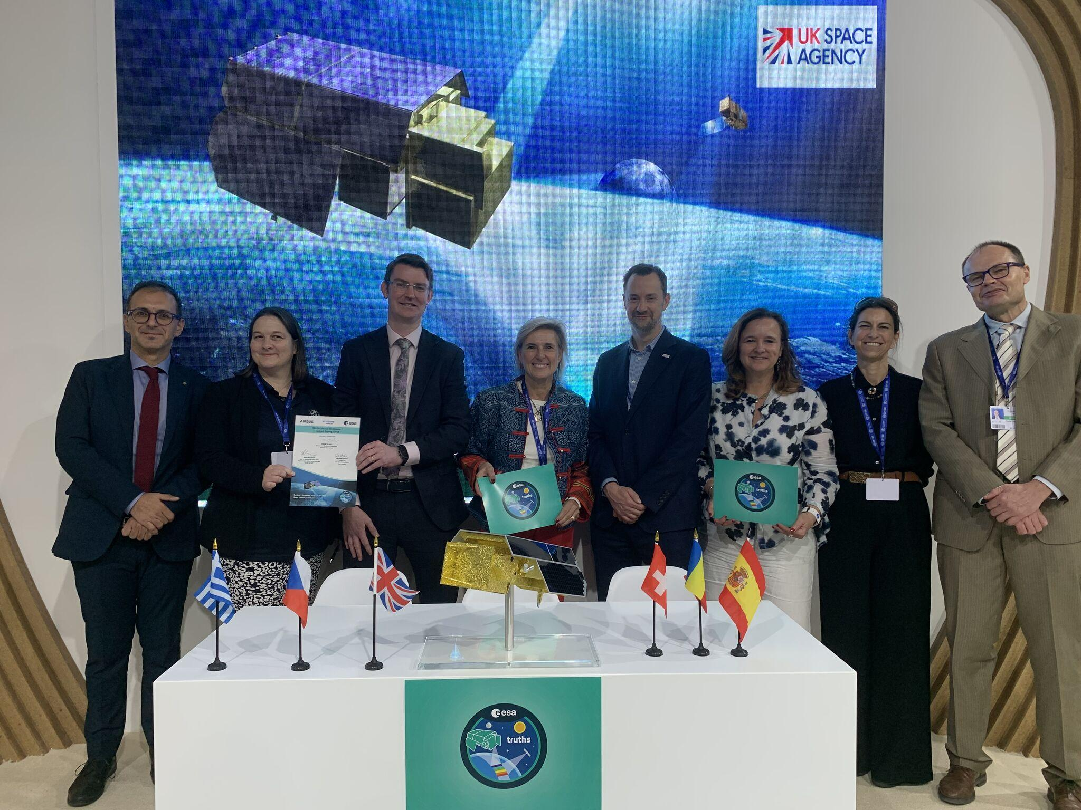
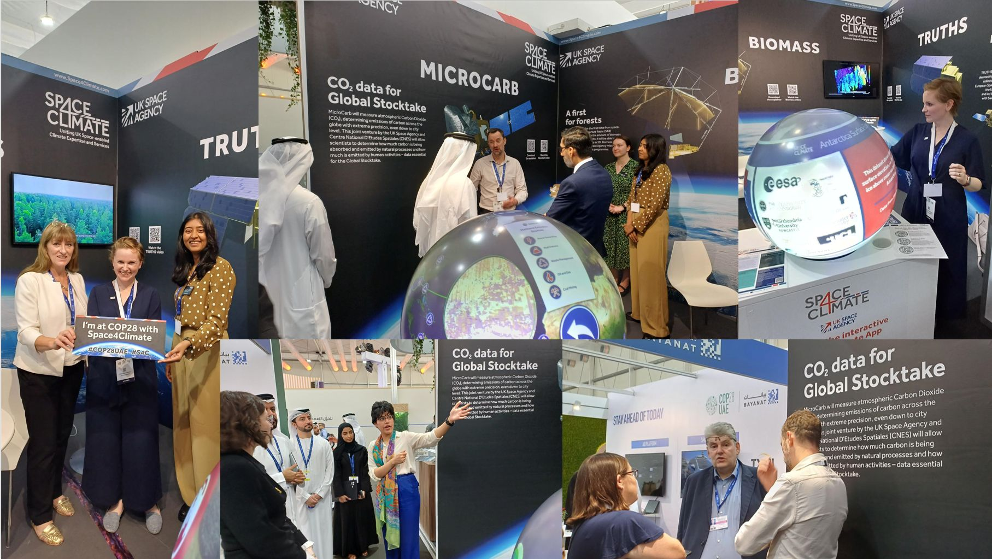
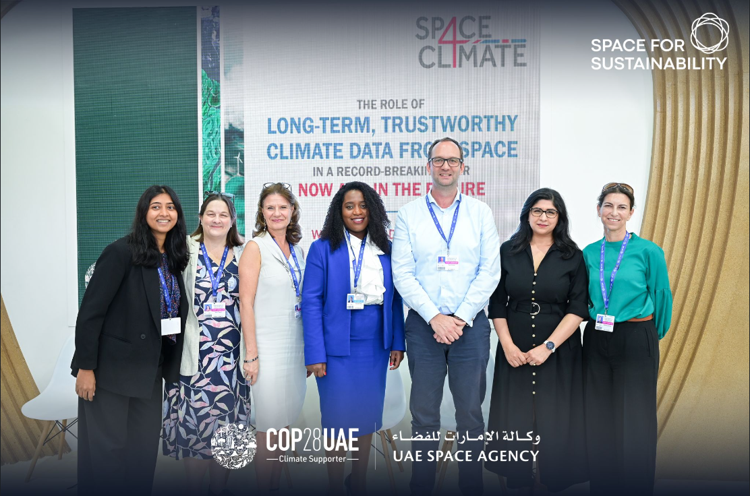
COP28 - Monitoring Methane from Space: Towards an Internationally Recognised Standard
UKSA-hosted event on the UAE-Space Agency Space Sustainability stand within the first ever COP ‘Space Pavilion’
Event supported by representatives from UKSA, ESA, JAXA, Kayrros, GHGSat, Edinburgh Uni & NPL
Supports key COP28 methane specific actions including the Oil and Gas Decarbonisation Charter

Slide 6
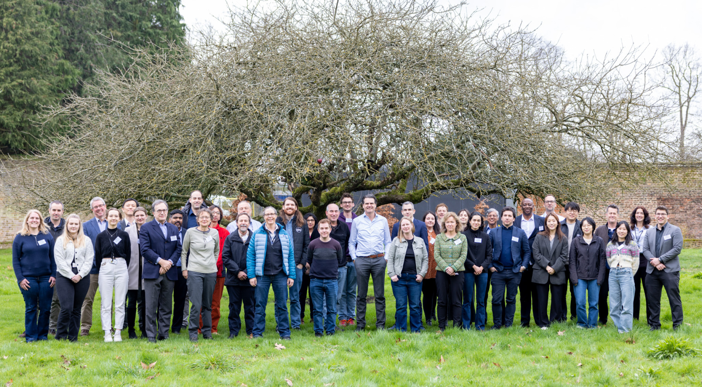
Satellite-derived methane standards workshop 26-28 Feb 2024
NPL hosted a UKSA-sponsored methane reporting standards workshop 26-28 Feb.
Representation from ESA, NASA, JAXA, Chinese, Korean public sector organisation, Leicester & Edinburgh unis, CEOS, EDF and commercial providers, GHGSat, MethaneSat, CarbonMapper as well as members of the ground validation community…
31 speakers
74 registered, 62 in person – typically 10 or so online at any one time.
Development program
Initial outlines by May 2024
Initial standards drafts for Sept 2024.

Slide 7
Documentary Standards Workshop Objective
The workshop was an opportunity to bring key stakeholders together to formulate a documentary standards structure, identify practical requirements and impediments and set out the programme roadmap and timelines to keep pace with a rapidly evolving sector.
Achieving community agreement on the need for development of documentary standards & their structure, for the process methods and reporting of methane (concentration and flux) products.
Understanding how these are implemented for reporting products at national, regional, sector, city and corporate scales.
Identifying the essential properties, terminology & methodologies and develop the principles of a documentary standards framework.
Identifying the stakeholders and their needs for a compatible documentary standards framework from space agency-led products, new space/commercial players and the product user community.
Create recommendations for the development of the documentary standards and a timeline for delivery.
Create a programme with an oversight committee within existing international fora/working groups to advise and advocate of the proposed documentary standards framework.

Slide 8
What do we mean by the term ‘documentary standards’
Definitions:
(Documentary) best practise is defined as guidance, is ‘voluntary’ & compliance statements can be open to interpretation.
Documentary standards are more stringent, allowing an objective Y/N compliance statement.
Looking to create compliance-determinable best practise for the methods and reporting of satellite-derived methane products

Slide 9
Workshop recommendations - structure
Standard will be agile, not static, to allow evolution of approach & focused on methods and reporting, not a static threshold performance basis. Defined to prevent the misuse of data (intentional or otherwise) and foster good use
Graded compliance to the documentary standard seen as a mark of rigorousness and trust. Compliance not required to operate in field. Use a graded compliance (Gold/Silver/Bronze) & encompass a ‘minimum viable’ to ‘ideal’ scale to maximise pragmatism.
Need documentary standards specific for individual use cases. Some underlying standard/best practise on product and metadata content, with specific focus on facility scale emissions for:
Alert (NRT leak identification)
Super emitter quantification (for regulation)
Time-averaged accounting emissions (per facility/basin)
Need agreed language & terminology. Extend existing definitions and taxonomy, concentrate on plume identification and quantification (L3 > L4) for legislation/ regulation.

Slide 10
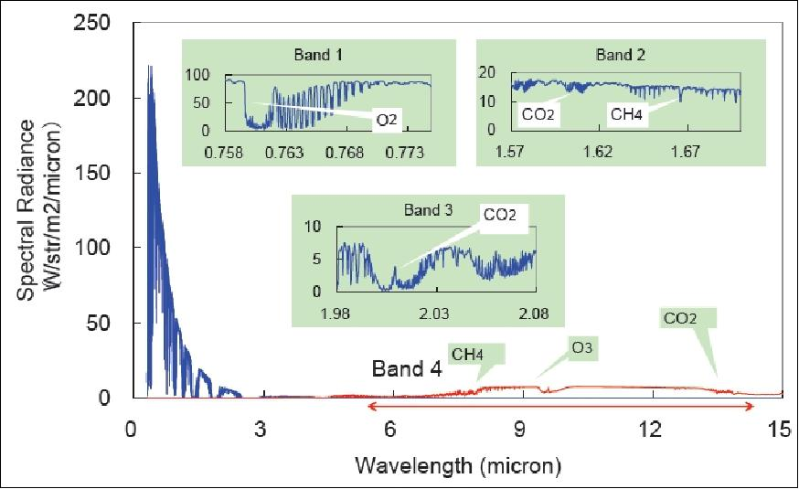
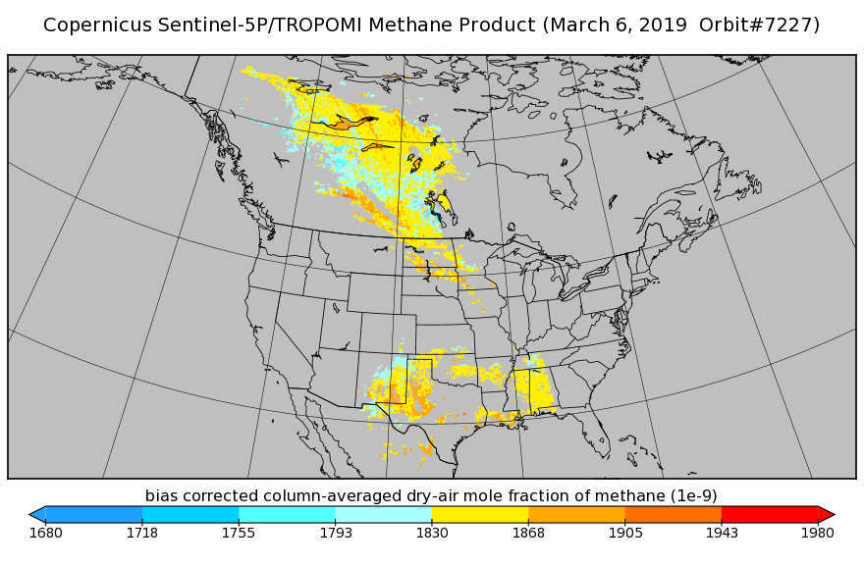
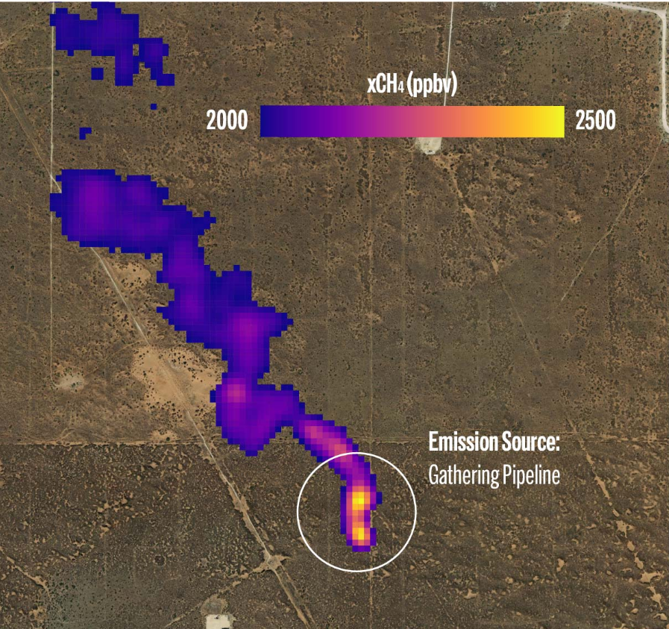
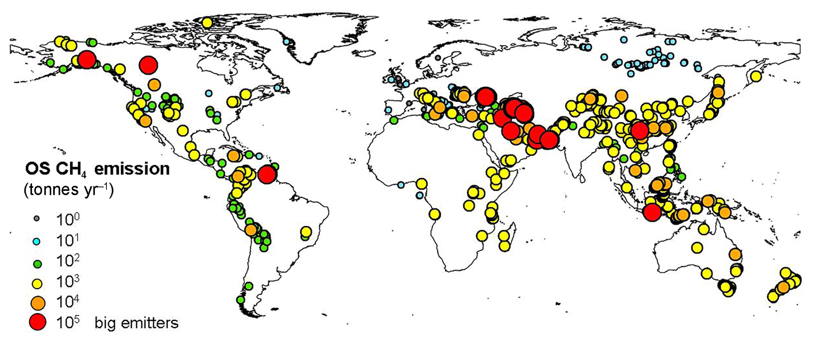
Workshop recommendations – CH4 product levels
Define the data product & metadata requirements at each level
L1 & concentration (L2) are well defined but need work for other L2 quantities.
L3 & L4 – Immature best practise – needs development
Define core L3/L4 metrics
Clear uncertainty description, including breakdown of major contributors
Transparency and reproducibility of products key for science users.
Need a public data sandbox for data exploration
Comparability at each stage essential
Validation – need ramp-up of comprehensive real-world dataset & support for controlled release program.
Level 1 spectra /bands/channels
Image credit: JAXA
Level 2 concentrations
/enhancements
Image credit: disc.gsfc.nasa.gov
Level 3 plume identification
© MethaneSat
Level 4 flux & emission rates
Image credit: 10.5194/essd-11-1-2019

Slide 11
Documentary standards development timeline
Commercial mission drivers demand a relatively short timescale for a working first version of documentary standards.
2024 – outline development & peer review
2025 – detailed development, peer review & v1 finalisation
Published for Q4 2025 – COP 30 & presentation at CEOS Plenary 2025.

Slide 12
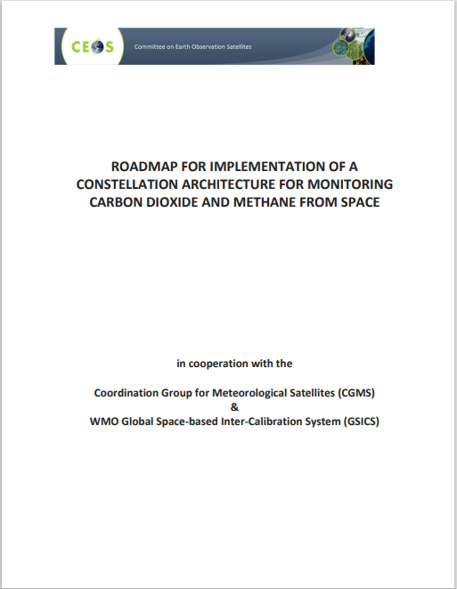
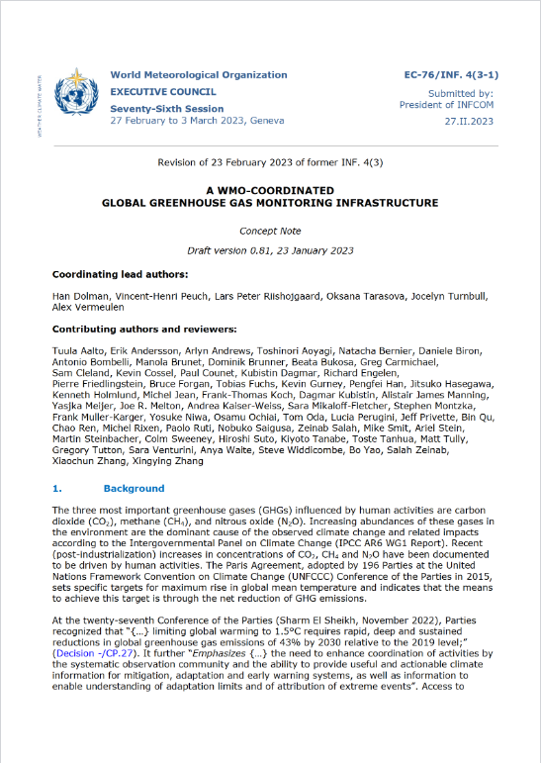
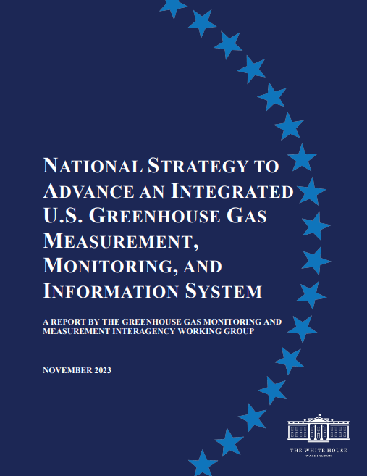
Working with parallel international initiatives
Build on previous CEOS work on best practises in the public and new space domains and want to partner with key parallel programmes and stakeholders to add value as an underpinning framework to enable reporting in the public and commercial sectors
UK audit scheme
CEOS GHG roadmap
UNEP IMEO
WMO G3W
US GHG Centre

Slide 13
CEOS role in documentary standards development
CEOS is a key stakeholder and ideologically would limit involvement to ~L2 products from space agency funded missions. So why take a leadership role in a more commercially-led L4 domain?
Space agencies are involved in data purchases from commercial companies – meeting documentary standards on these products are part of the due diligence process (ESA EDAP, NASA CSDA).
The landscape is not so clean cut – tip & cue type approaches integrate across the divide (Sentinel-5P & GHGSat).
Space agencies have sensors in this domain (e.g. EMIT, Sentinels 2 & 5P, PRISMA, EnMAP, CHIME, TRUTHS) and work in partnership with commercial players (e.g. CarbonMapper)
Declared CEOS support for international initiatives UNEP IMEO & WMO G3W necessarily intersect with the commercial emissions data sphere
CEOS partner organisations are well placed to contribute for public missions (ECMWF, CAMS)
CEOS can act in a co-ordinating role (in the vacuum of other candidates) in this relatively immature phase but open to stepping back as the initiative matures and suitable stakeholders assume roles.

Slide 14
Desired outcomes* from CEOS-SIT 39
GHG Inventories
Support best practice for bottom-up community to work with top-down community to derive accurate inventories in support of the global stock take and methane pledge (e.g. Area 1 US GHG center)
Standards development
Support of effort to define best practices/documentary standards for quantifying and reporting emissions to underpin work with partners (e.g. IMEO, G3W, CAMS, USA GHGCenter, NPL, NIST)
Acknowledgement of the role of CEOS - not owner of standards, but driver of international collaboration and alignment into parallel initiatives, e.g. support IMEO
GHG task team to continue integration of this work to make progress, and request an updated report at SIT-TW in September
Validation
Support validation efforts of facility scale emissions estimates: fit-for-purpose aircraft and ground campaigns
Support coordination of measurements across platforms for both validation and to increase confidence in large methane emission detection (an IMEO request)
*Collective from #7.3 & #7.4

