Slide 1
Best Practices for Reporting Satellite Informed Emissions
J Worden (NASA / JPL)
CEOS GHG TT
CEOS SIT 39 2024
April 7 Tokyo Japan

Slide 2
Background
The Global Stocktake (GST) is a comprehensive assessment of the world’s progress on climate action. Anchored in Article 14﻿ of the Paris Agreement, it is intended to inform Parties to the Agreement on their progress against its goals, including but not limited to limiting global temperature rise to 1.5°C.
Drastically reduce greenhouse gas emissions to keep global temperature rise below 2°C and ideally 1.5°C (Article 2.1.a)
The Global Methane Pledge (GMP) was launched at COP26 by the European Union and the United States.
Now Composed of 152 countries it aims to reduce methane emissions by 30% between 2020 and 2030: methane is a much stronger GHG (per 20 years) than CO2 but may also be easier to reduce as well known remediation efforts can be applied to managed sources such as landfills and fossil emissions

Slide 3
From the IPCC: atmospheric measurements can now be used to inform inventories
“… comparisons with atmospheric measurements are not established as a standard tool for verification to be applied by an inventory compiler. Still, considerable scientific progress in this area needs to be noted and inventory compilers may wish to take advantage of the potential of this approach, as it gives independent data for verification.”
IPCC Expert Meeting on Use of Atmospheric Observation Data in Emission Inventories

Slide 4
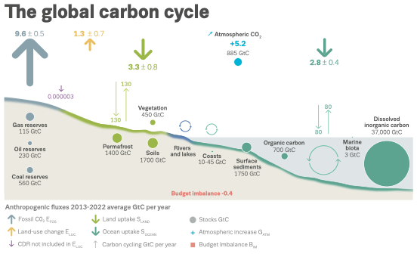
Satellite based Top-Down emissions estimates supporting the global stock-take could be critical to resolve model / inventory discrepancies that might disrupt policy selected decarbonization pathways
The global methane budget
Recent evidence suggests the land CO₂ sink might be greatly overestimated
(e.g. Xu et al. Sci Adv 2021) Change in ABG ~.2 Pg/year… Need ~2 Pg/year
Fossil emissions? Below Ground Biomass? Lateral Transport?
Top-down data suggest much larger livestock contribution and lower fossil emissions (e.g. Zhang et al. 2021, Worden et al. 2023, 2023). May need to change remediation practices to consider larger than expected food needs in order to meet Global Methane Pledge target

Slide 5
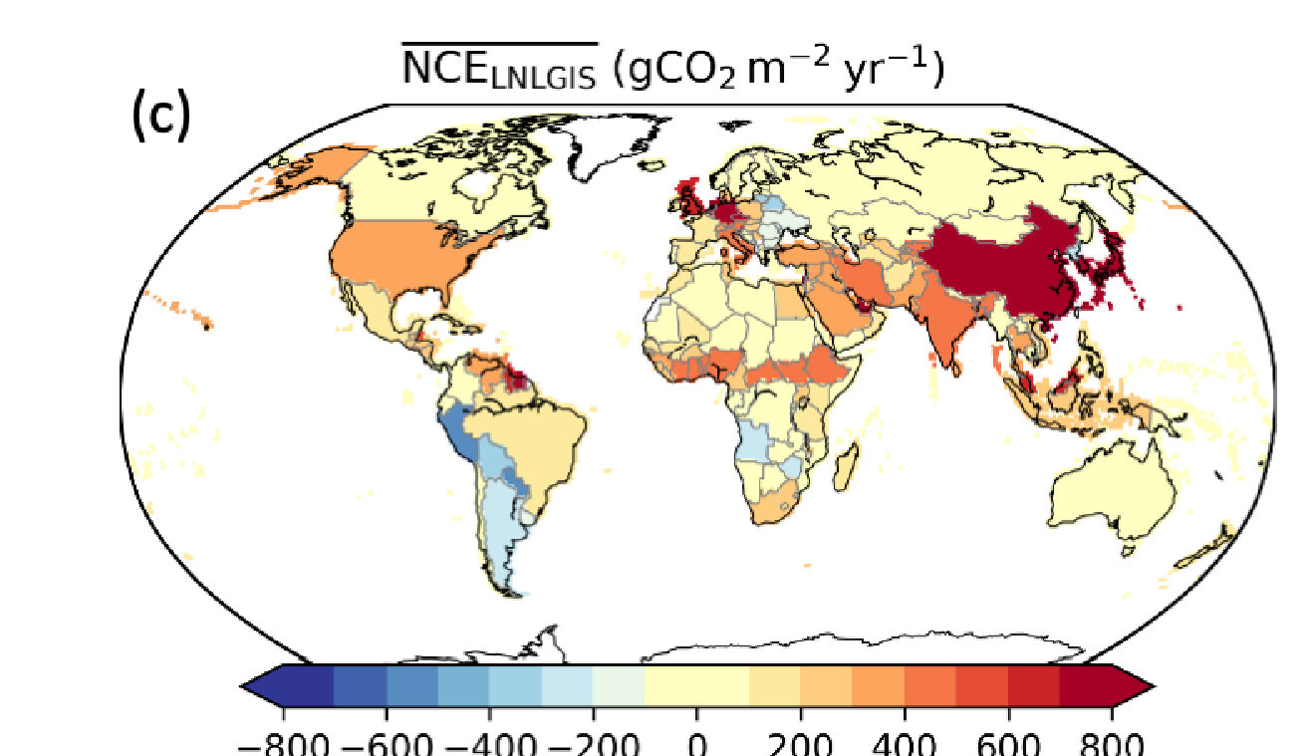
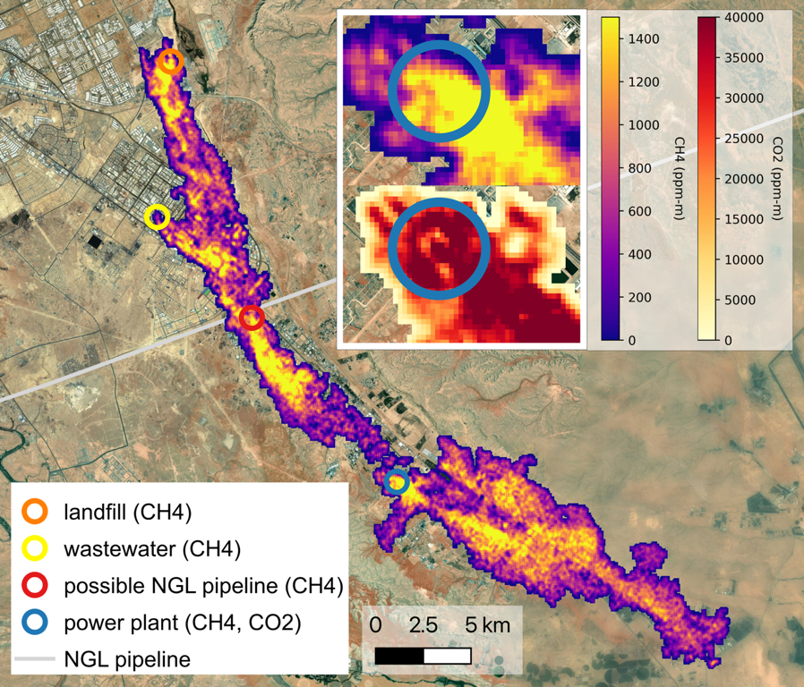
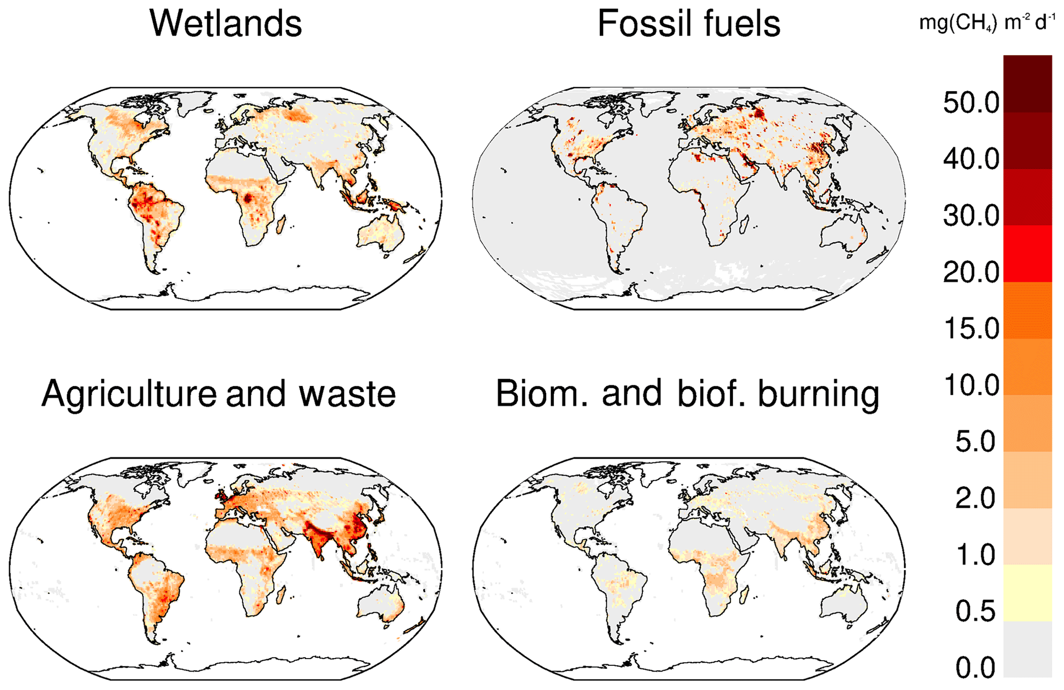
Multi-Scale Distribution of Fluxes and Emissions Require Multi-scale observing system (And Corresponding “Best Practices”)
Byrne et al. 2022
Saunois et al. 2022
Thorpe et al. 2024
CO₂ and CH₄ fluxes are composed of area sources such as forests and wetlands (length scales from 1 km to 1000’s of km) and facility scale sources (10’s of meters to 1km)

Slide 6
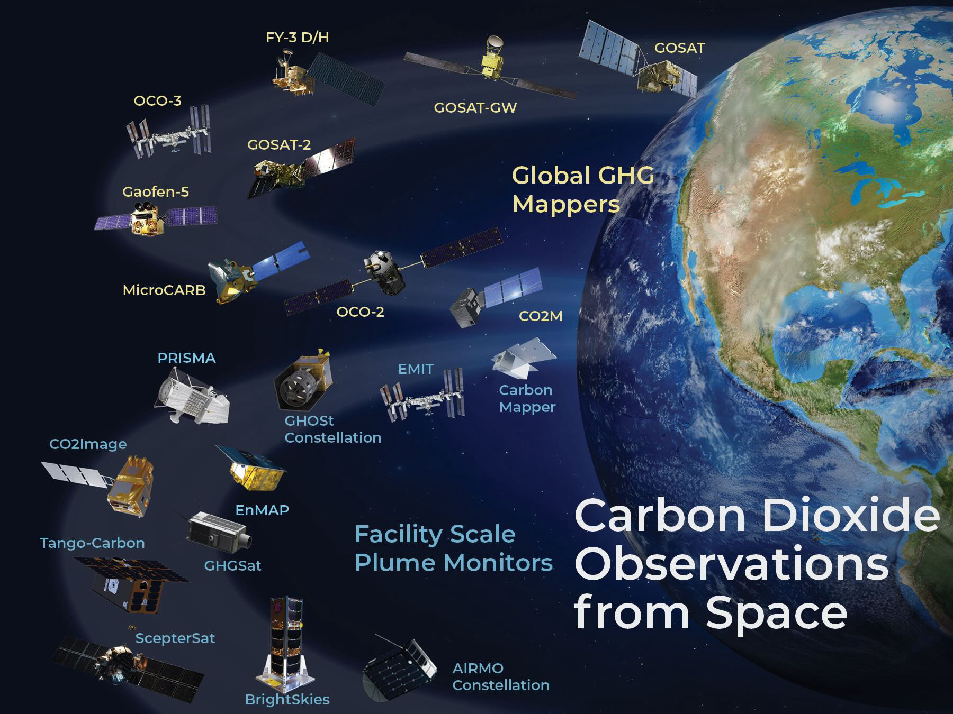
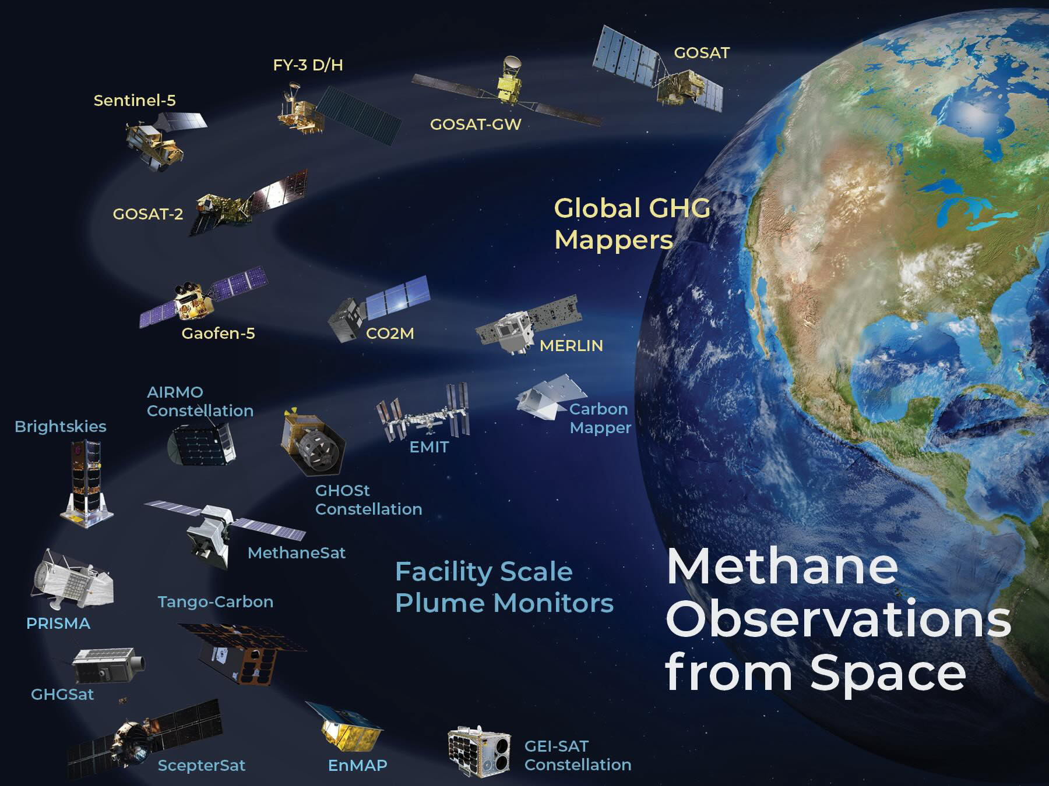
Constellation of observations are observing from the global to the facility scale.
Despite this massive improvement in GHG observing capacity, additional measurement systems are needed to resolve changes in carbon fluxes for major gaps such as oceans, cities, extreme events, (subsequent D. Crisp talk)

Slide 7
GHG Emission Users and Providers: The need for best practices in reporting (satellite based) emissions
WMO G3W is an umbrella agency that aims to provide monthly fluxes of GHG gases at 1 degree (~100km) resolution using a combination of satellite and in situ data and models
UNEP IMEO aims to provide actionable information about high methane emitters that typically occur at 10’s of meters
Copernicus CAMS will provide up-to-date CO₂ emissions for Europe
USA GHG Center will provide bottom-up USA methane inventory, global GHG natural fluxes, and satellite based information about methane high-emitters
🡪 These each have satellite based GHG emissions estimates at radically different scales, requiring different estimation approaches and therefore different best practices.

Slide 8
Why do we need “Best Practices”?
Trust!
Trust that the emissions reported based on public and New Space data sets can be used to track all aspects of the the carbon cycle that affect atmospheric CO₂ and CH₄.
For the rest of this presentation I will focus on CH₄ emissions at the facility scale (and by extension CO₂) but we expect the lessons learned to be relevant for area wide fluxes

Slide 9
Questions to be Addressed in Best Practices Discussion
What is part of the “Best Practices” discussion?
1) A community accepted practice or methodology for quantifying emissions. 2) Emissions are reproducible from reported products and algorithms (ATBD’s, product files description). 3) Well characterized VVUQ with traceability to a reference measurement.
(New Space) How can data product transparency be ensured for data collected by non-public sector missions that must guard their intellectual property? Do we need an independent assessor of New Space product quality (next presentation)?

Slide 10
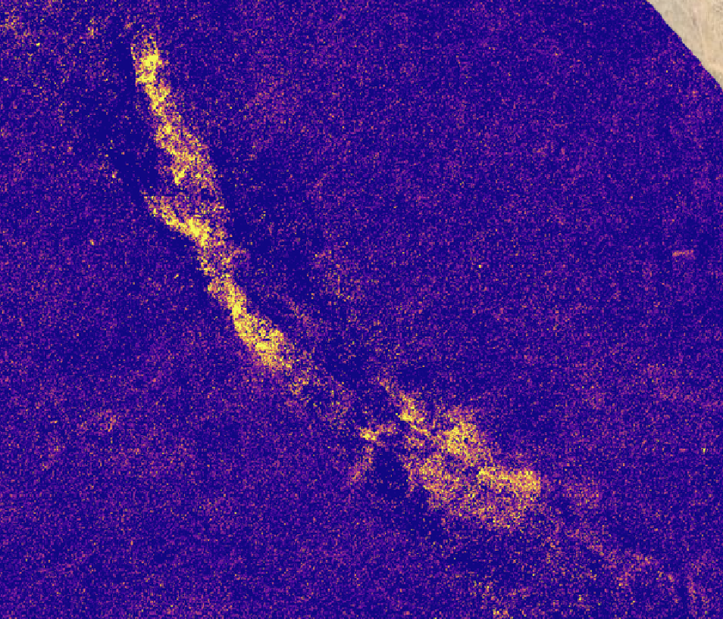
Best practices challenge for facility scale emissions: Scattering and albedo variations challenge Reproducibility
Enhanced CH4 from EMIT
Plume Mask
An algorithm + human operator first generates a plume mask
Expert must be used to determine a false positive in right-middle of image and to evaluate extension of plume in bottom right

Slide 11
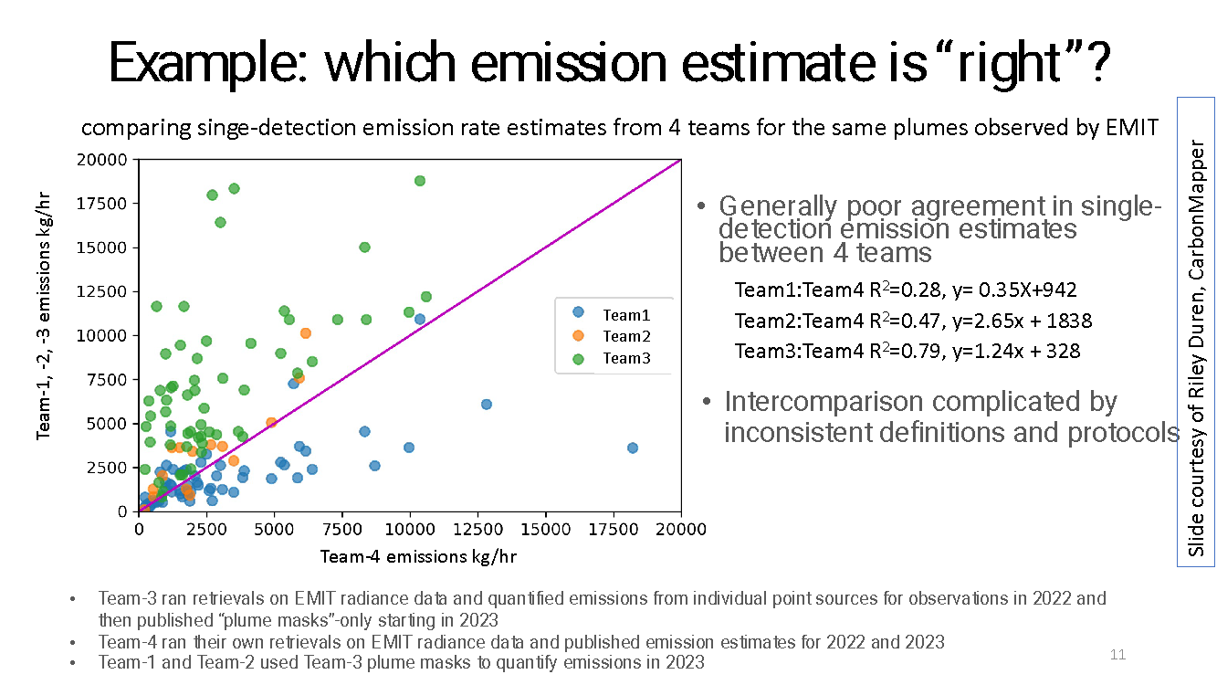
Best practices challenge for facility scale emissions: Scattering and albedo variations challenge Reproducibility

Slide 12
Best Practices Challenge: Need more robust Validation of plume detection + emissions estimates at facility scale
Developing best practices is facilitated by a robust network for validation as it allows testing of top-down methodologies and validation of emissions and their uncertainties
(Left Figure) Ground validation is possible for facility scale emissions estimates but this capability is still in its nascent phase and only provides validation under optimal conditions.
🡪 We need validation for the range of conditions that are typically observed, not for optimal conditions.
Can CEOS support validation of facility scale emissions?
Use of aircraft and ground campaigns to support emissions quantification, intercomparison, and validation
Coordination of satellite measurements to measure over same site
Figure courtesy of GHGSat

Slide 13
Summary
Summary:
Emissions based on Public and New Space observations of CO₂ and CH₄ are increasingly being used for policy as well as science and are likely needed for a functioning carbon market
We need a set of best practices (community accepted methodology, Verification, Validation, Uncertainty Quantification+traceability to reference measurements, reproducibility)
CEOS support of ”Best Practices” effort enables interaction with New Space measurements 🡪 New Space adoption of best practices increases trust / usability of their data.
IMEO supports Best Practice effort in order to improve trust of large methane emission detections.
Lessons learned can apply to developing best practices for area fluxes in support of the global stock take that are needed to track changes to the global carbon cycle.

Slide 14
Thank You!

Slide 15
Summary and Requests for Best Practices Effort
Requests:
Cross-validation requires coordination for tip/q and coordinated measurements (Also an IMEO request)
Support validation efforts of facility scale emissions estimates: fit for purpose aircraft and ground campaigns
Continued support of effort to define best practices for quantifying and reporting emissions
Support work with partners (e.g. IMEO, G3W, CAMS, USA GHGCenter, NPL, NIST) to develop Best Practices protocols for emissions estimates.
Support efforts for bottom-up community to work with top-down community to derive accurate inventories for tracking global fluxes in support of the stock take and methane pledge
Support development of best practices and corresponding quality assessment guidelines for New Space measurements
Discussion and Feedback Requested

Slide 16
(for Best Practices Discussion)
At what level should CEOS be involved?
CEOS affiliated agencies are already involved with supporting VVUQ through aircraft / ground campaigns and through developing methodology via Projects such as NASA EMIT + AVIRIS and ESA Medusa
Involvement with Best Practices supports integration of New Space data for use with public mission data

Slide 17
Use Case 2: Other factors affecting how plume mapping based emissions are reported from New Space
Intellectual property concerns mean that provenance of data in different levels of data products (L1 radiances, L2 concentration enhancements, and L4 emissions) are not necessarily traceable
Need to develop evaluation metrics for how well these products are reported and evaluated (in process with ESA / NASA evaluation team)
Public missions (e.g. EMIT, CO2Image) can be used as benchmarks for data products and transparency
May need to move away from “no false positive” for public missions and instead provide gradation of data quality flags

Slide 18
Best Practice Challenge for Global Top Down Emissions Estimates: Computational expense leads to issues with reproducibility, interpretation, and intercomparison
Traceability is not an issue with global “top-down estimates” as data are traceable back to robust cal/val system (e.g. TCCON / COCCON).
Computational expense leads to challenges with reproducibility.
Interpretation of data may be difficult because computational expense limits reporting of required products such as posterior covariances.
Example: Miller et al (Nat Com 2019) uses GOSAT data to report that Chinese (methane) coal emissions are not decreasing because of policy changes
Subsequent analysis by Zhang et al. (PNAS 2022) and Worden et al. (AGU Advances), also using GOSAT data, reveals that Miller et al. result is not accurate🡪 Correlations between emissions obfuscate reduction in coal emissions. The analytic inversions in Zhang et al. and Worden et al. report posterior covariances and priors and these allow us to more accurately assess of Chinese (methane) coal emissions and trends.
Conclusion: In order to robustly estimate emissions and their trends and to better intercompare between results, we need to report priors, prior and posterior covariances, and quality assessment metrics for top down inversions. (this is analogous to satellite composition products)

