Slide 1
SAFE CH4Rice (Methane) Project
Shinichi Sobue Kei Oyoshi, Go Segami JAXA
Agenda Item 7.4
SIT-39 2024, Tokyo, Japan
10th - 11th April 2024

Slide 2
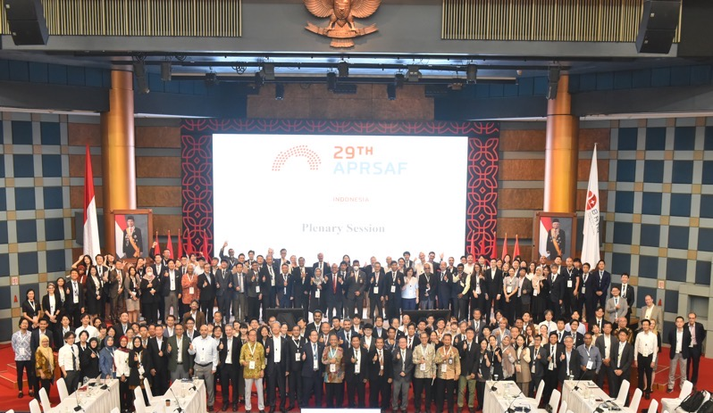
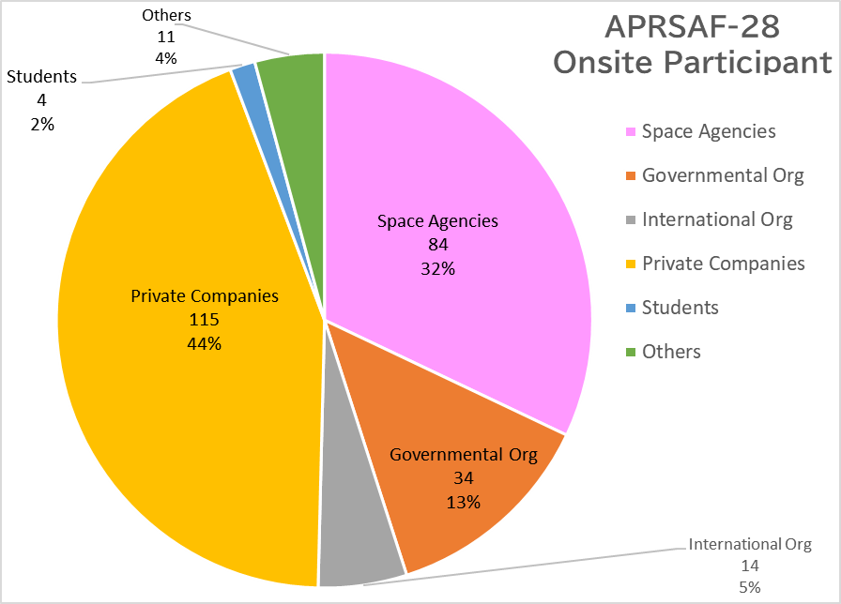
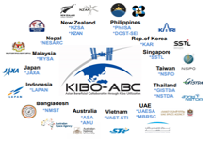
APRSAF : Asia-Pacific Regional Space Agency Forum
APRSAF-29 (2023) in Jakarta
September 19-22 @ BRIN HQ
434 participants from 23 countries & regions
APRSAF-30 (Nov. 2024) in Perth
APRSAF-31 (2025) in Philippines
APRSAF Annual Meeting
WG Reports
Country Reports
Special Sessions under the main theme
Space Policy Session
Space Leaders’ Round Table
Plenary Session
Satellite Applications for Societal Benefit (SA WG)
Enhancement of Space Capability (SC WG)
Space Frontier (SF WG)
V. Space Policy and Law
(SPL WG)
Space Education
for All (SE4A WG)
Space Industry Workshop
(SI WS)
SAFE (Space Applications For Environment)
Notes:
JAXA established the Asia-Pacific Regional Space Agency Forum (APRSAF) in 1993 to enhance space activities in the Asia-Pacific region.
Space agencies, governmental bodies, international organizations, private companies, universities, and research institutes from over 30 countries and regions take part in APRSAF, the largest space-related conference in the Asia-Pacific region. The increasing attendance of high-ranking officials and participants from industry at APRSAF events provides opportunities to discuss international cooperation for space activities in concrete terms.
We’ve had the pleasure of having 1-2 participants from Cambodia every year since the APRSAF-19 which took place in Malaysia in 2012.
The next annual session, the APRSAF-30, will take place in November this year in Perth, Australia, hosted by our colleagues at the Australian Space Agency (ASA). We very much look forward to having participants from Cambodia.

Slide 3
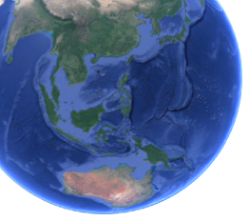
APRSAF SAFE Projects (Space Applications for Environment)
Enhancing multilateral collaboration from bilateral collaboration
Promoting data, tools and knowledge sharing, and capacity building to address regional common issues
Zero Hunger Clean Water & Saniti. nd.Innov & Infra
Sendai Framework
2015-2030
Climate Life on land Partnership for the Goals
Contribute to global agendas by solving regional common issues in the Asia-Pacific region
Agromet Project (since 2018)
Rice Crop Monitoring Project (since 2018)
CH4Rice Project
(since 2022)
Agromet information comparison and capacity building toward developing knowledge of integrated use of agromet information for rice crop growing outlook, regional food security related decision-making etc.
Rice map comparison and building platform for sharing data and tools to contribute to improvement of agricultural statistics, regional food security related decision-making etc.
Estimate methane emission from paddy rice by considering water level to contribute to Climate Change Mitigation through methane MRV, efficient irrigation and sustainable agriculture as well as Carbon Credit.
Project Lead: ISRO
Project Lead: GISTDA
Project Lead: VNSC

Slide 4
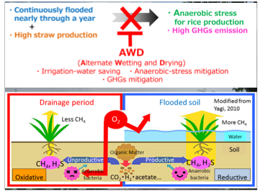
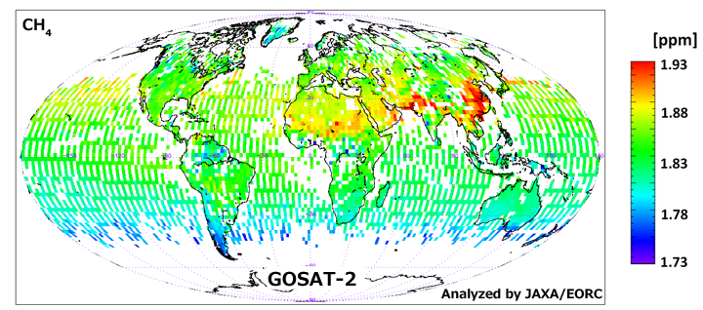
Methane Emission from Paddy Rice
Food systems are responsible for a third of global anthropogenic GHG emissions [Crippa et al, 2021]
CH₄ emission from rice paddies are estimated to be about 8 % of total global anthropogenic CH₄ emission [Saunois et al., 2020]
Asian region accounts for about 90% of the global rice production [FAO, 2023]
The amount of CH4 emission is a function of the number and duration of crops grown, water regimes , and soil type, temperature, and rice cultivar. [Guidelines for National Greenhouse Gas Inventories, IPCC, 2006]
Alternate Wetting and Drying (AWD) is effective rice cropping system to reduce methane emission and save water usage from rice cultivation.
Atmospheric CH₄ Concentration September 2019 by GOSAT-2
Alternate Wetting and Drying (AWD)
A management practice in irrigated rice characterized by periodic drying and flooding of fields to reduce water use and CH₄ emission.
https://www.naro.affrc.go.jp/archive/niaes/techdoc/methane_manual.pdf
https://www.eorc.jaxa.jp/en/earthview/2020/tp200310.html]

Slide 5
APRSAF/SAFE CH4Rice Project: Overview
Approved at the SAWG, APRSAF-28 (Hanoi, Vietnam, Nov, 2022) proposed by VNSC (Lead)
Expect to Contribute (Outcome)
Climate change mitigation such as carbon credit through CH₄ MRV (Monitoring, Reporting and Verification) using satellite and in-situ data
Water management by efficient irrigation with lower CH₄ emission (e.g. Alternate Wetting and Drying (AWD) or water saving irrigation)
Regional and global sustainable agriculture related initiatives/activities (e.g. CEOS, SDGs Goal2/13, GEOGLAM/Asia-RiCE, AOGEO etc. )
Implementation
Development of the methodology to monitor water inundation and CH₄ emission from rice paddies
Data/Tool/Knowledge sharing and capacity building for multi-lateral collaborations
Promote dialog with stakeholders/end-users with showing results (considering national policy, try to reach related agencies)
Synergies with other SAFE projects, Agromet and Rice Monitoring Projects

Slide 6
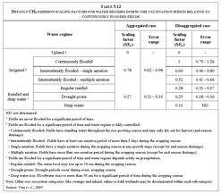
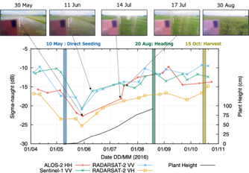
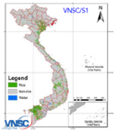
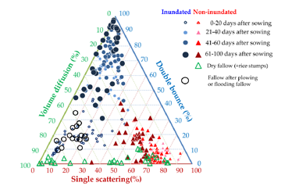
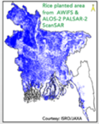
Estimation of Methane Emission from Paddy Rice
Try to use satellite data in the IPCC’s equation to estimate CH₄ emission from paddy rice
Multiplying by emission factors, cultivation period and harvested area
[IPCC, 2006, 2019]
Annual Methane Emissions
Emission Factors in IPCC Guideline [IPCC, 2006, 2019]
Emission Factors
Cultivation Period
Harvested Area
Water regimes is important factor for CH₄ emission Inundation identification using ALOS-2 full-pol data
Phenology (SAR and optical)
Rice Map (X/C/L-band SAR )
Supplemental use of Agromet data (Synergy with agromet project)
[H. Arai, W. Takeuchi, L. D. Nguyen et al., 2018]
Synergy with Rice Monitoring Project

Slide 7
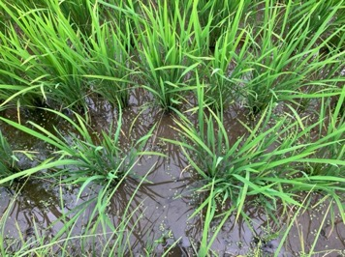
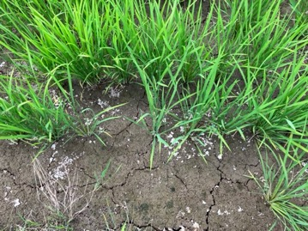
Water Inundation Monitoring using L-band SAR
L-band SAR with Full-pol data can identify the existence of water under rice.
Penetrates rice canopy and measure scattering components in detail
Strong double-bounce scattering by inundated paddy field [Arai et. al, 2018]
Paddy with water (inundation)
Paddy without water (non-inundation)
Double bounce
Single scattering

Slide 8
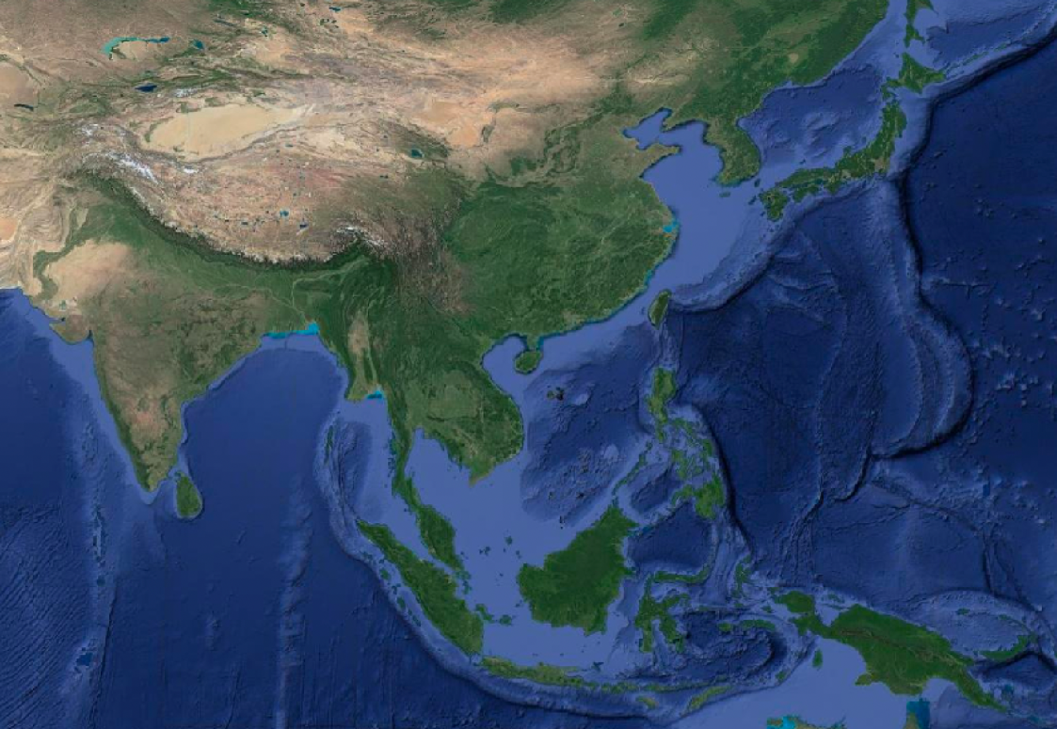
CH4Rice Project: Study Sites in Asia
Study Areas in cooperation with space agencies / MOA / Universities with companies
BRIN Indonesia: Subang
GISTDA Thailand: Chai Nat / Suphan Buri
ISRO India: Nawagam
JAXA Japan: Ibaraki / Miyagi
PhilSA Philippines: Bulacan
PUST Bangladesh: Rajshahi
VNSC/ESA Vietnam: Mekong Delta
ALOS-2 PALSAR2 (L-band, 6m Full-Pol SAR) observation for these areas and sharing the data
in-situ water-level/inundation measurement and AWS
International Collaboration
Bangladesh
Japan
Philippines
Thailand
India
Vietnam
Indonesia

Slide 9
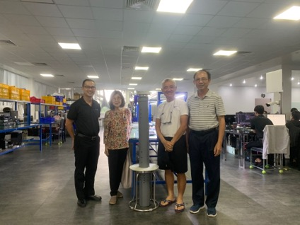
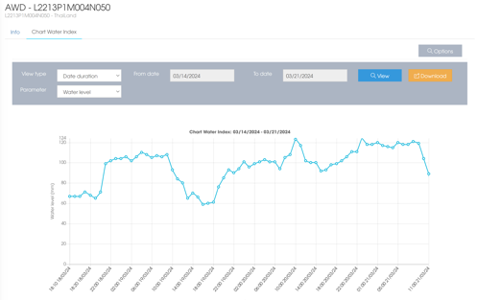
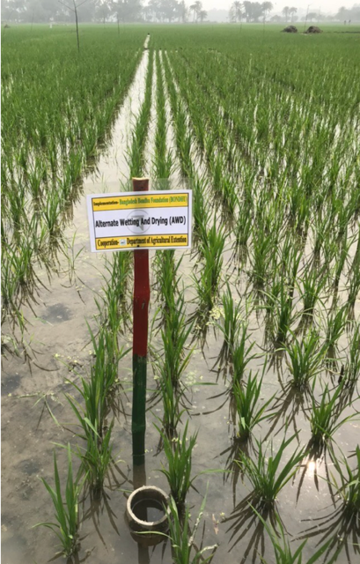
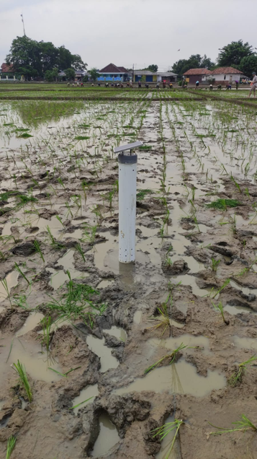
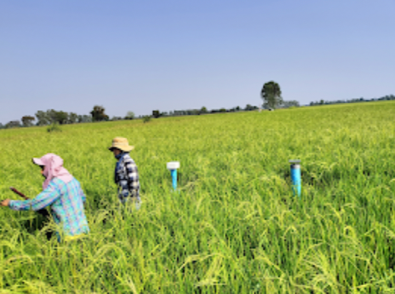
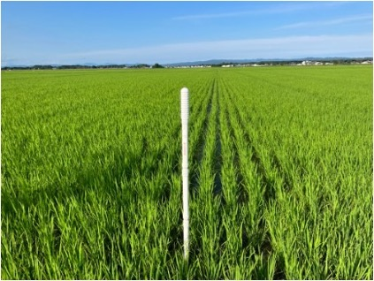
CH4Rice Project: in-situ Measurements for Validation
Automatic water-level equipment (manufactured by company in Japan, Thailand and VIetnam) have been installed in each study site through international collaboration.
Validation of water inundation monitoring with ALOS-2 PALSAR-2 will be done.
Vietnam
Near Real-time Monitoring
Bangladesh
Indonesia
Japan
Thailand

Slide 10
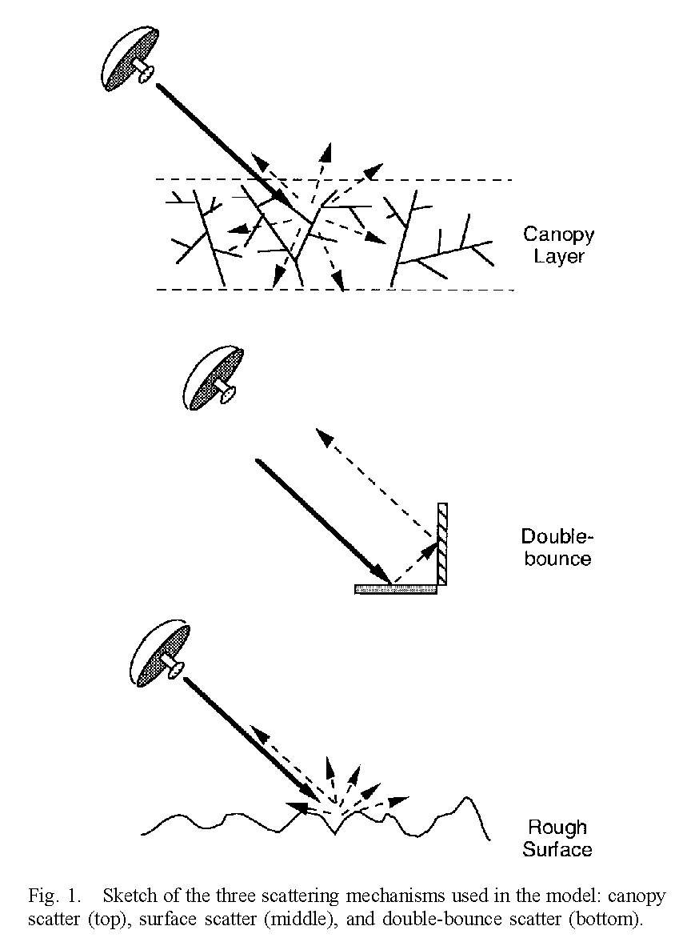
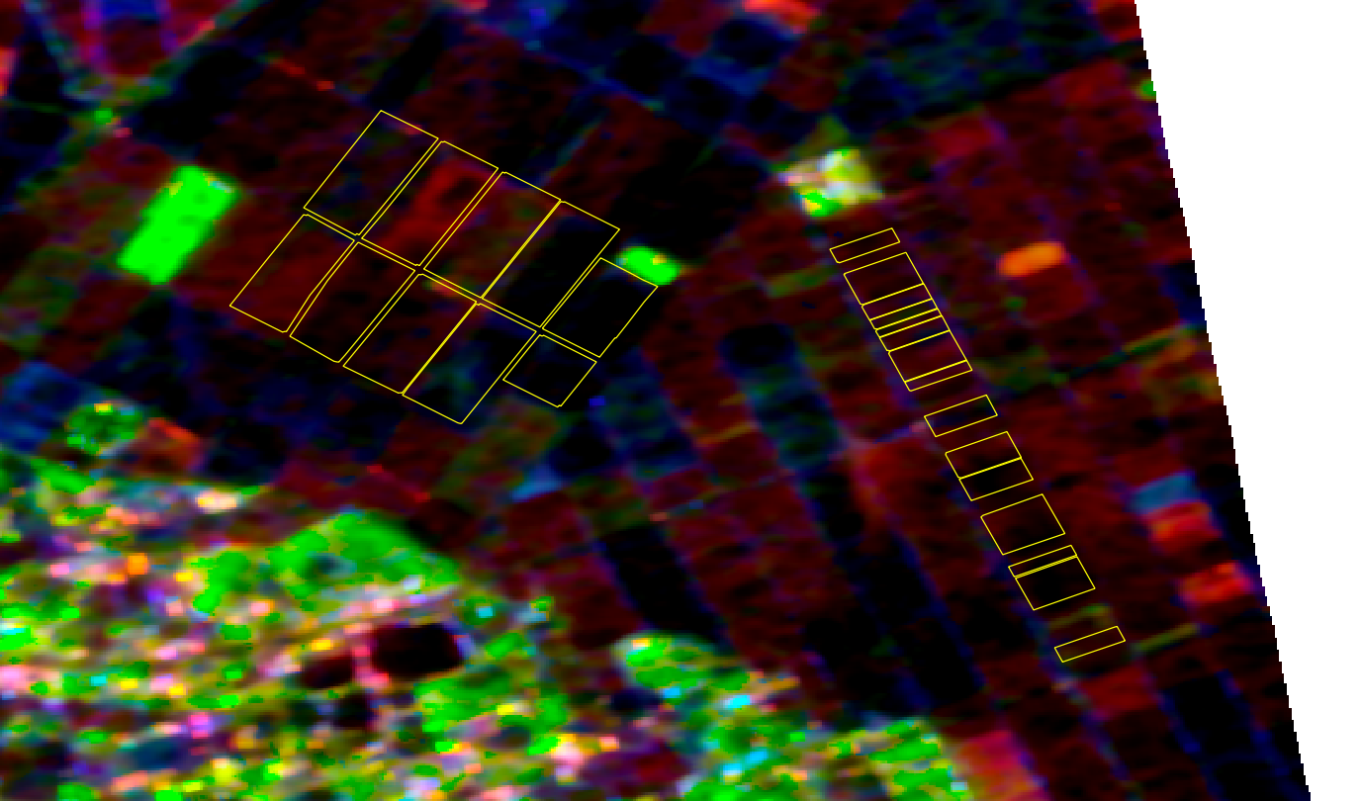
CH4Rice Project: Water inundation monitoring with L-band SAR
Utilize the characteristics of backscattering components from L1.1 data (Single Look Complex with full-pol) (e.g. Freeman’s three-component decomposition)
Freeman Decomposition
Red : double
Green : volume
Blue : surface
Tome, Miyagi, Japan
(yellow: target fields with in-situ data)
R: Double Bounce G: Volume Scattering B: Surface Scattering
[Freeman et al., TGRS, 1998]

Slide 11
CH4Rice Project: Schedule
ID | Activity | Sub-Activity | Organizations in Charge | 2023 |  |  |  | 2024 |  |  |  | 2025
0 | Events | APRSAF/SAWG, SAFE WS | All |  | ▲ | ▲ |  |  | ▲ | ▲ | ▲ |  | ▲ |  | ▲
 |  | Related Events |  |  |  |  | ▲
1 | Methodology Development | 1-1 Workplan Preparation | VNSC, Secretariat
 |  | 1-2 Study Area Selection | All
 |  | 1-3 Water Inundation Monitoring (in-situ & satellite monitoring) | All
 |  | 1-4 Methane Emission Estimation | All
 |  | 1-4 Tools Development | TBD
2 | Data/Tool Sharing | 2-1 Data Sharing (ALOS-2 Full-pol, etc.) | JAXA. TBD
 |  | 2-2 Tools Sharing via Platform Manual preparation | TBD
 |  | 2-3 Capacity Building (e.g. webinar, ARTSA etc.) | TBD
3 | Promote Dialogs with Stakeholders for Applications | 3-1 End-user (Public/Private sectors) 3-2 Other initiatives (CEOS, GEOGLAM/Asia-Rice etc.) TBD | All
SAFE WS
APRSAF-29
CEOS SIT
SAFE WS
APRSAF-30
Today
Delay

Slide 12
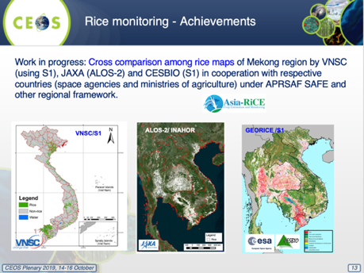
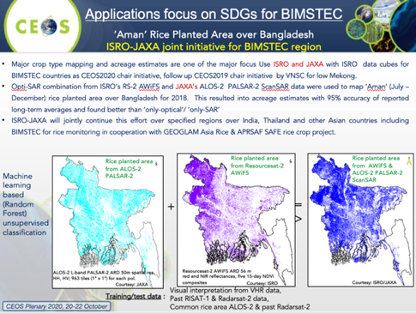
Utilize CEOS Chair Initiative Assets
Rice mapping and satellite data sharing activities of CEOS Chair initiatives
CEOS Chair initiative 2020 by ISRO, 2019 by VNSC, rice mapping, X/C/L-band comparison
Also, harmonizing APRSAF/SAFE project and GEOGLAM/Aisa-RiCE initiative
SIT Chair Initiatives

Slide 13
Future Plan: Collaboration with CEOS SIT Chair Initiative
Sharing SAFE CH4Rice project result on methane emission from paddy rice with CEOS committee as GHG measurement best practices.
Collecting data requirements (polarization, wavelength, spatial resolution etc.) and input into the discussions of Essential Agricultural Variables (EAV) in terms of sustainable/climate smart agriculture, algorithm/product comparison (water inundation, planted area, phenology etc.) for estimating methane emission from paddy rice.
In collaboration with CEOS, discussion with public and/or private sector, international initiatives/programs (e.g. IMEO) and other stakeholders to maximize the use of CH4Rice project results for methane MRV and carbon credits towards climate change mitigation. Consider to propose “Voluntary Carbon Standard” or international standard method (e.g. Japanese Joint Crediting Mechanism) using space-based data for carbon credit.

Slide 14
Concluding Remarks
SAFE CH4Rice (methane emission evaluation from paddy rice) project has been started since 2022 led by VNSC (Dr. Lam Dao Nguyen).
Study areas were selected in Asian region and in-situ measurement equipment have been installed in each region under international collaboration, ALOS-2 PALSAR-2 Full-Pol observation data for the region will be shared with participating agency.
Collaboration with CEOS to promote the CH4Rice project, especially collecting data requirements or standardization of the algorithm for estimating methane emission from paddy rice, and discussion with stakeholders.

Slide 15
Thank you very much for your attention !

