Slide 1
UNEP’s International Methane Emissions Observatory (IMEO): Activities and CEOS Cooperation
Cynthia A. Randles
UNEP IMEO
Agenda Item #7.3
SIT-39 2024, Tokyo, Japan
10th - 11th April 2024

Slide 2
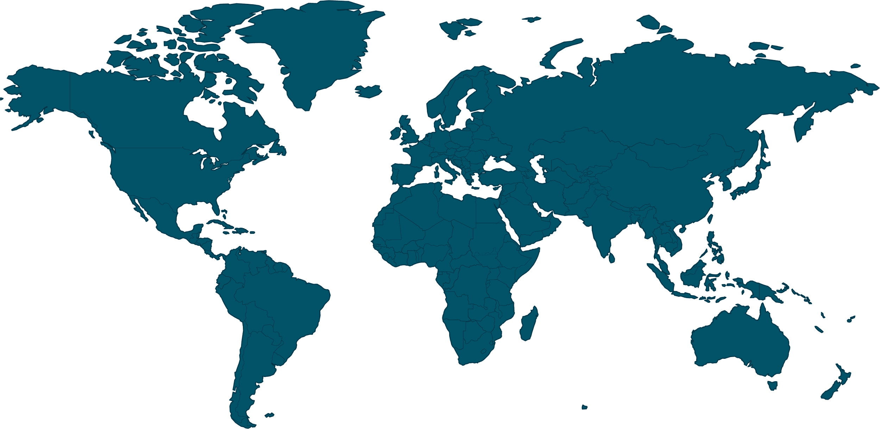
UNEP’s IMEO aims to provide the data required to target methane reductions at the speed and scale needed to achieve climate goals
Case Study: Measured Methane Emissions Intensity Significantly Higher than Estimated
Measurement data are crucial to ensure that mitigation actions and approaches are science-based and target the biggest opportunities for near-term emissions reduction
UNEP’s IMEO is a data aggregator and integrator, and, for satellites, a L4 data product producer and distributor
Engagement
Science Studies
OGMP2.0
Satellite Data & MARS
IMEO exists to provide open, reliable and actionable data to the individuals with the power to reduce methane emissions.

Slide 3
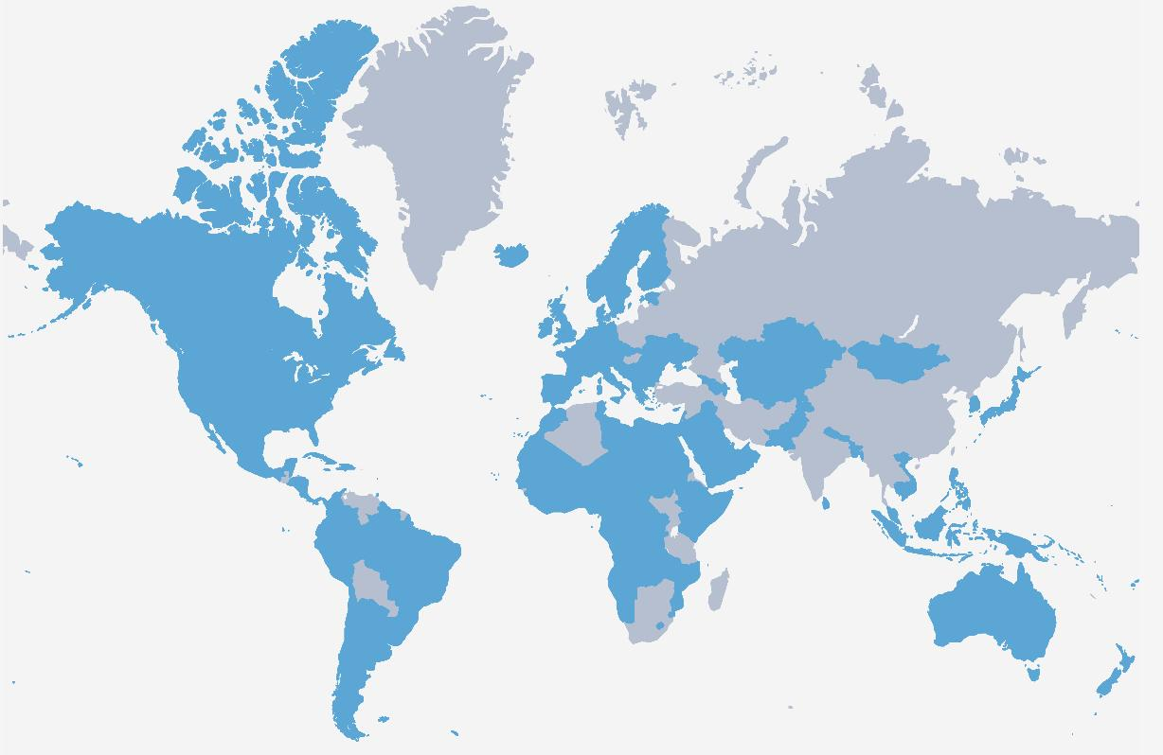
UNEP’s IMEO is a core implementing partner of the Global Methane Pledge (GMP)
Countries that have signed the EU- and US-led Global Methane Pledge representing ~50% of global anthropogenic emissions
Collective effort to reduce global methane emissions by 30% between 2020 and 2030
155
50%
30%
UNEP’s IMEO – as a core implementing partner of the Global Methane Pledge – will provide emissions data to track progress and facilitate technical assistance on science and transparency.
70%
Portion of the global GDP
covered by signatories

Slide 4
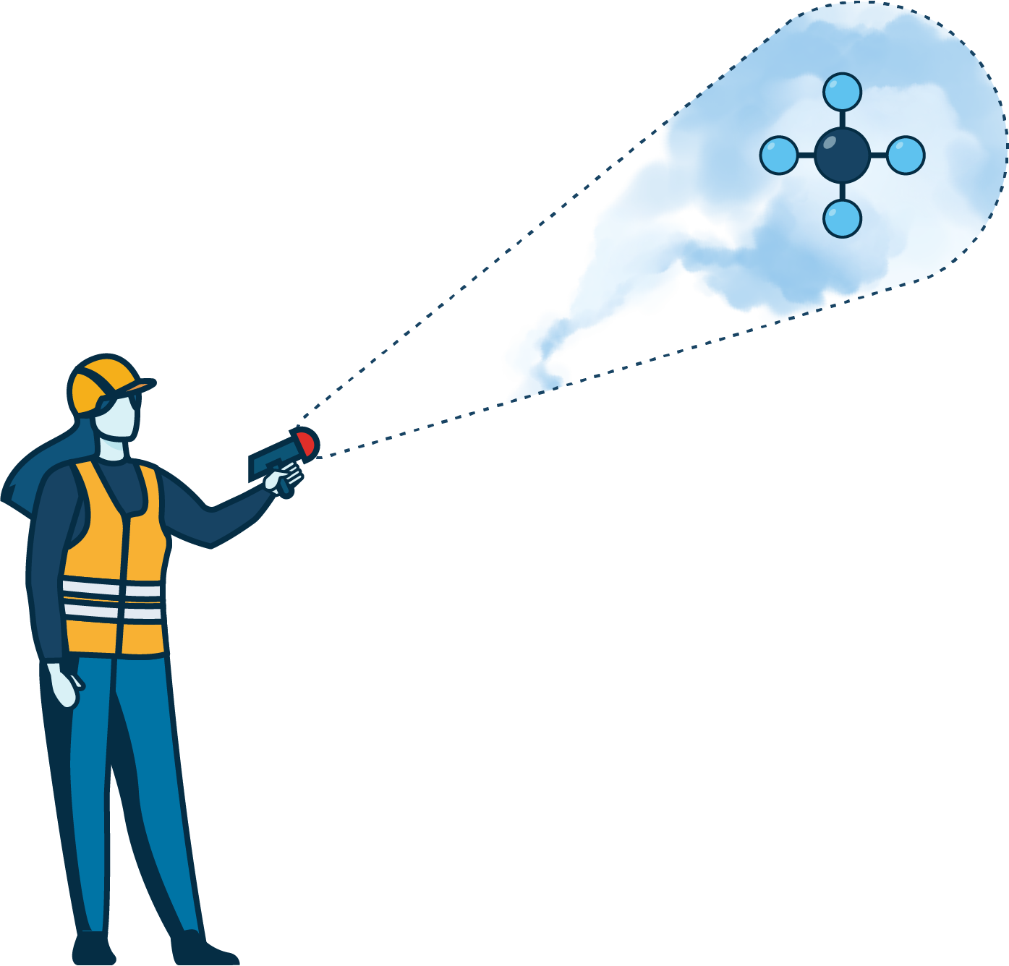
UNEP’s IMEO and CEOS hosted a convening of high-resolution satellite data providers and product developers
L4 Methane Emissions Alerting Products
e.g., Methane Alert and Response System (MARS) Use Case
L2 data availability as soon as possible (< 1 day ) after satellite overpass
Prioritize low latency and localization accuracy over emission estimate accuracy
Avoid false positives as much as possible
∫
L4 Methane Emissions Accounting
Products e.g., for data integration
Prioritize emission estimate accuracy over low data latency (but still ~ 2 weeks from detection; e.g., US EPA SEP program needs)
Highest quality control and traceability available due to regulatory and policy implications

Slide 5
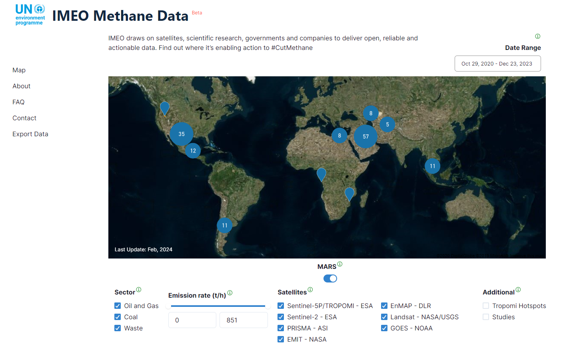
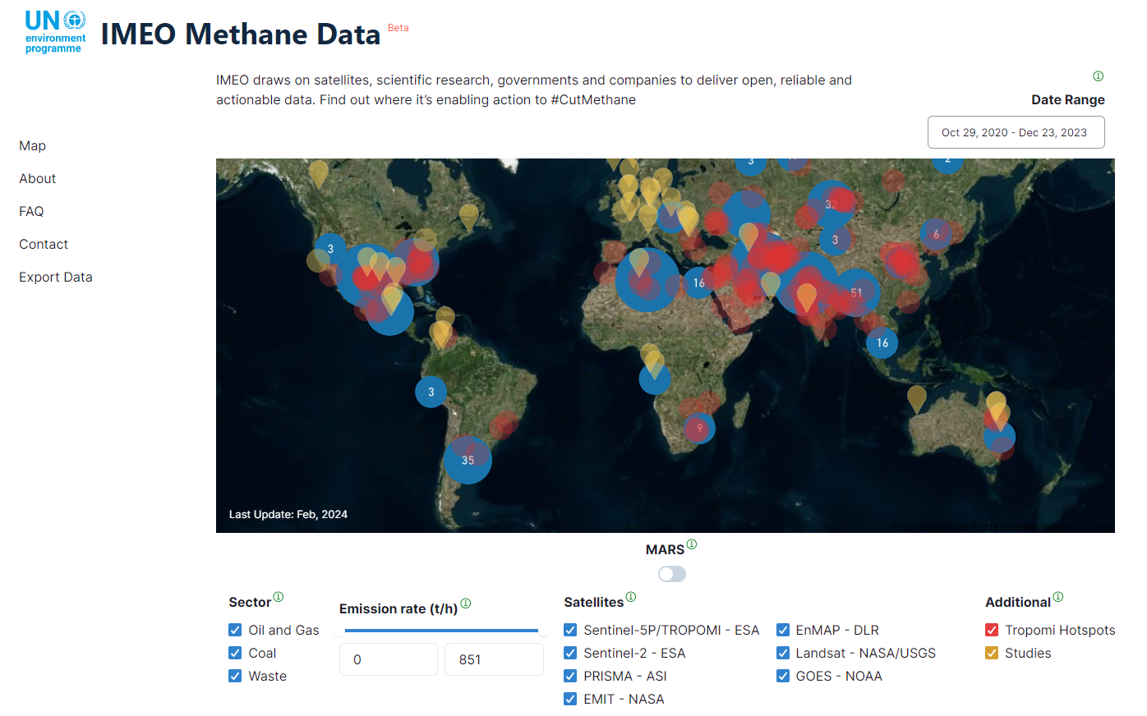
UNEP IMEO’s public portal increases transparency by sharing methane plumes detected using public satellites
Now in Beta version
The portal shows methane hotspots (TROPOMI), locations of IMEO science studies, and methane plumes from TROPOMI and high-resolution imagers
Includes plumes used for MARS alerts plus additional detections from multiple sectors
All public data is > 45 days from detection due to the MARS Data Policy
https://methanedata.unep.org

Slide 6
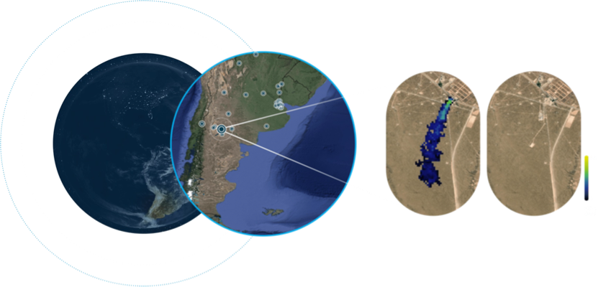
IMEO’s Methane Alert and Response System (MARS) provides rapid, actionable data to stakeholders
METHANE
>200
Detect and Attribute
ALERT
Notify and Engage Stakeholders
MARS notifications
>200 methane plumes notified for stakeholders
RESPONSE
Stakeholders Take Action
SYSTEM
Track, Learn, Collaborate, Improve
Estimated location of methane emissions events between Jan 2021 and Aug 2023. Dots are TROPOMI-detected plumes.
Successful mitigation in Argentina
Site of the successful mitigation event pre- and post-MARS notification. Plume on the left from NASA’s EMIT sensor, retrieval by UNEP IMEO

Slide 7
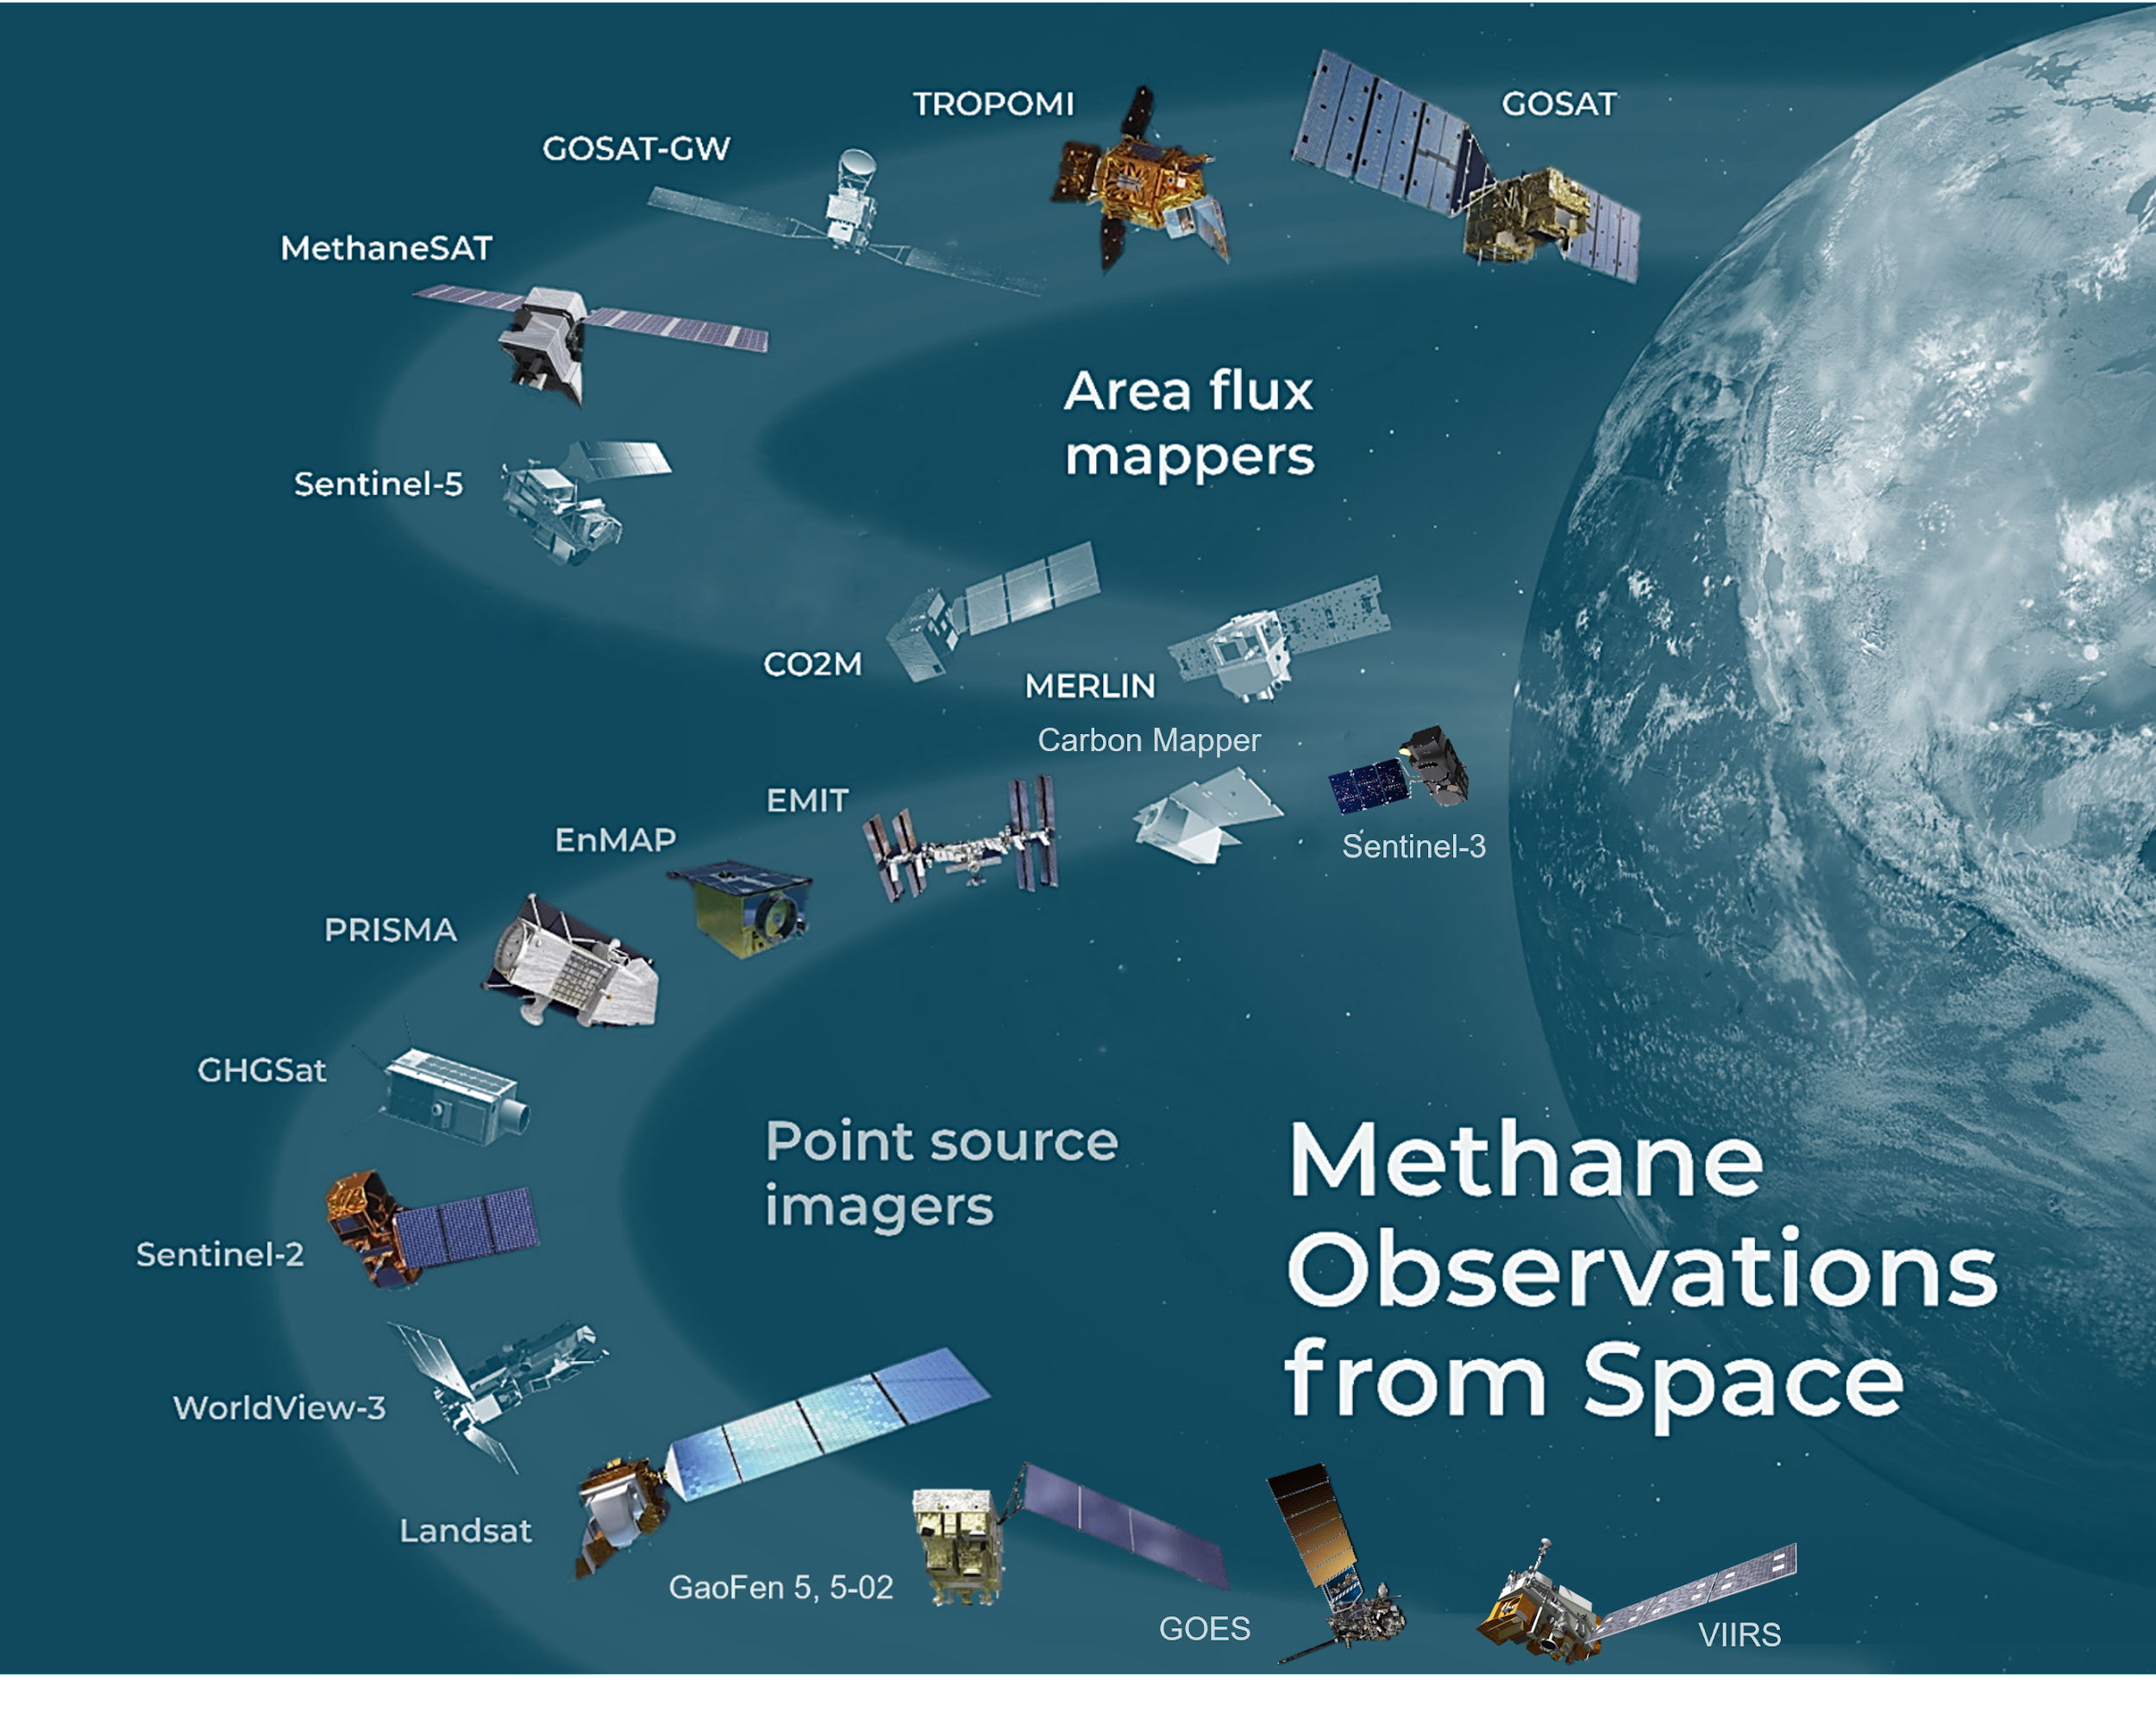
1
Component 1: UNEP IMEO collects and uses publicly available satellite data to derive L4 methane emissions products that drive notification and mitigation efforts for MARS and contribute to IMEO’s accounting efforts
Global mapping satellites are used to identify very large methane plumes and methane hot spots
Further analysis using other satellites and datasets enables attribution at the facility-scale
Figure adapted from Jacob et al., ACP, 2022

Slide 8
2
Component 2: MARS Notification Process
Governments and MARS-participating OGMP 2.0 companies notified simultaneously
If non-OGMP 2.0, government then companies
Initial Notification
Notice of the emission event, location, and potential operator
Preliminary Acknowledgement
As soon as possible after the detection
Acknowledgement and initial feedback
Governments and companies notified simultaneously with feedback form and support options
Follow Up
Within one week of the initial notification
Additional analysis, including potential source, emission rate + uncertainty shared
Mitigation and Tracking
After 45-75 days, all non-proprietary data and metadata is made publicly available

Slide 9
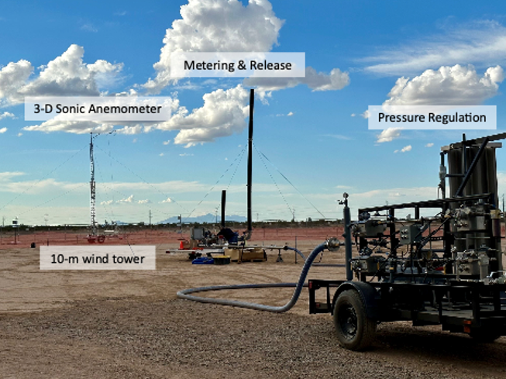
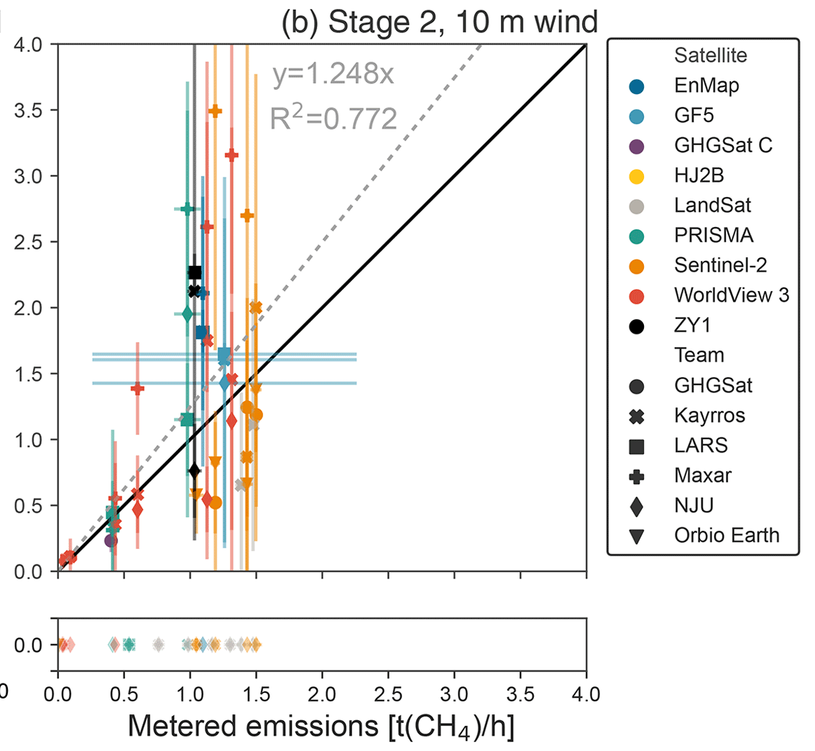
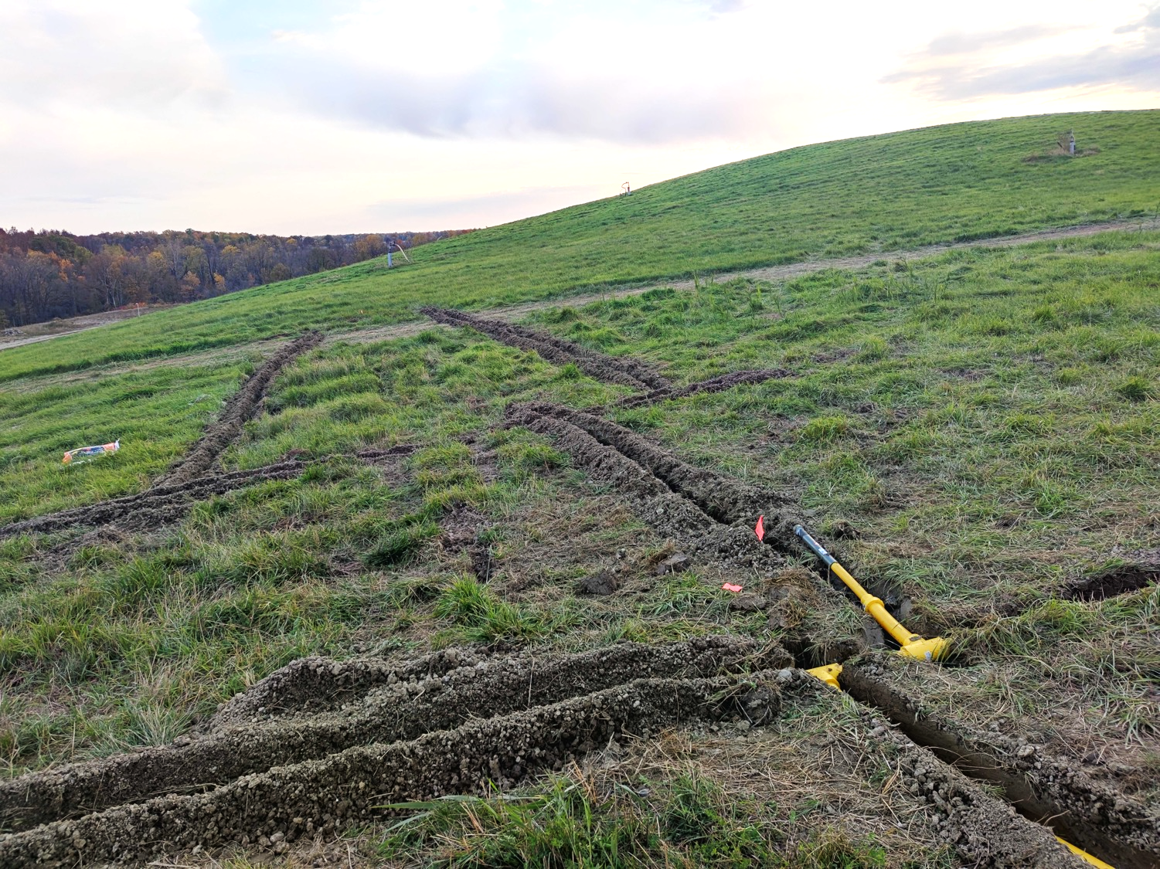
UNEP IMEO L4 Validation: Controlled Release Studies
UNEP’s IMEO, though its Methane Science Studies, sponsors controlled release studies for validation of L4 (emissions) data from satellites (and suborbital observations), including recent work from Stanford University [e.g., Sherwin et al., 2024]
Confirmed upcoming controlled release testing at TOTALEnergies TADI facility in France will focus on ground- and sub-orbital observing platforms
Planned Activities in Development:
Madrid Landfill measurement validation and intercomparison (with ESA)
Develop dispersed release study (Dave Risk, St. FX University, Canada)
Expand controlled releases globally (e.g., ASEAN region with JOGMEC)
Stanford Mobile Release Lab (PI Adam Brandt)
CEOS is encouraged to participate in these validation efforts in as many ways as possible including:
Dave Risk (StFX Uni) Pipes for dispersed controlled release of methane buried into a landfill type environment.
Individual PI/Contributor participation in controlled release studies
Satellite coordination and tasking for controlled release studies
Study design and facilitation
Institutional funding participation if desired
[Sherwin et al., AMT, 2024]
Please contact James France (jfrance@edf.org) for more information

Slide 10
Relationship between CEOS and IMEO
UNEP IMEO is both a user of publicly available satellite data (L1 to L2) and a producer of satellite data products (L4) from high-resolution plume imagers.
UNEP IMEO integrates these L4 products with other methane emissions datasets (e.g., from science studies and OGMP2.0)
UNEP IMEO distributes these L4 products to governments, companies, civil society, and the general public
UNEP IMEO sees CEOS as a trusted, key partner in implementing its mission
UNEP relies on CEOS member agencies to collect observations of CH₄ that cover as much of the globe as frequently as possible
For alerting, UNEP IMEO needs, preferably, at least L2 data as soon as possible after detection (< 1 day)
For accounting and data integration, UNEP IMEO needs to be able to produce accurate L4 methane data products by 2 weeks post detection
UNEP IMEO can greatly benefit from CEOS experience and expertise
CEOS can aid in UNEP IMEO’s systematic, timely production of L4 high-resolution data for both the alerting and accounting use cases
CEOS can help UNEP IMEO to produce transparent L4 methane data products that are traceable to internationally-accepted best practices.

Slide 11
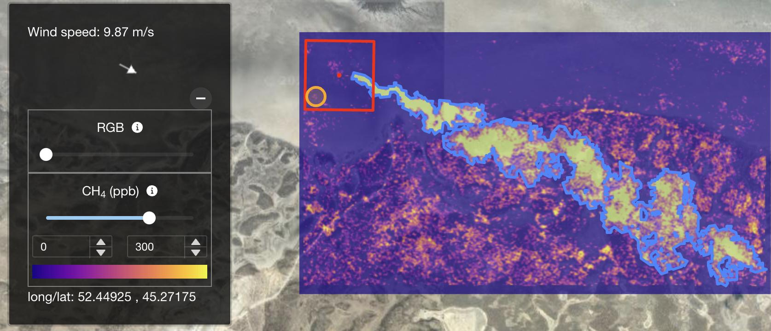
CEOS and UNEP IMEO can work together to provide actionable high-resolution methane data products
For MARS (alert use case) CEOS can:
Continue support for high priority tasking and data requests
Support IMEO L4 alerting products:
PRISMA
Support systematic development of IMEO L4 alerting products by providing L2 data products quickly (< 1 day)– low data latency is more critical than high accuracy
Develop tip-and-cue system with global mappers to automatically aid in coordination of plume imager tasking
Flux rate: 41.96 ± 20.73 t/h
For Data Integration (accounting use case) CEOS can:
Continue, along with UNEP IMEO and broader community, to enhance trust, transparency and traceability of satellite methane data products to promote their use by stakeholders (e.g., NPL/NIST best practice development)
Support validation of L4 methane data products through participating, coordinating/facilitating and/or funding of controlled release studies
Support the development of systematic and timely Level 2 (CEOS agencies) to Level 4 (UNEP IMEO) pipeline of high-quality, high-resolution satellite data that meets the needs of policy makers, regulators, and industry

Slide 12
Thank you !
Cynthia Randles,
MARS Program Manager, UNEP IMEO
cynthia.randles@un.org
11 April 2024

