Slide 1
Greenhouse Gas (GHG) Task Team
Yasjka Meijer, ESA
GHG Task Team Lead
Agenda Item 7.2
SIT-39 2024, Tokyo, Japan
11th April 2024

Slide 2
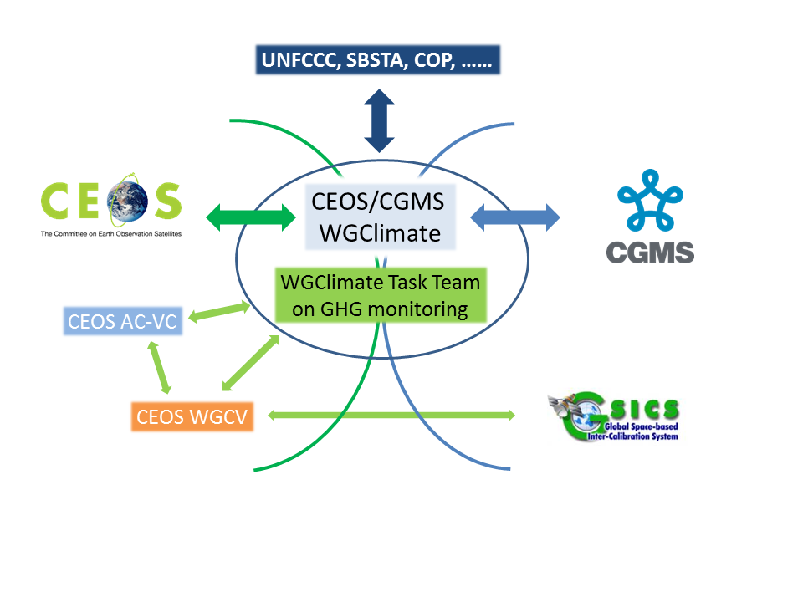
GHG Task Team
Responsible for implementation of the GHG Roadmap and its maintenance
TT interfaces with, stimulates and monitors GHG related activities across the various (CGMS &) CEOS WGs: WG-Climate, WG-CalVal, AC-VC, WG-CapD, NewSpace Task Team, etc
Actively ensure representation of these CEOS and CGMS bodies in GHG TT activities

Slide 3
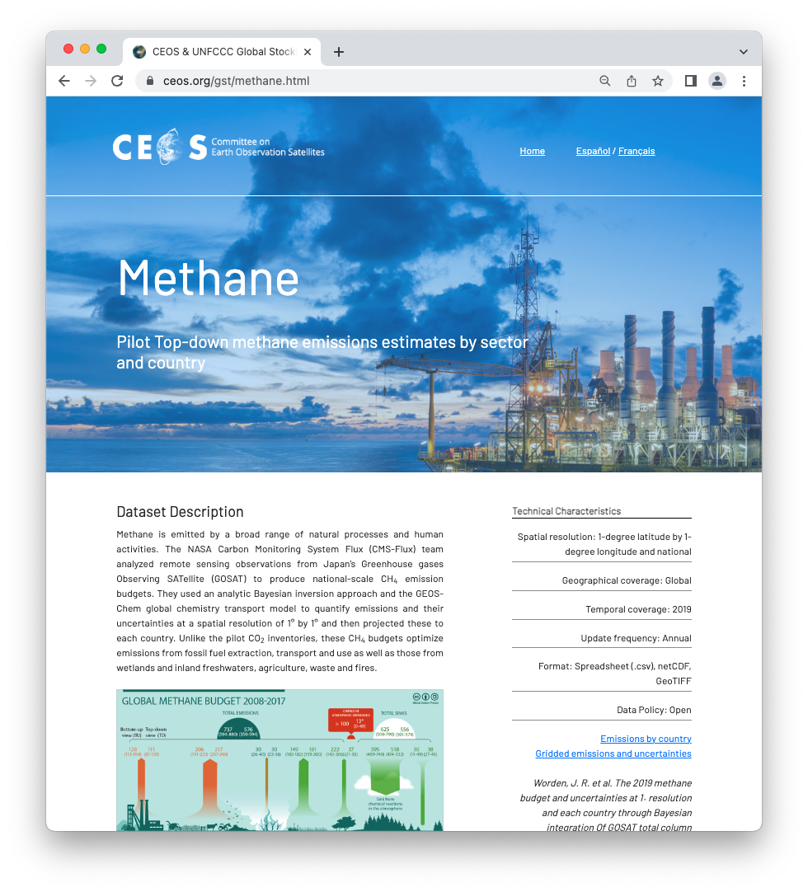
CEOS Carbon Roadmaps
Roadmaps/pillars of CEOS on carbon
GHG
AFOLU (now available)
Aquatic Carbon (in development)
Individual pillars need to be connected 🡪 define interfaces
🡪 New action to collaborate on carbon roadmap interfaces

Slide 4
GHG Task organisation
Area leads (plus deputies) appointed for each of the seven thematic areas in Annex C (actions) in the GHG Roadmap:
Stakeholder Engagement - Mark (John, Wenying)
System Development Facilitation – Richard (John, Kevin)
Operational Preparation and Training – TT discuss
Sensor Development – John (AC-VC) (Yasjka)
L1 & L2 GHG Product Development – Ruediger & Dave
Flux Inversion Model Development – Kevin (Frederic)
Calibration & Validation – Hiroshi (Kuze, WG-CV ACSG)
🡪 Active participation is still missing of WG CapD and CGMS WGs

Slide 5
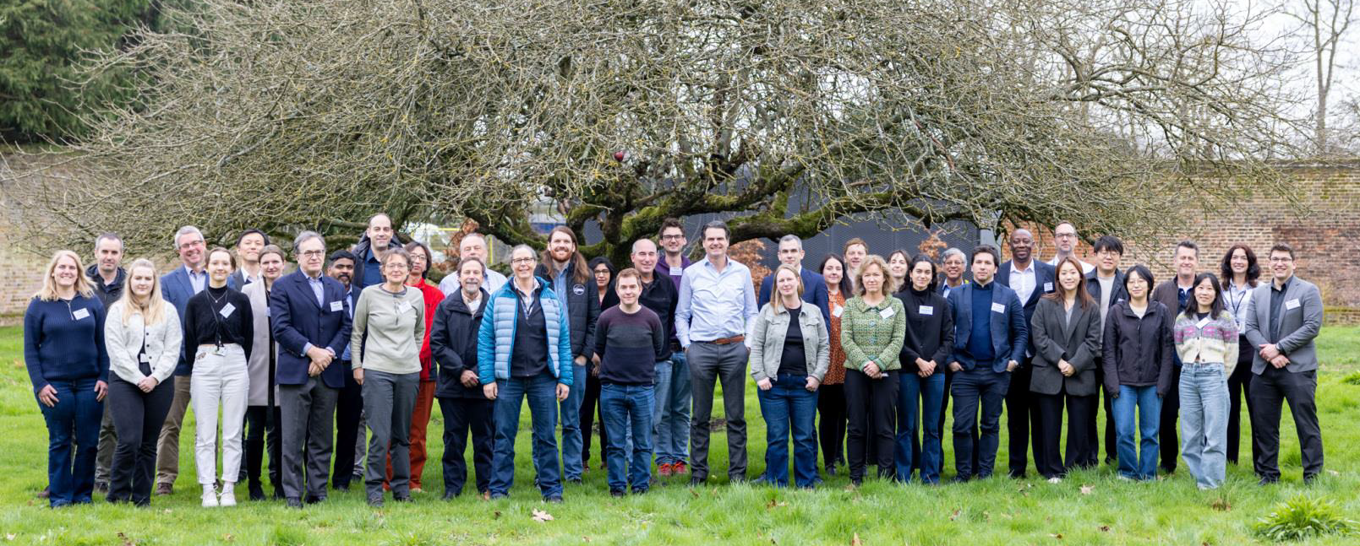
Recent Achievements
Soft update GHG Roadmap (CARB-23-05)
Action list updated through a thorough review per Area including prioritization
Product standardization 🡪 several meetings took place and is work in progress (CARB-23-05)
CEOS GHG Missions Portal; centralized overview of GHG Missions in one Portal ceos.org/ghg
New Space; Significant steps taken and progress made to enable further usage of their data
International Engagement
WMO’s Global GHG Watch. CEOS representatives in Study Group supporting the implementation plan
IMEO (members participating in WGs) & collaboration to intensify further.
International Methane Standards Workshop by NPL in Teddington, UK. Report will be generated with Recommendations & timeline summary (more under agenda item 7.4, CARB-23-05)

Slide 6
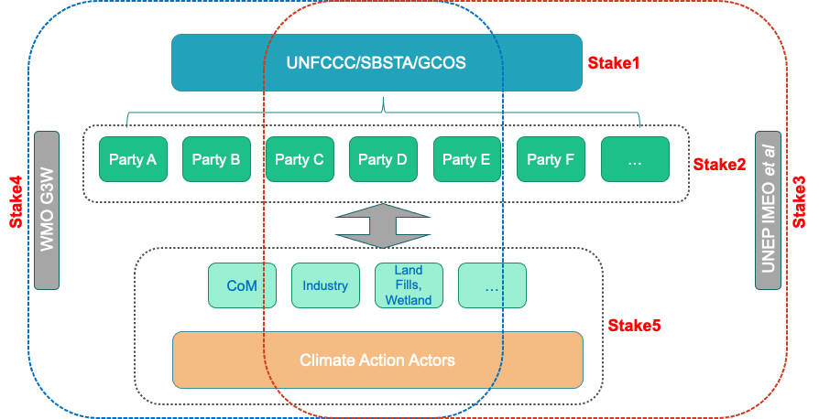
Stakeholder Landscape

Slide 7
WMO’s Global GHG Watch
G3W Implementation Plan v1.0
Aim has been to position CEOS as the trusted partner for space-based observations up to L2
Expectation is that stakeholders, like G3W, will gradually operationalize L2+ aspects
In section 3.5 (Theme: Space-based observations of GHGs and related variables), three specific actions were included:
O10: Liaise and prioritise with CEOS-CGMS for direct GHG observations from space
O11: Liaise and prioritise with CEOS-CGMS for indirect GHG observations from space (required to infer GHG fluxes)
O12: Liaise and prioritise with CEOS-CGMS for required space-based observations to monitor changes in the carbon cycle in a (future) changing climate
Some of the activities listed in GHG Roadmap can be (gradually) taken over by G3W
In implementation phase, there is a need to work on CEOS 🡨 🡪 G3W operational interfaces
🡪 Define interface between CEOS & G3W

Slide 8
UNEP’s IMEO
IMEO Working Groups
Several working groups were established and met twice
Clear need to continue this work of some of the working groups
Aim is to position CEOS as the trusted partner for space-based observations up to L2
Expectation is that stakeholders, like IMEO, will gradually operationalize L2+ aspects
Two specific activities were already identified supporting MARS):
An automated (fast) tip-and-cue system. CEOS agencies to provide automated messages from global mappers to indicate via IMEO areas of potential interest for plume mappers.
An automated hyperspectral ‘L2’ processing request. IMEO needs to investigate/follow-up on observed plumes by investigating for signs in, e.g., hyperspectral missions, which currently do not have methane plumes as part of their standard processing.
In its further evolution, there is a need to improve CEOS 🡨 🡪 IMEO operational interfaces
🡪 Implement interfaces between CEOS & IMEO

Slide 9
Proposed agency contributions
The mentioned IMEO elements are already or could become part of on-going ESA projects like:
WorldEmission, https://eo4society.esa.int/projects/world-emission/
MEDUSA, about to start, with KO on 10-4.
SMART-CH4 (https://eo4society.esa.int/projects/smart-ch4/), a part of this project to improve fine-scale emission detection from the high resolution satellites.
AI4CH4, kicked off in January (https://eo4society.esa.int/projects/ai4ch4/), they are aiming to develop advanced end-to-end AI model for automatic plume detection and quantification using the range of satellite data available
MEDUSA, kicked off yesterday and aims to provide clarity for users of satellite-based estimates of facility-scale GHG emission plumes, which will be done by intercomparing and validating the ensemble of products from different instruments
ESA is looking seriously into responding to the L2 intercomparison roadmap action under its CLIMATE SPACE programme aiming to KO with an activity in the next ~12 months.
Any other contributions?
🡪 Principals are requested to support implementation of GHG Roadmap activities

Slide 10
Next steps – GHG Roadmap
Toward GHG Roadmap Update v2 (new or updated CARB-23-04)
Recent developments require a full update of the GHG Roadmap
Action list has already been updated
Split between various spatial scales (point/area vs national/regional)
Split between CO₂ & CH₄
Need to integrate (among others) G3W and IMEO in the Roadmap
Seek, better understand and support (new) stakeholders with GHG data
Aim is to position CEOS:
Providing data up to L2 (including all related aspects, like cal/val, algos, product standardization, collecting new reqts. etc.)
Facilitating and enabling stakeholders to gradually operationalize L2+ aspects by providing expertise and showing L2+ products and related actionable information
🡪 DECISION needed to update GHG Roadmap
🡪 If yes, then principals are invited to support the updating process

Slide 11
Challenges & Way forward
Challenges:
Propper user engagement & reaching new stakeholders:
UNFCCC (GST)
CO₂: policymakers at smaller spatial & temporal scales (covenant of mayors, finance)
CH₄: policymakers, non-O&G related emissions, e.g. landfills, wetlands
Mission delays and data discontinuity (agenda 7.5)
False notion that New Space can do it all
Tackle the aquatic aspect of the carbon cycle
Timely switch to missions capable of monitoring the carbon cycle in a changing climate
Next steps of GHG Task Team:
Update GHG Roadmap & continue its implementation
Actively interface with G3W and IMEO
Ensure continuity to earlier/existing missions
Coordinate activities with AFOLU and Aquatic Carbon Roadmap

Slide 12
Thank you &
NOW TIME FOR DISCUSSION

Slide 13
BACKUP SLIDES

Slide 14
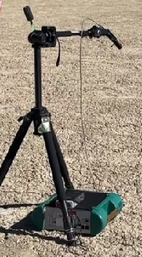
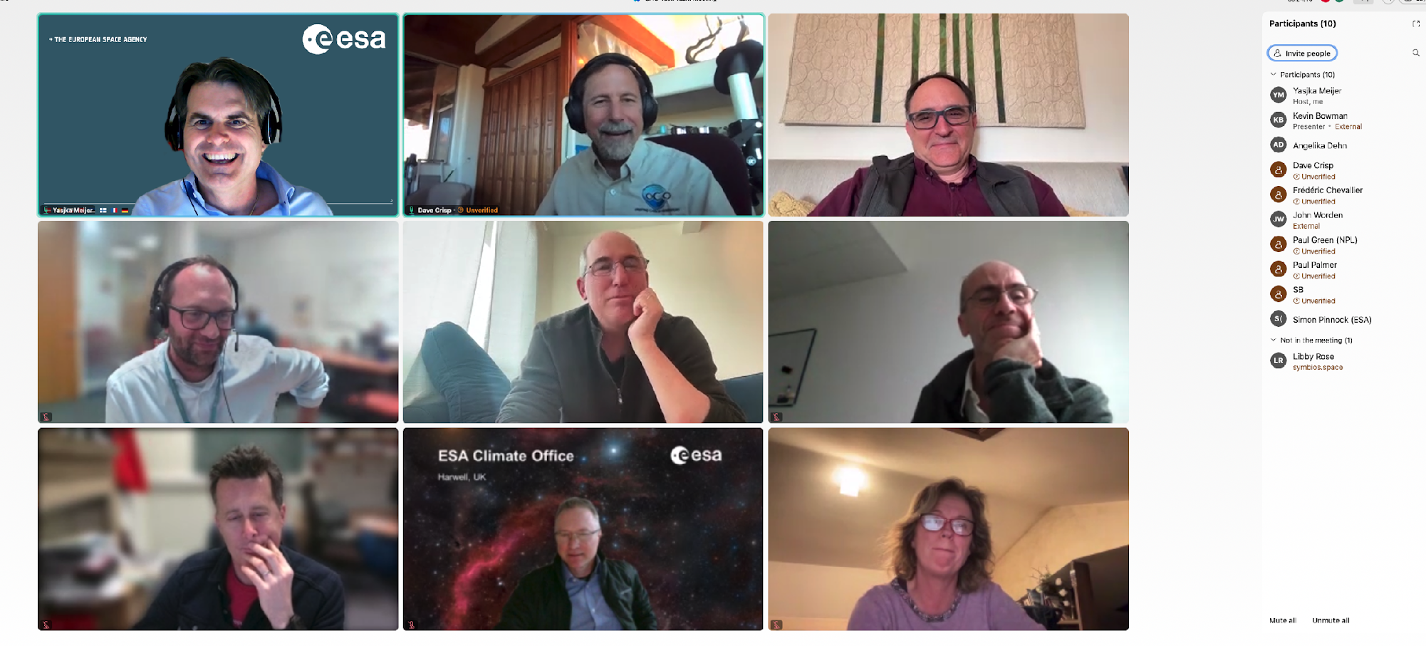
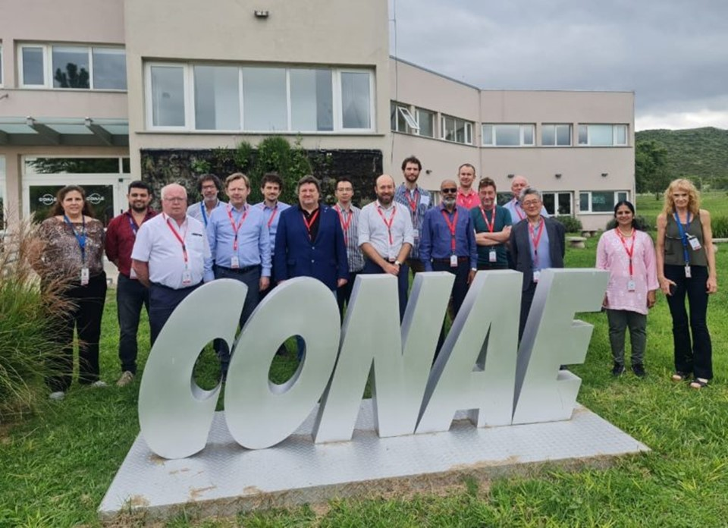
Recent GHG Task Meeting-4
Operational systems under implementation by various entities, such as CAMS and US GHG Center. WMO G3W is putting these initiatives in a coordinated international UN framework.
Several actions were identified as to be pursued more practically under G3W
WG-Cal/val has been very active. One key challenge is to resolve natural CO₂ fluxes which are varying by about 0.2 ppm/100 km and ocean fluxes varying by less than 0.1 ppm/100 km while the current XCO₂ accuracy remains 0.8 ppm
16th Joint Vicarious Calibration Campaign June 12-17, 2024 in Rail Road Valley
Need to coordinate controlled release experiments of methane
WGCV-53
GHG-TT 4

Slide 15
SIT 2024–25 headlines
JAXA SIT Chair Priorities:
Climate Policy Impact – addressing obstacles and opportunities for CEOS agency data, particularly AFOLU/Biomass map datasets, to have maximum impact in the key climate policy processes such as the Global Stocktake of the Paris Agreement
GHG observations from space - addressing coordination for data continuity challenges ahead and developing good practices so that operators of all kinds may contribute to societal needs
Next step is a dedicated GHG side meeting on 9 April, and SIT-39 meeting with GHG session on 10-11 April in Tokyo

