Slide 1
Greenhouse Gas Observations – Session Introduction
David Crisp and
Hiroshi Suto (SIT Chair Team)
Agenda Item 7.1
SIT-39 2024, Tokyo, Japan
10th - 11th April 2024

Slide 2
Session Overview
Session Discussion Points:
  Remind ourselves WHY CEOS should focus on greenhouse gases (GHGs)
  Review CEOS Agency GHG activities and Roadmap progress
  Justify need for standards for space-based GHG products
  Define new partnering opportunities with WMO & IMEO
  Debate a way forward towards Global Stocktake 2 (GST2, 2028)
Session Decision Points:
  Action to update CEOS GHG Roadmap for 2024 CEOS Plenary
  Actions to ensure consistency across space-based GHG product standards
  Action to further develop the CEOS-IMEO relationship
  Actions supporting CEOS-WMO cooperation on G3W
  Actions supporting a GST2 target for public-sector space agencies.

Slide 3
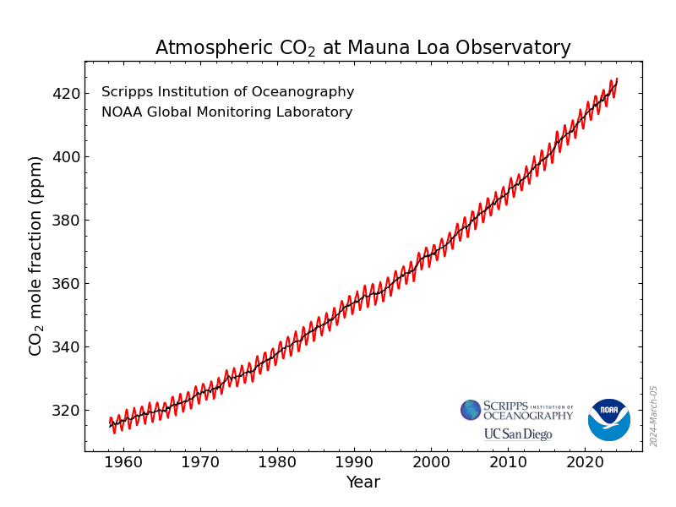
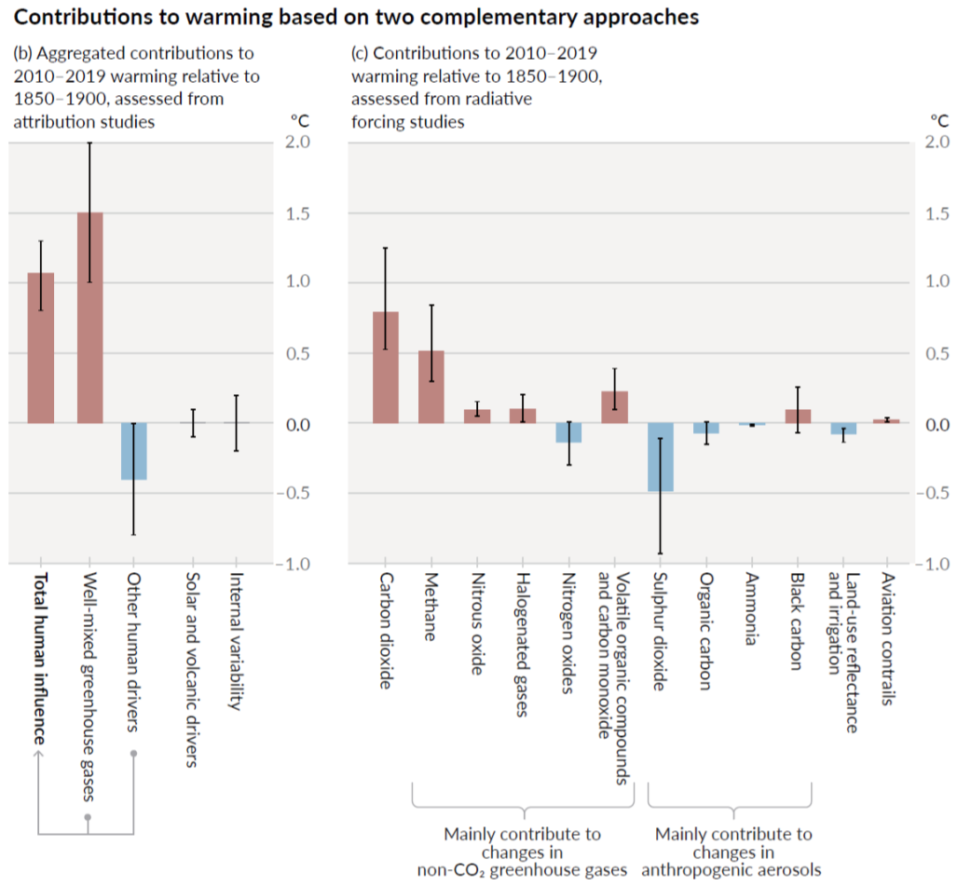
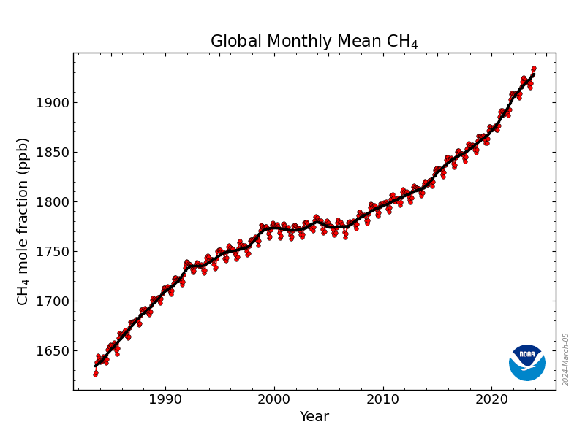
Why Monitor CO₂ and CH₄?
Human activities have increased atmospheric CO₂ concentrations by more than 50% since the beginning of the industrial age
CH₄ concentrations have increased by more than 160% over this period
These two gases are now responsible for over 90% of the observed 1.1 °C global warming
IPCC AR6
CO₂
~60% of Global Warming
CH₄
~30% of Global Warming

Slide 4
What Processes Control CO₂ and CH₄?
Carbon Dioxide (CO₂) Sources and Sinks*
Fossil Fuel Use 35 Gt CO₂/yr
Land Use Change 5 GtC O₂/yr
Land Biosphere -12 Gt CO₂/yr
Ocean -10 Gt CO₂/yr
Methane (CH₄) Sources**
Agriculture & Waste 0.206 Gt CH₄ /yr
Natural Wetlands 0.148 Gt CH₄ /yr
Fossil Fuel Production & Use 0.128 Gt CH₄/yr
Biomass & biofuel burning 0.030 Gt CH₄/yr
Land Biosphere
Ocean
Fossil
Land Use Change
*Friedlingstein et al. Global Carbon Budget, ESSD, 2023
**Saunois et al., Global Methane Budget, ESSD, 2020
Agriculture & Waste
Wetlands
Fossil
Biomass
& Biofuel

Slide 5
Tracking CO₂ and CH₄ on Relevant Scales
Different types of space-based data are needed to track CO₂ and CH₄ emission sources and natural sinks on different scales across the globe
On National/Region-scales, space-based GHG measurements can
  Provide a transparent way to develop national inventories and assess collective progress toward national GHG emission reduction goals
  Track changes in natural sources & sinks due to human activities & climate change
On the scale of large urban areas (City scale), space-based GHG data can
  Track changes to the ~70% of all anthropogenic GHG emissions originating from energy, transportation and industry in cities
For individual facility scale, space-based GHG data can
  Track emission from fossil-fired power plants, pipeline leaks

Slide 6
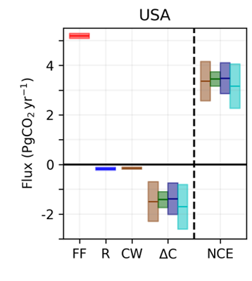
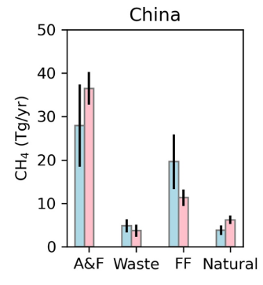
CEOS GHG Roadmap Progress
Contributions to the first global stocktake
  Contributed national-scale budgets of CO₂ and CH₄ to the first Global Stocktake (GST1), providing critical baseline for assessing collective progress toward the goals of the UNFCCC and Paris Agreement
  Strengthened & refocused partnerships (GEO, WMO, UNEP, & UNFCCC), identifying space-based measurements supporting Paris Agreement
  Fostered development of WMO Global Greenhouse Gas Watch (G3W)
Tracking GHG data quality, continuity and gaps
  Implemented CEOS GHG Portal – A one-stop shop for GHG Missions
  Worked with partners to begin implementing a pre-operational system for generating and delivering GHG products to stakeholders
  Began developing best practices for space-based GHG information
CO₂
CH₄
Examples of national GHG budgets delivered to UNFCCC to support GST1

Slide 7
Critical Developments since the CEOS GHG Roadmap was approved
The first global stocktake (GST1) was executed
  Thus far, there has been limited use of scientific observations and data across the board
  CEOS products provide a critical baseline for use in future GSTs
WMO is implementing G3W to support regional & national GHG MVS
  CEOS and its member agencies are expected to play a major role in this effort
UNEP established the International Methane Emissions Observatory (IMEO) including its Methane Alert and Response System (MARS) to track large methane leaks
CEOS agencies are preparing to launch MicroCarb, GOSAT-GW, and CO2M
Non-governmental players (New Space) began playing an increasing role in space-based measurements of GHGs and other climate variables
  12 GHGSat satellites, MethaneSAT launch, upcoming launch of Carbon Mapper and more
155 nations committed to the Global Methane Pledge – to reduce anthropogenic methane emissions by at least 30% from 2020 levels by 2030

Slide 8
Presentations in this Session
Coordination of space-based assets is more important than ever
Yasjka Meijer (WGClimate GHG-TT Lead) will review status & plans for GHG Roadmap
Cynthia Randles (UNEP IMEO) will give an update on IMEO & possible roles for CEOS
John Worden (AC-VC GHG Lead) will discuss ongoing efforts to develop best practices for space-based CH₄ products
H. Suto and D. Crisp will review status of current and planned GHG missions, prospects & challenges to data continuity and plans for GST2
Gianpaolo Balsomo (WMO G3W) will join us remotely to provide an update on the WMO Global Greenhouse Gas Watch (G3W) and opportunities for collaborations with CEOS

