Slide 1
SIT-39 2024
Commercial Sector Issues
Various
Agenda Item #6.3
SIT-39 2024, Tokyo, Japan
10th - 11th April 2024

Slide 2
CEOS New Space Task Team Recommendations and Impact on the CEOS 2024-2026 Work Plan
Marie-Claire Greening, ESA
Agenda Item #6.3
SIT-39 2024, Tokyo, Japan
10th - 11th April 2024

Slide 3
NSTT White Paper Recommendations
In view of augmenting the scientific and operational potential of long-term, institutional programmes, CEOS Members and Associates should act collectively in using the CEOS mechanisms to identify and support potential complementary capabilities enabled by New Space and other commercial actors.
CEOS Members and Associates should strive to continue to share information on relevant events and activities related to New Space, including commercial data evaluation results when possible. CEOS Agencies should also investigate ways to work together on cooperation agreements with New Space actors possibly including common lines to take on end-user licence agreements and Intellectual Property Rights (IPR) issues.
Cooperation and collaboration opportunities should be sought with to facilitate interoperability between private and public sector data and future CEOS SIT Chairs are encouraged to routinely provide the opportunity for CEOS Members and Associates to report on developments in the standards domain, be they from public or private sources, at future SIT Technical Workshops.

Slide 4
2024-2026 CEOS Work Plan deliverables
Number | Objective/Deliverable Title | Projected Completion | Responsible CEOS Entity(ies)
OUT-24-01 | CEOS and the ‘New Space’ Agenda | 2026 Q4 | CEOS Chair SIT Chair
OUT-24-02 | Increase engagement with the commercial sector on CEOS-ARD | 2024 Q4 | CEOS-ARD OG
OUT-24-03 | Unify CEOS engagement with the commercial sector at at key meetings with respect to ARD and Cal/Val | 2026 Q4 | CEOS-ARD OG
OUT-24-04 | Revise the CEOS-ARD Industry Engagement Strategy | 2024 Q4 | CEOS-ARD OG
OUT-24-05 | Ensure that legacy and new public and commercial datasets can be used more interoperably | 2024 Q4 | WGISS
OUT-24-06 | Integrate New Space data into the CEOS Analytics Lab | 2024 Q4 | SEO

Slide 5
OUT-24-01
CEOS and the ‘New Space’ Agenda
CEOS Members and Associates should strive to continue to share information on relevant events and activities related to New Space, including commercial data evaluation results when possible, as detailed in recommendation 2 from the 2023 CEOS New Space White Paper. CEOS Agencies should also investigate ways to work together on cooperation agreements with New Space actors possibly including common lines to take on end-user licence agreements and IPR issues. The CEOS and SIT Chairs should thus consider, where appropriate, options to include discussions on New Space and the commercial sector in the SIT, SIT TW and CEOS Plenary agendas for 2024, 2025 and 2026.
Responsible: CEOS Chair, SIT Chair
Completion Date: 2026 Q4

Slide 6
OUT-24-02
Increase engagement with the commercial sector on CEOS-ARD
Recommended deliverable from the 2023 CEOS New Space White Paper: To ensure users can benefit from increased complementarity and interoperability of CEOS Agency and New Space datasets, the CEOS-ARD initiative should identify and implement mechanisms to deepen engagement with the New Space sector, consistent with CEOS Governing Documents. Examples include establishing a mechanism to consult the New Space sector during the development and review of CEOS-ARD Product Family Specifications (PFS), encouraging commercial sector participation in the ISO-AGC ARD Standards Working Group, and encouraging and assisting New Space entities to undertake self-assessments of their datasets against CEOS-ARD PFSs.
Responsible: CEOS ARD OG
Completion Date: 2024 Q4

Slide 7
OUT-24-03
Unify CEOS engagement with the commercial sector at at key meetings with respect to ARD and Cal/Val
Recommended deliverable from the 2023 CEOS New Space White Paper: CEOS Members and Associates should continue unified engagement with New Space actors on key topics such as ARD, Cal/Val and data quality via CEOS representation at key meetings including VH-RODA, JACIE, IGARSS, Living Planet Symposium, and ARD2x.
Responsible: CEOS ARD OG
Completion Date: 2026 Q4

Slide 8
OUT-24-04
Revise the CEOS-ARD Industry Engagement Strategy
Recommended deliverable from the 2023 CEOS New Space White Paper: A revision of CEOS-ARD Industry Engagement Strategy should include consideration of aspects of specific relevance to the New Space sector, and the CEOS-ARD Oversight Group should consider the merits of organising a dedicated New Space workshop.
Responsible: CEOS ARD OG
Completion Date: 2024 Q4

Slide 9
OUT-24-05
Ensure that legacy and new public and commercial datasets can be used more interoperably
Recommended deliverable from the 2023 CEOS New Space White Paper: The CEOS Interoperability Roadmap will ensure that legacy and new public and commercial datasets can be used more interoperably to generate advanced decision-support products and new research applications. As such, adequate resources should be made available to complete its development and maturation
Responsible: WGISS
Completion Date: 2024 Q4

Slide 10
OUT-24-06
Integrate New Space data into the CEOS Analytics Lab
Recommended deliverable from the 2023 CEOS New Space White Paper: The CEOS Systems Engineering Office should demonstrate the integration of New Space data into the CEOS Analytics Lab and evaluate its interoperability with common CEOS datasets.
Responsible: SEO
Completion Date: 2024 Q4

Slide 11
Thank you!

Slide 12
Report on Tokyo LSI-VC Industry Engagement Session
Steve Labahn, LSI-VC
Agenda Item #6.3
SIT-39 2024, Tokyo, Japan
10th - 11th April 2024

Slide 13
LSI-VC / CEOS-ARD Industry Engagement Session
Objectives
Learn about activities in the Japanese commercial LSI / ARD sector! As well as the unique applications, users and issues in Japanese EO.
Build connections between government space agencies and Japanese commercial sector.
Identify activities to improve interoperability of land surface imaging datasets from CEOS agencies and commercial providers.
Explore application of the CEOS-ARD Framework to Japanese commercial EO datasets.
Participation of the Japanese commercial EO sector in the development and refinement of the CEOS-ARD Specifications and the activities of the LSI-VC more generally.
Improving the discoverability, accessibility and utilisation of EO data and CEOS-ARD – with a particular focus on the cloud providers operating in Japan.
Uptake of Japanese commercial data and capabilities in support of the global development priorities of CEOS and its partners.

Slide 14






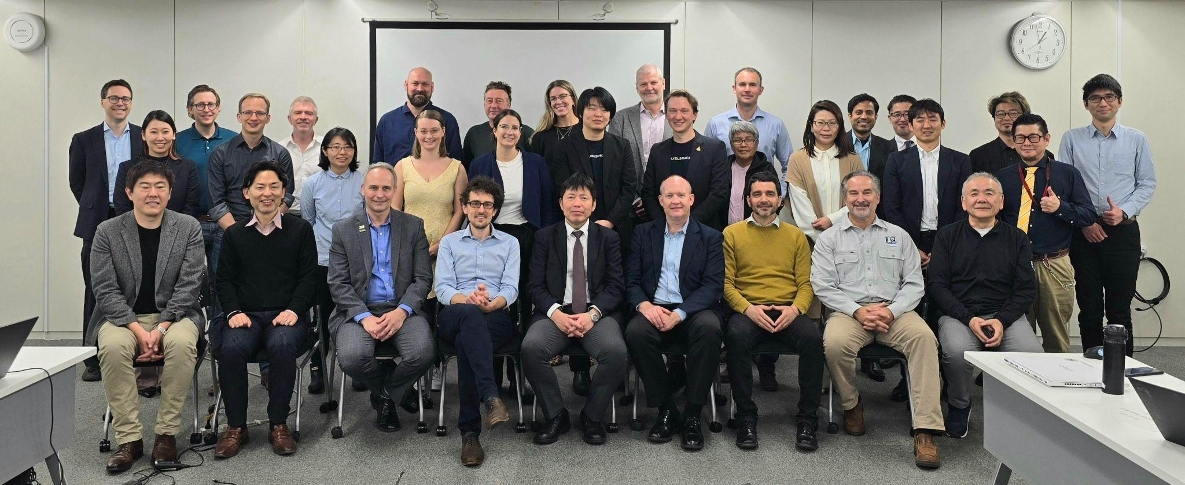
LSI-VC / CEOS-ARD Industry Engagement Session
Six Japanese companies
From all along the data value chain
Engaging with CEOS-ARD already
  Data providers Synspective & AxelSpace reviewing CEOS-ARD specs and interested in submitting self assessments
  Clear potential use case for CEOS-ARD specs to guide data procurement
Clearly a focus on improving data quality
  They look to CEOS Agencies for support
  Existing users of RadCalNet
Shared CEOS Analytics Lab New Space Interoperability project

Slide 15
LSI-VC / CEOS-ARD Industry Engagement Session
Positive and engaging workshop
Many connections made at personal / technical level
Companies expressed interest in joining LSI-VC and CEOS-ARD discussions more regularly
Shared CEOS communications and other resources which were well received
Growing the CEOS-ARD GitHub user community
  Ensuring broader community engagement in the definition and uptake of the CEOS-ARD specifications
Follow up and connection made to WGCV also
First workshop - others planned for other regions
Potential follow up workshop next year around SIT-40 (Japan)

Slide 16
CEOS Analytics Lab &
Commercial Interoperability Study
David Borges
Systems Engineering Office
Committee on Earth Observation Satellites
NASA Earth Science Division
SIT-39 Agenda Item 6.3
11 April 2024

Slide 17
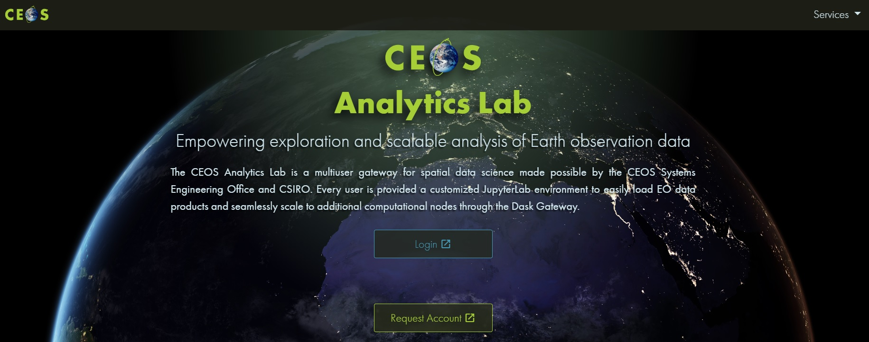
CEOS Analytics Lab
ceos.org/cal

Slide 18
Analytics Lab Architecture
Analytics Lab is an implementation of CSIRO’s Earth Analytics Science and Innovation platform (EASI)
Combination on several open-source projects:
  JupyterHub
  Open Data Cube (ODC)
  AWS
  Dask scaling
Scales individual user environments on demand.
Analysis can scale beyond the user environment using Dask workers that are used only when the analysis is run.

Slide 19
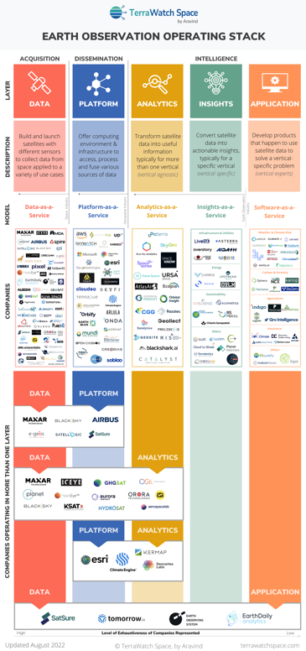
Commercial Interoperability Project
CEOS New Space Task Team (NSTT) Deliverable
  D5) SEO should demonstrate the integration of New Space data into CEOS Analytics Lab and evaluate its interoperability with common CEOS datasets.
Optical
  Landsat 8, 9
  Sentinel-2
  Maxar
  Planet Planetscope
  DESIS
SAR
  Sentinel-1
  ALOS
  Umbra
  ICEYE
  Capella

Slide 20
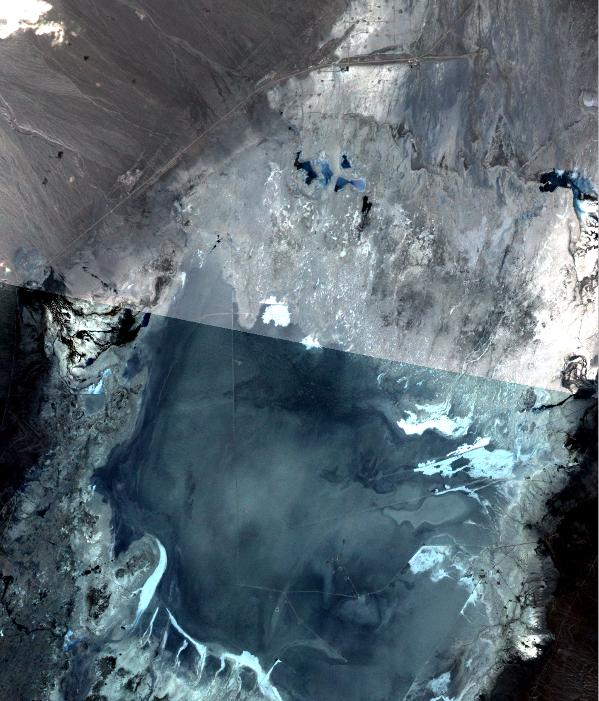
Commercial Interoperability Study Value
Importance:
  Improve understanding of commercial image quality as compared to public imagery datasets
  Explore challenges of working with data from both commercial and public platforms
  End User Perspective: Understand workflows necessary to incorporate multiple data sources
  Provide a foundation of knowledge to promote increased use of commercial data
  Formulate future recommendations for guiding CEOS policy regarding commercial data
  Test usage on the CEOS Analytics Lab (CAL) and the Open Data Cube
  Delineate Interoperability of Systems vs Data

Slide 21
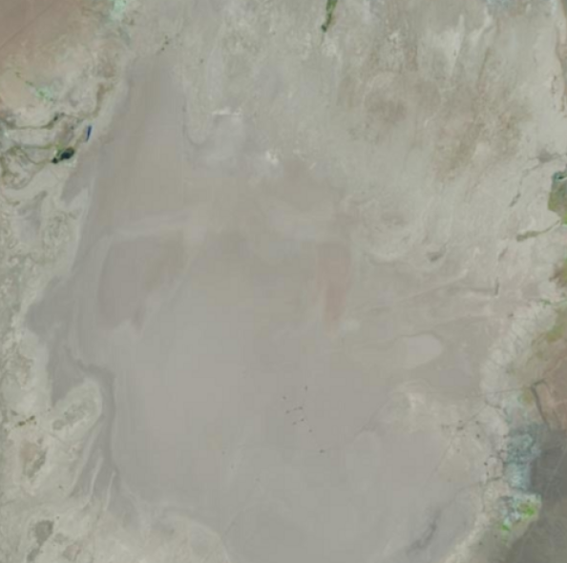
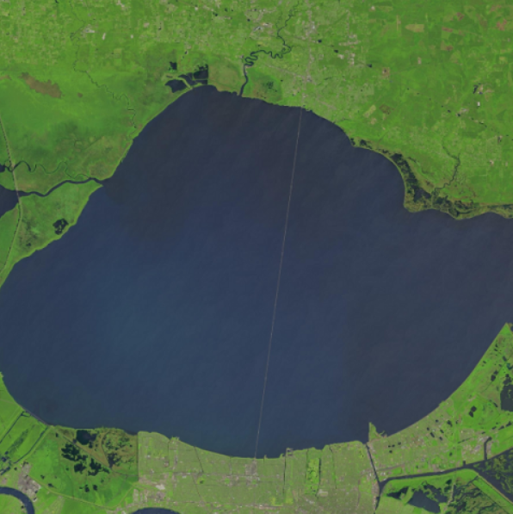
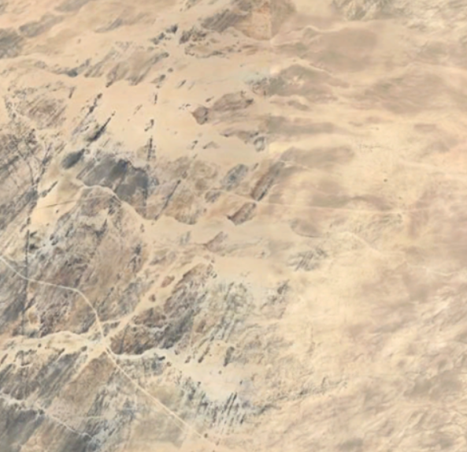
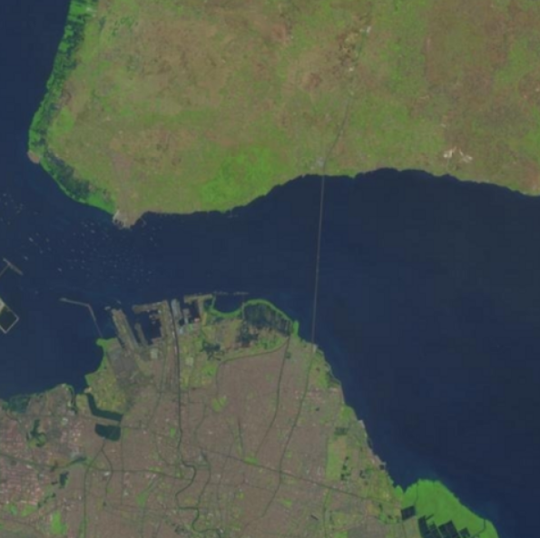
CEOS-SEO Preliminary Interoperability Analysis Sources
Level 2A Data (Monthly Comparisons, 2018-Present):
Cal/Val Sites
Commercial Platforms | Public Platforms
Planet Dove/SuperDove | Landsat 8/9
Maxar WorldView-02/03 | Sentinel 2
Teledyne DESIS | HLS
Railroad Valley
Lake Pontchartrain
Bridge
Cal/Val Sites | Northern Hemisphere | Southern Hemisphere
Radiometric | Railroad Valley Playa (Nevada, USA) | Gobabeb (Namibia, Africa)
Spatial | Lake Ponchartrain Causeway (Louisiana, USA) | Suramadu Bridge (Indonesia, Asia)
Gobabeb
Suramadu Bridge

Slide 22
Commercial Interoperability Project
Key Considerations and Challenges (Optical)
  Sensor Variation
    Impacts spectral band alignment, spatial detail, signal strength
  Processing Biases
    Differences in atmospheric correction and vendor-specific sharpening will influence direct comparisons
  Situational Factors
    Slight time offsets and viewing geometry differences create irreducible limitations
  Commercial data compliance with CEOS-ARD PFS

Slide 23


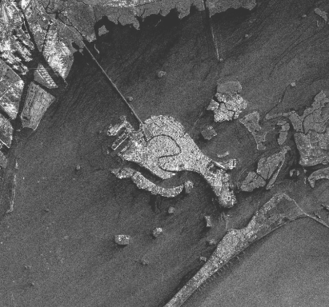
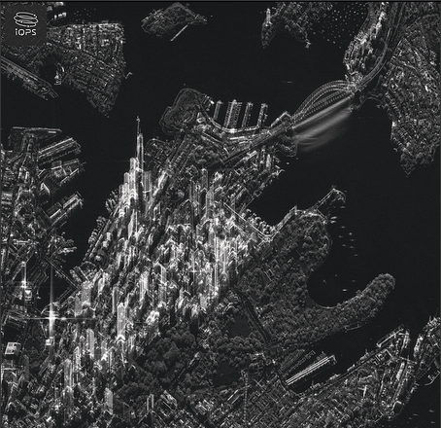
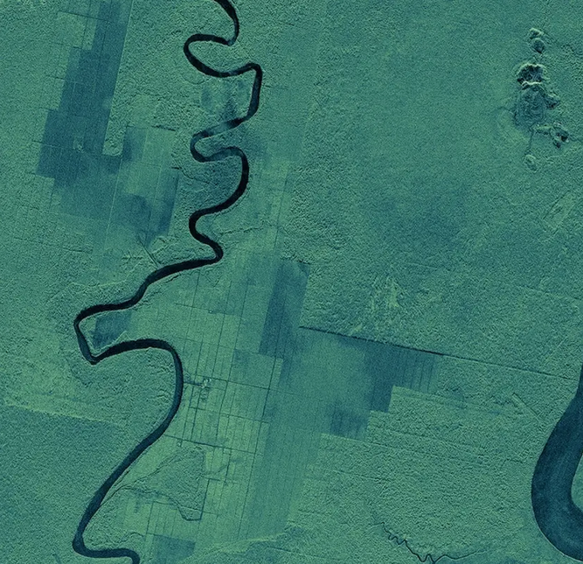
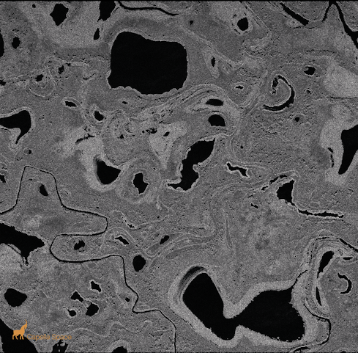
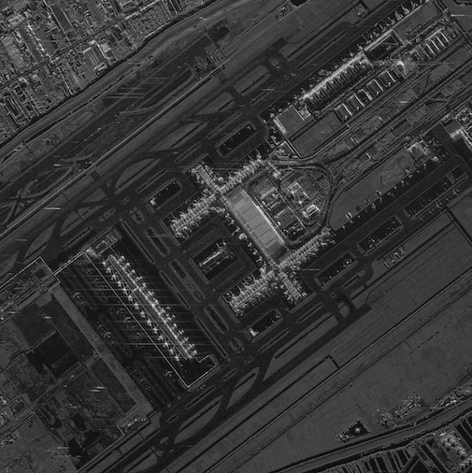
Commercial SAR – SEO Assessment
Increase in small commercial “New Space” SAR companies
X-band SAR systems
Light-weight, low cost
Large satellite constellations (10~50 satellites)
Very high spatial resolution (0.2~2 m)
Very high temporal revisit capacity (daily/sub-daily)
Main market segment: defence, security
Targeted observations per user requests
Strategic background observation plans - probably not
Current (SAR) actors:
Capella Space (USA) [9]
ICEYE (Finland) [32]
iQPS (Japan) [3]
Synspective (Japan) [2]
Umbra (USA) [7]
Others?...
Image credit: Synspective
Image credit: iQPS
Image credit: ICEYE
Image credit: Capella
Image credit: Umbra

Slide 24
Commercial SAR – SEO Assessment
SEO assessment (sample data)
Data quality
  Geometry, Radiometry
User friendliness
  Product levels
  Documentation
Data accessibility
  Sample data
  Data for purchase
CEOS-ARD
  Interest & relevance in providing CEOS-ARD product levels
  Mock (self-)assessment of sample products
CEOS Analytics Lab (CAL)
  Feasibility for inclusion of sample data
  Additional processing?
Image credit: Synspective
Image credit: iQPS
Image credit: ICEYE
Image credit: Capella
Image credit: Umbra

Slide 25

Commercial Engagement Update
Timothy Stryker, USGS
Agenda Item #6.3
SIT-39 2024, Tokyo, Japan
10th - 11th April 2024

Slide 26
USGS National Engagement
❖Sustainable Land Imaging Program Partnership
▪Core Public-Service Data Continuity/Improvement through Government-Operated Systems
▪International Data Access
▪Commercial Data Use (a “both/and” rather than an “either/or” approach)
❖Commercial EO Contracts
▪With U.S. Agency Partners - “Buy Once, Use Many Times”
▪USGS FY 25 Budget Request: Commercial EO Pilot ($5 million)
❖Use of Commercial Cloud Data Hosting and Distribution Services
▪“2030 Challenge” for U.S. Civil EO Agencies
Notes:
●SLI Program Partnership moving into the future is “multi source” and “multi modal” in nature, relying upon a mix of core government observations, international data, and commercial EO observations and services
●Commercial EO Contracts
○Utilizing NRO and more recently, NASA contracts, while seeking some of our own funding for a pilot project
○Electro-Optical: Maxar, BlackSky, Planet
○SAR: Capella, ICEye (U.S.), and Umbra
●Commercial Cloud Providers
○More and more users accessing our data through AWS (our current contractor) and third-party commercial cloud services
○2030s Challenge: How will USGS and other U.S. agencies – indeed, all CEOS agencies – seamlessly handle and make accessible to our users the tsunami of government and commercial EO data volumes coming our way within the next decade

Slide 27
USGS National/Int’l Engagement
❖JACIE: Over Two Decades of Highly Productive Agency-Industry Dialogues
▪Commercial EO Data Quality
▪Improved Calibration Techniques
▪Standardizing Evaluation Methodologies
❖Landsat Value-Adders Forum Hosted by GA and USGS, 1 March 2024
▪Current Landsat Operations and Upcoming Landsat Next Mission Overview
▪Landsat Collections Evolution
▪2030 Challenge faced by USGS, GA, others
▪Value-Adders Landsat Applications: Current and Future Challenges
▪“Wouldn’t it be nice if Landsat…”
Notes:
●JACIE has had a positive relationship with commercial providers for over 20 years:
○Helping commercial providers improve their data quality, promoting improved calibration techniques, and standardizing evaluation methodologies.
○Recent industry identified needs are a common geospatial reference (GCPs for Very-High Res), increased SAR and Thermal calibration targets and methodologies, and open-source tools quality metrics and to help with interoperability
○JACIE, VH-RODA and our annual ARD-industry Workshops offer excellent opportunities for additional CEOS “brand” engagement
○JACIE Total Participants (Hybrid format): 575 Participants from 32 Countries throughout the course of the week and its multiple side events
■JACIE In-Person Stats:
■Agencies: ESA, NGA, USGS, NRO, NOAA, USDA, NASA, Korea Aerospace Research Institute
■Posters: NPL, ISRO
■Commercial EO Data Providers: Maxar, Pixxel, Orbital Sidekick, Umbra, EarthDaily Analytics, HydroSat, ICEYE, Wolverine Radar, SatelliteVu, Constellr, GHGSAT, Wyvern
■Commercial Value Adders: LabSphere, NV5 (ESRI), L3Harris, KorrAI, Global Insights, I2R,SuperPixel Corp, Four Resolutions Inc.
■Academia: Univ. of Maryland, Rochester Institute of Technology, George Mason Univ, Univ. of Washington, Purdue Univ.
○
●Landsat Value-Adders Workshop
○A key input we heard from industry reinforced the need for more multi-source/multi-modal use cases
○Commercial EO providers want continued focus on interoperability.
○So we believe that our collective CEOS LSI-VC, WGISS, and WGCV priorities have us on the right track

Slide 28
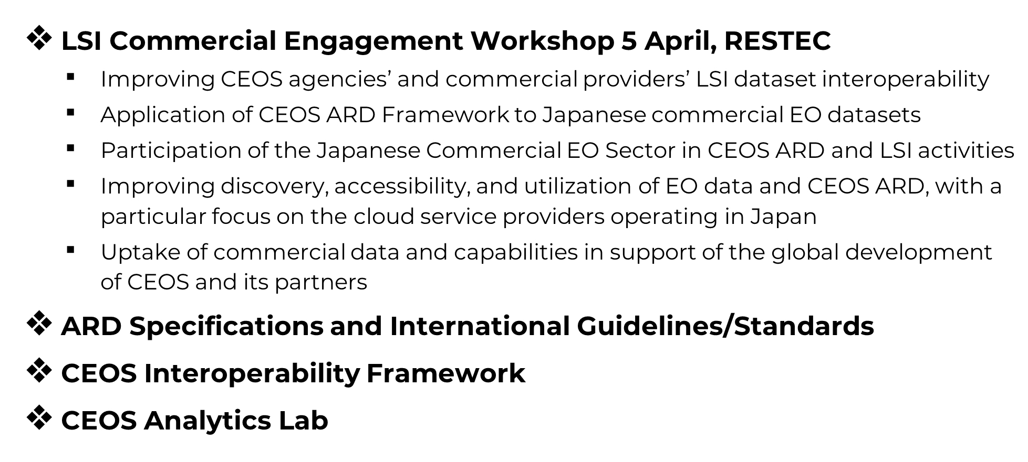

USGS-CEOS Commercial Engagement
Notes:
●LSI VC Workshop was addressed separately in the LSI-VC report, so I won’t repeat details here - just a very useful and successful meeting – thank you very much to RESTEC and JAXA for their support.
●Per Steve Volz’s comments yesterday, USGS is considering the possibility of a similar U.S.-based Commercial Engagement workshop this Fall aligned to the joint WGISS/WGCV meeting. WGISS can be an important CEOS entry point for Data Interoperability and New Space.
●Initial driver for SEO creating the CEOS Analytics Lab was to provide a shared resource for technical collaboration on crosscutting CEOS activities
●Discussions are ongoing between SEO, WGISS, LSI-VC, and ARD Oversight Group, to ensure it is a useful resource for the CEOS Interoperability Framework, CEOS ARD specifications, and emerging commercial engagement.
●We expect the Analytics Lab will prove a useful resource to advance these important CEOS activities.

Slide 29
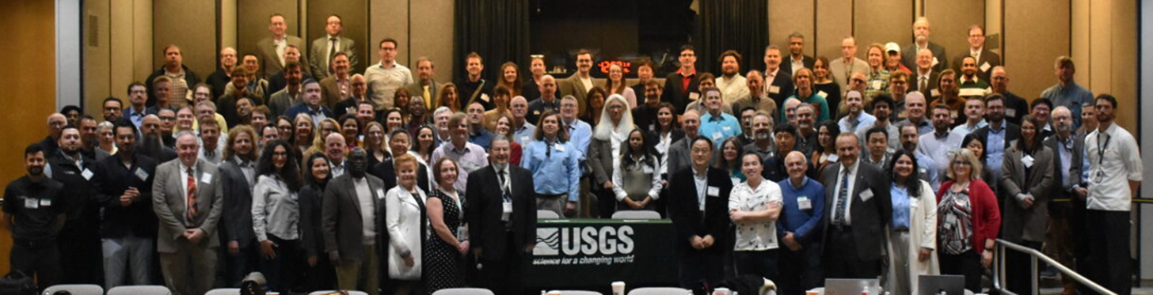
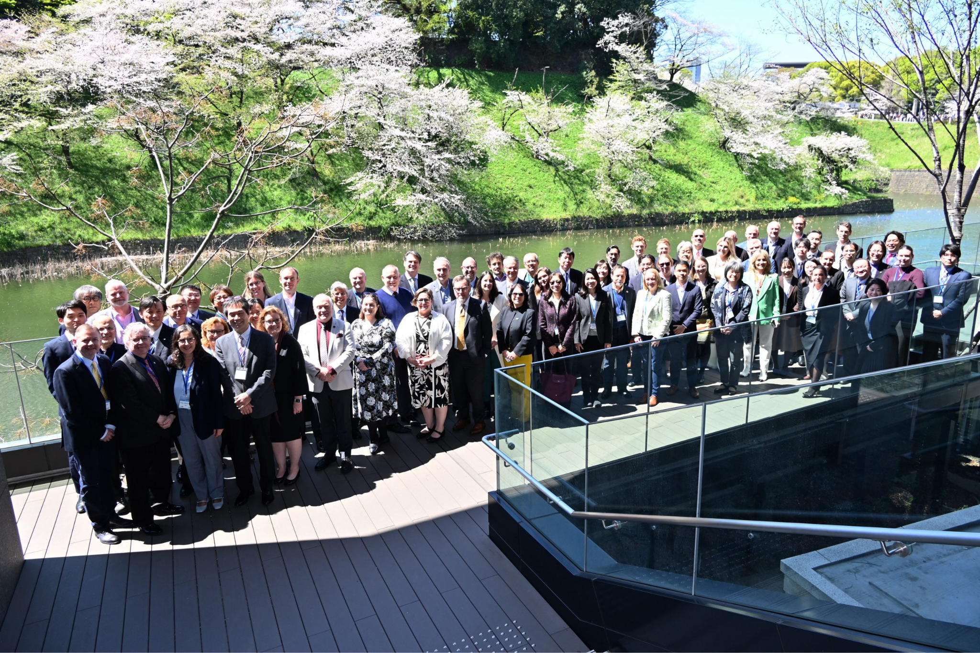
Thank You!
JACIE Meeting, March 11-14, In-person Attendees, Reston, Virginia
Notes:
●Our Communities Can Do Much More Together than We Can Separately!
●In addition to the many useful engagements occurring with the CEOS WGs, VCs, and other interest/coordination activities, we recommend SIT- and Plenary-level engagement with commercial space.
●USGS will be happy to support any such events.

Slide 30
Other Agency Update (TBA)
TBA, TBA
Agenda Item #6.3
SIT-39 2024, Tokyo, Japan
10th - 11th April 2024

