Slide 1

SIT-39
2024
WMO Update
Natalia Donoho, WMO
Agenda Item #6.2
SIT-39 2024, Tokyo, Japan
10th - 11th April 2024

Slide 2
Presentation outline
WMO Space Programme
15th Session of Consultative Meetings on High-Level Policy on Satellite Matters (CM-15, February 2024) meeting outcomes
Commercial sector perspectives
Other updates of relevance to CEOS and space agencies

Slide 3
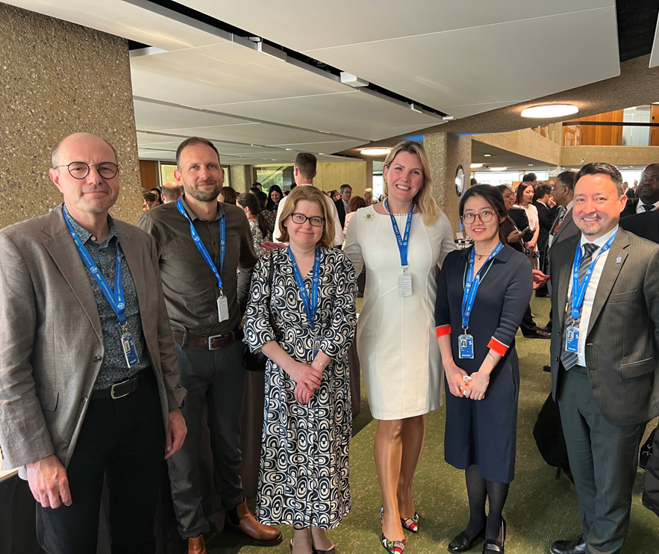
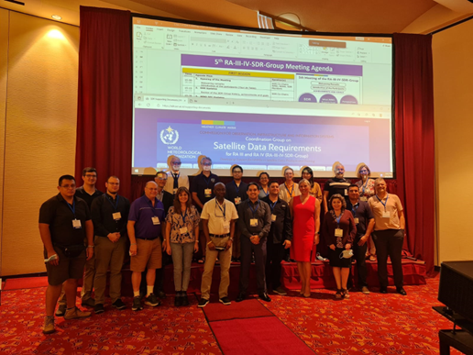
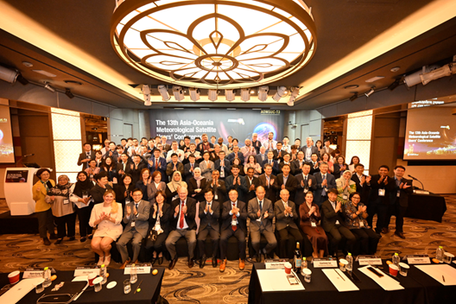
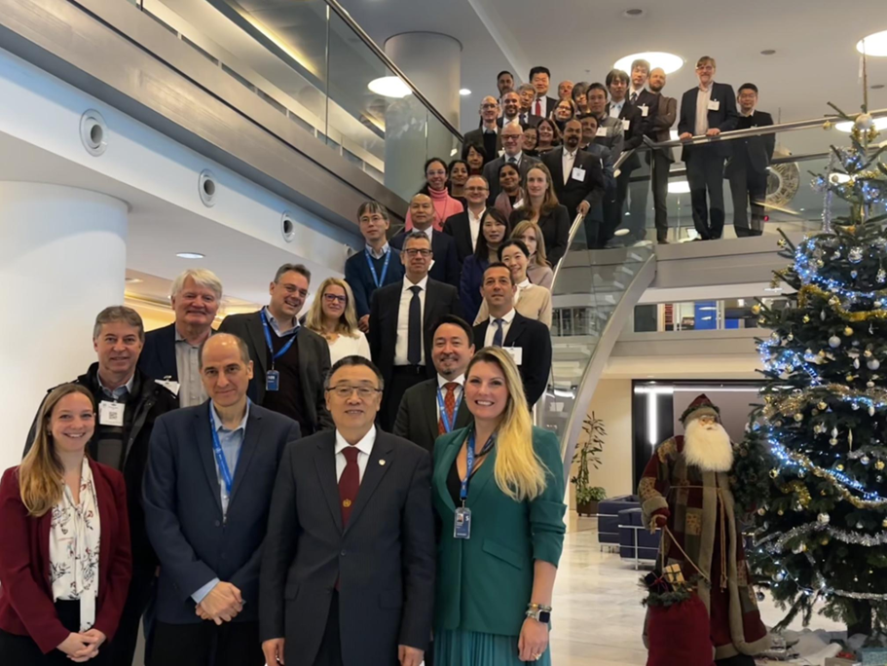
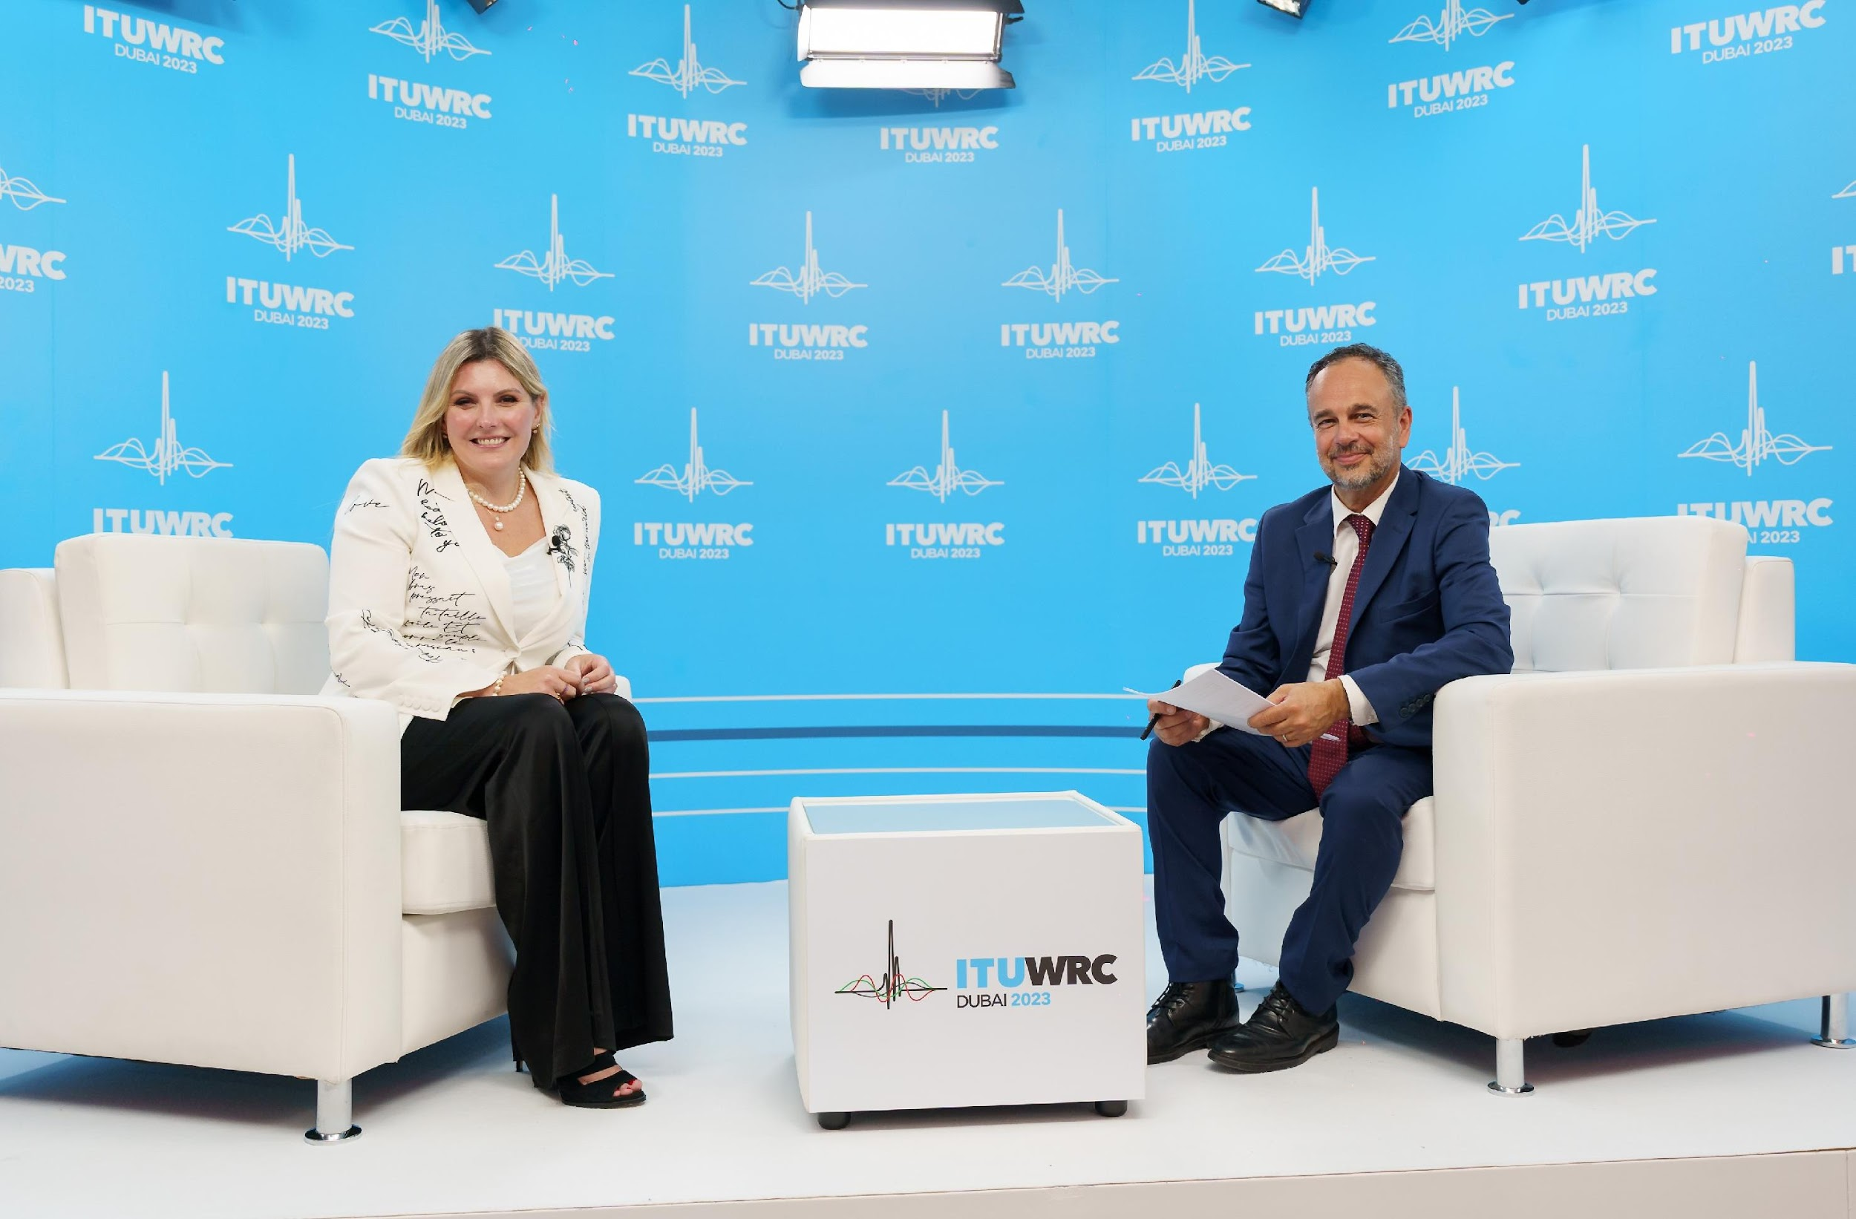
Space System and Utilization Division
a.k.a. WMO Space Programme
Integrated space-based observing system,
Availability and Use of Satellite Data and Products,
Capacity Building and User Engagement,
Space Weather Coordination,
Coordination for the use of radio frequency spectrum.

Slide 4
Consultative Meetings on High-Level Policy on Satellite Matters (CM-15)
The 15th Session of the Consultative Meetings on High-level Policy on Satellite Matters (CM-15) was held at WMO 6-7 Feb 2024
Approximately 70 participants from space agencies and the WMO Secretariat (both in person and online)
The role of the Consultative Meetings on High-level Policy on Satellite Matters is to facilitate a formal and substantive communication between leadership of space agencies and representatives of the World Meteorological Organization (WMO)
  Presidents of the Commission for Observation
  Infrastructure and Information Systems (INFCOM)
  The Commission for Weather, Climate, Hydrological, Marine and Related Environmental Services and Applications (SERCOM)
  Secretary-General and Directors.
 | ‹#›

Slide 5
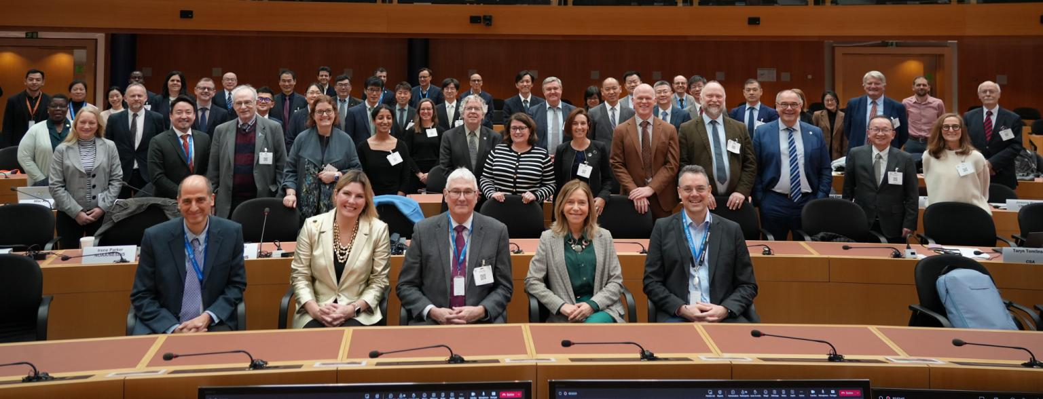
CM-15: WMO reinvigorated relations with space agencies

Slide 6
WMO Priorities: CM-15 meeting
The overall goal of CM-15 was to revitalize the strategic level dialogue with space agencies. In particular, the meeting also delved into numerous critical topics, including:
Collaborative efforts to support Members with the least capacity, particularly in advancing Early Warnings for All
Dealing with new paradigms of bringing data and users together in the face of growing data volumes and capabilities
Exploring best practices and emerging opportunities in collaboration with the commercial satellite sector.
Pioneering the transformation of the Global Greenhouse Gas Watch (G3W) from concept to reality in the years ahead.
Anticipating the impact of the impending but still nebulous AI revolution on weather and climate enterprise, particularly concerning satellite data.
Examining the evolution of WMO, its space program, and WIGOS processes, including the update of the WIGOS 2040 Vision document, to better serve the framing of user requirements and satellite agencies' responses.
 | ‹#›

Slide 7
Session: Space Agencies’ Perspective
Space agencies provided a brief introduction of their agency and emphasized their interactions with the World Meteorological Organization (WMO)
Requests to WMO including:
Coordinate long-term plan to urge governments to act.
Better accessibility of the satellite data
Enhance user engagement
Contributions to the capacity building of satellite data utilization
Mission-enable the full spectrum of early warnings, climate resilience, ecosystem awareness, and adaptation
 | ‹#›

Slide 8
Session: Users’ perspective to demonstrate the importance of space-based observations
Talks on NWP and perspectives form WMO Regions
High volume of satellite data assimilated in NWP modelling
AI based weather modelling is under development by several companies and institutes showing promising results.
Call for WMO to develop framing/parameters/clear statement of need and approach, as well as framework for capacity development and training
 | ‹#›

Slide 9
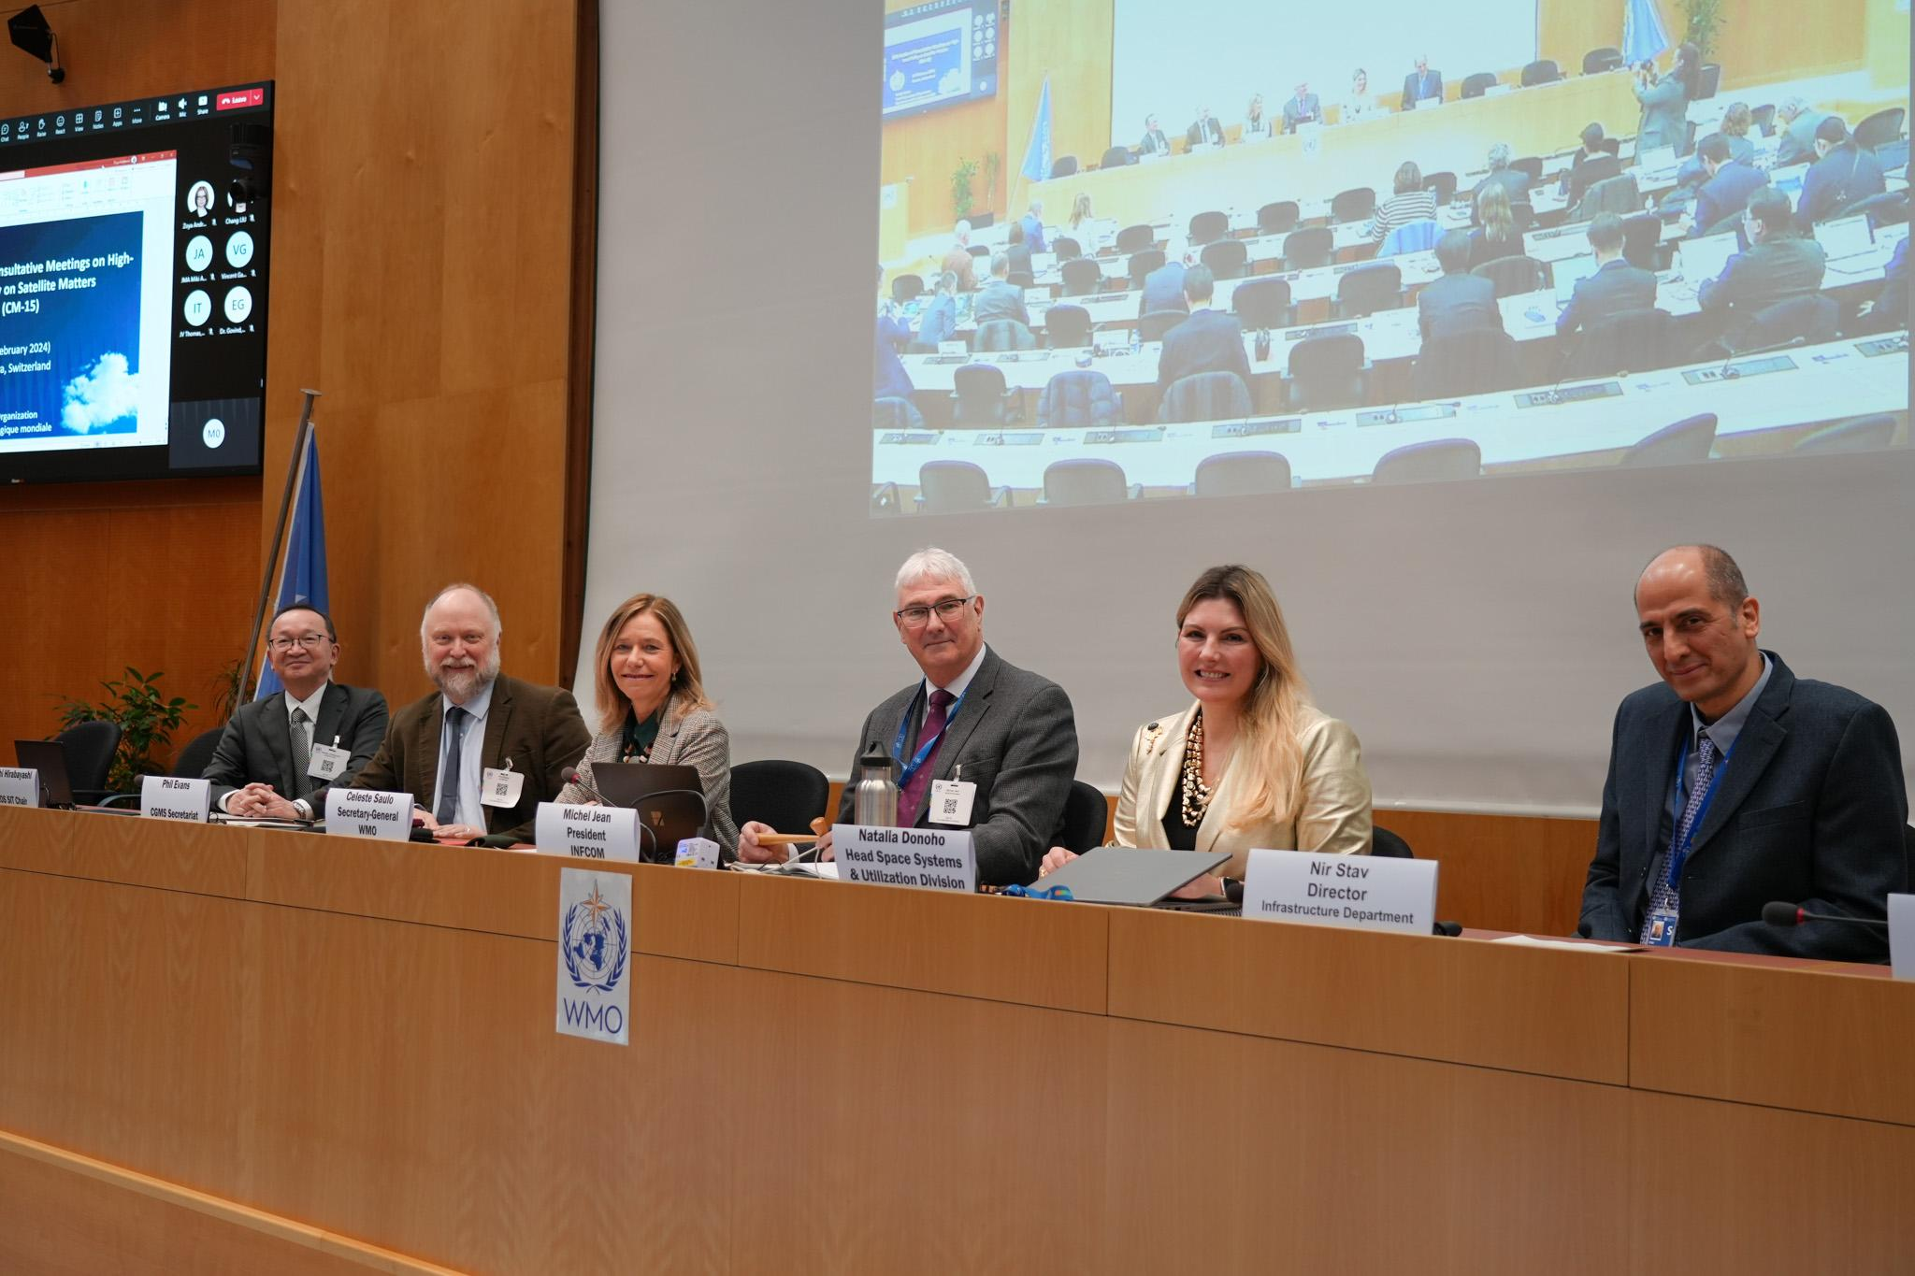
CM-15: Outcomes
Six key topics were raised during the roundtable discussion, focusing on:
Increasing benefits of satellite data for Developing Countries
      Work together to support the regional needs of Members in light of the UN Early Warnings for All initiative, by expediting expression of those needs and required approaches and by supporting training activities in cooperation with the Regional Associations;
High Data Volumes
Facilitate a dialogue with space agencies for WIS 2.0 implementation;
  Coordinated Involvement of the Private Sector.
Support a three-way dialogue, with space agencies and the private sector, on commercial sector engagement related to space-based observing systems using the Open Consultative Platform;
Coordination for Greenhouse Gas Monitoring
WIGOS Vision
Lead engagement with space agencies in updating the WIGOS 2040 Vision.
AI Technology for Improved Satellite Data Exploitation

Slide 10

CGMS Futures 2022+
Relationship with the Private Sector
Harness/leverage the opportunities of a rapidly growing commercial space
sector while maintaining operational standards and open data sharing
Lead: WGIII – Champion: Mara Browne/NOAA
Short-Term Activity: Best practices for End User License Agreements/data procurements
Future Activities:
Identify future commercial EO technologies – and share info on pilots/testbeds/etc. to evaluate new commercial EO technologies.
Assess the operational maturity of commercial observation technology.
Interfaces: Engage with private sector through the WMO Open Platform consultative mechanism, WMO and through technical and scientific working groups.

Slide 11
Fifth High-Level Session of the Open Consultative Platform (OCP-HL-5)
OCP high-level sessions are held every year in conjunction with EC or Congress sessions, which provide a dialogue mechanism between WMO and the private sector and academy. The dialogues focus on key challenges with long-lasting impacts on WMO and its Members, which can only be addressed by engaging all stakeholders, including the public, private and academic sectors.
The issues concerning coordination and collaboration with commercial satellite owners keep bubbling up in the discussions of CGMS, CEOS, CM and other events attended by space agencies and satellite operators.
Date and time: 12:00-13:40 CEST (10:00-11:40 UTC), Thursday, 13 June 2024 (during EC-78) – all tentative
Purpose: To invite the public sector (space agencies, WMC and NMHSs) and commercial satellite companies to share their strategy and policy on engagement as well as collaboration models;
To come up with recommendations, from satellite data users perspective, on a strategy of engagement to ensure a) complementary roles of observations from different players; b) quality and continuity of satellite data essential for forecast and severe weather warnings for the world; c) WMO’s communication with both private companies and other platforms of public-private consultation (CGMS, CEOS, CM, etc.).

Slide 12
Other updates of relevance to CEOS and space agencies – INFCOM-3
  8.1(1) Amendments to WIGOS Manual (WMO-No. 1160)
    Observing component for Space Weather & integration into WIGOS
    Radio frequency (RF) matters & concept of National FP
    An update of the GCOS Climate Monitoring Principles
    Space observations & Issuers of WSIs, WMO core and recommended satellite data
  8.1(2) Update of WIGOS Guide (WMO No. 1165)
    Observing component for Space Weather & integration into WIGOS
    Radio frequency (RF) matters – new section and Terms of Reference on National Focal Points for RF matters
  8.1(3) Plan for update of the WIGOS Vision 2040 (WMO-No. 1243) and the High-level Guidance on the Evolution of GOSs during 2023–2027 (WMO-No. 1334)
    Proposed updates should be presented to INFCOM-4 for endorsement and then to Cg-20 for approval,
    SC-ON should lead the updates, ensuring wide consultations among broad community of stakeholders, such as NMHSs, space agencies, relevant international organizations and programmes, observing system developers, and other private and academic sectors.
  8.1(5) Update of the Guidelines on Best Practices for Achieving User Readiness for new meteorological Satellites (WMO-NO. 1187)

Slide 13
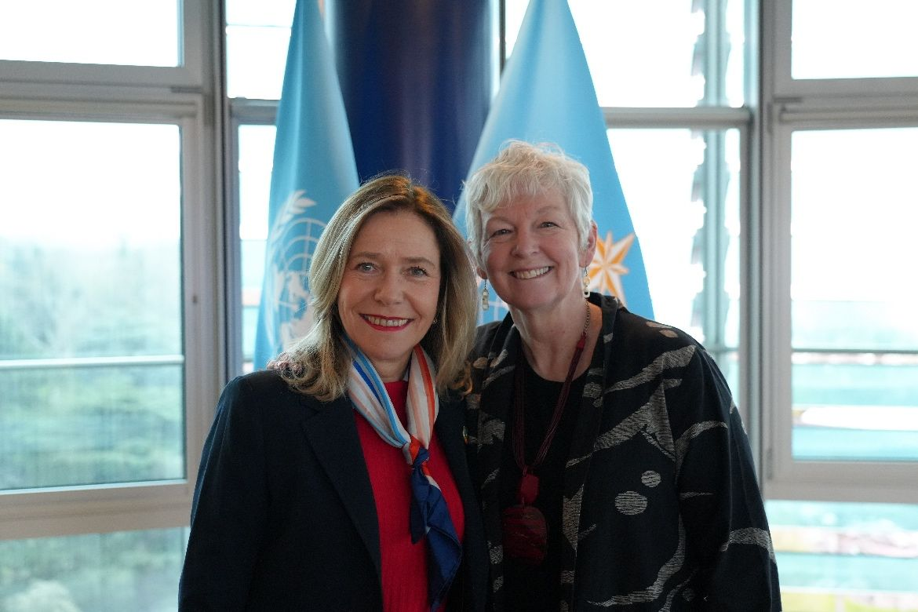

Other updates of relevance to CEOS and space agencies – New WMO leadership
Professor Celeste Saulo was appointed as the first female and South American Secretary-General of the World Meteorological Organization (WMO) by the Nineteenth World Meteorological Congress (Cg-19). Her four-year term began on 1 January 2024. Prior to this, she served as the Director of the National Meteorological Service of Argentina since 2014 and was the First Vice-President of the WMO.
Ms. Ko Barrett was appointed as WMO Deputy Secretary-General in January 2024 and began her mandate on 1 April 2024. Prior to this, she was the Senior Advisor for Climate at the US National Oceanic and Atmospheric Administration (NOAA).
Mr. Thomas Asare was appointed WMO Assistant Secretary-General in January 2024 and will begin his mandate on 1 May 2024. Mr. Asare is a finance and development executive with over 25 years of experience.

