Slide 1
Updates from the Virtual Constellations
Osmau Ochiai
JAXA SIT Chair Team
Agenda item #6.1.4
SIT-39 2024, Tokyo, Japan
10th - 11th April 2024

Slide 2
Atmospheric Composition (AC-VC)
New deliverables in the CEOS Work Plan:
Follow up from the 2019 white paper on Air Quality Validation
Follow up from the 2022 white paper on PM2.5
Efforts to improve measurements of air quality in the global south.
Would welcome new membership from southern hemisphere agencies to help progress this
Next AC-VC meeting is in planning, to be held at the NOAA Center for Weather and Climate Prediction in College Park, MD, sometime during July to September (date TBC).
Supporting JAXA SIT Chair GHG Priority, in particular the GHG Roadmap

Slide 3
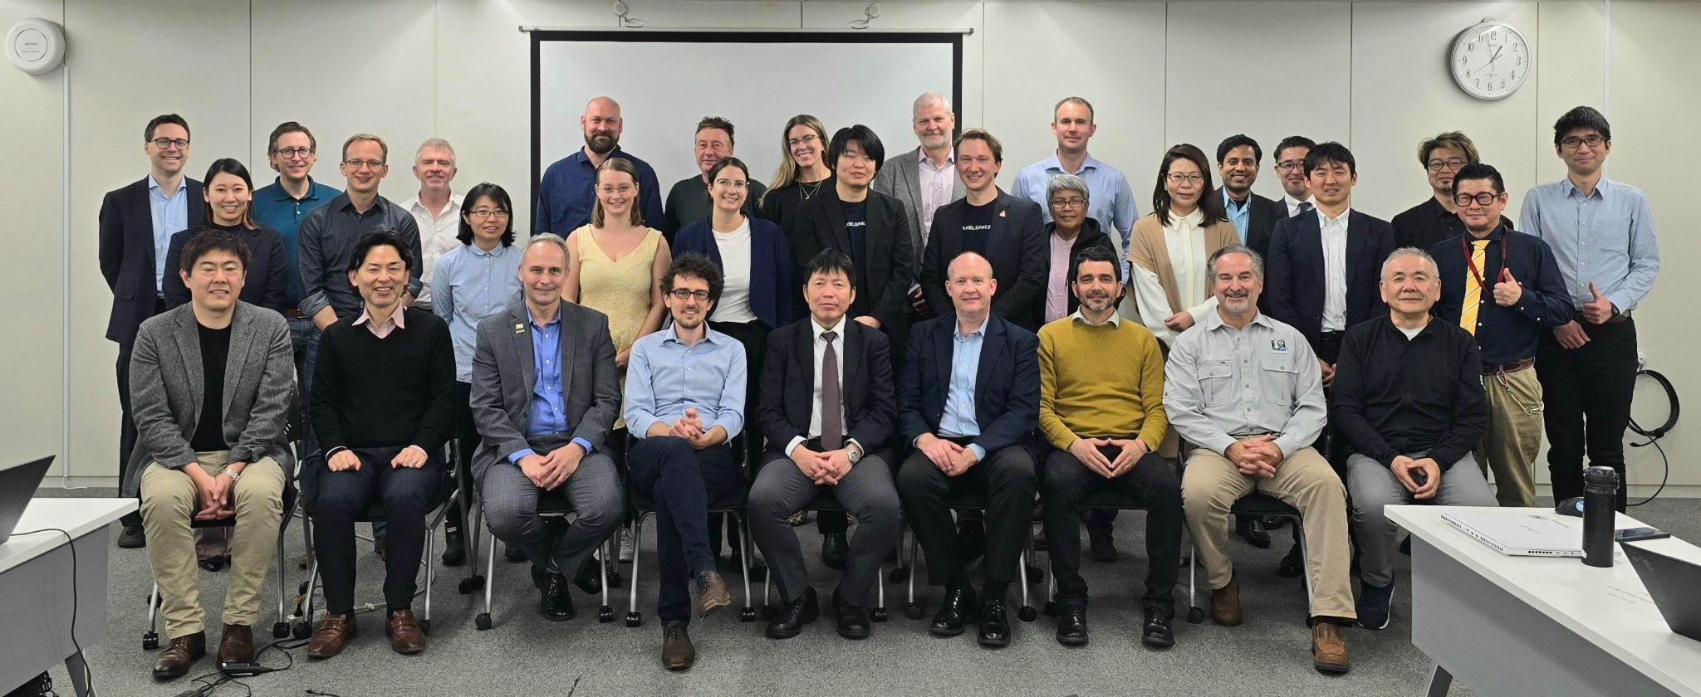
Land Surface Imaging (LSI-VC)
LSI-VC-15 was held last week
Key discussion was approach for dealing with various high level product needs of thematic communities (e.g., EAVs, EBVs, ECVs) Dedicated presentation on GEOGLAM
Expansion of scope requires expert appointments to LSI Subgroups
Supported agencies’ ongoing CEOS-ARD self-assessments
CEOS-ARD / LSI support to the CEOS Ecosystem Extent Task Team Demonstrators
Land CEOS-ARD specification technical discussions and advancement
Accommodate high resolution EO datasets
CEOS-ARD STAC Extensions
CEOS-ARD GitHub
Combined optical PFS discussions - increase consistency
Dedicated presentations:
CEOS-ARD Strategy 2024
ESA PolInSAR recommendations
Japanese Commercial Sector workshop on LSI and CEOS-ARD
LSI-VC members are major contributors to the OGC/ISO ARD SWG, discussion ongoing. Ensuring alignment with CEOS-ARD.

Slide 4
Ocean Colour Radiometry (OCR-VC)
Main priority is Aquatic Carbon Roadmap (Item 8.1)
System Vicarious Calibration (SVC) infrastructures in support of Climate-quality OCR data records white paper is almost ready for publication
Working with LSI-VC to extend the Aquatic Reflectance ARD PFS to oceans
Creating one harmonised specification for inland, coastal and open waters.
IOCCG will meet on 22-26 April - next steps to be discussed

Slide 5
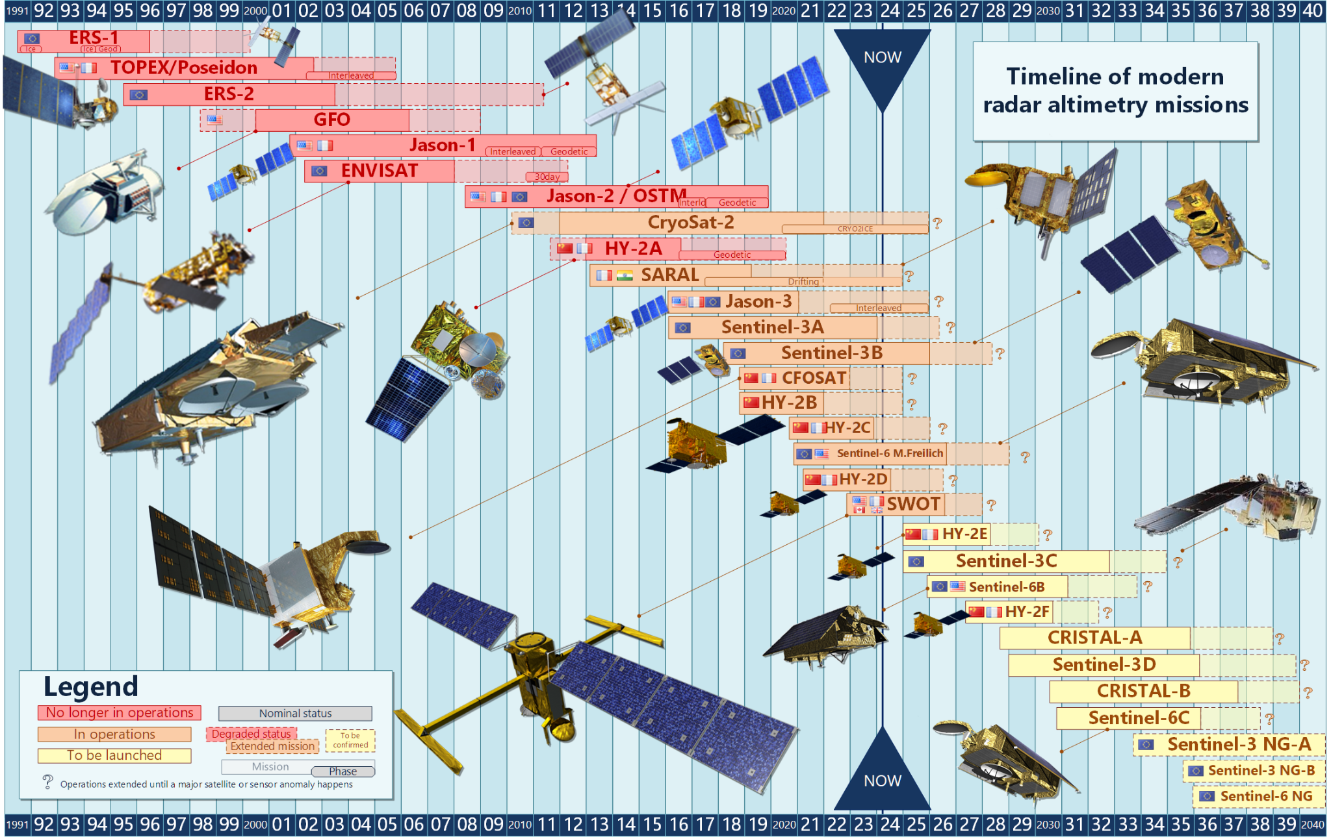
Ocean Surface Topography (OST-VC)
OST-VC White Paper ‘A Coordinated International Satellite Altimetry Virtual Constellation: Toward 2050’ is nearing completion
Update of the last version dated 2009
Aiming for completion at the end of 2024
Will present a draft at SIT Technical Workshop 2024
Missing membership from China - nominations welcomed!

Slide 6
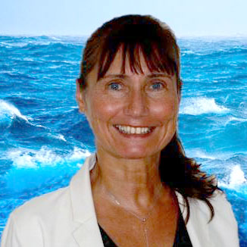
OST-VC Leadership
Annick Sylvestre-Baron of CNES is retiring this month
Will be replaced by Yannice Faugere from CNES.
Yannice is already well-known by OST Science Team, and has been an active member of the community for many years.
Thank you Annick for your many years of leadership, and welcome Yannice!

Slide 7
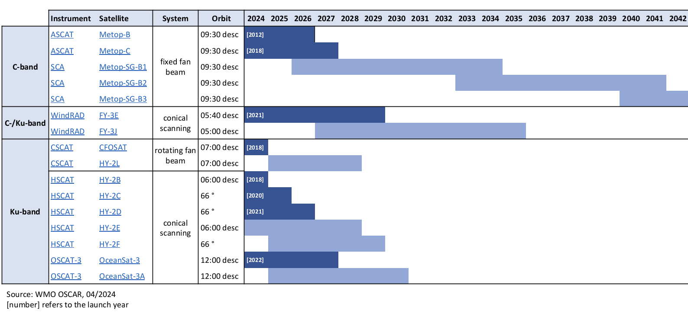
Ocean Surface Vector Winds (OSVW-VC)
IOVWST will meet in May, 2024 - the first in person meeting since the pandemic
IOVWST is the primary forum for subject matter experts
OSVW-VC looking at collaborations with COAST, in particular for coastal surface winds

Slide 8
Sea Surface Temperature (SST-VC)
Seeking additional engagement to expand participation in SST-VC from CEOS members
Current member is SANSA, JAXA, NASA, NOAA, EUMETSAT, ESA, ISRO, BoM, CMA, KMA
Seeking additional membership from CONAE, CSA, and INPE
Continuing participation and contribution to CEOS ARD Oversight Group
Looking for areas to collaborate with newly proposed COAST-VC, ensuring no overlap in work with the SST-VC
Focusing on user needs and mission requirements of very and ultra-high resolution SST in coastal and high-latitude regions
Ed Armstrong (NASA) stepped down as SST-VC co-lead in January 2024 but remains in the team. Misako Kachi (JAXA) took over his place and works with Christo Whittle (SANSA) as SST-VC co-leads.

Slide 9
Precipitation (P-VC)
Thanks to Chris for already presenting the update!

Slide 10
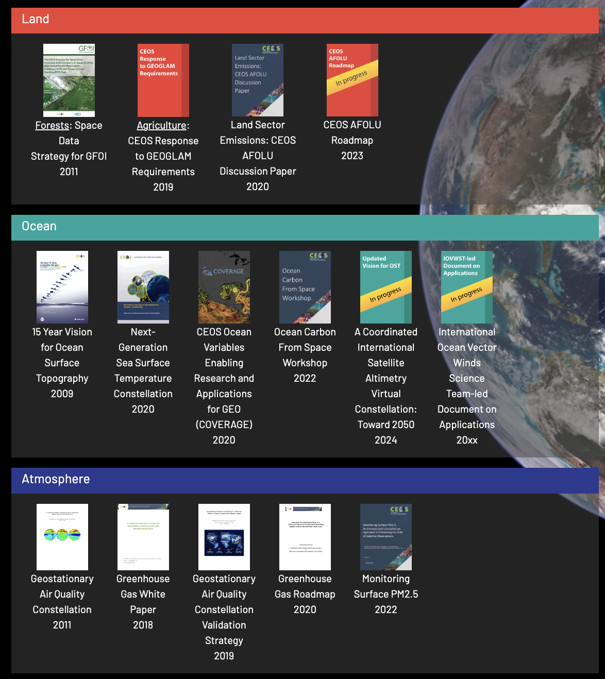
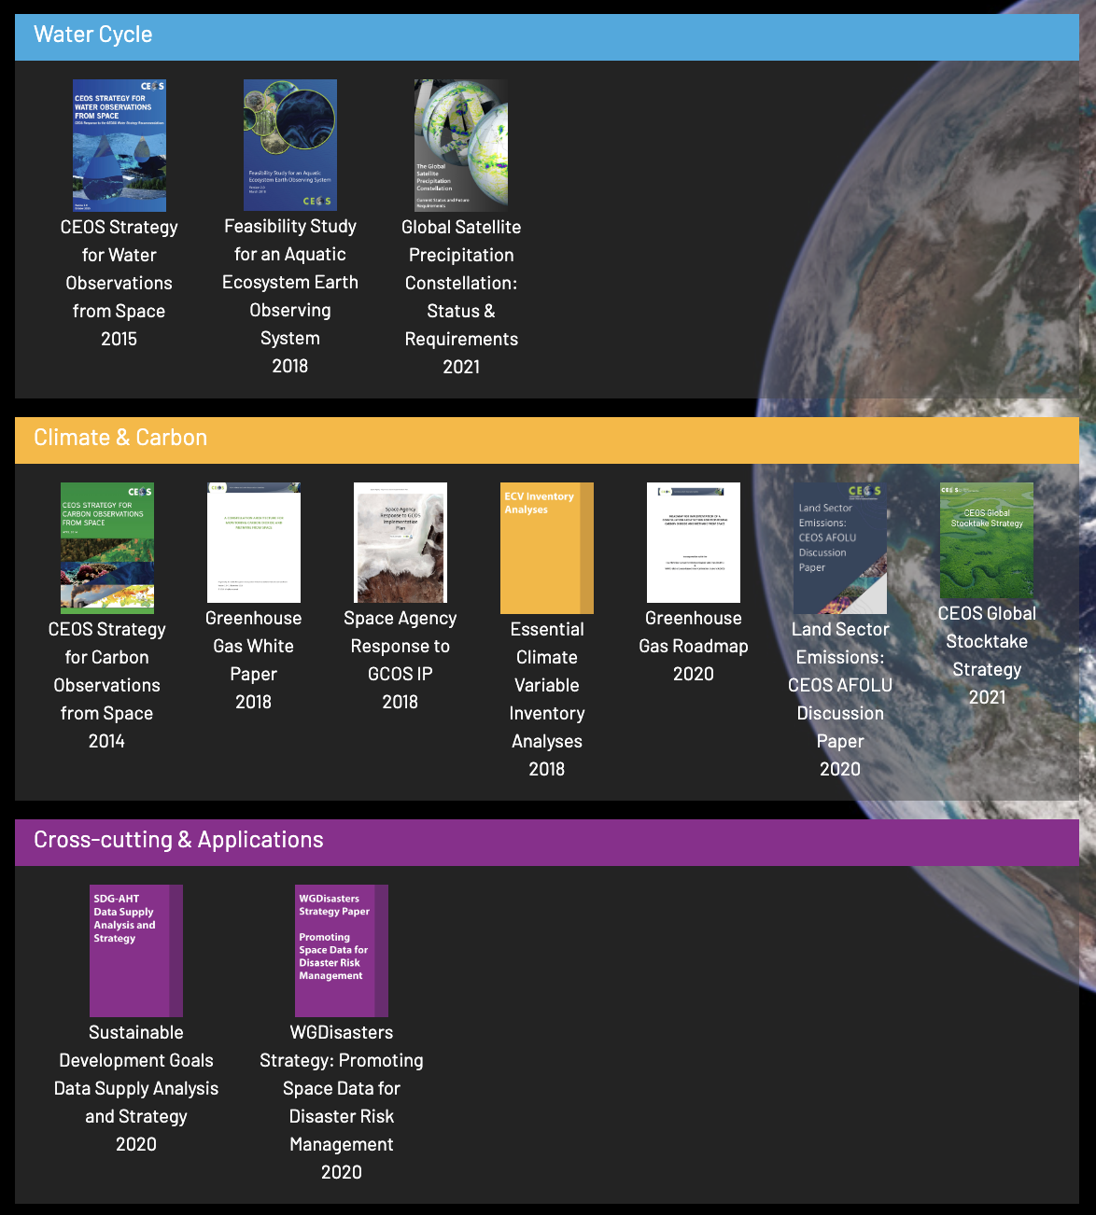
ceos.org/observations
Highlights thematic strategy documents produced by VCs and WGs
Emphasis on the coordination of mission planning for observation continuity
VCs & WGs: please continue to provide the SIT Chair / SEO with updates to new or existing strategy documents

