Slide 1
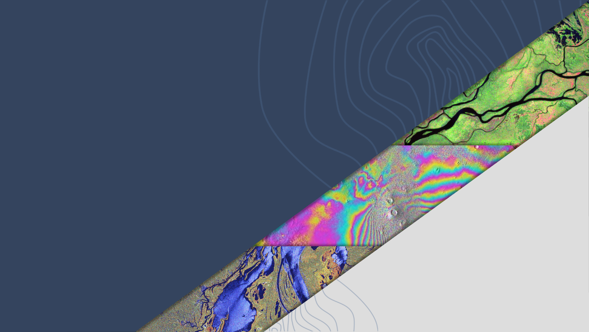

SIT-39 2024
LSI-VC: ESA POLINSAR Workshop Recommendations
Ake Rosenqvist, JAXA
Francesco Sarti, ESA
Magdalena Fitrzyk RSAC c/o ESA
Laura Frulla, CONAE
Agenda Item 6.1.2
SIT-39, Tokyo, Japan, 9-11 April 2024

Slide 2
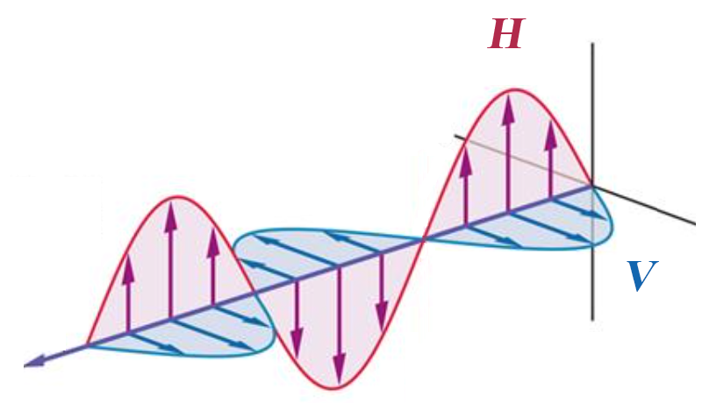
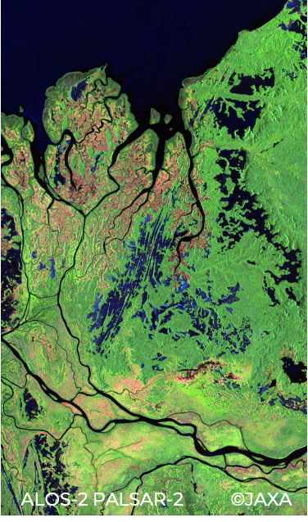

Background
Fully polarimetric, quad-polarisation (QP), data provides information about both backscatter amplitude and backscatter phase - for each polarisation combination (HH/HV/VH/VV)
Polarimetric phase varies depending on the ground target → enables enhanced retrieval of target structural parameters
Time-series of QP data enables interferometric analysis of changes in polarimetric phase (Pol-InSAR)
Radar wavelength (λ) directly correlated with target size → multi-frequency (multi-wavelength) data enables enhanced retrieval of target structural parameters
ALOS-2 PALSAR-2 (JAXA) Processing: Y. Yamaguchi (U. Niigata)

Slide 3
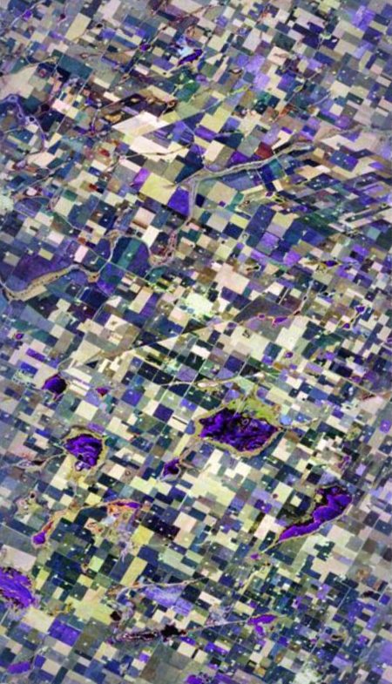
Background
Despite great potential – POLINSAR and multi-frequency research and applications still underdeveloped
Scarcity of consistent time-series of polarimetric data for R&D
Lack of (near)coincident, multi-sensor, multi-frequency datasets for SAR-SAR (polarimetric) interoperability analysis
Complexity of polarimetric processing 🡪 high entry level for new users
  Scarcity of easy-to-use software tools for POLINSAR analysis
  Lack of analysis-ready polarimetric datasets.
SAOCOM-1 (CONAE) Processing: CONAE

Slide 4
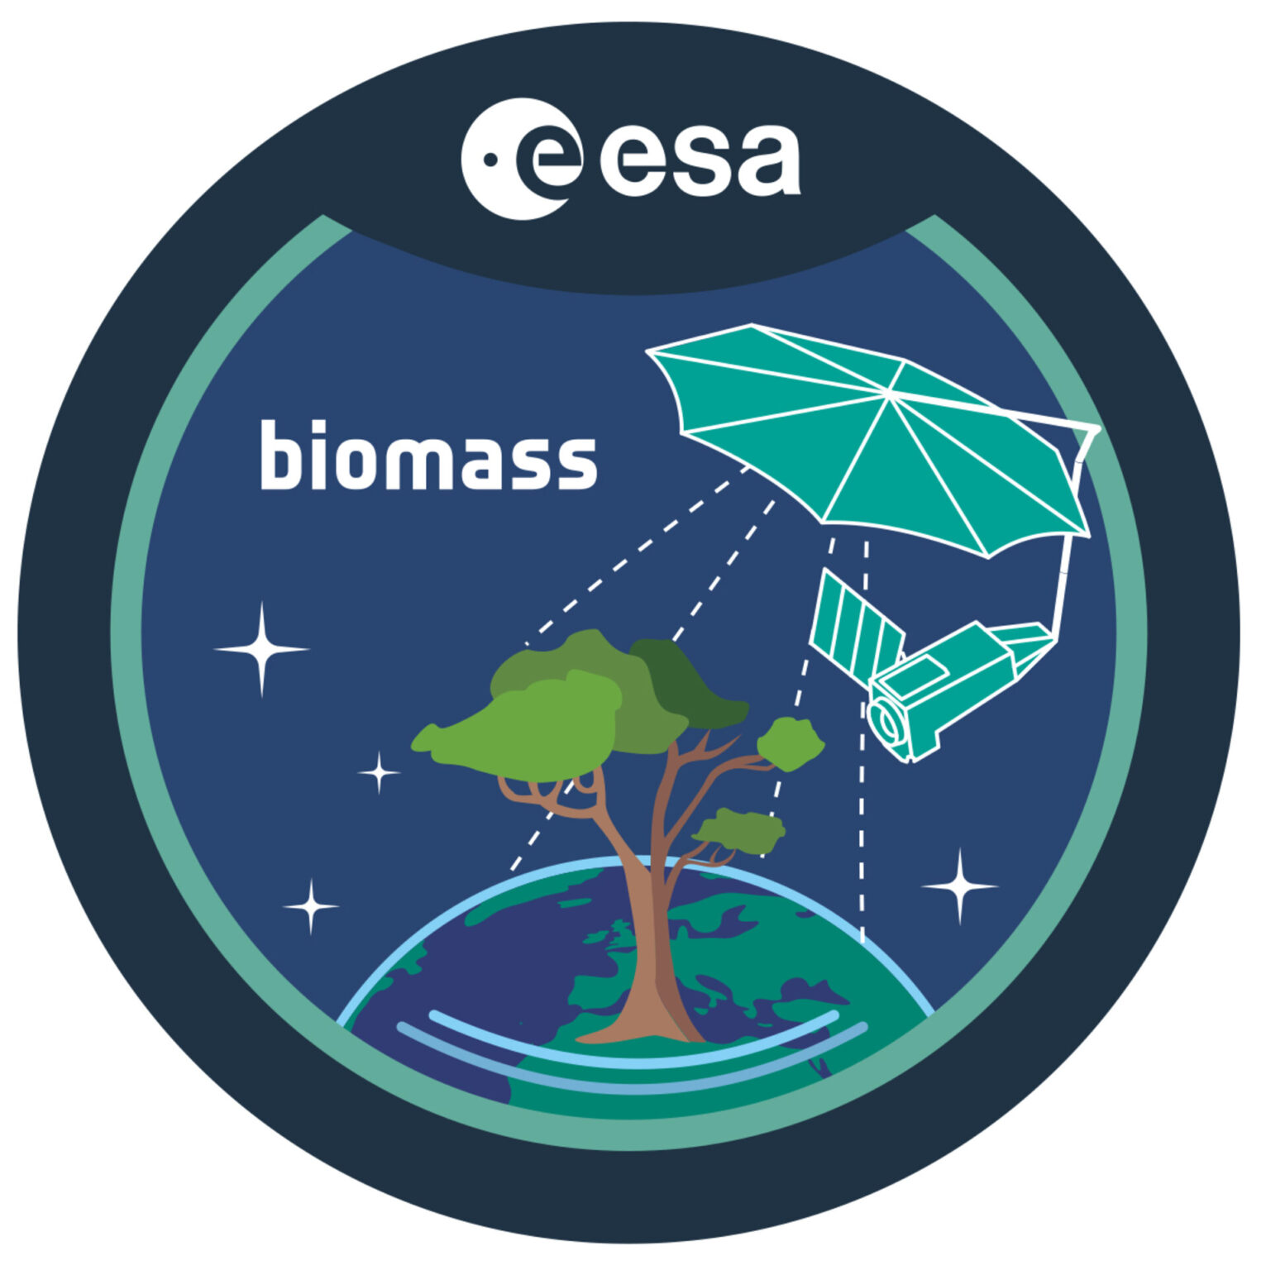









CEOS Polarimetric missions
CEOS capacity exists!
A large number of current and imminent CEOS missions with polarimetric (QP) capacity
Missions span all radar frequency bands (P, L, S, C, X)
Recent technology developments (wide observation swaths @ fine spatial resolution; high speed downlink)
→ Significantly improved capacity for routine QP observations.
→ Readiness to exploit the full potential of Synthetic Aperture . Radar

Slide 5


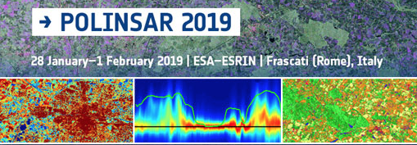


User community engagement
Long-term engagement with PolSAR/Pol-InSAR community: ESA POLINSAR workshops for 20+ years.
JAXA K&C Initiative int’l R&D program with dedicated PolSAR theme. CONAE, CSA, ISRO national PolSAR programs.
Users represent range of applications – i.a., agriculture, forestry, wetlands, cryosphere, soil moisture 🡪 close link to LSI-VC
Need to revitalise POLINSAR R&D. Recommendations from ESA POLINSAR workshop brought forward to LSI-VC: → POLINSAR sessions at LSI-VC-14 (2023) & -15 (2024) 🡪 Establishment of POLINSAR initiative under LSI-VC

Slide 6

POLINSAR recommendations to SIT (1/3)
1. Establishment of a POLINSAR Reference Site Network
Reference sites representing range of biomes and application areas
Established sites of on-going SAR/PolSAR/Pol-InSAR research by CEOS agencies (CONAE, CSA, DLR, ESA, ISRO, JAXA)
Access to in-situ, Lidar and/or airborne SAR data
Seek synergy with ongoing CEOS & GEO ground validation networks, e.g. GEO-TREES, AFOLU/Biomass Harmonisation.

Slide 7
POLINSAR recommendations to SIT (2/3)
2a. Dedicated Polarimetric observations over POLINSAR Reference Sites
Coordinated CEOS Agency effort under LSI-VC
Build time-series of QP data for PolSAR and Pol-InSAR
Multi-mission observations at multiple (P, L, S, C, X) frequencies
Best effort basis
2b. Long-term vision
As 2a, but with regional/global-scale focus
Integration of Polarimetry in strategic background mission observation plans

Slide 8
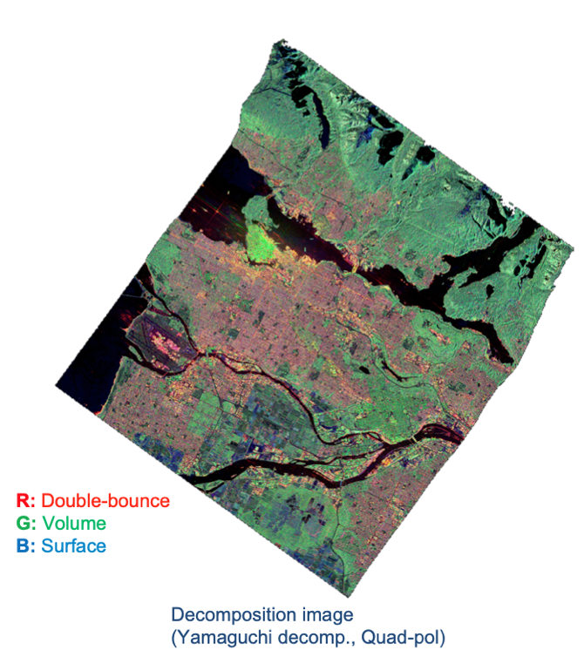

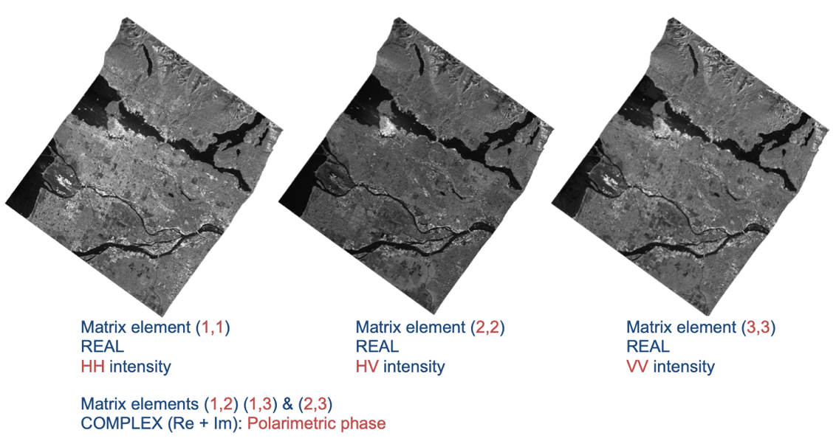
POLINSAR recommendations to SIT (3/3)
3. Simplified Data Access for R&D
Single data repository for QP datasets (on the CEOS Analytics Lab)
Open access for R&D groups (data sharing model similar to that for WGDisasters?)
Use of user-friendly product standards (→ CEOS-ARD)
POLINSAR software tools
Support further development of open software tools for POLINSAR processing and analysis (ESA PolSARPro, SNAP)
Integration into the SEO CAL platform
CEOS-ARD
Polarimetric Radar

Slide 9
Suggested SIT-39 Actions
CEOS Agencies:
Support the LSI-VC POLINSAR initiative and recommendations
Designate Agency Point of Contact for coordination with LSI-VC POLINSAR Team
Task QP observations & Provide archived data over POLINSAR Reference Sites on a best-effort basis
LSI-VC POLINSAR Team:
Short-list suggested POLINSAR Reference Sites
Coordinate multi-sensor QP observations with Agency PoCs
Establish POLINSAR repository & populate with archived QP data
Interim reporting at 2025 ESA POLINSAR Workshop

