Slide 1
SIT-39
2024
Precipitation Virtual
Constellation
Chris Kidd, NASA/GSFC
Takuji Kubota, JAXA
Agenda Item 6.1
SIT-39 2024, Tokyo, Japan
10th - 11th April 2024

Slide 2
Outline
P-VC Terms of Reference (revised)
CEOS ARD for Precipitation: thoughts

Slide 3
P-VC Terms of Reference
The P-VC was established prior to the launch of the GPM mission in 2014, to coordinate satellite precipitation measurements from the range of available sensors
The GPM mission is the realisation of the P-VC and provides a focus for a strong international precipitation community through the NASA and JAXA science teams, as well as the International Precipitation Working Group (IPWG) of the CGMS.
Co-Leads: Chris Kidd (NASA/UMD) and Takuji Kubota (JAXA)
Membership: ESA, EUMETSAT, NOAA, ISRO, NASA, JAXA, CNES, IPWG co-chairs
P-VC meetings at annual NASA PMM Science Team meetings and bi-annual IPWG meetings.

Slide 4
P-VC outline
Main P-VC goals:
Maintain and enhance the precipitation constellation
Integrate new satellites and sensors
Develop and refine retrieval schemes
Validate precipitation products
Support from CEOS for:
current missions, including continuation of precipitation-capable missions beyond end-of-life (where practical) and for mitigation strategies where necessary;
planned new missions (such as AMSR-3, PMM, CIMR, JPSS-4, etc);
development of a long-term strategy for a viable and sustainable precipitation constellation, including new and emerging technologies;
maintaining, expansion and exploitation of (not directly funded) global ground validation (e.g. USA, Europe, S.Africa, S.America, Japan, S.Korea, India, Australia, etc).

Slide 5
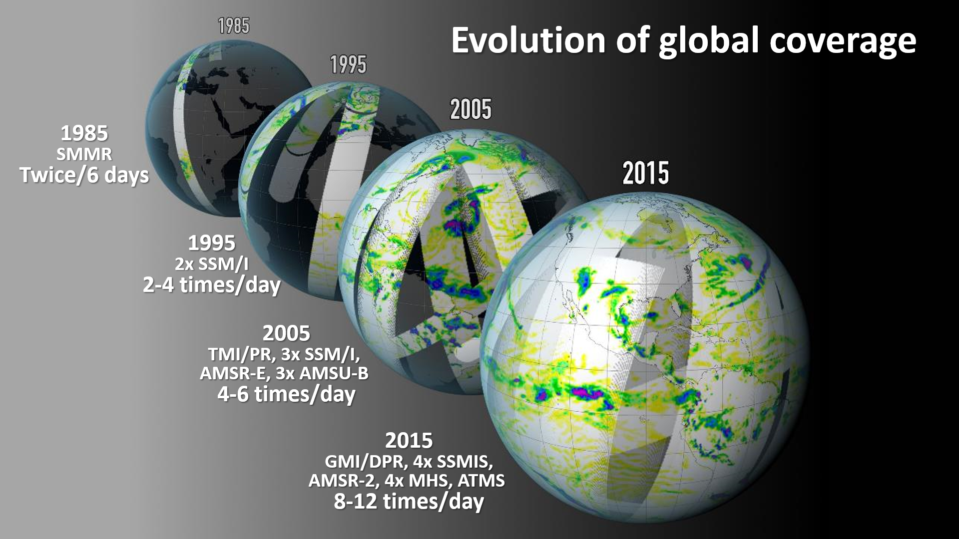
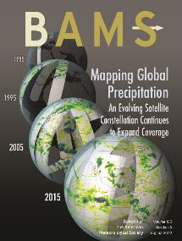
…an evolving success story…

Slide 6
NASA updates
GPM updates – 10th anniversary (Feb’24)
Orbit boost – Nov 2023: Small changes in characteristics due to increase in footprint size
Constellation: next launch likely to be WSF-M1 (potential impact on SSMIS)
TROPICS (cubesat constellation)
T01 – failed in December 2023 (2.5 yr operations), T07 failed after 1 month.
T03/T06 ‘operational’ with precipitation products (T05 data being calibrated)
Atmosphere Observing System – International collaborative missions in a Decoupled Architecture: 6 spacecraft and 4 launches
Polar:
Inclined:
PMM (JAXA) + HF radiometer (France)
HF radiometer (France)
NASA SmallSat bus (NASA launch)
Lidar, Italy (NASA contribution)
HF radiometer + Polarimeter (NASA) + TICFIRE (Canada) HAWCsat (Canada)
Doppler Radar (competed mission)

Slide 7
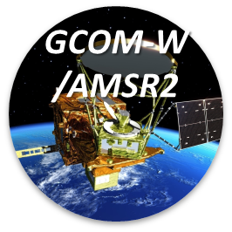
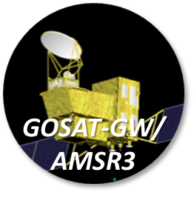
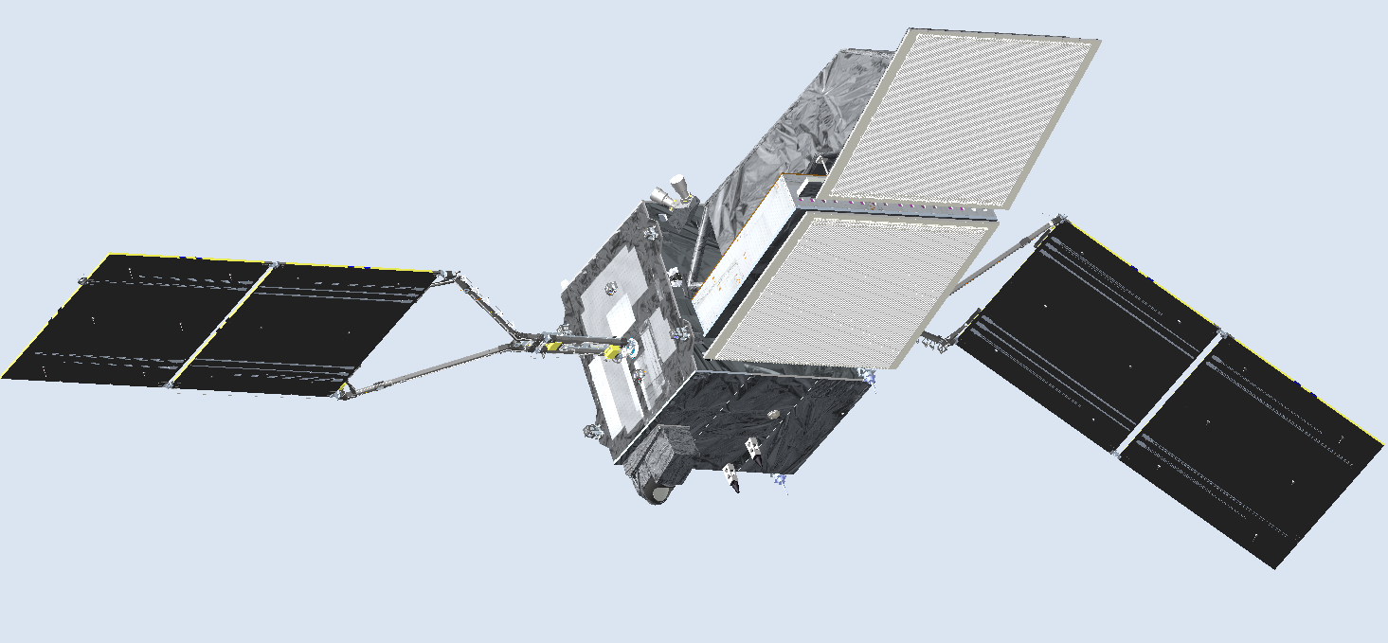
JAXA status updates
GCOM-W AMSR2
  12-year anniversary in May 2024 - in good condition and continue science mission
  New function in the AMSR Earth Environment Viewer, a web visualization tool
  (https://www.eorc.jaxa.jp/AMSR/viewer/)
GOSAT-GW AMSR3
  Algorithm development for AMSR3 ongoing - utilizing experiences and outcomes from AMSR2 as well as introduction of snowfall retrieval using new high-frequency channels, preparation of sample products in AMSR3 format
  Preparation of cross-calibration, especially for new high-frequency channels with GMI & SSMIS (as backup)
  Launch of GOSAT-GW Satellite in JFY2024; Critical Design Review (CDR) has completed in Oct. 2023
    AMSR3 products released to the public ca.1 year after launch (earlier to the PIs/partner agencies)
    Near-real-time data distribution: regional data at direct receiving stations & global data within 2-3 hrs
Precipitation Measuring Mission (PMM)
  In June 2023, JAXA’s Precipitation Measuring Mission (PMM) Project Team was established for the Spacecraft carrying the Ku-band Doppler Precipitation Radar (KuDPR)
  One of the key contributions from JAXA to P-VC activities is spaceborne precipitation radar observations by TRMM/PR and GPM/DPR. KuDPR will contribute to P-VC objectives: “activities to develop and improve knowledge and understanding of precipitation processes, the distribution of precipitation and the changes in precipitation over time on a global basis”
Ku-band Doppler Precipitation Radar (KuDPR)

Slide 8
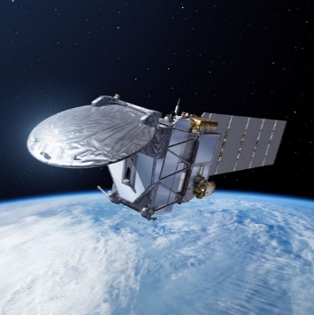
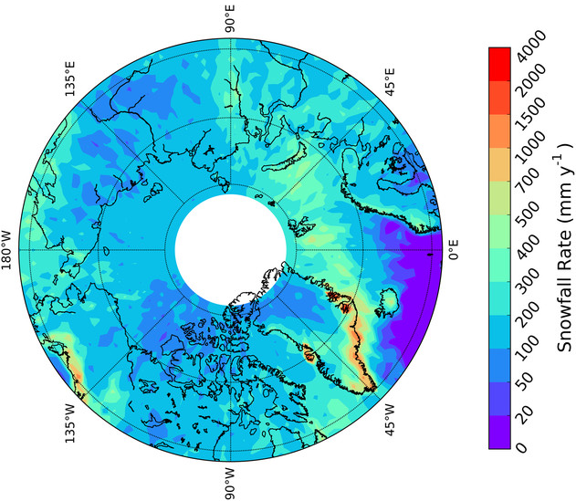
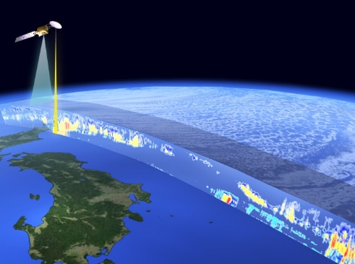
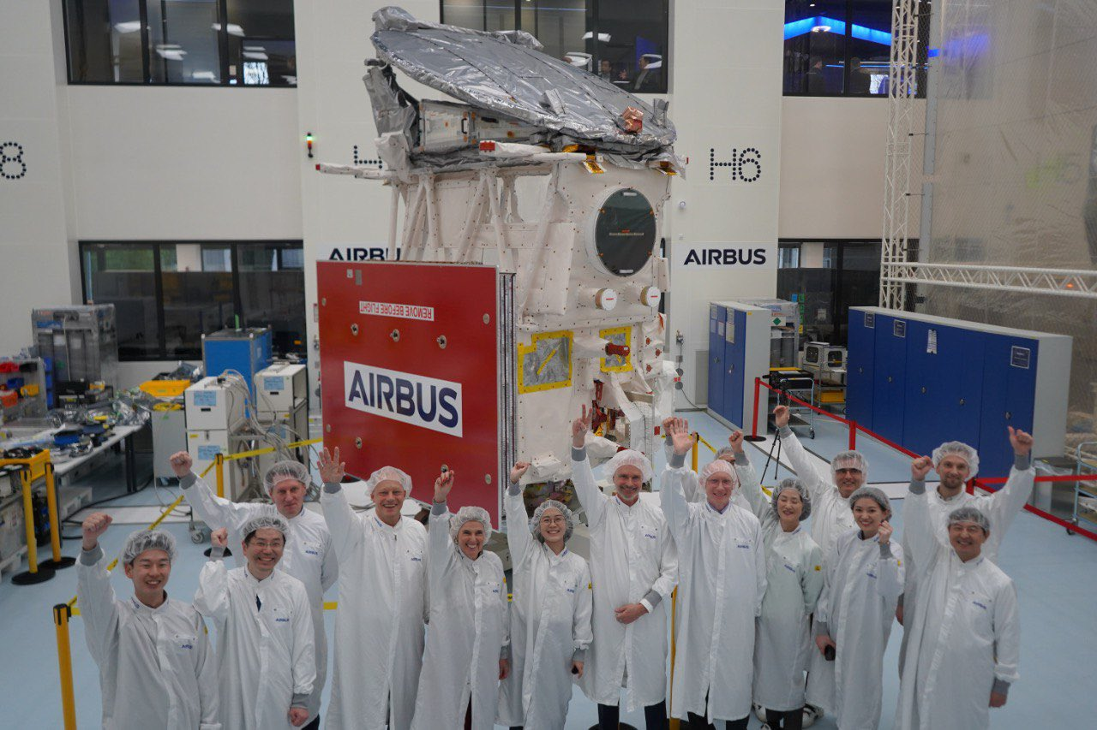
JAXA – ESA updates
To be launched
in May 2024
Europe-Japan joint mission
3 dimensional global distributions of cloud and aerosol to contribute to precise understanding of climate change
JAXA and NICT provides world's first satellite-based cloud vertical motion by the Cloud Profiling Radar (CPR) at 94 GHz with Doppler Capability at 0.8 km spatial resolution.
EarthCARE is planned to be launched in Vandenberg, California in May 2024.
CPR will be used to measure global features of snowfall and light precipitation.
EarthCARE
Cloud/
Aerosol
Radiation
Budget
Mean surface snowfall rate 2007–10 from CloudSat/CPR (Edel et al. 2020)
Orbit | Sun-synchronous sub-recurrent orbit Altitude: approx. 400km Inclination angle: 97.05° Local Sun Time at Desc.: 14:00 Revisit time: 25 days
Instruments | - Cloud Profiling Radar (CPR) by NICT & JAXA - Atmospheric Lidar (ATLID) by ESA - Multi-Spectral Imager (MSI) by ESA - Broad-Band Radiometer (BBR) by ESA
Mass | Approx. 2.2 tons at launch
Designed lifetime | 3 years
Group photo in front of EarthCARE satellite in the cleanroom at Airbus’ facilities in Friedrichshafen, Germany (February 2024).

Slide 9
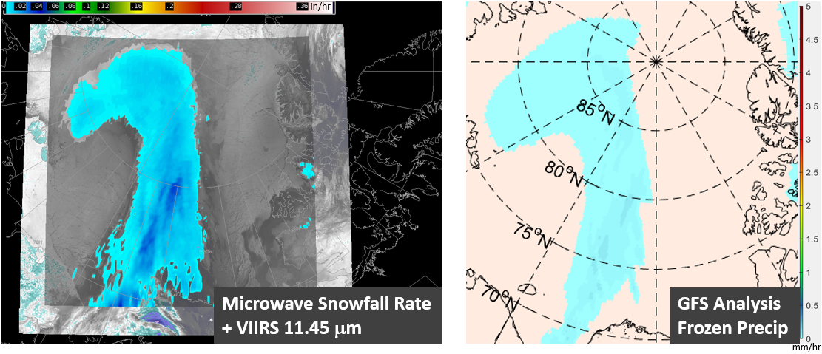
NOAA updates
Future missions:
  GOES-U (June 25, 2024), QuickSounder (2026), JPSS-4 (2027), JPSS-3 (2032), LEO Weather Satellites (LWS, 2030+), GeoXO (2032+)
Precipitation (Rainfall and Snowfall) Products
  Innovation: AI and machine learning enhanced algorithms; multi-platform merged products
  Applications: Support weather nowcasting/short term forecasting and hydrological modeling; reduce latency using Direct Broadcast data
NOAA Snowfall Rate Product Captures Snowfall near the North Pole
  Contributions to the Precipitation Community
  NOAA continues to produce and archive operational Level-2, Level-3, and geo-based precipitation products, and make the data publicly available to domestic and international users

Slide 10
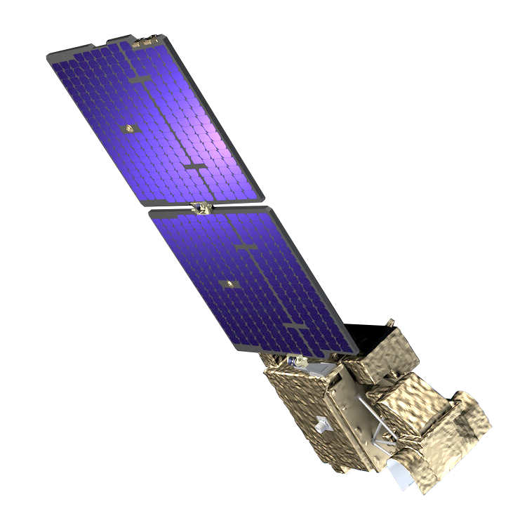
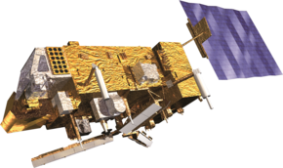
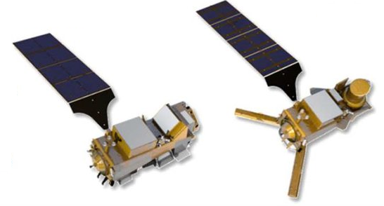
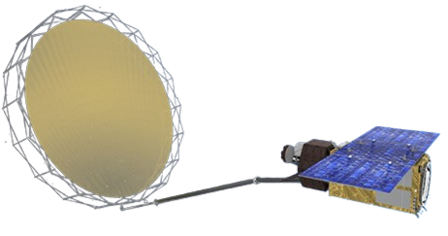
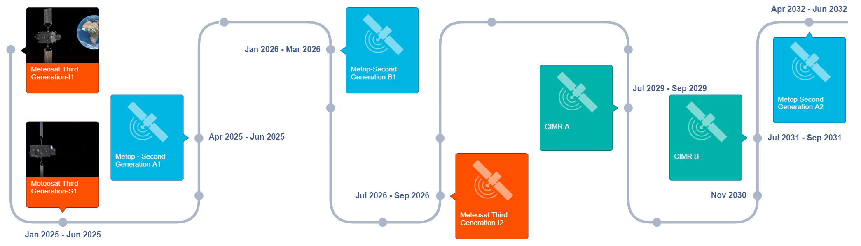
EUMETSAT Passive Microwave Missions
As follow-on of the EUMETSAT Polar System (EPS) Programme, (with the MHS and AMSU-A), the EPS – Second Generation (SG) will include the MicroWave Sounder (MWS) and MicroWave Imager (MWI) and Ice Cloud Imager (ICI). MWS will be complemented by a constellation of small PMW sounders - EPS-Sterna (in its Phase B). Finally, the Copernicus Imaging Microwave Radiometer, CIMR, Level-2 global ocean and atmospheric products will be developed and operated at EUMETSAT.
 | 1.4 GHz | 6.9 GHz | 10.7 GHz | 18.7 GHz | 23.8 GHz | 31.4 / 36.5 | 50-57 GHz | 89 GHz | 118.7 GHz | 157 / 165.5 | 183.3 GHz | 229 / 243 | 325 GHz | 448 GHz | 664 GHz
MHS |  |  |  |  |  |  |  |  |  |  | x2
AMSU-A |  |  |  |  |  |  | x12
EPS-Sterna |  |  |  |  |  |  | x8 |  |  |  | x5 |  | x4
MWS |  |  |  |  |  |  | x14 |  |  |  | x5
ICI |  |  |  |  |  |  |  |  |  |  | x3 |  | x3 | x3
MWI |  |  |  |  |  |  | x4 |  | x4 |  | x5
CIMR
EPS
EPS-SG
Copernicus
https://www.eumetsat.int/
planned-launches

Slide 11
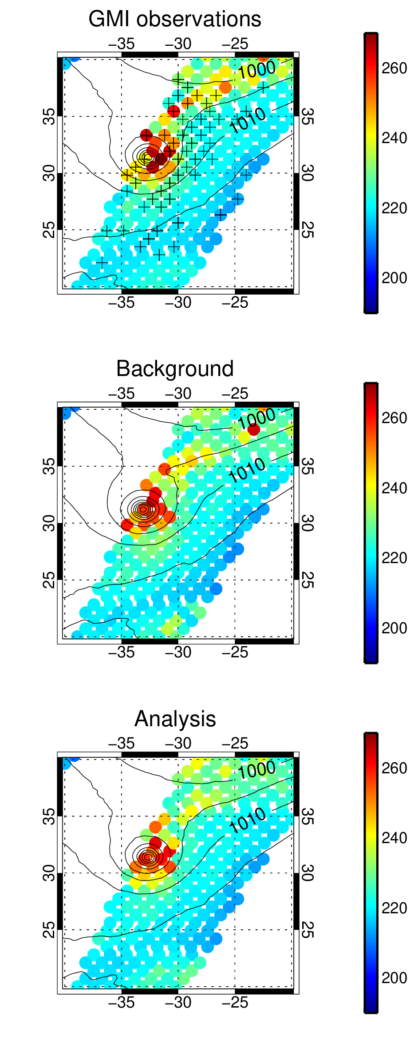
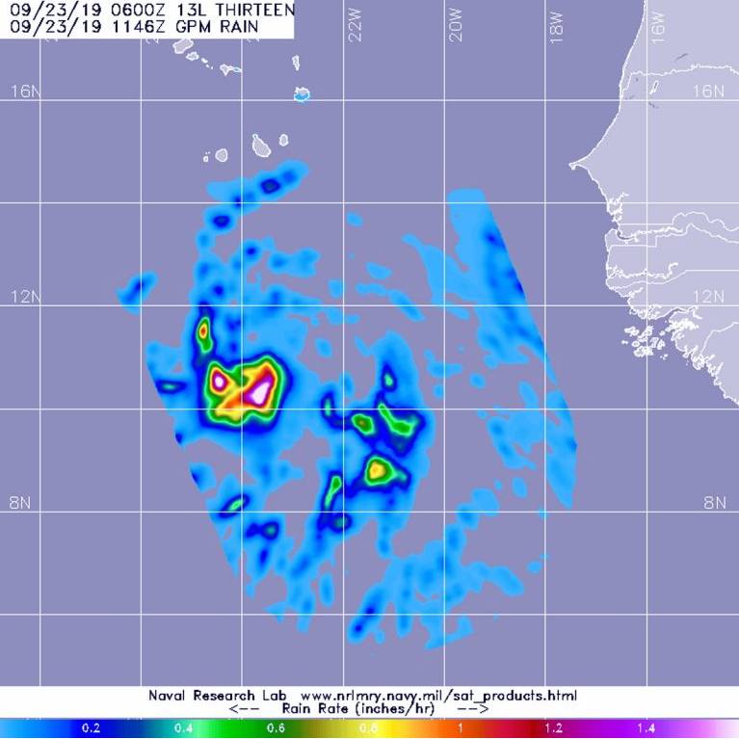
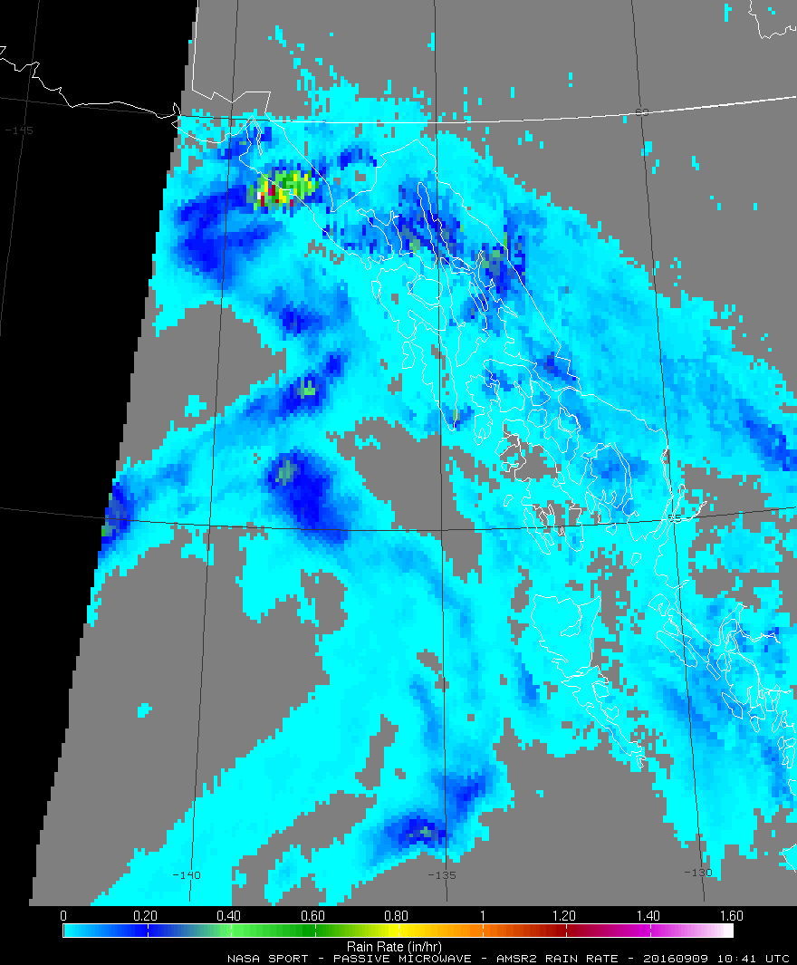
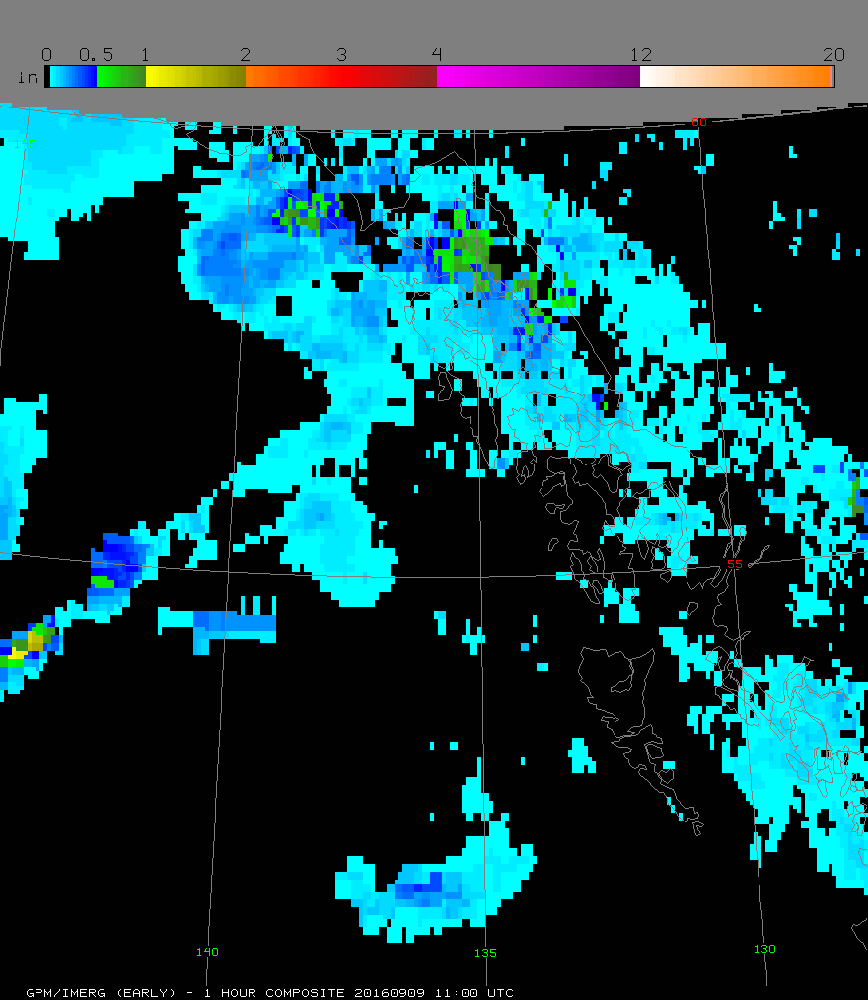
GPM Applications - modelling
NRL and NHC:
GPM observed rainfall rate helps reveal TC internal structure, including convective bands, shear patterns, eyewall formation, and eyewall replacement cycles.
ECMWF:
Assimilation of GMI Tb in NWP for initializing model runs
NASA SPoRT/ NWS WFOs:
Atmospheric river/ extremes nowcasting and forecasting using L2 rain rate & 1-hr accumulation IMERG
NASA GMAO:
Data assimilation in NASA GEOS model (Kim et al. 2020) using GMI

Slide 12
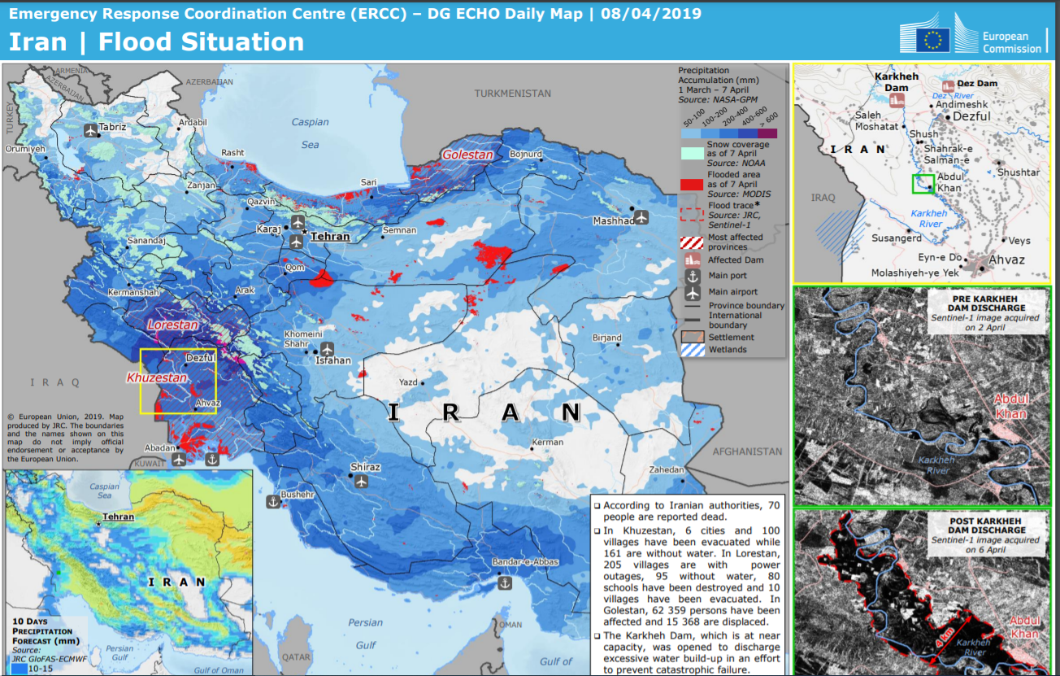
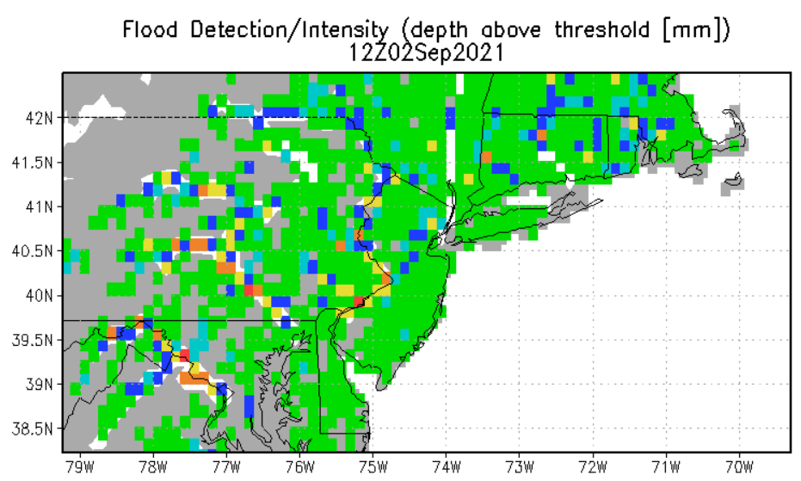
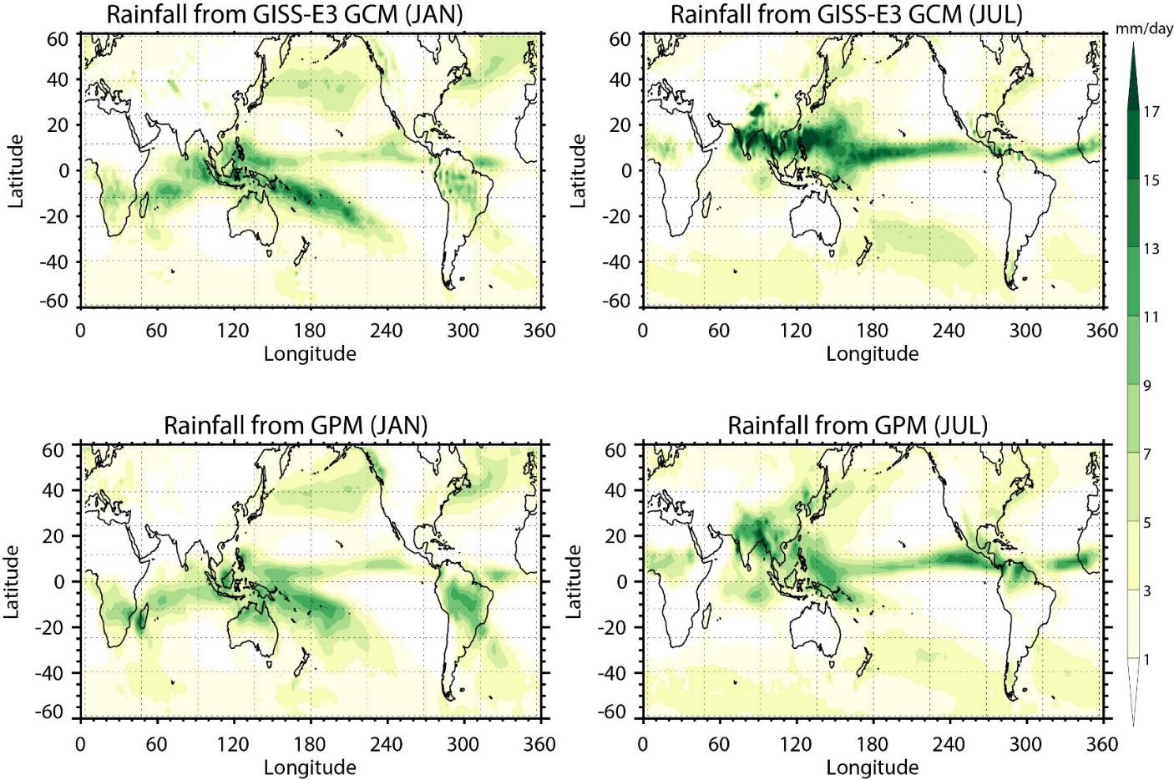
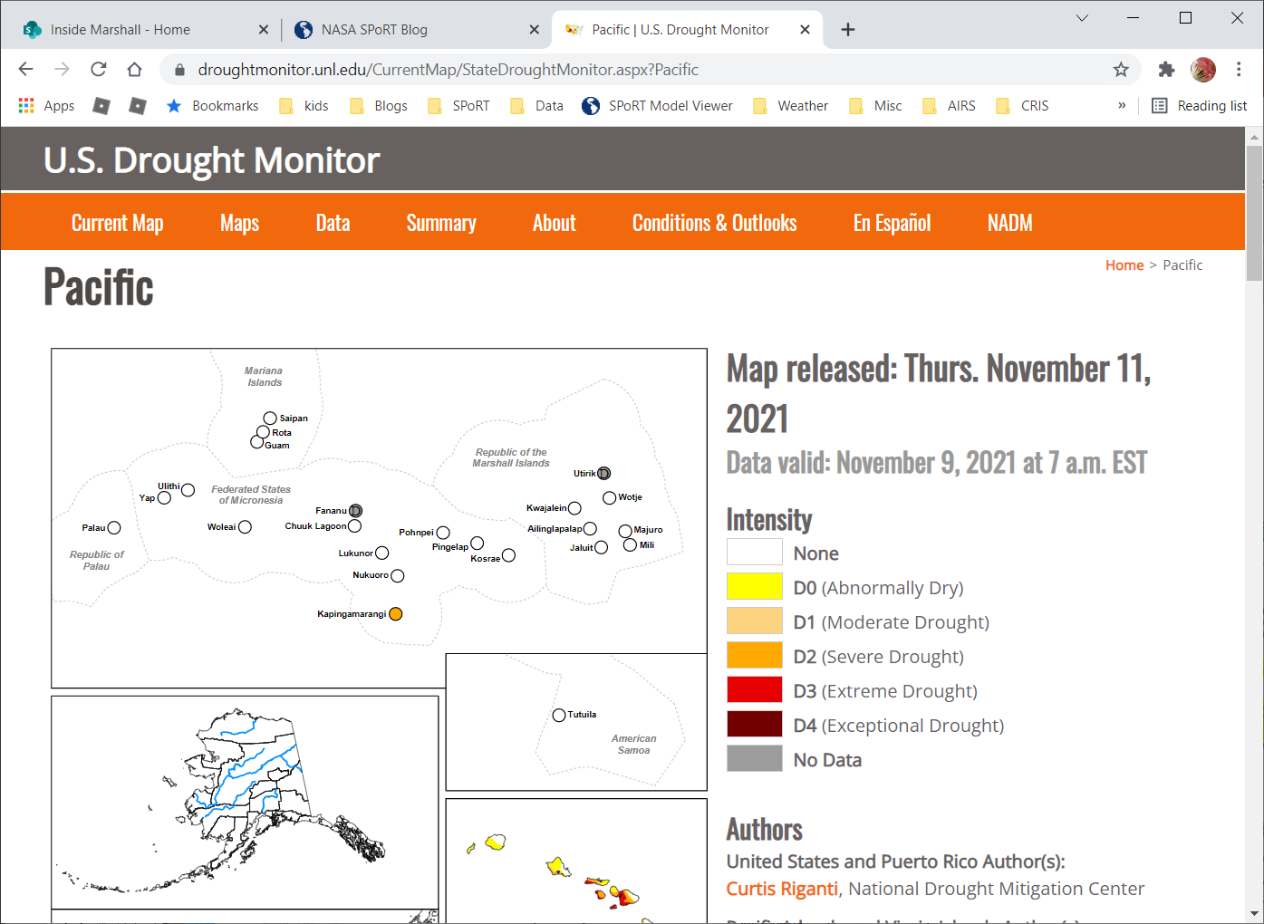
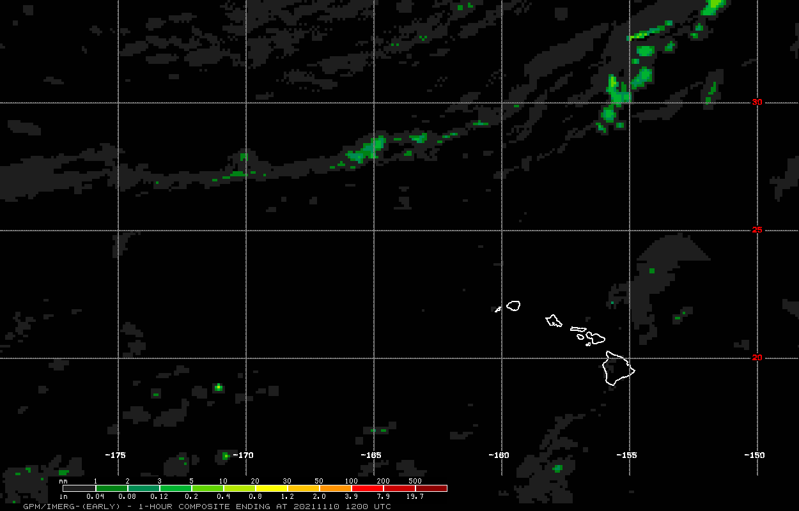
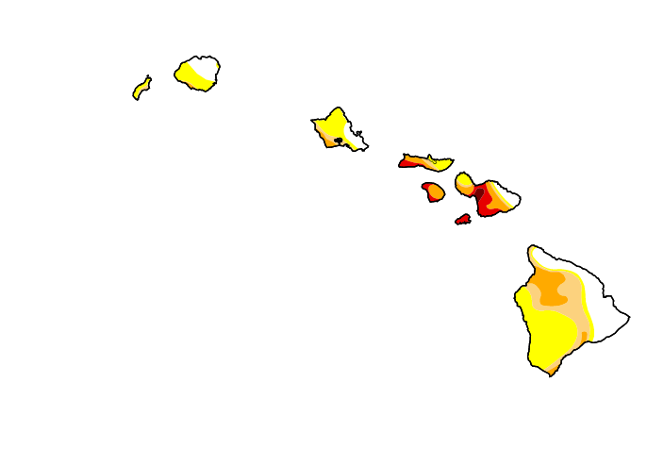
GPM Applications - hazards
ERCC:
7-day accumulation IMERG real-time (Early, Late) for disaster monitoring and response.
Observations
Global Flood Monitoring System: IMERG Real-Time
Hawaii US Drought Monitor Report: using IMERG accumulations
NASA GISS:
Climate model parameterization development and model validation using IMERG Final.
Courtesy of Greg Elsaesser (NASA GISS)

Slide 13
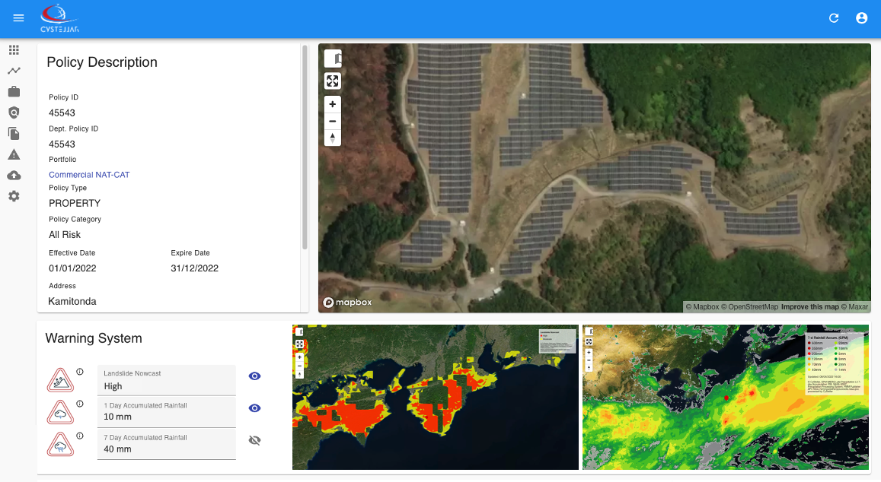
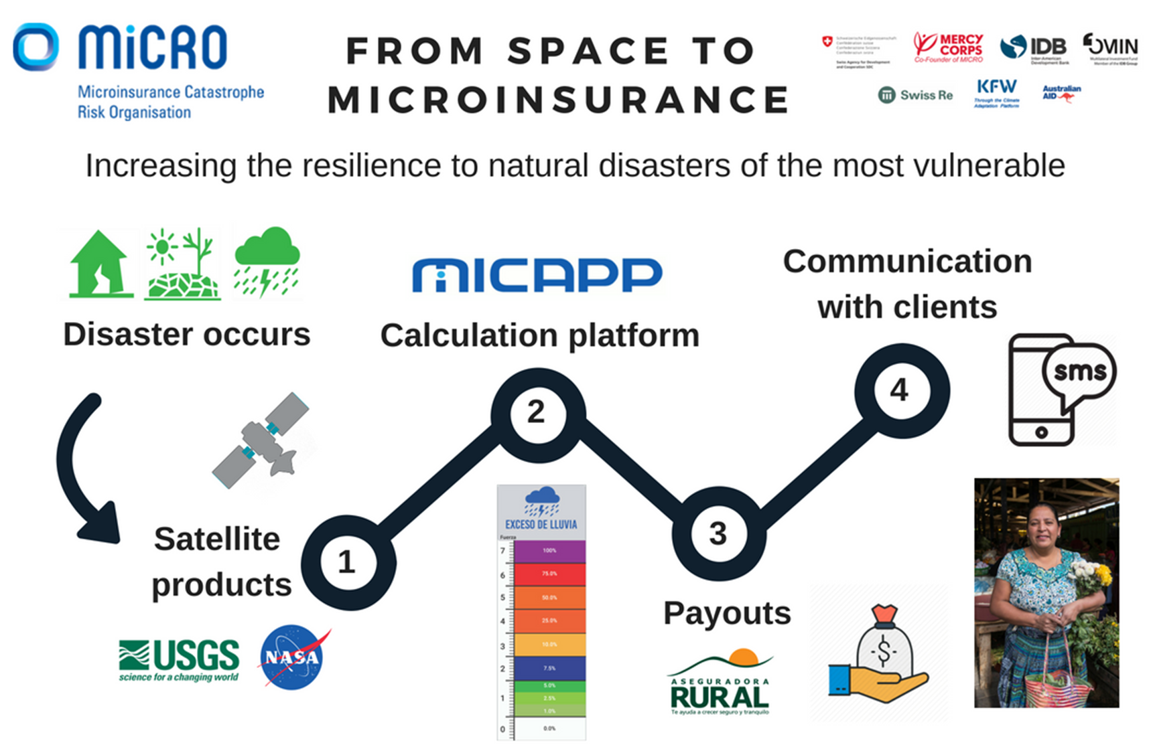
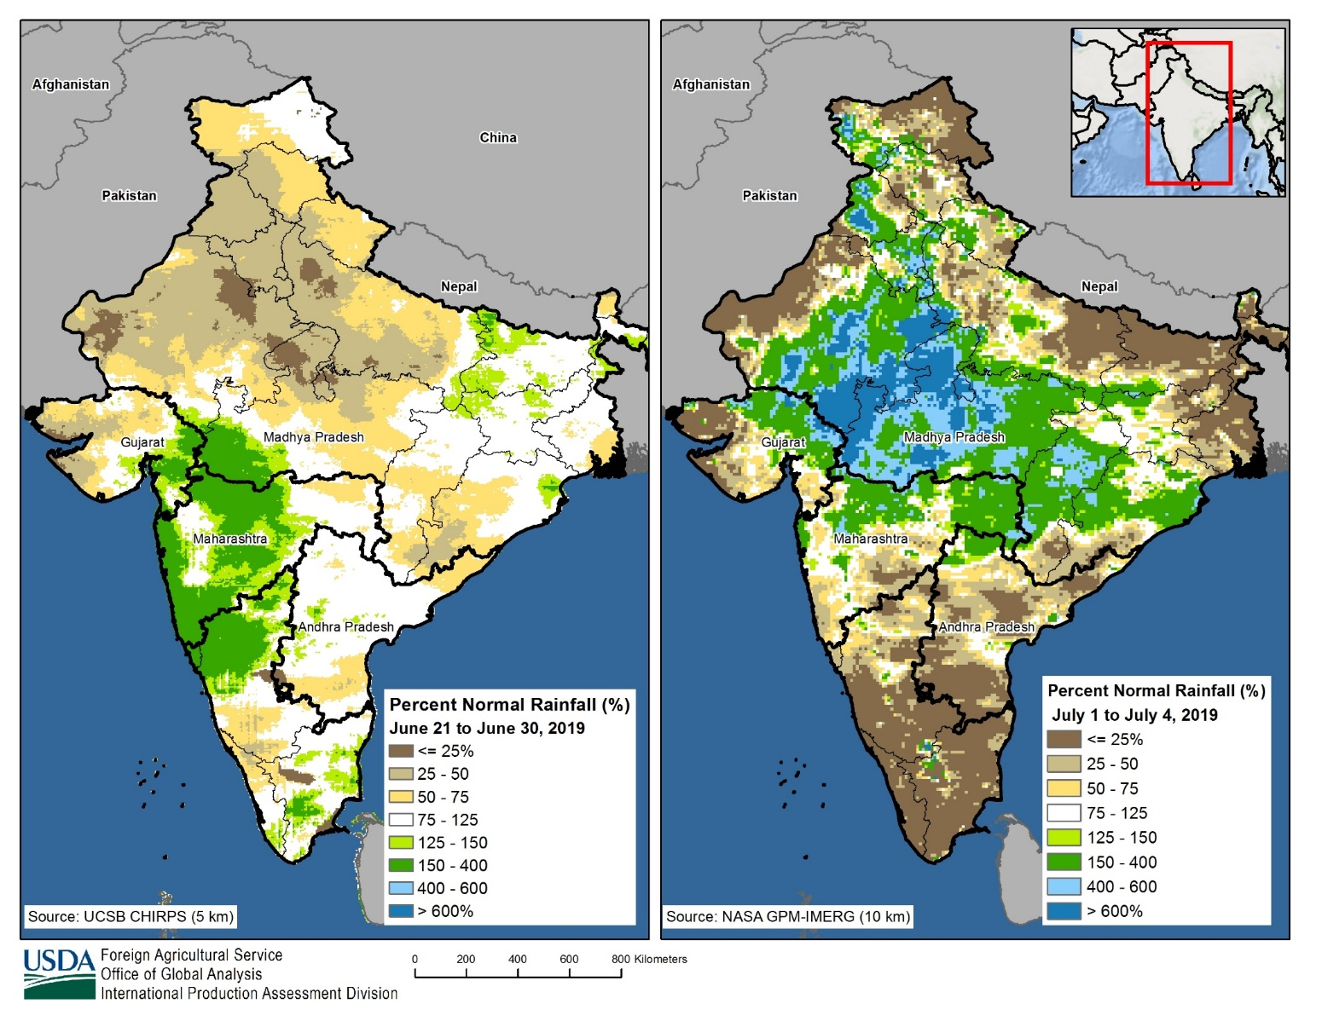
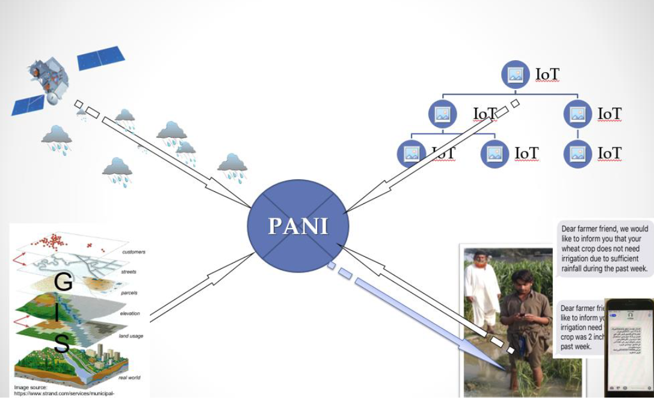
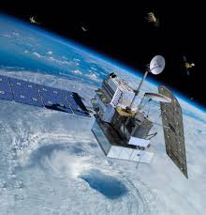
GPM Applications - agriculture
Insurance/ MiCRO:
Define extreme precipitation thresholds using IMERG (Early, Late, Final) for index-based insurance products and trigger policy payouts
Cloud-based risk management platform: using IMERG Late accumulations
UW/PANI:
Combines IMERG, weather model, GIS, and personalized farm data to generate irrigation advisories via cellphones.
USDA FAS:
Integration of IMERG (Early, Late) for validation to estimate growing season onset, crop productivity and other variables.
GPM

Slide 14
GPM Communications & Outreach
Active presence on the web, social media, publications, events and conferences, visualizations, print/online materials, stakeholder and community engagement and innovative data access tools:
Reaching 7 million people through online activities, with >64k page-views/month (GPM main page), 130k page-views/month (Education page), and 20k page-views/month (Data Access)
Facebook NASAAtmosphere: >480k followers, and on “X” (formerly Twitter) NASAAtmosphere: >430k followers (as of March, 2024)
50 lesson plans (K-12)
GPM Mentorship Program for three consecutive years (2022, 2023, 2024):
Over 300 participants across 69 countries
26 hours of recorded lectures and presentations
39 facilitated capstone projects highlighting use of GPM data (for just years ‘22 and ‘23)
Application Workshops engaging hydrologists, engineers and planners, meteorological, supply chain, data driven agriculture, and hydrological communities
Leveraging conferences such as AGU and NASA SPoRT and TROPICS communities
Conference sessions devoted to precipitation (AGU, JpGU, EGU, AOGS, IGARSS, etc)

Slide 15
Revised Terms of Reference
The original P-VC Terms of Reference were written in 2013.
Main goals of the P-VC remain the same: revisions primarily relate to updating the available precipitation-capable missions and the associated 3- and 5-year horizon goals.
In addition, representation of agencies/organisations has been updated:
We welcome:
Adrien Deschamps (CNES)
Thorsten Fehr (ESA)
Vinia Mattioli (EUMETSAT), and
Neerja Sharma (ISRO)

Slide 16
Discussion/comments?

Slide 18
ARD for Precipitation - thoughts
Is it needed? Are we re-inventing the wheel?
Exchange of meteorological data has a long (and necessary) history.
Development of satellite systems for meteorology enhanced this exchange.
Current “satellite precipitation products” are largely in standard formats overseen by agencies/organisations – primarily netcdf, HDF, (some in grib or BUFR) – all designed to be analysis-ready and inter-operable.
Precipitation users utilise different data levels:
Level 1, A/B/C – brightness temperatures (Ta, Tb, calibrated Tb)
Level 2 A/(B) – instantaneous precipitation retrievals at full resolution
Level 3 A/(B) – multi-satellite, multi-sensor, gridded precipitation
Which level to start at?

Slide 19
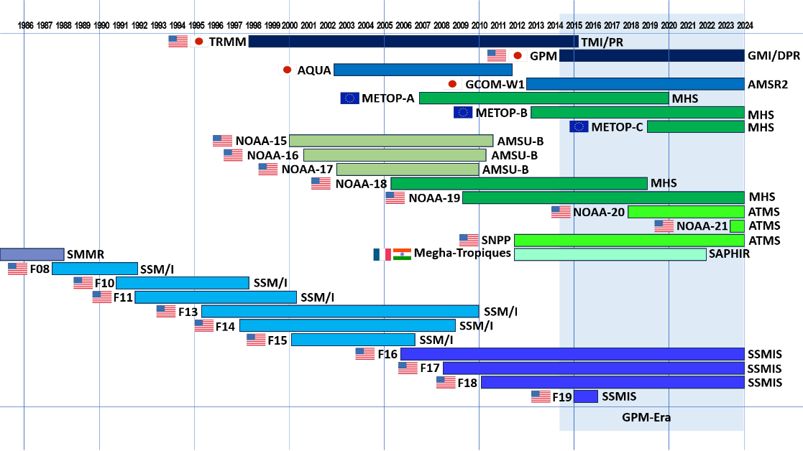
Precipitation-capable missions
TRMM and GPM are the only missions dedicated to precipitation
Users have become very adept at utilising other data sources
(these are just the ‘core’ missions)
1978
Nimbus-7
ESMR-5 1972;
ESMR-6 1975
Working across many years of different satellite observations to provide consistent data records for climate studies

Slide 20
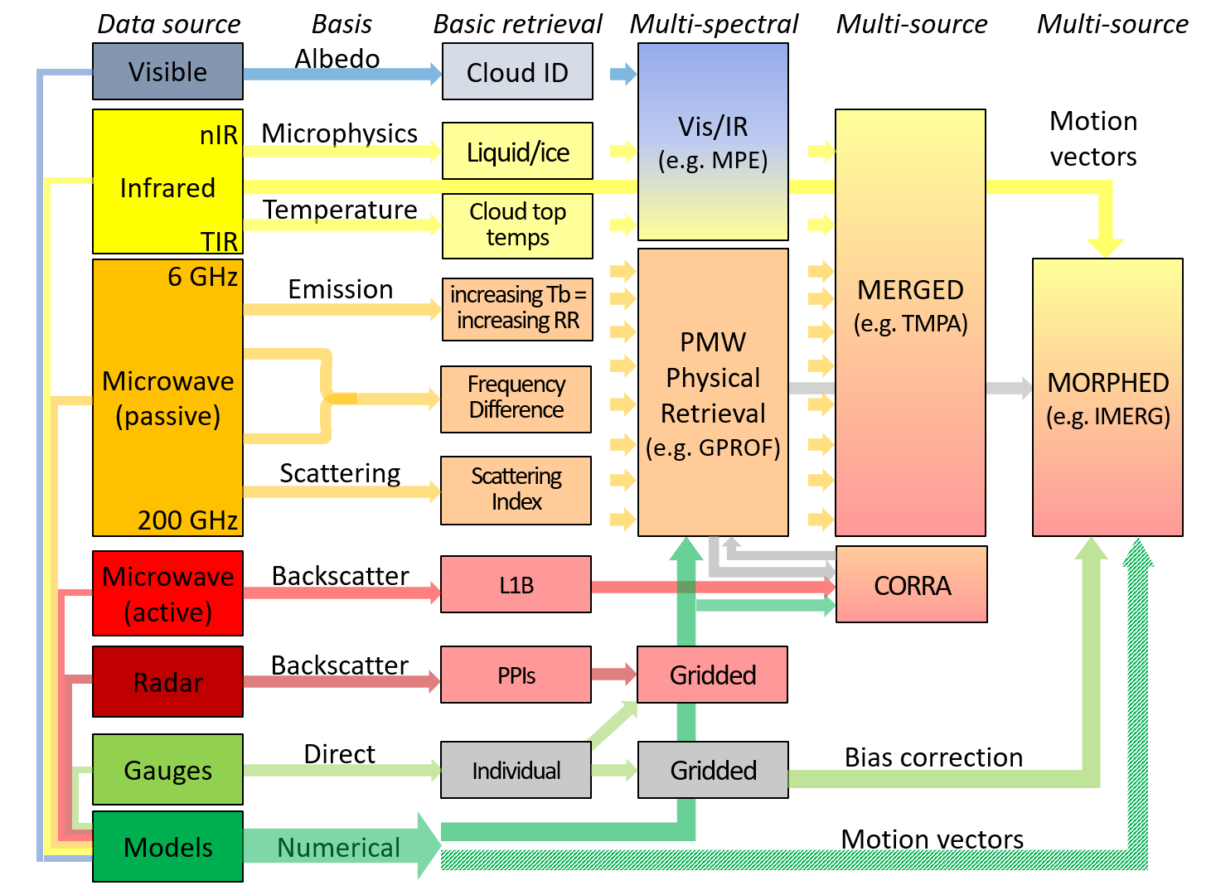
Multi-satellite / multi-sensor data
Satellite estimates of precipitation encompass a wide range of frequencies together with auxiliary data.
Retrieval of precipitation from satellite observations is complex since the range of precipitation properties and characteristics is large (cloud, rainfall, snowfall, hail).
Requires a multi-spectral, multi-satellite, multi-sensor approach

Slide 21

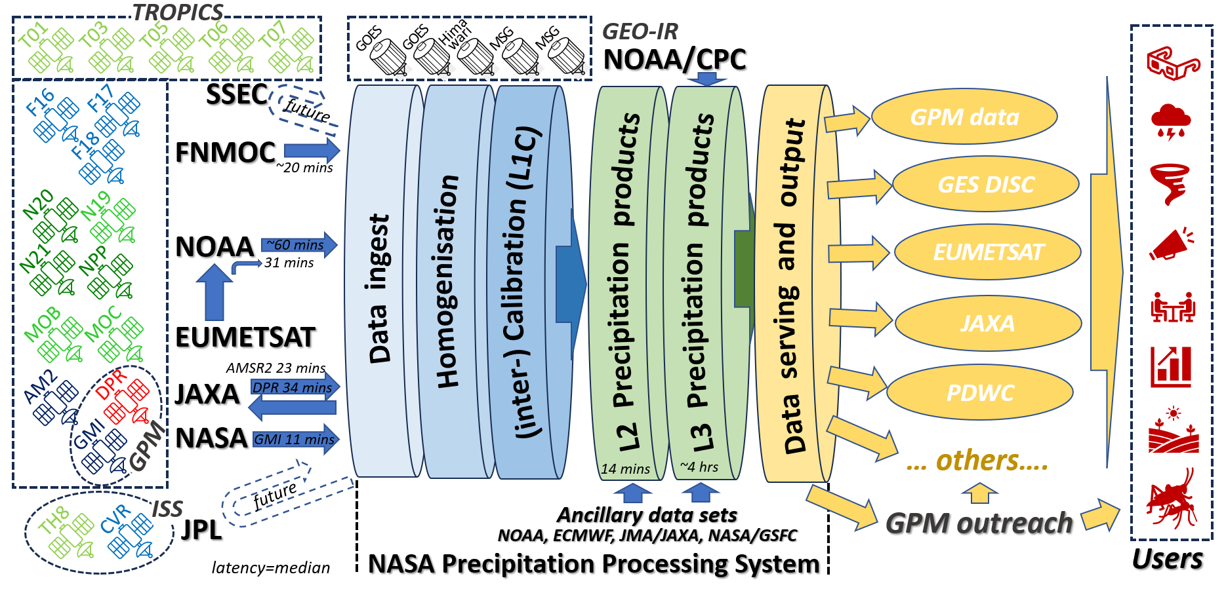
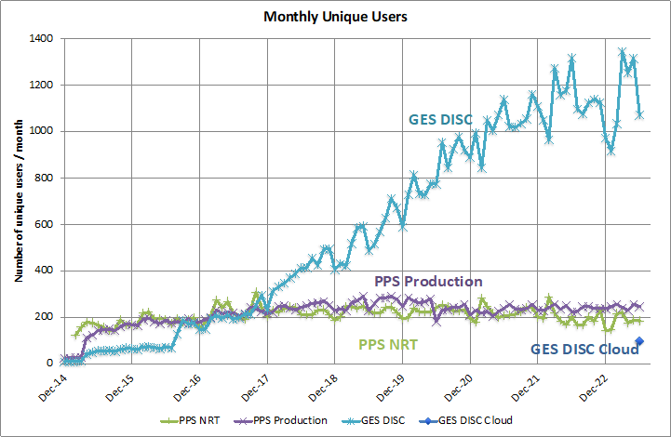
Mature Processing Systems
GPM constellation

Slide 22






Data already used by many users
Hawaii US Drought Monitor Report: using IMERG accumulations
NWP; TC monitoring; S2S & climate modeling
Landslide nowcasting; Flood estimation; Reinsurance; Situational awareness
Track precipitation anomalies for vector and water borne diseases
Atmospheric river/extremes nowcasting and forecasting: using L2 rain rate and 1-hr accumulation of IMERG, NASA SPoRT/ NWS WFOs
Assimilation of GMI Tbs in NWP for initializing model runs at ECMWF
Assess freshwater inputs for hydropower generation
Monitor changes in precipitation associated with animal migration
Assess freshwater inputs to quantify water fluxes

Slide 23
Precipitation ARD specifications?
Large user community (>300M product downloads over the 10 years of GPM)
Main agencies & organisations comply with existing data standards
Commerical organisations adopting these standards (it’s in their interests)
Why?
Ensure consistency of products into the future – and between products.
To set a standard for new (or reprocessed) products to attain.
Where to start?
Product family specification – ‘light’ – assessing common criteria amongst existing providers
L3 Gridded products easiest, L2 (instantaneous/fov resolution) & L1 (Ta/Tbs) less so.
ARD standards ↔ user communities ↔ data providers
Precipitation is more than Earth Observation - need to engage with WMO/CGMS, NWP centres, etc

